Slide 1
Event Relations and Probability Rules

Slide 2
Event Relation
Sometimes the event of interest can be formed as a combination of several other events. Need to consider 3 important event rules (same as set theory)

Slide 3
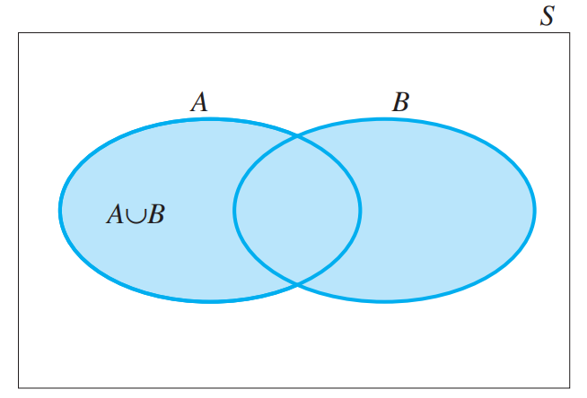
The Union Rule
The union of events A and B, denoted by A ∪ B, is the event that either A or B or both occur.

Slide 4
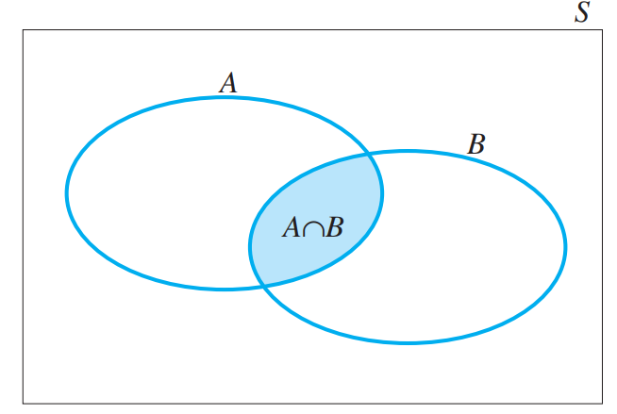
Intersection Rule
The intersection of events A and B, denoted by A ∩ B, is the event that both A and B occur.

Slide 5
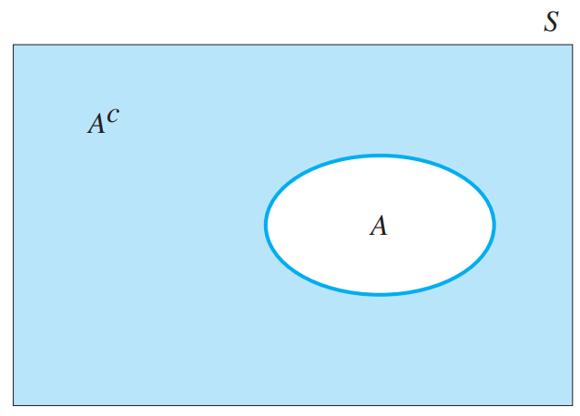
Complement Rule
The complement of an event A, denoted by A^{c} (or A’), is the event that A does not occur

Slide 6
Example
Two fair coins are tossed, and the outcome is recorded. These are the events of interest:
A: Observe at least one head
B: Observe at least one tail
Define the events A, B, A ⋃ B, A ⋂ B, and A^{c} as collections of simple events, and find their probabilities

Slide 7
Calculating Probabilities for Unions and Complements

Slide 8
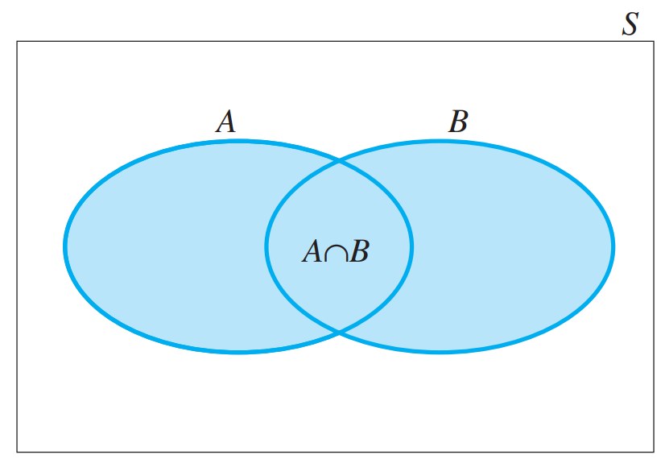
The Addition Rule
Given two events, A and B, the probability of their union, A ⋃ B, is equal to
P(A ⋃ B) = P(A) + P(B) - P(A ⋂ B)

Slide 9
Mutually Exclusive
What happens if two events are mutually exclusive?

Slide 10
Rule for Complement
P(A) + P(A^{c}) = 1
Or
P(A) = 1 - P(A^{c})

Slide 11
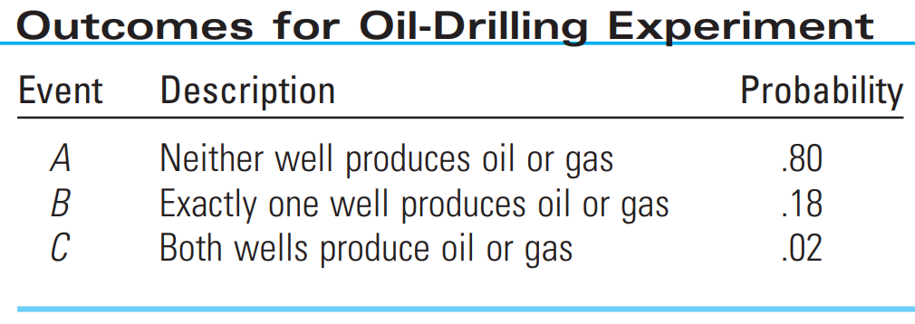
Example
An oil-prospecting firm plans to drill two exploratory wells. Past evidence is used to assess the possible outcomes listed in Table
Find P(A ⋃ B) and P(B ⋃ C)

Slide 12
The event A ⋃ B can be described as the event that at most one well produces oil or gas, and B ⋃ C describes the event that at least one well produces gas or oil.

Slide 13
Independence, Conditional Probability and The Multiplication Rule

Slide 14
Independent and Dependent Events
There is a probability rule that can be used to calculate the probability of the intersection of several events. However, this rule depends on the important statistical concept of independent or dependent events.

Slide 15
Definition
Two events, A and B, are said to be independent if and only if the probability of event B is not influenced or changed by the occurrence of event A, or vice versa.

Slide 16
Given
The probability of an event A, given that the event B has occurred, is called the conditional probability of A, given that B has occurred, denoted by P(A|B)

Slide 17
General Multiplicative Rule
The probability that both A and B occur when the experiment is performed is
P(A⋂B) = P(A) * P(B|A)

Slide 18
Conditional Probability
P(A|B) = P(A⋂B) / P(B) Given P(B) ≠0
P(B|A) = P(A⋂B) / P(A) Given P(A) ≠0

