Slide 1
Probability

Slide 2
How Probability is Used
Probability is used as a tool. It allows you to evaluate the reliability of your conclusions about the population when you have only sample information.

Slide 3
Coin Toss
You toss the coin repeatedly, you will generate an infinitely large number of Hs and Ts—the entire population. What does this population look like? If the coin is fair, then the population should contain 50% Hs and 50% Ts. Now toss the coin one more time. What is the chance of getting a head? Most people would say that the “probability” or chance is 1/2.
Now suppose you are not sure whether the coin is fair; that is, you are not sure whether the makeup of the population is 50–50. You decide to perform a simple experiment. You toss the coin n 10 times and observe 10 heads in a row. Can you conclude that the coin is fair? Probably not, because if the coin were fair, observing 10 heads in a row would be very unlikely; that is, the “probability” would be very small. It is more likely that the coin is biased.

Slide 4
Some Terminology

Slide 5
Experiment
An experiment is the process by which an observation (or measurement) is obtained.
• Recording a test grade
• Measuring daily rainfall
• Testing a printed circuit board to determine whether it is a defective product or an acceptable product
• Tossing a coin and observing the face that appears

Slide 6
Simple Event
A simple event is the outcome that is observed on a single repetition of the experiment. It is often denoted by the capital E with a subscript
Example: Toss a die
There are total 6 simple events
E₁ : Observe 1 E₂: Observe 2
E₃ : Observe 3 E₄ : Observe 4
E₅ : Observe 5 E₆ : Observe 6

Slide 7
Event
An event is a collection of simple events.
We can define the events A and B for the die tossing experiment:
A: Observe an odd number
B: Observe a number less than 4
Since event A occurs if the upper face is 1, 3, or 5, it is a collection of three simple
events and we write A= {E₁, E₃, E₅}. Similarly, the event B occurs if the upper face
is 1, 2, or 3 and is defined as a collection or set of these three simple events:
B = {E₁, E₂, E₃}.

Slide 8
Mutually Exclusive Events
Two events are mutually exclusive if, when one event occurs, the others cannot, and vice versa.
Question: Are the previous events mutually exclusive?

Slide 9
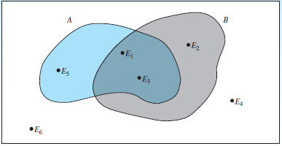
Sample Space
The set of all simple events is called the sample space, denoted by S

Slide 10
Sample Space
For a single coin toss, the possible outcomes are either heads (H) or tails (T).
Sample Space, S: {H, T}
What is we toss the coin twice? What will be the sample space of that experiment?

Slide 11
Relative Frequency
if an experiment is performed n times, then the relative frequency of a particular occurrence A — is
Relative frequency = Frequency / n
Where the frequency is the number of times the event A occurred.
What if n -> ∞
you will eventually generate the entire population.

Slide 12
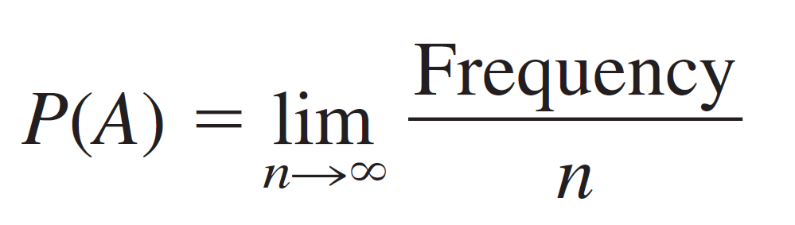
Probability
In this population, the relative frequency of the event A is defined as the probability of event A; that is,

Slide 13
Probability value range
P(A) behaves like a relative frequency, P(A) must be a proportion lying between 0 and 1. P(A) = 0 if the event A never occurs, and P(A) = 1 if the event A always occurs. The closer P(A) is to 1, the more likely it is that A will occur.

Slide 14
Probability
if you tossed a balanced, six-sided die an infinite number of times, you would expect the relative frequency for any of the six values, x = 1, 2, 3, 4, 5, 6, to be 1/6.
It is impossible, to repeat an experiment an infinite number of times.
An important consequence of the relative frequency definition of probability involves the simple events. Since the simple events are mutually exclusive, their probabilities must satisfy two conditions.

Slide 15
Requirements for Simple Event Probabilities
Each probability must lie between 0 and 1.
The sum of the probabilities for all simple events in S equals 1.

Slide 16
Probability (Definition)
The probability of an event A is equal to the sum of the probabilities of the simple events contained in A.

Slide 17
Example
Toss two fair coins and record the outcome. Find the probability of observing exactly one head in the two tosses.

