Slide 1
Random Variables, Mathematical Expectation and Variance of a random variable

Slide 2
Random Variable

Slide 3
Scenario
You toss a die and measure x, the number observed on the upper face. The variable x can take on any of six values—1, 2, 3, 4, 5, 6—depending on the random outcome of the experiment.

Slide 4
Definition
A variable x is a random variable if the value that it assumes, corresponding to the outcome of an experiment, is a chance or random event.

Slide 5
Example
x Number of defects on a randomly selected piece of furniture
x SAT score for a randomly selected college applicant
x Number of telephone calls received by a crisis intervention hotline during a randomly selected time period

Slide 6
Recap
A variable is a characteristic that changes or varies over time and/or for different individuals or objects under consideration.
A discrete variable can assume only a finite or countable number of values. (e.g. number of family members, number of new car sales, and number of defective tires returned)
A continuous variable can assume the infinitely many values corresponding to the points on a line interval. (e.g. height, weight, time, distance, and volume)

Slide 7
Qualitative or quantitative
Identify each of the following variables as qualitative or quantitative:
The most frequent use of your microwave oven (reheating, defrosting, warming, other)
The number of consumers who refuse to answer a telephone survey
The door chosen by a mouse in a maze experiment (A, B, or C)
The winning time for a horse running in the Kentucky Derby
The number of children in a fifth-grade class who are reading at or above grade level

Slide 8
WHAT IS THE DIFFERENCE BETWEEN VARIABLE AND RANDOM VARIABLE

Slide 9
Probability Distributions

Slide 10
Defining probability
We defined probability as the limiting value of the relative frequency as the experiment is repeated over and over again.
Now we define the probability distribution for a random variable x as the relative frequency distribution constructed for the entire population of measurements.

Slide 11
Definition of Probability Distributions
The probability distribution for a discrete random variable is a formula, table, or graph that gives the possible values of x, and the probability p(x) associated with each value of x.
The values of x represent mutually exclusive numerical events.
Summing p(x) over all values of x is equivalent to adding the probabilities of all simple events which is?

Slide 12
REQUIREMENTS FOR A DISCRETE PROBABILITY
DISTRIBUTION
0 ≤ p(x)≤ 1
⅀ p(x) = 1

Slide 13
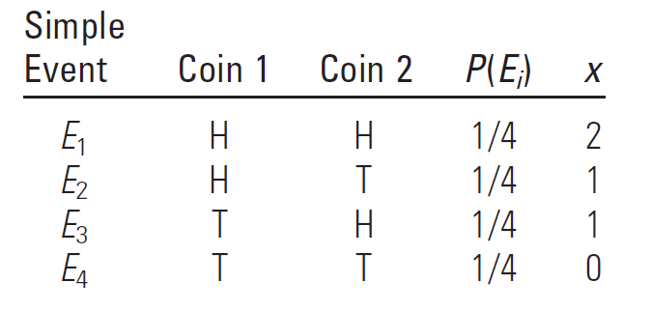
Example
Toss two fair coins and let x equal the number of heads observed. Find the probability distribution for x

Slide 14
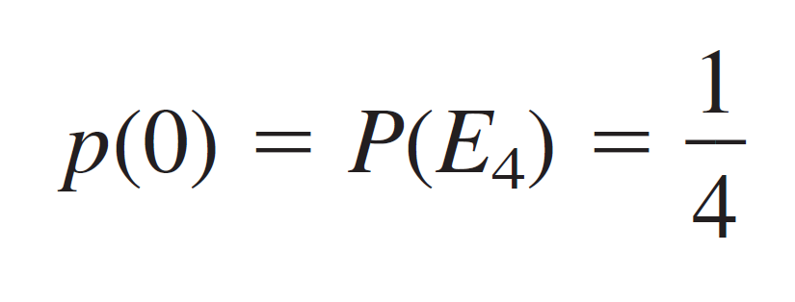
Example (Cont..)
For each value of x, you can calculate p(x) by adding the probabilities of the simple events in that event. For example, when x = 0,
For x=1, what is the probability?

Slide 15
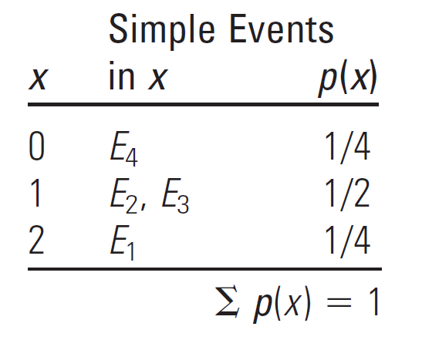
Probability Distributions

Slide 16
The Mean and Standard Deviation for a Discrete Random Variable

Slide 17
Question
What is the mean of x ?

Slide 18
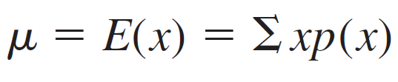
Formula
Let x be a discrete random variable with probability distribution p(x). The mean or expected value of x is given as

Slide 19

Variance
Let x be a discrete random variable with probability distribution p(x) and mean μ. The variance of x is

Slide 20
Standard Deviation
The standard deviation s of a random variable x is equal to the positive square root of its variance.

