Slide 1
Measures of Variability

Slide 2
What is measures of variability
Some questions
What is variable?
What are the types of variables?
Why do we tend to find the center of data? Give some examples

Slide 3
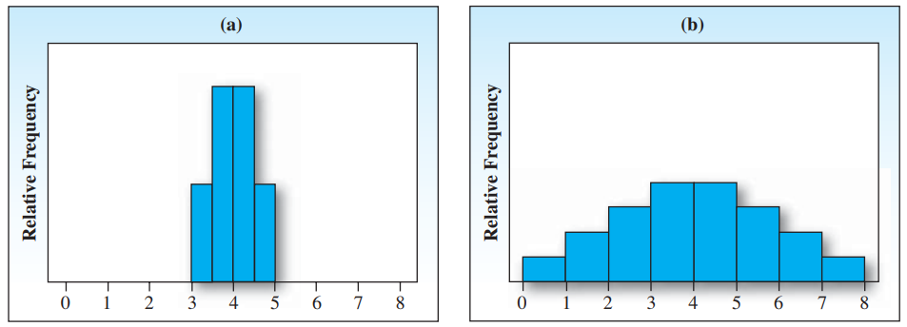
What is measures of variability

Slide 4
What is measures of variability
Data sets may have the same center but look different because of the way the numbers spread out from the center.

Slide 5
Variability or Dispersion
Variability, or dispersion, refers to how spread out or clustered the values in a dataset are around a central value, such as the mean or median.
Understanding variability helps us assess the consistency of data and provides insight into how typical or unusual certain data points may be.
Measures of variability can help you create a mental picture of the spread of the data. The simplest measure of variation is the range.

Slide 6
Range
The range, R, of a set of n measurements is defined as the difference between the largest and smallest measurements.

Slide 7
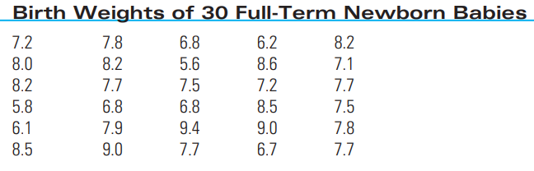
Practice

Slide 8
Birth Weight Data
What is the Range?
How many classes should we create?
Can we draw a frequency histogram?
Method of left inclusion

Slide 9
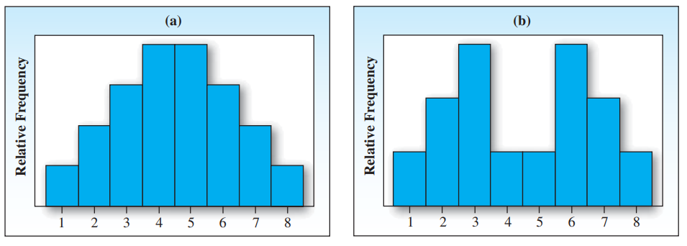

Slide 10
Is there a measure of variability that is more sensitive than the range?

Slide 11
Measure of Variability
Let’s draw a diagram with the following data
5, 7, 1, 2, 4
Mean: 19/5 = 3.8

Slide 12
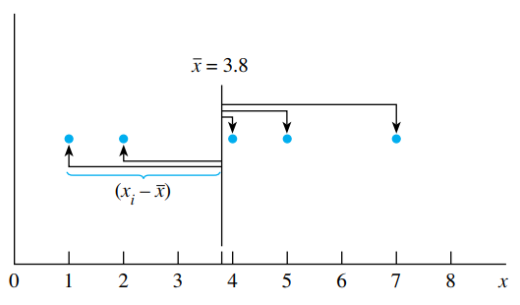
Measure of Variability
The horizontal distances between each dot (measurement) and the mean x will help you to measure the variability.
If the distances are large, the data are more spread out or variable than if the distances are small.

Slide 13
Deviation
If x_{i} is a particular dot (measurement), then the deviation of that measurement from the mean is (x_{i} - x ).
Measurements to the right of the mean produce positive deviations, and those to the left produce negative deviations.

Slide 14
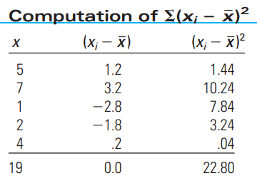
Deviation
Because the deviations in the second column of the table contain information on variability, one way to combine the five deviations into one numerical measure is to average them. The average will not work because some of the deviations are positive, some are negative, and the sum is always zero.

Slide 15
Deviation
Another possibility might be to disregard the signs of the deviations and calculate the average of their absolute values. This method has been used as a measure of variability in exploratory data analysis and in the analysis of time series data.

Slide 16
Variance
From the sum of squared deviations, a single measure called the variance is calculated (Column 3).
Variance is the mean of the squared deviations from the mean, showing how data points are spread out.

Slide 17
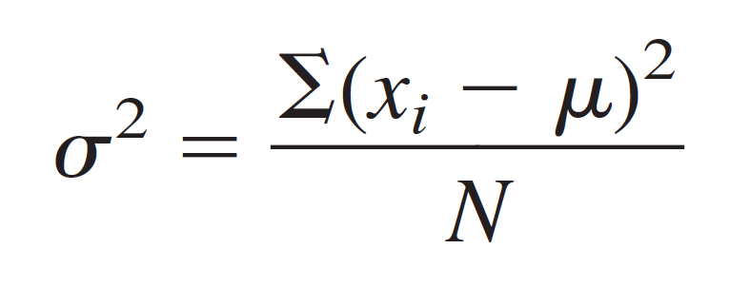
Variance
The variance of a population of N measurements is the average of the squares of the deviations of the measurements about their mean μ. The population
variance is denoted by 𝜎² and is given by the formula

Slide 18
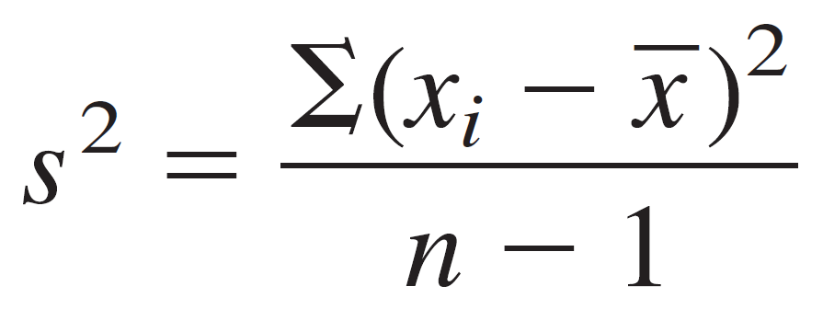
Variance
The variance of a sample of n measurements is the sum of the squared deviations of the measurements about their mean x divided by (n - 1). The sample variance is denoted by s² and is given by the formula

Slide 19
Standard Deviation
The standard deviation of a set of measurements is equal to the positive square root of the variance.

Slide 20
Tchebysheff’s Theorem
Given a number k greater than or equal to 1 and a set of n measurements, at least [1 (1/k²)] of the measurements will lie within k standard deviations of their mean.

