Slide 1
Computer Networking

Slide 2
Chapter 1: Computer Networks and the Internet
Overview/roadmap:
What is the Internet?
What is a protocol?
The Network edge: hosts, access network, physical media
The Network core: packet/circuit switching, internet structure
Performance: loss, delay, throughput
Security
Protocol layers, service models
History of Computer Networking and the Internet

Slide 3
Network and Computer Networks
Network:
A collection of interconnected elements or nodes that communicate and interact with each other to achieve a specific purpose or to facilitate the exchange of information, resources, or services. Networks can take various forms and serve different functions.
Computer Network:
A system of interconnected computers and devices that enable data and information sharing, such as the internet or a local area network (LAN).

Slide 4
Different Type of Networks
Social Network:
An online platform or community where individuals or entities connect, communicate, and share information, often for social or professional purposes. Examples include Facebook, LinkedIn, and Twitter.
Transportation Network:
A system of roads, highways, railways, and other infrastructure that enables the movement of people and goods from one location to another.

Slide 5
Different Type of Networks
Electrical Network:
A grid of interconnected electrical components (e.g., power generators, transformers, power lines) that distribute electricity to homes, businesses, and industries.
Communication Network:
A system that facilitates the transmission of information, such as telecommunication networks for phone calls, text messages, or data transmission.

Slide 6
Different Type of Networks
Neural Network:
A computational model inspired by the structure and function of the human brain, used in machine learning and artificial intelligence for tasks like pattern recognition and decision-making.
Biological Network:
A network of biological elements, such as neurons in the brain, genes in a genome, or species in an ecosystem, that interact to perform biological functions.

Slide 7
Different Type of Networks
Supply Chain Network:
A network of organizations, suppliers, manufacturers, distributors, and retailers that collaborate to produce and deliver products or services to consumers.
Social Infrastructure Network:
A system of facilities and services (e.g., healthcare, education, utilities) that support and enhance the well-being of a community or society.

Slide 8
Different Type of Networks
Peer-to-Peer (P2P) Network:
A decentralized network architecture in which individual devices or nodes can directly communicate and share resources without relying on a central server.

Slide 9
Internet Applications
Communication:
Line
Email
Skype
Google Meet
Zoom
WhatsApp
Facebook Messenger
Job Search:
LinkedIn
Glassdoor
CareerBuilder
ZipRecruiter
Online Shopping:
Amazon
eBay
Paytm Mall
Walmart
AliExpress
Web Browsing:
Internet Explorer
Google Chrome
Mozilla Firefox
Safari
Opera
Conqueror
Lynx
Tor Browser
UC Browser
Brave Browser

Slide 10
Internet Applications
Social Market Updates:
Bloomberg
CNBC
Market Watch
Investing.com
Stock Twits
Stock Edge
Travel:
MakeMyTrip
Expedia
Airbnb
Skyscanner
Google Maps
Research:
Google Scholar
Mendeley
Flipboard
Researcher
Google Keep
Curiosity
Paperity
Slack
DropBox
E-Commerce:
Amazon
Paytm Mall
Online Payments:
Paypal
Paytm
Google Pay
Amazon Pay
Line Pay

Slide 11

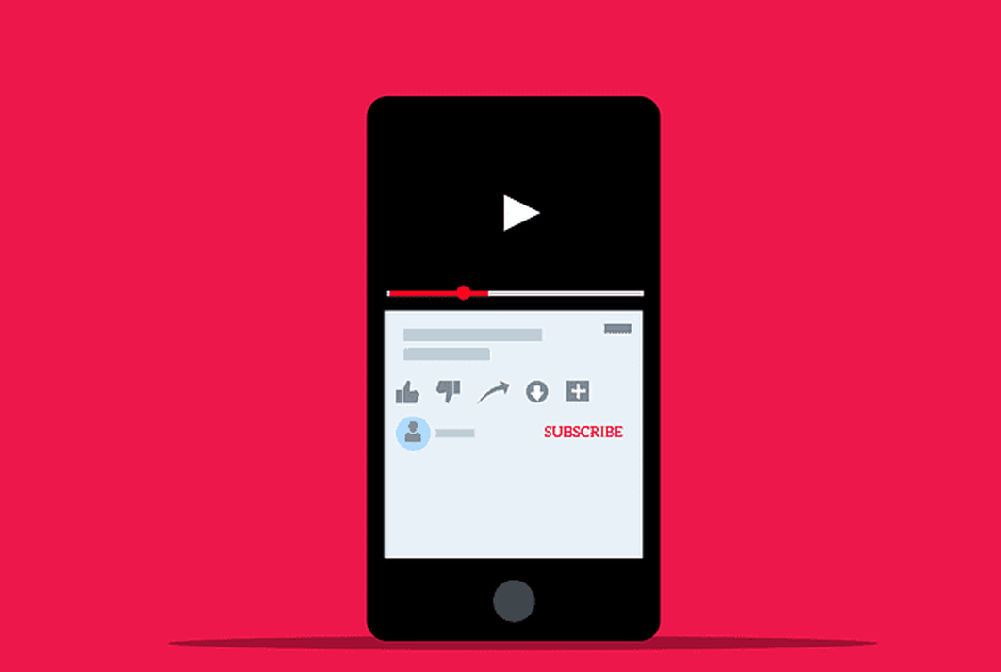
Internet Applications
Social Networking:
Entertainment:

Slide 12
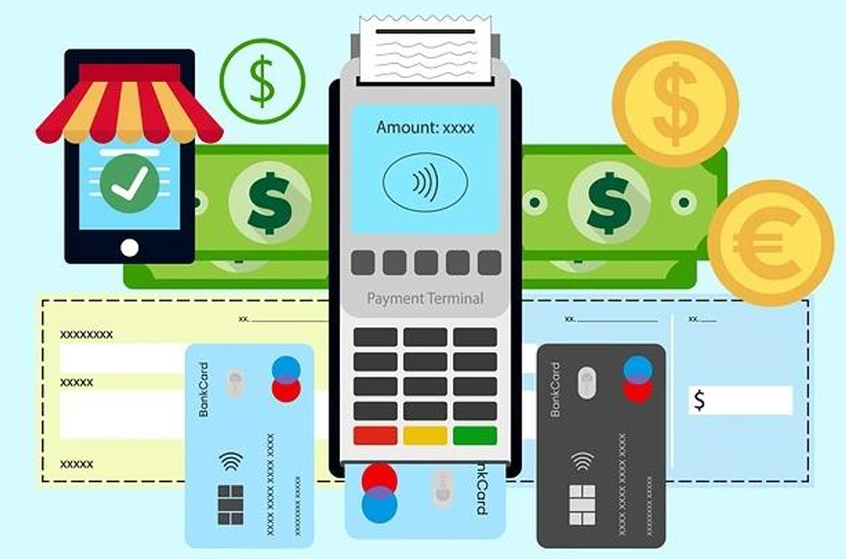
Internet Applications
E-Banking:

Slide 13

Internet Applications
E-Learning:

Slide 14
Chapter 1: Computer Networks and the Internet
Overview/roadmap:
What is the Internet?
What is a protocol?
The Network edge: hosts, access network, physical media
The Network core: packet/circuit switching, internet structure
Performance: loss, delay, throughput
Security
Protocol layers, service models
History of Computer Networking and the Internet

Slide 15
Internet
Two ways to explain internet:
1. we can describe the nuts and bolts of the Internet, that is, the basic hardware and software components that make up the Internet.
2. Second, we can describe the Internet in terms of a networking infrastructure that provides services to distributed applications

Slide 16
















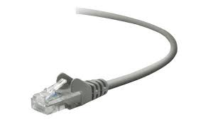
The Internet: a “nuts and bolts” view
Billions of connected computing devices:
  hosts = end systems
  running network apps at Internet’s “edge”
mobile network
national or global ISP
Packet switches: forward packets (chunks of data)
  routers, switches
local or regional ISP
Internet
Communication links
  fiber, copper, radio, satellite
  transmission rate: bandwidth
home network
content
provider
network
datacenter
network
Networks
  collection of devices, routers, links: managed by an organization
enterprise
network
16

Slide 17
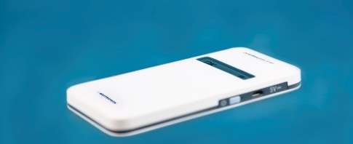
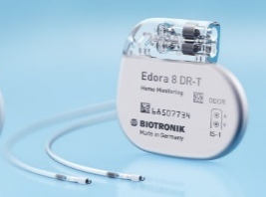


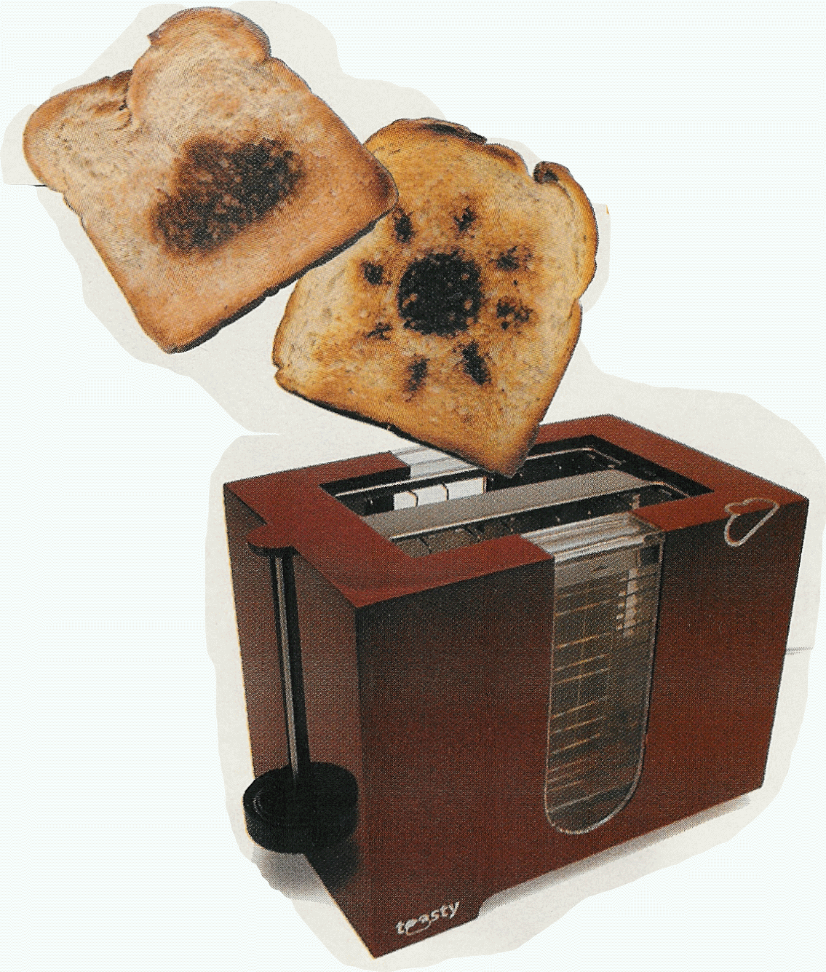

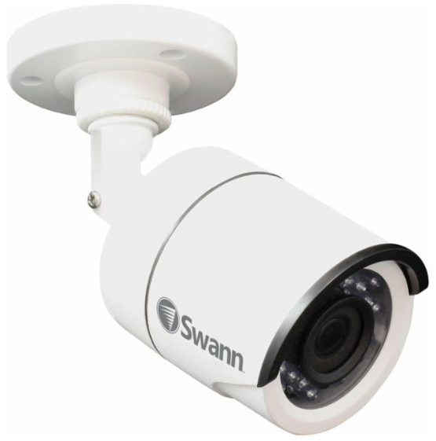
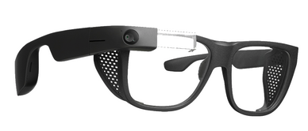


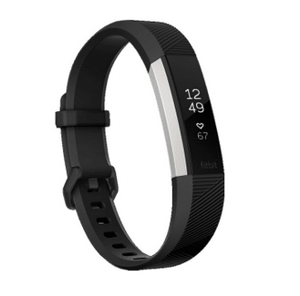

“Fun” Internet-connected devices
Pacemaker & Monitor
Tweet-a-watt:
monitor energy use
Amazon Echo
IP picture frame
Web-enabled toaster +
weather forecaster
Internet
refrigerator
Slingbox: remote
control cable TV
Security Camera
AR devices
sensorized,
bed
mattress
Others?
Internet phones
Fitbit

Slide 18
The Internet: a “nuts and bolts” view
Internet: “network of networks”
  Interconnected ISPs
mobile network
4G
national or global ISP
protocols are everywhere
  control sending, receiving of messages
  e.g., HTTP (Web), streaming video, Skype, TCP, IP, WiFi, 4G, Ethernet
IP
Streaming
video
Skype
local or regional ISP
home network
content
provider
network
Internet standards
  RFC: Request for Comments
  IETF: Internet Engineering Task Force
HTTP
datacenter
network
Ethernet
TCP
enterprise
network
WiFi

Slide 19
The Internet: a “service” view
Infrastructure that provides services to applications:
  Web, streaming video, multimedia teleconferencing, email, games, e-commerce, social media, inter-connected appliances, …
mobile network
national or global ISP
Streaming
video
Skype
local or regional ISP
provides programming interface to distributed applications:
  “hooks” allowing sending/receiving apps to “connect” to, use Internet transport service
  provides service options, analogous to postal service
home network
content
provider
network
HTTP
datacenter
network
enterprise
network

Slide 20
The Internet: a “service” view
Analogous to postal service
Suppose Alice wants to send a letter to Bob using the postal service. Alice, of course, can’t just write the letter (the data) and drop the letter out her window. Instead, the postal service requires that Alice put the letter in an envelope; write Bob’s full name, address, and zip code in the center of the envelope; seal the envelope; put a stamp in the upper-right-hand corner of the envelope; and finally, drop the envelope into an official postal service mailbox. Thus, the postal service has its own “postal service interface,” or set of rules, that Alice must follow to have the postal service deliver her letter to Bob. In a similar manner, the Internet has a socket interface that the program sending data must follow to have the Internet deliver the data to the program that will receive the data.
The postal service, of course, provides more than one service to its customers. It provides express delivery, reception confirmation, ordinary use, and many more services. In a similar manner, the Internet provides multiple services to its applications. When you develop an Internet application, you too must choose one of the Internet’s services for your application.

Slide 21
Chapter 1: Computer Networks and the Internet
Overview/roadmap:
What is the Internet?
What is a protocol?
The Network edge: hosts, access network, physical media
The Network core: packet/circuit switching, internet structure
Performance: loss, delay, throughput
Security
Protocol layers, service models
History of Computer Networking and the Internet

Slide 22
What’s a protocol?
Human protocols:
“what’s the time?”
“I have a question”
introductions
… specific messages sent
… specific actions taken when message received, or other events
Network protocols:
computers (devices) rather than humans
all communication activity in Internet governed by protocols
Protocols define the format, order of messages sent and received among network entities, and actions taken on msg transmission, receipt

Slide 23



What’s a protocol?
A human protocol and a computer network protocol:
Hi
TCP connection
request
Hi
TCP connection
response
Got the
time?
GET http://gaia.cs.umass.edu/kurose_ross
2:00
<file>
time
Q: other human protocols?
Notes:
Explain important points
distributed entities, exchanging messages (governed by protocols)
Time going down
go over definition of protocol (showing format, order of messages sent and received, and actions taken)
We’ll see these kinds of diagrams a lot

