Slide 1
Computer Networking

Slide 2
Chapter 1: Computer Networks and the Internet
Overview/roadmap:
What is the Internet?
What is a protocol?
The Network edge: hosts, access network, physical media
The Network core: packet/circuit switching, internet structure
Performance: loss, delay, throughput
Security
Protocol layers, service models
History of Computer Networking and the Internet

Slide 3
















A closer look at Internet structure
mobile network
Network edge:
hosts: clients and servers
servers often in data centers
national or global ISP
local or regional ISP
home network
content
provider
network
datacenter
network
enterprise
network
3

Slide 4
A closer look at Internet structure
mobile network
Network edge:
hosts: clients and servers
servers often in data centers
Access networks, physical media:
wired, wireless communication links
Connects end systems to the internet
national or global ISP
local or regional ISP
home network
content
provider
network
datacenter
network
enterprise
network

Slide 5
A closer look at Internet structure
mobile network
Network edge:
hosts: clients and servers
servers often in data centers
Access networks, physical media:
wired, wireless communication links
Network core:
  interconnected routers
  network of networks
national or global ISP
local or regional ISP
home network
content
provider
network
datacenter
network
enterprise
network

Slide 6
Access networks and physical media
Q: How to connect end systems to edge router?
residential access nets
institutional access networks (school, company)
mobile access networks (WiFi, 4G/5G)
mobile network
national or global ISP
local or regional ISP
What to look for:
transmission rate (bits per second) of access network?
shared or dedicated access among users?
home network
content
provider
network
datacenter
network
enterprise
network

Slide 7

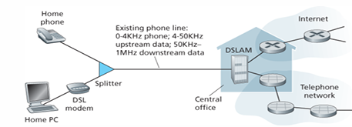
Access networks: digital subscriber line (DSL)
central office
telephone
network
DSL
modem
splitter
DSLAM
voice, data transmitted
at different frequencies over
dedicated line to central office
ISP
DSL access
multiplexer
  One of the technology used for access N/W is DSL
  Advantages:
  Use existing telephone line to central office DSLAM
  • data over DSL phone line goes to Internet
  • voice over DSL phone line goes to telephone net
  24-52 Mbps dedicated downstream transmission rate
  3.5-16 Mbps dedicated upstream transmission rate

Slide 8
Access networks: digital subscriber line (DSL)
central office
telephone
network
DSL
modem
splitter
DSLAM
voice, data transmitted
at different frequencies over
dedicated line to central office
ISP
DSL access
multiplexer
  The maximum rate is also limited by the distance between the home and the CO, the gauge of the twisted-pair line and the degree of electrical interference.
  Engineers have expressly designed DSL for short distances between the home and the CO; generally, if the residence is not located within 5 to 10 miles of the CO, the residence must resort to an alternative form of Internet access.

Slide 9



Access networks: cable-based access
cable headend
…
cable
modem
splitter
C
O
N
T
R
O
L
V
I
D
E
O
V
I
D
E
O
V
I
D
E
O
V
I
D
E
O
V
I
D
E
O
V
I
D
E
O
D
A
T
A
D
A
T
A
1
2
3
4
5
6
7
8
9
Channels
frequency division multiplexing (FDM): different channels transmitted in different frequency bands

Slide 10
Access networks: cable-based access
cable headend
…
cable
modem
splitter
CMTS
cable modem
termination system
data, TV transmitted at different
frequencies over shared cable
distribution network
ISP
HFC: hybrid fiber coax
  asymmetric: up to 40 Mbps – 1.2 Gbs downstream transmission rate, 30-100 Mbps upstream transmission rate
network of cable, fiber attaches homes to ISP router
  homes share access network to cable headend

Slide 11
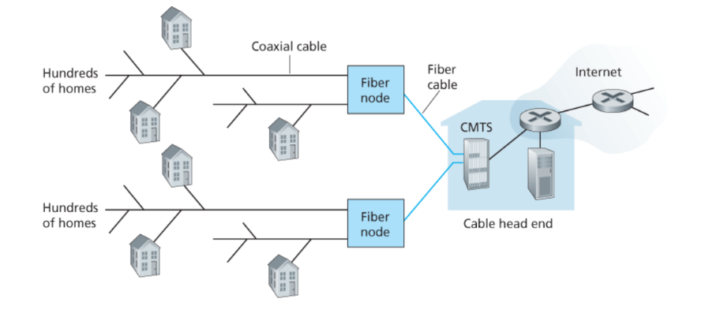
Access networks: cable-based access
A hybrid fiber-coaxial access network

Slide 12
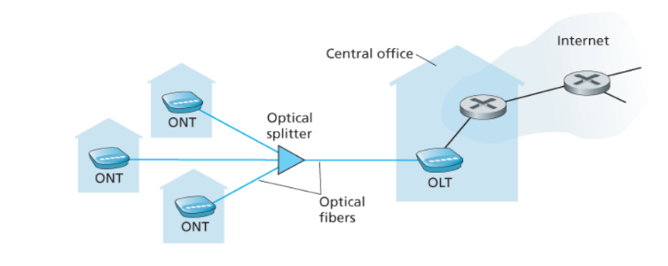
Access networks: Fiber to the home internet access
▪ FTTH Internet access
▪ Optical splitter combines multiple homes on a single optical fiber
▪ Optical network terminator (ONT) provides internet to the home (optical to digital)
▪ Optical line terminator (OLT) providing conversion between optical and electrical signals,
connects to the Internet via a telco router
▪ FTTH can potentially provide Internet access rates in the gigabits per second range

Slide 13
Access networks: Fiber to the home internet access
▪ Two other access network technologies are also used to provide Internet access to the home where DSL, cable, and FTTH are not available (e.g., in some rural settings),
        ▪ A satellite link can be used to connect a residence to the Internet at speeds
        of more than 1 Mbps; StarBand and HughesNet are two such satellite access
        providers.
        ▪ Dial-up access over traditional phone lines is based on the same model as
        DSL—a home modem connects over a phone line to a modem in the ISP.
        Compared with DSL and other broadband access networks, dial-up access is
        very slow at 56 kbps.

Slide 14







Access networks: home networks
wireless
devices
to/from headend or central office
often combined
in single box
cable or DSL modem
WiFi wireless access
point (54, 450 Mbps)
router, firewall, NAT
wired Ethernet (1 Gbps)

Slide 15








Wireless access networks
Shared wireless access network connects end system to router
via base station aka “access point”
Wide-area cellular access networks
  provided by mobile, cellular network operator (10’s km)
  10’s Mbps
  4G cellular networks (5G coming)
Wireless local area networks (WLANs)
  typically within or around building (~100 ft)
  802.11b/g/n (WiFi): 11, 54, 450 Mbps transmission rate
to Internet
to Internet

Slide 16









Access networks: enterprise networks
Enterprise link to
ISP (Internet)
institutional router
Ethernet
switch
institutional mail,
web servers
companies, universities, etc.
  mix of wired, wireless link technologies, connecting a mix of switches and routers (we’ll cover differences shortly)
    Ethernet: wired access at 100Mbps, 1Gbps, 10Gbps
    WiFi: wireless access points at 11, 54, 450 Mbps

Slide 17
Links: physical media
Consider a bit traveling from one end system, through a series of links and routers, to another end system.
The source end system first transmits the bit, and shortly thereafter the first router in the series receives the bit;
The first router then transmits the bit, and shortly thereafter the second router receives the bit; and so on…
From source to destination, it passes through a series of transmitter-receiver pairs.
For each transmitter receiver pair, the bit is sent by propagating electromagnetic waves or optical pulses across a physical medium.
The physical medium can twisted-pair copper wire, coaxial cable, multimode fiber-optic cable, and satellite radio spectrum.
Physical media fall into two categories: guided media and unguided media.
    With guided media, the waves are guided along a solid medium, such as a fiber-optic cable, a twisted-pair copper wire, or a coaxial cable.
    With unguided media, the waves propagate in the atmosphere and in outer space, such as in a wireless LAN or a digital satellite channel

Slide 18
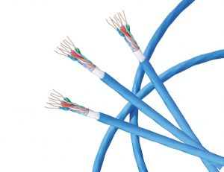
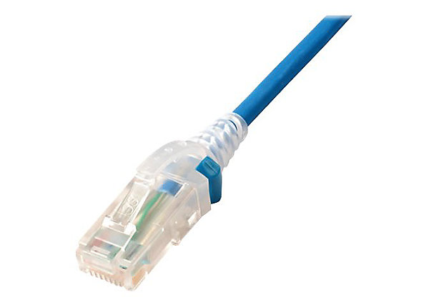
Links: physical media
bit: propagates between
transmitter/receiver pairs
physical link: what lies between transmitter & receiver
guided media:
  signals propagate in solid media: copper, fiber, coax
unguided media:
  signals propagate freely, e.g., radio
Twisted pair (TP)
two insulated copper wires
  Category 5: 100 Mbps, 1 Gbps Ethernet
  Category 6: 10Gbps Ethernet

Slide 19
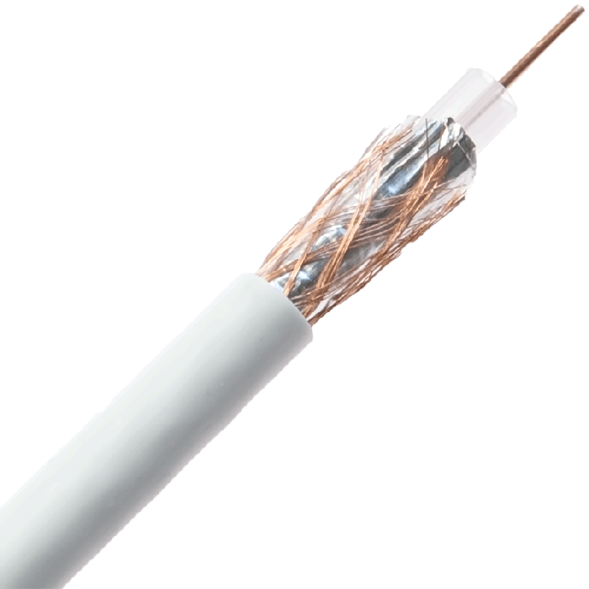
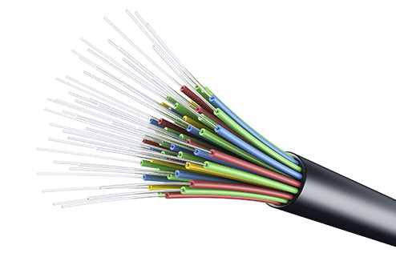
Links: physical media
Coaxial cable:
two concentric copper conductors
bidirectional
broadband:
  multiple frequency channels on cable
  100’s Mbps per channel
Fiber optic cable:
glass fiber carrying light pulses, each pulse a bit
high-speed operation:
  high-speed point-to-point transmission (10’s-100’s Gbps)
low error rate:
  repeaters spaced far apart
  immune to electromagnetic noise

Slide 20
Links: physical media
Wireless radio
signal carried in electromagnetic spectrum
no physical “wire”
broadcast and “half-duplex” (sender to receiver)
propagation environment effects:
  reflection
  obstruction by objects
  interference
Radio link types:
terrestrial microwave
  up to 45 Mbps channels
Wireless LAN (WiFi)
  Up to 100’s Mbps
wide-area (e.g., cellular)
  4G cellular: ~ 10’s Mbps
satellite
  up to 45 Mbps per channel
  270 msec end-end delay
  geosynchronous versus low-earth-orbit

Slide 21
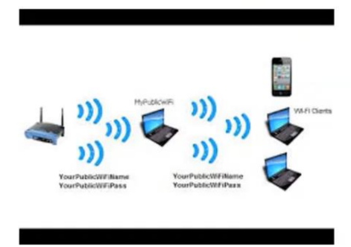
Links: physical media
LAN (e.g., WiFi)
54 Mbps
A building
Penetrate through walls

Slide 22
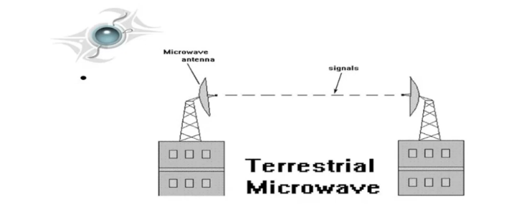
Links: physical media
Microwave
Used for long distance telephone service
Parabolic dish mounted high
Used for both voice and TV transmission

Slide 23
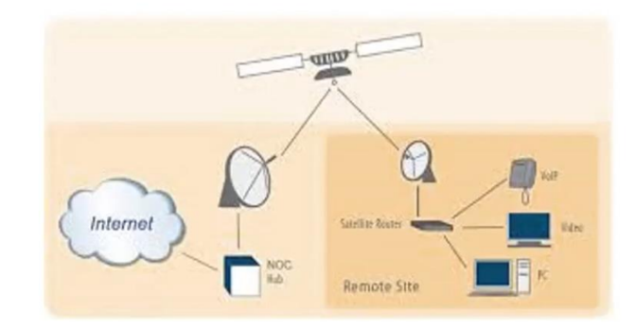
Links: physical media
Satellite
Kbps to 45 Mbps channel (or multiple smaller channels
270 msec end-end delay

