Slide 1
Computer Networking

Slide 2
Chapter 1: Computer Networks and the Internet
Overview/roadmap:
What is the Internet?
What is a protocol?
The Network edge: hosts, access network, physical media
The Network core: packet/circuit switching, internet structure
Performance: loss, delay, throughput
Security
Protocol layers, service models
History of Computer Networking and the Internet

Slide 3
















The network core
mesh of interconnected routers
packet-switching: hosts break application-layer messages into packets
  forward packets from one router to the next, across links on path from source to destination
  each packet transmitted at full link capacity
mobile network
national or global ISP
local or regional ISP
home network
content
provider
network
datacenter
network
enterprise
network

Slide 4
Two key network-core functions
routing algorithm
Routing:
global action: determine source-destination paths taken by packets
routing algorithms
routing algorithm
Forwarding:
local action: move arriving packets from router’s input link to appropriate router output link
local forwarding table
local forwarding table
header value
output link
0100
0101
0111
1001
3
2
2
1
1
3
2
0111
destination address in arriving
packet’s header

Slide 5
Circuit Switching
In circuit-switched networks, the resources needed along a path (buffers, link transmission rate) to provide for communication between the end systems are reserved for the duration of the communication session between the end systems.
Example:
▪ Traditional telephone networks

Slide 6

Circuit Switching
end-end resources allocated to, reserved for “call” between source and destination
in diagram, each link has four circuits.
  call gets 2nd circuit in top link and 1st circuit in right link.
dedicated resources: no sharing
  circuit-like (guaranteed) performance
circuit segment idle if not used by call (no sharing)
commonly used in traditional telephone networks
if each link between adjacent switches has a transmission rate of 1 Mbps, then each end-to end circuit-switch connection gets 250 kbps of dedicated transmission rate.

Slide 7
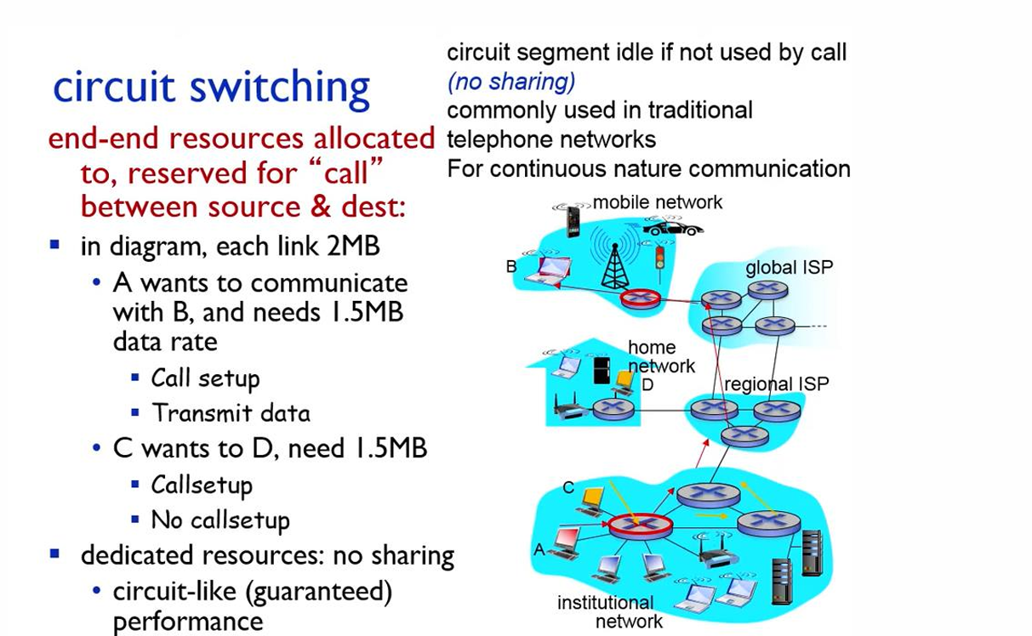
Circuit Switching

Slide 8
Circuit switching: FDM and TDM
Frequency Division Multiplexing (FDM)
optical, electromagnetic frequencies divided into (narrow) frequency bands
each call allocated its own band, can transmit at max rate of that narrow band
4 users
frequency
time
Time Division Multiplexing (TDM)
time is divided into frames of fixed duration
each frame is divided into a fixed number of time slots
each call allocated periodic slot(s), can transmit at maximum rate of (wider) frequency band, but only during its time slot(s)
frequency
time

Slide 9
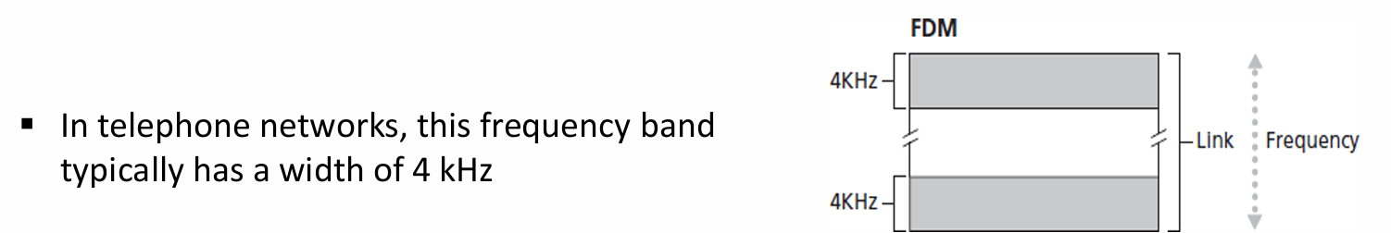
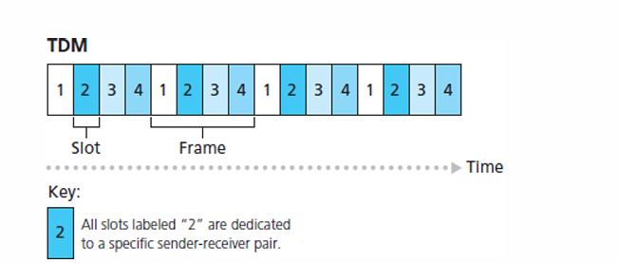
Circuit switching: FDM and TDM

Slide 10
Circuit switching: FDM and TDM
For TDM, the transmission rate of a circuit is equal to the frame rate multiplied by the number of bits in a slot.
For example, if the link transmits 8,000 frames per second and each slot consists of 8 bits, then the transmission rate of each circuit is 64 kbps.

Slide 11
Circuit switching: FDM and TDM
Example:
Let us consider how long it takes to send a file of 640,000 bits from Host A to Host B over a circuit switched network. Suppose that all links in the network use TDM with 24 slots and have a bit rate of 1.536 Mbps. Also suppose that it takes 500 msec to establish an end-to-end circuit before Host A can begin to transmit the file. How long does it take to send the file?
Solution:
▪Each circuit has a transmission rate of:
1.536 Mbps/24=64 kbps
so it takes (640,000 bits)/(64 kbps)=10 seconds to transmit the file. To this 10 seconds we add the circuit establishment time, giving 10.5 seconds to send the file.

Slide 12
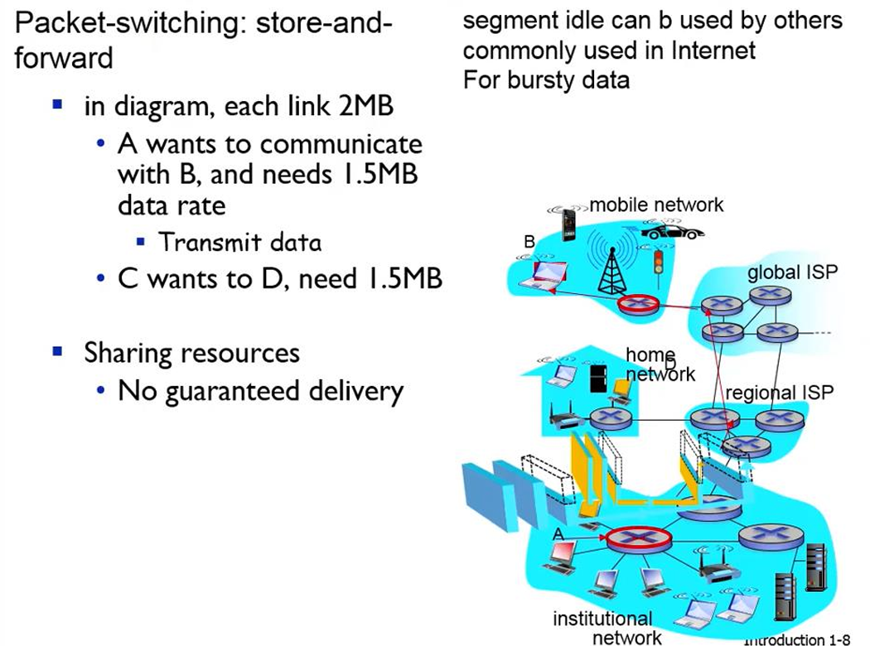
Packet switching: store and forward

Slide 13

Host: sends packets of data
host sending function:
takes application message
breaks into smaller chunks, known as packets, of length L bits
transmits packet into access network at transmission rate R
  link transmission rate, aka link capacity, aka link bandwidth
two packets,
L bits each
2
1
host
R: link transmission rate
packet
transmission
delay
time needed to
transmit L-bit
packet into link
L (bits)
R (bits/sec)
=
=

Slide 14



Packet-switching: store-and-forward
L bits
per packet
source
3
2
1
destination
R bps
R bps
Transmission delay: takes L/R seconds to transmit (push out) L-bit packet into link at R bps
Store and forward: entire packet must arrive at router before it can be transmitted on next link
End-end delay: 2L/R (above), assuming zero propagation delay (more on delay shortly)
One-hop numerical example:
L = 10 Kbits
R = 100 Mbps
one-hop transmission delay = 0.1 msec

Slide 15
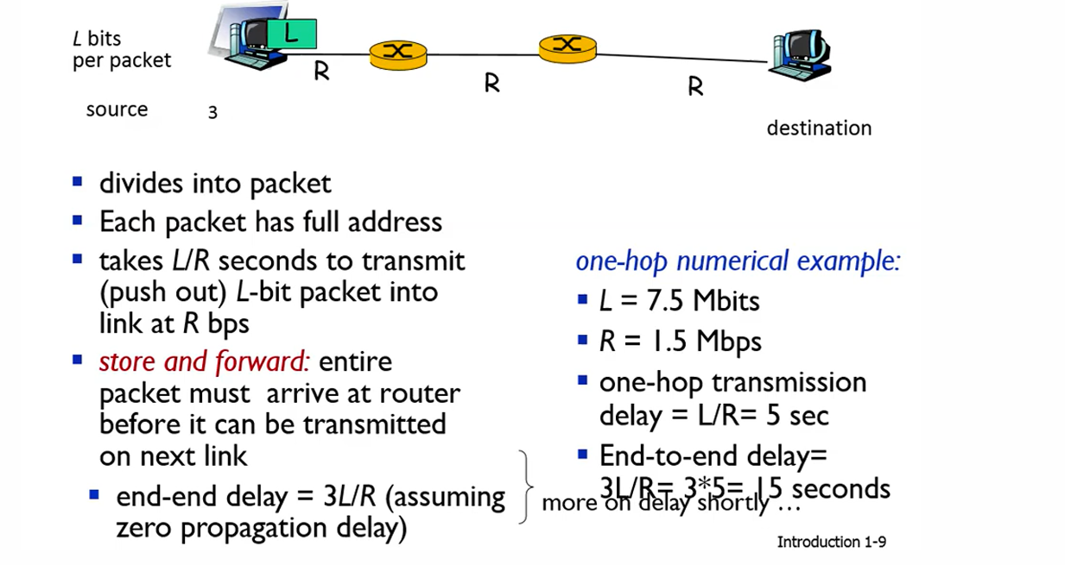
Packet switching: store and forward

Slide 16
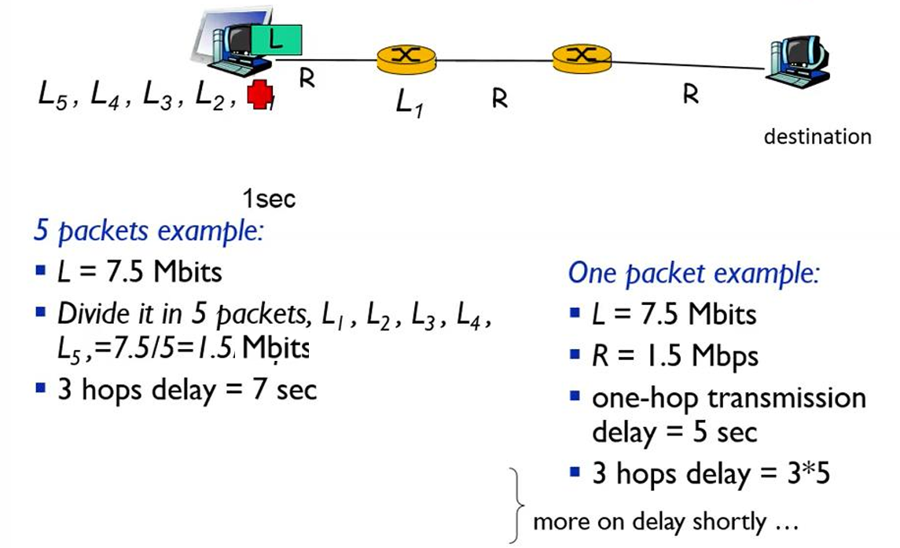
Packet switching: store and forward

Slide 17
Packet-switching: queueing delay, loss
R = 100 Mb/s
C
A
R = 1.5 Mb/s
D
B
E
queue of packets
waiting for output link
Packet queuing and loss: if arrival rate (in bps) to link exceeds transmission rate (bps) of link for a period of time:
packets will queue, waiting to be transmitted on output link
packets can be dropped (lost) if memory (buffer) in router fills up

Slide 18
Packet switching versus circuit switching
packet switching allows more users to use network!
Example:
1 Gb/s link
each user:
  100 Mb/s when “active”
  active 10% of time
…..
N
users
1 Gbps link
circuit-switching: 10 users
packet switching: with 35 users, probability > 10 active at same time is less than .0004 *
Q: how did we get value 0.0004?
Q: what happens if > 35 users ?
* Check out the online interactive exercises for more examples: http://gaia.cs.umass.edu/kurose_ross/interactive

Slide 19
Packet switching versus circuit switching
Is packet switching a “slam dunk winner”?
great for “bursty” data – sometimes has data to send, but at other times not
  resource sharing
  simpler, no call setup
excessive congestion possible: packet delay and loss due to buffer overflow
  protocols needed for reliable data transfer, congestion control
Q: How to provide circuit-like behavior?
  bandwidth guarantees traditionally used for audio/video applications
Q: human analogies of reserved resources (circuit switching) versus on-demand allocation (packet switching)?

Slide 20
Internet structure: a “network of networks”
Hosts connect to Internet via access Internet Service Providers (ISPs)
    residential, enterprise (company, university, commercial) ISPs
Access ISPs in turn must be interconnected
    so that any two hosts can send packets to each other
Resulting network of networks is very complex
    evolution was driven by economics and national policies
Let’s take a stepwise approach to describe current Internet structure

Slide 21
Internet structure: a “network of networks”
Question: given millions of access ISPs, how to connect them together?
…
…
access
net
access
net
access
net
access
net
access
net
access
net
access
net
…
…
access
net
access
net
access
net
access
net
access
net
access
net
…
access
net
access
net
…
access
net

Slide 22
Internet structure: a “network of networks”
Question: given millions of access ISPs, how to connect them together?
…
…
access
net
access
net
access
net
access
net
access
net
…
…
access
net
access
net
connecting each access ISP to each other directly doesn’t scale: O(N²) connections.
…
…
…
access
net
access
net
…
access
net
access
net
access
net
…
access
net
…
access
net
access
net
…
access
net

Slide 23
Internet structure: a “network of networks”
Option: connect each access ISP to one global transit ISP?
Customer and provider ISPs have economic agreement.
…
…
access
net
access
net
access
net
access
net
access
net
access
net
access
net
…
…
global
ISP
access
net
access
net
access
net
access
net
access
net
access
net
…
access
net
access
net
…
access
net

Slide 24
Internet structure: a “network of networks”
But if one global ISP is viable business, there will be competitors ….
…
…
access
net
access
net
access
net
access
net
access
net
access
net
ISP A
access
net
…
…
access
net
ISP B
access
net
ISP C
access
net
access
net
access
net
access
net
…
access
net
access
net
…
access
net

Slide 25
Internet structure: a “network of networks”
But if one global ISP is viable business, there will be competitors …. who will want to be connected
Internet exchange point
…
…
access
net
access
net
access
net
access
net
access
net
IXP
access
net
access
net
ISP A
…
…
access
net
IXP
ISP B
access
net
ISP C
access
net
access
net
peering link
access
net
access
net
…
access
net
access
net
…
access
net

Slide 26
Internet structure: a “network of networks”
… and regional networks may arise to connect access nets to ISPs
…
…
access
net
access
net
access
net
access
net
access
net
IXP
access
net
access
net
ISP A
…
…
access
net
IXP
ISP B
access
net
ISP C
access
net
access
net
access
net
regional ISP
access
net
…
access
net
access
net
…
access
net

Slide 27
Internet structure: a “network of networks”
… and content provider networks (e.g., Google, Microsoft, Akamai) may run their own network, to bring services, content close to end users
…
…
access
net
access
net
access
net
access
net
access
net
IXP
access
net
access
net
ISP A
…
…
Content provider network
access
net
IXP
ISP B
access
net
ISP C
access
net
access
net
access
net
regional ISP
access
net
…
access
net
access
net
…
access
net

Slide 28
Internet structure: a “network of networks”
Tier 1 ISP
Tier 1 ISP
Google
IXP
IXP
IXP
Regional ISP
Regional ISP
access
ISP
access
ISP
access
ISP
access
ISP
access
ISP
access
ISP
access
ISP
access
ISP
At “center”: small # of well-connected large networks
  “tier-1” commercial ISPs (e.g., Level 3, Sprint, AT&T, NTT), national & international coverage
  content provider networks (e.g., Google, Facebook): private network that connects its data centers to Internet, often bypassing tier-1, regional ISPs

Slide 29
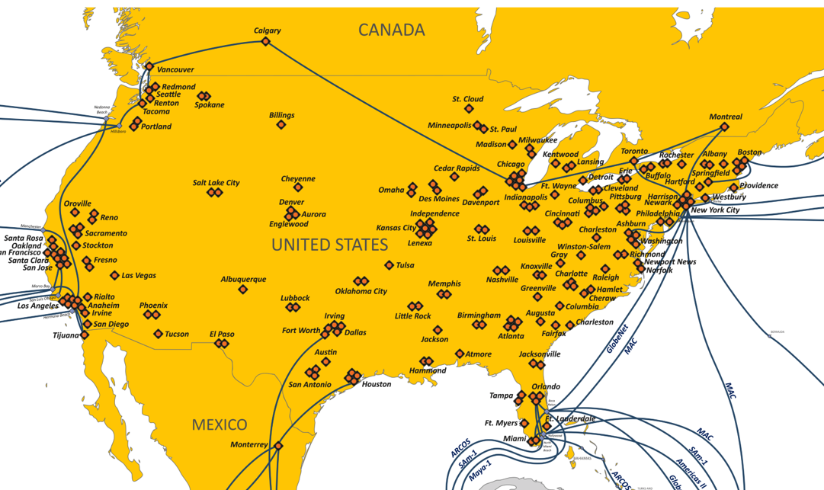
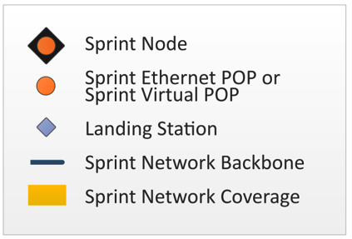
Tier-1 ISP Network map: Sprint (2019)
POP: point-of-presence
to/from other Sprint PoPS
links to peering networks
…
…
…
…
…
links to/from Sprint customer networks

