Slide 1
Software Project Management
Dr. Md. Nasim Adnan

Slide 2
What is a Project
Project Management Institute (2004) defines a project as a temporary endeavor undertaken to create a unique product or service.
The definition entails five important characteristics of a project, some explicitly mentioned and some following as a consequence.
The first characteristic is that a project is temporary, that is, it has a beginning and an end.
In many cases, determining the start and the end is easy. Consider the following examples: a contract sign-off, a formal authorization to proceed from senior management, a system going in production…

Slide 3
What is a Project
In practice, however, many projects begin by slowly building up resources and interest, while the official start happens sometime after the resources and work have been invested.
Others have residual work and activities going on after the official end, for instance to follow up on defects and problems found in project outputs.
In all cases, however, projects officially have a start and a conclusion.

Slide 4
The fact that a project is temporary has a natural consequence. Every project will, in fact, have:
  An initiating phase, during which the project infrastructure and the project’s goals are drafted.
  A planning phase, during which project goals are refined, activities identified and scheduled, and many other support activities are properly planned.
  An executing phase, during which the actual work takes place. Running in parallel, a monitoring phase measures the progress and raises flags when plans and reality disagree.
  A final closing phase, where the project outputs are handed out and the project is closed.

Slide 5
The amount and intensity of work in a project change according to the project phase.
The initiating and planning phases will require a relatively small amount of work.
Work will accumulate fast during the execution phase, many of which are running in parallel. As the project gets near to its conclusion, work will reduce and stop, of course, when the project delivers its outputs.

Slide 6
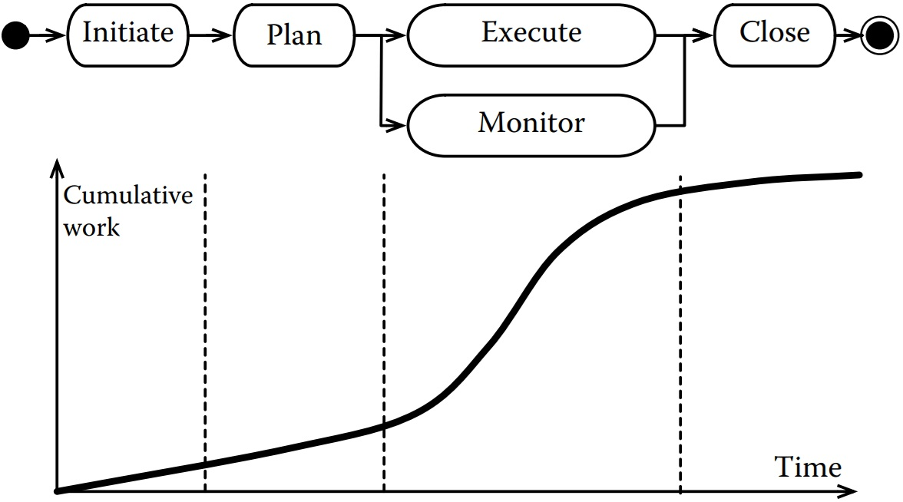

Slide 7
The second characteristic is that a project delivers an output in the form of a product, a service, or a capability. The outputs are tangible, and often their properties are also measurable.
Thus, a project can be set up and organized, starting from the description and the characteristics of the outputs it delivers.
Such description, in fact, entails the work that has to be done to build the outputs.
The description of the project outputs also defines the project completion criteria: the project ends when the outputs are delivered as specified.

Slide 8
Things are not always so simple, however. Many projects have a clear output, but the way in which this is achieved might not be clear.
Consider, for instance, a situation in which we want to improve the performances of a software system.
The goal is clear, but the means to achieve it might not. In other situations, the outputs might not be completely clear or well spelled out.
This is quite common in software development, where coming out with a complete and unambiguous description of a system is not always easy.

Slide 9
The third characteristic is that projects are resource constrained. A limited time is available to build the project outputs.
Also limited will be other project resources, such as the budget and the team.
An important consequence is that the project manager and the team have to find an achievable solution, while respecting all project constraints.
Thus, the output of a project is seldom the best possible solution but rather the best solution given the constraints.

Slide 10
The fourth characteristic is that a project requires a progressive elaboration to build the project outputs.
At the beginning, different ways are possible to achieve the project goals. As we move along, many project activities require to take choices, which reduce the degrees of freedom.
Thus, the cost of changes increases as a project progresses, since the amount of rework necessary to implement a change increases as we reduce our degrees of freedom.

Slide 11
The fifth and final characteristic is that a project delivers a unique output. Thus, what a project delivers has some novelty, one way or the other.
This allows us to introduce the last important characteristic, namely, that a project always has some risk coming in the form of menaces or opportunities.
Risks come from the unique characteristics of the project outputs, which sometimes are not fully understood or not clear when a project starts.
Having seen the main qualities of a project, we need to mention that not all work is a project. Work that is not a project is called operational, even though one might still call it a project.

Slide 12
Programs, Subprojects, and Portfolios
Projects come in different sizes. Small projects might require the work of a few people for a few weeks or a few months. Larger projects might involve the work of thousands of people for years.
Consider, for instance, the development of the F22 fighter aircraft. The development started in 1986 with a first phase to build two prototypes, which lasted 50 months.
After the demonstration of the prototypes and the selection of the best model, the actual development started in 1991, with the first production aircraft delivered in 2003. The total costs of the project are estimated at 67.3 USD billion, in then-year dollars.

Slide 13


Slide 14
Although in principle the development of the F22 could be organized as a single project, a more practical approach organizes its construction at different levels of abstraction and granularity.
Projects are thus often organized and combined to achieve objectives larger than those of any single initiative.
A common classification distinguishes among portfolios, subprojects, and programs.

Slide 15
Programs: A program is a set of related projects managed in a coordinated way. The underlying motivation is that coordination allows one to achieve additional benefits.
The most famous program is probably the U.S. manned space program, which culminated with men landing on the moon.
Subprojects: Complex projects for which program management is an overkill can be organized and broken down into subprojects.
A subproject is thus the way in which one can organize the implementation of some specific objectives of a larger project.

Slide 16
Portfolios: Organizations often use projects to develop similar systems.
The term portfolio management thus identifies a situation in which a set of independent projects are coordinated to achieve better results.

Slide 17
What is a Software Project
When we think about software projects, probably the first thing that comes to mind is developing applications. Even when the main goal is developing an application, coding is just one of many activities…
In the following, we look at the main types of software-related projects.

Slide 18
Application Development
From the project management point of view, we can distinguish the following types of applications:
One-offs or bespoke systems that are software systems specifically created for a customer.
A bespoke system often implements a specific need of a customer, although in some cases the customer base of the final product could be large.
Some examples of bespoke systems include a luggage tracking software, a compiler for a specific hardware platform, and a system to monitor a fleet of trucks.
For bespoke systems, the specification of the application to develop (more in general of the project goals) will have to be agreed with the customer.

Slide 19
Off-the-shelf applications are software systems implementing a function which is useful to many different users.
It is the software we buy from marketplaces or stores and it is the equivalent of a Toyota Corolla: one size fits all.
The goals and functions of the applications, in this case, come from the company developing the system, which sometimes conducts user surveys, to better understand needs and features that are most useful.
The main characteristic is that the system is the same for each user and that the company developing the system sets the roadmap, choosing when to upgrade, what functions to add, and when to do maintenance.

Slide 20
Finally, a customized off-the-shelf application sits somewhere between the two other types of applications.
They are systems that are developed similar to off-the-shelf applications. However, they need to (or can) be customized to fit the customer needs.
An example of a customized off-the-shelf application is an Enterprise Resource Planning (ERP) system. An ERP system helps plan the resources of an organization and automate information management.
While the engine of many ERPs is generic (and developed as an off-the-shelf application), many other characteristics (modules to use, what data has to be stored, how information flows) need to be customized for each client.

Slide 21
Software Project Management
Software project management is the integration of management techniques into software development.
The need for such integration has its root in the 1960s, in the days of the “software crisis,” when practitioners recognized the increasing complexity of delivering software products meeting the specifications.
A number of works started then to improve the software development practices, detailing and structuring technical activities more rationally.

Slide 22
Similar to system engineering, software engineering shares many concerns that can be dealt with by sound management practices.
As software engineering matured as a discipline, more interest grew in the systematic integration of management activities in the software production process.
Software development and project management thus started to be integrated more tightly. This is exactly what we start doing in this course.

Slide 23


