Slide 1
Software Engineering
Dr. Md. Nasim Adnan

Slide 2
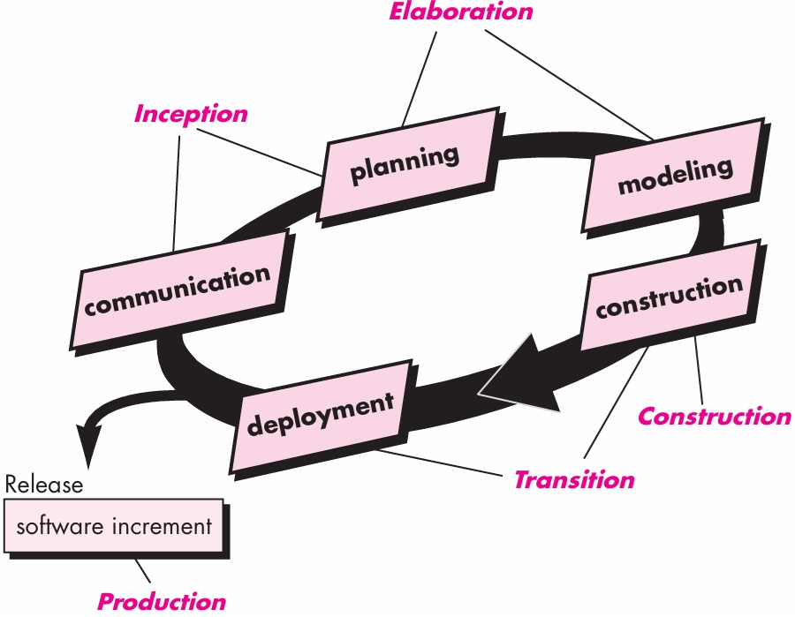
Why we model?

Slide 3
Modeling is a proven and well-accepted engineering technique.
Unsuccessful software projects fail in their own unique ways, but all successful projects are alike in many ways.
There are many elements that contribute to a successful software organization; one common thread is the use of modeling.
We do model so that we can better understand the system we are developing.

Slide 4
What is a Model?
A model is a simplification of reality
A model provides the blueprints of a system

Slide 5
Benefits of Model
Models help us to visualize a system as it is or as we want it to be
Models permit us to specify the structure or behaviour of a system
Models give us a template that guides us in constructing a system
Models document the decisions we have made

Slide 6
Limitation of Human Ability
The larger and more complex the system, the more important modeling becomes, for one very simple reason:
  Because we cannot comprehend such a system in its entirety.
There are limits to the human ability to understand complexity.
Through modelling we can narrow down the to a subsystem of a complex system to focus on the intended aspect at a time.

Slide 7
Principles of Modeling – 1st
The choice of what models to create has a profound influence on how a problem is attacked and how a solution is shaped.
In other words, choose models intelligently. The right models will illuminate the wicked development problems.

Slide 8
Principles of Modeling – 2nd
Every model may be expressed at different levels of precision.
Sometimes a quick and simple executable model of the user interface is exactly what you need (balsamiq); at other times, one has to get down and dirty with the bits.
In any case, the best kinds of models are those that let you choose your degree of detail, depending on who is viewing and why they need to view it.

Slide 9
Principles of Modeling – 3rd
The best models are connected to reality.
A Model connected to reality makes it more understandable and presentable. The more abstract a model is the more it needs to be closer to reality.

Slide 10
Principles of Modeling – 4th
No single model is sufficient.
  Every nontrivial system is best approached through a small set of nearly independent models.
  You need to look at several models to fully understand something you are looking for.
  In this way, models complement each other.

Slide 11
Requirement Modeling
At a technical level, software engineering begins with a series of modeling tasks that lead to a specification of requirements and a design representation for the software to be built.
The requirements model— actually a set of models—is the first technical representation of a system.

Slide 12
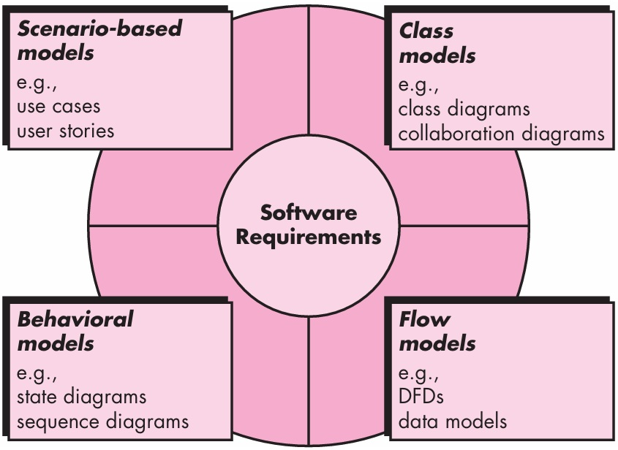

Slide 13
Scenario-based Modeling
Although the success of a computer-based system or product is measured in many ways, user satisfaction resides at the top of the list.
If you understand how end users (and other actors) want to interact with a system, your software team will be better able to properly characterize requirements and build meaningful requirements and design models.
Hence, requirements modeling with UML begins with the creation of scenarios in the form of use case diagrams.

Slide 14
UML
Unified Modeling Language (UML) is a standardized general-purpose modeling language in the field of object-oriented software engineering.
UML includes a set of graphic notation techniques to create visual models of object-oriented software systems.

Slide 15
UML is a Language for Visualizing
Independent of Programming Language
One person can write a model using UML, and another person, or even another tool, can interpret that model unambiguously
It is possible to map UML model to Programming Languages such as C++, Java or C#, or even to different RDBMS

Slide 16
Goals of UML
Visibility
Extensibility
Independence
Object Oriented

Slide 17
Use Case Modeling
After the scope has been decided (Recognition of Need + Feasibility Study), gathering of requirements can commence.
Requirements are gathered by various communication techniques such as
  Interviewing the people involved
  Filling of questionnaires by the stakeholders
  Observing the manual version (if any) of the system to be automated
It is during the Requirements Gathering, use cases come into play.
The fundamental aim of writing use cases is to get functional requirements of the system under design.
Hence, the use cases serve as a model for white box testing to decide whether a requirement has been achieved or not.

Slide 18
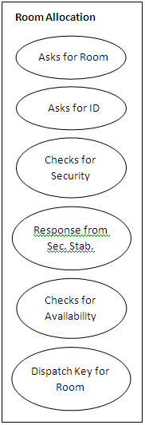

Slide 19
Actors and Use Cases
The first step in writing a use case is to define the set of “actors” that will be involved in the story. Actors are the different people (or devices) that use the system or product.
Actors represent the roles that people (or devices) play as the system operates. Defined somewhat more formally, an actor is anything that communicates with the system or product and that is external to the system itself. Every actor has one or more goals when using the system.
Once actors have been identified, use cases can be developed.

Slide 20
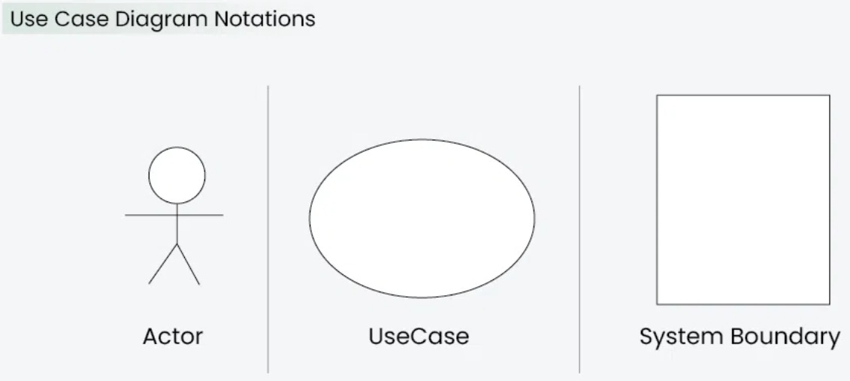
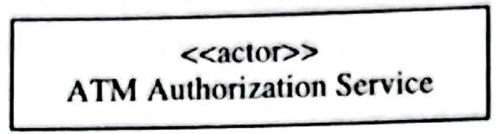

Slide 21
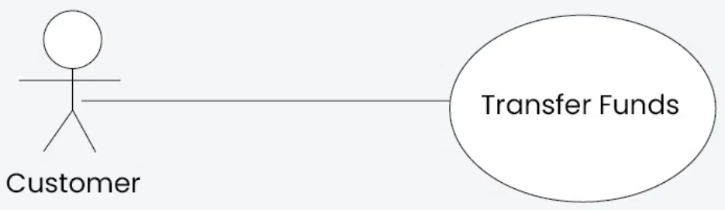
Use Case Relationships
Association Relationship

Slide 22
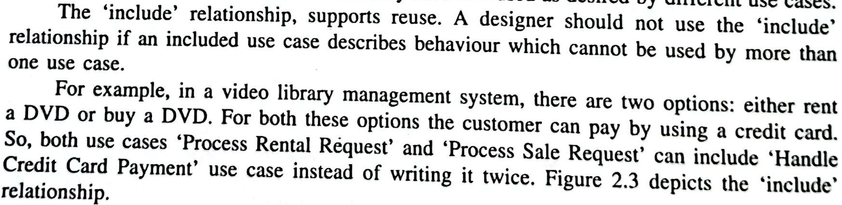
Include Relationship

Slide 23
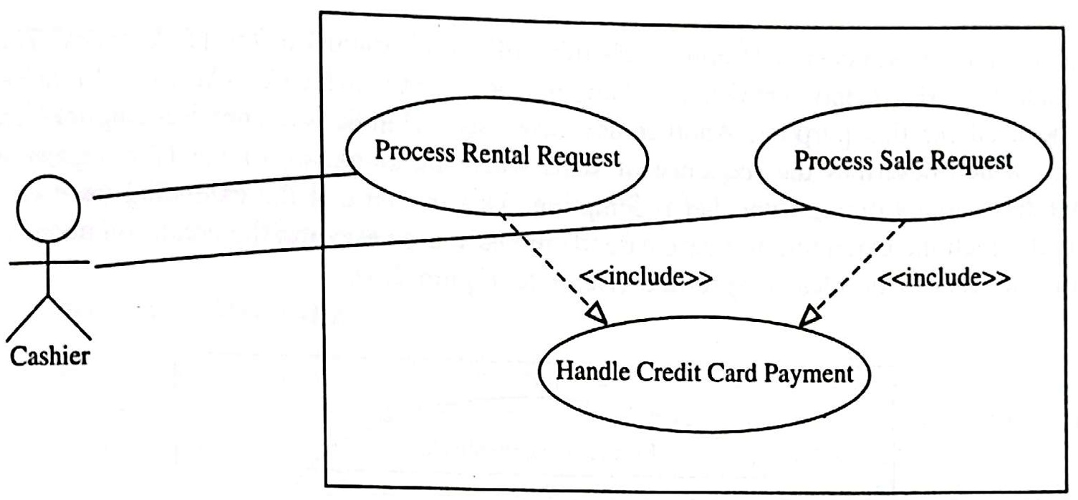

Slide 24
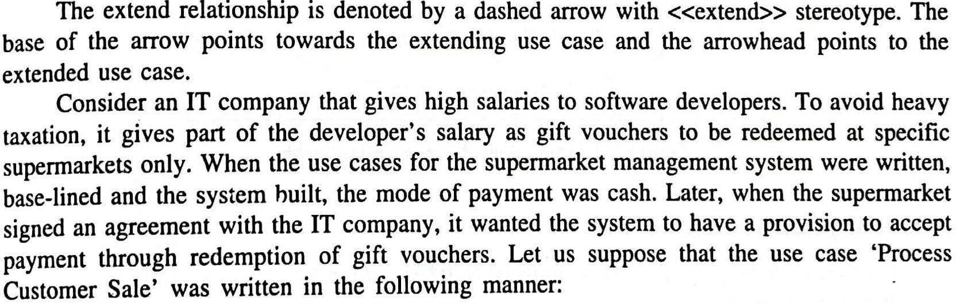
Extend Relationship

Slide 25
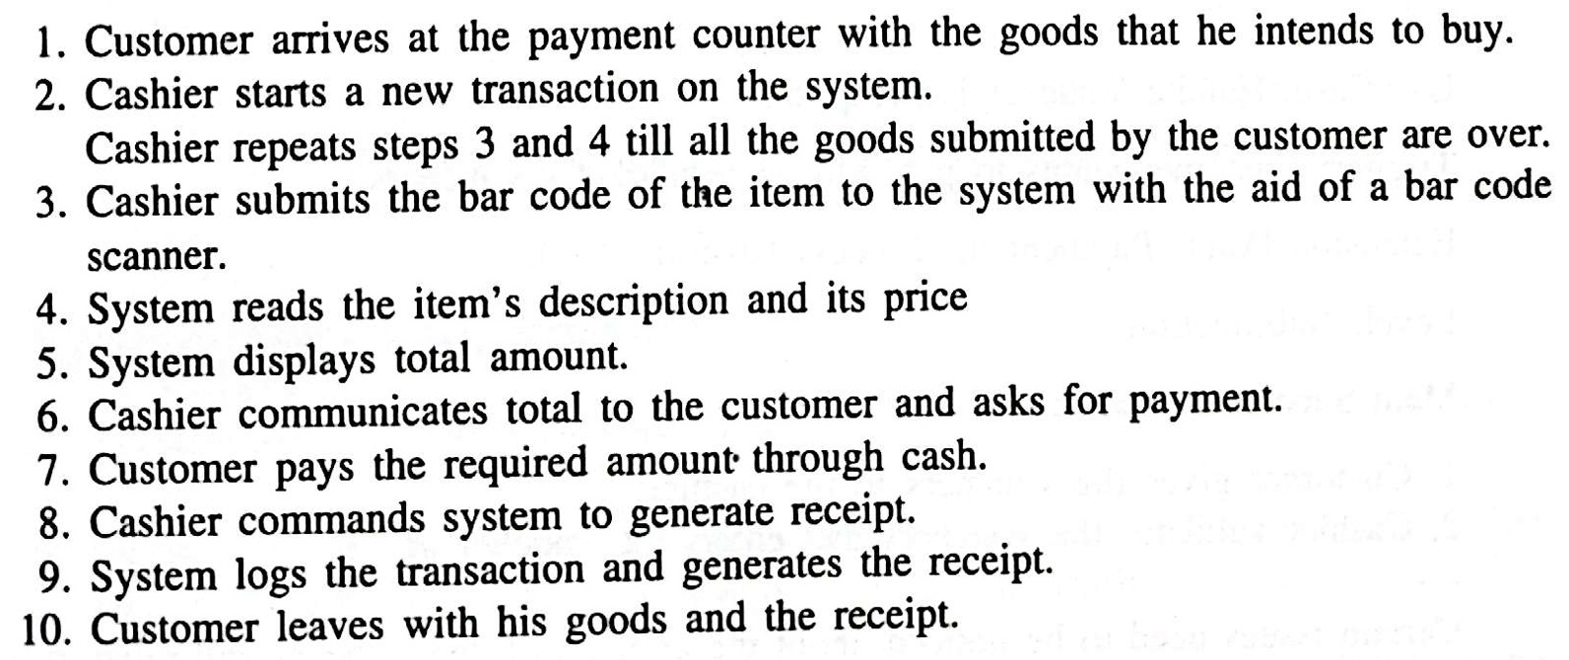

Slide 26
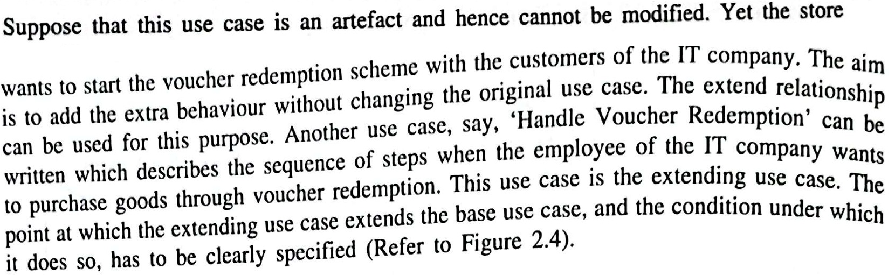

Slide 27
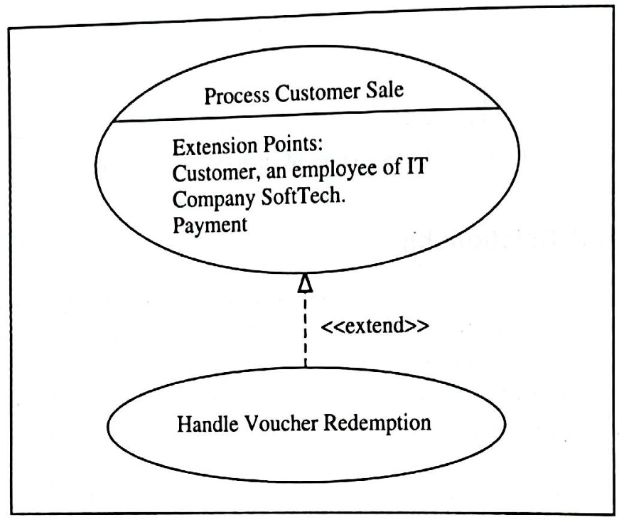

Slide 28
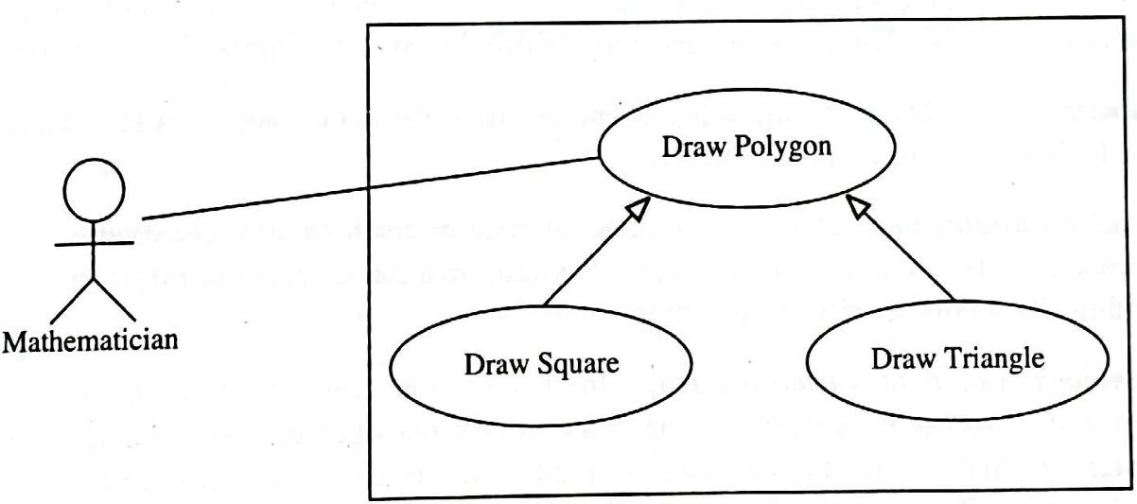
Generalization relationship

Slide 29
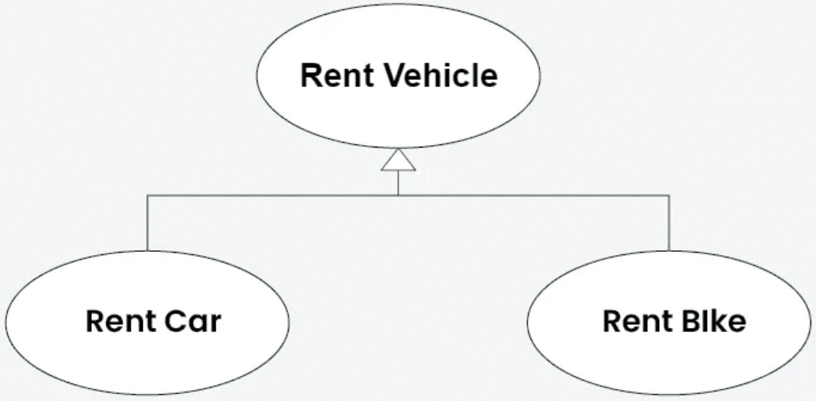
Generalization relationship

Slide 30
How to draw a Use Case diagram in UML?
Step 1: Identify Actors
Step 2: Identify the main functionalities or actions the actors must perform using the system. These are your use cases.
Step 3: Specify requirements, pre and post conditions
Step 4: Connect Actors and Use Cases
Step 5: Add System Boundary
Step 6: Define Relationships
Step 7: Review and Refine
Step 8: Validate

Slide 31
Use Case Diagram for Online Shopping System
Actors:
  Customer
  Admin
Use Cases:
  Browse Products
  Add to Cart
  Checkout
  Manage Inventory (Admin)
Requirements:
  The Customer can browse products, add to the cart, and complete the checkout
  The Admin can manage the inventory

Slide 32
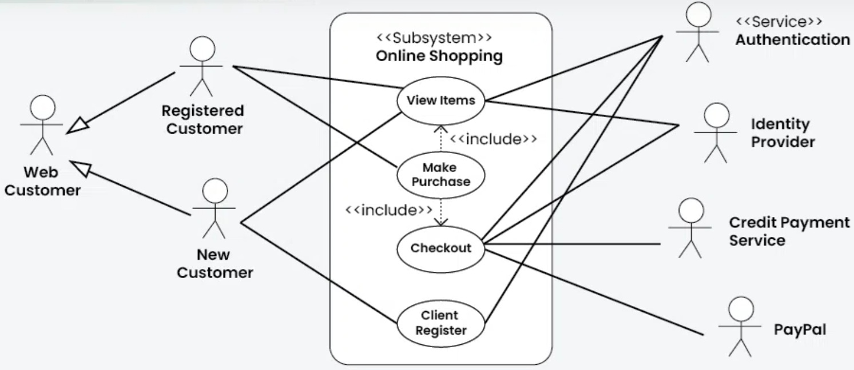

Slide 33
Use Case Diagram Tools
draw.io
Microsoft Visio

Slide 34
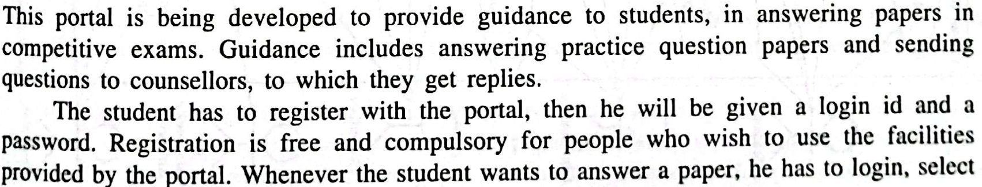
Case Study: A Career Guidance Portal

Slide 35
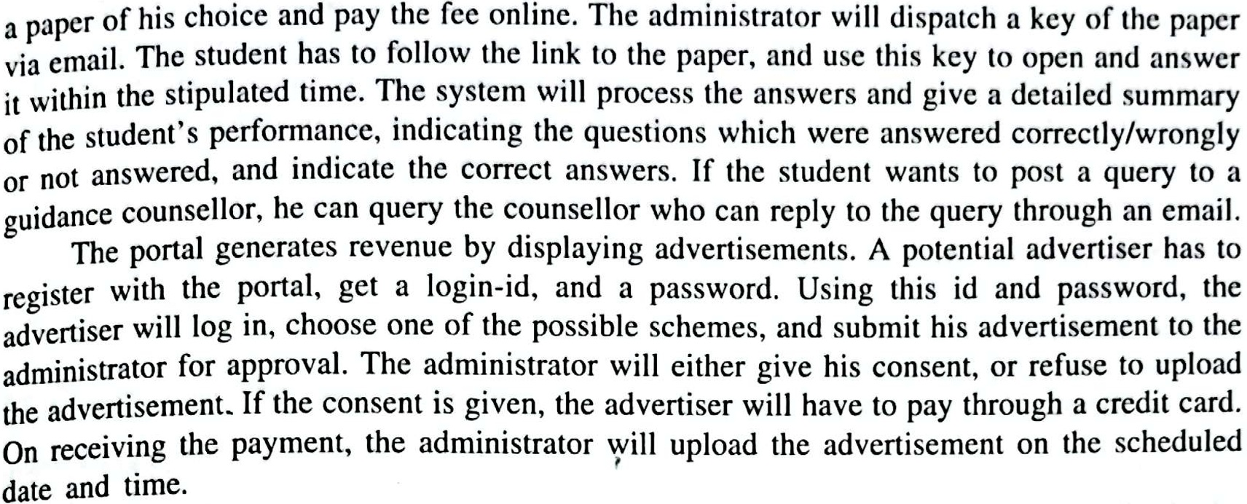

Slide 36
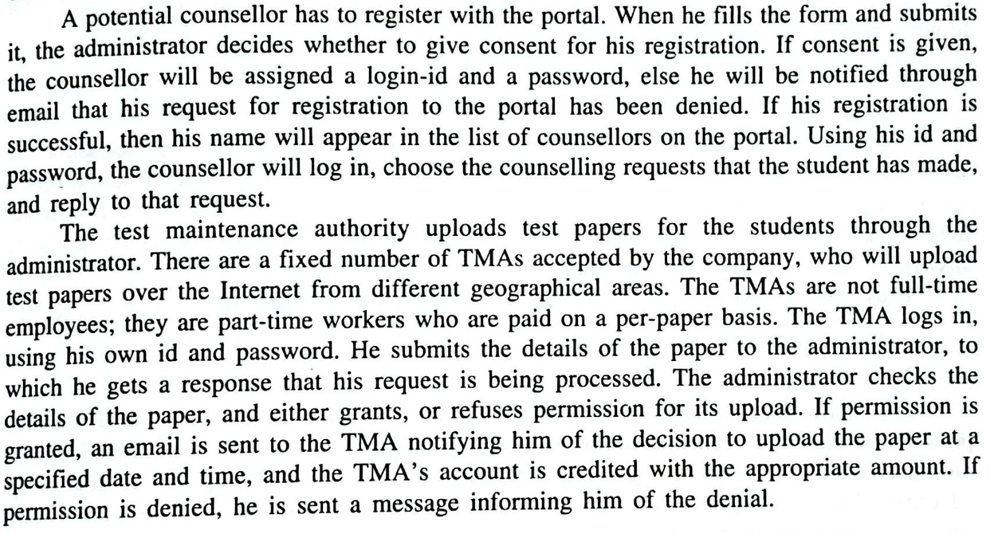

Slide 37
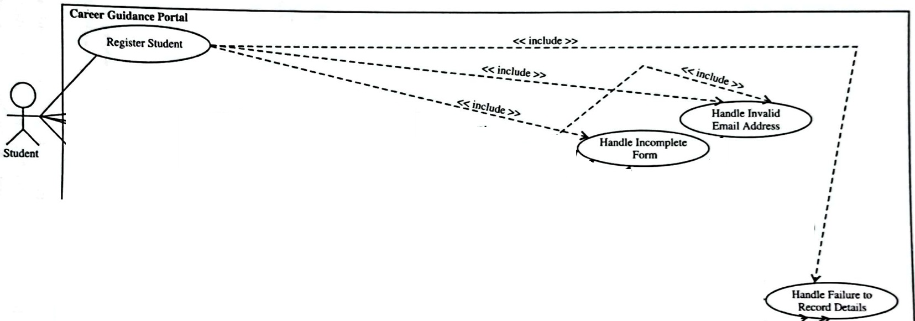

Slide 38
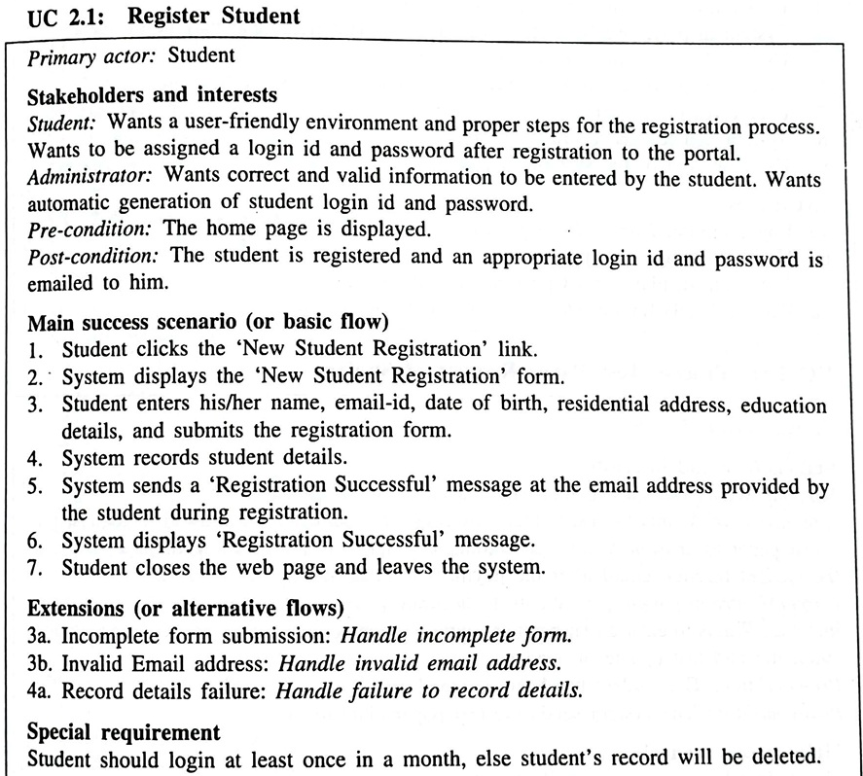

Slide 39


