Slide 1
Software Engineering
Dr. Md. Nasim Adnan

Slide 2
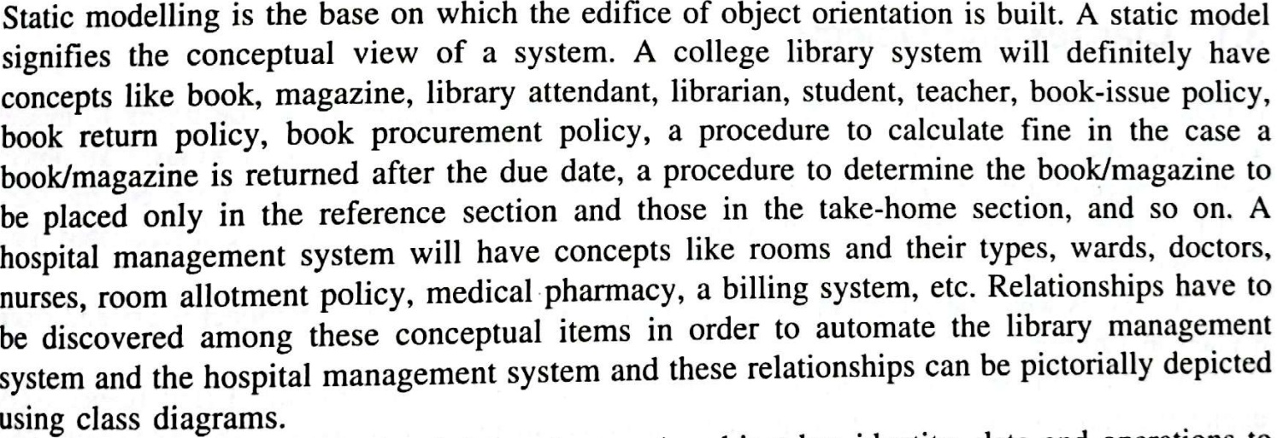
Static Modeling using Class Diagram

Slide 3
Book Class
Properties
  Title
  Category
  Author
  Publisher
  Catalogue name
  Accession number
  Page number

Slide 4
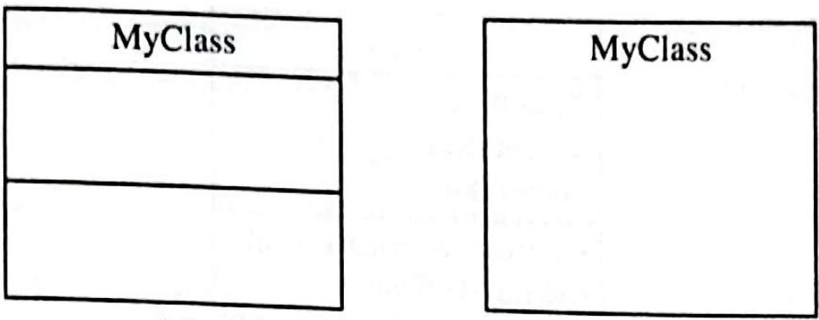
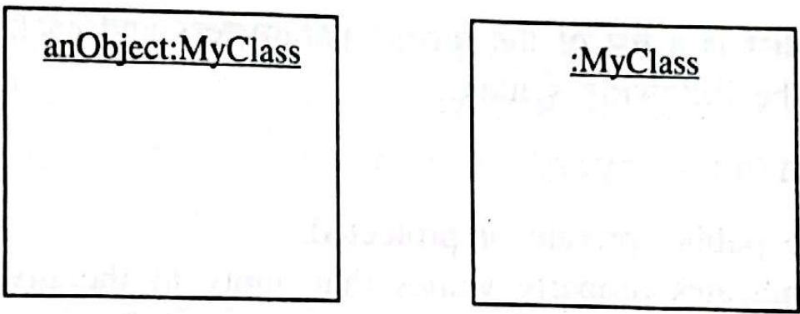
UML: Class Diagram and its Object

Slide 5
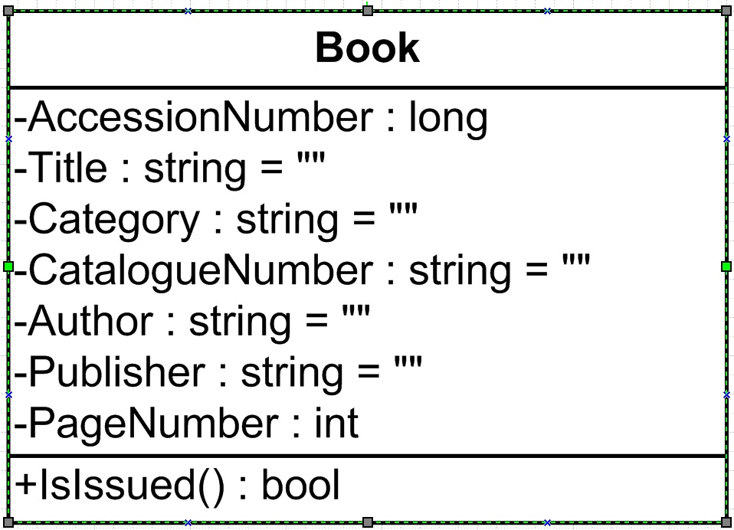

Slide 6
Visibility of Attributes/Properties and Operations/Methods
Private: -
Protected: #
Public: +

Slide 7
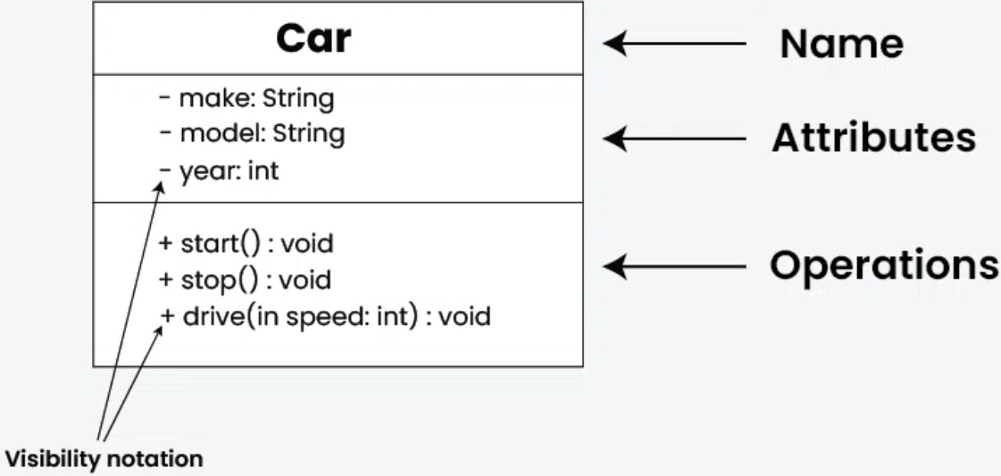

Slide 8
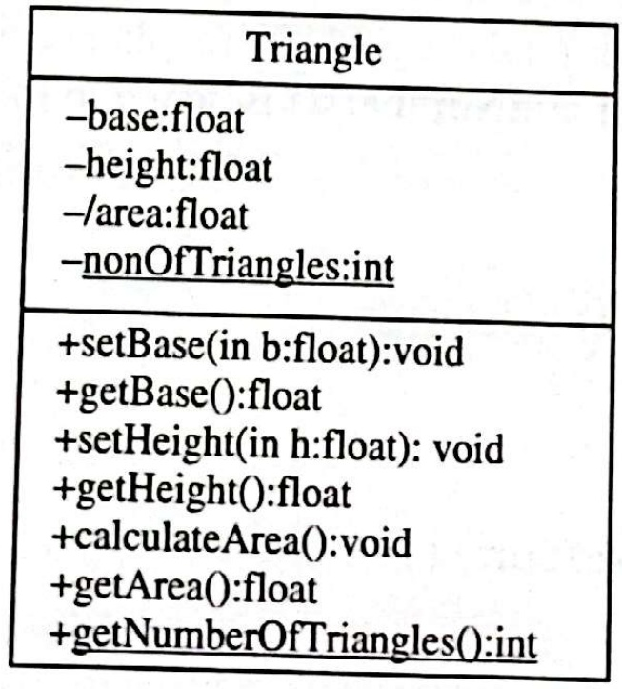

Slide 9
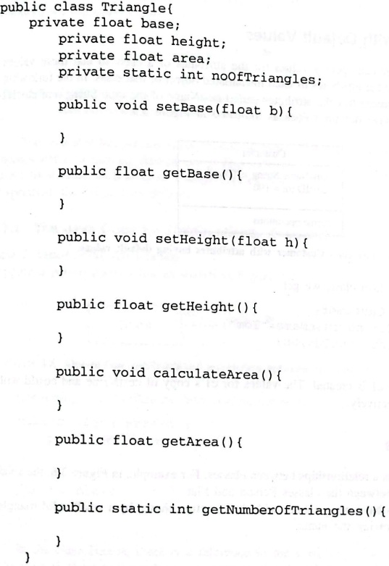
Mapping a Class Diagram to a Programming Language

Slide 10
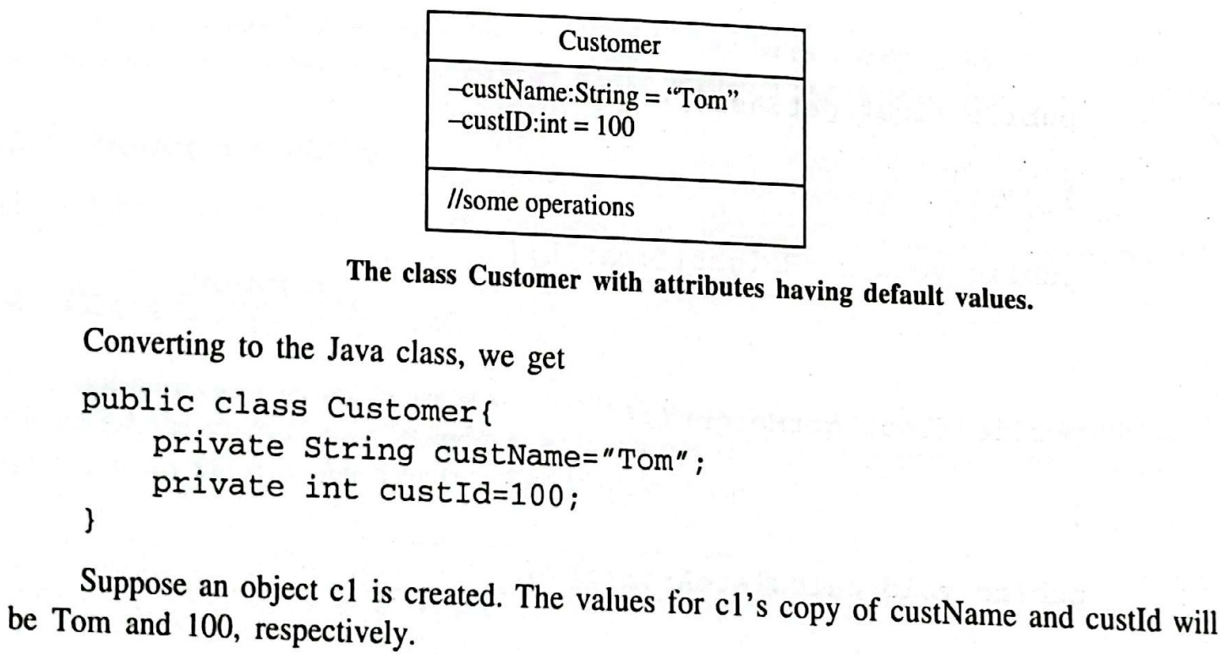
Attributes with Default Value

Slide 11
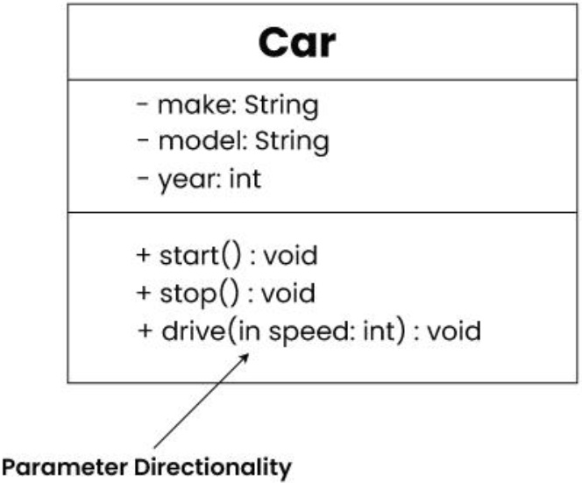
Parameter Directionality
In
Out
InOut

Slide 12
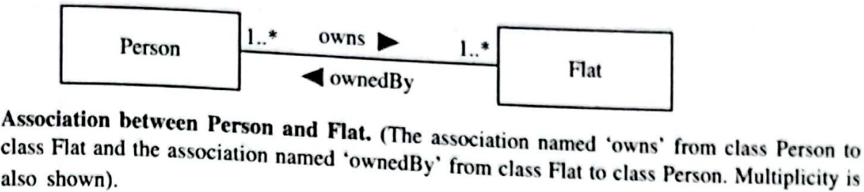
Relationship between Classes
Association

Slide 13
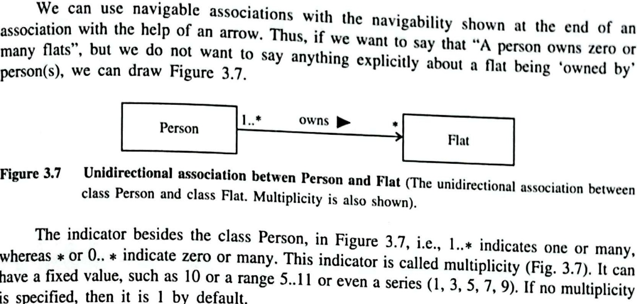

Slide 14
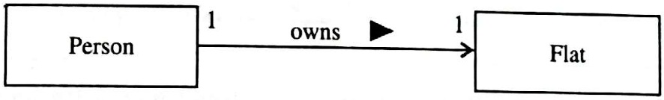
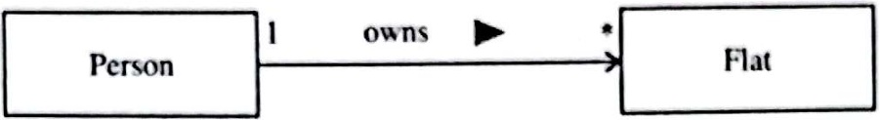
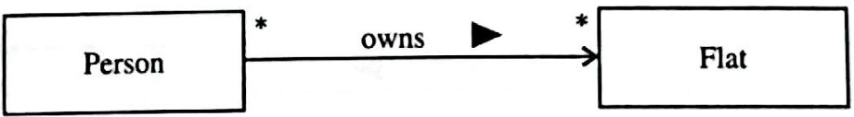
One-to-one, One-to-many and Many-to-many

Slide 15
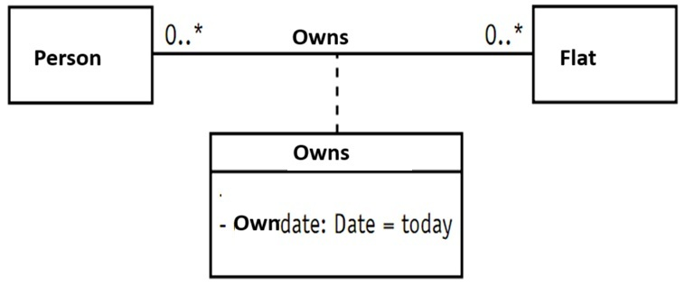
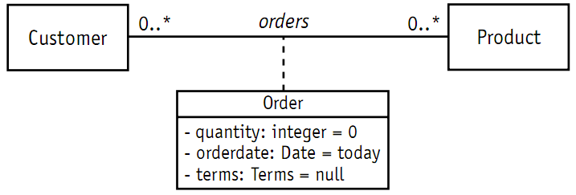

Slide 16
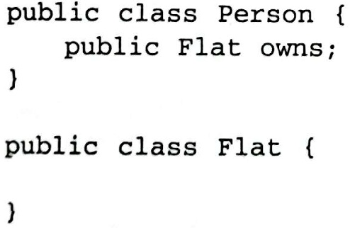
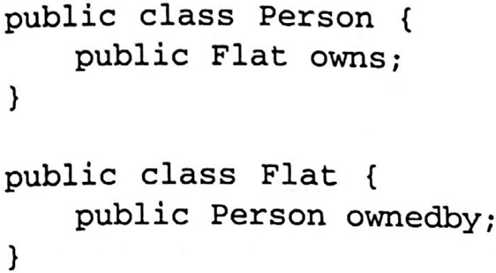
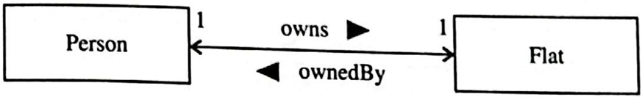
Unidirectional vs. Bidirectional Association
Here Person is Source class and Flat is Target Class
Here ouns and ownedBy are Role Names

Slide 17
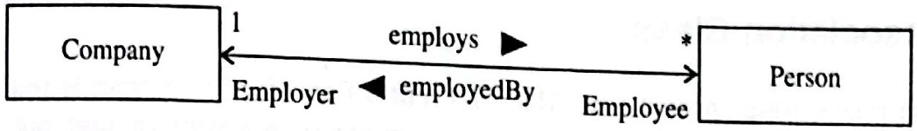
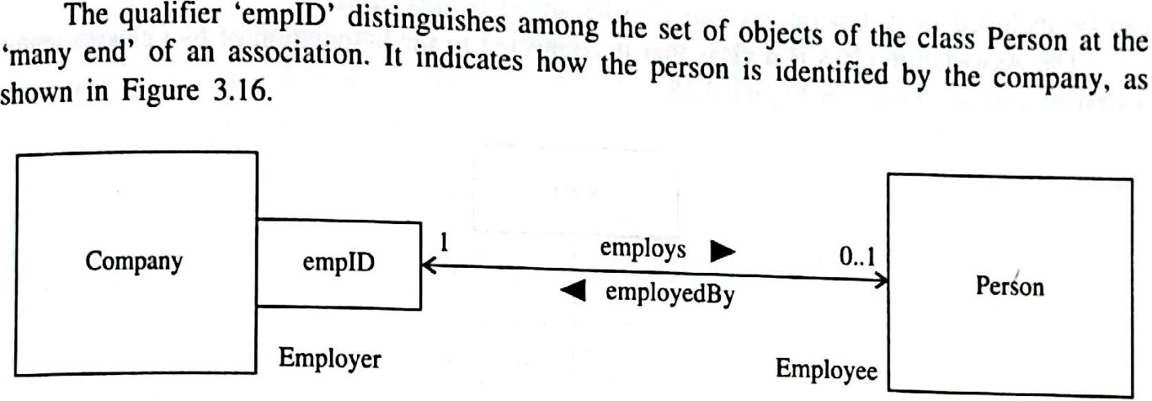
Qualified Association

Slide 18
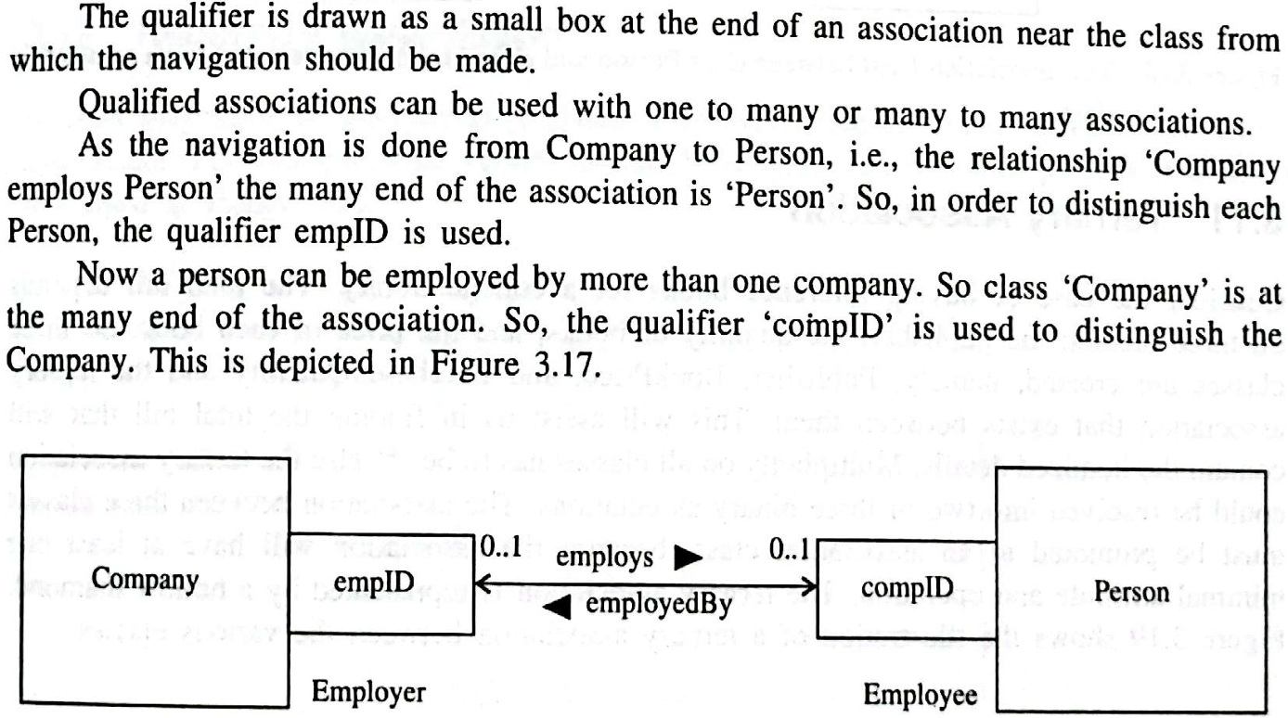

Slide 19
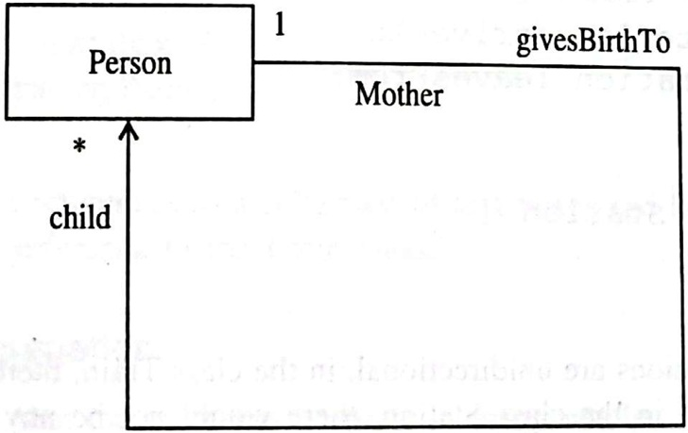
Recursive Association

Slide 20
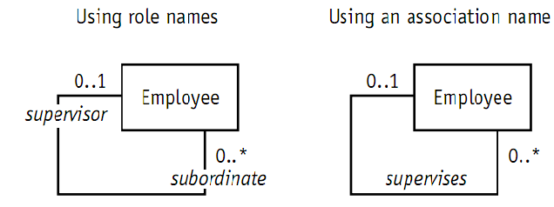

Slide 21
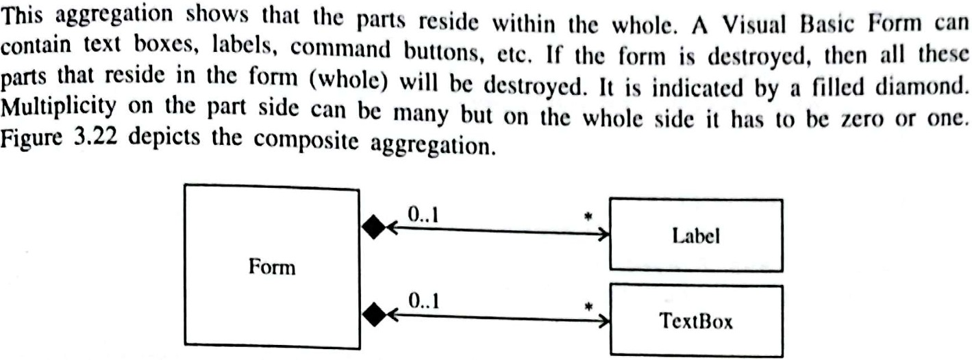
Aggregation: Composite

Slide 22
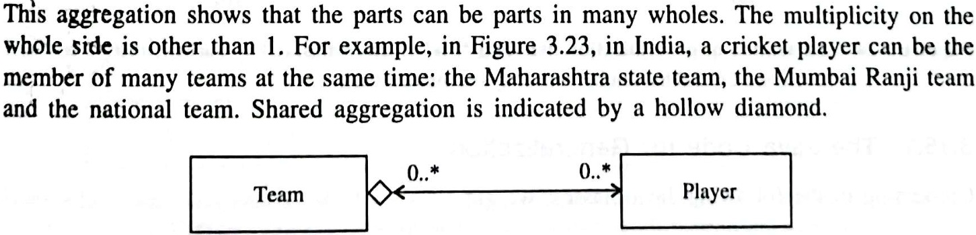
Aggregation: Shared

Slide 23
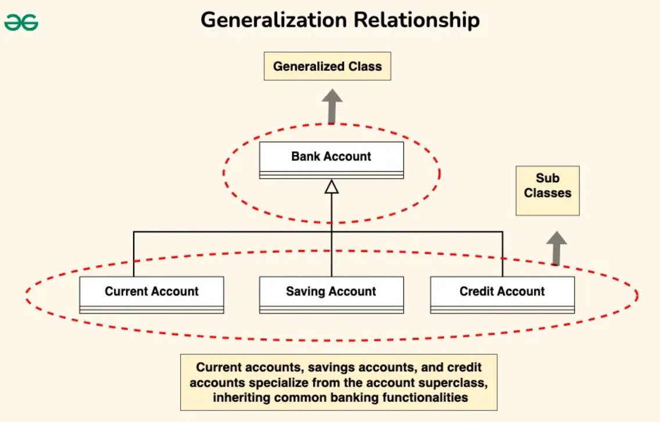
Generalization

Slide 24
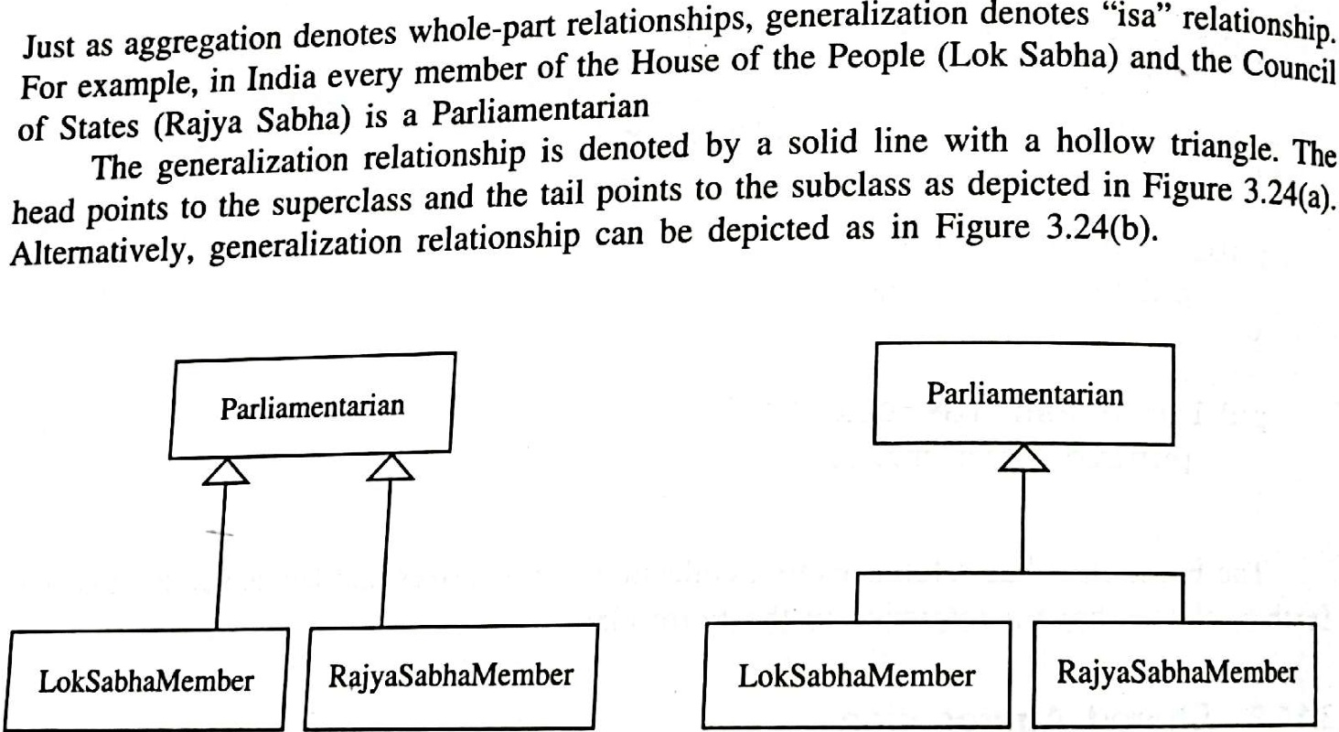

Slide 25
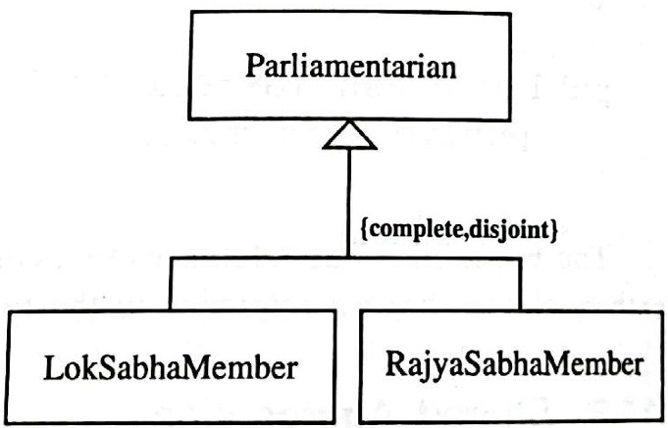
Subclass Partitioning

Slide 26
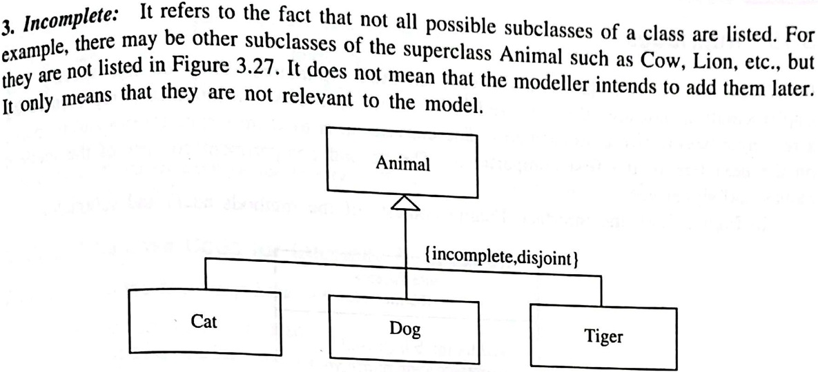

Slide 27
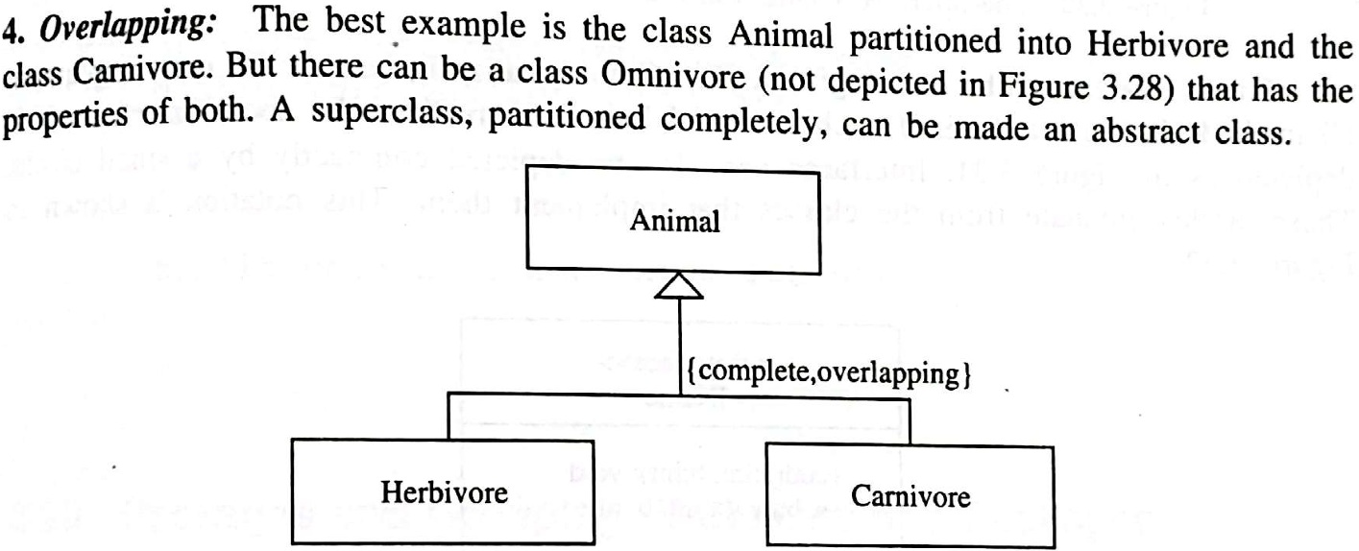

Slide 28
Subclass Partitioning

Slide 29
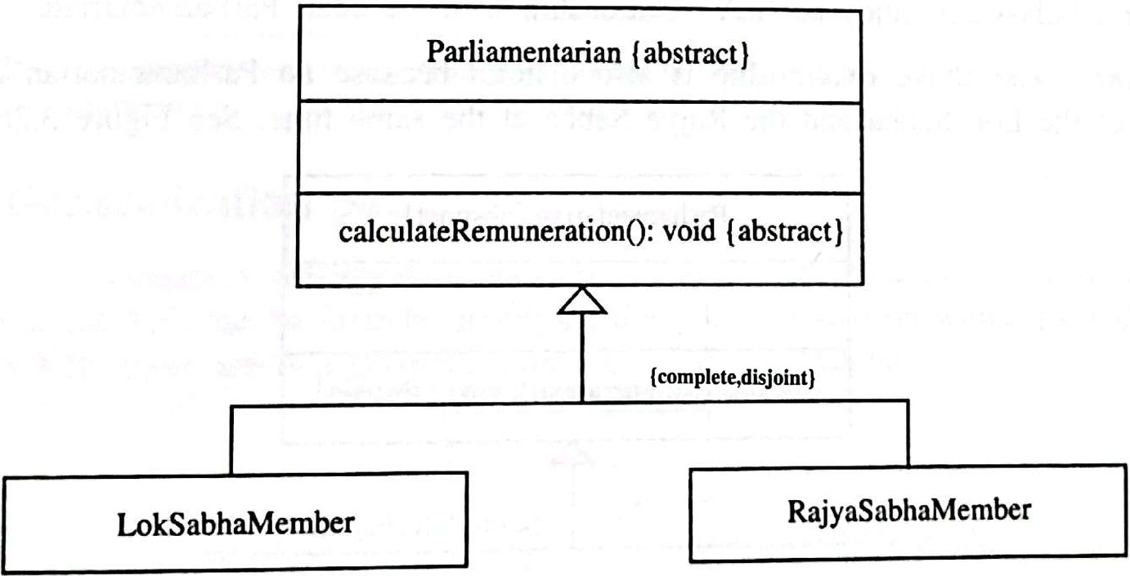
Abstract Class

Slide 30
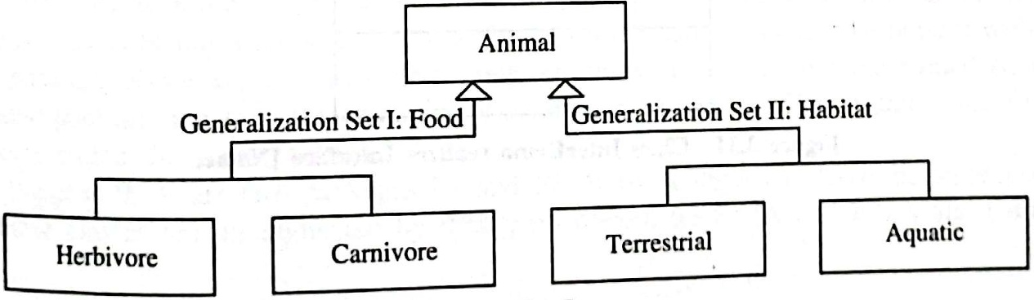
Generalization Set

Slide 31
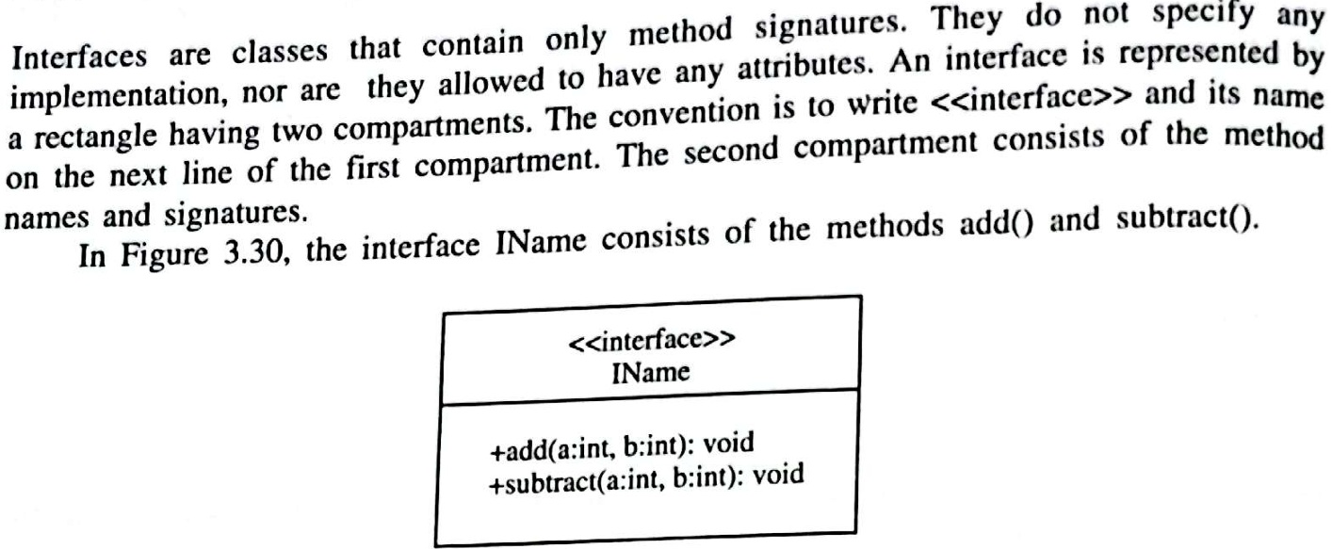
Interfaces

Slide 32
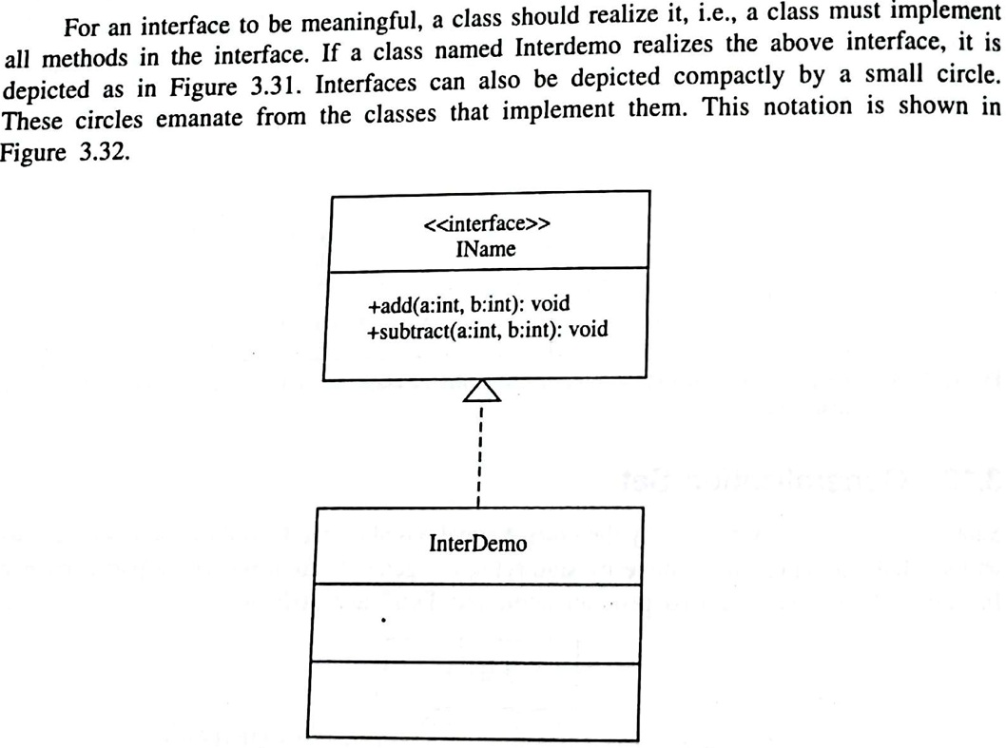
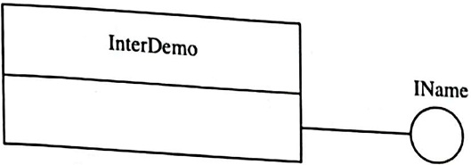

Slide 33
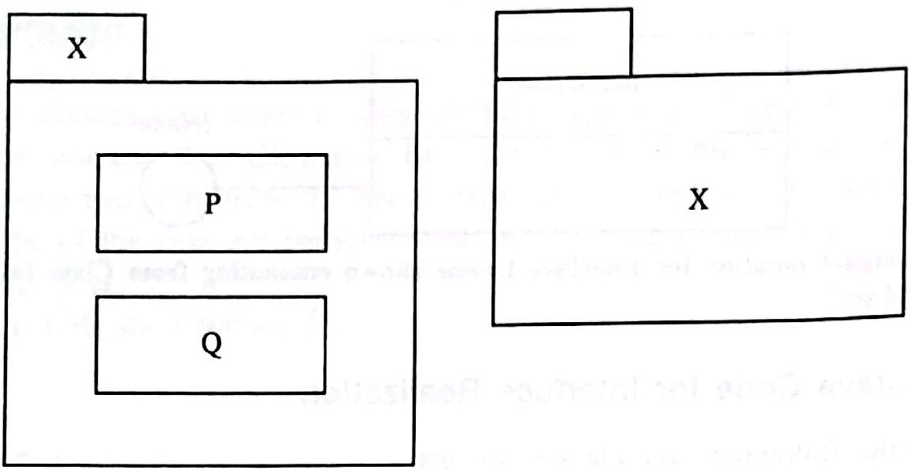
Packages and Grouping of Classes into Packages

Slide 34
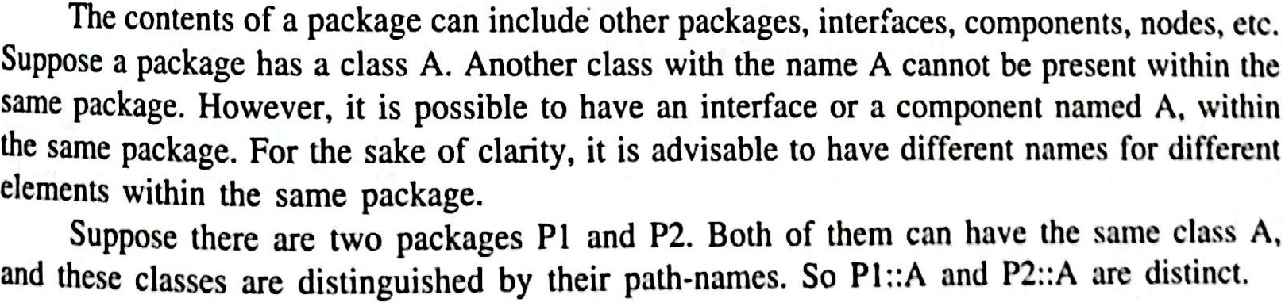
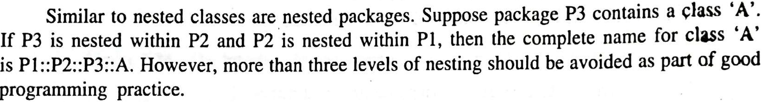

Slide 35
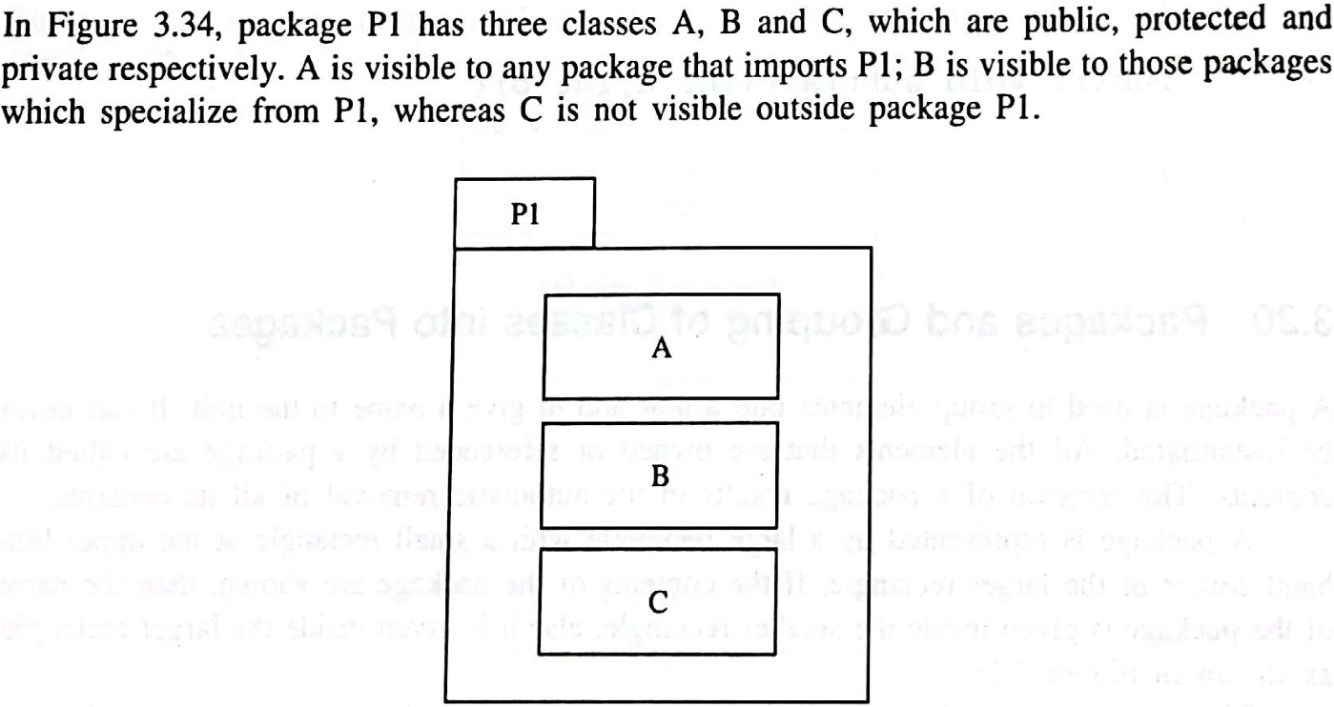
Graphical Display of Owned Elements

Slide 36
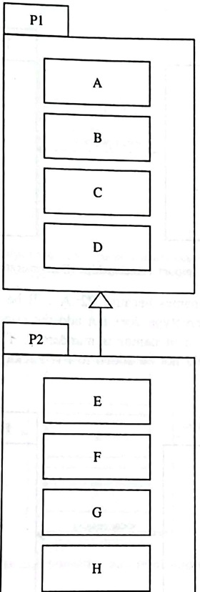
Inherits/Specializes

Slide 37
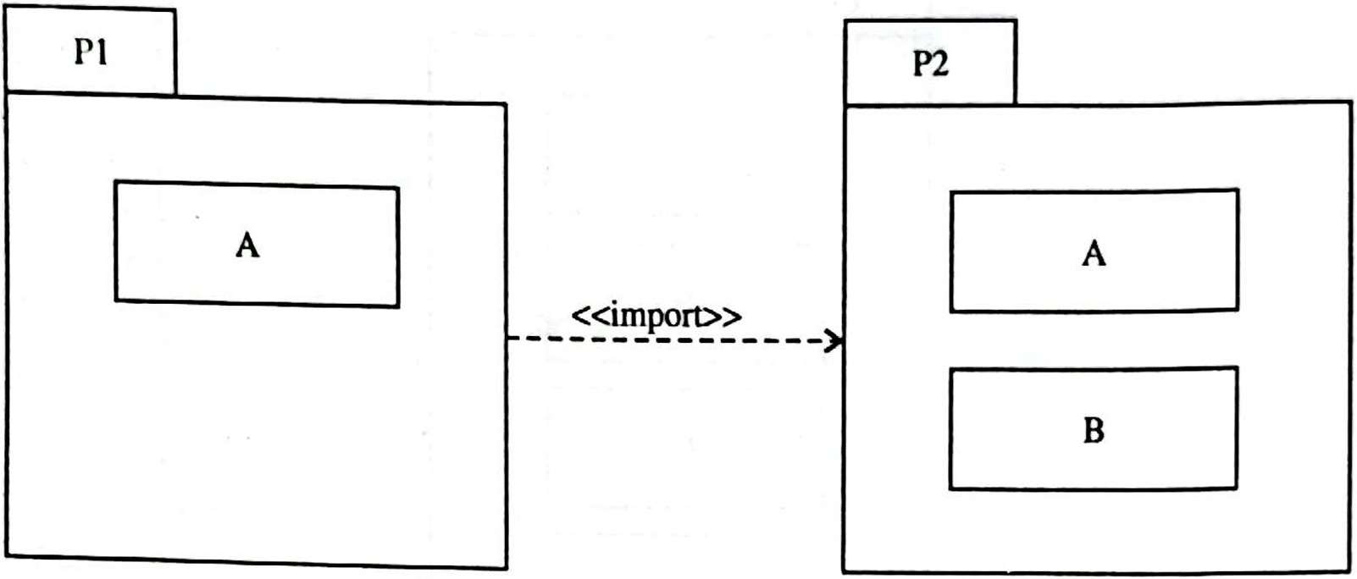
Import, Access and Export

Slide 38
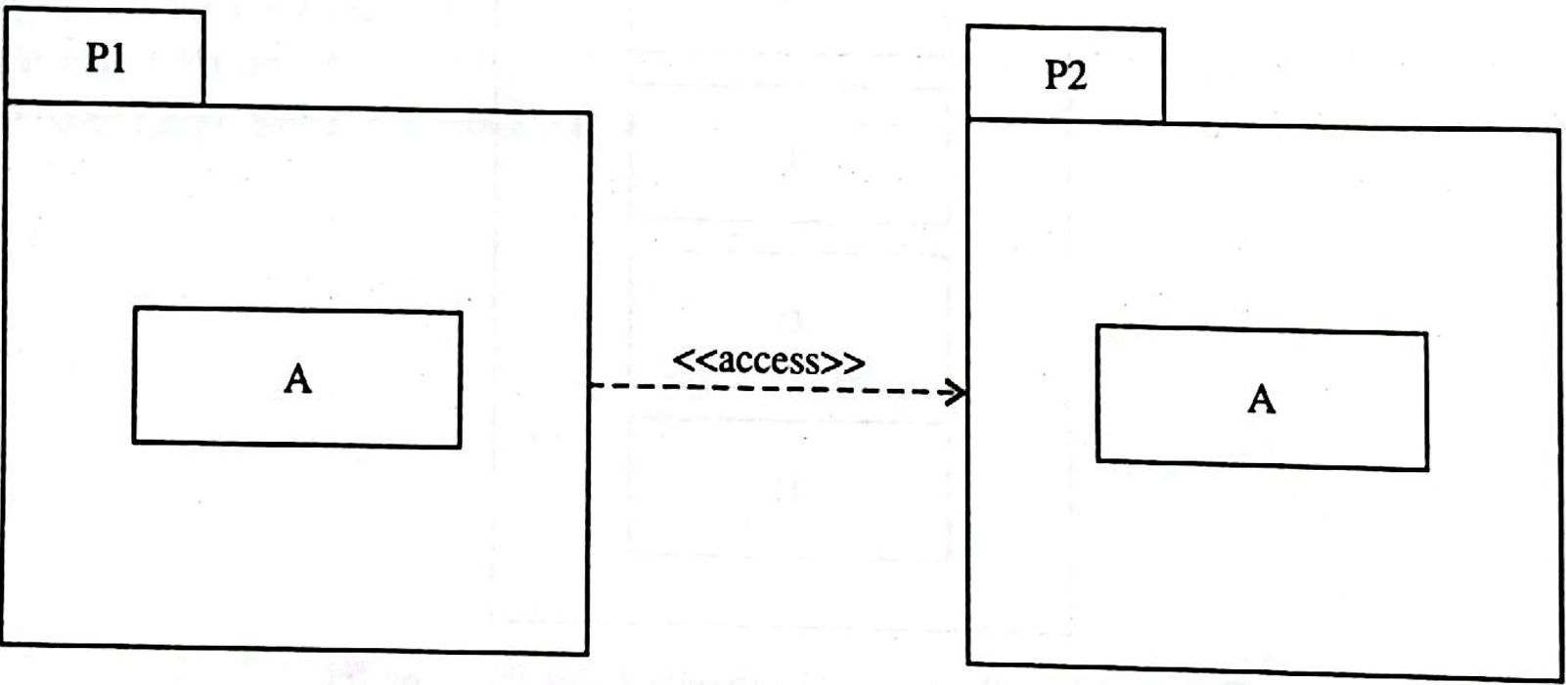

Slide 39
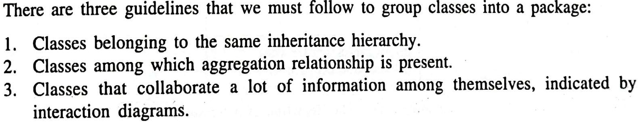

Slide 40
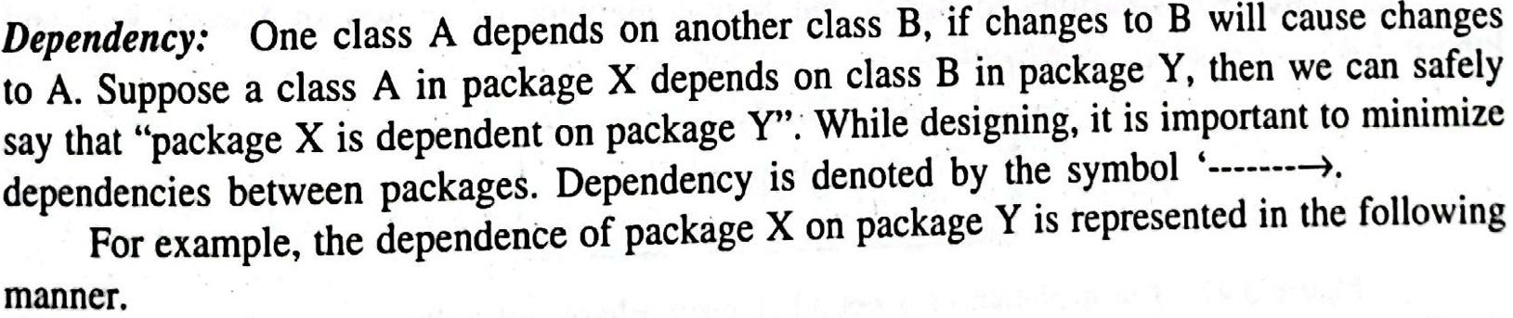
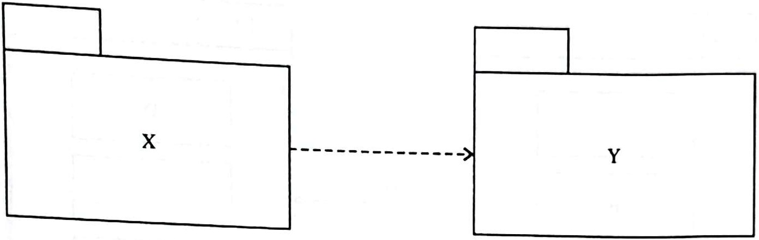
Dependency

Slide 41
Purpose of Class Diagrams
This is the only UML that can appropriately depict various aspects of the OOPs concept.
Proper design and analysis of applications can be faster and efficient.

Slide 42
How to draw Class Diagrams
Step 1: Identify Classes
Step 2: List Attributes and Methods
Step 3: Identify Relationships/Associations
Step 4: Create Class Boxes
Step 5: Add Attributes and Methods
Step 6: Draw Relationships
Step 7: Label Relationships
Step 8: Review and Refine
Step 9: Validate

Slide 43
Identification of Classes and their Attributes

Slide 44
Identification of Relationships/ Associations

Slide 45


