Slide 1
Software Engineering
Dr. Md. Nasim Adnan

Slide 2
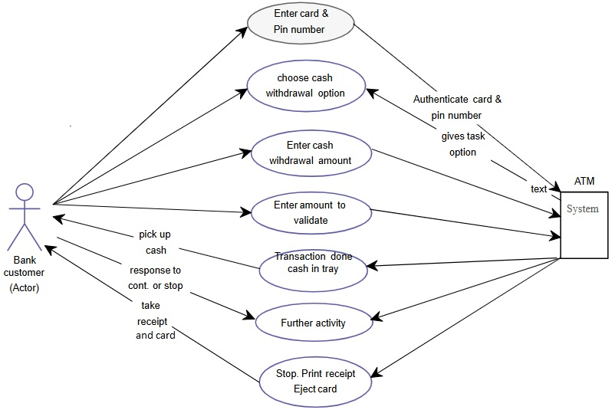
Use Case

Slide 3
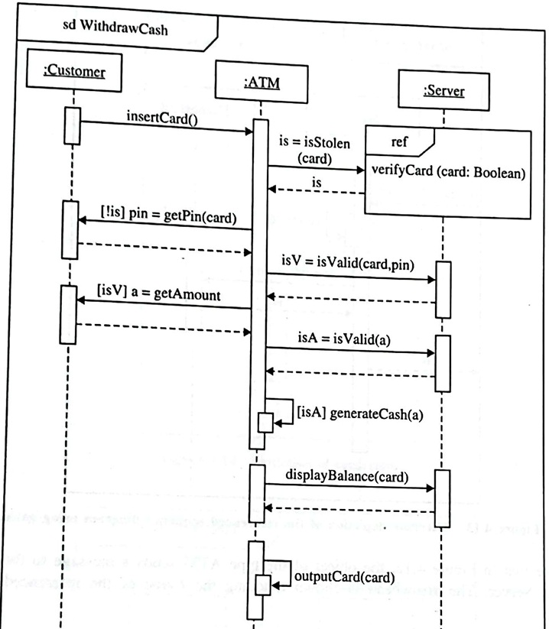
Interaction Diagram

Slide 4
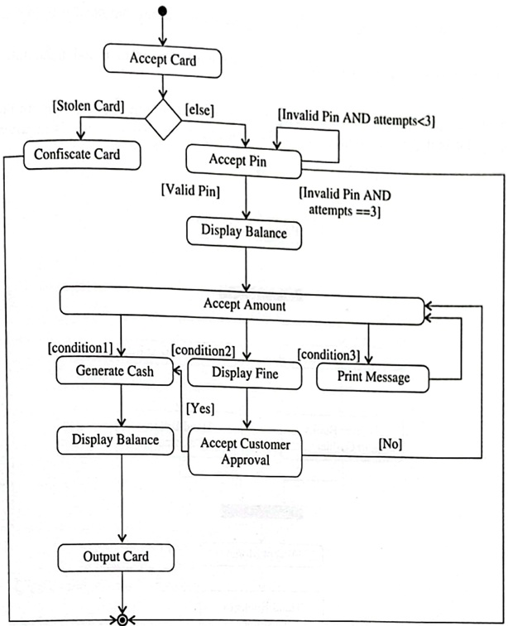
Activity Diagram

Slide 5
Principles of Modeling – 4th
No single model is sufficient.
  Every nontrivial system is best approached through a small set of nearly independent models.
  You need to look at several models to fully understand something you are looking for.
  In this way, models complement each other.

Slide 6
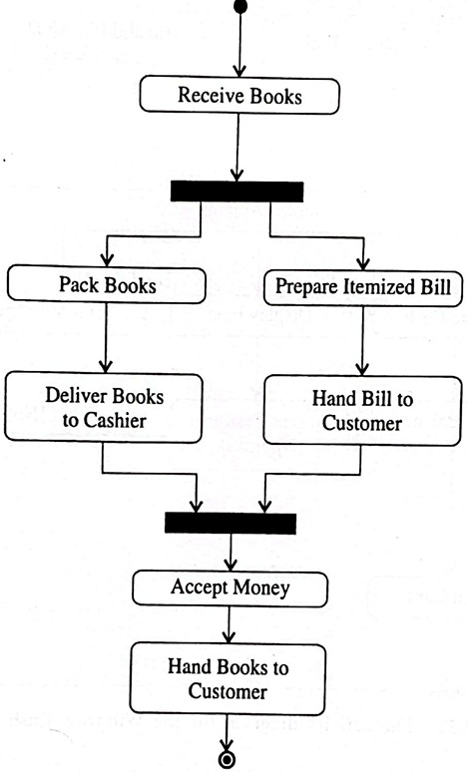
Depicting Parallel Activities

Slide 7
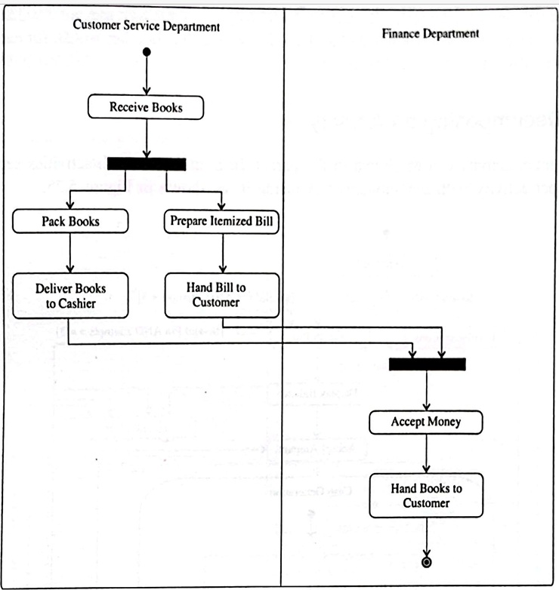
Swimlanes

Slide 8
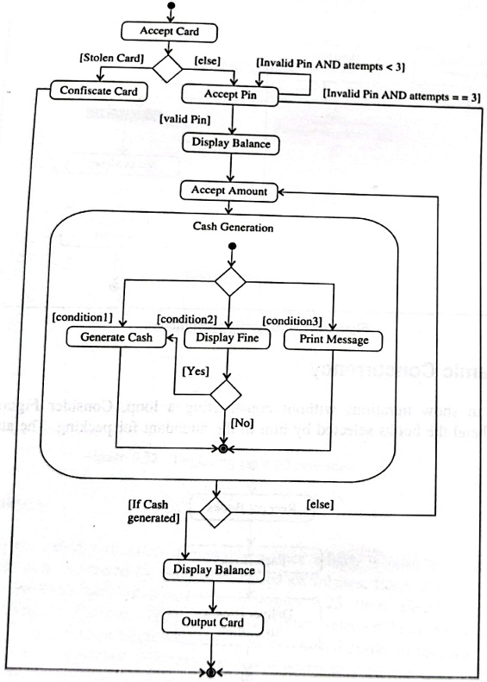
Decomposing an Activity

Slide 9
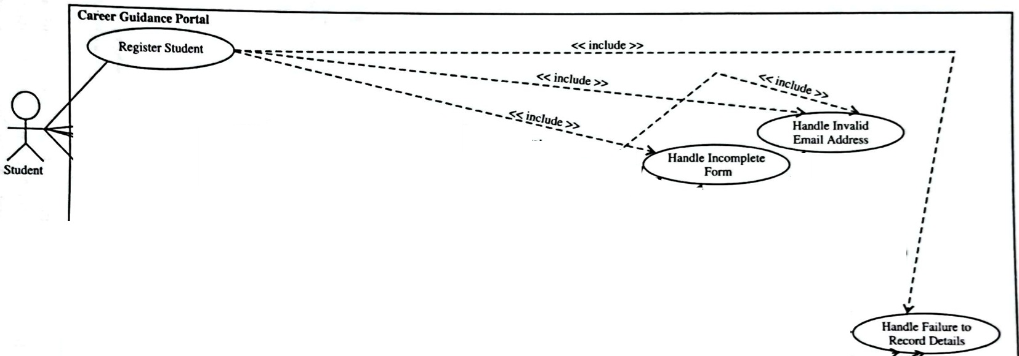

Slide 10
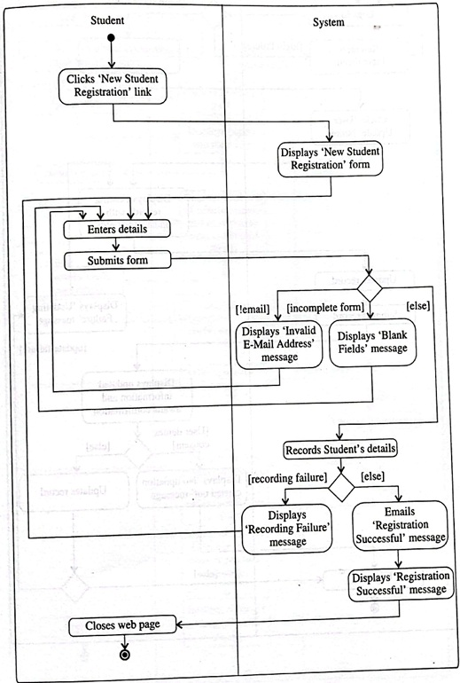
Activity Diagram for Career Guidance Portal

Slide 11
How to draw Activity Diagrams
Step 1. Identify the Initial State and Final States
Step 2. Identify the Intermediate Activities Needed
Step 3. Identify the Conditions or Constraints
Step 4. Draw the Diagram with Appropriate Notations
Step 5: Review and Refine
Step 6: Validate

Slide 12
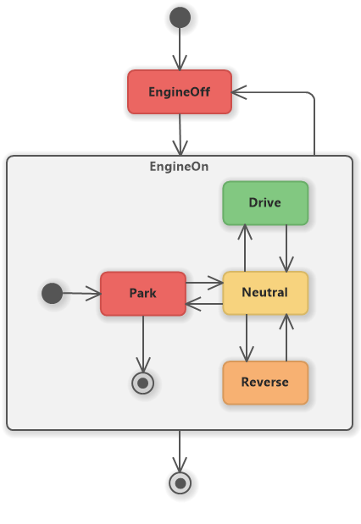
State Diagram

Slide 13
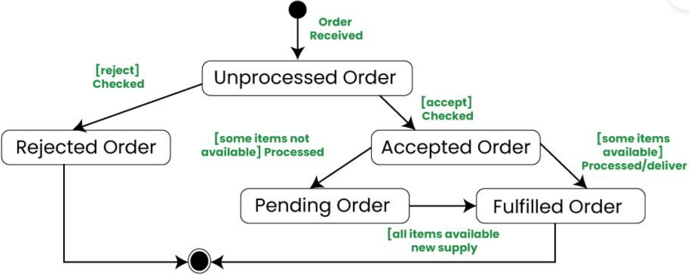
State Diagram

Slide 14
Hotel Room???

Slide 15
How to draw State Diagrams
Step 1: Identify the System
Step 2: Identify Initial and Final States
Step 3: Identify Possible States
Step 4: Label Triggering Events (if any)
Step 5: Draw the Diagram with appropriate notations
Step 6: Review and Refine
Step 7: Validate

Slide 16


