Slide 1
Introduction to Managerial Accounting and Cost Concepts
Chapter1

Slide 2
Managerial Accounting and Financial Accounting
Managerial accounting
provides information
for managers of an
organization who
direct and control
its operations.
Financial accounting
provides information
to stockholders,
creditors and others
who are outside
the organization.

Slide 3
Work of Management
Planning
Directing and
Motivating
Controlling

Slide 4
Planning and Control Cycle
Formulating Long-and
Short-Term Plans (Planning)
Begin
Comparing Actual
to
Planned Performance (Controlling)
Implementing
the Plans
(Directing and Motivating)
Decision
Making
Measuring
Performance (Controlling)

Slide 5
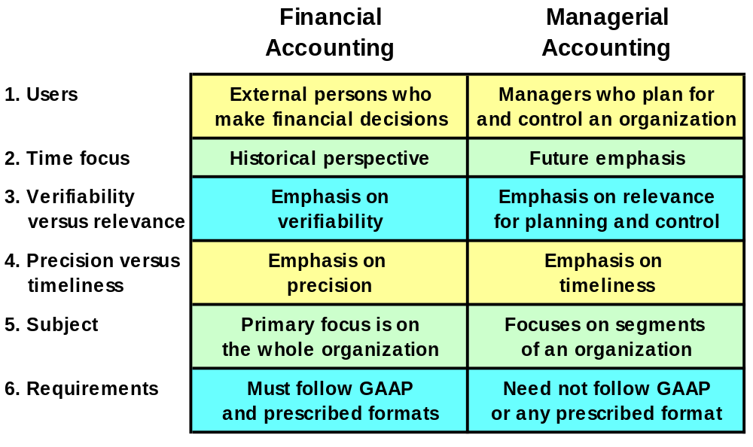
Differences Between Financial and Managerial Accounting

Slide 6
Comparing Merchandising and Manufacturing Activities
Merchandisers . . .
  Buy finished goods.
  Sell finished goods.
Manufacturers . . .
  Buy raw materials.
  Produce and sell finished goods.
MegaLoMart

Slide 7
Manufacturing Costs
Direct
Materials
Direct
Labor
Manufacturing
Overhead
The Product

Slide 8
Direct Materials
Those materials that become an integral part of the product and that can be conveniently traced directly to it.
Example: A radio installed in an automobile

Slide 9
Direct Labor
Those labor costs that can be easily traced to individual units of product.
Example: Wages paid to automobile assembly workers

Slide 10
Manufacturing Overhead
Manufacturing costs that cannot be traced directly to specific units produced.
Examples: Indirect labor and indirect materials
Wages paid to employees who are not directly involved in production work.
Examples: maintenance workers, janitors and security guards.
Materials used to support the production process.
Examples: lubricants and cleaning supplies used in the automobile assembly plant.

Slide 11
Classifications of Costs
Manufacturing costs are often
classified as follows:
Direct
Material
Direct
Labor
Manufacturing
Overhead
Prime
Cost
Conversion
Cost

Slide 12
Nonmanufacturing Costs
Marketing and selling costs . . .
  Costs necessary to get the order and deliver the product.
Administrative costs . . .
  All executive, organizational, and clerical costs.

Slide 13
Quick Check ✓
Which of the following costs would be considered manufacturing overhead at Boeing? (More than one answer may be correct.)
  A. Depreciation on factory forklift trucks.
  B. Sales commissions.
  C. The cost of a flight recorder in a Boeing 767.
  D. The wages of a production shift supervisor.

Slide 14
Quick Check ✓
Which of the following costs would be considered manufacturing overhead at Boeing? (More than one answer may be correct.)
  A. Depreciation on factory forklift trucks.
  B. Sales commissions.
  C. The cost of a flight recorder in a Boeing 767.
  D. The wages of a production shift supervisor.

Slide 15
Product Costs Versus Period Costs
Product costs include direct materials, direct labor, and manufacturing overhead.
Period costs are not included in product costs. They are expensed on the income statement.
Inventory
Cost of Good Sold
Expense
Sale
Balance
Sheet
Income
Statement
Income
Statement

Slide 16
Quick Check ✓
Which of the following costs would be considered a period rather than a product cost in a manufacturing company?
  A. Manufacturing equipment depreciation.
  B. Property taxes on corporate headquarters.
  C. Direct materials costs.
  D. Electrical costs to light the production facility.

Slide 17
Quick Check ✓
Which of the following costs would be considered a period rather than a product cost in a manufacturing company?
  A. Manufacturing equipment depreciation.
  B. Property taxes on corporate headquarters.
  C. Direct materials costs.
  D. Electrical costs to light the production facility.

Slide 18
Balance Sheet
Merchandiser
Current assets
  Cash
  Receivables
  Prepaid expenses
  Merchandise inventory
Manufacturer
Current Assets
  Cash
  Receivables
  Prepaid Expenses
  Inventories
    Raw Materials
    Work in Process
    Finished Goods

Slide 19
Balance Sheet
Merchandiser
Current assets
  Cash
  Receivables
  Prepaid expenses
  Merchandise inventory
Manufacturer
Current Assets
  Cash
  Receivables
  Prepaid Expenses
  Inventories
    Raw Materials
    Work in Process
    Finished Goods
Materials waiting to be processed.
Partially complete products – some material, labor, or overhead has been added.
Completed products awaiting sale.

Slide 20
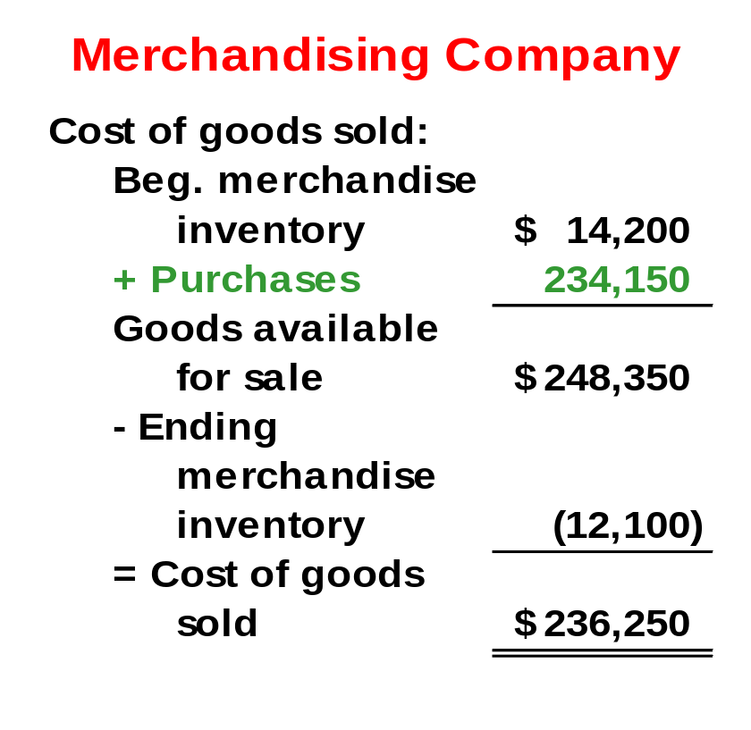
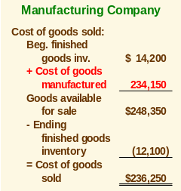
The Income Statement
Cost of goods sold for manufacturers differs only slightly from cost of goods sold for merchandisers.

Slide 21
Manufacturing Cost Flows
Income
Statement
Expenses
Balance Sheet
Costs Inventories
Material Purchases
Raw Materials
Direct Labor
Work in
Process
Manufacturing
Overhead
Cost of
Goods
Sold
Finished
Goods
Selling and
Administrative
Period Costs
Selling and
Administrative

Slide 22
Quick Check ✓
Which of the following transactions would immediately result in an expense? (There may be more than one correct answer.)
  A. Work in process is completed.
  B. Finished goods are sold.
  C. Raw materials are placed into production.
  D. Administrative salaries are accrued and paid.

Slide 23
Quick Check ✓
Which of the following transactions would immediately result in an expense? (There may be more than one correct answer.)
  A. Work in process is completed.
  B. Finished goods are sold.
  C. Raw materials are placed into production.
  D. Administrative salaries are accrued and paid.

Slide 24
Inventory Flows
Beginning
balance
$$
Additions
$$$
Available
$$$$$
+
=
Available
$$$$$
_
Withdrawals
$$$
Ending
balance
$$
=

Slide 25
Quick Check ✓
If your bank balance at the beginning of the month was $1,000, you deposited $100 during the month, and withdrew $300 during the month, what would be the balance at the end of the month?
  A. $1,000.
  B. $ 800.
  C. $1,200.
  D. $ 200.

Slide 26
Quick Check ✓
If your bank balance at the beginning of the month was $1,000, you deposited $100 during the month, and withdrew $300 during the month, what would be the balance at the end of the month?
  A. $1,000.
  B. $ 800.
  C. $1,200.
  D. $ 200.
$1,000 + $100 = $1,100
$1,100 - $300 = $800

Slide 27
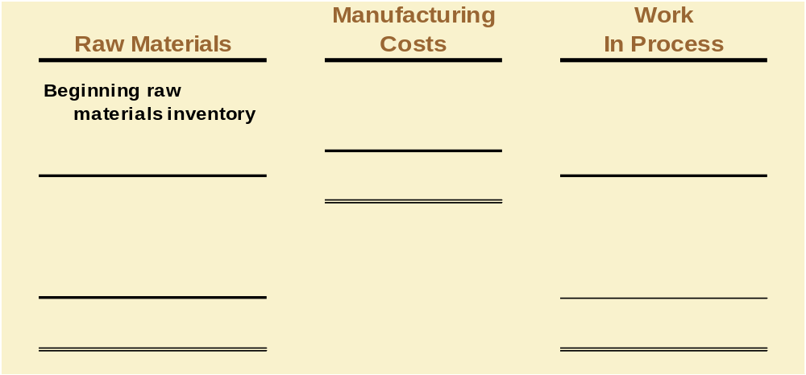
Product Costs - A Closer Look
Beginning inventory is the inventory carried over from the prior period.

Slide 28
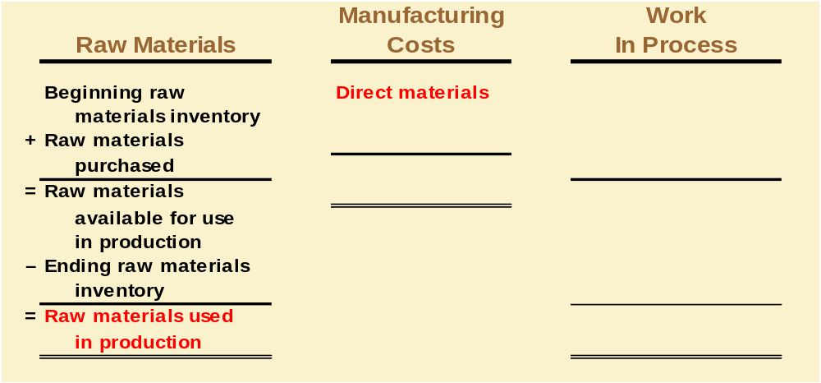
Product Costs - A Closer Look
As items are removed from raw materials inventory and placed into the production process, they are
called direct materials.

Slide 29
Quick Check ✓
Beginning raw materials inventory was $32,000. During the month, $276,000 of raw material was purchased. A count at the end of the month revealed that $28,000 of raw material was still present. What is the cost of direct material used?
    A. $276,000
    B. $272,000
    C. $280,000
    D. $ 2,000

Slide 30
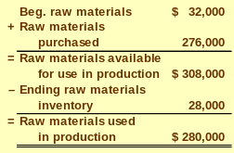
Quick Check ✓
Beginning raw materials inventory was $32,000. During the month, $276,000 of raw material was purchased. A count at the end of the month revealed that $28,000 of raw material was still present. What is the cost of direct material used?
    A. $276,000
    B. $272,000
    C. $280,000
    D. $ 2,000

Slide 31
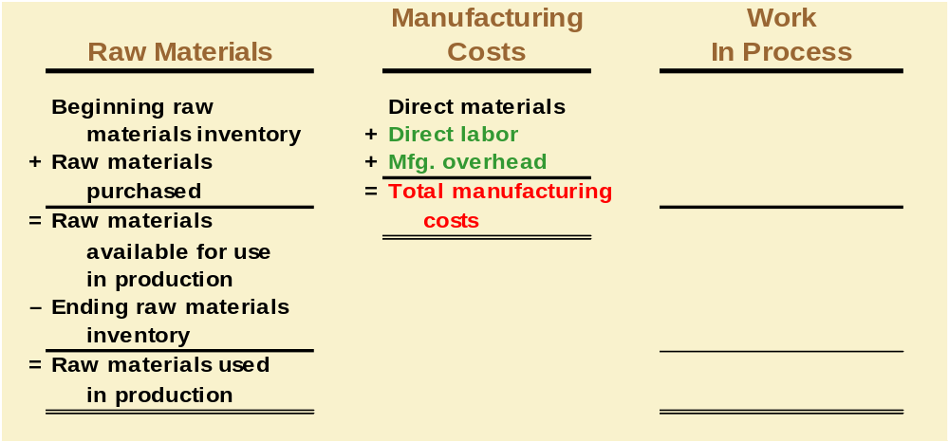
Product Costs - A Closer Look

Slide 32
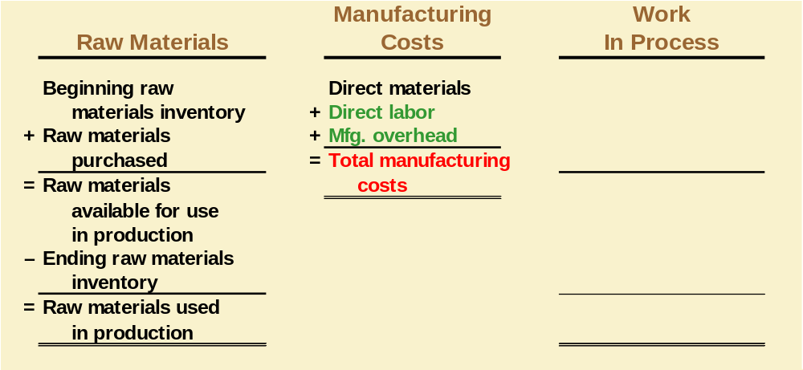
Product Costs - A Closer Look
Conversion costs are costs incurred to convert the direct material into a finished product.

Slide 33
Quick Check ✓
Direct materials used in production totaled $280,000. Direct labor was $375,000 and factory overhead was $180,000. What were total manufacturing costs incurred for the month?
    A. $555,000
    B. $835,000
    C. $655,000
    D. Cannot be determined.

Slide 34
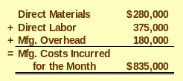
Quick Check ✓
Direct materials used in production totaled $280,000. Direct labor was $375,000 and factory overhead was $180,000. What were total manufacturing costs incurred for the month?
    A. $555,000
    B. $835,000
    C. $655,000
    D. Cannot be determined.

Slide 35
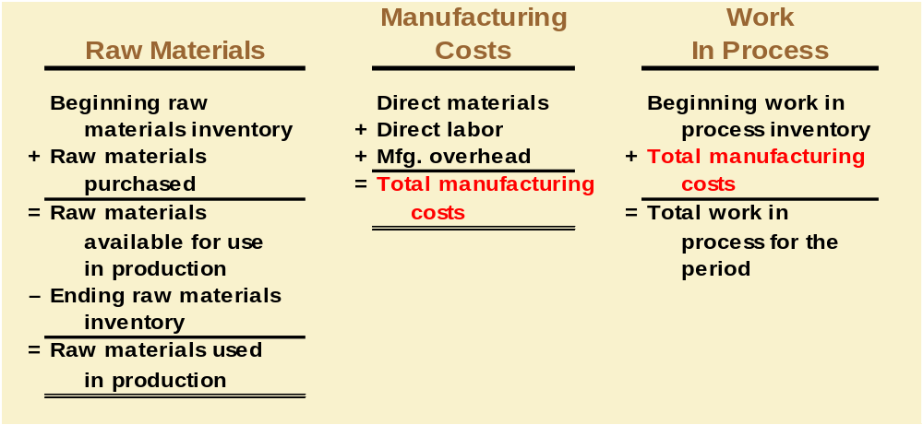
Product Costs - A Closer Look
All manufacturing costs incurred during the period are added to the beginning balance of work in process.

Slide 36
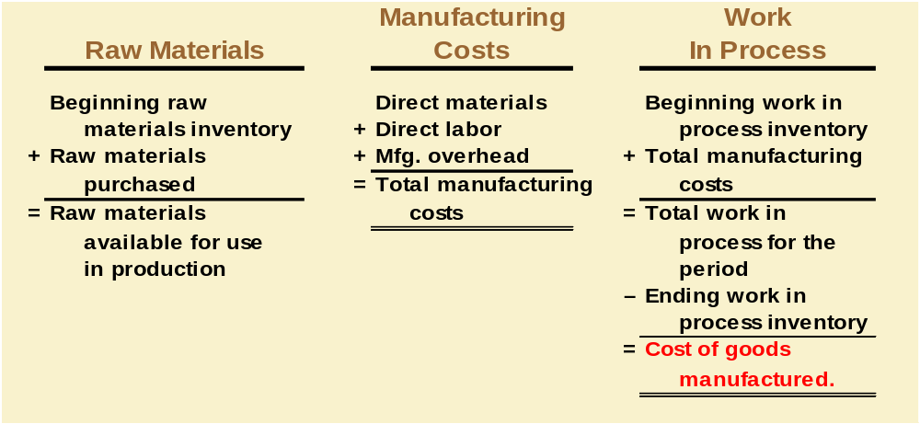
Product Costs - A Closer Look
Costs associated with the goods that are completed during the period are transferred to finished goods inventory.

Slide 37
Quick Check ✓
Beginning work in process was $125,000. Manufacturing costs incurred for the month were $835,000. There were $200,000 of partially finished goods remaining in work in process inventory at the end of the month. What was the cost of goods manufactured during the month?
    A. $1,160,000
    B. $ 910,000
    C. $ 760,000
    D. Cannot be determined.

Slide 38
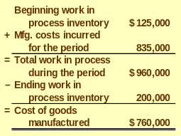
Quick Check ✓
Beginning work in process was $125,000. Manufacturing costs incurred for the month were $835,000. There were $200,000 of partially finished goods remaining in work in process inventory at the end of the month. What was the cost of goods manufactured during the month?
    A. $1,160,000
    B. $ 910,000
    C. $ 760,000
    D. Cannot be determined.

Slide 39
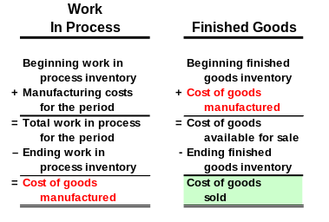
Product Costs - A Closer Look

Slide 40
Quick Check ✓
Beginning finished goods inventory was $130,000. The cost of goods manufactured for the month was $760,000. And the ending finished goods inventory was $150,000. What was the cost of goods sold for the month?
  A. $ 20,000.
  B. $740,000.
  C. $780,000.
  D. $760,000.

Slide 41
Quick Check ✓
Beginning finished goods inventory was $130,000. The cost of goods manufactured for the month was $760,000. And the ending finished goods inventory was $150,000. What was the cost of goods sold for the month?
  A. $ 20,000.
  B. $740,000.
  C. $780,000.
  D. $760,000.
$130,000 + $760,000 = $890,000
$890,000 - $150,000 = $740,000

Slide 42
Cost Classifications for Predicting Cost Behavior
How a cost will react to changes in the level of business activity.
  Total variable costs change when activity changes.
  Total fixed costs remain unchanged when activity changes.

Slide 43
Total Variable Cost
Your total long distance telephone bill is based on how many minutes you talk.
Total Long Distance
Telephone Bill
Minutes Talked

Slide 44
Variable Cost Per Unit
The cost per long distance minute talked is constant. For example, 10 cents per minute.
Per Minute
Telephone Charge
Minutes Talked

Slide 45
Total Fixed Cost
Your monthly basic telephone bill probably does not change when you make more local calls.
Monthly Basic Telephone Bill
Number of Local Calls

Slide 46
Fixed Cost Per Unit
The average cost per local call decreases as more local calls are made.
Monthly Basic Telephone Bill per Local Call
Number of Local Calls

Slide 47
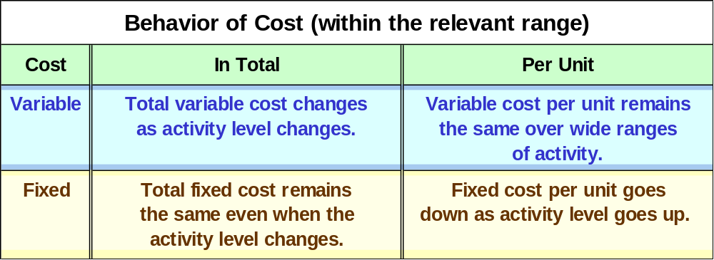
Cost Classifications for Predicting Cost Behavior

Slide 48
Quick Check ✓
Which of the following costs would be variable with respect to the number of cones sold at a Baskins & Robbins shop? (There may be more than one correct answer.)
  A. The cost of lighting the store.
  B. The wages of the store manager.
  C. The cost of ice cream.
  D. The cost of napkins for customers.

Slide 49
Quick Check ✓
Which of the following costs would be variable with respect to the number of cones sold at a Baskins & Robbins shop? (There may be more than one correct answer.)
  A. The cost of lighting the store.
  B. The wages of the store manager.
  C. The cost of ice cream.
  D. The cost of napkins for customers.

Slide 50
Quick Check ✓
Which of the following costs would be variable with respect to the number of people who buy a ticket for a show at a movie theater? (There may be more than one correct answer.)
  A. The cost of renting the film.
  B. Royalties on ticket sales.
  C. Wage and salary costs of theater employees.
  D. The cost of cleaning up after the show.

Slide 51
Quick Check ✓
Which of the following costs would be variable with respect to the number of people who buy a ticket for a show at a movie theater? (There may be more than one correct answer.)
  A. The cost of renting the film.
  B. Royalties on ticket sales.
  C. Wage and salary costs of theater employees.
  D. The cost of cleaning up after the show.

Slide 52
Direct Costs and Indirect Costs
Direct costs
Costs that can be
easily and conveniently traced to a unit of product or other cost objective.
Examples: direct material and direct labor
Indirect costs
Costs cannot be easily and conveniently traced to a unit of product or other cost object.
Example: manufacturing overhead

Slide 53
Differential Costs and Revenues
Costs and revenues that differ among alternatives.
Example: You have a job paying $1,500 per month in your hometown. You have a job offer in a neighboring city that pays $2,000 per month. The commuting cost to the city is $300 per month.
Differential revenue is:
$2,000 – $1,500 = $500
Differential cost is:
$300

Slide 54
Quick Check ✓
Suppose you are trying to decide whether to drive or take the train to Portland to attend a concert. You have ample cash to do either, but you don’t want to waste money needlessly. Is the cost of the pizza you ate last night relevant in this decision? In other words, should the cost of the pizza affect the decision of whether you drive or take the train to Portland?
  A. Yes, the cost of the pizza is relevant.
  B. No, the cost of the pizza is not relevant.

Slide 55
Quick Check ✓
Suppose you are trying to decide whether to drive or take the train to Portland to attend a concert. You have ample cash to do either, but you don’t want to waste money needlessly. Is the cost of the pizza you ate last night relevant in this decision? In other words, should the cost of the pizza affect the decision of whether you drive or take the train to Portland?
  A. Yes, the cost of the pizza is relevant.
  B. No, the cost of the pizza is not relevant.

Slide 56
Quick Check ✓
Suppose you are trying to decide whether to drive or take the train to Portland to attend a concert. You have ample cash to do either, but you don’t want to waste money needlessly. Is the cost of the train ticket relevant in this decision? In other words, should the cost of the train ticket affect the decision of whether you drive or take the train to Portland?
  A. Yes, the cost of the train ticket is relevant.
  B. No, the cost of the train ticket is not relevant.

Slide 57
Quick Check ✓
Suppose you are trying to decide whether to drive or take the train to Portland to attend a concert. You have ample cash to do either, but you don’t want to waste money needlessly. Is the cost of the train ticket relevant in this decision? In other words, should the cost of the train ticket affect the decision of whether you drive or take the train to Portland?
  A. Yes, the cost of the train ticket is relevant.
  B. No, the cost of the train ticket is not relevant.

Slide 58

Note
Every decision involves a choice from among at least two alternatives.
Only those costs and benefits that differ between alternatives (i.E., Differential costs and benefits) are relevant in a decision. All other costs and benefits can and should be ignored.

Slide 59
Quick Check ✓
Suppose you are trying to decide whether to drive or take the train to Portland to attend a concert. You have ample cash to do either, but you don’t want to waste money needlessly. Is the annual cost of licensing your car relevant in this decision?
  A. Yes, the licensing cost is relevant.
  B. No, the licensing cost is not relevant.

Slide 60
Quick Check ✓
Suppose you are trying to decide whether to drive or take the train to Portland to attend a concert. You have ample cash to do either, but you don’t want to waste money needlessly. Is the annual cost of licensing your car relevant in this decision?
  A. Yes, the licensing cost is relevant.
  B. No, the licensing cost is not relevant.

Slide 61
Quick Check ✓
Suppose you are trying to decide whether to drive or take the train to Portland to attend a concert. You have ample cash to do either, but you don’t want to waste money needlessly. Is the depreciation on your car relevant in this decision?
  A. Yes, the depreciation is relevant.
  B. No, the depreciation is not relevant.

Slide 62
Quick Check ✓
Suppose you are trying to decide whether to drive or take the train to Portland to attend a concert. You have ample cash to do either, but you don’t want to waste money needlessly. Is the depreciation on your car relevant in this decision?
  A. Yes, the depreciation is relevant.
  B. No, the depreciation is not relevant.
Depreciation that
is a function of miles driven
would be relevant.
Depreciation that is a
function of the passage of
time would not be relevant.

Slide 63
Opportunity Costs
The potential benefit that is given up when one alternative is selected over another.
Example: If you were
not attending college,
you could be earning
$15,000 per year.
Your opportunity cost
of attending college for one year is $15,000.

Slide 64
Sunk Costs
Sunk costs cannot be changed by any decision. They are not differential costs and should be ignored when making decisions.
Example: You bought an automobile that cost $10,000 two years ago. The $10,000 cost is sunk because whether you drive it, park it, trade it, or sell it, you cannot change the $10,000 cost.

Slide 65
Quick Check ✓
Suppose that your car could be sold now for $5,000. Is this a sunk cost?
  A. Yes, it is a sunk cost.
  B. No, it is not a sunk cost.

Slide 66
Quick Check ✓
Suppose that your car could be sold now for $5,000. Is this a sunk cost?
  A. Yes, it is a sunk cost.
  B. No, it is not a sunk cost.

Slide 67


Slide 68
End of Chapter 1

Slide 69


