Slide 1
Cost-Volume-Profit Relationships
Chapter6

Slide 2
Cost-Volume-Profit (CVP)
CVP analysis is a powerful tool that helps managers understand the relationships among cost, volume and profit. CVP analysis focuses on how profits are affected by the following five factors:
Selling prices
Sales volume
Unit variable costs
Total fixed costs
Mix of products sold

Slide 3
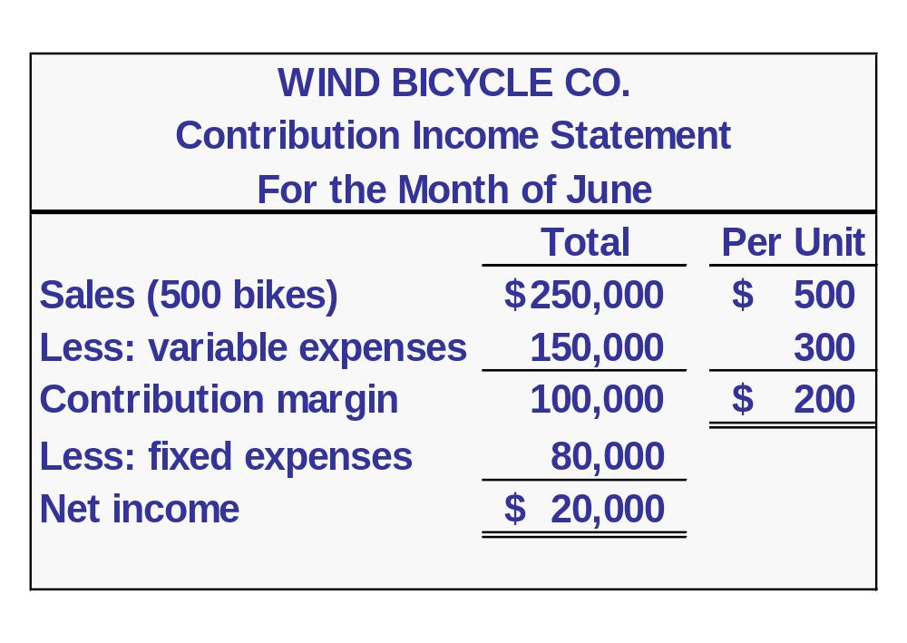
The Basics of Cost-Volume-Profit (CVP) Analysis
Contribution Margin (CM) is the amount remaining from sales revenue after variable expenses have been deducted.

Slide 4
The Basics of Cost-Volume-Profit (CVP) Analysis
CM goes to cover fixed expenses.

Slide 5
The Basics of Cost-Volume-Profit (CVP) Analysis
After covering fixed costs, any remaining CM contributes to income.

Slide 6
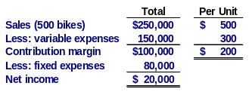

The Contribution Approach
Consider the following information developed by the accountant at Wind Bicycle Co.:

Slide 7
The Contribution Approach
For each additional unit Wind sells, $200 more in contribution margin will help to cover fixed expenses and profit.

Slide 8
The Contribution Approach
Each month Wind must generate at least $80,000 in total CM to break even.

Slide 9
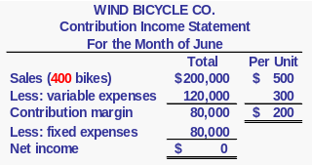
The Contribution Approach
If Wind sells 400 units in a month, it will be operating at the break-even point.

Slide 10
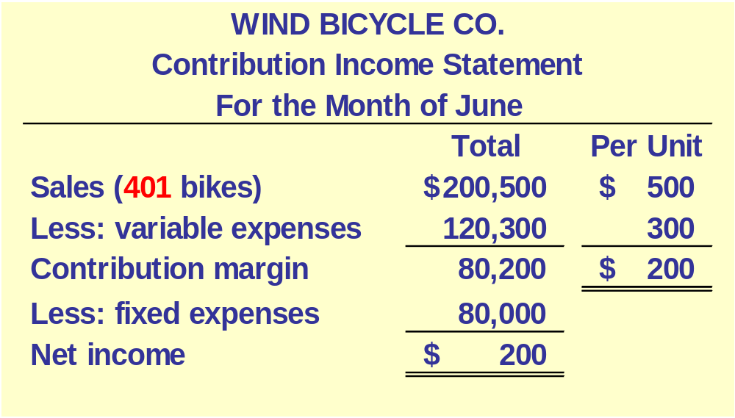
The Contribution Approach
If Wind sells one additional unit (401 bikes), net income will increase by $200.

Slide 11
The Contribution Approach
The break-even point can be defined either as:
  The point where total sales revenue equals total expenses (variable and fixed).
  The point where total contribution margin equals total fixed expenses.

Slide 12
Contribution Margin Ratio
The contribution margin ratio is:
For Wind Bicycle Co. the ratio is:
Contribution margin
Sales
CM Ratio =
$200
$500
= 40%

Slide 13
Contribution Margin Ratio
At Wind, each $1.00 increase in sales revenue results in a total contribution margin increase of 40¢.
If sales increase by $50,000, what will be the increase in total contribution margin?

Slide 14
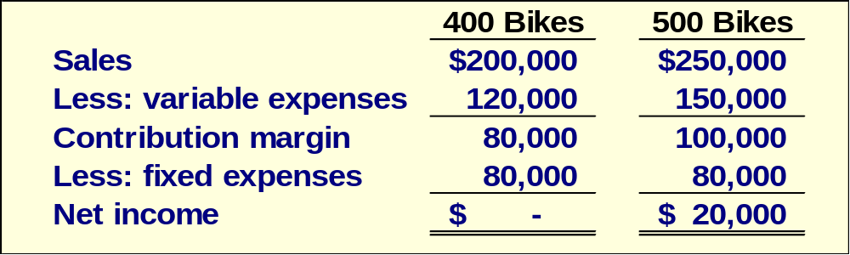
Contribution Margin Ratio
A $50,000 increase in sales revenue

Slide 15
Contribution Margin Ratio
A $50,000 increase in sales revenue
results in a $20,000 increase in CM.
($50,000 × 40% = $20,000)

Slide 16
Quick Check ✓
Coffee Klatch is an espresso stand in a downtown office building. The average selling price of a cup of coffee is $1.49 and the average variable expense per cup is $0.36. The average fixed expense per month is $1,300. 2,100 cups are sold each month on average. What is the CM Ratio for Coffee Klatch?
  a. 1.319
  b. 0.758
  c. 0.242
  d. 4.139

Slide 17
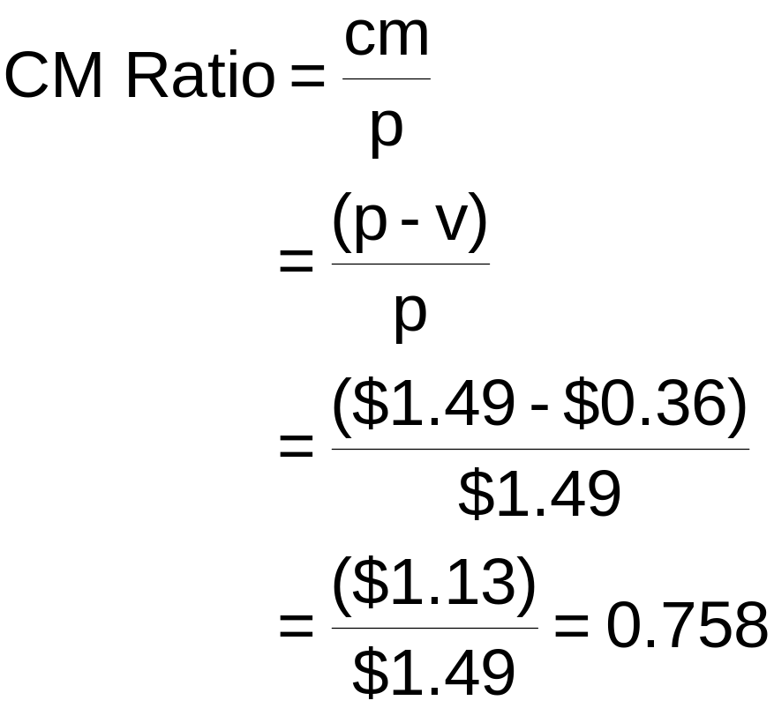
Quick Check ✓
Coffee Klatch is an espresso stand in a downtown office building. The average selling price of a cup of coffee is $1.49 and the average variable expense per cup is $0.36. The average fixed expense per month is $1,300. 2,100 cups are sold each month on average. What is the CM Ratio for Coffee Klatch?
  a. 1.319
  b. 0.758
  c. 0.242
  d. 4.139

Slide 18
Changes in Fixed Costs and Sales Volume
Wind is currently selling 500 bikes per month. The company’s sales manager believes that an increase of $10,000 in the monthly advertising budget would increase bike sales to 540 units.
Should we authorize the requested increase in the advertising budget?

Slide 19
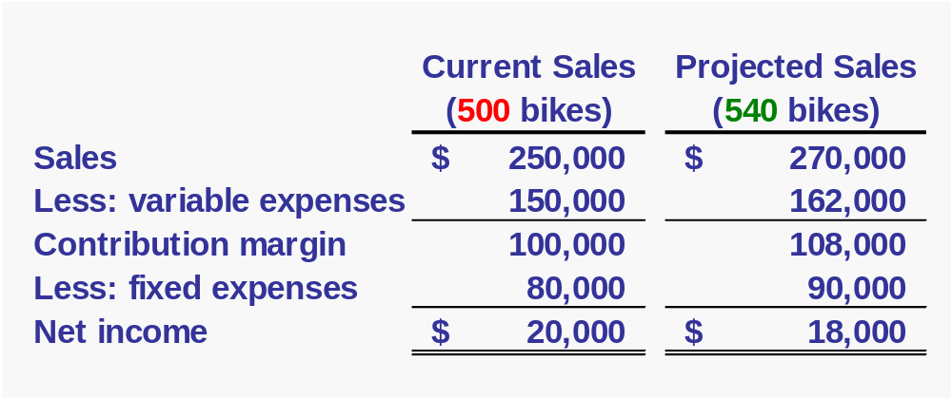
Changes in Fixed Costs and Sales Volume
$80,000 + $10,000 advertising = $90,000
Sales increased by $20,000, but net income decreased by $2,000.

Slide 20
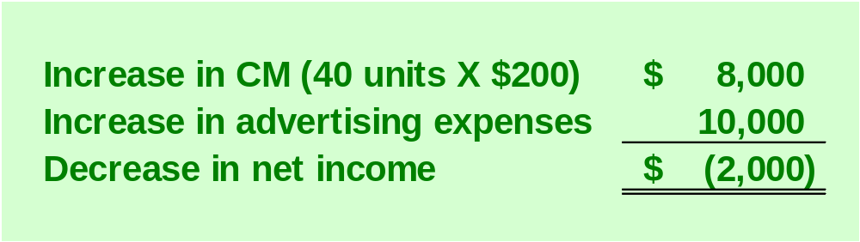
Changes in Fixed Costs and Sales Volume
The Shortcut Solution

Slide 21
Break-Even Analysis
Break-even analysis can be approached in two ways:
  Equation method
  Contribution margin method.

Slide 22
Equation Method
Profits = Sales – (Variable expenses + Fixed expenses)
OR
Sales = Variable expenses + Fixed expenses + Profits
At the break-even point
profits equal zero.

Slide 23
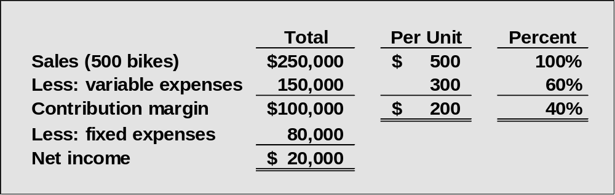
Equation Method
Here is the information from Wind Bicycle Co.:

Slide 24
Equation Method
We calculate the break-even point as follows:
Sales = Variable expenses + Fixed expenses + Profits
$500Q = $300Q + $80,000 + $0
Where:
Q = Number of bikes sold
$500 = Unit sales price
$300 = Unit variable expenses
$80,000 = Total fixed expenses

Slide 25
Equation Method
We calculate the break-even point as follows:
Sales = Variable expenses + Fixed expenses + Profits
$500Q = $300Q + $80,000 + $0
$200Q = $80,000
Q = 400 bikes

Slide 26
Equation Method
We can also use the following equation to compute the break-even point in sales dollars.
Sales = Variable expenses + Fixed expenses + Profits
X = 0.60X + $80,000 + $0
Where:
X = Total sales dollars
0.60 = Variable expenses as a percentage of sales
$80,000 = Total fixed expenses

Slide 27
Equation Method
We can also use the following equation to compute the break-even point in sales dollars.
Sales = Variable expenses + Fixed expenses + Profits
X = 0.60X + $80,000 + $0
0.40X = $80,000
X = $200,000

Slide 28
Contribution Margin Method
The contribution margin method is a variation of the equation method.
Break-even point
in units sold
Fixed expenses
Unit contribution margin
=
Break-even point in
total sales dollars
Fixed expenses
CM ratio
=

Slide 29
Quick Check ✓
Coffee Klatch is an espresso stand in a downtown office building. The average selling price of a cup of coffee is $1.49 and the average variable expense per cup is $0.36. The average fixed expense per month is $1,300. 2,100 cups are sold each month on average. What is the break-even sales in units?
  a. 872 cups
  b. 3,611 cups
  c. 1,200 cups
  d. 1,150 cups

Slide 30
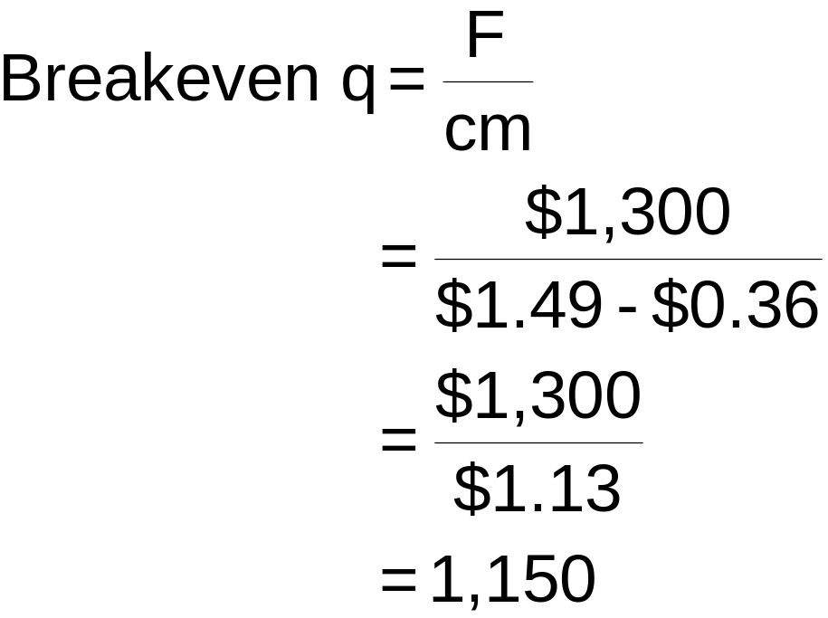
Quick Check ✓
Coffee Klatch is an espresso stand in a downtown office building. The average selling price of a cup of coffee is $1.49 and the average variable expense per cup is $0.36. The average fixed expense per month is $1,300. 2,100 cups are sold each month on average. What is the break-even sales in units?
  a. 872 cups
  b. 3,611 cups
  c. 1,200 cups
  d. 1,150 cups

Slide 31
Quick Check ✓
Coffee Klatch is an espresso stand in a downtown office building. The average selling price of a cup of coffee is $1.49 and the average variable expense per cup is $0.36. The average fixed expense per month is $1,300. 2,100 cups are sold each month on average. What is the break-even sales in dollars?
  a. $1,300
  b. $1,715
  c. $1,788
  d. $3,129

Slide 32
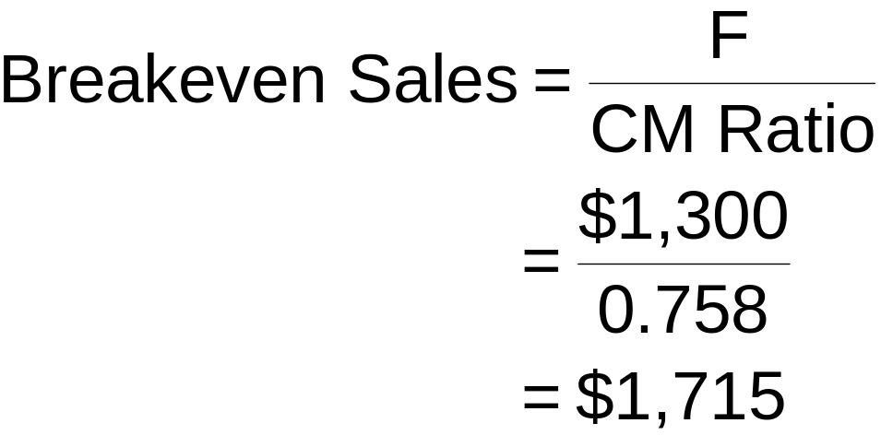
Quick Check ✓
Coffee Klatch is an espresso stand in a downtown office building. The average selling price of a cup of coffee is $1.49 and the average variable expense per cup is $0.36. The average fixed expense per month is $1,300. 2,100 cups are sold each month on average. What is the break-even sales in dollars?
  a. $1,300
  b. $1,715
  c. $1,788
  d. $3,129

Slide 33
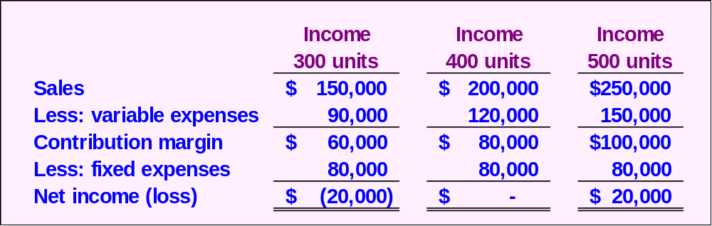
CVP Relationships in Graphic Form
Viewing CVP relationships in a graph gives managers a perspective that can be obtained in no other way. Consider the following information for Wind Co.:

Slide 34
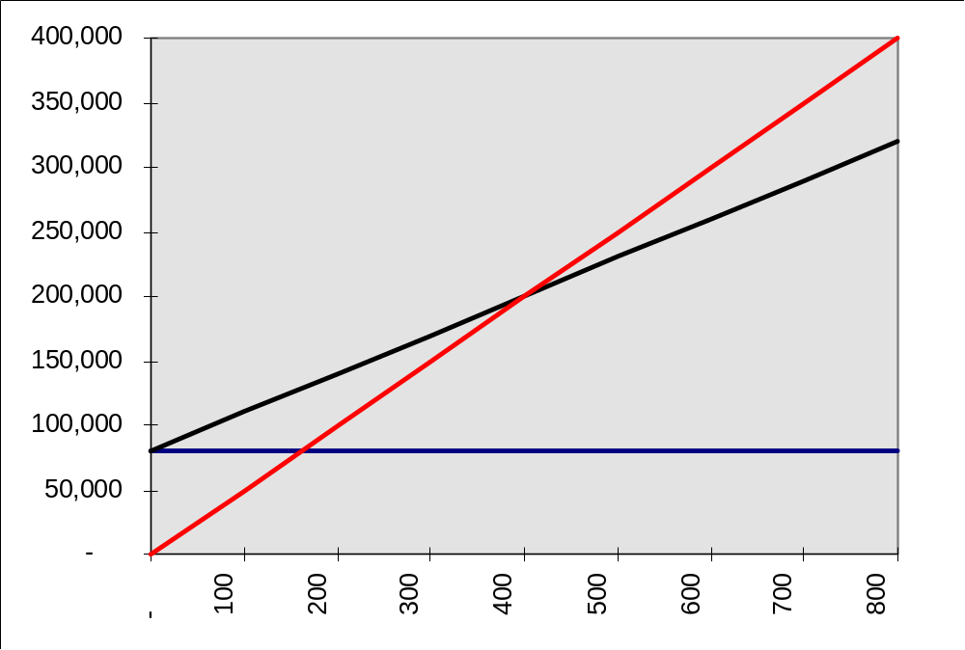
CVP Graph
Total Expenses
Dollars
Fixed expenses
Units

Slide 35
CVP Graph
Total Sales
Dollars
Units

Slide 36
CVP Graph
Profit Area
Dollars
Break-even point
Loss Area
Units

Slide 37
Target Profit Analysis
Suppose Wind Co. wants to know how many bikes must be sold to earn a profit of $100,000.
We can use our CVP formula to determine the sales volume needed to achieve a target net profit figure.

Slide 38
The CVP Equation
Sales = Variable expenses + Fixed expenses + Profits
$500Q = $300Q + $80,000 + $100,000
$200Q = $180,000
Q = 900 bikes

Slide 39
The Contribution Margin Approach
We can determine the number of bikes that must be sold to earn a profit of $100,000 using the contribution margin approach.
Units sold to attain
the target profit
Fixed expenses + Target profit
Unit contribution margin
=
$80,000 + $100,000
$200
= 900 bikes

Slide 40
Quick Check ✓
Coffee Klatch is an espresso stand in a downtown office building. The average selling price of a cup of coffee is $1.49 and the average variable expense per cup is $0.36. The average fixed expense per month is $1,300. How many cups of coffee would have to be sold to attain target profits of $2,500 per month?
  a. 3,363 cups
  b. 2,212 cups
  c. 1,150 cups
  d. 4,200 cups

Slide 41
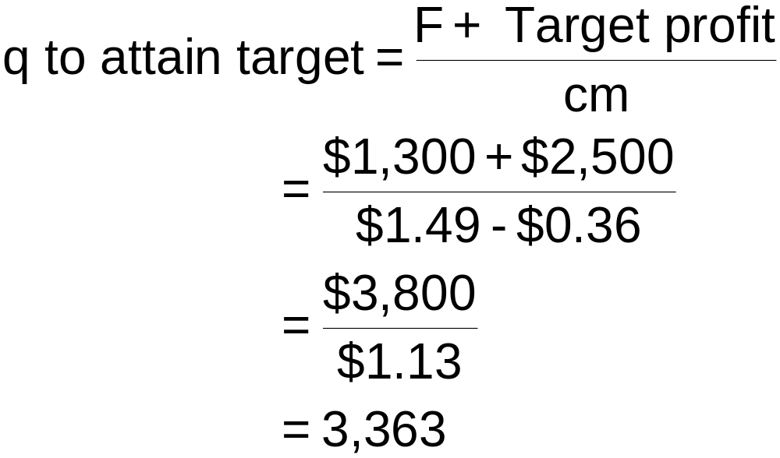
Quick Check ✓
Coffee Klatch is an espresso stand in a downtown office building. The average selling price of a cup of coffee is $1.49 and the average variable expense per cup is $0.36. The average fixed expense per month is $1,300. How many cups of coffee would have to be sold to attain target profits of $2,500 per month?
  a. 3,363 cups
  b. 2,212 cups
  c. 1,150 cups
  d. 4,200 cups

Slide 42
The Margin of Safety
Excess of budgeted (or actual) sales over the break-even volume of sales. The amount by which sales can drop before losses begin to be incurred.
Margin of safety = Total sales - Break-even sales
Let’s calculate the margin of safety for Wind.

Slide 43
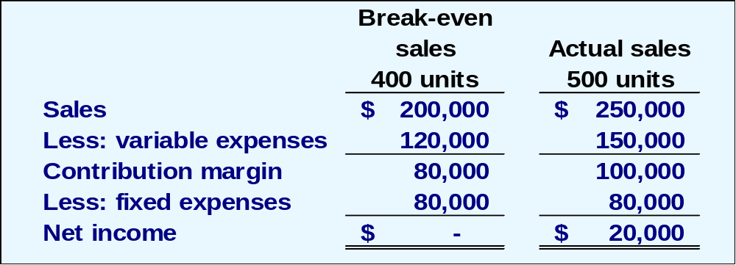
The Margin of Safety
Wind has a break-even point of $200,000. If actual sales are $250,000, the margin of safety is $50,000 or 100 bikes.

Slide 44
The Margin of Safety
The margin of safety can be expressed as 20 percent of sales.
($50,000 ÷ $250,000)

Slide 45
Quick Check ✓
Coffee Klatch is an espresso stand in a downtown office building. The average selling price of a cup of coffee is $1.49 and the average variable expense per cup is $0.36. The average fixed expense per month is $1,300. 2,100 cups are sold each month on average. What is the margin of safety?
  a. 3,250 cups
  b. 950 cups
  c. 1,150 cups
  d. 2,100 cups

Slide 46
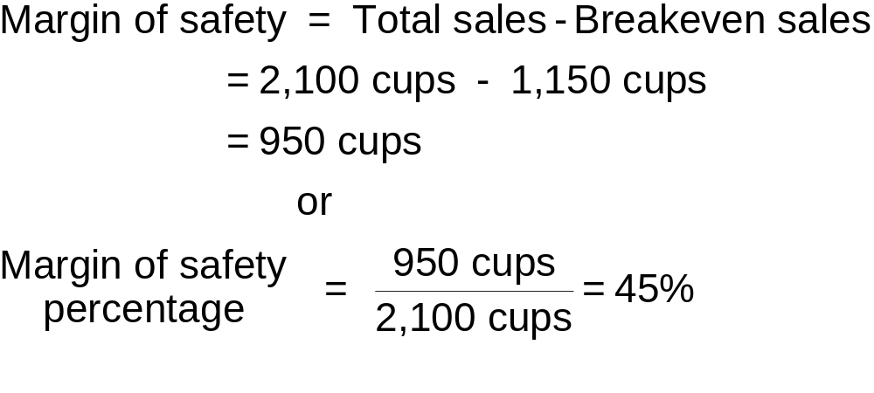
Quick Check ✓
Coffee Klatch is an espresso stand in a downtown office building. The average selling price of a cup of coffee is $1.49 and the average variable expense per cup is $0.36. The average fixed expense per month is $1,300. 2,100 cups are sold each month on average. What is the margin of safety?
  a. 3,250 cups
  b. 950 cups
  c. 1,150 cups
  d. 2,100 cups

Slide 47
Operating Leverage
A measure of how sensitive net income is to percentage changes in sales.
With high leverage, a small percentage increase in sales can produce a much larger percentage increase in net income.
Degree of
operating leverage
Contribution margin
Net income
=

Slide 48
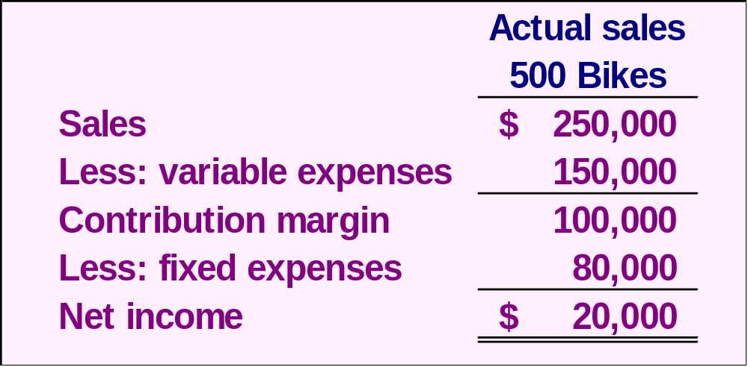
Operating Leverage
$100,000
$20,000
= 5

Slide 49
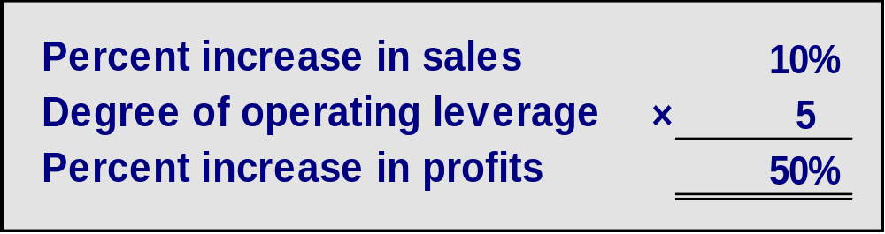
Operating Leverage
With a measure of operating leverage of 5, if Wind increases its sales by 10%, net income would increase by 50%.
Here’s the proof!

Slide 50
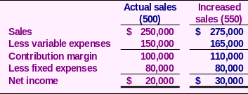
Operating Leverage
10% increase in sales from
$250,000 to $275,000 . . .
. . . results in a 50% increase in
income from $20,000 to $30,000.

Slide 51
Quick Check ✓
Coffee Klatch is an espresso stand in a downtown office building. The average selling price of a cup of coffee is $1.49 and the average variable expense per cup is $0.36. The average fixed expense per month is $1,300. 2,100 cups are sold each month on average. What is the operating leverage?
  a. 2.21
  b. 0.45
  c. 0.34
  d. 2.92

Slide 52
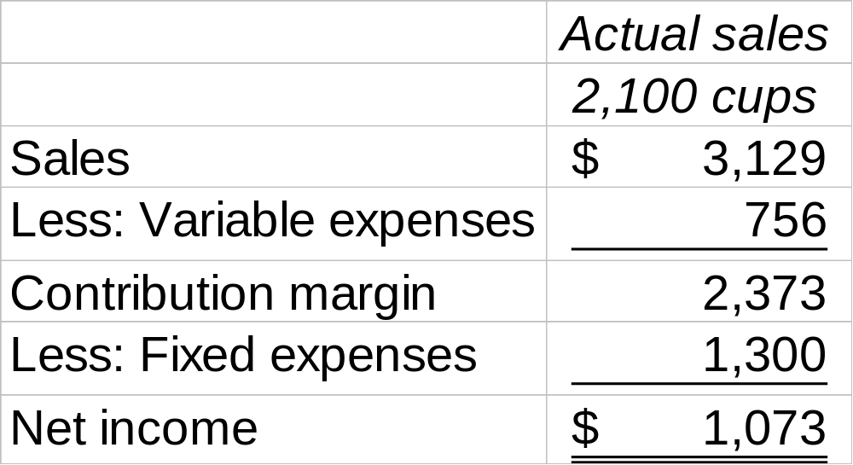
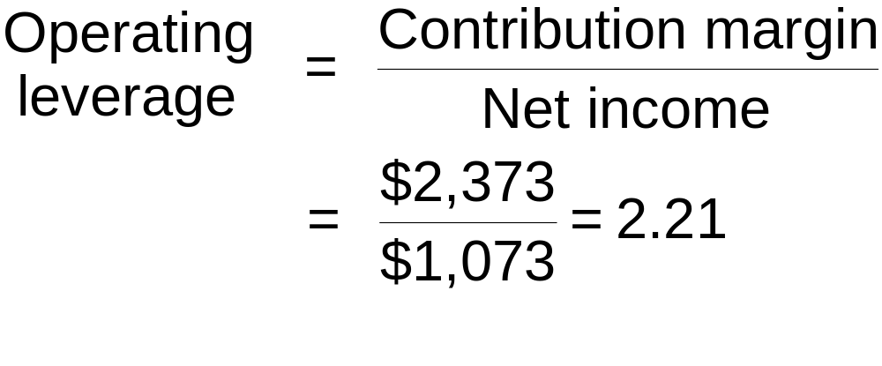
Quick Check ✓
Coffee Klatch is an espresso stand in a downtown office building. The average selling price of a cup of coffee is $1.49 and the average variable expense per cup is $0.36. The average fixed expense per month is $1,300. 2,100 cups are sold each month on average. What is the operating leverage?
  a. 2.21
  b. 0.45
  c. 0.34
  d. 2.92

Slide 53
Quick Check ✓
At Coffee Klatch the average selling price of a cup of coffee is $1.49, the average variable expense per cup is $0.36, and the average fixed expense per month is $1,300. 2,100 cups are sold each month on average.
If sales increase by 20%, by how much should net income increase?
  a. 30.0%
  b. 20.0%
  c. 22.1%
  d. 44.2%

Slide 54
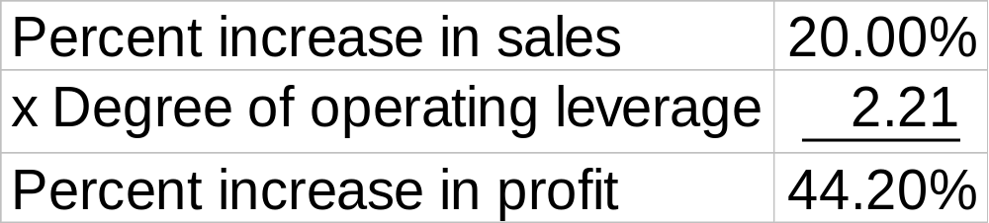
Quick Check ✓
At Coffee Klatch the average selling price of a cup of coffee is $1.49, the average variable expense per cup is $0.36, and the average fixed expense per month is $1,300. 2,100 cups are sold each month on average.
If sales increase by 20%, by how much should net income increase?
  a. 30.0%
  b. 20.0%
  c. 22.1%
  d. 44.2%

Slide 55

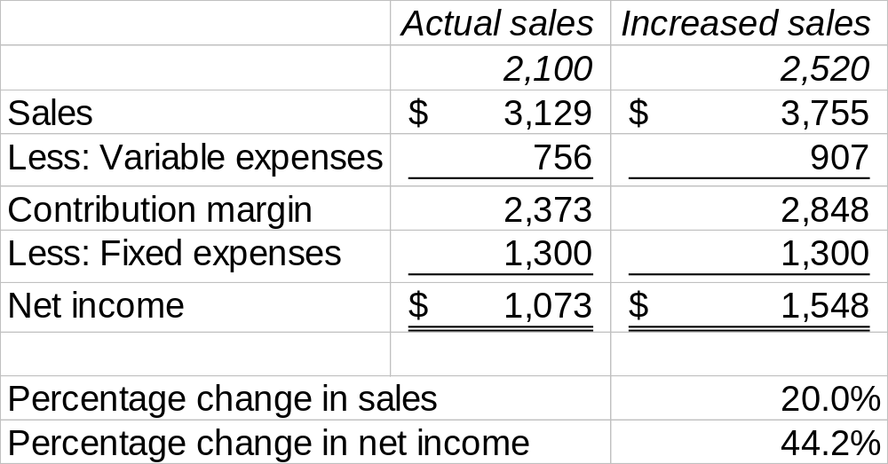
Note: Verify increase in profit

Slide 56
The Concept of Sales Mix
Sales mix is the relative proportions in which a company’s products are sold.
Different products have different selling prices, cost structures, and contribution margins.
Let’s assume Wind sells bikes and carts and see how we deal with break-even analysis.

Slide 57
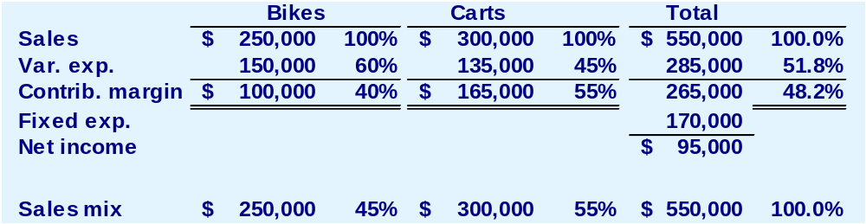
Multi-product break-even analysis
Wind Bicycle Co. provides the following information:
$265,000
$550,00
= 48.2% (rounded)

Slide 58
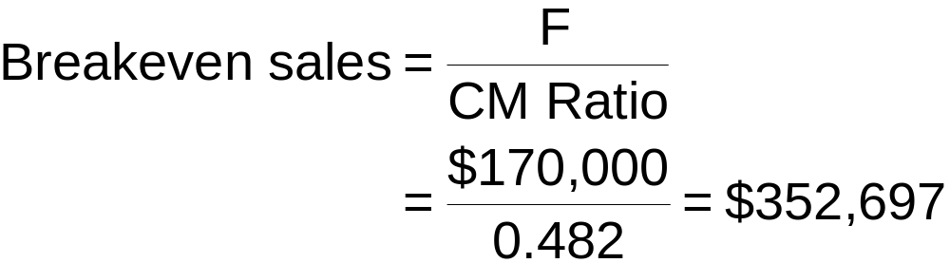
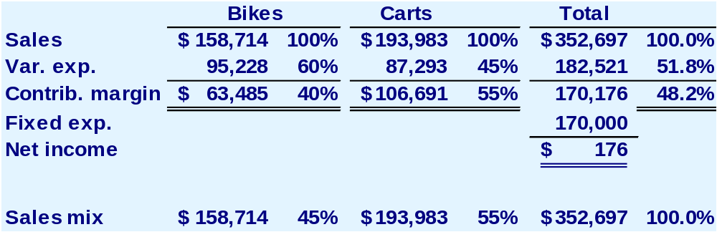
Multi-product break-even analysis
Rounding error

Slide 59
Assumptions of CVP Analysis
Selling price is constant throughout the entire relevant range.
Costs are linear throughout the entire relevant range.
In multi-product companies, the sales mix is constant.
In manufacturing companies, inventories do not change (units produced = units sold).

Slide 60

End of Chapter 6
We made
it!

