Slide 1
786
Course Code:
AIS 4205
Course Title:
Accounting Information Systems
Text Book:
Accounting Information Systems, Essential Concepts and Applications: Wilkinson, Cerullo, Raval, Wong-on-wing Publisher: John Wiley & Sons.

Slide 2
Reasons for Studying Accounting Information Systems
As an accountant, you will be closely involved with AlSs during your entire career. Not only will you be a user of these AISs but you may possibly become a developer of such systems Furthermore, as an auditor, you will be expected to evaluate AISs.
Almost all business firms have computers as integral parts of their information systems. As information has become more vital, the management of data and the preparation of needed reports have become more complex and varied functions. You need to acquire the knowledge and skills that will enable you to apply computer-based AlSs in effectively achieving these functions. Otherwise, you are likely to be much less productive in employing your accounting knowledge and skills.

Slide 3
Modern-day information systems are also rapidly changing and improving. They are incorporating new developments from fields like the Internet and e- commerce, object technology, telecommunications, and control. You should be aware of these developments and others that are just emerging, since they will be increasingly common in the future. With adequate knowledge and skills concerning computer-based information systems, you should be in a position to take advantage of the opportunities they offer.

Slide 4
AIS 4205
Accounting Information Systems :
AIS
Accounting
Information
Systems

Slide 5
Accounting
Accounting is a data identification, collection, and storage process as well as an information development, measurement, and communication process. By definition, accounting is an information system, since an AIS collects, records, stores, and processes accounting and other data to produce information for decision makers.

Slide 6
Information
In the broadest sense, information is intelligence that is meaningful and useful to persons for whom it is intended. Accounting information is the output of AlSs and is financially oriented. Usually, information is derived from the processing of data. Data are the raw facts and figures even symbols that together from the inputs to an information system.

Slide 7
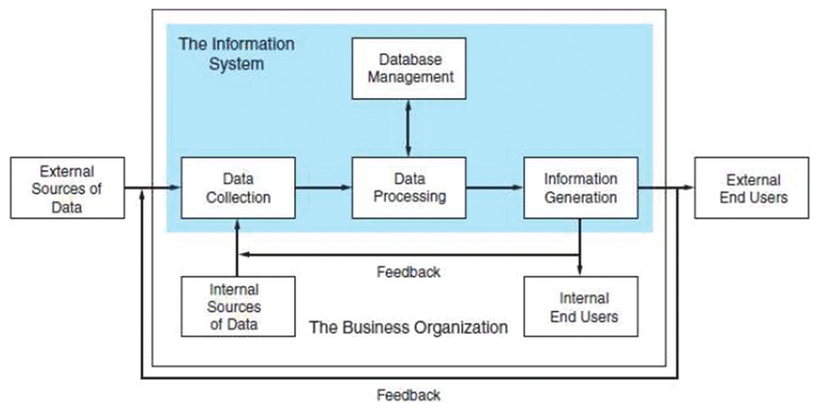
Operations within the accounting activity

Slide 8
Systems
A system is a unified group of interacting parts that function together to achieve its purposes. The world is brimming with systems, those that are natural and those made by humans. Most systems are composed of smaller subsystems that support the larger system. For example, a college of business is a system composed of various departments, each of which is a subsystem. Moreover, the college itself is a subsystem of the university.

Slide 9
Accounting Information Systems
The preceding descriptions of accounting, information, and system enable us to develop a workable definition of an AIS. An accounting information system is a unified structure within an entity, such as a business firm, that employs physical resources and other components to transform economic data into accounting information, with the purpose of satisfying the information needs of a variety of users.

Slide 10
Objectives of AIS
To support the firm’s day-to-day operations
To support decision making by internal decision makers
To fulfill obligations relating to Stewardship

Slide 11
An Information Systems Framework
The information system is the set of formal procedures by which data are collected, processed into information, and distributed to users. The following Figure shows the information system of a hypothetical manufacturing firm decomposed into its elemental subsystems.
Notice that two broad classes of systems emerge from the decomposition: the accounting information system (AIS) and the management information system (MIS). The information system accepts input, called transactions, which are converted through various processes into output information that goes to users. Transactions fall into two classes: financial transactions and nonfinancial transactions. Hence, transaction is an event that affects or is of interest to the organization and is processed by its information system as a unit of work.

Slide 12
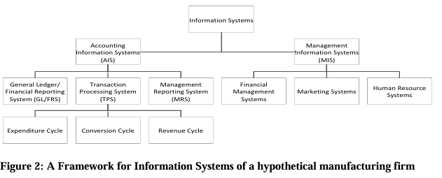

Slide 13
The Management Information System (MIS)
Management often requires information that goes beyond the capability of AIS. As organizations grow in size and complexity, specialized functional areas emerge, requiring additional information for production planning and control, sales forecasting, inventory warehouse planning, market research, and so on. The MIS processes nonfinancial transactions that are not normally processed by AIS.

