Slide 1
The Information Environment
Like other business resources (e.g. raw materials, capital, and labor), information is vital for the survival of a business organization. In this regard, we have to recognize information as a business resource. Every business day, vast quantities of information flow to decision makers and other users to meet a variety of internal needs. In addition, information flows out from the organization to external users, such as customers, suppliers, and stakeholders who have an interest in the firm.

Slide 2
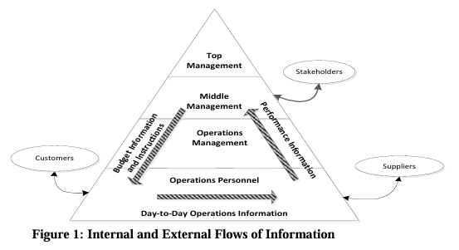
Information flows.

Slide 3
Data versus Information
Data are facts, which may or may not be processed (edited, summarized, or refined) and have no direct effect on the user. By contrast, information causes the user to take an action that he or she otherwise could not, or would not, have taken. Information is often defined simply as processed data. This is an inadequate definition. Information is determined by the effect it has on the user, not by its physical form. Thus, information is not just a set of processed facts arranged in a formal report. Information allows users to take action to resolve conflicts, reduce uncertainty, and make decisions.

Slide 4
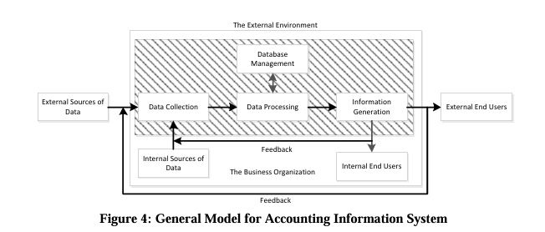

Slide 5
A General Model for AIS
An AIS can be a paper-and-pencil manual system, a complex system using the latest in IT, or something in between. Regardless of the approach taken, the process is the same. The AIS must collect, enter, process, store, and report data and information. The paper and pencil or the computer hardware and software are merely the tools used to produce the information.

Slide 6
Framework of AIS and various subsystems
There are six components of an AIS:
The people who use the system
The procedures and instructions used to collect, process, and store data
The data about the organization and its business activities
The software used to process the data
The information technology infrastructure, including the computers, peripheral devices, and network communications devices used in the AIS
The internal controls and security measures that safeguard AIS data.

Slide 7
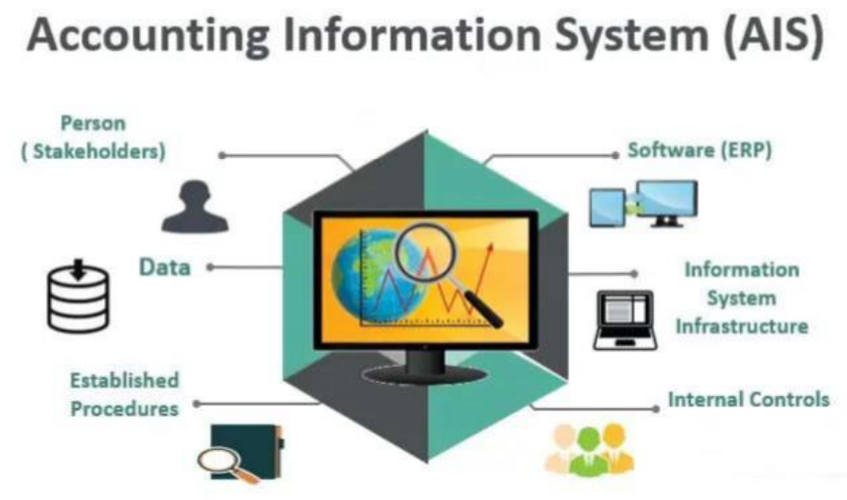
Framework of AIS and various subsystems

Slide 8
AIS subsystems
In order to explain how accounting information system could achieve the goals, it is needed to classify organizations’ activities into five main cycles which are the subsystems of AIS:
Expenditure cycle
Production cycle
Human resources cycle
Revenue cycle
Financing cycle

Slide 9
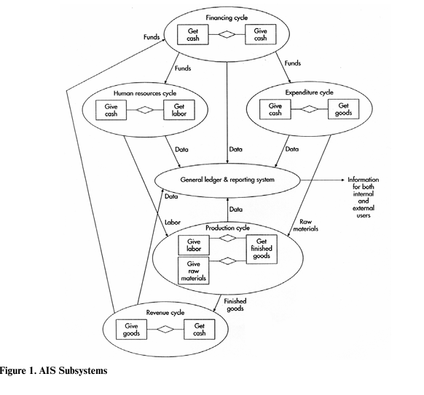

Slide 10
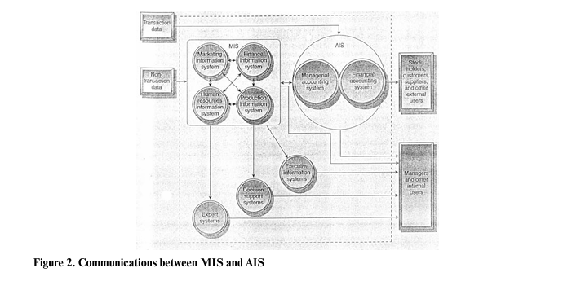

Slide 11
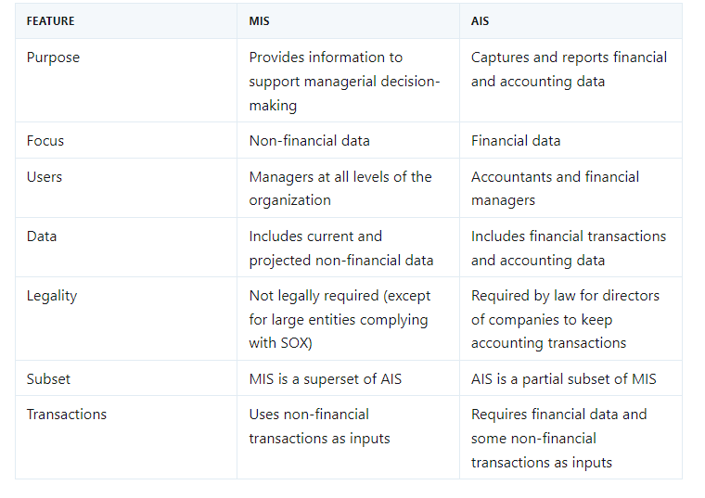

Slide 12
Factors Influencing of AIS
There are three areas that specifically influence AIS;
Behavioral Analysis,
Quantitative Methods and
Contemporary Management Concepts.

Slide 13
Factors Influencing Design of AIS
Financial reporting standard
Institutional accounting
Infrastructure and technology management commitment
Data and information quality
Employee attitude and willingness
System complexity
Organizational culture

Slide 14
Components of Accounting Information System
General Ledger System
Asset Management
Order-entry System
Inventory Control System
Payroll System
Cash Management

Slide 15
How an AIS Can Add Value to an Organization
A well designed AIS can add value to an organization by:
Improving the quality and reducing the costs of products or services
Improving efficiency
Sharing knowledge
Improving the efficiency and effectiveness of its supply chain
Improving the internal control structure
Improving decision making

Slide 16
Goal conflict vs. Goal congruence
Goal conflict occurs when a subsystem’s goals are inconsistent with the goals of another subsystem or with the system as a whole. Goal congruence occurs when a subsystem achieves its goals while contributing to the organization’s overall goal. The larger the organization and the more complicated the system, the more difficult it is to achieve goal congruence.

