Slide 1
DATABASE SYSTEMS
Database Systems:
Over the past 50 years, a number of different approaches or models have represented accounting information systems. Each new model evolved because of the shortcomings and limitations of its predecessor. An interesting feature in this evolution is that the newest technique does not immediately replace older models. Thus, at any point in time, various generations of systems exist across different organizations and may even coexist within a single enterprise.

Slide 2
Database Systems
The modern auditor needs to be familiar with the operational features of all AIS approaches that he or she is likely to encounter. This chapter deals with four such models:
The Manual processes,
The Flat-file systems,
The database approach,
The database management system.

Slide 3
The Manual process model
The manual process model is the oldest and most traditional form of accounting systems. Manual systems constitute the physical events, resources, and personnel that characterize many business processes. This includes such tasks as order-taking, warehousing materials, manufacturing goods for sale, shipping goods to customers, and placing orders with vendors.
This model also includes the physical task of record keeping that is manually. Manual procedures facilitate to understand the internal control activities, including segregation of functions, supervision, independent verification, audit trails, and access controls.

Slide 4
The Flat-File Model
The flat-file approach is most often associated with so-called legacy systems (outdated systems). These are large mainframe systems that were implemented in the late 1960s through the 1980s.
Organizations today still use these systems extensively. The flat-file model describes an environment in which individual data files are not related to other files. End users in this environment own their data files rather than share them with other users.

Slide 5
Many so-called legacy (outdated) systems are characterized by the flat-file approach to data management. In this environment, users own their data files. Exclusive ownership of data is a natural consequence of two problems associated with the legacy-system era.
The first is a business culture that erects barriers between organizational units that inhibit entity-wide integration of data.
The second problem stems from limitations in flat-file management technology that require data files to be structured to the unique needs of the primary user.

Slide 6
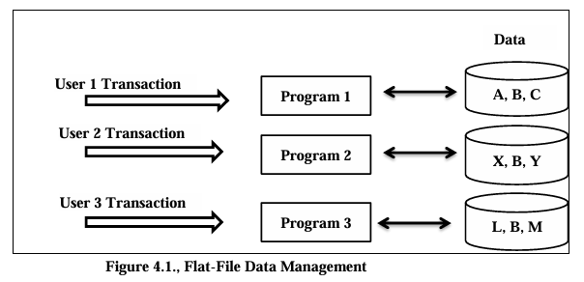
Figure: Flat-File Data Management

Slide 7
Flat-File Data Management
In the above figure, the file contents are represented conceptually with letters. Each letter could signify a single data attribute (field), a record, or an entire file. Note also that data element B is present in all user files. This is called data redundancy and is the cause of three types of data management problems:
(1) Data storage,
(2) Data updating, and
(3) Currency of information.
Each of these, as well as a fourth problem, task-data dependency, which is not directly related to data redundancy will be examined next.

Slide 8
The Database Approach
The most obvious change from the flat-file model is the pooling of data into a common database that is shared by all the users. Thus flat-file problems solved, because data sharing (the absence of ownership) is the central concept of the database approach. The followings are characteristics of database:
No data redundancy
Single update
Current values
Task-data independence

Slide 9
The Database Management System
The purpose of the DBMS is to provide controlled access to the database. The DBMS is a special software system that is programmed to know which data elements each user is authorized to access. The user’s program sends requests for data to the DBMS, which validates and authorizes access to the database in accordance with the user’s level of authority. The DBMS will deny requests for data that the user is unauthorized to access.

Slide 10
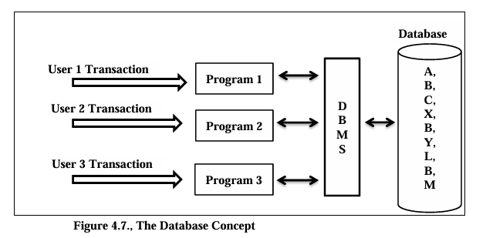

Slide 11
Difference between File system & DBMS
File system | DBMS
File system is a collection of data. Any management with the file system, user has to write the procedures File system gives the details of the data representation and Storage of data. In File system storing and retrieving of data cannot be done efficiently. Concurrent access to the data in the file system has many problems like a. Reading the file while other deleting some information, updating some information File system doesn’t provide crash recovery mechanism. Eg. While we are entering some data into the file if System crashes then content of the file is lost. Protecting a file under file system is very difficult | DBMS is a collection of data and user is not required to write the procedures for managing the database. DBMS provides an abstract view of data that hides the details. DBMS is efficient to use since there are wide varieties of sophisticated techniques to store and retrieve the data. DBMS takes care of Concurrent access using some form of locking. DBMS has crash recovery mechanism, DBMS protects user from the effects of system failures. DBMS has a good protection mechanism.

Slide 12
Data Independence
Data independence can be defined as the capacity to change the schema at one level without changing the schema at next higher level. There are two types of data Independence. They are :
Logical data independence.
Physical data independence.
Logical data independence is the capacity to change the conceptual schema without having to change the external schema.
Physical data independence is the capacity to change the internal schema without changing the conceptual schema.

Slide 13
When not to use a DBMS
Main inhibitors (costs) of using a DBMS
High initial investment and possible need for additional hardware.
Overhead for providing generality, security, concurrency control, recovery, and integrity functions When a DBMS may be unnecessary
If the database and applications are simple, well defined and not expected to change.
If there are stringent real-time requirements that may not be met because of DBMS overhead.
If access to data by multiple users is not required.
If the database system is not able to handle the complexity of data because of modeling limitations
If the database users need special operations not supported by the DBMS.

Slide 14
Types of Databases and Database Applications
Traditional Applications:
Numeric and Textual Databases
More Recent Applications:
Multimedia Databases
Geographic Information Systems (GIS)
Data Warehouses
Real-time and Active Databases
Many other applications

Slide 15
Data Model
A model is an abstraction process that hides superfluous details. Data modeling is used for representing entities of interest and their relationship in the database. Data model is a collection of concepts that can be used to describe the structure of a database which provides the necessary means to achieve the abstraction. The structure of a database means that holds the data.

Slide 16
Types of Data Models
High Level- Conceptual data model.
Low Level – Physical data model.
Relational or Representational
Object-oriented Data Models
Object-Relational Models

Slide 17
High Level-conceptual data model: User level data model is the high level or conceptual model. This provides concepts that are close to the way that many users perceive data.
Low level-Physical data model : provides concepts that describe the details of how data is stored in the computer model. Low level data model is only for Computer specialists not for end-user.
Representation data model: It is between High level & Low level data model Which provides concepts that may be understood by end-user but that are not too far removed from the way data is organized by within the computer.
In Object Oriented Data Model, data and their relationships are contained in a single structure which is referred as object in this data model. In this, real world problems are represented as objects with different attributes.
The Object-Relational data model refers to a combination of a Relational database model and an Object-Oriented database model. As a result, it supports classes, objects, inheritance, and other features found in Object-Oriented models, as well as data types, tabular structures, and other features found in Relational Data Models.

Slide 18
Schemas versus Instances
“Schema” and “Instance” are key ideas in a database management system (DBMS) that help organize and manage data. A schema can be referred to as the blueprint of the database while an instance is the actual contents of the database at a given point of time.
What is Schema?
Schema is the overall description of the database. The basic structure of how the data will be stored in the database is called schema. In DBMS, the term schema refers to the architecture of the database which describes how it will appear or will be constructed. It describes the organization of data such as tables, relationships as well as constraints. A schema is a template that dictates how data items in a database will be stored, arranged, and accessed.

Slide 19
Example
Let’s say a table teacher in our database named school, the teacher table requires the name, dob, and doj in their table so we design a structure as:
Teacher table
Name: String
Doj: date
Dob: date

Slide 20
Types of Schema
Schema is of three types: Logical Schema, Physical Schema and view Schema.
Logical Schema – It describes the database designed at a logical level.
Physical Schema – It describes the database designed at the physical level.
View Schema – It defines the design of the database at the view level.

Slide 21
What is Instance?
An instance of DBMS refers to real data in a database coming at some particular point in time. Instance on the other hand refers to the content in the database in as much as it refers to the structure defined under a particular schema at a given point.

Slide 22
Example
Let’s say a table teacher in our database whose name is School, suppose the table has 50 records so the instance of the database has 50 records for now and tomorrow we are going to add another fifty records so tomorrow the instance has a total of 100 records. This is called an instance.

Slide 23
Difference Between Schema and Instance
Schema | Instance
It is the overall description of the database. | It is the collection of information stored in a database at a particular moment.
The schema is same for the whole database. | Data in instances can be changed using addition, deletion, and updating.
Does not change Frequently. | Changes Frequently.
Affects the entire database structure. | Affects only the current state of data.
Requires significant effort and planning to change. | Easily altered by performing CRUD (Create, Read, Update, Delete) operations.
Table structures, relationships, constraints. | Data entries, records in tables.

Slide 24
DBMS Languages
A DBMS has appropriate languages and interfaces to express database queries and updates.
Database languages can be used to read, store and update the data in the database.

Slide 25
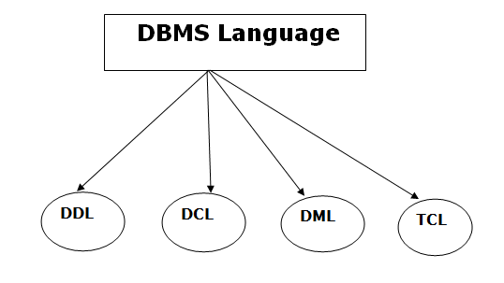
Types of Database Languages

Slide 26
Data Definition Language (DDL)
DDL stands for Data Definition Language. It is used to define database structure or pattern.
It is used to create schema, tables, indexes, constraints, etc. in the database.
Using the DDL statements, you can create the skeleton of the database.
Data definition language is used to store the information of metadata like the number of tables and schemas, their names, indexes, columns in each table, constraints, etc.
Here are some tasks that come under DDL:
Create: Alter: Drop: Truncate: Rename: Comment:

Slide 27
Data Manipulation Language (DML)
DML stands for Data Manipulation Language. It is used for accessing and manipulating data in a database. It handles user requests.
Here are some tasks that come under DML:
Select: Insert: Update: Delete: Merge: Call:
Explain Plan: Lock Table:

Slide 28
Data Control Language (DCL)
DCL stands for Data Control Language. It is used to retrieve the stored or saved data.
The DCL execution is transactional. It also has rollback parameters.
Here are some tasks that come under DCL:
Grant: Revoke:

Slide 29
Transaction Control Language (TCL)
TCL is used to run the changes made by the DML statement. TCL can be grouped into a logical transaction.
Here are some tasks that come under TCL:
Commit: Rollback:

Slide 30
Database Design Process
The organization’s database is its physical repository for financial and nonfinancial data. We use the term database in the generic sense. It can be a filing cabinet or a computer disk. Figure 4.4. presents a breakdown of the database environment into four primary elements: users, the DBMS, the database administrator, and the physical database.

Slide 31
Users
Users access the database in two ways.
The first is via user application programs that systems professionals prepare. These programs send data access requests (calls) to the DBMS, which validates the requests and retrieves the data for processing.
The second method of database access is via direct query, which requires no formal user programs. The DBMS has a built-in query facility that allows authorized users to process data independent of professional programmers.

Slide 32
Database Management System
The DBMS provides a controlled environment to assist (or prevent) user access to the database and to efficiently manage the data resource. Database Management Systems (DBMS) are software systems used to store, retrieve, and run queries on data. A DBMS serves as an interface between an end-user and a database, allowing users to create, read, update, and delete data in the database.

Slide 33
Database Administrator
The Database Administrator (DBA) is responsible for managing the database resource. Multiple users sharing a common database require organization, coordination, rules, and guidelines to protect the integrity of the database. In large organizations the DBA function may consist of an entire department of technical personnel under the database administrator. In smaller organizations someone within the computer services group may assume DBA responsibility. The duties of the DBA fall into the following areas:
database planning,
database design,
database implementation,
database operation and maintenance, and
database change and growth.

Slide 34
The Physical Database
This is the lowest level of the database. The physical database consists of magnetic spots on magnetic disks. The other levels of the database (for example, the user view, conceptual view, and internal view) are abstract representations of the physical level. At the physical level, the database is a collection of records and files.

Slide 35
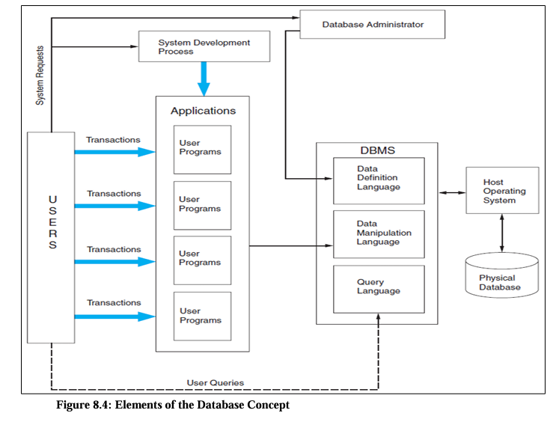

Slide 36
Types of Database Model
Hierarchical database model.
Relational model.
Network model.
Object-oriented database model.
Entity-relationship model.
Document model.
Entity-attribute-value model.
Star schema.

Slide 37
The Relational (REA) Database Model
REA is an accounting framework for modeling an organization’s critical resources, events, and agents (REA) and the relationships between them. Once specified, both accounting and non- accounting data about these phenomena can be identified, captured, and stored in a relational database. From this repository, user views can be constructed that meet the needs of all users in the organization. The availability of multiple views allows flexible use of transaction data and permits the development of accounting information systems that promote, rather than inhibit, integration. The REA model was proposed in 1982 as a theoretical model for accounting.

Slide 38
A system is relational if it:
Represents data in the form of two-dimensional tables such as the database table, called Customer,
Supports the relational algebra functions of restrict, project, and join.

Slide 39
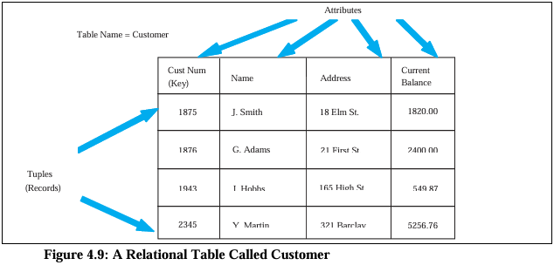

Slide 40
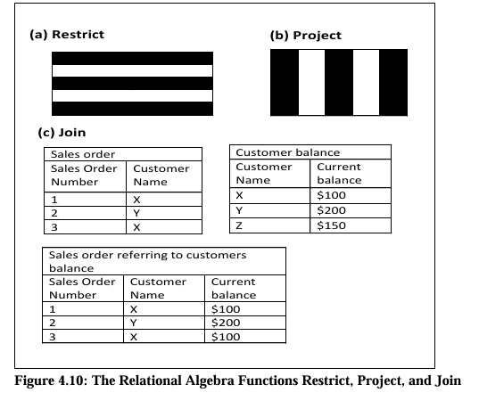

Slide 41
These three algebra functions are examined in the following section.
Restrict: Project: Join:
Although restrict, project, and join is not the complete set of relational functions, it is a useful subset that satisfies most business information needs.

Slide 42
The Elements of REA Database Model
Events
Agents(Entities)
Resources

