Slide 1
Simulation Modeling and Analysis
Dr. Md. Nasim Adnan

Slide 2
The Nature of Simulation
This is a course about techniques for using computers to imitate, or simulate, the operations of various kinds of real-world facilities or processes (in other words, called systems).
A system is defined to be a collection of entities, e.g., people or machines, that interact together toward the accomplishment of some logical end.

Slide 3
System
In practice, what is meant by “the system” depends on the objectives of a particular study. The collection of entities that comprise a system for one study might be only a subset of the overall system for another.
For example, if one wants to study a bank to determine the number of tellers needed to provide adequate service for customers, the system can be defined to be that portion of the bank consisting of the tellers and the customers waiting in line or being served.
If, on the other hand, the loan officer and the safe-deposit boxes are to be included, the definition of the system must be expanded in an obvious way.

Slide 4
System
We define the state of a system to be that collection of variables necessary to describe a system at a particular time, relative to the objectives of a study.
In a study of a bank, examples of possible state variables are the number of busy tellers, the number of customers in the bank, and the time of arrival of each customer in the bank.
We categorize systems to be of two types, discrete and continuous. A discrete system is one for which the state variables change instantaneously at separated points in time.

Slide 5
A bank is an example of a discrete system, since state variables— e.g., the number of customers in the bank—change only when a customer arrives or when a customer finishes being served and departs.
A continuous system is one for which the state variables change continuously with respect to time. An airplane moving through the air is an example of a continuous system, since state variables such as position and velocity can change continuously with respect to time.
Few systems in practice are wholly discrete or wholly continuous…

Slide 6
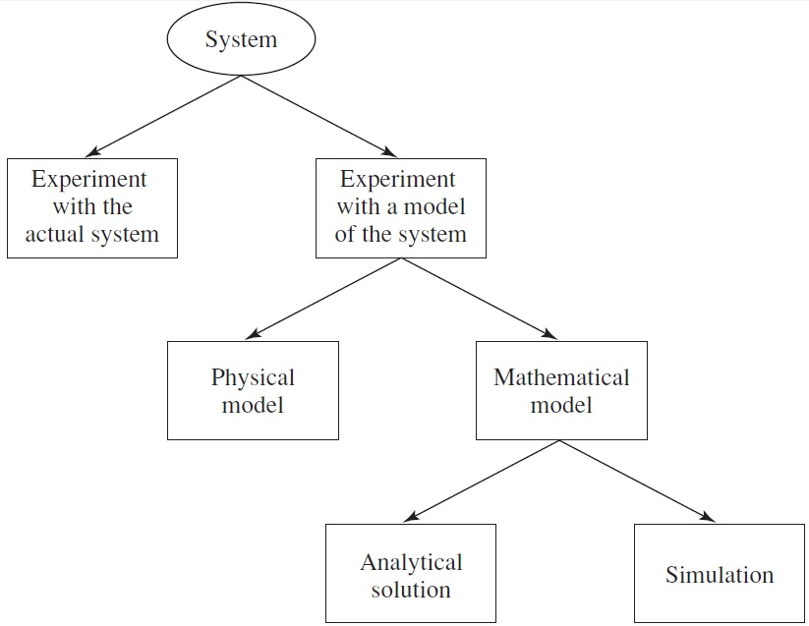
Ways to Study a System

Slide 7
Experiment with the Actual System vs. Experiment with a Model of the System
If it is possible (and cost-effective) to alter the system physically and then let it operate under the new conditions, it is probably desirable to do so, for in this case there is no question about whether what we study is valid.
However, it is rarely feasible to do this, because such an experiment would often be too costly or too disruptive to the system.

Slide 8
For example, a bank may be contemplating reducing the number of tellers to decrease costs, but actually trying this could lead to long customer delays and alienation.
In another way, the “system” might not even exist, but we nevertheless want to study it in its various proposed alternative configurations to see how it should be built in the first place..

Slide 9
Physical Model vs. Mathematical Model
To most people, the word “model” evokes images of clay cars in wind tunnels, cockpits disconnected from their airplanes to be used in pilot training, or miniature supertankers scurrying about in a swimming pool.
More examples include tabletop scale models of material-handling systems, and in at least one case a full-scale physical model of a fast-food restaurant with real (and presumably hungry) humans.

Slide 10
But the vast majority of models built for such purposes are mathematical, representing a system in terms of logical and quantitative relationships.
That system are then manipulated and changed to see how the model reacts, and thus how the system would work in reality.

Slide 11
Analytical Solution vs. Simulation
If the model is simple enough, it may be possible to work with its relationships and quantities to get an exact, mathematical model.
  y = m x + c
However, many systems are highly complex, so that valid mathematical models of them are themselves highly complex, precluding any possibility of an analytical solution.
In this case, the model must be studied by means of simulation, i.e., numerically exercising the model for the inputs in question to see how they affect the performance.

Slide 12
Ways to Study a System

Slide 13
We now classify simulation models along three different dimensions:
Static vs. Dynamic Simulation Models:
  A static simulation model is a representation of a system at a particular time, or one that may be used to represent a system in which time simply plays no role.
  On the other hand, a dynamic simulation model represents a system as it evolves over time, such as a conveyor system in a factory.

Slide 14
Deterministic vs. Stochastic Simulation Models:
  If a simulation model does not contain any probabilistic (i.e., random) components, it is called deterministic…
  In deterministic models, the output is “determined” once the set of input quantities and relationships in the model have been specified.
  Many systems, however, must be modeled as having at least some random input components, and these give rise to stochastic simulation models.
  Most queueing systems are modeled stochastically. Stochastic simulation models produce output that is itself random, and must therefore be treated as only an estimate of the true characteristics of the model.

Slide 15
Continuous vs. Discrete Simulation Models:
It should be mentioned that a discrete model is not always used to model a discrete system, and vice versa.

Slide 16
DISCRETE-EVENT SIMULATION
Discrete-event simulation concerns the modeling of a system as it evolves over time by a representation in which the state variables change instantaneously at separate points in time.
Although discrete-event simulation could conceptually be done by hand calculations, the amount of data that must be stored and manipulated for most real-world systems dictates that discrete-event simulations be done on a digital computer.

Slide 17
Consider a service facility with a single server—e.g., a one-operator barbershop or an information desk at an airport—for which we would like to estimate the (expected) average delay in queue (line) of arriving customers, where the delay in queue is the length of the time interval from his arrival at the facility to he begins being served.
For the objective of estimating the average delay of a customer, the state variables for a discrete-event simulation model of the facility would be the status of the server, i.e., either idle or busy, the number of customers waiting in queue to be served (if any), and the time of arrival of each person waiting in queue.

Slide 18
Components and Organization of a Discrete-Event Simulation Model
System state: The collection of state variables necessary to describe the system at a particular time
Simulation clock: A variable giving the current value of simulated time
Event list: A list containing the next time when each type of event will occur
Statistical counters: Variables used for storing statistical information about system performance
Initialization routine: A subprogram to initialize the simulation model at time 0

Slide 19
Timing routine: A subprogram that determines the next event from the event list and then advances the simulation clock to the time when that event is to occur
Event routine: A subprogram that updates the system state when a particular type of event occurs (there is one event routine for each event type)
Library routines: A set of subprograms used to generate random observations from probability distributions that were determined as part of the simulation model

Slide 20
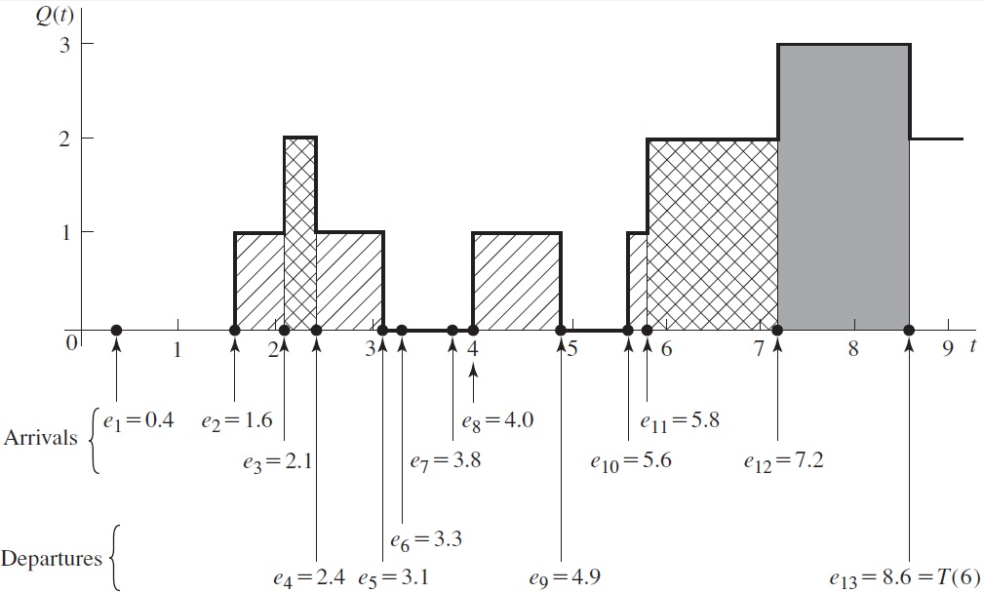

Slide 21
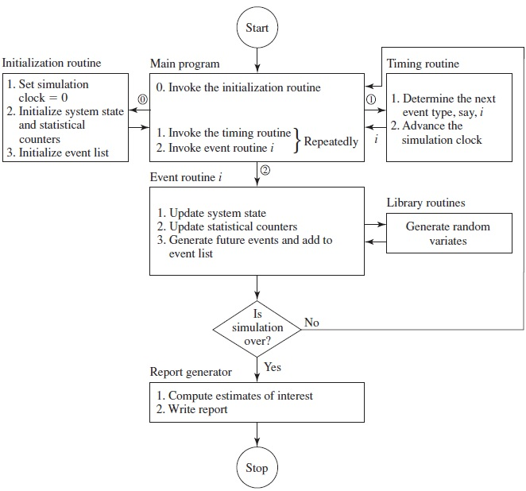

Slide 22
A system is a well-defined collection of entities. Entities are characterized by data values called attributes, and these attributes are part of the system state for a discrete-event simulation model
The server has the attribute “server status” (busy or idle), and the customers waiting in queue have the attribute “time of arrival.” (The number of customers in the queue might also be considered an attribute of the server.)

Slide 23
SIMULATION OF A SINGLE-SERVER QUEUEING SYSTEM
We now show in detail how to simulate a single-server queueing system such as a one-operator barbershop.
Although this system seems very simple compared with those usually of real interest, how it is simulated is actually quite representative of the operation of simulations of great complexity.

Slide 24
Problem Statement
Consider a single-server queueing system (see the next Figure) for which the interarrival times A₁, A₂, . . . are independent and identically distributed (IID) random variables.
“Identically distributed” means that the interarrival times have the same probability distribution.
A customer who arrives and finds the server idle enters service immediately, and the service times S₁, S₂, . . . of the successive customers are IID random variables that are independent of the interarrival times.

Slide 25
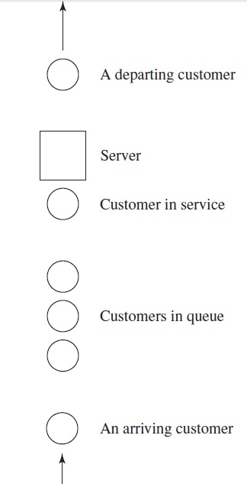

Slide 26
A customer who arrives and finds the server busy joins the end of a single queue. Upon completing service for a customer, the server chooses a customer from the queue (if any) in a first-in, first out (FIFO) manner.
The simulation will begin in the “empty-and-idle” state; i.e., no customers are present and the server is idle.
At time 0, we will begin waiting for the arrival of the first customer, which will occur after the first interarrival time, A_{1,} rather than at time 0 (which would be a possibly valid, but different, modeling assumption).

Slide 27
We wish to simulate this system until a fixed number (n) of customers have completed their delays in queue; i.e., the simulation will stop when the n-th customer enters service.
Note that the time the simulation ends is thus a random variable, depending on the observed values for the interarrival and service-time random variables.

Slide 28
To measure the performance of this system, we will look at estimates of three quantities. First, we will estimate the expected average delay in queue of the n customers completing their delays during the simulation; we denote this quantity by d(n).
The word “expected” in the definition of d(n) means this: on a given run of the simulation, the actual average delay observed of the n customers depends on the interarrival and service-time random variables.

Slide 29
On another run of the simulation (or on a different day for the real system) there would probably be arrivals at different times, and the service times required would also be different; this would give a different value for the average of the n delays. Thus, the average delay on a given run of the simulation is properly regarded as a random variable itself.
From a single run of the simulation resulting in customer delays D₁, D₂, . . . , D_{n}, an obvious estimator of d(n) is:

Slide 30
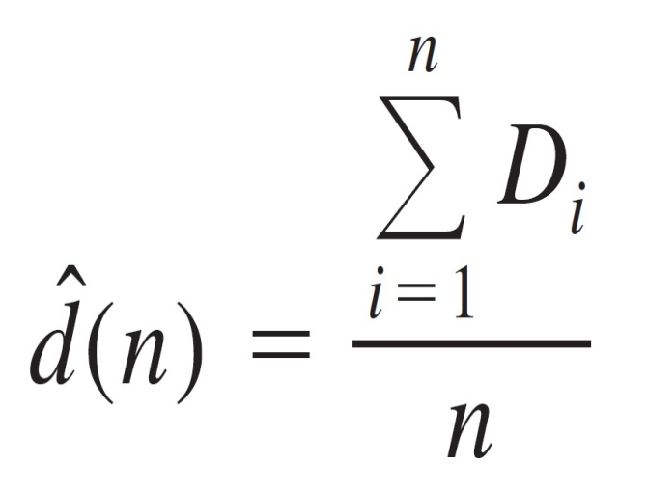
which is just the average of the n D_{i}’s that were observed in the simulation.

Slide 31
While an estimate of d(n) gives information about system performance from the customers’ point of view, the management of such a system may want different information; indeed, since most real simulations are quite complex and may be time-consuming to run, we usually collect many output measures of performance, describing different aspects of system behavior.
One such measure for our simple model here is the expected average number of customers in the queue (but not being served), denoted by q(n)…

Slide 32
This is a different kind of “average” than the average delay in queue, because it is taken over (continuous) time, rather than over customers (being discrete).
Thus, we need to define what is meant by this time-average number of customers in queue.
To do this, let Q(t) denote the number of customers in queue at time t, for any real number t >= 0, and let T(n) be the time required to observe our n delays in queue.

Slide 33
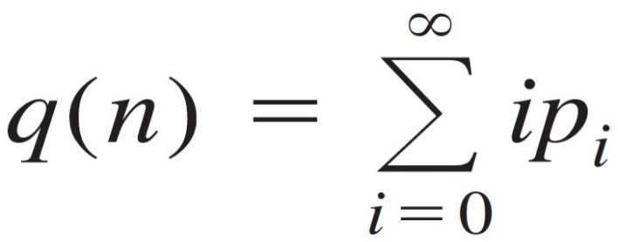
Then for any time t between 0 and T(n), Q(t) is a nonnegative integer. Further, if we let p be the expected proportion (which will be between 0 and 1) of the time that Q(t) is equal to i, then a reasonable definition of q(n) would be:

Slide 34
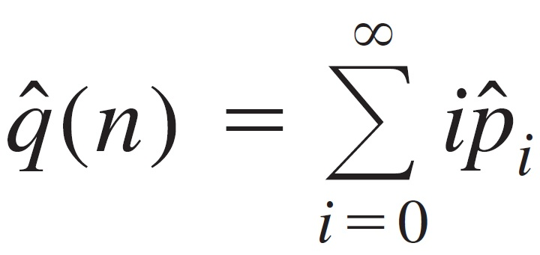
Computationally, however, it is easier to rewrite qˆ(n) using some geometric considerations. If we let T_{i} be the total time during the simulation that the queue is of length i, then T(n) = T₀ + T₁ + T₂ + ∙ ∙ ∙ and pˆi = T_{i}/T(n), so that we can rewrite the above equation as:

Slide 35
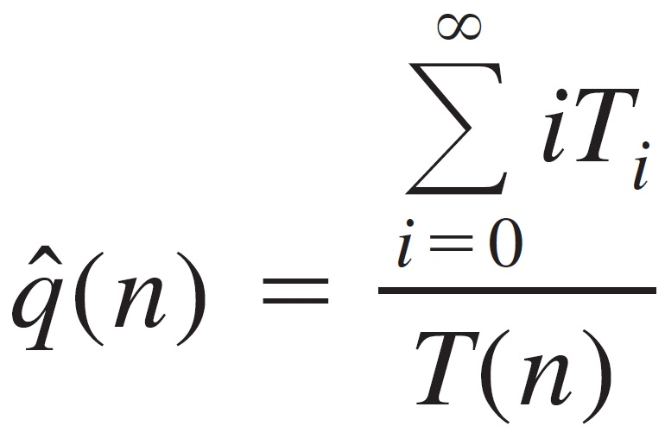
The next figure illustrates a possible time path, or realization, of Q(t) for this system in the case of n = 6.
Arrivals occur at times 0.4, 1.6, 2.1, 3.8, 4.0, 5.6, 5.8, and 7.2. Departures (service completions) occur at times 2.4, 3.1, 3.3, 4.9, and 8.6, and the simulation ends at time T(6) = 8.6.

Slide 37
Remember in looking at the previous figure that Q(t) does not count the customer in service (if any), so between times 0.4 and 1.6 there is one customer in the system being served, even though the queue is empty [Q(t) = 0].
The same is true between times 3.1 and 3.3, between times 3.8 and 4.0, and between times 4.9 and 5.6. Between times 3.3 and 3.8, however, the system is empty of customers and the server is idle, as is obviously the case between times 0 and 0.4.
To compute qˆ(n), we must first compute the T_{i}’s, which can be read off the previous figure as the (sometimes separated) intervals over which Q(t) is equal to 0, 1, 2, and so on:

Slide 38
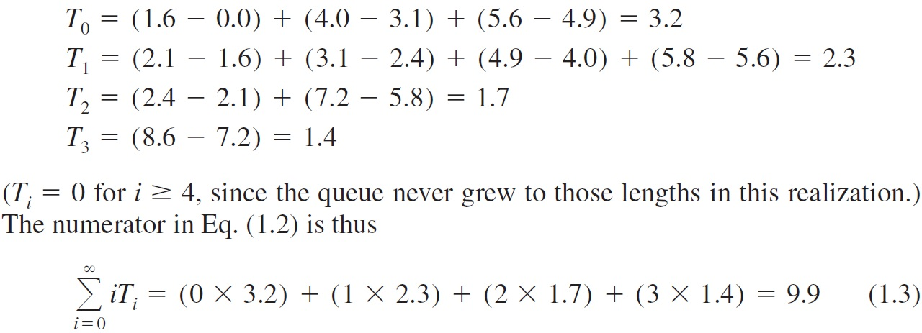
and so our estimate of the time-average number in queue from this particular simulation run is qˆ(6) = 9.9/8.6 = 1.15

Slide 39
SIMULATION OF AN INVENTORY SYSTEM
We shall now see how simulation can be used to compare alternative ordering policies for an inventory system.
Problem Statement:
  A company that sells a single product which is important enough to its customers would like to decide how many items it should have in inventory for each of the next n months (n is a fixed input parameter).
  The times between demands are IID exponential random variables with a mean of 0.1 month.

Slide 40
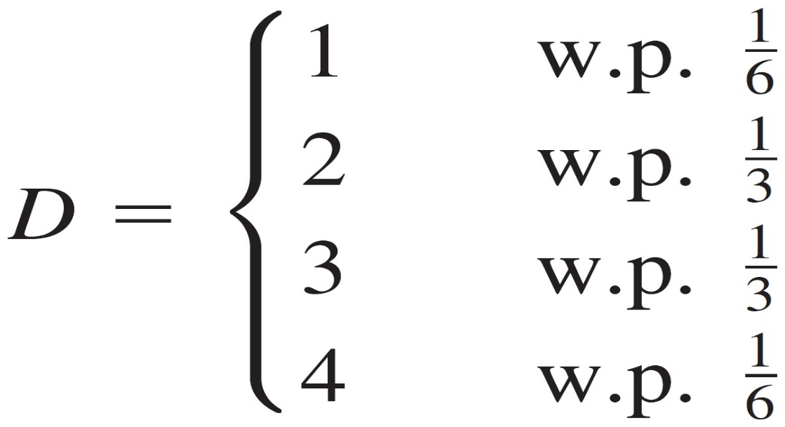
SIMULATION OF AN INVENTORY SYSTEM
Problem Statement:
  The sizes of the demands, D, are IID random variables (independent of when the demands occur), with

Slide 41
SIMULATION OF AN INVENTORY SYSTEM
Problem Statement:
  At the beginning of each month, the company reviews the inventory level and decides how many items to order from its supplier.
  If the company orders Z items, it incurs a cost of K+iZ, where K = $32 is the setup cost and i = $3 is the incremental cost per item ordered (If Z = 0, no cost is incurred).
  When an order is placed, the time required for it to arrive (called the delivery lag or lead time) is a random variable that is distributed uniformly between 0.5 and 1 month.

Slide 42
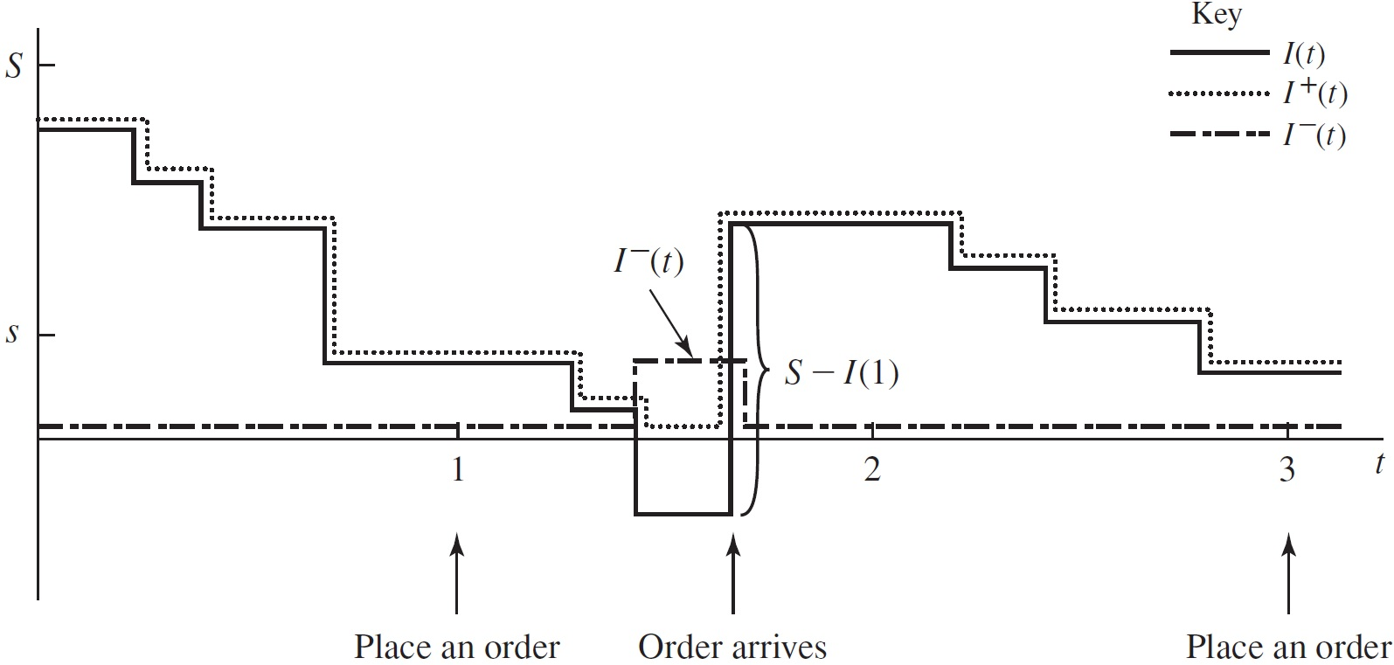
SIMULATION OF AN INVENTORY SYSTEM

Slide 43
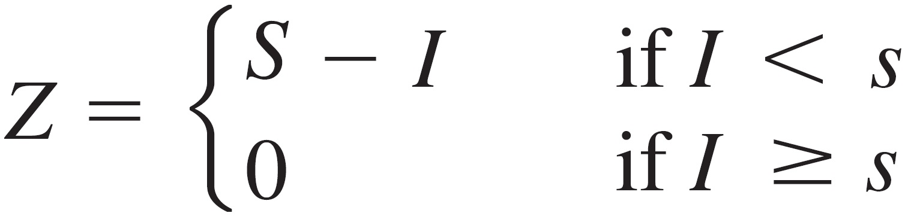
SIMULATION OF AN INVENTORY SYSTEM
The company uses a stationary (s, S) policy to decide how much to order, i.e.,
where I is the inventory level at the beginning of the month

Slide 44
SIMULATION OF AN INVENTORY SYSTEM
When a demand occurs, it is satisfied immediately if the inventory level is at least as large as the demand.
If the demand exceeds the inventory level, the excess of demand over supply is backlogged and satisfied by future deliveries (In this case, the new inventory level is equal to the old inventory level minus the demand size, resulting in a negative inventory level).
When an order arrives, it is first used to eliminate as much of the backlog (if any) as possible; the remainder of the order (if any) is added to the inventory.

Slide 45
SIMULATION OF AN INVENTORY SYSTEM
So far, we have discussed only one type of cost incurred by the inventory system, the ordering cost.
However, most real inventory systems also have two additional types of costs, holding and shortage costs, which we discuss after introducing some additional notation.
Let I(t) be the inventory level at time t [note that I(t) could be positive, negative, or zero]
Let I⁺(t) = max{I(t), 0} be the number of items physically on hand in the inventory at time t [note that I⁺(t) >= 0}]; and let I⁻(t) = max{-I(t), 0} be the backlog at time t [I⁻(t) >= 0 as well].
A possible realization of I(t), I⁺(t), and I⁻(t) is shown in the next figure. The time points at which I(t) decreases are the ones at which demands occur.

Slide 46
SIMULATION OF AN INVENTORY SYSTEM

Slide 47
SIMULATION OF AN INVENTORY SYSTEM
For our model, we shall assume that the company incurs a holding cost of h = $1 per item per month held in (positive) inventory.
The holding cost includes such costs as warehouse rental, insurance, taxes, and maintenance, as well as the opportunity cost of having capital tied up in inventory rather than invested elsewhere.
We have ignored in our formulation the fact that some holding costs are still incurred when I⁺(t) = 0.
However, since our goal is to compare ordering policies, ignoring this factor, which after all is independent of the policy used, will not affect our assessment of which policy is best.

Slide 48
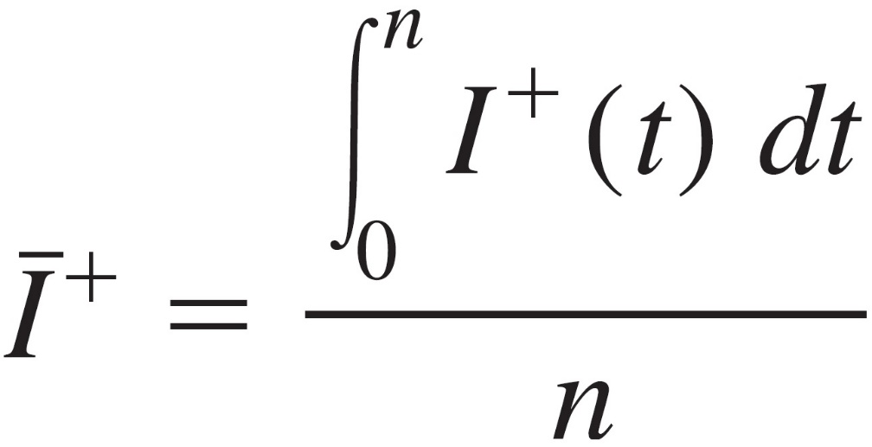
SIMULATION OF AN INVENTORY SYSTEM
Now, since I⁺(t) is the number of items held in inventory at time t, the time-average (per month) number of items held in inventory for the n-month period is:
which is akin to the definition of the time-average number of customers in queue given previously. Thus, the average holding cost per month is hĪ⁺.

Slide 49
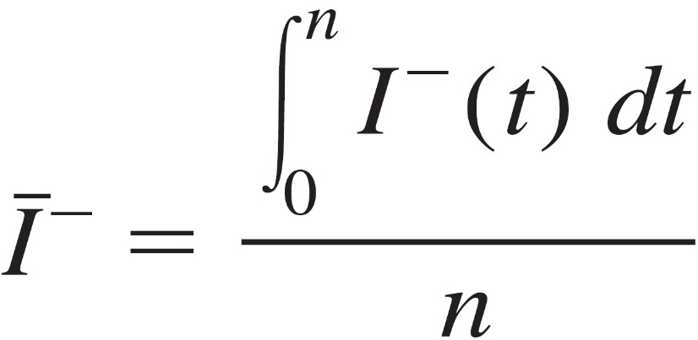
SIMULATION OF AN INVENTORY SYSTEM
Similarly, suppose that the company incurs a backlog cost of π = $5 per item per month in backlog; this accounts for the cost of extra record keeping when a backlog exists, as well as loss of customers’ goodwill. The time-average number of items in backlog is:
so the average backlog cost per month is πĪ⁻.

Slide 50
SIMULATION OF AN INVENTORY SYSTEM
Assume that the initial inventory level is I(0) = 60 and that no order is outstanding.
We simulate the inventory system for n = 120 months and use the average total cost per month (which is the sum of the average ordering cost per month, the average holding cost per month, and the average shortage cost per month) to compare the following nine inventory policies:

Slide 51
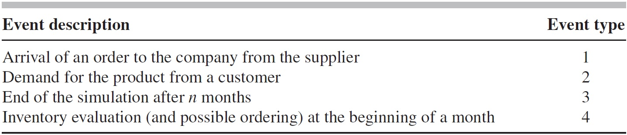
Program Organization and Logic
Our model of the inventory system uses the following types of events:
We have chosen to make the end of the simulation event type 3 rather than type 4, since at time 120 both “end-simulation” and “inventory-evaluation” events will eventually be scheduled and we would like to execute the former event first at this time (Since the simulation is over at time 120, there is no sense in evaluating the inventory and possibly ordering, incurring an ordering cost for an order that will never arrive).

Slide 52
Program Organization and Logic
The execution of event type 3 before event type 4 is guaranteed because the timing routine gives preference to the lowest-numbered event if two or more events are scheduled to occur at the same time.
In general, a simulation model should be designed to process events in an appropriate order when time ties occur.
An event graph appears in the next Figure.

Slide 53
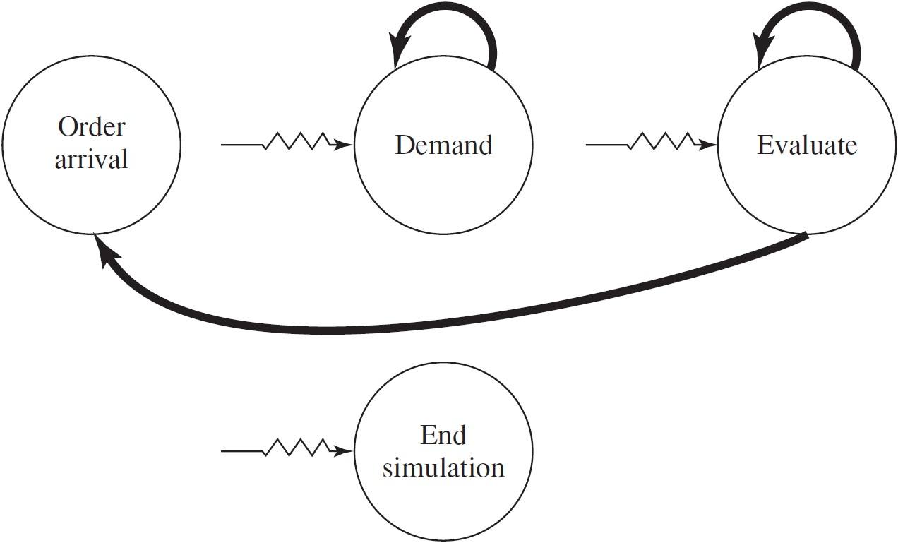
Program Organization and Logic

Slide 54
Program Organization and Logic
There are three types of random variates needed to simulate this system. The interdemand times are distributed exponentially.
The demand-size random variate D must be discrete, as described above, and can be generated as follows.
First divide the unit interval into the contiguous subintervals C1 = [0, 1/6], C2 = [1/6, 1/2], C3 = [1/2, 5/6] and C4 = [5/6, 1], and obtain a U(0, 1) random variate U from the random-number generator.

Slide 55
Program Organization and Logic
If U falls in C1, return D = 1; if U falls in C2, return D = 2; and so on.
Since the width of C1 is 1/6 - 0 = 1/6, and since U is uniformly distributed over [0, 1], the probability that U falls in C1 (and thus that we return D = 1) is 1/6; this agrees with the desired probability that D = 1.
Similarly, we return D = 2 if U falls in C2, having probability equal to the width of C2, 1/2 – 1/6 = 1/3, as desired; and so on for the other intervals.
The subprogram to generate the demand sizes uses this principle and takes as input the cutoff points defining the above subintervals, which are the cumulative probabilities of the distribution of D.

Slide 56
Program Organization and Logic
We now describe the logic for event types 1, 2, and 4, which actually involve state changes.
The order-arrival event is flowcharted in the next figure, and must make the changes necessary when an order (which was previously placed) arrives from the supplier.
The inventory level is increased by the amount of the order, and the order-arrival event must be eliminated from consideration.
A flowchart for the demand event is also given in the next figure, and processes the changes necessary to represent a demand’s occurrence.

Slide 57
Program Organization and Logic
First, the demand size is generated, and the inventory is decremented by this amount.
Finally, the time of the next demand is scheduled into the event list. Note that this is the place where the inventory level might become negative.

Slide 58
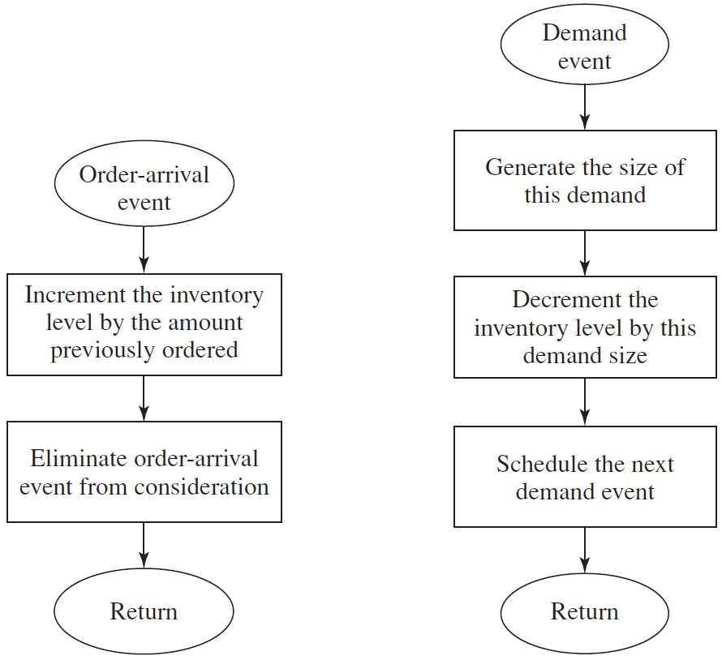
Program Organization and Logic

Slide 59
Program Organization and Logic
The inventory-evaluation event, which takes place at the beginning of each month, is flowcharted in the next figure.
If the inventory level I(t) at the time of the evaluation is at least s, then no order is placed, and nothing is done except to schedule the next evaluation into the event list.
On the other hand, if I(t) < s, we want to place an order for S - I(t) items.
This is done by storing the amount of the order [S - I(t)] until the order arrives, and scheduling its arrival time.
In this case as well, we want to schedule the next inventory-evaluation event.

Slide 60
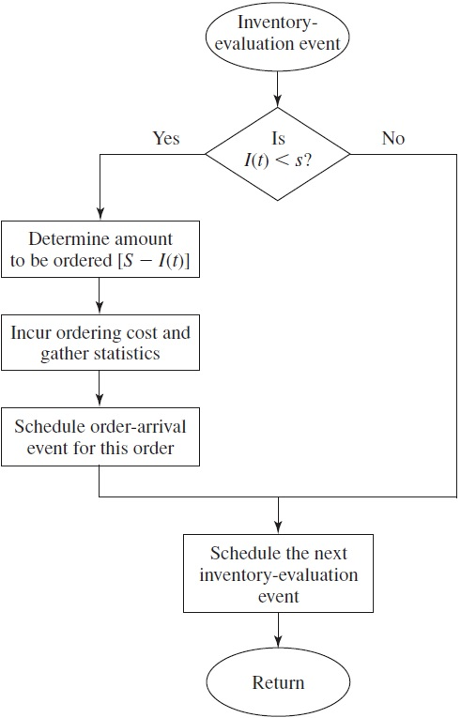

Slide 61
Program Organization and Logic
It is convenient to write a separate nonevent routine to update the continuous-time statistical accumulators which is flowcharted in the next figure.
The principal issue is whether we need to update the area under I⁻(t) or I⁺(t) (or neither).
If the inventory level since the last event has been negative, then we have been in backlog, so the area under I⁻(t) only should be updated. On the other hand, if the inventory level has been positive, we need only update the area under I⁺(t).
If the inventory level has been zero (a possibility), then neither update is needed.
The code for this routine also brings the variable for the time of the last event up to the present time. This routine will be invoked from the main program just after returning from the timing routine, regardless of the event type or whether the inventory level is actually changing at this point.
This provides a simple (if not the most computationally efficient) way of updating integrals for continuous-time statistics.

Slide 62
