Slide 1
Simulation Modeling and Analysis
Dr. Md. Nasim Adnan

Slide 2
Random Variables and their Properties
An experiment is a process whose outcome is not known with certainty. The set of all possible outcomes of an experiment is called the sample space and is denoted by S.
The outcomes themselves are called the sample points in the sample space.
If the experiment consists of flipping a coin, then S = {H, T}
  where the symbol { } means the “set consisting of,” and “H” and “T” mean that the outcome is a head and a tail, respectively.

Slide 3
If the experiment consists of tossing a die, then S = {1, 2, . . . , 6}
  where the outcome i means that i appeared on the die, i = 1, 2, . . . , 6.
  A random variable is a function (or rule) that assigns a real number (any number greater than -ꚙ and less than ꚙ) to each point in the sample space S.

Slide 4
In general, we denote random variables by capital letters such as X, Y, Z and the values that random variables take on by lowercase letters such as x, y, z.
The distribution function (sometimes called the cumulative distribution function) F(x) of the random variable X is defined for each real number x as follows:
F(x) = P(X <= x) for -ꚙ < x < ꚙ

Slide 5
where P(X <= x) means the probability associated with the event {X <= x}.
Thus, F(x) is the probability that, when the experiment is done, the random variable X will take on a value no larger than the number x.

Slide 6
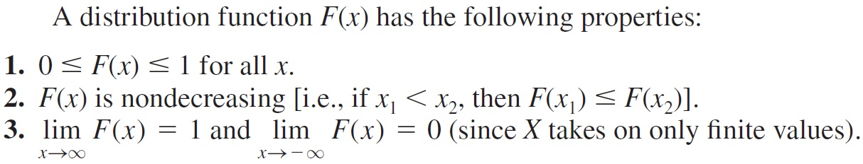

Slide 7
A random variable X is said to be discrete if it can take on at most a countable number of values, say, x1, x2, . . . An example of an uncountable set is all real numbers between 0 and 1.)
Thus, a random variable that takes on only a finite number of values x1, x2, . . . , xn is discrete. The probability that the discrete random variable X takes on the value xi is given by:
p(xi) = P(X = xi) for i = 1, 2, . . .

Slide 8
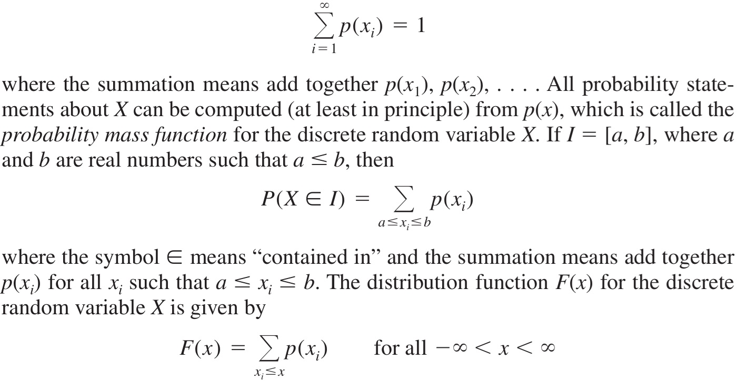
and we must have

Slide 9
For the inventory example, the size of the demand for the product is a discrete random variable X that takes on the values 1, 2, 3, 4 with respective probabilities 1/6, 1/3, 1/3, 1/6.
The probability mass function and the distribution function for X are given in the following figures.

Slide 10
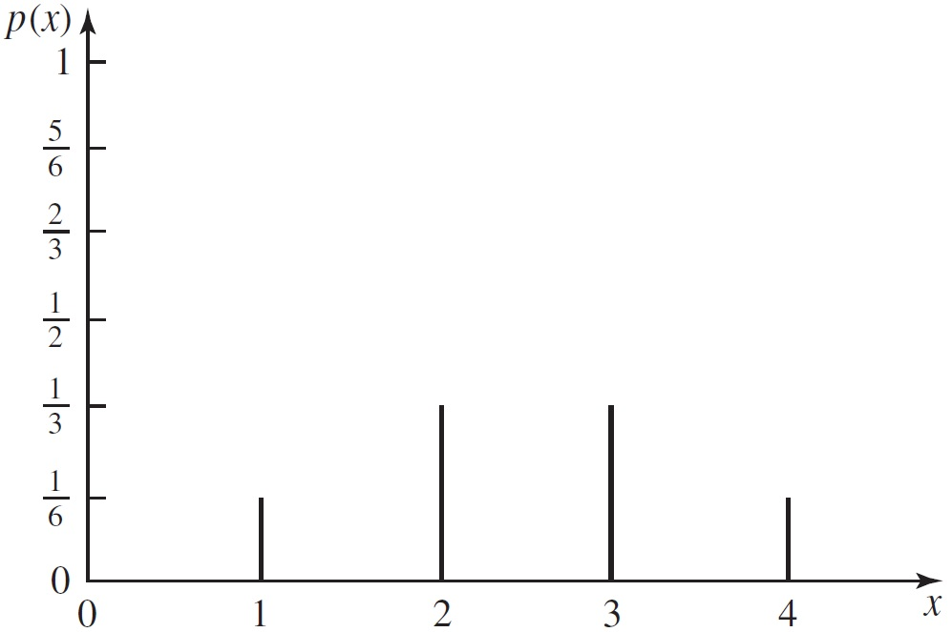

Slide 11
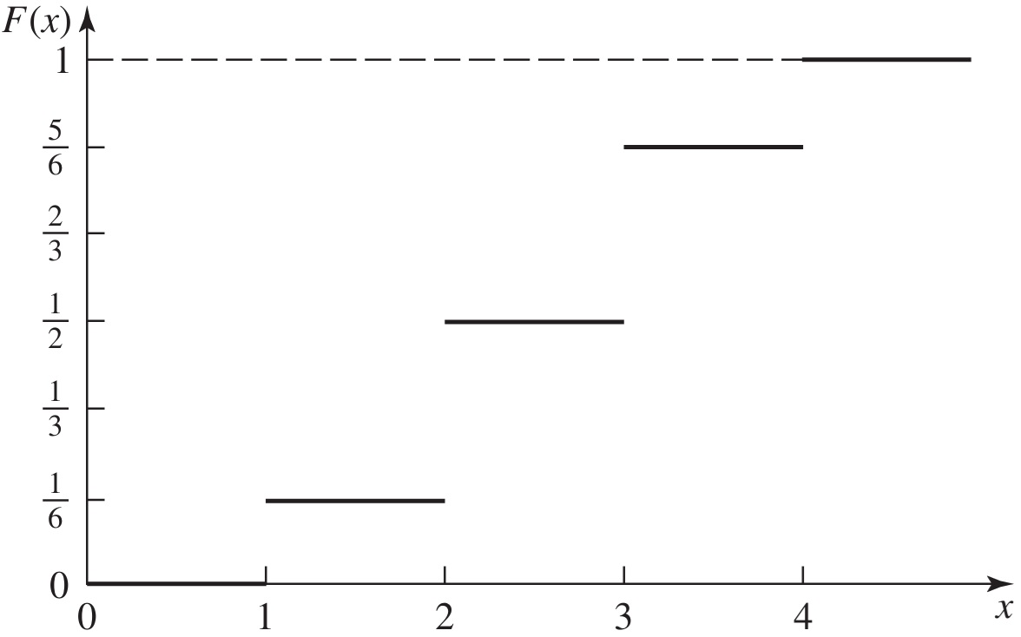

Slide 12
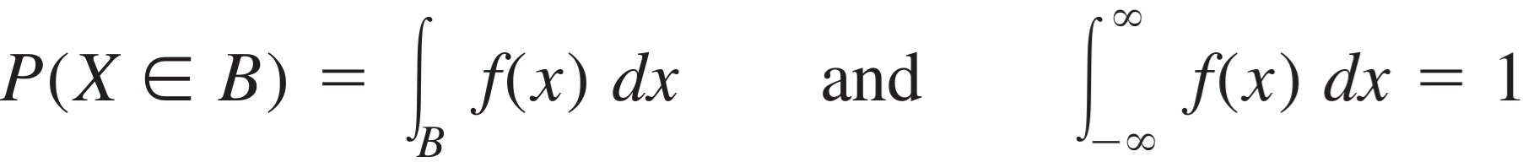
We now consider random variables that can take on an uncountably infinite number of different values (e.g., all nonnegative real numbers).
A random variable X is said to be continuous if there exists a nonnegative function f(x) such that for any set of real numbers B:

Slide 13
Thus, the total area under f(x) is 1.
Also, if X is a nonnegative random variable, as is often the case in simulation applications, the second range of integration is from 0 to ꝏ.
All probability statements about X can (in principle) be computed from f(x), which is called the probability density function for the continuous random variable X.

Slide 14
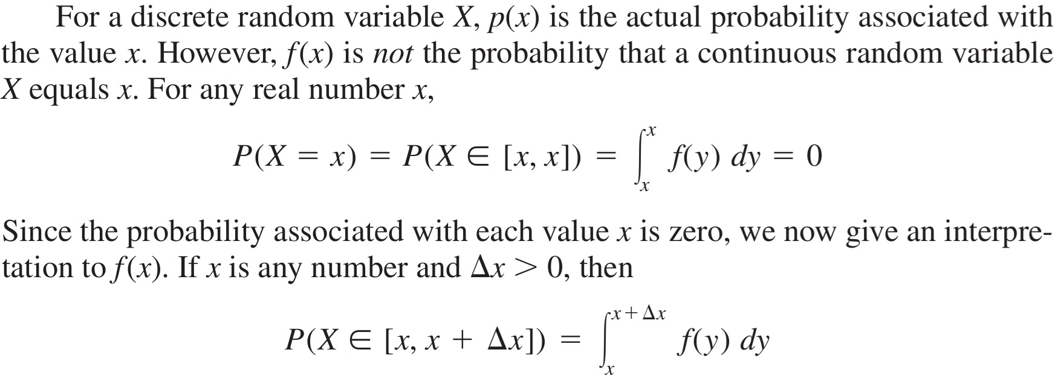

Slide 15
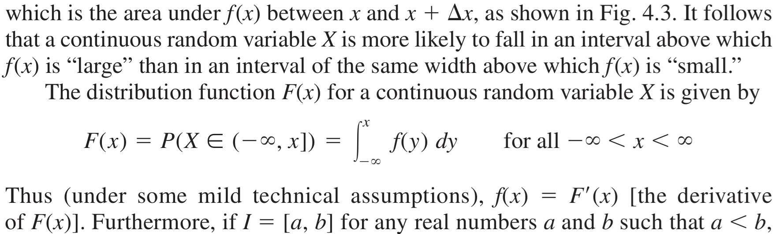
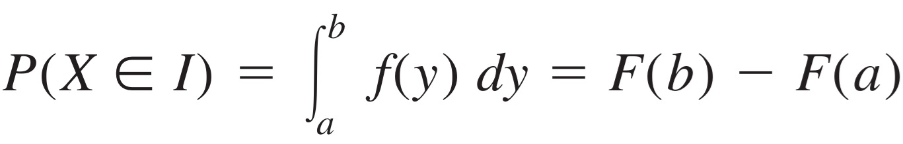

Slide 16
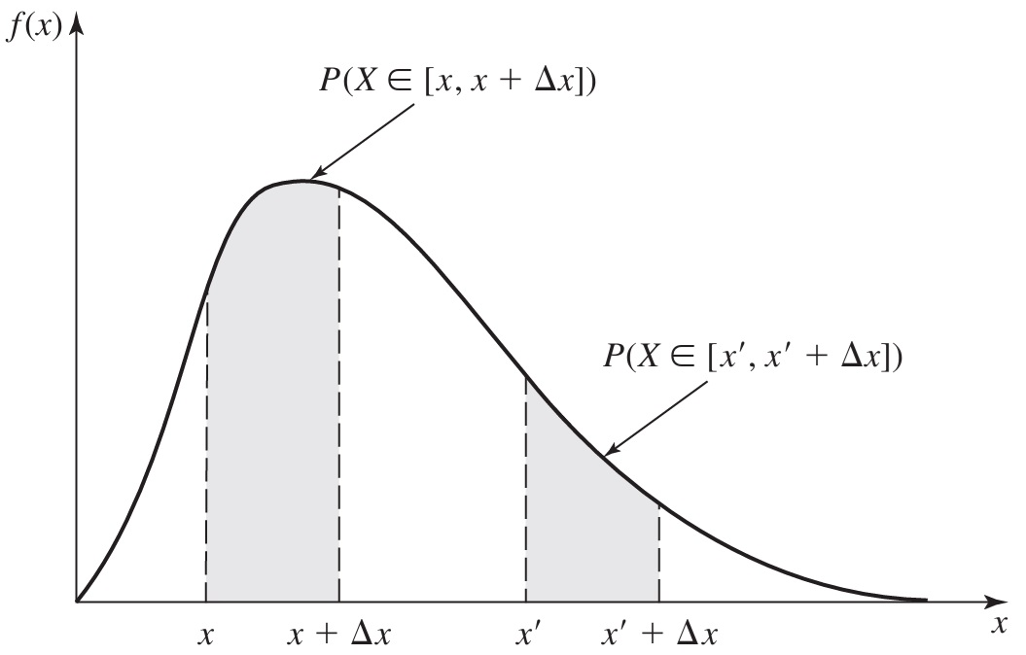

Slide 17
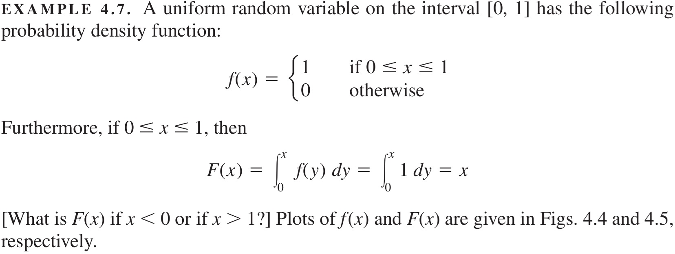

Slide 18
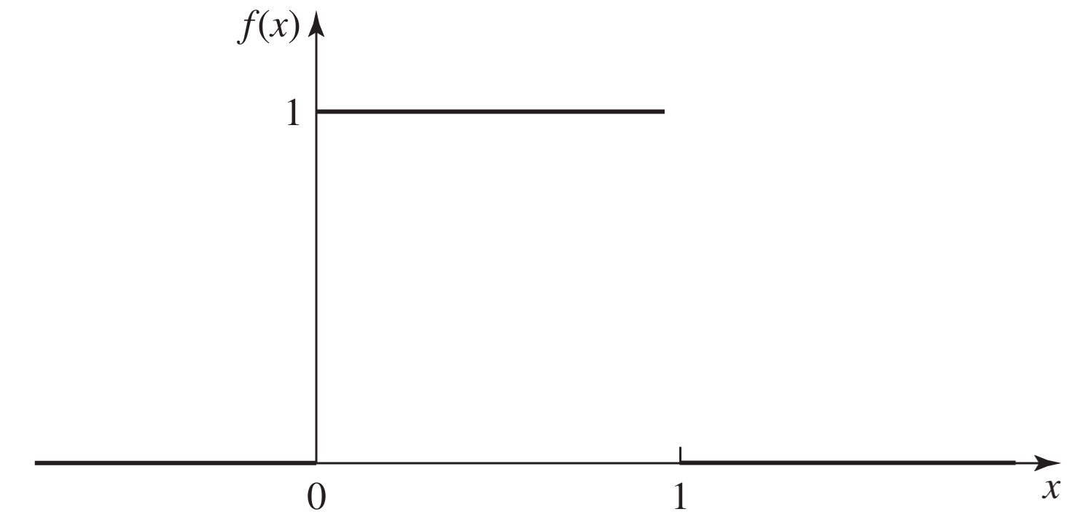

Slide 19
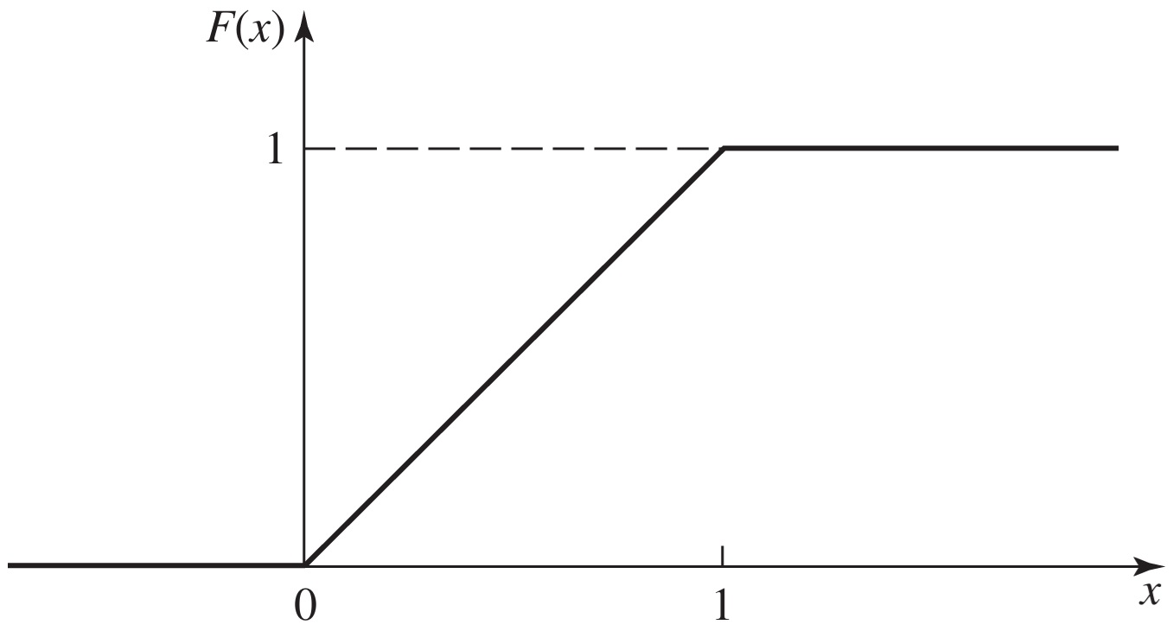

Slide 20
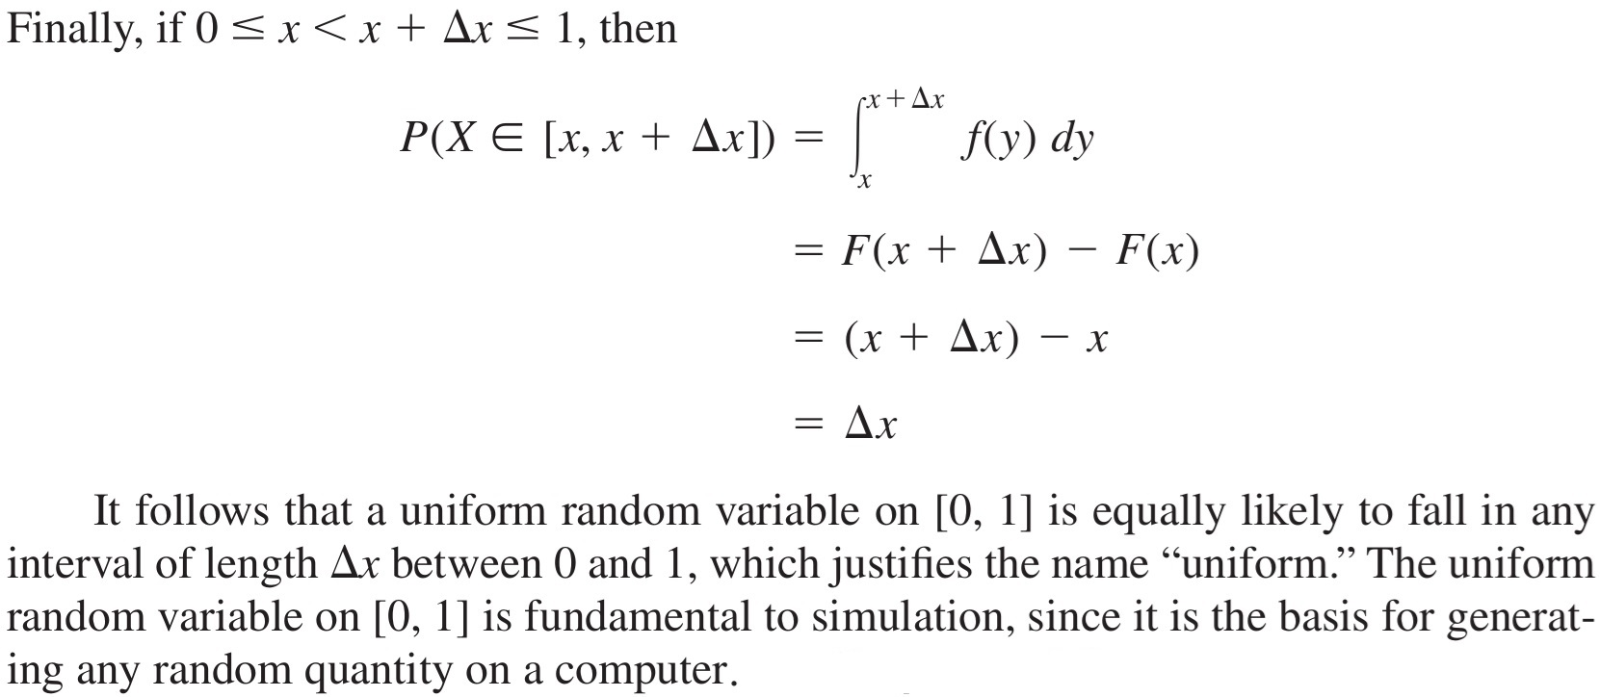

Slide 21
Random-Number Generators
A simulation of any system or process in which there are inherently random components (Single-Server Queueing System) requires a method of generating or obtaining numbers that are random.
We now study some methods of generating random numbers from the uniform distribution on the interval [0, 1]; this distribution is denoted by U(0, 1).
We agree that arithmetic generators, if designed carefully, can produce numbers that appear to be independent draws from the U(0, 1) distribution, in that they pass a series of statistical tests.

Slide 22
A “good” arithmetic random-number generator should possess several properties:
  Above all, the numbers produced should appear to be distributed uniformly on [0, 1] and should not exhibit any correlation with each other; otherwise, the simulation’s results may be completely invalid.
  From a practical standpoint, we would naturally like the generator to be fast and avoid the need for a lot of storage.
  We would like to be able to reproduce a given stream of random numbers exactly, for at least two reasons.
    First, this can sometimes make debugging or verification of the computer program easier.

Slide 23
    More importantly, we might want to use identical random numbers in simulating different systems in order to obtain a more precise comparison.
  There should be provision in the generator for easily producing separate “streams” of random numbers. We can think of the different streams as being separate and independent generators.
We would like the generator to be portable, i.e., to produce the same sequence of random numbers for all standard compilers and computers.

Slide 24
LINEAR CONGRUENTIAL GENERATORS
Many random-number generators in use today are linear congruential generators (LCGs), introduced by Lehmer (1951).
A sequence of integers Z₁, Z₂, . . . is defined by the recursive formula
Z_{i} = (aZ_{i-1}+c)(mod m)
where m (the modulus), a (the multiplier), c (the increment), and Z₀ (the seed) are nonnegative integers.

Slide 25
Therefore, 0 <= Z_{i} <= m - 1, and to obtain the desired random numbers U_{i} (for i = 1, 2, . . . ) in [0, 1], we let U_{i} = Z_{i}/m.
We shall concentrate our attention for the most part on the Z_{i}’s, although the precise nature of the division of Zi by m should be paid attention to due to differences in the way various computers and compilers handle floating-point arithmetic.
In addition to non-negativity, the integers m, a, c, and Z₀ should satisfy 0 < m, a < m, c < m, and Z₀ < m.

Slide 26
In fact, one can show by mathematical induction that that every Z_{i} is completely determined by m, a, c, and Z₀.
However, by careful choice of these four parameters we try to induce behavior in the Z_{i}’s that makes the corresponding Ui’s appear to be independent and identically distributed IID U(0, 1) random variables when subjected to a variety of tests.

Slide 27
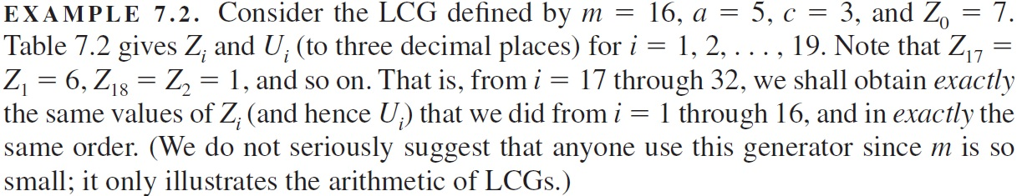
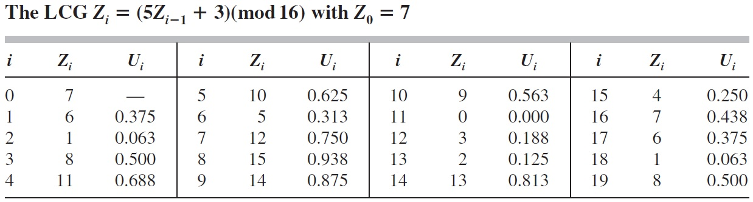

Slide 28
One objection to LCGs might be that the Ui’s can take on only the rational values 0, 1/m, 2/m, . . . , (m-1)/m; in fact, the Ui’s might actually take on (only a fraction of) these values, depending on the specification of the constants m, a, c, and Z₀, as well as on the nature of the floating-point division by m.
Thus there is no possibility of getting a value of U_{i} between, say, 0.1/m and 0.9/m, whereas this should occur with probability 0.8/m>0.
As we shall see, the modulus m is usually chosen to be very large, say 10⁹ or more, so that the points in [0, 1] where the U_{i}’s can fall are very dense; for m >= 10⁹, there are at least a billion possible values.

Slide 29
Even full-period LCGs, however, can exhibit nonuniform behavior in segments within a cycle.
For example, if we generate only m/2 consecutive Zi’s, they may leave large gaps in the sequence 0, 1, . . . , m - 1 of possible values.
Thus, it is useful to know how to choose m, a, and c so that the corresponding LCG will have full period.
The following theorem, proved by Hull and Dobell (1962), gives such a characterization:

Slide 30
The LCG defined previously has full period if and only if the following three conditions hold:
(a) The only positive integer that (exactly) divides both m and c is 1.
(b) If q is a prime number (divisible by only itself and 1) that divides m, then q divides a - 1.
(c) If 4 divides m, then 4 divides a - 1.

Slide 31
Obtaining a full (or at least a long) period is just one desirable property for a good LCG.
We also want good statistical properties (such as apparent independence), computational and storage efficiency, reproducibility, facilities for separate streams, and portability.
Reproducibility is simple, for we must only remember the initial seed used, Z₀, and initiate the generator with this value again to obtain the same sequence of U_{i}’s exactly.
Also, we can easily resume generating the Z_{i}’s at any point in the sequence by saving the final Z_{i} obtained previously and using it as the new seed; this is a common way to obtain nonoverlapping, “independent” sequences of random numbers.

Slide 32
LINEAR CONGRUENTIAL GENERATORS
Many random-number generators in use today are linear congruential generators (LCGs), introduced by Lehmer (1951).
A sequence of integers Z₁, Z₂, . . . is defined by the recursive formula
Z_{i} = (aZ_{i-1}+c)(mod m)
where m (the modulus), a (the multiplier), c (the increment), and Z₀ (the seed) are nonnegative integers.

Slide 34
The “looping” behavior of the LCG in the previous figure is inevitable. By the definition (Z_{i} = (aZ_{i-1}+c)(mod m)), whenever Z_{i} takes on a value it has had previously, exactly the same sequence of values is generated, and this cycle repeats itself endlessly.
The length of a cycle is called the period of a generator. For LCGs, Z_{i} depends only on the previous integer Z_{i-1}, and since 0 <= Zi <= m - 1, it is clear that the period is at most m; if it is in fact m, the LCG is said to have full period.
Clearly, if a generator is full-period, any choice of the initial seed Z₀ from {0, 1, . . . , m - 1} will produce the entire cycle in some order.

Slide 36
Streams are typically set up in a LCG by simply specifying the initial seed for each stream.
For example, if we want streams of length 1,000,000 each, we set Z₀ for the first stream to some value, then use Z_{1,000,000} as the seed for the second stream, Z_{2,000,000} as the seed for the third stream, and so on.
Because of condition (a) in the previously demonstrated Theorem, LCGs tend to behave differently for c > 0 (called mixed LCGs) than for c = 0 (called multiplicative LCGs).

Slide 37
The LCG defined previously has full period if and only if the following three conditions hold:
(a) The only positive integer that (exactly) divides both m and c is 1.
(b) If q is a prime number (divisible by only itself and 1) that divides m, then q divides a - 1.
(c) If 4 divides m, then 4 divides a - 1.

Slide 38
Mixed Generators
For c > 0, condition (a) in the Theorem is possible, so we might be able to obtain full period m.
For a large period and high density of the Ui’s on [0, 1], we want m to be large.
Furthermore, in the early days of computer simulation when computers were relatively slow, dividing by m to obtain the remainder was a relatively slow arithmetic operation, and it was desirable to avoid having to do this division explicitly…

Slide 39
Multiplicative Generators
Multiplicative LCGs are advantageous in that the addition of c is not needed, but they cannot have full period since condition (a) of the aforementioned Theorem cannot be satisfied.
As we shall see, however, it is possible to obtain period m - 1 if m and a are chosen carefully.
It’s still computationally efficient to choose m = 2^{b} and thus avoid explicit division.
However, it can be shown that in this case the period is at most 2^{b-2}, that is, only one-fourth of the integers 0 through m - 1 can be obtained as values for the Zi’s.

Slide 40
OTHER KINDS OF GENERATORS
Although LCGs are probably the most widely used and best understood kind of random-number generator, there are many alternative types.
Most of these other generators have been developed in an attempt to obtain longer periods and better statistical properties.

Slide 41
More General Congruences
LCGs can be thought of as a special case of generators defined by:
  Zi = g(Zi-1, Zi-2, . . .)(mod m)
where g is a fixed deterministic function of previous Zj’s. As with LCGs, the Zi’s defined by the aforementioned Equation lie between 0 and m - 1, and the U(0, 1) random numbers are given by Ui = Zi/m.

Slide 42
One obvious generalization of LCGs would be to let g(Zi-1, Zi-2, . . .) = a’Z²i-1 + aZi-1 + c, which produces a quadratic congruential generator.
A special case that has received some attention is when a’ = a = 1, c = 0, and m is a power of 2, has better statistical properties.
Since Zi still depends only on Zi-1 (and not on earlier Zj’s), and since 0 <= Zi <= m - 1, the period of quadratic congruential generators is at most m, as for LCGs.

Slide 43
A different choice of the function g is to maintain linearity but to use earlier Zj’s; this gives rise to generators called multiple recursive generators (MRGs) and defined by
  g(Zi-1, Zi-2, . . .) = a1Zi-1 + a2Zi-2 + . . . + aq Zi-q
where a1, a2, . . . , aq are constants.
A period as large as m^{q} - 1 then becomes possible if the parameters are chosen properly.
L’Ecuyer, Blouin, and Couture (1993) investigated such generators and identified several specific generators of this type that perform well, and give portable implementations.

Slide 44
Composite Generators
Several researchers have developed methods that take two or more separate generators and combine them in some way to generate the final random numbers.
It is hoped that this composite generator will exhibit a longer period and better statistical behavior than any of the simple generators composing it.
The disadvantage in using a composite generator is, of course, that the cost of obtaining each Ui is more than that of using one of the simple generators alone.

Slide 45
Perhaps the earliest kind of composite generators used a second LCG to shuffle the output from the first LCG.
Initially, a vector V = (V1, V2, . . . , Vk) is filled sequentially with the first k Ui’s from the first LCG (k = 128 was originally suggested).
Then the second LCG is used to generate a random integer i distributed uniformly on the integers 1, 2, . . . , k, and Vi is returned as the first U(0, 1) variate; the first LCG then replaces this ith location in V with its next Ui s onward, and the second LCG randomly chooses the next returned random number from this updated V…
Shuffling has a natural intuitive appeal, especially since we would expect it to break up any correlation and greatly extend the period.

Slide 46
Despite these apparent advantages of rearranging a simple generator’s output in some way, there is not as much known about shuffled generators; for example, one cannot jump into an arbitrary point of a shuffled generator’s output sequence without generating all the intermediate values, whereas this is possible for LCGs.

Slide 47
Another way to combine two generators (in simplified form) is to let {Z₁i} and {Z₂i} denote the integer sequences generated by two different LCGs with different moduli, then let Zi = (Z₁i - Z₂i)(mod m) for some integer m, and finally set Ui = Zi/m.
This idea could clearly be extended to more than two generators, and has several advantages; the period is very long (at least 10¹⁸ in one example), the multipliers in each of the component generators can be small (thus promoting portability and usability on virtually any computer), the resulting generator is quite fast, and the statistical properties of these generators also appear to be very good.

Slide 48
One very appealing class of generators is obtained by combining multiple recursive generators (MRGs) in a particular way.
Here, J different MRGs are implemented simultaneously to form the sequences {Z₁,i}, {Z₂,i}, . . . , {Z_{J},i}.
Letting m1 be the modulus used in the first of these MRGs, and letting d1, d2, . . . , dJ be specified constants, we define
  Yi = (d1Z₁,i + d2Z₂,i + . . . + dJZ_{J},i)(mod m1)
and finally return Ui = Yi/m1 as the ith random number for use in the simulation.

Slide 49
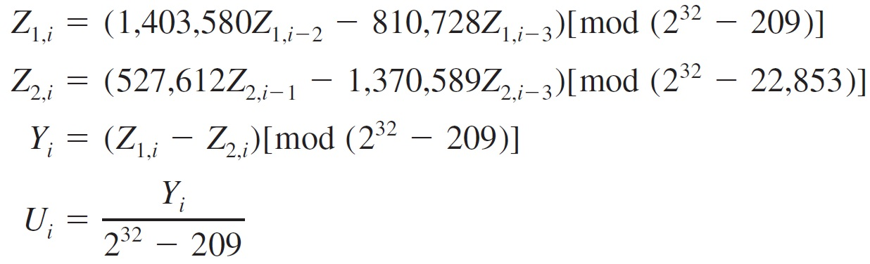
Although the parameters for these kinds of generators must be chosen very carefully, extremely long periods and exceptionally good statistical properties are possible.
L’Ecuyer (1999) carried out an extensive search for good parameter settings and the simplest of them, where J = 2 MRGs are combined, has a period of approximately 2¹⁹¹ as well as excellent statistical properties.

Slide 50
Feedback Shift Register Generators

