Slide 1
Simulation Modeling and Analysis
Dr. Md. Nasim Adnan

Slide 2
Introduction
To carry out a simulation using random inputs such as interarrival times or demand sizes, we have to specify their probability distributions.
For example, in the simulation of the single-server queueing system, the interarrival times can be taken to be IID exponential random variables with a mean of 1 minute; the demand sizes in the inventory simulation were specified to be 1, 2, 3, or 4 items with respective probabilities 1/6, 1/3, 1/3, and 1/6.
Given that the input random variables to a simulation model follow particular distributions, the simulation proceeds through time by generating random values from those particular distributions.

Slide 3
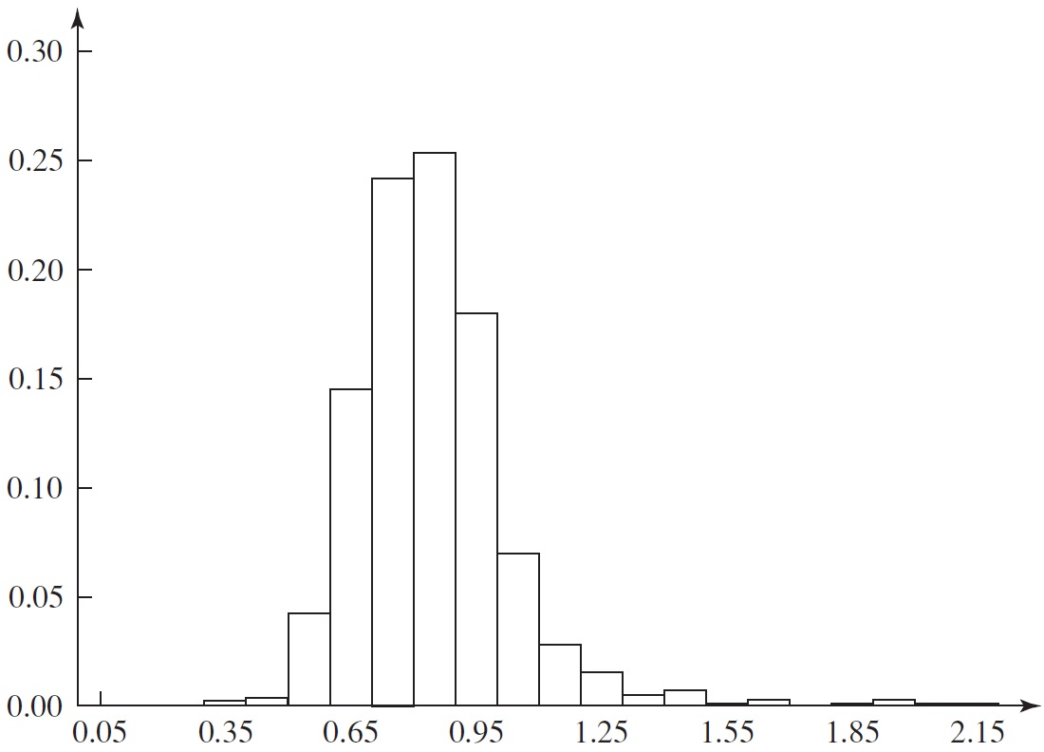
A histogram for 856 ship-loading times (in days)

Slide 4
USEFUL PROBABILITY DISTRIBUTIONS
The purpose of this study is to discuss a variety of distributions that have been found to be useful in simulation modeling.
  Continuous distributions
  Discrete distributions

Slide 5
Continuous Distributions: Uniform

Slide 6
Continuous Distributions: Exponential

Slide 7
Discrete Distributions: Bernoulli

