Slide 1

Cyber Security & Digital Forensics CSE - 4207
Lecture - 01
Dr. Md. Alam Hossain
Professor
Jashore University of Science & Technology

Slide 2

Outline
The Security Mindset
Meet the Adversary
Security and Standards Organizations
Key Security Concepts
Levels of Impact
Computer Security Challenges
Aspects of Security
Passive Attacks
Active Attacks
Model for Network Security
Model for Network Access Security

Slide 3
The Security Mindset
“Security requires a particular mindset. Security professionals --at least the good ones --see the world differently. They can't walk into a store without noticing how they might shoplift. They can't use a computer without wondering about the security vulnerabilities. They can't vote without trying to figure out how to vote twice. They just can't help it.”
— Bruce Schneier

Slide 4

Meet the Adversary
“Computer security studies how systems behave in the presence of an adversary.”
The adversary - the attacker/ the bad guy
An intelligence that actively tries to cause the system to misbehave.

Slide 5
Know Your Enemy
The art of war teaches us to rely not on the likelihood of the enemy's not coming, but on our own readiness to receive him; not on the chance of his not attacking, but rather on the fact that we have made our position unassailable.
—The Art of War, Sun Tzu

Slide 6
Thinking Like an Attacker
Look for weakest links –easiest to attack.
  Identify assumptions that security depends on.
Are they false?
  Think outside the box: Not constrained by system designer’s worldview.

Slide 7
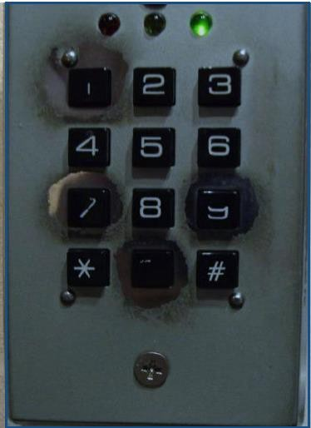
Find the Code

Slide 8

What are some security systems you interact with in everyday life?

Slide 9
Security and Standards Organizations
National Institute of Standards & Technology (NIST)
Internet Society (ISOC)
International Telecommunication Union Telecommunication Standardization Sector (ITU-T)
International Organization for Standardization (ISO)

Slide 10
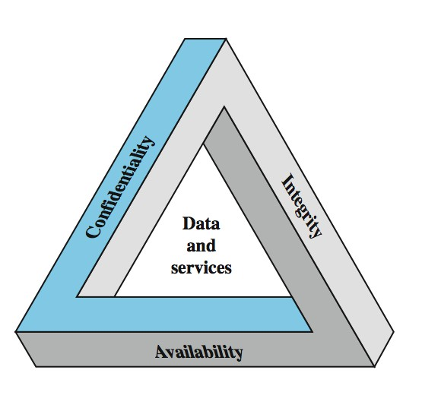
Key Security Concepts

Slide 11
Levels of Impact
Can define 3 levels of impact from a security breach
  Low
  Moderate
  High

Slide 12
Examples of Security Requirements
Confidentiality – student grades
Integrity – patient information
Availability – authentication service

Slide 13
Computer Security Challenges
not simple
must consider potential attacks
procedures used counter-intuitive
involve algorithms and secret info
must decide where to deploy mechanisms
battle of wits between attacker / admin
not perceived on benefit until fails
requires regular monitoring
too often an after-thought
regarded as impediment to using system

Slide 14
Aspects of Security
consider 3 aspects of information security:
  security attack
  security mechanism
  security service
note terms
  threat –a potential for violation of security
  attack –an assault on system security, a deliberate attempt to evade security services

Slide 15
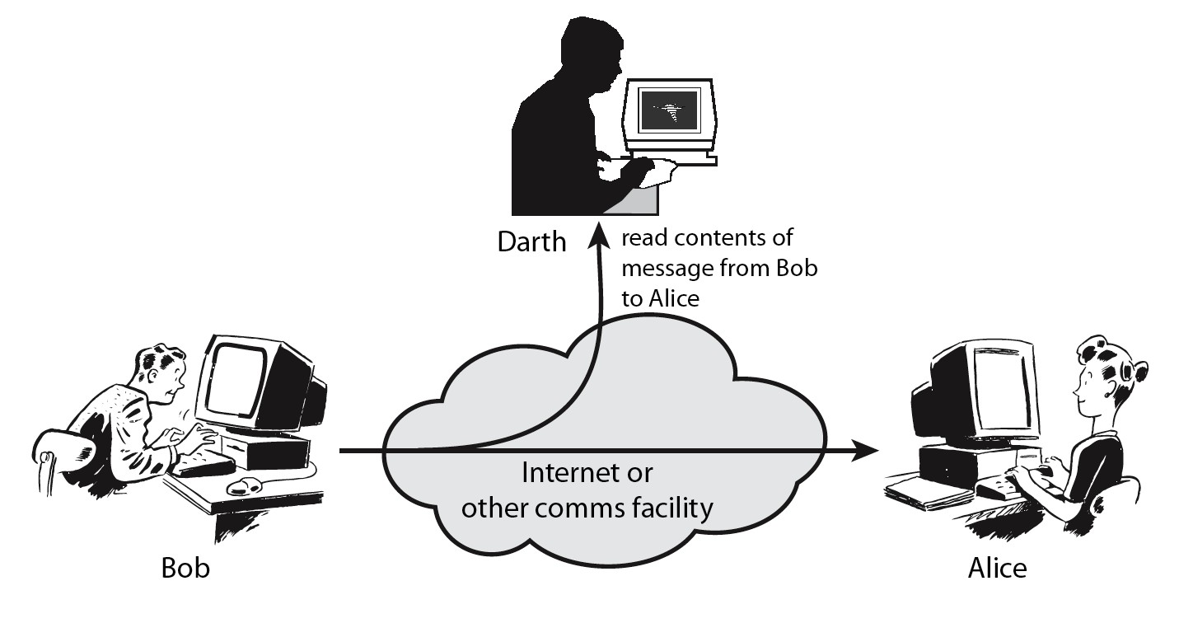
Passive Attacks

Slide 16
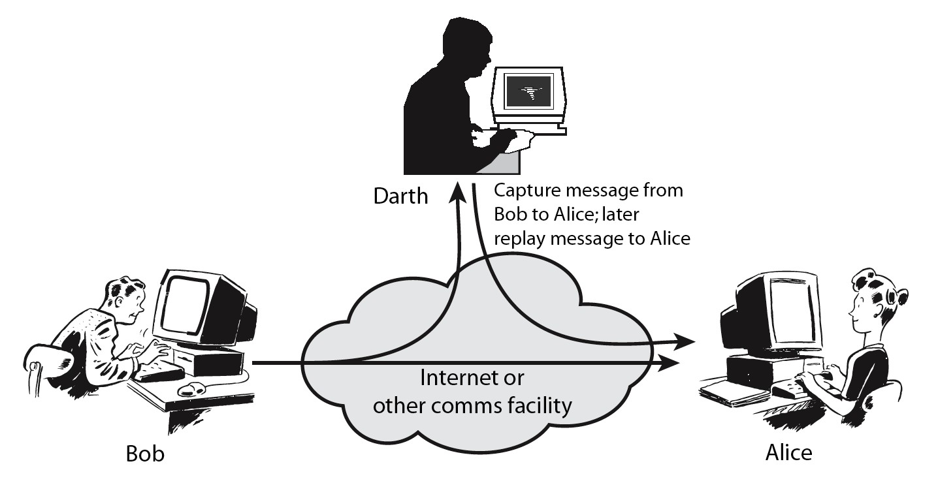
Active Attacks

Slide 17
Security Services
X.800:
  “a service provided by a protocol layer of communicating open systems, which ensures adequate security of the systems or of data transfers”
RFC 2828:
  “a processing or communication service provided by a system to give a specific kind of protection to system resources”

Slide 18
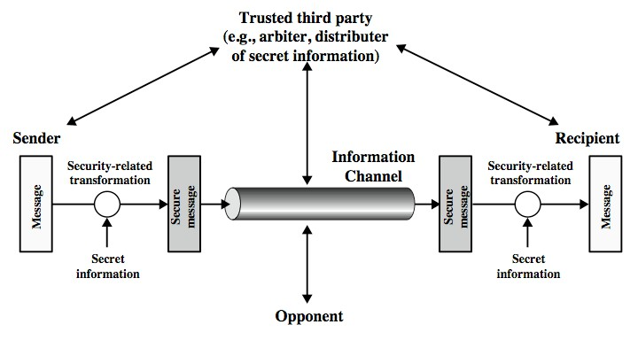
Model for Network Security

Slide 19
Model for Network Security
Using this model requires us to:
Design a suitable algorithm for the security transformation
Generate the secret information (keys) used by the algorithm
Develop methods to distribute and share the secret information
Specify a protocol enabling the principals to use the transformation and secret information for a security service

Slide 20
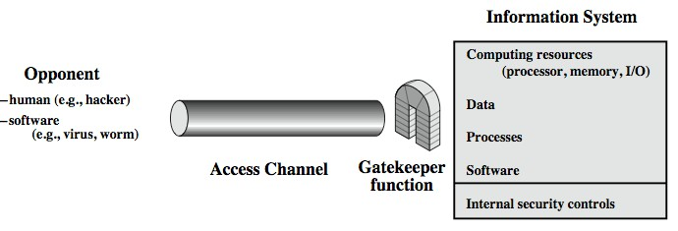
Model for Network Access Security

Slide 21
Model for Network Access Security
Using this model requires us to:
Select appropriate gatekeeper functions to identify users
Implement security controls to ensure only authorized users access designated information or resources

Slide 22
Thank You

