Slide 1

Cyber Security & Digital Forensics CSE - 4207
Lecture - 02
Dr. Md. Alam Hossain
Professor
Jashore University of Science & Technology

Slide 2

Outline
Cyber crime and its types
Types of Hacker
Ethical Hacking
Hacking Terminology
Incident Management
Vulnerability assessment and its types
Penetration Testing and its types

Slide 3
Cyber Crime
Offences against computer data and systems
Illegal access
Illegal interception
Data interference
System interference
Misuse of devices

Slide 4
Types of Cyber Crime
Hacking
Denial of service attack
Virus Dissemination
Computer Vandalism
Cyber Terrorism
Software Piracy

Slide 5
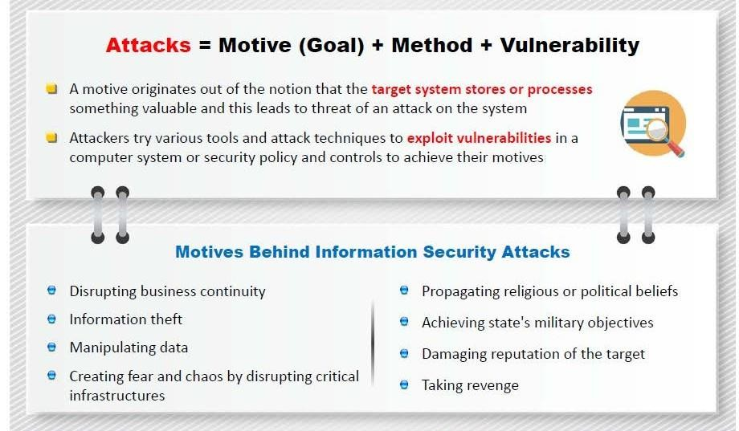
Motivations of Attacks

Slide 6
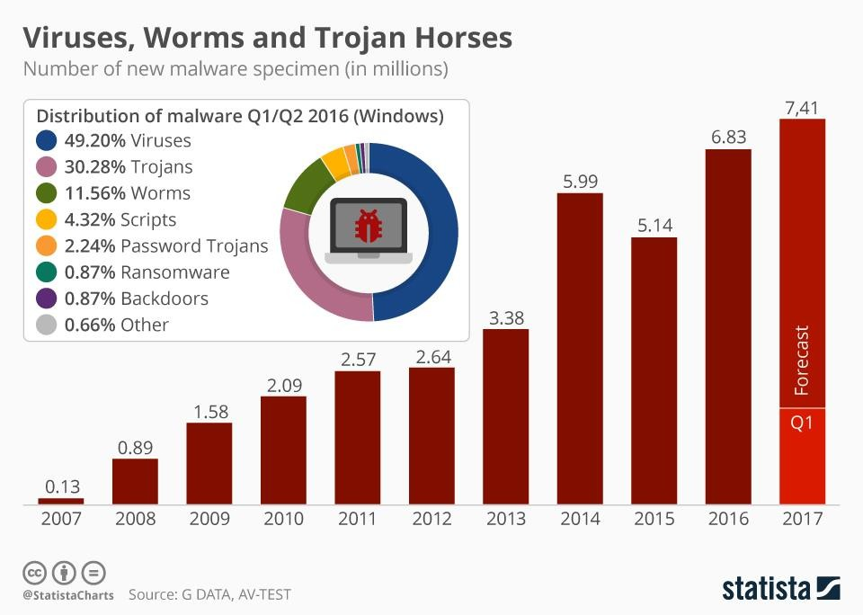
Distributed Attacks

Slide 7
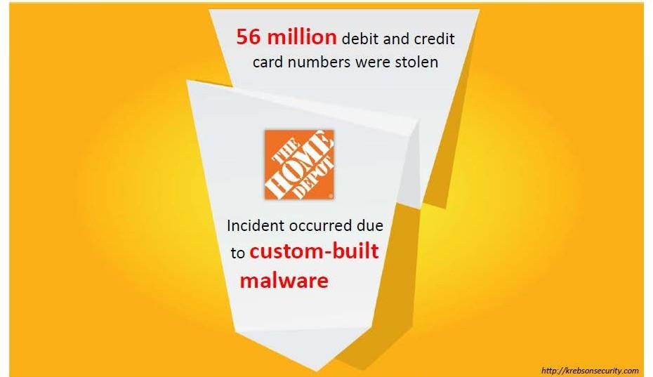
Incidents

Slide 8
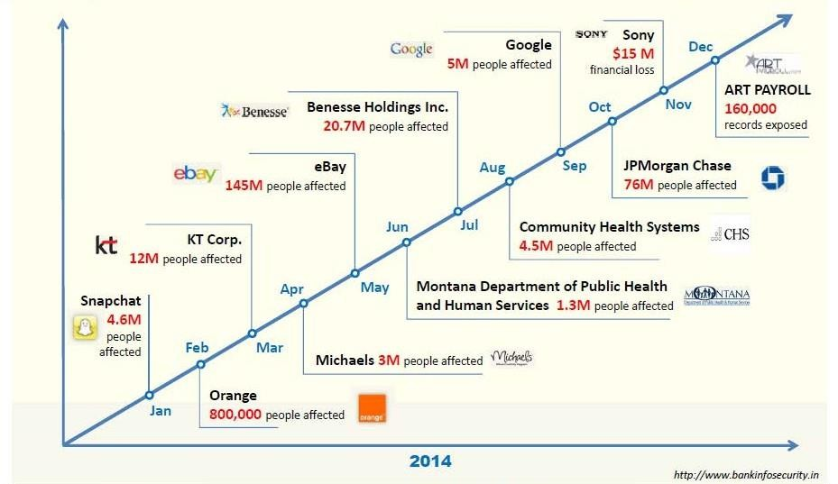
Incidents

Slide 9
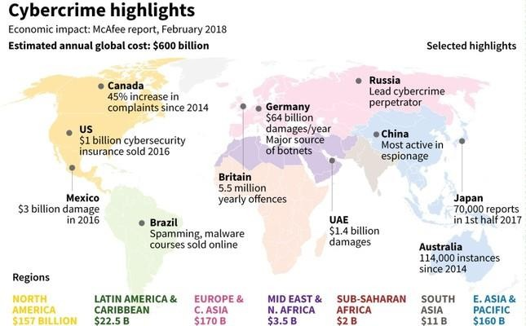
Cyber Crime Global Cost

Slide 10
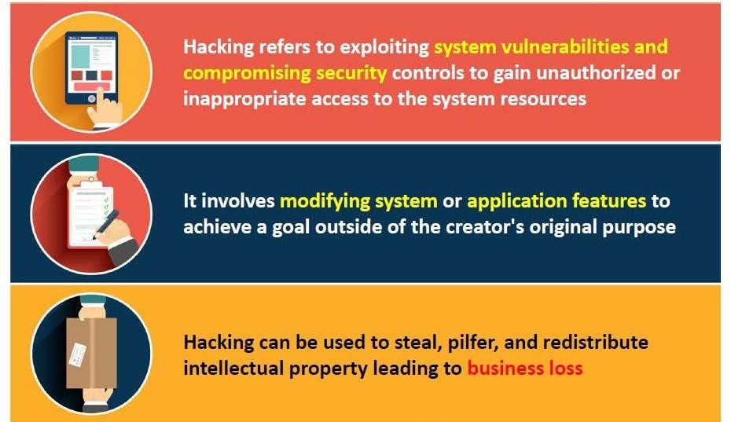
Hacking

Slide 11
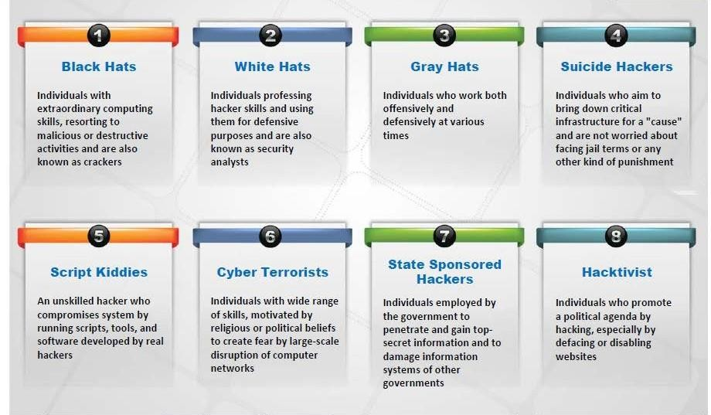
Types of Hacker

Slide 12
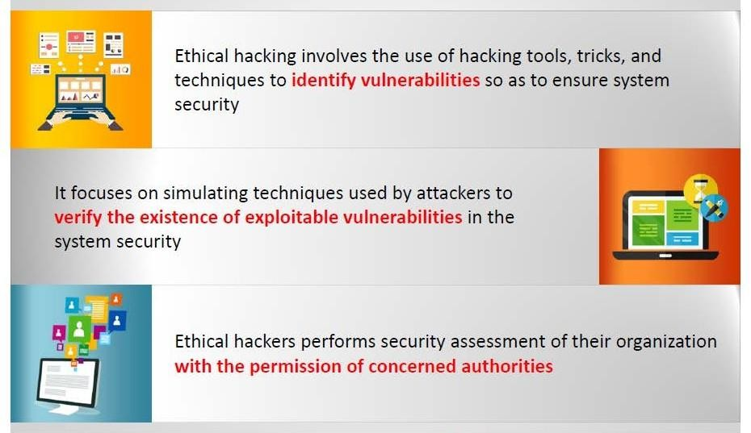
Ethical Hacking

Slide 13
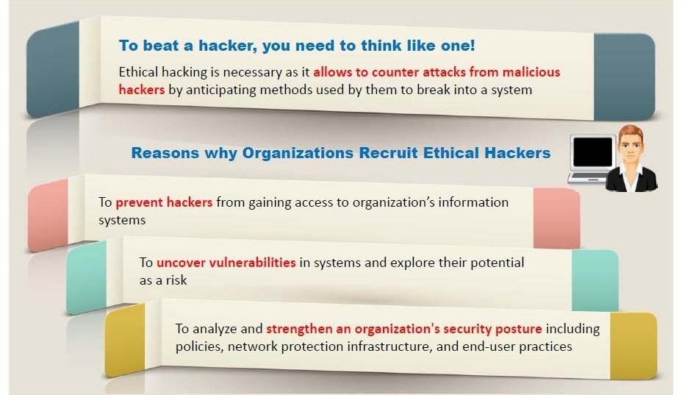
Ethical Hacking

Slide 14
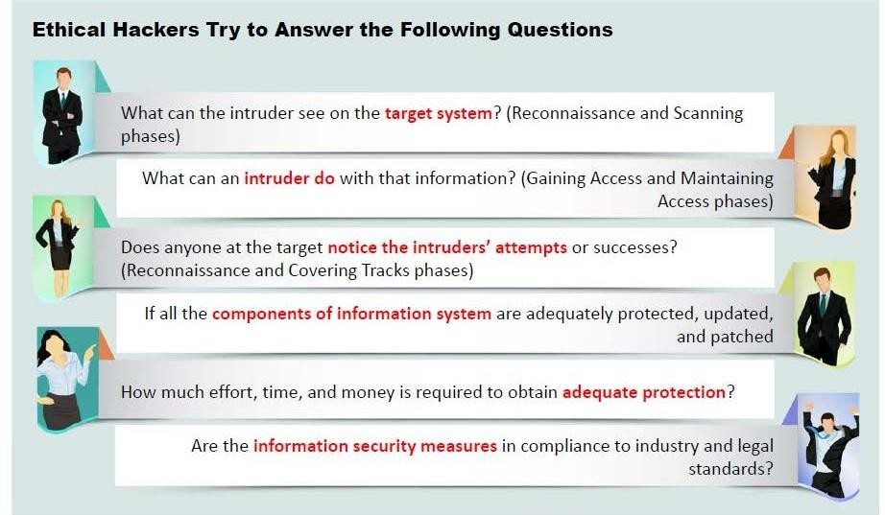
Ethical Hacking

Slide 15
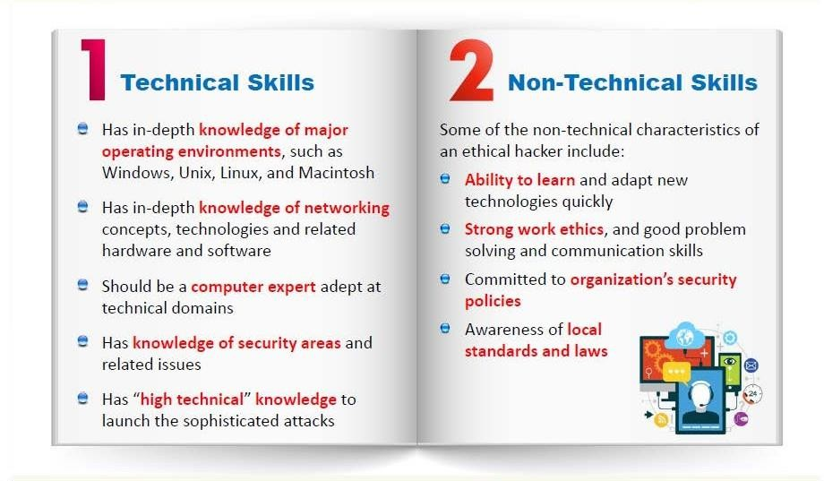
Skills of a Hacker

Slide 16
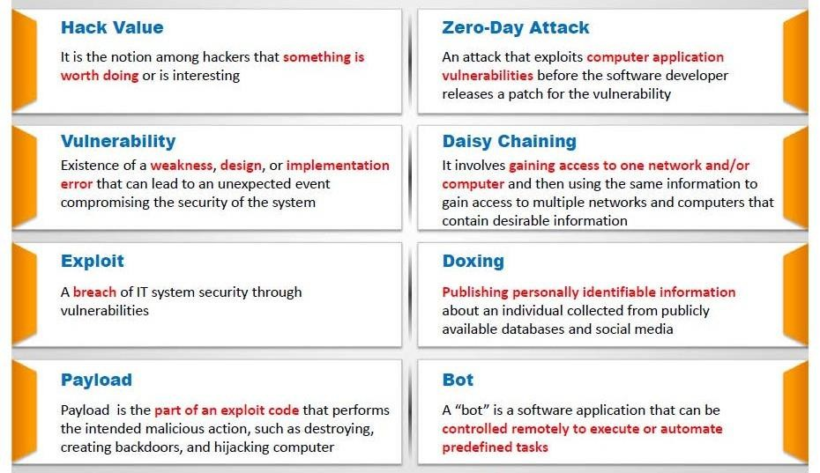
Hacking Terminology

Slide 17
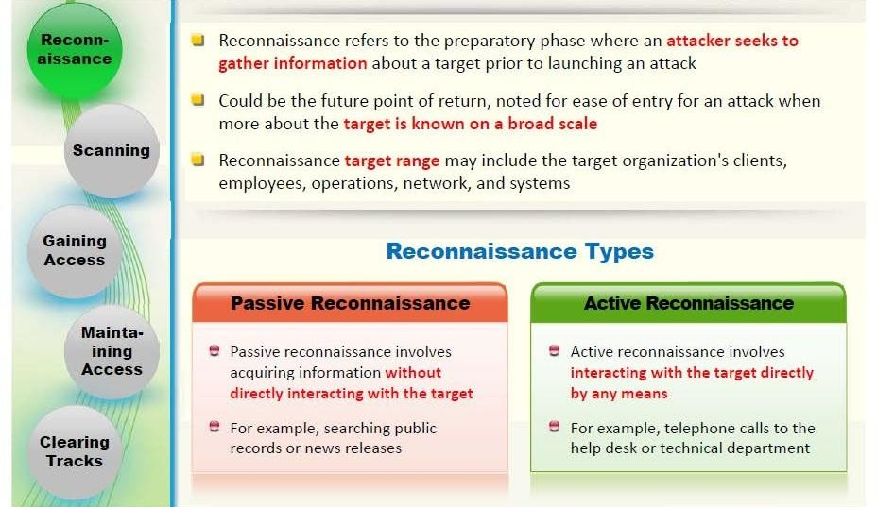
Hacking Terminology

Slide 18
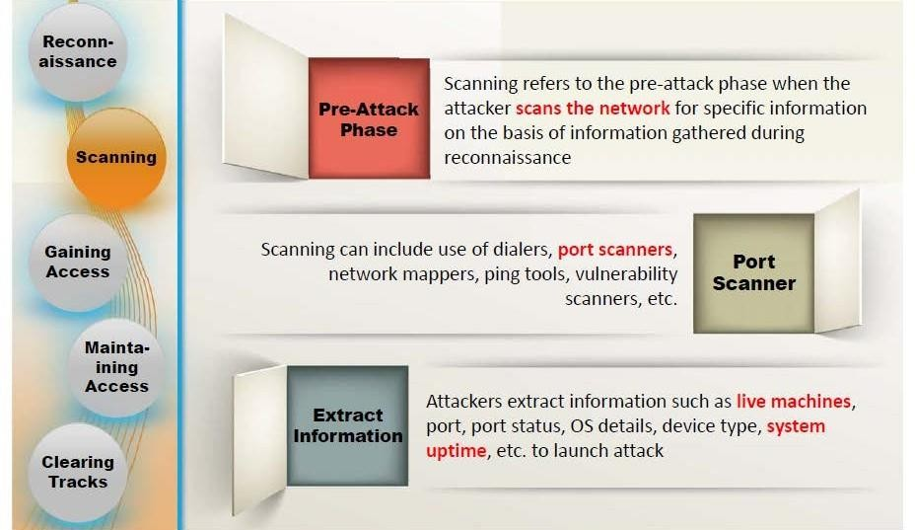
Hacking Terminology

Slide 19
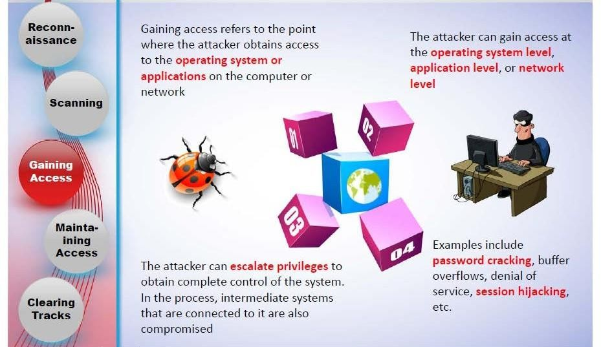
Hacking Terminology

Slide 20
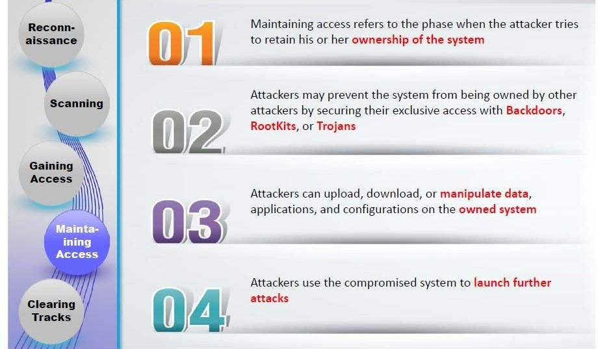
Hacking Terminology

Slide 21
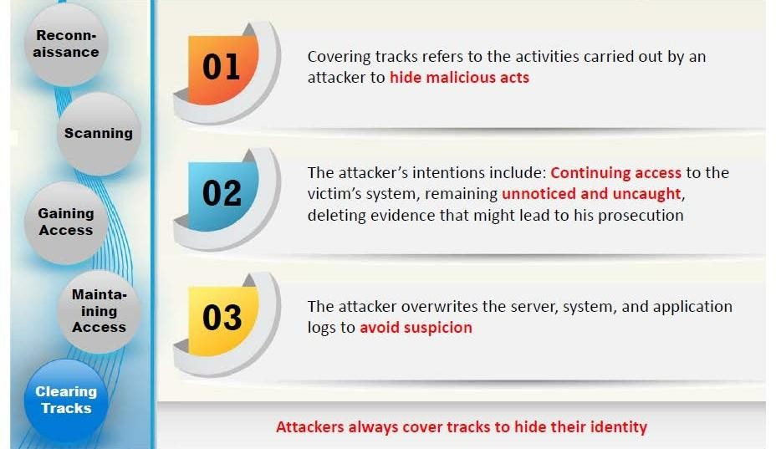
Hacking Terminology

Slide 22
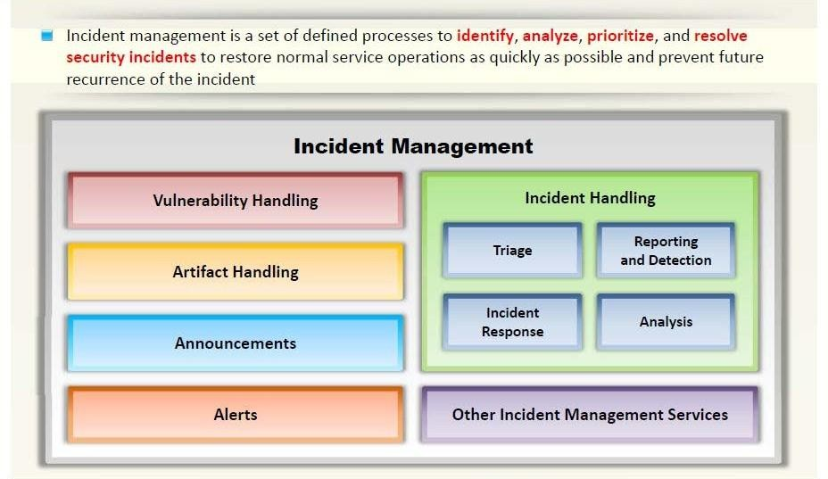
Incident Management

Slide 23
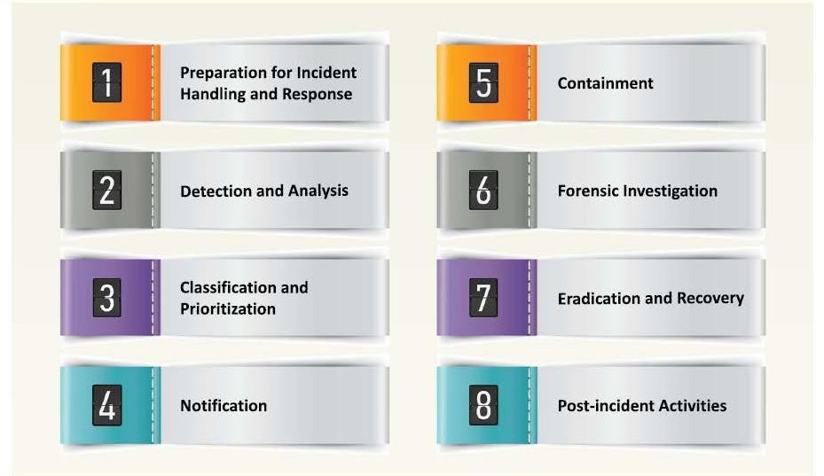
Incident Management

Slide 24
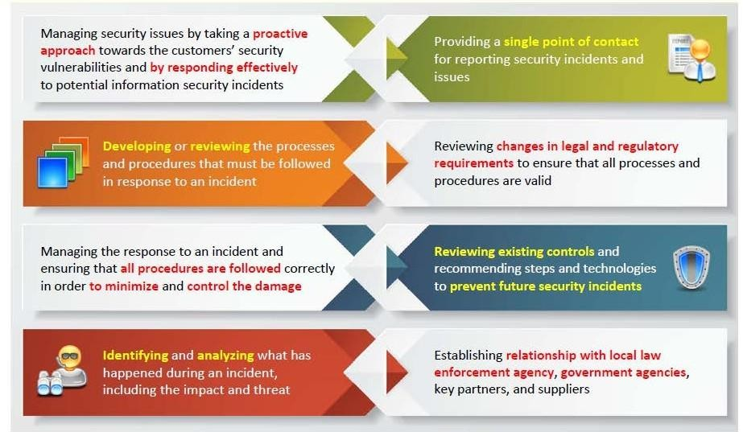
Responsibility of Incident Management Team

Slide 25
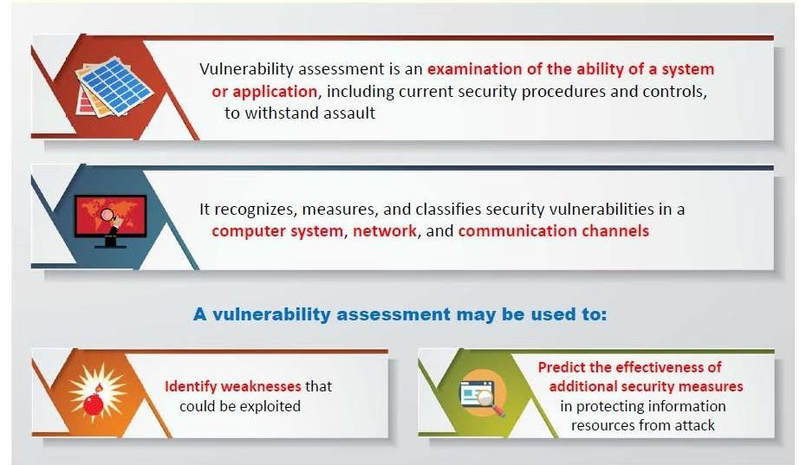
Vulnerability Assessment

Slide 26
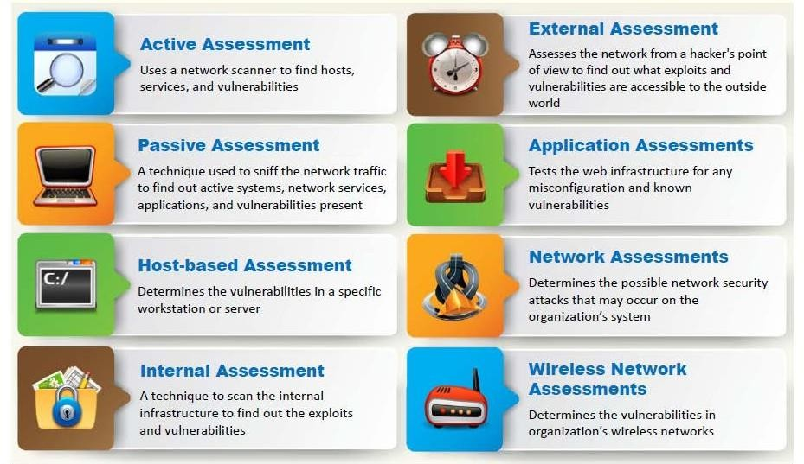
Vulnerability Assessment Types

Slide 27
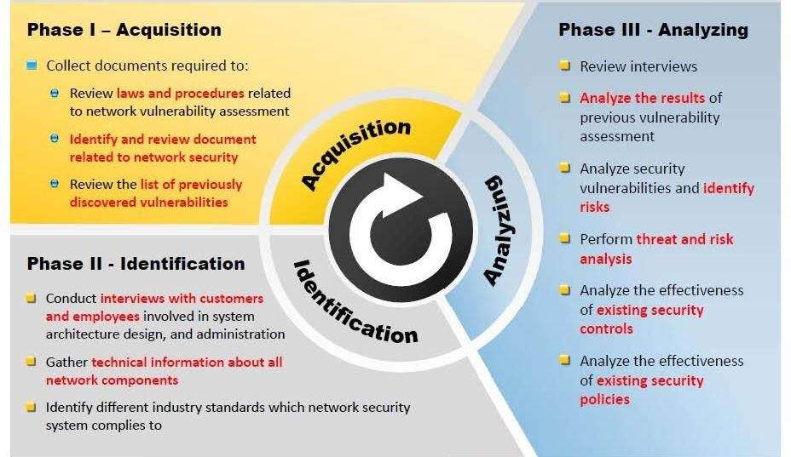
Network Vulnerability Assessment Method

Slide 28
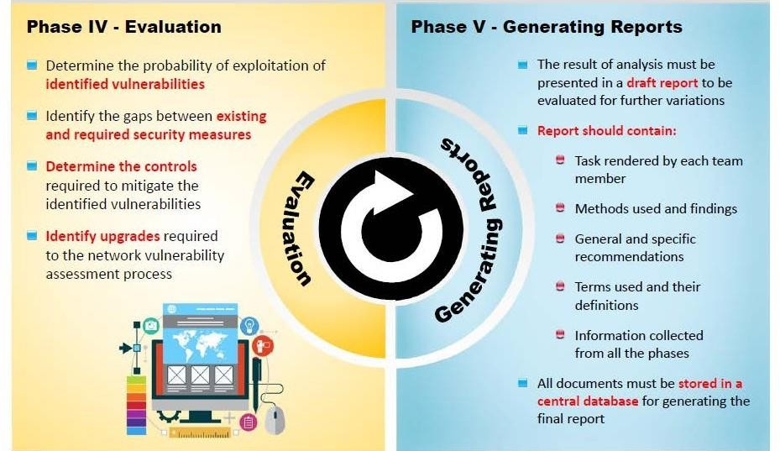
Network Vulnerability Assessment Method

Slide 29
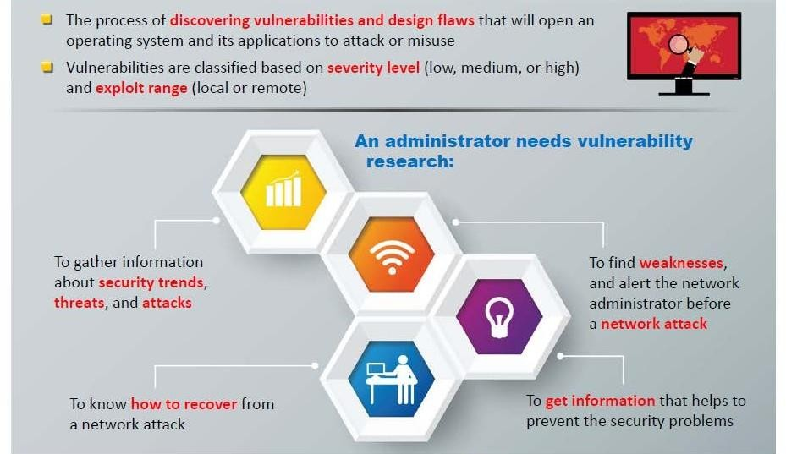
Vulnerability Research

Slide 30
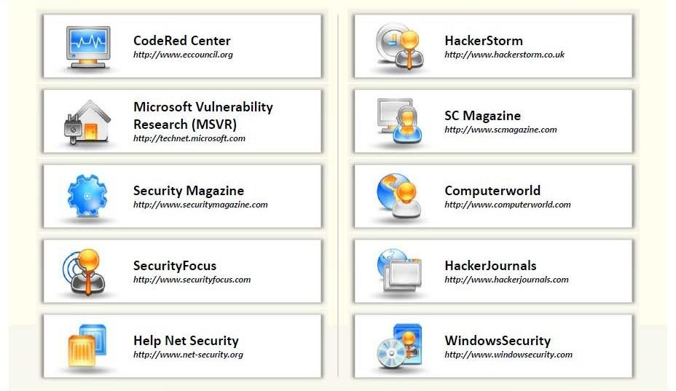
Vulnerability Research Web Sites

Slide 31
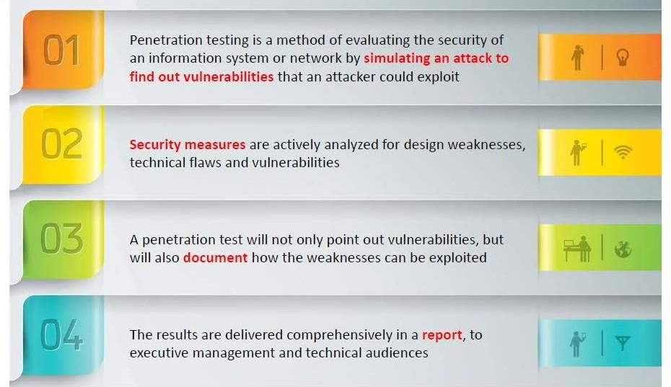
Vulnerability Research Web Sites

Slide 32
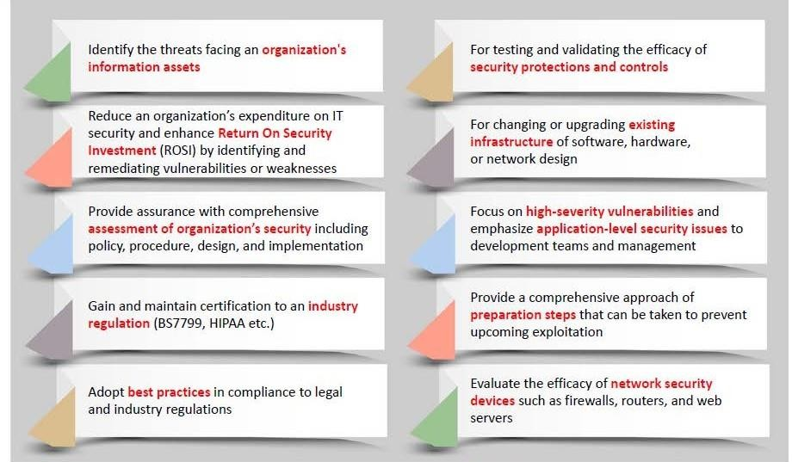
Why Penetration Testing

Slide 33
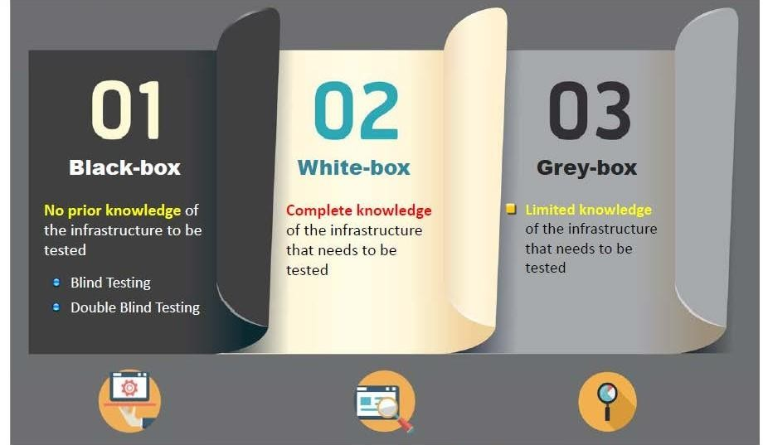
Types of Penetration Testing

Slide 34
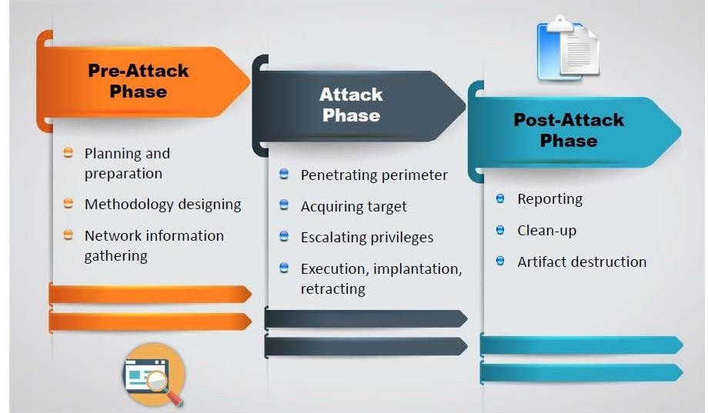
Phase of Penetration Testing

Slide 35
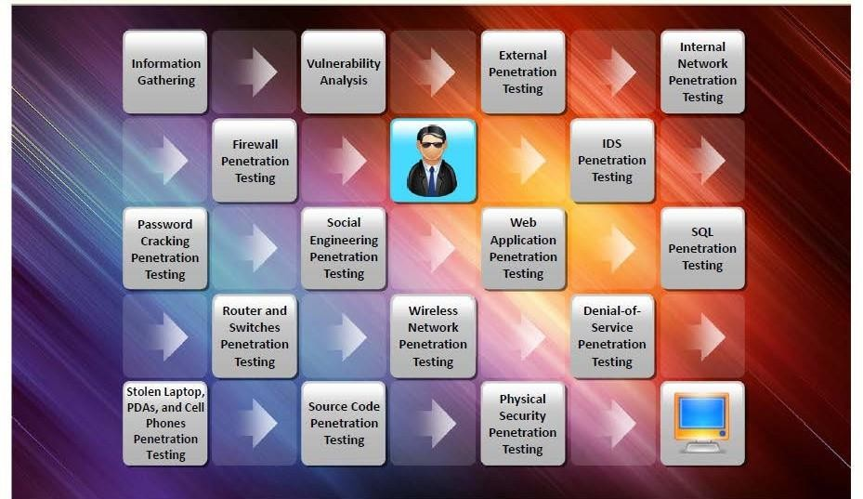
Penetration Testing

Slide 36
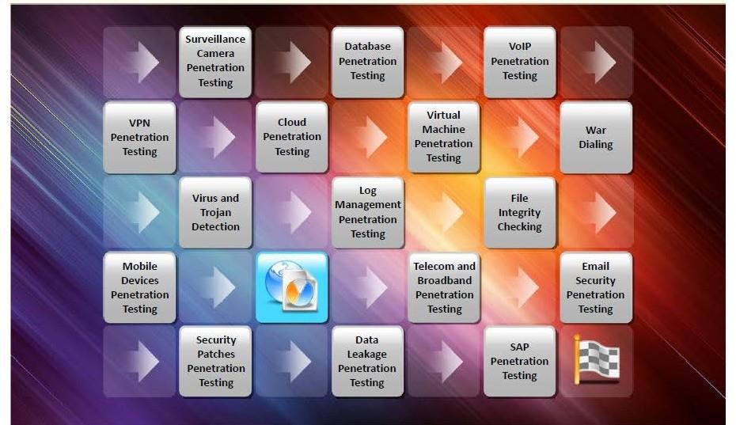
Penetration Testing

Slide 37
Thank You

