Slide 1

Cyber Security & Digital Forensics CSE - 4207
Lecture - 03
Dr. Md. Alam Hossain
Professor
Jashore University of Science & Technology

Slide 2

Outline
Some Basic Terminology
Symmetric Cipher Model
Cryptanalysis
Cryptanalytic Attacks
Brute Force Search
Monoalphabetic Cipher
Caesar Cipher
Language Redundancy and Cryptanalysis
English Letter Frequencies
Example Cryptanalysis

Slide 3
Some Basic Terminology
Plaintext- original message
Ciphertext- coded message
Cipher- algorithm for transforming plaintext to ciphertext
Key- info used in cipher known only to sender/receiver
Encipher (encrypt)- converting plaintext to ciphertext
Decipher (decrypt)- recovering ciphertext from plaintext
Cryptography- study of encryption principles/methods
Cryptanalysis (code breaking)- study of principles/ methods of deciphering ciphertext without knowing key
Cryptology-field of both cryptography and cryptanalysis

Slide 4
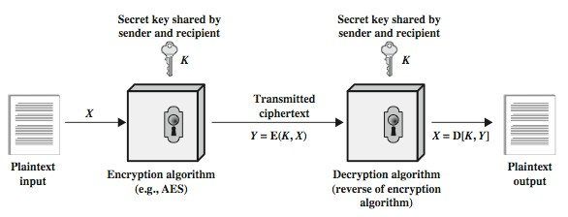
Symmetric Cipher Model

Slide 5
Requirements
two requirements for secure use of symmetric encryption:
  a strong encryption algorithm
  a secret key known only to sender / receiver
mathematically have:
Y = E(K, X)
X = D(K, Y)
  assume encryption algorithm is known
  implies a secure channel to distribute key

Slide 6
Cryptography
Can characterize cryptographic system by:
  type of encryption operations used
    Substitution
    Transposition
    Product
  number of keys used
    Single-key or private
    Two-key or public
  way in which plaintext is processed
    Block
Stream
6

Slide 7
Cryptanalysis
objective to recover key not just message
general approaches:
  cryptanalytic attack
  brute-force attack
if either succeed all key use compromised

Slide 8
Cryptanalytic Attacks
ciphertext only
  only know algorithm & ciphertext, is statistical, know or can identify plaintext
known plaintext
  know/suspect plaintext & ciphertext
chosen plaintext
  select plaintext and obtain ciphertext
chosen ciphertext
  select ciphertext and obtain plaintext
chosen text
  select plaintext or ciphertext to en/decrypt

Slide 9
More Definitions
Unconditional security
  no matter how much computer power or time is available, the cipher cannot be broken since the ciphertext provides insufficient information to uniquely determine the corresponding plaintext
Computational security
  given limited computing resources (i.e. time needed for calculations is greater than age of universe), the cipher cannot be broken

Slide 10
Brute Force Search
always possible to simply try every key
most basic attack, proportional to key size
assume either know / recognize plaintext

Slide 11
Classical Substitution Ciphers
where letters of plaintext are replaced by other letters or by numbers or symbols
or if plaintext is viewed as a sequence of bits, then substitution involves replacing plaintext bit patterns with ciphertext bit patterns

Slide 12
Monoalphabetic Cipher
rather than just shifting the alphabet
could shuffle (jumble) the letters arbitrarily
each plaintext letter maps to a different random ciphertext letter
hence key is 26 letters long
Plain: Cipher: Plaintext:
abcdefghijklmnopqrstuvwxyz
DKVQFIBJWPESCXHTMYAUOLRGZN
ifwewishtoreplaceletters
Ciphertext: WIRFRWAJUHYFTSDVFSFUUFYA

Slide 13
Monoalphabetic Cipher Security
now have a total of 26! = 4 x 1026keys
with so many keys, might think is secure
but would be !!!WRONG!!!
problem is language characteristics

Slide 14
Caesar Cipher
Earliest known substitution cipher - by Julius Caesar
First attested use in military affairs
Replaces each letter by 3rd letter on
example:
  meet me after the toga party
  PHHW PH DIWHU WKH WRJD SDUWB

Slide 15
Caesar Cipher
can define transformation as:
a b c d e f g h i j k l m n o p q r s t u v w x y z
D E F G H I J K L M N O P Q R S T U V W X Y Z A B C
mathematically give each letter a number
a b c d e f g h i j k l m n o p q r s t u v w x y z
0 1 2 3 4 5 6 7 8 9 10 11 12 13 14 15 16 17 18 19 20 21 22
23 24 25
then have Caesar cipher as:
c = E(k, p) = (p + k) mod (26)
p = D(k, c) = (c –k) mod (26)

Slide 16
Cryptanalysis of Caesar Cipher
only have 26 possible ciphers
– A maps to A,B,..Z
could simply try each in turn
a brute force search
given ciphertext, just try all shifts of letters
do need to recognize when have plaintext
eg. break ciphertext "GCUA VQ DTGCM"

Slide 17
Language Redundancy and Cryptanalysis
human languages are redundant
eg "th lrd s m shphrd shll nt wnt"
letters are not equally commonly used
in English E is by far the most common letter
– followed by T,R,N,I,O,A,S
other letters like Z,J,K,Q,X are fairly rare
have tables of single, double & triple frequencies for various languages
letter

Slide 18
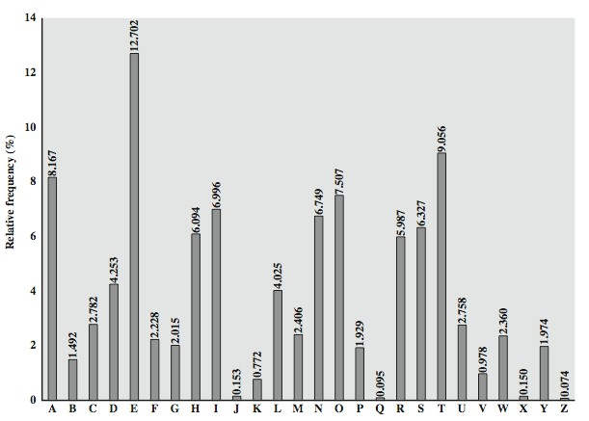
English Letter Frequencies

Slide 19
Use in Cryptanalysis
key concept- monoalphabetic substitution ciphers do not change relative letter frequencies
discovered by Arabian scientists in 9thcentury
calculate letter frequencies for ciphertext
compare counts/plots against known values
if caesar cipher look for common peaks/troughs
  peaks at: A-E-I triple, NO pair, RST triple
  troughs at: JK, X-Z
for monoalphabetic must identify each letter
  tables of common double/triple letters help

Slide 20
Example Cryptanalysis
given ciphertext:
  UZQSOVUOHXMOPVGPOZPEVSGZWSZOPFPESXUDBMETS XAIZVUEPHZHMDZSHZOWSFPAPPDTSVPQUZWYMXUZUHS XEPYEPOPDZSZUFPOMBZWPFUPZHMDJUDTMOHMQ
count relative letter frequencies (see text)
guess P & Z are e and t
guess ZW is th and hence ZWP is the
proceeding with trial and error finally get:
  it was disclosed yesterday that several informal but direct contacts have been made with political representatives of the viet cong in moscow

Slide 21
Thank You
21

