Slide 1

Cyber Security & Digital Forensics CSE - 4207
Lecture - 04
Dr. Md. Alam Hossain
Professor
Jashore University of Science & Technology

Slide 2

Outline
Polyalphabetic Ciphers
  Playfair Cipher
  Vigenère Cipher
  Kasiski Method

Slide 3
Playfair Cipher
not even the large number of keys in a monoalphabetic cipher provides security
one approach to improving security was to encrypt multiple letters
the Playfair Cipher is an example
invented by Charles Wheatstone in 1854, but named after his friend Baron Playfair
3

Slide 4
Playfair Key Matrix
a 5X5 matrix of letters based on a keyword
fill in letters of keyword
fill rest of matrix with other letters
eg. using the keyword MONARCHY
M | O | N | A | R
C | H | Y | B | D
E | F | G | I/J | K
L | P | Q | S | T
U | V | W | X | Z
4

Slide 5
Encrypting and Decrypting
plaintext is encrypted two letters at a time
  if a pair is a repeated letter, insert filler like 'X’
  if both letters fall in the same row, replace each with letter to right (wrapping back to start from end)
  if both letters fall in the same column, replace each with the letter below it (wrapping to top from bottom)
  otherwise each letter is replaced by the letter in the same row and in the column of the other letter of the pair

Slide 6
Playfair Key Matrix
Plaint Text:
SECRET MESSAGE SE CR ET ME SS AG E
SE CR ET ME SX SA GE
Cipher Text: LI DM KL CL XA XB JF
**Decryption process is the same. Just reverse the 4 rules.

Slide 7
Security of Playfair Cipher
security much improved over monoalphabetic
since have 26 x 26 = 676 digrams
would need a 676 entry frequency table to analyse (verses 26 for a monoalphabetic)
and correspondingly more ciphertext
was widely used for many years
– eg. by US & British military in WW1
it can be broken, given a few hundred letters
since still has much of plaintext structure

Slide 8
Polyalphabetic Ciphers
Polyalphabetic substitution ciphers
  improve security using multiple cipher alphabets
  make cryptanalysis harder with more alphabets to guess and flatter frequency distribution
  use a key to select which alphabet is used for each letter of the message
  use each alphabet in turn
  repeat from start after end of key is reached

Slide 9
Vigenère Cipher
simplest polyalphabetic substitution cipher
effectively multiple caesar ciphers
key is multiple letters long K = k₁k₂... k_{d}
i^{th} letter specifies i^{th} alphabet to use
use each alphabet in turn
repeat from start after d letters in message
decryption simply works in reverse

Slide 10
Example of Vigenère Cipher
write the plaintext out
write the keyword repeated above it
use each key letter as a caesar cipher key
encrypt the corresponding plaintext letter
eg. using keyword deceptive
key:
plaintext:
ciphertext: ZICVTWQNGRZGVTWAVZHCQYGLMGJ
deceptivedeceptivedeceptive wearediscoveredsaveyourself

Slide 11
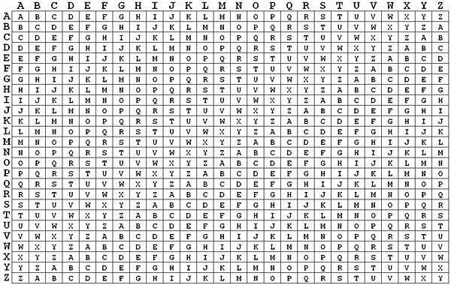
Example of Vigenère Cipher

Slide 12
More Example of Vigenère Cipher
Key: LEMON
Plain Text:
Key-stream:
•
Encryption: Cross-match S,L-> D; E,E->I;
Cipher Text: DIOFRE QQGFLKQ
SECRET MESSAGE (13)
LEMONL EMONLEM (13)
C,M-> O….
Decryption: Start with key-stream and look for the corresponding cipher text in the same row/column.

Slide 13
Aid for encryption/decryption
simple aid can assist with en/decryption
a Saint-Cyr Slides a simple manual aid
a slide with repeated alphabet
line up plaintext 'A' with key letter, eg 'C'
then read off any mapping for key letter
can bend round into a cipher disk
or expand into a Vigenère Table

Slide 14
Security of Vigenère Ciphers
have multiple ciphertext letters for each plaintext letter
hence letter frequencies are obscured
but not totally lost
start with letter frequencies
see if look monoalphabetic or not
if not, then need to determine number of alphabets, since then can attach each

Slide 15
Kasiski Method
method developed by Babbage / Kasiski
repetitions in ciphertext give clues to period
so find same plaintext an exact period apart
which results in the same ciphertext
of course, could also be random fluke
eg. repeated “VTW” in previous example
suggests size of 3 or 9
then attack each monoalphabetic cipher individually using same techniques as before

Slide 16
Thank You

