Slide 1

Cyber Security & Digital Forensics CSE - 4207
Lecture - 05
Dr. Md. Alam Hossain
Professor
Jashore University of Science & Technology

Slide 2

Outline
Polyalphabetic Ciphers
  Autokey Cipher
  Vernam Cipher
  One-Time Pad
Monoalphabetic Cipher vs Polyalphabetic Cipher

Slide 3
Autokey Cipher
Autokey Cipher is a polyalphabetic substitution cipher
It is closely related to the Vigenere cipher but uses a different method of generating the key
It was invented by Blaise de Vigenère in 1586
In general, more secure than the Vigenere cipher
But still have frequency characteristics to attack

Slide 4
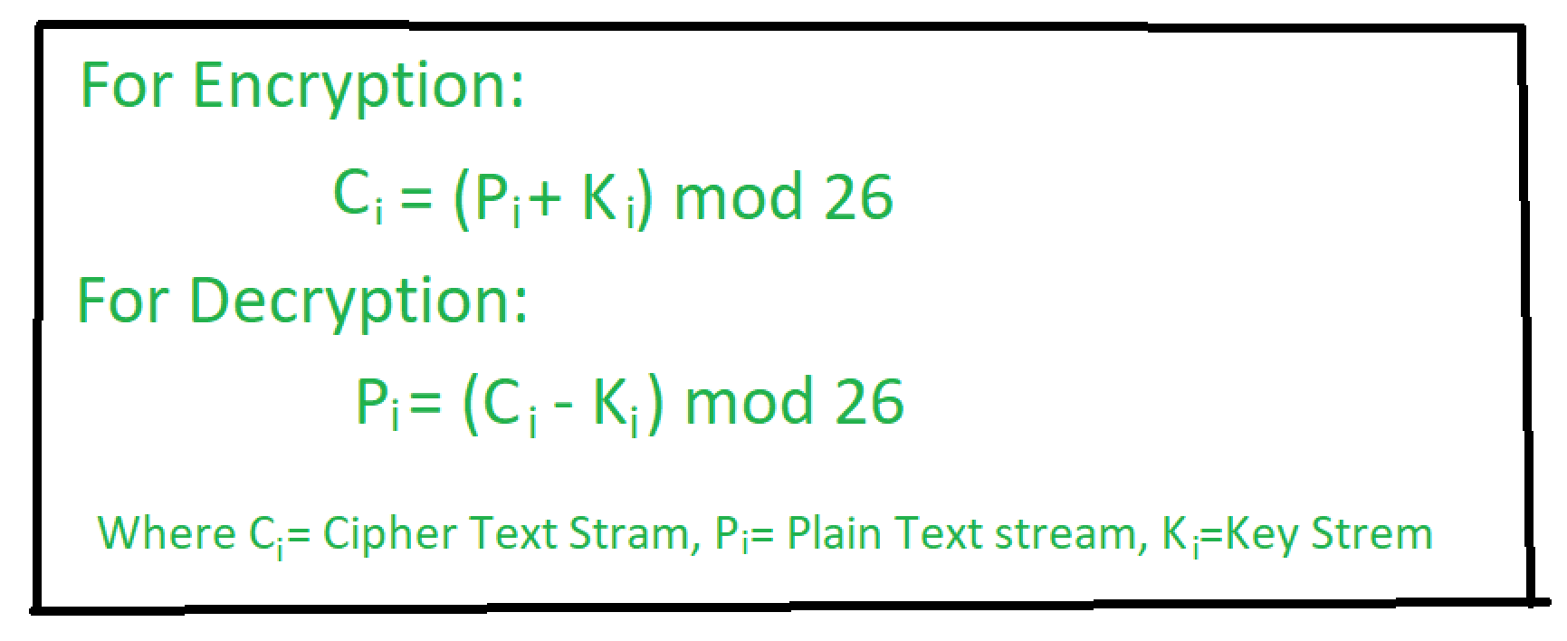
Autokey Cipher

Slide 5
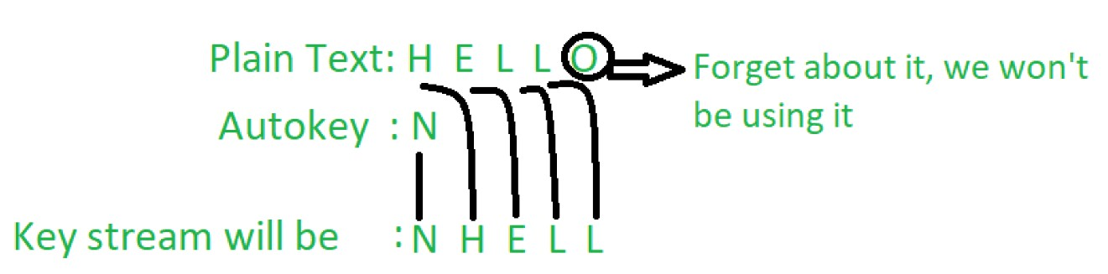
Autokey Cipher Example
Plaintext = "HELLO"
Autokey = N
Ciphertext = "ULPWZ"

Slide 6
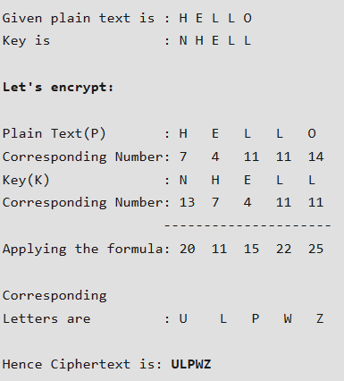
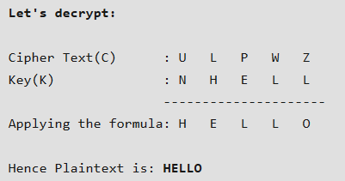


Autokey Cipher Example
0 | A | 9 | J | 18 | S
1 | B | 10 | K | 19 | T
2 | C | 11 | L | 20 | U
3 | D | 12 | M | 21 | V
4 | E | 13 | N | 22 | W
5 | F | 14 | O | 23 | X
6 | G | 15 | P | 24 | Y
7 | H | 16 | Q | 25 | Z
8 | I | 17 | R

Slide 7
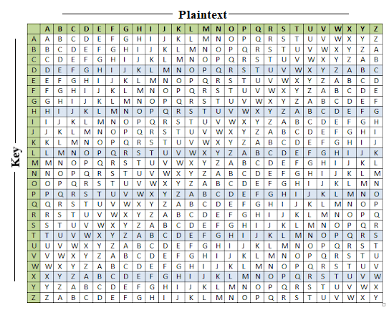
Autokey Cipher Alternative Solution
key:
plaintext:
ciphertext:
deceptivewearediscoveredsav wearediscoveredsaveyourself
ZICVTWQNGKZEIIGASXSTSLVVWLA

Slide 8
Vernam Cipher
ultimate defense is to use a key as long as the plaintext
with no statistical relationship to it
invented by AT&T engineer Gilbert Vernam in 1918
originally proposed using a very long but eventually repeating key
also known as One-Time Pad
8

Slide 9
One-Time Pad
if a truly random key as long as the message is used, the cipher will be secure
called a One-Time pad
is unbreakable since ciphertext bears no statistical relationship to the plaintext
since for any plaintext & any ciphertext there exists a key mapping one to other
can only use the key once though
problems in generation & safe distribution of key
9

Slide 10
Vernam Cipher
Vernam Cipher is a method of encrypting alphabetic text. It is simply a type of substitution cipher.
In this mechanism we assign a number to each character
of the Plain-Text, like (a = 0, b = 1, c = 2, … z = 25).
Method to take key:
In Vernam cipher algorithm, we take a key to encrypt the plain text which length should be equal to the length of the plain text.
10

Slide 11
Vernam Cipher
Encryption Algorithm:
Assign a number to each character of the plain-text and the key according to alphabetical order.
Add both the number (Corresponding plain-text character number and Key character number).
Subtract the number from 26 if the added number is greater than 26, if it isn’t then leave it.
11

Slide 12
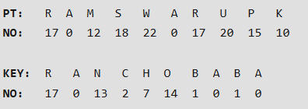
Vernam Cipher Example
Plain-Text: Key:
RAMSWARUPK RANCHOBABA
Now according to our encryption algorithm we assign a
number to each character of our plain-text and key.
Add the number of Plain-Text and Key and after doing the addition and subtraction operation (if required), we will get the corresponding Cipher-Text character number.

Slide 13
Vernam Cipher Example
In this case, there are two numbers which are greater than the 26 so we have to subtract 26 from them and after applying the subtraction operation the new Cipher text character numbers are as follow:
New Cipher-Text
is after getting the corresponding
character from the number.

Slide 14
Vernam Cipher Example
Try to decrypt by reversing the algorithm!!
14

Slide 15
Monoalphabetic Cipher vs Polyalphabetic Cipher
Monoalphabetic Cipher | Polyalphabetic cipher
Once a key is chosen, each alphabetic character of plaintext is mapped onto a unique alphabetic character of a ciphertext. | Each alphabetic character of plaintext can be mapped onto “m” alphabetic characters of a ciphertext.
The relationship between a character in the plaintext and the characters in the ciphertext is one-to-one. | The relationship between a character in the plaintext and the characters in the ciphertext is one-to-many.
A stream cipher is a monoalphabetic cipher if the value of k_{i} does not depend on the position of the plaintext character in the plaintext stream | A stream cipher is a polyalphabetic cipher if the value of id does depend on the position of the plaintext character in the plaintext stream.
Monoalphabetic cipher includes additive, multiplicative, affine and monoalphabetic substitution cipher. | Polyalphabetic cipher includes autokey, Playfair, Vigenere, Hill, one-time pad, rotor, and Enigma cipher.
15

Slide 16
Thank You
16

