Slide 1

Cyber Security & Digital Forensics CSE - 4207
Lecture - 06
Dr. Md. Alam Hossain
Professor
Jashore University of Science & Technology

Slide 2

Outline
Introduction to Communication Security
RSA
Encryption
Decryption
Diffie and Hellman Key Exchange
Bucket Brigade Attack

Slide 3

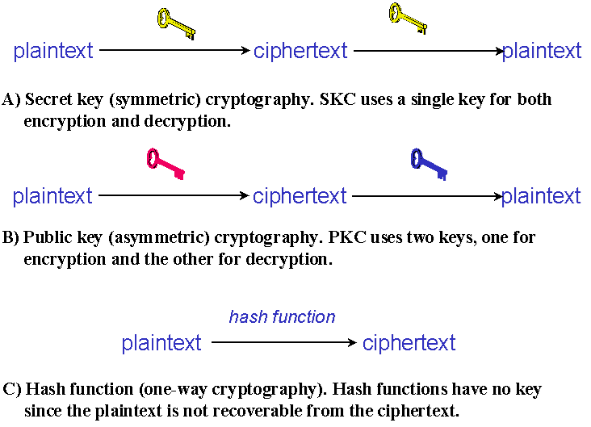
Introduction to Communication Security

Slide 4
RSA
First practicable publickey cryptosystems
Encryption key- public
Decryption key- private
Invented by Ron Rivest, Adi Shamir and Leonard Adleman
RSA algorithm has 3 steps:
  Generation of public and private keys
  Encryption
  Decryption
4

Slide 5
RSA – Generation of Public & Private Keyes
Pick two prime numbers p & q
p= 3 and q= 11
Calculate n=p*q
n= 33
Calculate φ (n) =(p-1)*(q-1)
Ф (n) = 20
Choose integer e such that
1 <e<φ(n) and GCD(e,φ(n))=1
e=7,11,13,17,19
e = 7

Slide 6

RSA – Generation of Public & Private Keyes
e* d (mod φ (n)) = 1
Public Key = {e, n} Private Key = {d, n}
7 * d (mod 20) = 1
( 7 * d) / 20 =1
d = 3

Slide 7
RSA- Encryption
C = Me mod n Where,
C = Cipher Text
M= Original Message Public Key = {e, n}
Let, M = 31 and Public Key= {7, 33}
C= 31⁷ mod 33 = 4
7

Slide 8
RSA- Decryption
M=C^{d} mod n
Let, Cipher Text=4, Private Key= {4, 33} M= 4³ mod 33= 31
8

Slide 9
Why RSA is Secure?
Factoring an integer with at least 512-bit is very hard!
But if you can factor big number n then given public key <e,n>, you can find d, and hence the private key by:
  Knowing factors p, q, such that, n = p×q
  Then compute ø(n) =(p-1)(q-1)
  Then find d such that e×d = 1 mod ø(n)

Slide 10
Diffie and Hellman Key Exchange
First published public-key algorithm
By Diffie and Hellman in 1976 along with the exposition of public key concepts
Used in a number of commercial products
Practical method to exchange a secret key securely that can then be used for subsequent encryption of messages
Security relies on difficulty of computing discrete logarithms

Slide 11
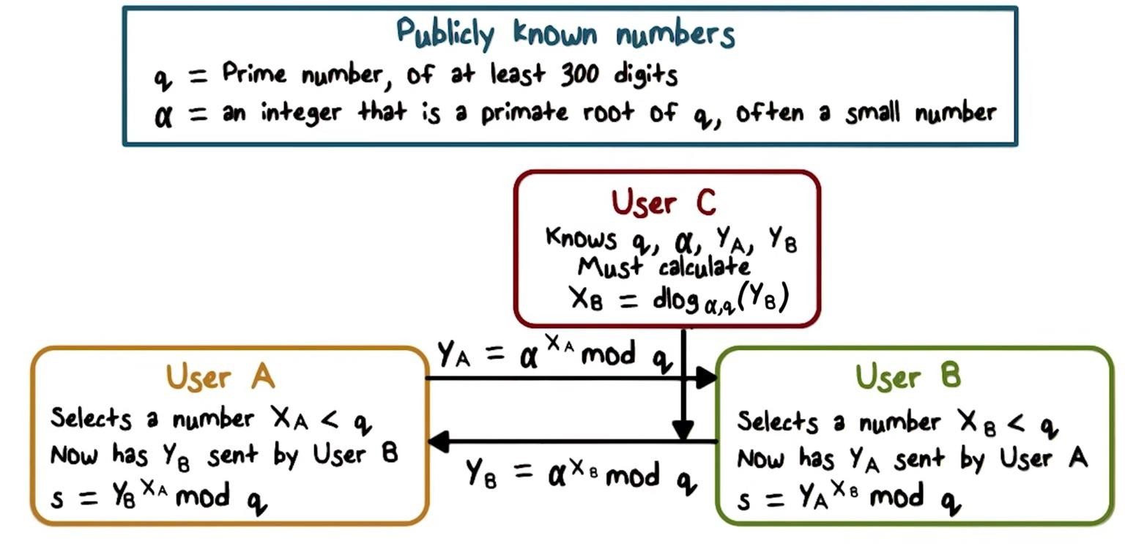
Diffie and Hellman Key Exchange

Slide 12
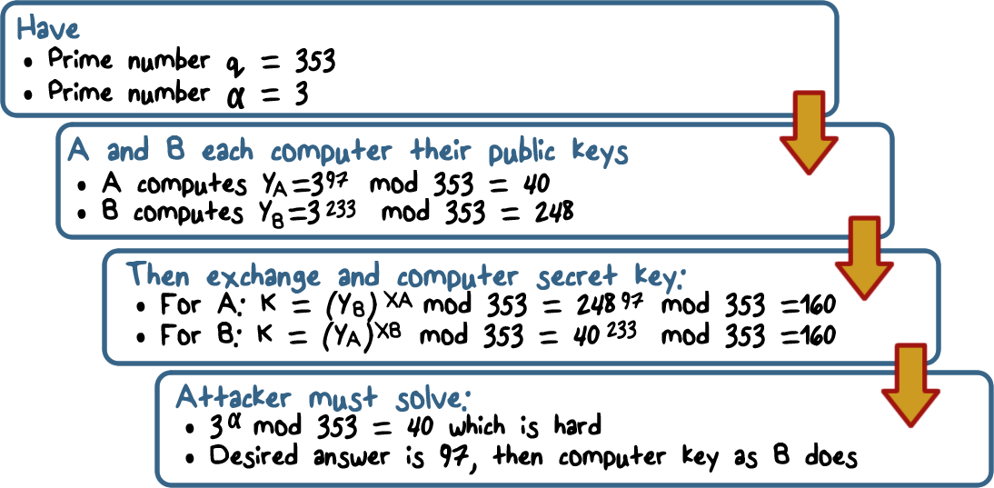
Diffie-Hellman Example

Slide 13
Diffie-Hellman Quiz
Alice and Bob agree to use
prime q = 23 and primitive root α = 5
Alice chooses secret a = 6 Bob chooses secret b= 15
What number does Alice send Bob? What number does Bob send Alice?

Slide 14
Diffie-Hellman Security
Shared key (the secret) itself never transmitted
Discrete logarithm is very hard
Y = α^{X} mod q
Conjecture: given Y, α, and q, it is extremely hard to compute the value of X because q is a very large prime (discrete logarithm)

Slide 15
Diffie-Hellman Limitations
Expensive exponential operation
  DoS possible
The scheme itself cannot be used to encrypt anything – it is for secret key establishment
No authentication, so you cannot sign anything

Slide 16
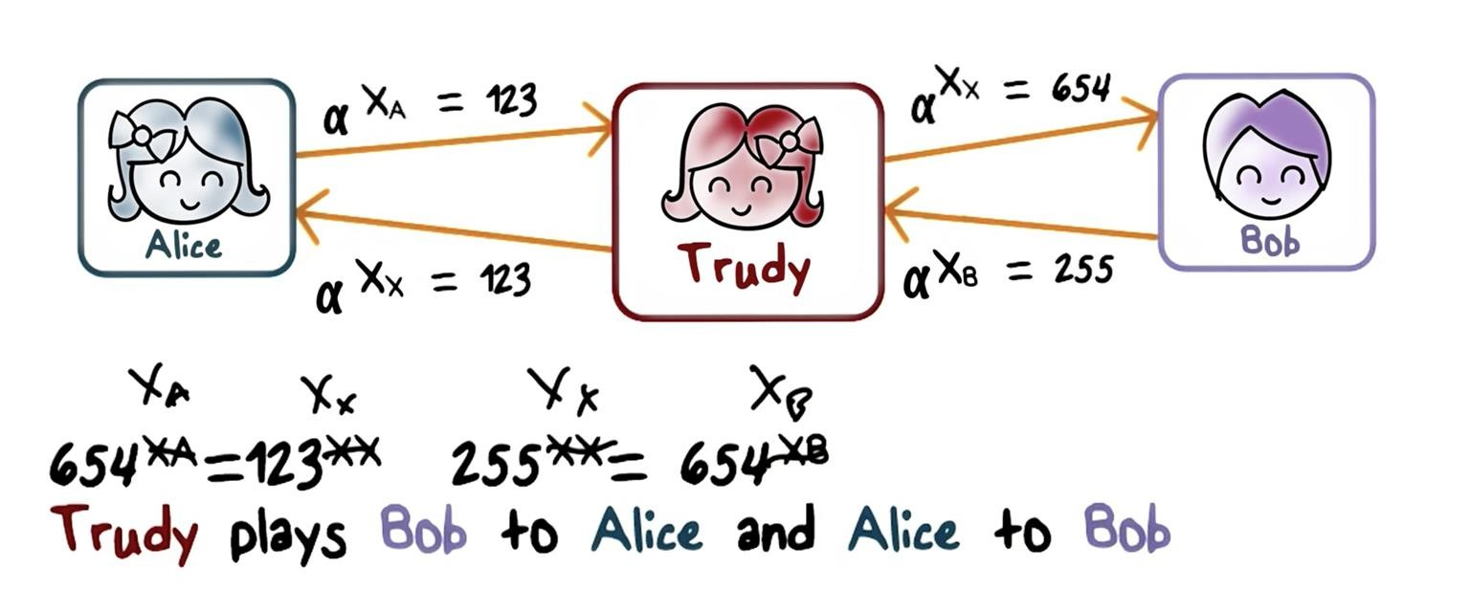
Bucket Brigade Attack, Man-in-the-Middle(MIM)

Slide 17
Thank You
17

