Slide 1

Cyber Security & Digital Forensics CSE - 4207
Lecture - 07
Dr. Md. Alam Hossain
Professor
Jashore University of Science & Technology

Slide 2

Outline
Transposition Ciphers
  Rail Fence Cipher
  Columnar Transposition Cipher
Product Ciphers
Rotor Machines
Steganography

Slide 3
Transposition Ciphers
now consider classical transposition or permutation ciphers
these hide the message by rearranging the letter order
without altering the actual letters used
can recognize these since have the same frequency distribution as the original text

Slide 4
Rail Fence cipher
Encryption:
In a transposition cipher, the order of the alphabets is re- arranged to obtain the cipher-text.
In the rail fence cipher, the plain-text is written downwards and diagonally on successive rails of an imaginary fence.
When we reach the bottom rail, we traverse upwards moving diagonally, after reaching the top rail, the direction is changed again. Thus the alphabets of the message are written in a zig-zag manner.
After each alphabet has been written, the individual rows are combined to obtain the cipher-text.

Slide 5


Rail Fence Cipher Example
For example, if the message is “DEMONSLAYER” and the number of rails = 3 then cipher is prepared as:
D |  |  |  | N |  |  |  | Y
 | E |  | O |  | S |  | A |  | E
 | M |  |  |  | L |  |  |  | R
Cipher Text: DNYEOSAEMLR

Slide 6
Rail Fence Cipher Example
Decryption:
As we’ve seen earlier, the number of columns in rail fence cipher remains equal to the length of plain-text message. And the key corresponds to the number of rails.
Hence, rail matrix can be constructed accordingly. Once we’ve got the matrix we can figure-out the spots where texts should be placed (using the same way of moving diagonally up and down alternatively ).
Then, we fill the cipher-text row wise. After filling it, we traverse the matrix in zig-zag manner to obtain the original text.

Slide 7

Rail Fence Cipher Example
Cipher Text: DNYEOSAEMLR
Cipher text length = 11, Key= 3. So Matrix=33
D |  |  |  | N |  |  |  | Y
 | E |  | O |  | S |  | A |  | E
 |  | M |  |  |  | L |  |  |  | R
Plain Text: DEMONSLAYER

Slide 8
Columnar Transposition Ciphers
Encryption:
  In a transposition cipher, the order of the alphabets is re-arranged to obtain the cipher-text.
  The message is written out in rows of a fixed length, and then read out again column by column, and the columns are chosen in some scrambled order.
  Width of the rows and the permutation of the columns
are usually defined by a keyword.

Slide 9
Columnar Transposition Ciphers
Encryption:
  For example, the word GUITAR is of length 6, and the permutation is defined by the alphabetical order of the letters in the keyword. In this case, the order would be “2 6 3 5 1 4”.
  Any spare spaces are filled with nulls or left blank or placed by a character (Example: _).
  Finally, the message is read off in columns, in the order specified by the keyword.

Slide 10
Columnar Transposition Ciphers
Plaint Text: Bohemian Rhapsody Key: GUITAR (length=6)
G | U | I | T | A | R
2 | 6 | 3 | 5 | 1 | 4
B | o | h | e | m | i
a | n |  | R | h | a
p | s | o | d | y | -
The numbering of
the key is done according to the
alphabetic order.
Now print the columns in 1, 2, 3, 4, 5, 6 order
Cipher Text: mhyBaph oia-eRdons

Slide 11
Columnar Transposition Ciphers
Decryption:
To decipher it, the recipient has to work out the column lengths by dividing the message length by the key length.
Then, write the message out in columns again, then re- order the columns by reforming the key word.

Slide 12
Product Ciphers
ciphers using substitutions or transpositions are not secure because of language characteristics
hence consider using several ciphers in succession to make harder, but:
  two substitutions make a more complex substitution
  two transpositions make more complex transposition
  but a substitution followed by a transposition makes a new much harder cipher
this is bridge from classical to modern ciphers

Slide 13
Rotor Machines
before modern ciphers, rotor machines were most common complex ciphers in use
widely used in WW2
German Enigma, Allied Hagelin, Japanese Purple
implemented a very complex, varying substitution cipher
used a series of cylinders, each giving one substitution, which rotated and changed after each letter was encrypted
with 3 cylinders have 263=17576 alphabets

Slide 14
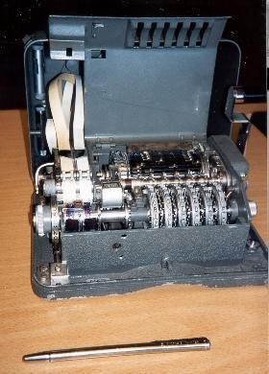
Hagelin Rotor Machine

Slide 15
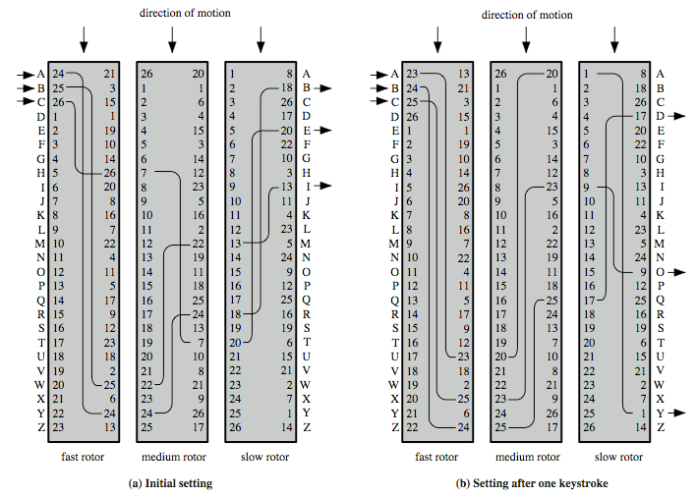
Rotor Machine Principles

Slide 16
Steganography
an alternative to encryption
hides existence of message
using only a subset of letters/words in a longer message marked in some way
using invisible ink
hiding in LSB (Least Significant Bit) in graphic image or sound file
has drawbacks
high overhead to hide relatively few info bits
advantage is can obscure encryption use

Slide 17
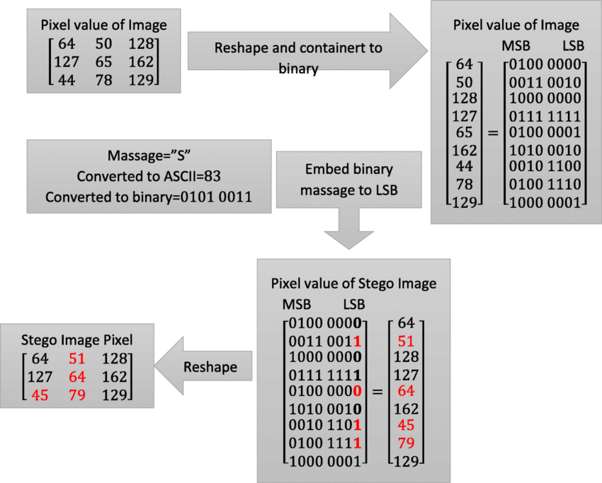
LSB Steganography

Slide 18
Thank You

