Slide 1



Cyber Security & Digital Forensics CSE - 4207
Lecture - 09
Dr. Md. Alam Hossain
Professor
Jashore University of Science and Technology

Slide 2







Outline
Botnet
DDoS using Botnet
Botnet and C&C problem
Advanced Persistent Threat
Malware Obfuscation
Unpacking

Slide 3
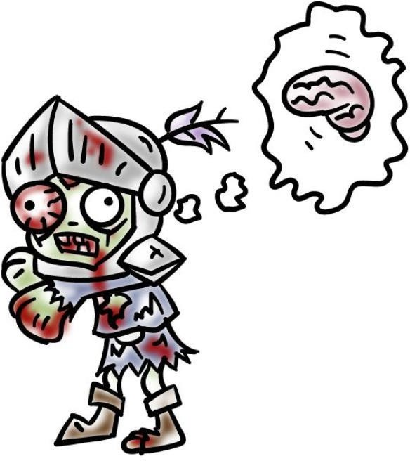
Botnet
Bot (Zombie)
A compromised computer under the control
of an attacker
Bot code (malware) on the computer
communicates with the attacker’s server and carries out malicious activities per attacker’s instructions

Slide 4
Botnet
Botnet
  A network of bots controlled by an attacker to perform coordinated malicious activities
  Key platform for most Internet-based attacks and frauds

Slide 5

Attacks and Frauds by Botnets
Spam
Key Logging &
D_{T}a_{ft}t_{e}a_{f}/_{t}Identity
Distributed Denial
of Service (DDOS)
Key/Password
Attacks
Clickfraud
C…racking
A_{T}n_{e}o_{r}n_{r}y_{o}m_{ris}iz_{t}ed&
Pftisfting &
Cfteating in online _{Com}Cr_{m}im_{un}in_{ic}a_{a}l _{tion}
Pftarming
games/polls

Slide 6
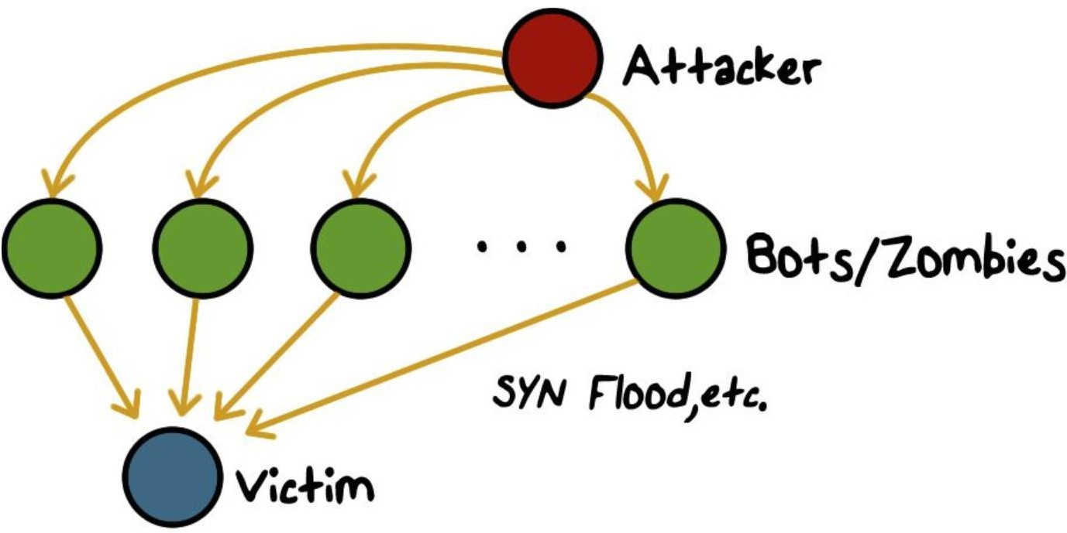
DDos Using Botnets

Slide 7
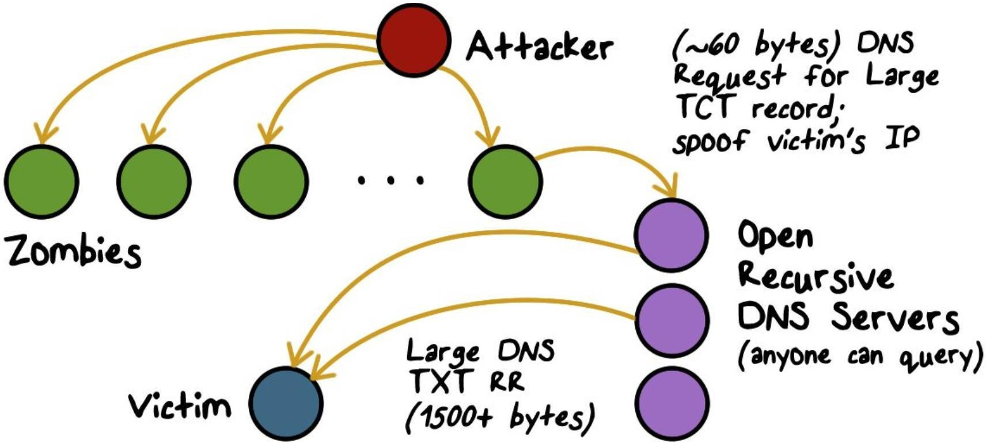
Amplified Distributed Reflective Attacks

Slide 8
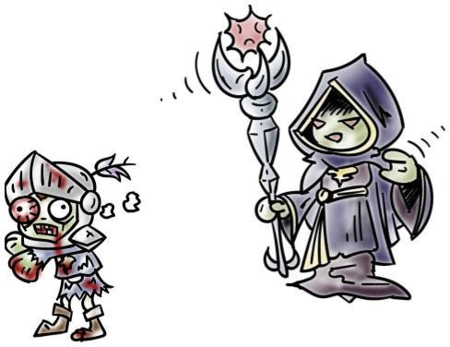
Botnet Command and Control
Botnet is a network of compromised computers that the “botmaster” uses for malicious purposes
  There needs to be command & control (C&C) from the botmaster to the bots
    Example: a bot reports to the
botmaster its status, is directed to a site to download a malware (botcode) update, and/or receives instructions to spam/phish/DDoS, etc.

Slide 9
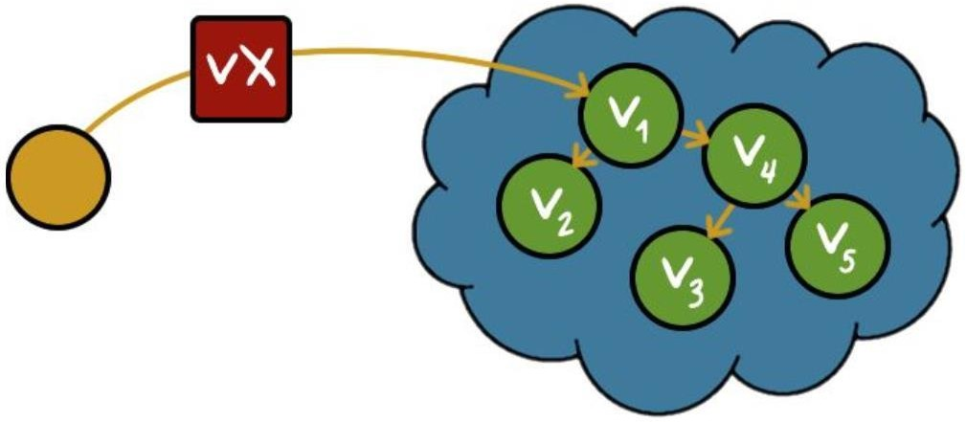
Botnet C&C Problem
Naively, we could have victims contact us…
  Suppose we create malware (vx)
    Download vx code; ddle;fi compile
    Uses email propagation/social engineering
  We mail it...
Spreading is easy,
but what if we want to use the
compromised computers (victims)?

Slide 10
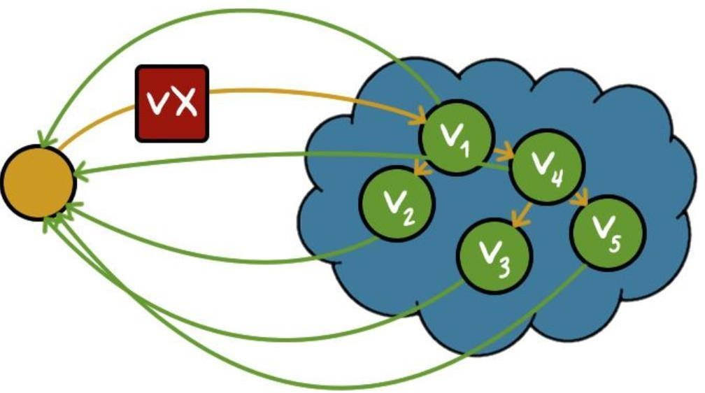
Botnet C&C- Naive Approacft
Naively, we could have victims contact us…
  Problems:
    VX must include author's address
(not stealthy)
    Single rallying point (not robust)
    VX has hard-coded address (not mobile)

Slide 11

Botnet C&C Design
How can bots contact tfteir master
safely?
Simple, naïve approacft:
  Victims contact single IP, website, ping a server, etc.
  Easily defeated (ISP intervention, blackhole routing, etc.)
  Still used by script-kiddies, first-time malware authors

Slide 12
Botnet C&C Design
Design considerations:
Efficient and reliable
  Able to reach to a sizable set of bots within a time limit
Stealthy
  Hard to detect (i.e., blended with normal/regular traffic)
Resilient
  Hard to disable or block

Slide 13
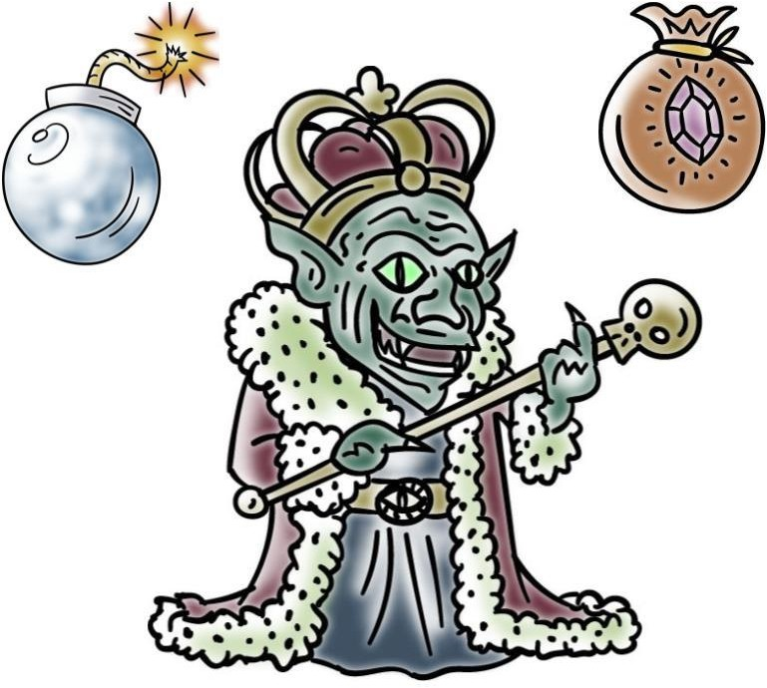
Advanced Persistent Tftreat (APT)
Advanced:
  (Special) malware
  Special operation and operators
Persistent:
  Long-term presence, multi-step, “low-and-slow”
Threat:
  Targeted at high-value organization and information

Slide 14
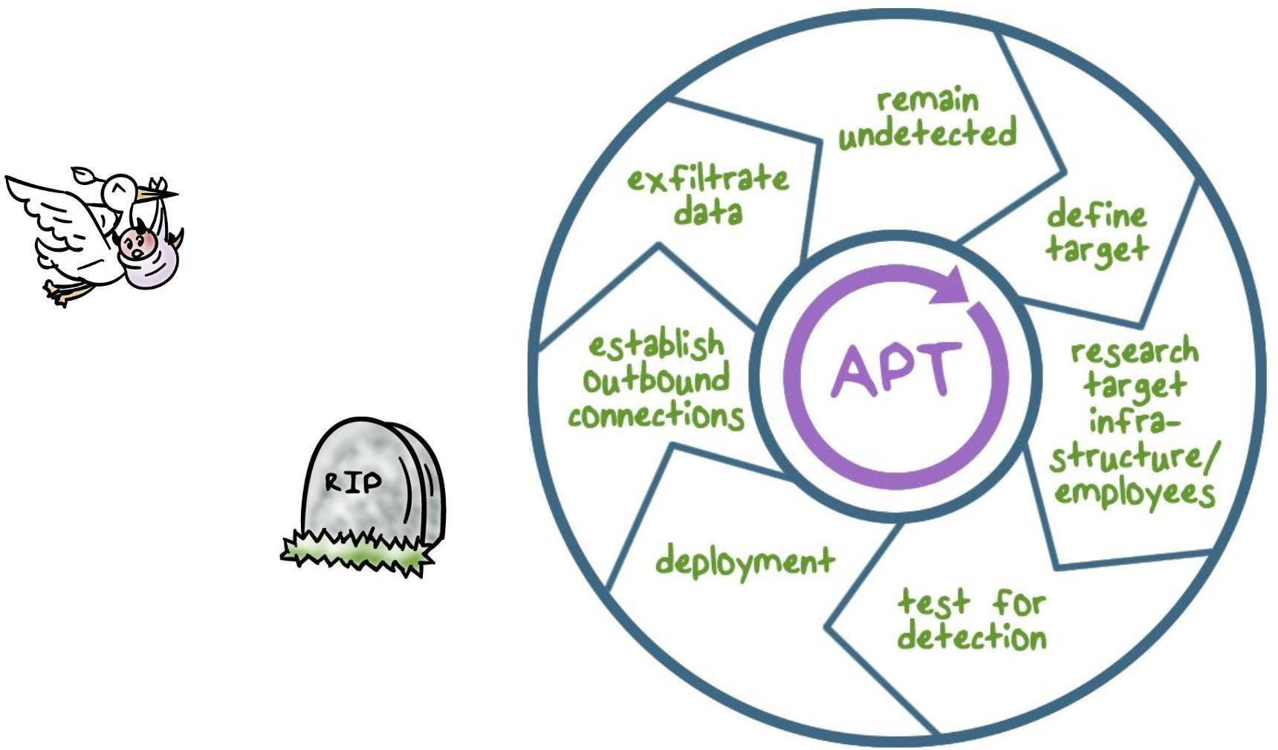
APT Lifecycle

Slide 15
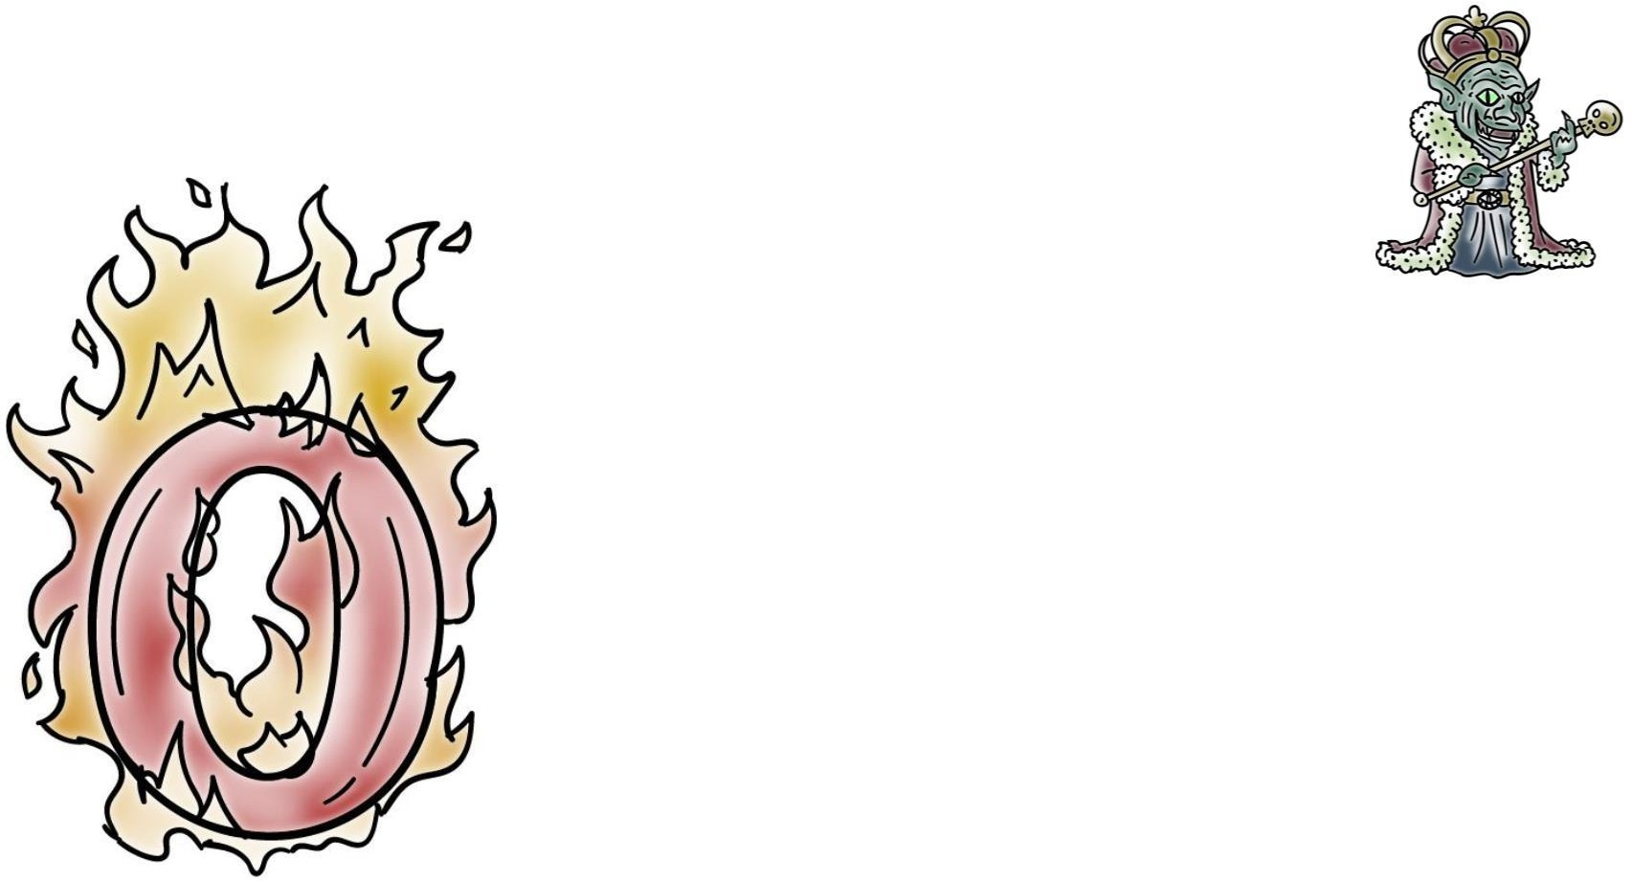
APT Cftaracteristics
Zero-day exploit or a specially crafted malware
No readily available signature for its detection

Slide 16
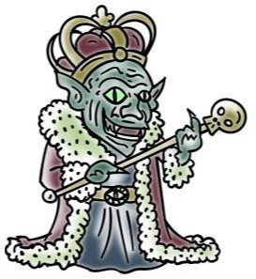
APT Cftaracteristics
Social-engineering to trick even the most sophisticated users.
Example:
First compromise core internal network control elements such as routers and web servers to learn about the valuable targets;
Then play man-in-the-middle (MITM) on the compromised routers/server to make social-engineering attacks very convincing, e.g., to even forge answers to challenge or inquiry by suspecting users

Slide 17
APT Cftaracteristics
Carry out its intended mission, such as data tampering and exfiltration, in a low-and-slow fashion to completely blend in with normal activities
Example:
  Acts only when the targeted user is authoring and sending a document
  Make repeated, small incremental change to data to accomplish the eventual attack goal
  Not detectable anomaly by existing approaches

Slide 18
APT Cftaracteristics
APT is a persistent operation that involves multiple deliberate steps over time, rather than a single attack act
Example:
Employ a combination of steps to move laterally
through the network and target only the necessary systems and users at each attack step

Slide 19
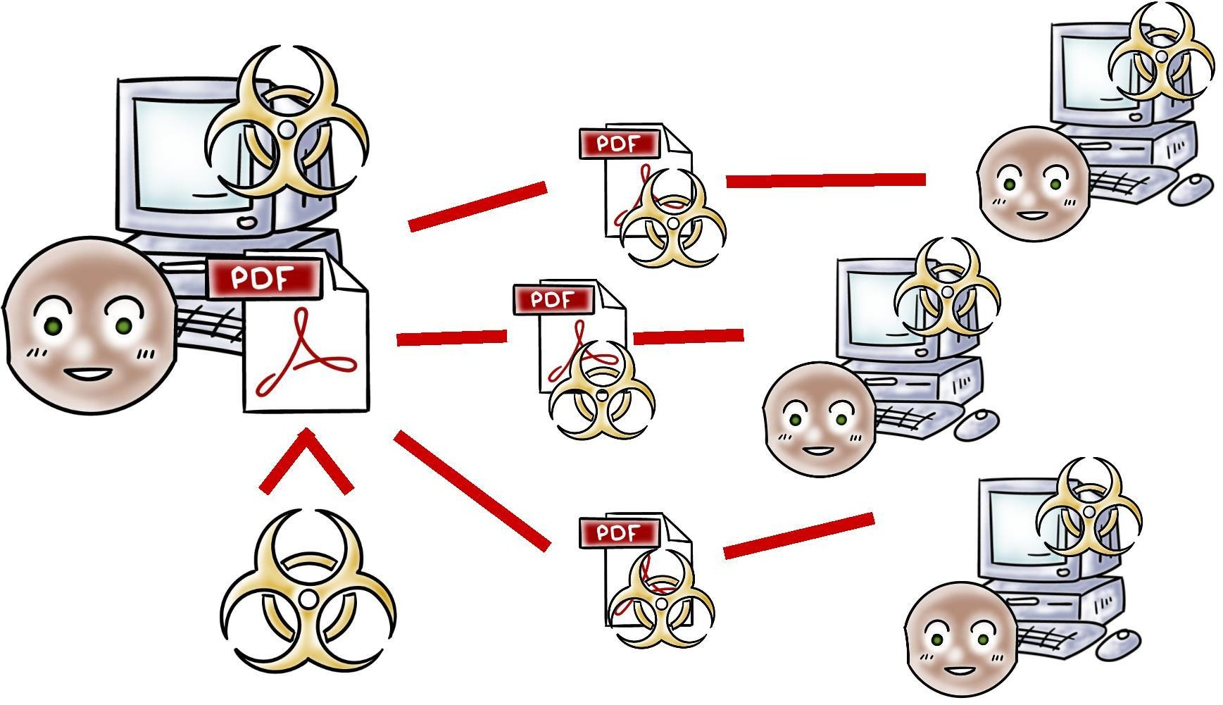
APT Example

Slide 20
Thank You

