Slide 1
Linear regression: Session 1
Adnane Ez-zizi
21/03/2018

Slide 2
Objectives
Introduce simple linear regression
Show how to run a simple linear regression in R
Show how to interpret the outputs that you get from R
Introduce confidence intervals in simple linear regression

Slide 3
Does this R output look familiar?
Notes:
One major goal of this tutorial is to get you to a point where you can independently run and interpret linear regression in R

Slide 4
Our case study
Imagine that we have some data about the sales of a product in 200 different markets, along with the advertising budgets for three different media: TV, radio, and newspaper.
Advertising <- read.csv("Advertising.csv")
head(Advertising, n=3)
X TV radio newspaper sales
1 1 230.1 37.8 69.2 22.1
2 2 44.5 39.3 45.1 10.4
3 3 17.2 45.9 69.3 9.3

Slide 5
Questions we can answer using linear regression
Is their a relationship between each advertising budget and the sales?
If yes, how strong is this relationship?
How accurately can we estimate the effect of each medium on the sales?
Which media contribute to the sales?
How accurately can we predict the future sales knowing the advertising budget?
Is there a synergy among the advertising media?
Notes:
In this session we will try to answer the first 3 questions

Slide 6
Task (warm-up): mlu data set
Data set description:
During language acquisition, it is claimed that caregivers adapt their language to the language abilities of children. The data set follows a particular child and record an hour conversation between the child and the mother once every month from the age of 2 to 4.
The variables “chi” and “mot” record, for both the child and the mother, a measure of language complexity/competency for children called Mean Length of Utterance (MLU).

Slide 7
Task 1 (warm-up): mlu data set
To do:
Load the mlu data set (use the file “mlu.txt”)
How many variables and observations are there?

Slide 8
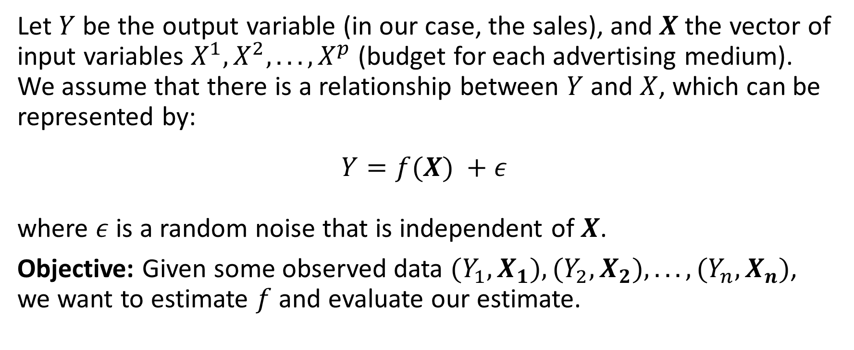
The general form of a statistical model
Let $Y$ be the output variable (in our case, the sales), and $X$ the vector of input variables $X^{1},X^{2},...,X^{p}$ (budget for each advertising medium). We assume that there is a relationship between $Y$ and $X$, which can be represented by:
$$Y=f(X) +ε$$
where $ε$ is a random noise that is independent of $X$.
Objective: Given some observed data $(Y_{1},X_{1}),(Y_{2},X_{2}),...,(Y_{n},X_{n})$, we want to estimate $f$ and evaluate our estimate.
Notes:
$ε$ is basically the error that we make by approximating $Y$ by $f(X)$.
Vectors are denoted in bold

Slide 9
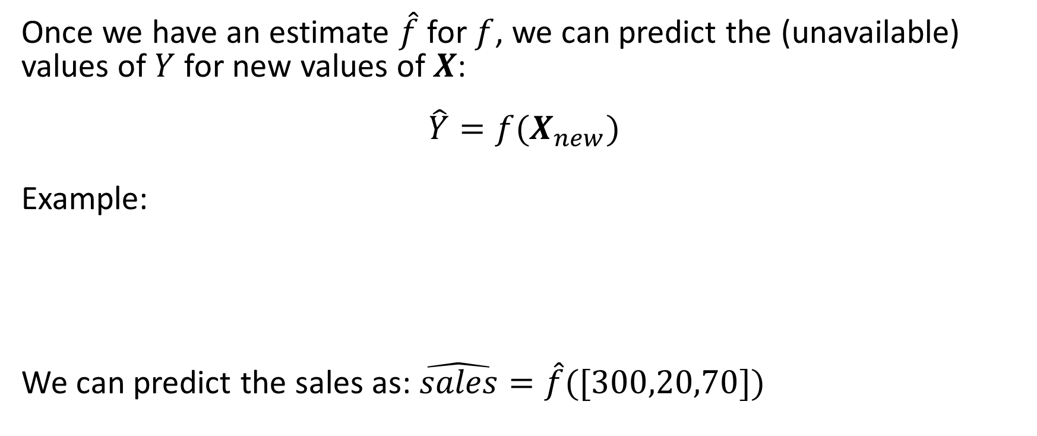
The general form of a statistical model
Once we have an estimate $\hat{f}$ for $f$, we can predict the (unavailable) values of $Y$ for new values of $X$:
$$\hat{Y}=f(X_{new})$$
Example:
We can predict the sales as: $\hat{sales}=\hat{f}([300,20,70])$
Notes:
We can predict the sales as: $\hat{sales}=\hat{f}([300,20,70])$

Slide 10
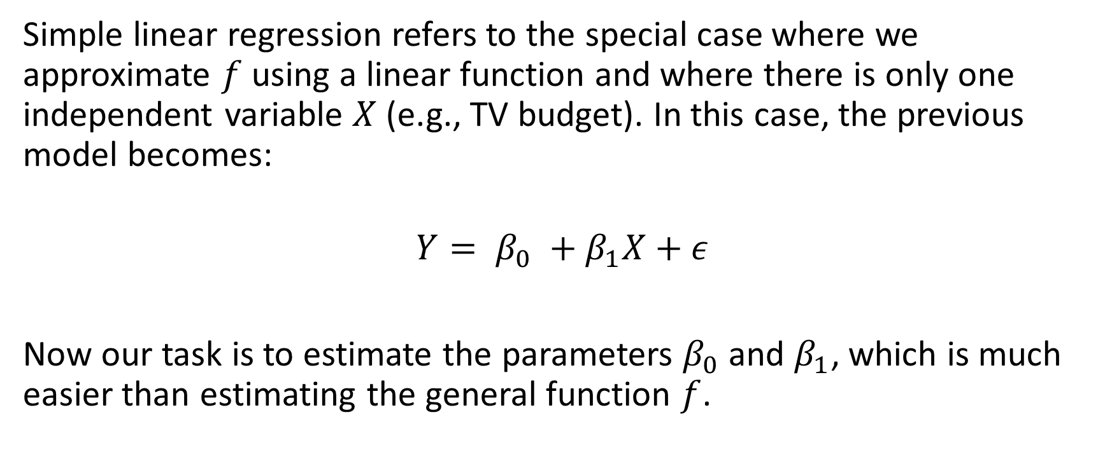
Simple linear regression
Simple linear regression refers to the special case where we approximate $f$ using a linear function and where there is only one independent variable $X$ (e.g., TV budget). In this case, the previous model becomes:
$$Y= β_{0} +β_{1}X+ε$$
Now our task is to estimate the parameters $β_{0}$ and $β_{1}$, which is much easier than estimating the general function $f$.
Notes:
We can predict the sales as: $\hat{sales}=\hat{f}([300,20,70])$

Slide 11
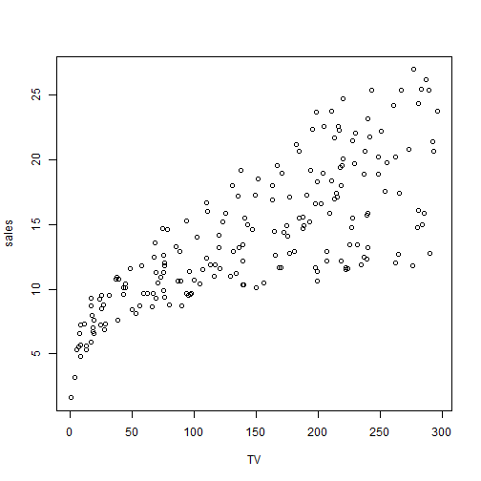
Simple linear regression
Back to our example: Is their a relationship between the TV advertising budget and the sales? And if yes, is the relationship linear?

Slide 12
Task 2: making a plot using the mlu data
To do:
Plot the relationship between the mother’s and child’s MLU.
Does the relationship look linear?

Slide 13
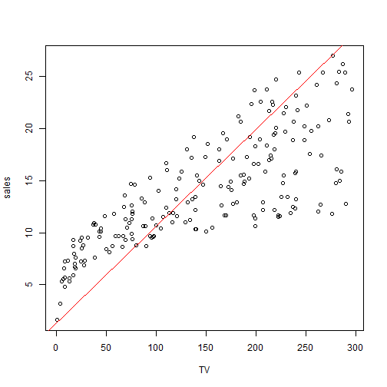
Simple linear regression
How can we choose a regression line that best fits the data? Maybe this one?
Notes:
We can predict the sales as: $\hat{sales}=\hat{f}([300,20,70])$

Slide 14
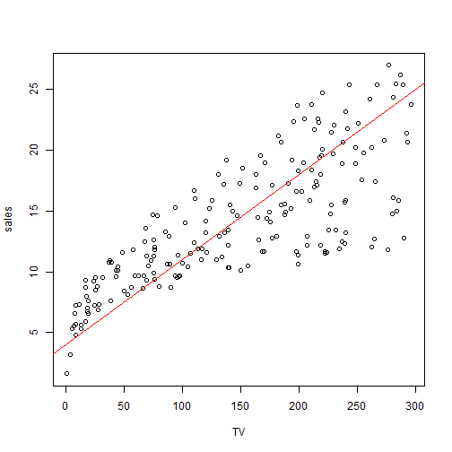
Simple linear regression
Or this one?
Notes:
We can predict the sales as: $\hat{sales}=\hat{f}([300,20,70])$

Slide 15
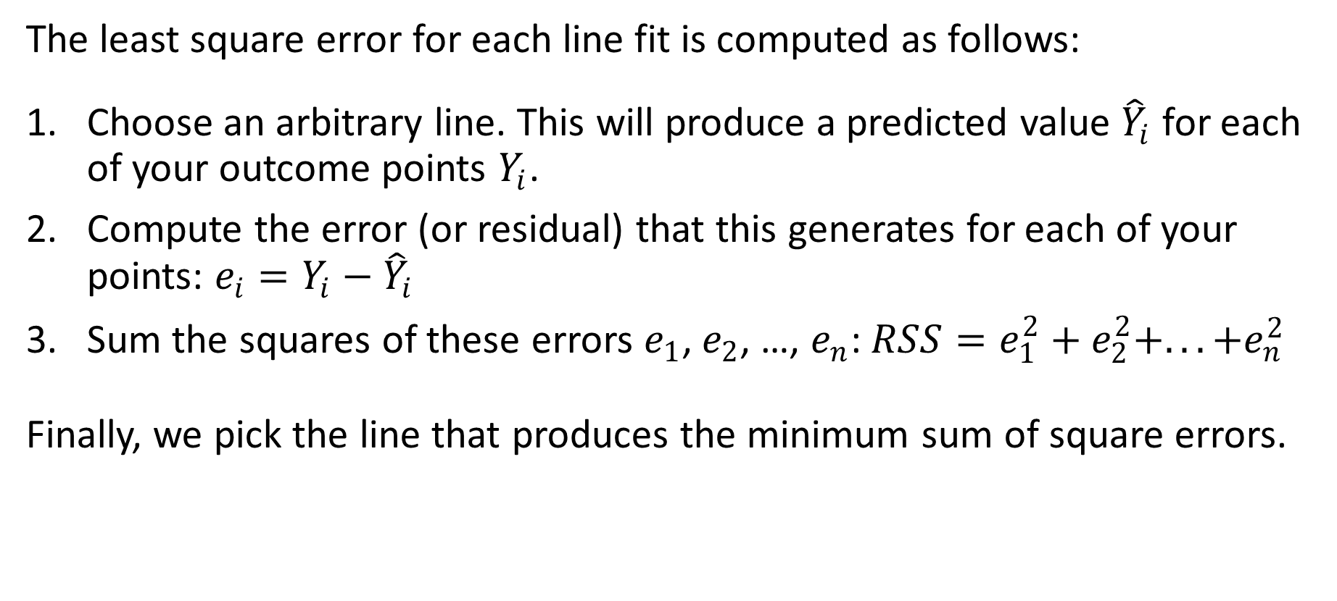
Method of least squares: finding the best fitting regression line
The least square error for each line fit is computed as follows:
Choose an arbitrary line. This will produce a predicted value ${\hat{Y}}_{i}$ for each of your outcome points $Y_{i}$.
Compute the error (or residual) that this generates for each of your points: $e_{i}=Y_{i}−{\hat{Y}}_{i}$
Sum the squares of these errors $e_{1}$, $e_{2}$, …, $e_{n}$: $RSS=e_{1}^{2}+e_{2}^{2}+...+e_{n}^{2}$
Finally, we pick the line that produces the minimum sum of square errors.
Notes:
Method of least squares for finding the best fitting regression line

Slide 16
Simple linear regression: fit in R
fit.TV = lm(sales ~ TV, data = Advertising)
summary(fit.TV)
Call:
lm(formula = sales ~ TV, data = Advertising)
Residuals:
Min 1Q Median 3Q Max
-8.3860 -1.9545 -0.1913 2.0671 7.2124
Coefficients:
Estimate Std. Error t value Pr(>|t|)
(Intercept) 7.032594 0.457843 15.36 <2e-16 ***
TV 0.047537 0.002691 17.67 <2e-16 ***
---
Signif. codes: 0 '***' 0.001 '**' 0.01 '*' 0.05 '.' 0.1 ' ' 1
Residual standard error: 3.259 on 198 degrees of freedom
Multiple R-squared: 0.6119, Adjusted R-squared: 0.6099
F-statistic: 312.1 on 1 and 198 DF, p-value: < 2.2e-16
Notes:
The first command line fits a linear regression to the ‘Advertising’ data, while the second one displays the results

Slide 17
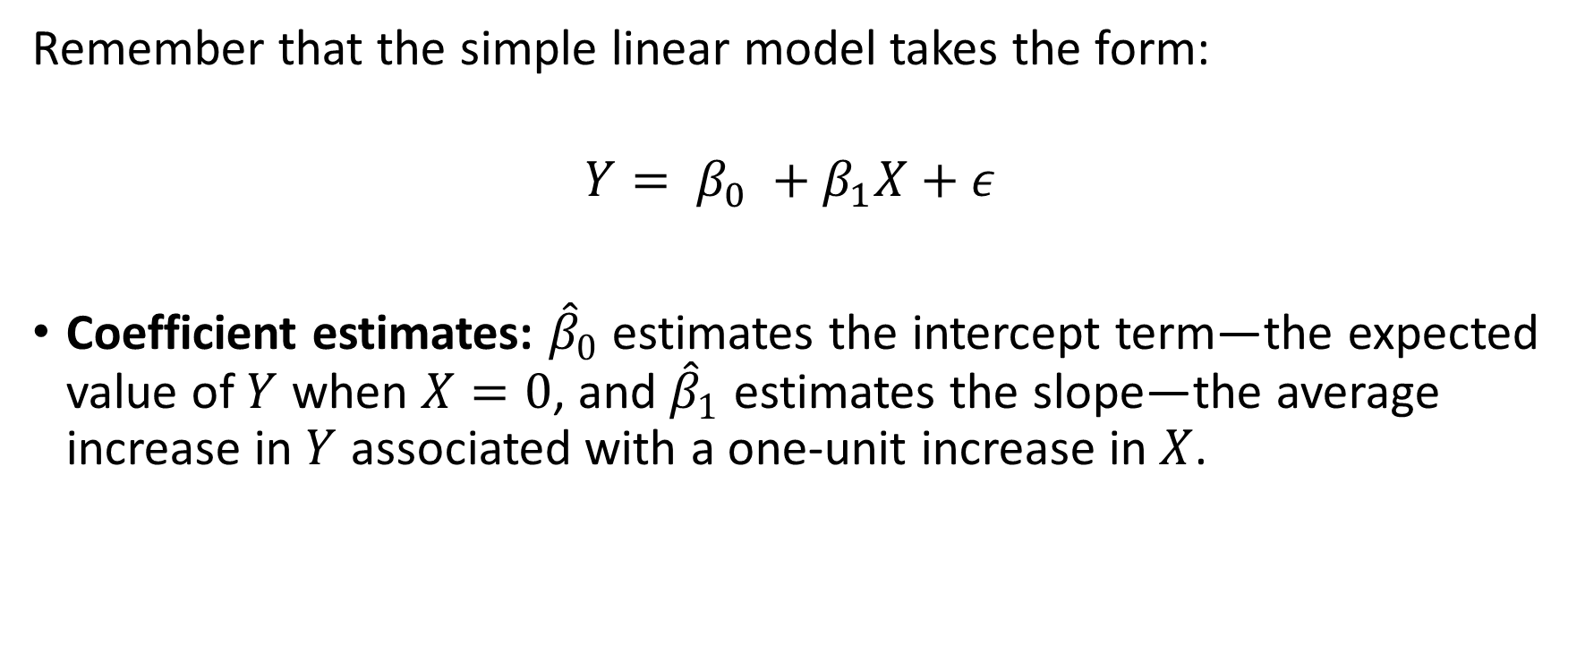
Interpreting the results: coefficient estimates
Remember that the simple linear model takes the form:
$$Y= β_{0} +β_{1}X+ε$$
Coefficient estimates: ${\hat{β}}_{0}$ estimates the intercept term—the expected value of $Y$ when $X=0$, and ${\hat{β}}_{1}$ estimates the slope—the average increase in $Y$ associated with a one-unit increase in $X$.

Slide 18
Interpreting the results: standard errors of the coefficients
Measure how far off each coefficient estimate is from the true coefficient.
Mathematically speaking, if you have many samples from which you compute each time the coefficient estimate. This will produce a distribution of estimates. The standard deviation of the resulting distribution is called standard error of the coefficient estimate.

Slide 19
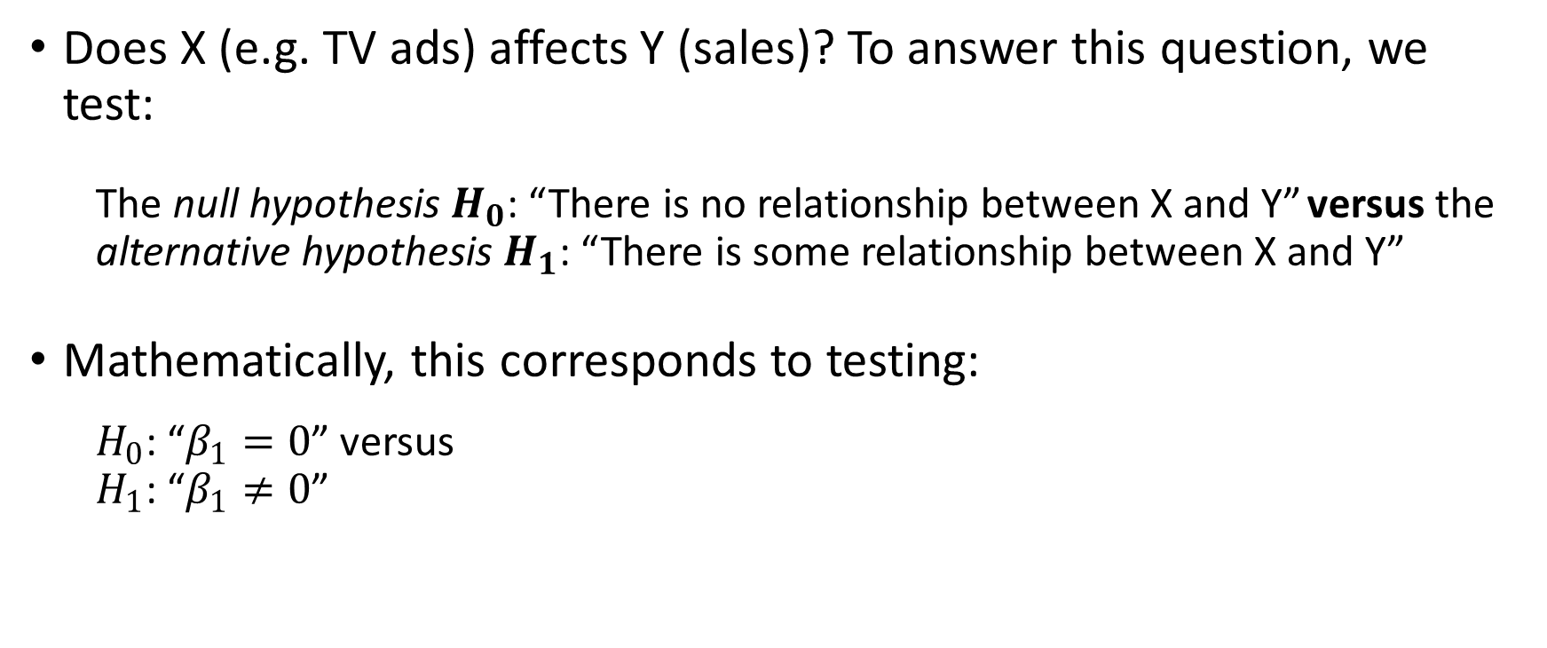
Interpreting the results: hypothesis testing
Does X (e.g. TV ads) affects Y (sales)? To answer this question, we test:
The null hypothesis $H_{0}$: “There is no relationship between X and Y” versus the alternative hypothesis $H_{1}$: “There is some relationship between X and Y”
Mathematically, this corresponds to testing:
$H_{0}$: “$β_{1}=0$” versus $H_{1}$: “$β_{1}≠0$”

Slide 20
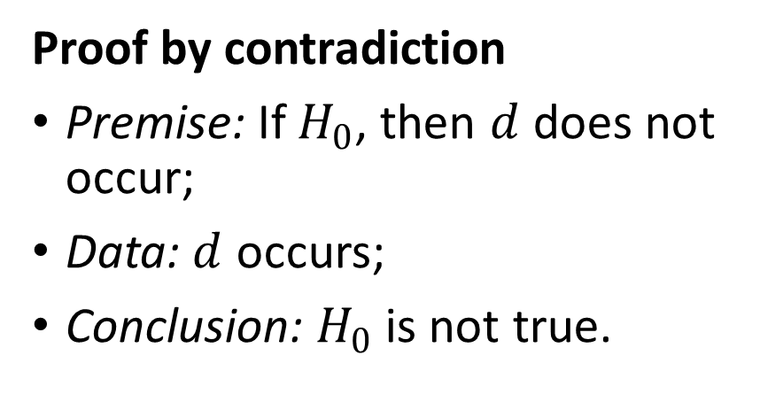
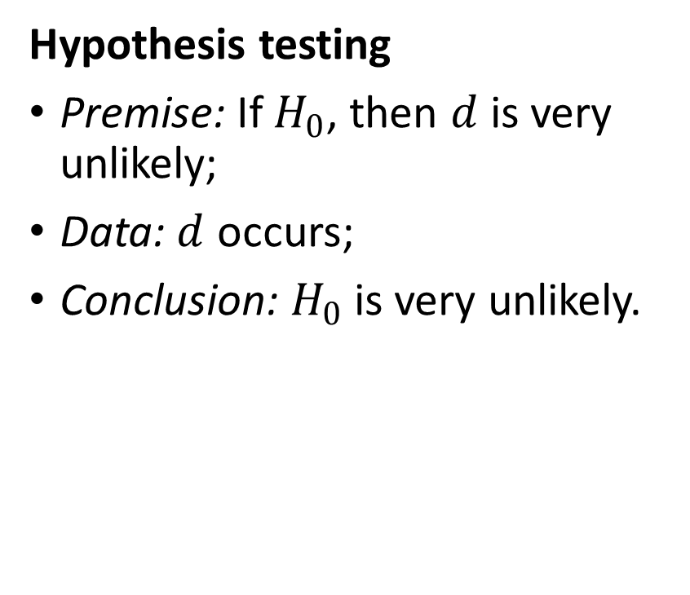
Interpreting the results: hypothesis testing (comparison to a proof by contradiction)
Proof by contradiction
Premise: If $H_{0}$, then $d$ does not occur;
Data: $d$ occurs;
Conclusion: $H_{0}$ is not true.
Hypothesis testing
Premise: If $H_{0}$, then $d$ is very unlikely;
Data: $d$ occurs;
Conclusion: $H_{0}$ is very unlikely.
Example: Alibi (being elsewhere at the time of the crime)

Slide 21
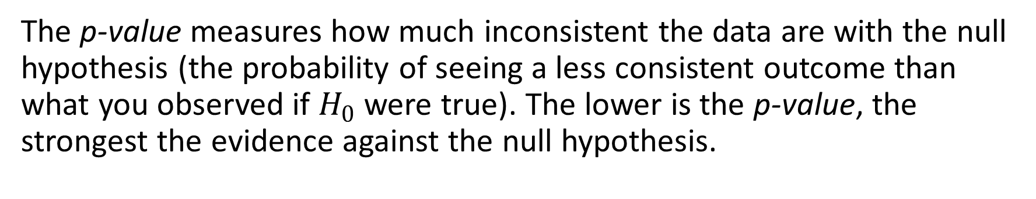
Interpreting the results: p-value
The p-value measures how much inconsistent the data are with the null hypothesis (the probability of seeing a less consistent outcome than what you observed if $H_{0}$ were true). The lower is the p-value, the strongest the evidence against the null hypothesis.

Slide 22
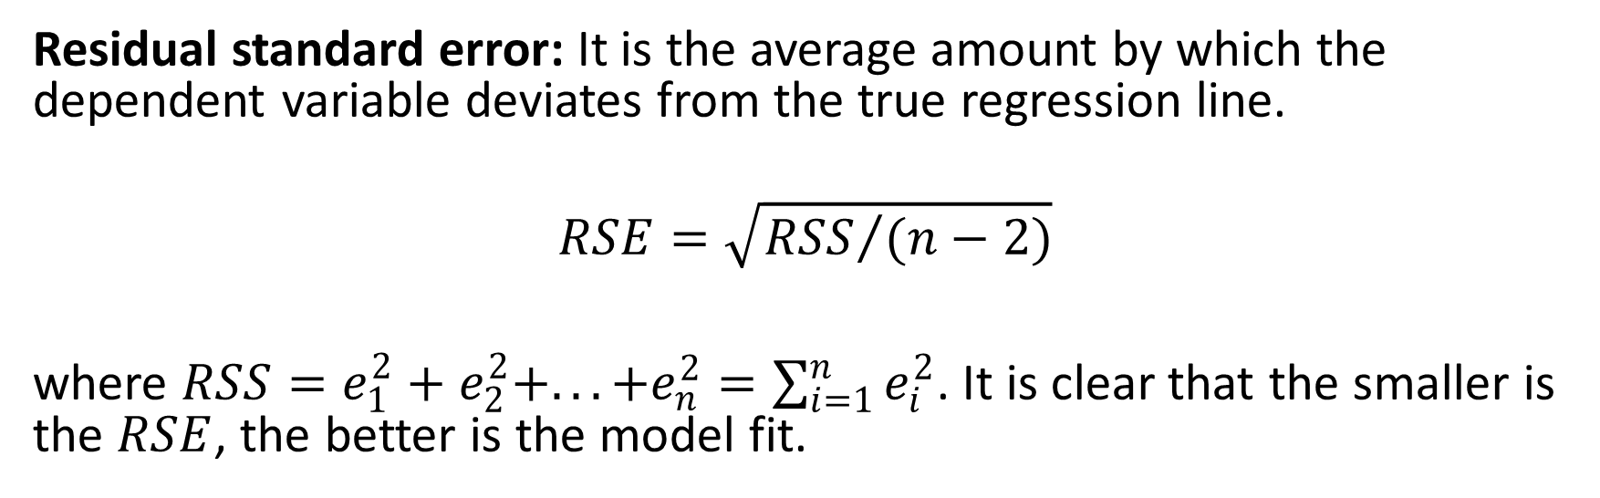
Interpreting the results: quality of model fit
Residual standard error: It is the average amount by which the dependent variable deviates from the true regression line.
$$RSE=\sqrt{{RSS}/{(n−2)}}$$
where $RSS=e_{1}^{2}+e_{2}^{2}+...+e_{n}^{2}=\sum_{i=1}^{n}{e_{i}^{2}}$. It is clear that the smaller is the $RSE$, the better is the model fit.
Notes:
$RSS$ measures the amount of variability that is left unexplained after performing the regression

Slide 23
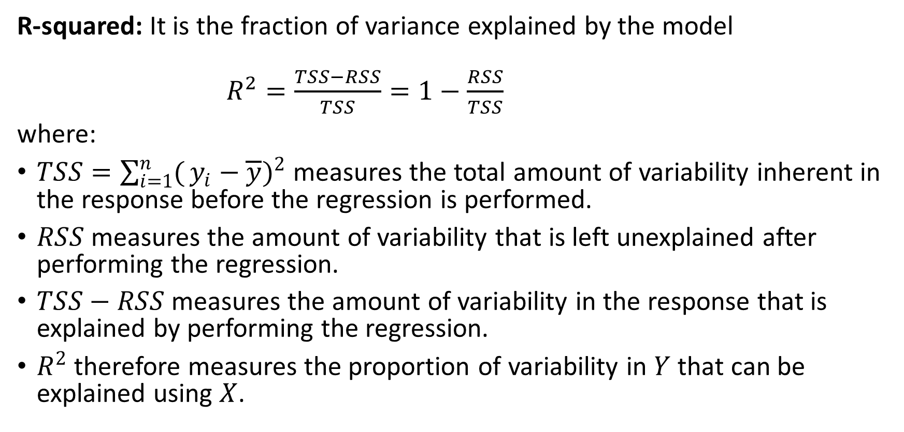
Interpreting the results: quality of model fit
R-squared: It is the fraction of variance explained by the model
$R^{2}=\frac{TSS−RSS}{TSS}=1−\frac{RSS}{TSS}$
where:
$TSS=\sum_{i=1}^{n}{(}y_{i}−\overline{y})^{2}$ measures the total amount of variability inherent in the response before the regression is performed.
$RSS$ measures the amount of variability that is left unexplained after performing the regression.
$TSS−RSS$ measures the amount of variability in the response that is explained by performing the regression.
$R^{2}$ therefore measures the proportion of variability in $Y$ that can be explained using $X$.
Notes:
$\overline{y}$ is the average value of the response variable Y

Slide 24
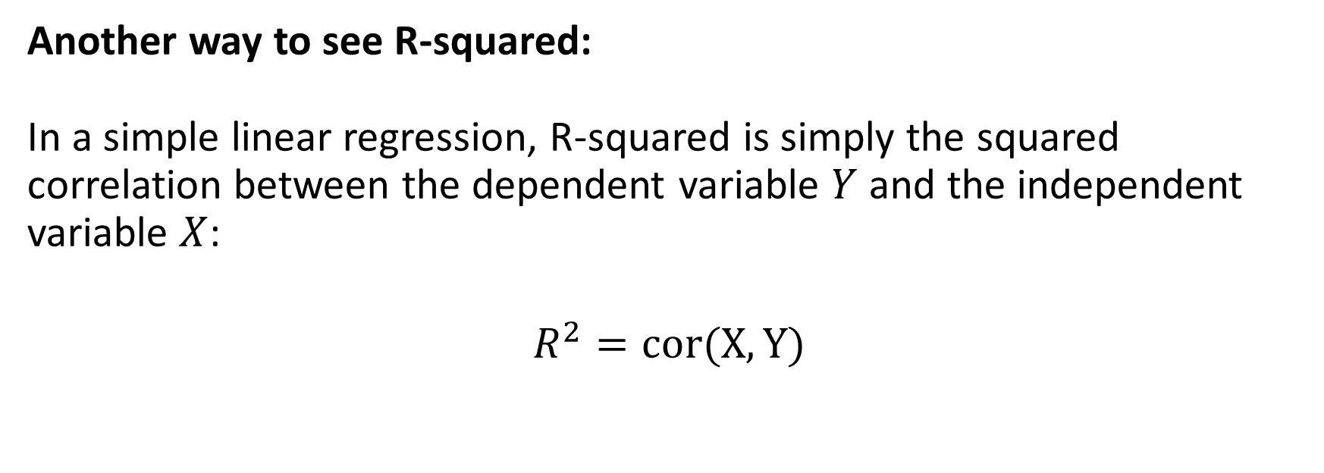
Interpreting the results: quality of model fit
Another way to see R-squared:
In a simple linear regression, R-squared is simply the squared correlation between the dependent variable $Y$ and the independent variable $X$:
$$R^{2}=cor(X,Y)$$

Slide 25

Back to our initial point: Does this R output make more sense now?
Call:
lm(formula = sales ~ TV, data = Advertising)
Residuals:
Min 1Q Median 3Q Max
-8.3860 -1.9545 -0.1913 2.0671 7.2124
Coefficients:
Estimate Std. Error t value Pr(>|t|)
(Intercept) 7.032594 0.457843 15.36 <2e-16 ***
TV 0.047537 0.002691 17.67 <2e-16 ***
---
Signif. codes: 0 '***' 0.001 '**' 0.01 '*' 0.05 '.' 0.1 ' ' 1
Residual standard error: 3.259 on 198 degrees of freedom
Multiple R-squared: 0.6119, Adjusted R-squared: 0.6099
F-statistic: 312.1 on 1 and 198 DF, p-value: < 2.2e-16
${Sales}_{i}=7.0326+0.0476×{TV}_{i}$
Average error
p-values (the coefficient are
significantly different from 0)
Proportion of
Variance explained by the model
Nobs – Ncoeffs
(the ‘n-2’ in the
formula of RSE)

Slide 26
Back to our initial questions
Is there a relationship between TV advertising budget and sales?
-> Yes, the regression coefficient suggests that the sales are positively related to the TV advertising budget---the more you spend on TV advertising, the higher the sales. Also, the effect of TV advertising on the sales is robust since the coefficient is significantly different from 0.
If yes, how strong is this relationship?
-> The percentage error is 23% (RSE/mean(Y)).
-> TV advertising budget can explain 61% of the variability in the sales.

Slide 27
Questions we can answer using simple linear regression
How accurately can we estimate the effect of TV advertising on sales?
-> The standard error (SE) of the TV coefficient is 0.002691, which represents less than 6% of the coefficient estimate.
-> We can also use the standard error to construct what we call a confidence interval for the TV coefficient, instead of producing a unique point estimate, such that we will be pretty sure that the true coefficient will be in the interval.

Slide 28
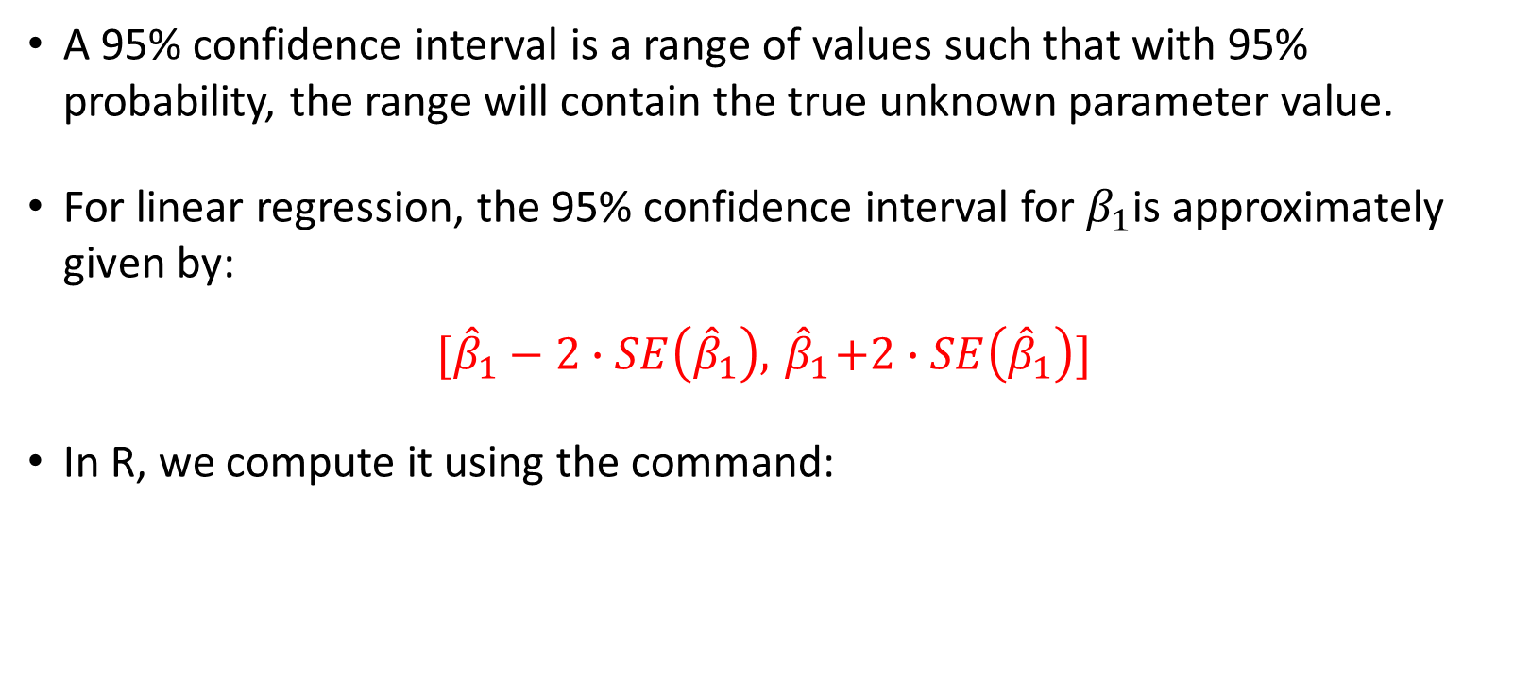
Confidence intervals
A 95% confidence interval is a range of values such that with 95% probability, the range will contain the true unknown parameter value.
For linear regression, the 95% confidence interval for $β_{1}$is approximately given by:
$$[{\hat{β}}_{1}−2∙SE\left({\hat{β}}_{1}\right), { \hat{β}}_{1}+2∙SE\left({\hat{β}}_{1}\right)]$$
In R, we compute it using the command:
confint(fit1, "TV")
2.5 % 97.5 %
TV 0.04223072 0.05284256

Slide 29
Task 3: Simple linear regression on the mlu data
To do:
Build a simple linear regression model to explain “mot” as a function of “chi”.
Construct a 95% confidence interval for the regression coefficient of chi.
What can you conclude?

Slide 30
The end

