Slide 1
Linear regression: Session 2
Adnane Ez-zizi
18/04/2018

Slide 2
Outline
Multiple linear regression model
Multiple linear regression versus multiple simple linear regression
The F-test for model comparison
Modelling interactions between the predictors

Slide 3
Recap from last time

Slide 4
Let's recap from last time
Example:
We have some data about the sales of a product in 200 different markets, along with the advertising budgets for three different media: TV, radio, and newspaper.
Advertising <- read.csv("Advertising.csv")
head(Advertising, n=3)
X TV radio newspaper sales
1 1 230.1 37.8 69.2 22.1
2 2 44.5 39.3 45.1 10.4
3 3 17.2 45.9 69.3 9.3

Slide 5

Back to our initial point: Does this R output make more sense now?
Call:
lm(formula = sales ~ TV, data = Advertising)
Residuals:
Min 1Q Median 3Q Max
-8.3860 -1.9545 -0.1913 2.0671 7.2124
Coefficients:
Estimate Std. Error t value Pr(>|t|)
(Intercept) 7.032594 0.457843 15.36 <2e-16 ***
TV 0.047537 0.002691 17.67 <2e-16 ***
---
Signif. codes: 0 '***' 0.001 '**' 0.01 '*' 0.05 '.' 0.1 ' ' 1
Residual standard error: 3.259 on 198 degrees of freedom
Multiple R-squared: 0.6119, Adjusted R-squared: 0.6099
F-statistic: 312.1 on 1 and 198 DF, p-value: < 2.2e-16
${Sales}_{i}=7.0326+0.0476×{TV}_{i}$
Average error
p-values (the coefficient are
significantly different from 0)
Proportion of
Variance explained by the model
Nobs – Ncoeffs
(the ‘n-2’ in the
formula of RSE)

Slide 6
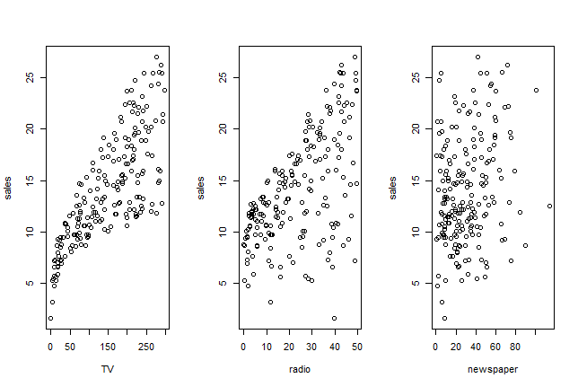
Multiple linear regression model
In our advertising example, we have looked only at the effect of TV advertising on sales. What if we want to know if radio and newspaper advertising are also effective? Or maybe even more effective?

Slide 7
Multiple simple regression models (TV)
fit.TV = lm(sales ~ TV, data = Advertising)
summary(fit.TV)
Call:
lm(formula = sales ~ TV, data = Advertising)
Residuals:
Min 1Q Median 3Q Max
-8.3860 -1.9545 -0.1913 2.0671 7.2124
Coefficients:
Estimate Std. Error t value Pr(>|t|)
(Intercept) 7.032594 0.457843 15.36 <2e-16 ***
TV 0.047537 0.002691 17.67 <2e-16 ***
---
Signif. codes: 0 '***' 0.001 '**' 0.01 '*' 0.05 '.' 0.1 ' ' 1
Residual standard error: 3.259 on 198 degrees of freedom
Multiple R-squared: 0.6119, Adjusted R-squared: 0.6099
F-statistic: 312.1 on 1 and 198 DF, p-value: < 2.2e-16

Slide 8
Multiple simple regression models (Radio)
fit.radio = lm(sales ~ radio, data = Advertising)
summary(fit.radio)
Call:
lm(formula = sales ~ radio, data = Advertising)
Residuals:
Min 1Q Median 3Q Max
-15.7305 -2.1324 0.7707 2.7775 8.1810
Coefficients:
Estimate Std. Error t value Pr(>|t|)
(Intercept) 9.31164 0.56290 16.542 <2e-16 ***
radio 0.20250 0.02041 9.921 <2e-16 ***
---
Signif. codes: 0 ‘***’ 0.001 ‘**’ 0.01 ‘*’ 0.05 ‘.’ 0.1 ‘ ’ 1
Residual standard error: 4.275 on 198 degrees of freedom
Multiple R-squared: 0.332, Adjusted R-squared: 0.3287
F-statistic: 98.42 on 1 and 198 DF, p-value: < 2.2e-16

Slide 9
Multiple simple regression models (Newspaper)
fit.news = lm(sales ~ newspaper, data = Advertising)
summary(fit.news)
Call:
lm(formula = sales ~ newspaper, data = Advertising)
Residuals:
Min 1Q Median 3Q Max
-11.2272 -3.3873 -0.8392 3.5059 12.7751
Coefficients:
Estimate Std. Error t value Pr(>|t|)
(Intercept) 12.35141 0.62142 19.88 < 2e-16 ***
newspaper 0.05469 0.01658 3.30 0.00115 **
---
Signif. codes: 0 ‘***’ 0.001 ‘**’ 0.01 ‘*’ 0.05 ‘.’ 0.1 ‘ ’ 1
Residual standard error: 5.092 on 198 degrees of freedom
Multiple R-squared: 0.05212, Adjusted R-squared: 0.04733
F-statistic: 10.89 on 1 and 198 DF, p-value: 0.001148

Slide 10
Problems
Not clear how we can make a single prediction of sales given the budget of each advertising medium?
When estimating each coefficient, we ignored the other two media. This can lead to very misleading estimates of the individual media effects on sales if there are correlations between the predictors.

Slide 11
Multiple linear regression

Slide 12
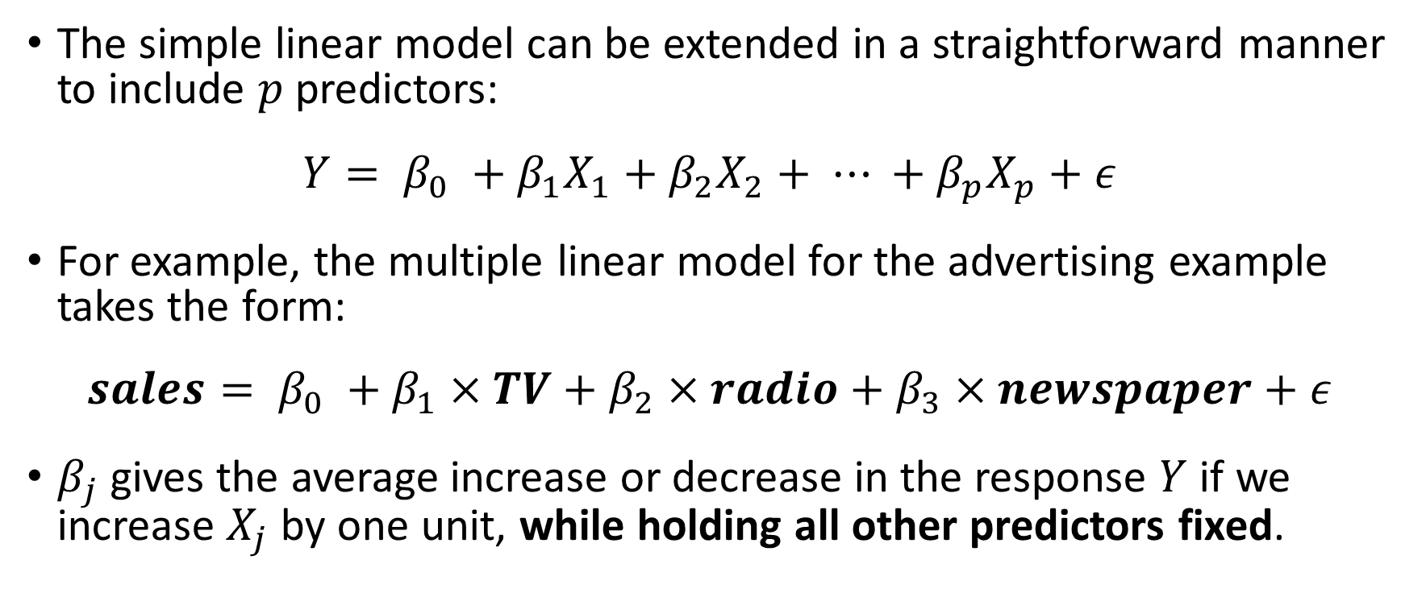
Multiple linear regression model
The simple linear model can be extended in a straightforward manner to include $p$ predictors:
$$Y= β_{0} +β_{1}X_{1}+β_{2}X_{2}+ ⋯ +β_{p}X_{p}+ε$$
For example, the multiple linear model for the advertising example takes the form:
$$sales= β_{0} +β_{1}×TV+β_{2}×radio+β_{3}×newspaper+ε$$
$β_{j}$gives the average increase or decrease in the response $Y$ if we increase $X_{j}$ by one unit, while holding all other predictors fixed.
Notes:
Additivity assumption: The effect of each predictor is independent of the value of the other predictors

Slide 13
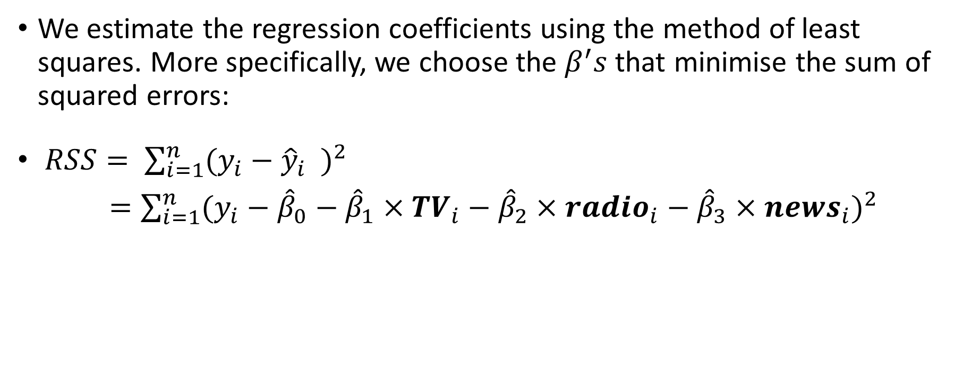
Multiple linear regression model: estimating the coefficients
We estimate the regression coefficients using the method of least squares. More specifically, we choose the $β^{′}s$that minimise the sum of squared errors:
$RSS= \sum_{i=1}^{n}{{(y_{i}−{\hat{y}}_{i} )}^{2}}$
$=\sum_{i=1}^{n}{{(y_{i}−{\hat{β}}_{0}−{\hat{β}}_{1}×{TV}_{i}−{\hat{β}}_{2}×{radio}_{i}−{\hat{β}}_{3}×{news}_{i})}^{2}}$

Slide 14
Multiple linear regression in R
lm.fit = lm(sales ~ TV + radio + newspaper, data = Advertising)
summary(lm.fit)
Call:
lm(formula = sales ~ TV + radio + newspaper, data = Advertising)
Residuals:
Min 1Q Median 3Q Max
-8.8277 -0.8908 0.2418 1.1893 2.8292
Coefficients:
Estimate Std. Error t value Pr(>|t|)
(Intercept) 2.938889 0.311908 9.422 <2e-16 ***
TV 0.045765 0.001395 32.809 <2e-16 ***
radio 0.188530 0.008611 21.893 <2e-16 ***
newspaper -0.001037 0.005871 -0.177 0.86
---
Signif. codes: 0 ‘***’ 0.001 ‘**’ 0.01 ‘*’ 0.05 ‘.’ 0.1 ‘ ’ 1
Residual standard error: 1.686 on 196 degrees of freedom
Multiple R-squared: 0.8972, Adjusted R-squared: 0.8956
F-statistic: 570.3 on 3 and 196 DF, p-value: < 2.2e-16
Notes:
What do you notice here? An answer is given in the next slide

Slide 15
Multiple linear regression in R: coefficients
The coefficients of TV and radio budgets are positive and significant, suggesting that as you increase the spending on TV or radio advertising, sales go up.
The coefficient of newspaper budget is no longer significant and is near 0, suggesting that newspaper advertising has no effect on sales.
The multiple regression coefficient estimates for TV and radio are similar to those of the simple regression. This is not true for newspaper:

Slide 16
Multiple linear regression in R: coefficients
Multiple linear regression model:
Simple linear regression models
(Intercept) TV radio newspaper
2.9389 0.0458 0.1885 -0.0010
(Intercept) TV
7.0326 0.0475
(Intercept) radio
9.3116 0.2025
(Intercept) newspaper
12.3514 0.0547
Notes:
Here we compare the coefficients obtained from the multiple regression model with those obtained from the separate simple linear regression models

Slide 17
Why does the coefficient for newspaper different in the two models?
Consider the correlation matrix (in R, use cor(Advertising[, 2:5])):
-> In markets where we spend more on radio, sales will tend to be higher,
and also newspaper advertising will be higher.
So if we build a simple linear regression that looks at the relationship between sales and newspaper ignoring radio, we might find that high values of newspaper advertising tend to be associated with higher values of sales, even though newspaper advertising does not affect sales.
TV radio newspaper sales
TV 1.0000 0.0548 0.0566 0.782
radio 0.0548 1.0000 0.3541 0.576
newspaper 0.0566 0.3541 1.0000 0.228
sales 0.7822 0.5762 0.2283 1.000

Slide 18
To retain: Multiple regression allows you to test the effect of each predictor while controlling for the effect of the other predictors.

Slide 19
Multiple linear regression: assessing the model fit
lm.fit = lm(sales ~ TV + radio + newspaper, data = Advertising)
summary(lm.fit)
Call:
lm(formula = sales ~ TV + radio + newspaper, data = Advertising)
Residuals:
Min 1Q Median 3Q Max
-8.8277 -0.8908 0.2418 1.1893 2.8292
Coefficients:
Estimate Std. Error t value Pr(>|t|)
(Intercept) 2.938889 0.311908 9.422 <2e-16 ***
TV 0.045765 0.001395 32.809 <2e-16 ***
radio 0.188530 0.008611 21.893 <2e-16 ***
newspaper -0.001037 0.005871 -0.177 0.86
---
Signif. codes: 0 ‘***’ 0.001 ‘**’ 0.01 ‘*’ 0.05 ‘.’ 0.1 ‘ ’ 1
Residual standard error: 1.686 on 196 degrees of freedom
Multiple R-squared: 0.8972, Adjusted R-squared: 0.8956
F-statistic: 570.3 on 3 and 196 DF, p-value: < 2.2e-16
Notes:
Let’s see if the model fit has improved or not by adding radio and newspaper predictors

Slide 20

Multiple linear regression: assessing the model fit using the $RSE$ and $R^{2}$
The percentage error (RSE/mean(Y)) is 12% (compare it to 23% with the simple linear regression on TV).
By including all three predictors we now explain about 89.7% of the variability in sales, in comparison with 61.2% with TV alone.
To take into account the number of predictors, we should compare the adjusted R squared: 89.6% (full model) versus 61% (TV model).

Slide 21
Multiple linear regression: Predicting new scenarios
Once we have fitted the regression model, we can use it to generate new predictions. For example, we can answer questions like: “Is it better to invest £100,000 on TV alone or £50000 on both TV and radio?”
This can be tested using the predict.lm() function in R:
predict.lm(lm.fit, data.frame(TV=c(100,50), radio=c(0,50), newspaper=c(0,0)))
1 2
7.515 14.654

Slide 22
Task 1:
Fit a multiple linear regression model for the mlu data
Predict the mother's MLU at age 50 months if the child's MLU is 3.7

Slide 23
F-test

Slide 24
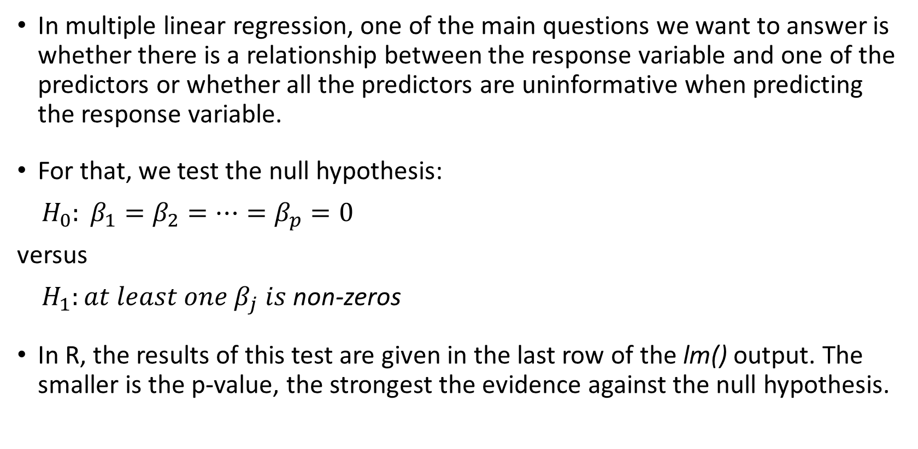
Multiple linear regression: assessing the model fit using the F-test
In multiple linear regression, one of the main questions we want to answer is whether there is a relationship between the response variable and one of the predictors or whether all the predictors are uninformative when predicting the response variable.
For that, we test the null hypothesis:
$H_{0}: β_{1}=β_{2}=⋯=β_{p}=0$
versus
$H_{1}:at least one β_{j} is$ non-zeros
In R, the results of this test are given in the last row of the lm() output. The smaller is the p-value, the strongest the evidence against the null hypothesis.

Slide 25
Multiple linear regression: Assessing the model fit using the F-test
Call:
lm(formula = sales ~ TV + radio + newspaper, data = Advertising)
Residuals:
Min 1Q Median 3Q Max
-8.8277 -0.8908 0.2418 1.1893 2.8292
Coefficients:
Estimate Std. Error t value Pr(>|t|)
(Intercept) 2.938889 0.311908 9.422 <2e-16 ***
TV 0.045765 0.001395 32.809 <2e-16 ***
radio 0.188530 0.008611 21.893 <2e-16 ***
newspaper -0.001037 0.005871 -0.177 0.86
---
Signif. codes: 0 ‘***’ 0.001 ‘**’ 0.01 ‘*’ 0.05 ‘.’ 0.1 ‘ ’ 1
Residual standard error: 1.686 on 196 degrees of freedom
Multiple R-squared: 0.8972, Adjusted R-squared: 0.8956
F-statistic: 570.3 on 3 and 196 DF, p-value: < 2.2e-16
F-test results

Slide 26
F-test for model comparison
The F-test can also be used to compare two “nested” models
anova(fit.TV, lm.fit)
Analysis of Variance Table
Model 1: sales ~ TV
Model 2: sales ~ TV + radio + newspaper
Res.Df RSS Df Sum of Sq F Pr(>F)
1 198 2103
2 196 557 2 1546 272 <2e-16 ***
Notes:
Nested model: all terms of a smaller model occur in a larger model

Slide 27
Interactions between the predictors

Slide 28
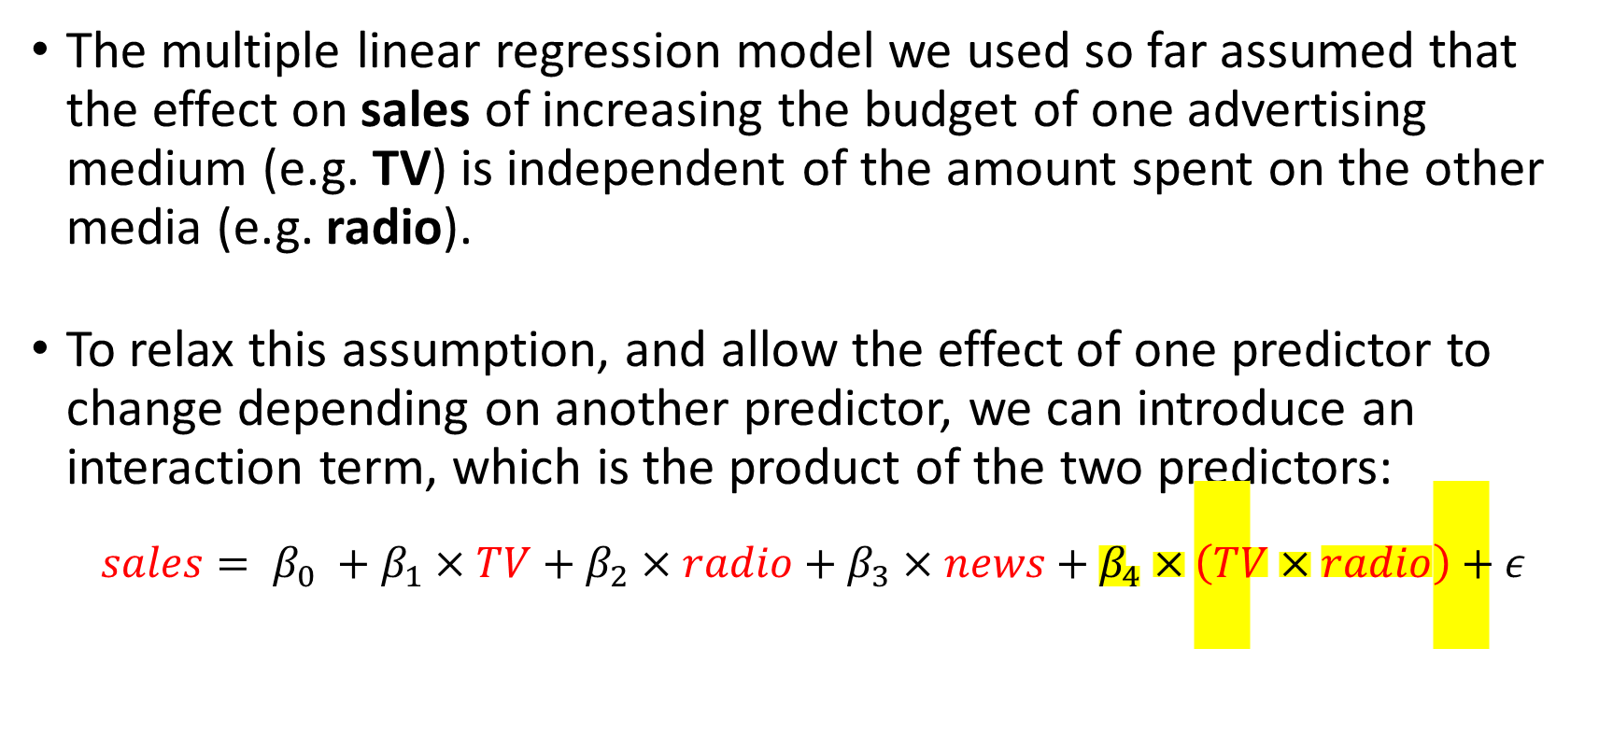
Modelling interactions between the predictors
The multiple linear regression model we used so far assumed that the effect on sales of increasing the budget of one advertising medium (e.g. TV) is independent of the amount spent on the other media (e.g. radio).
To relax this assumption, and allow the effect of one predictor to change depending on another predictor, we can introduce an interaction term, which is the product of the two predictors:
$$sales= β_{0} +β_{1}×TV+β_{2}×radio+β_{3}×news+β_{4}×\left(TV×radio\right)+ε$$
Notes:
Go to the model fit summary page and see the average effect on sales of a one-unit increase in TV, regardless of the amount spent on radio.

Slide 29
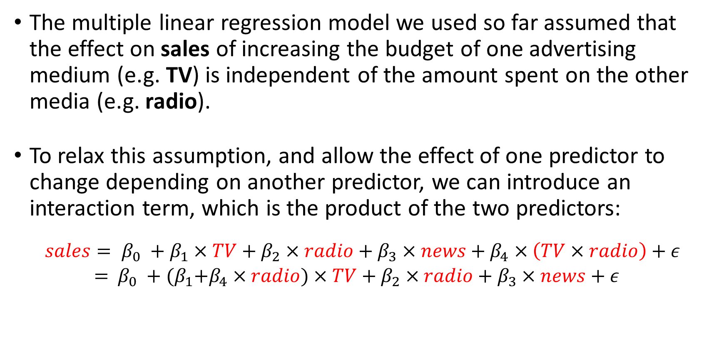
Modelling interactions between the predictors
The multiple linear regression model we used so far assumed that the effect on sales of increasing the budget of one advertising medium (e.g. TV) is independent of the amount spent on the other media (e.g. radio).
To relax this assumption, and allow the effect of one predictor to change depending on another predictor, we can introduce an interaction term, which is the product of the two predictors:
$$sales= β_{0} +β_{1}×TV+β_{2}×radio+β_{3}×news+β_{4}×\left(TV×radio\right)+ε$$
$=$ $β_{0} +{(β}_{1}+β_{4}×radio)×TV+β_{2}×radio+β_{3}×news+ε$

Slide 30
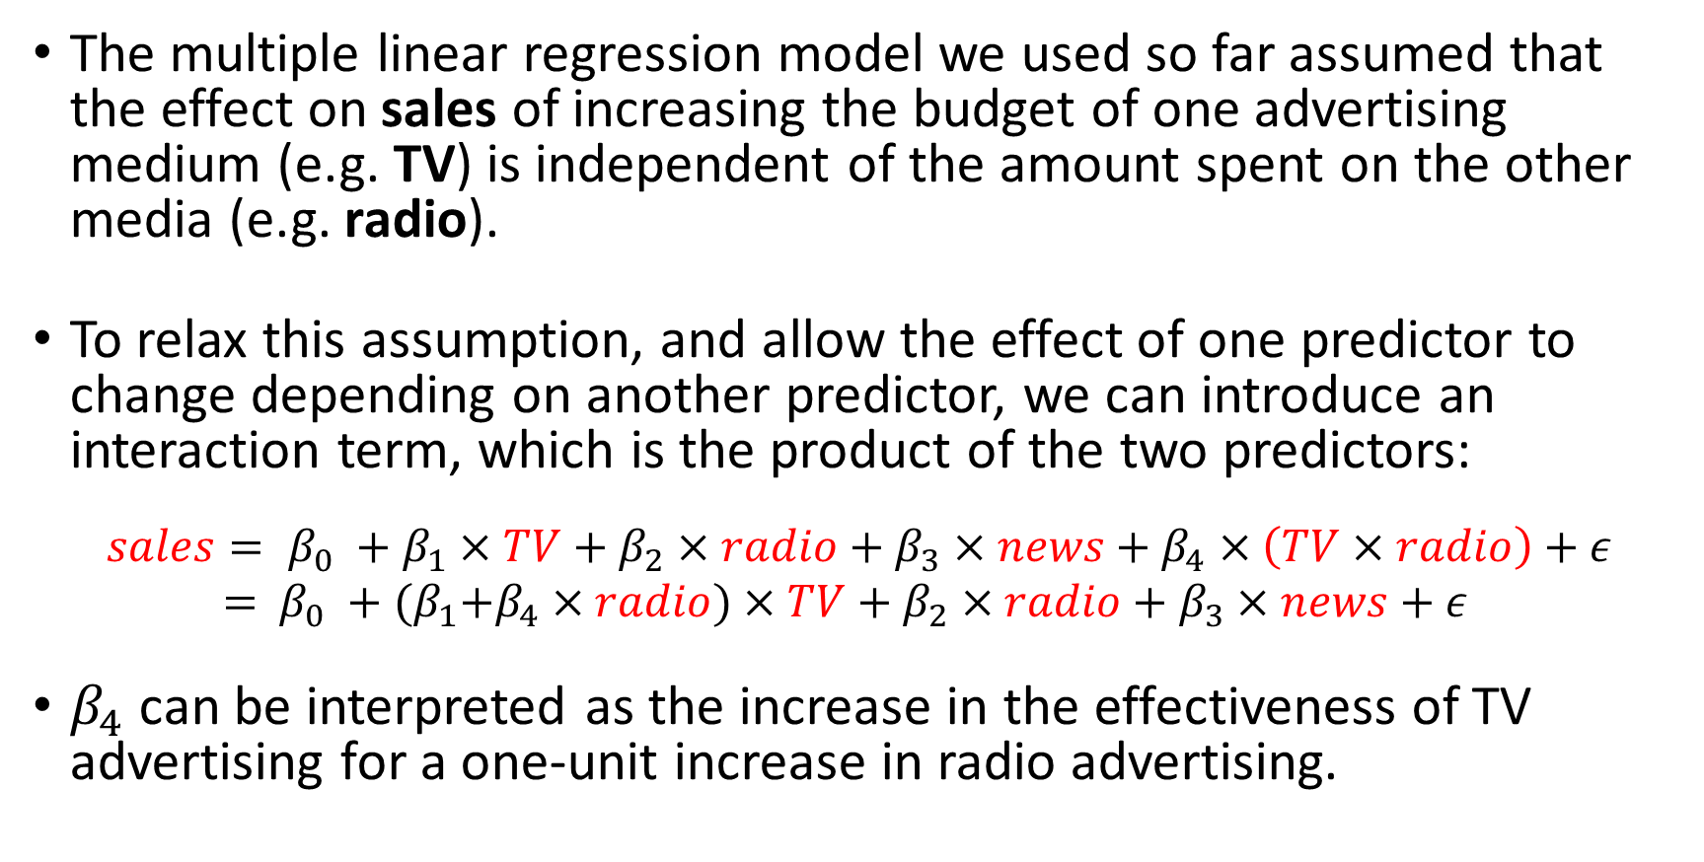
Modelling interactions between the predictors
The multiple linear regression model we used so far assumed that the effect on sales of increasing the budget of one advertising medium (e.g. TV) is independent of the amount spent on the other media (e.g. radio).
To relax this assumption, and allow the effect of one predictor to change depending on another predictor, we can introduce an interaction term, which is the product of the two predictors:
$$sales= β_{0} +β_{1}×TV+β_{2}×radio+β_{3}×news+β_{4}×\left(TV×radio\right)+ε$$
$=$ $β_{0} +{(β}_{1}+β_{4}×radio)×TV+β_{2}×radio+β_{3}×news+ε$
$β_{4}$ can be interpreted as the increase in the effectiveness of TV advertising for a one-unit increase in radio advertising.

Slide 31
Multiple linear regression in R: Interactions
fit.inter = lm(sales ~ TV + radio + TV:radio + newspaper, data = Advertising)
summary(fit.inter)
Residuals:
Min 1Q Median 3Q Max
-6.293 -0.398 0.181 0.596 1.501
Coefficients:
Estimate Std. Error t value Pr(>|t|)
(Intercept) 6.7284119 0.2533195 26.56 <2e-16 ***
TV 0.0190668 0.0015093 12.63 <2e-16 ***
radio 0.0279917 0.0091412 3.06 0.0025 **
newspaper 0.0014442 0.0032955 0.44 0.6617
TV:radio 0.0010873 0.0000526 20.69 <2e-16 ***
---
Signif. codes: 0 ‘***’ 0.001 ‘**’ 0.01 ‘*’ 0.05 ‘.’ 0.1 ‘ ’ 1
Residual standard error: 0.945 on 195 degrees of freedom
Multiple R-squared: 0.968, Adjusted R-squared: 0.967
F-statistic: 1.47e+03 on 4 and 195 DF, p-value: <2e-16
Notes:
Notice the changes in RSE and adjusted R-squared

Slide 32
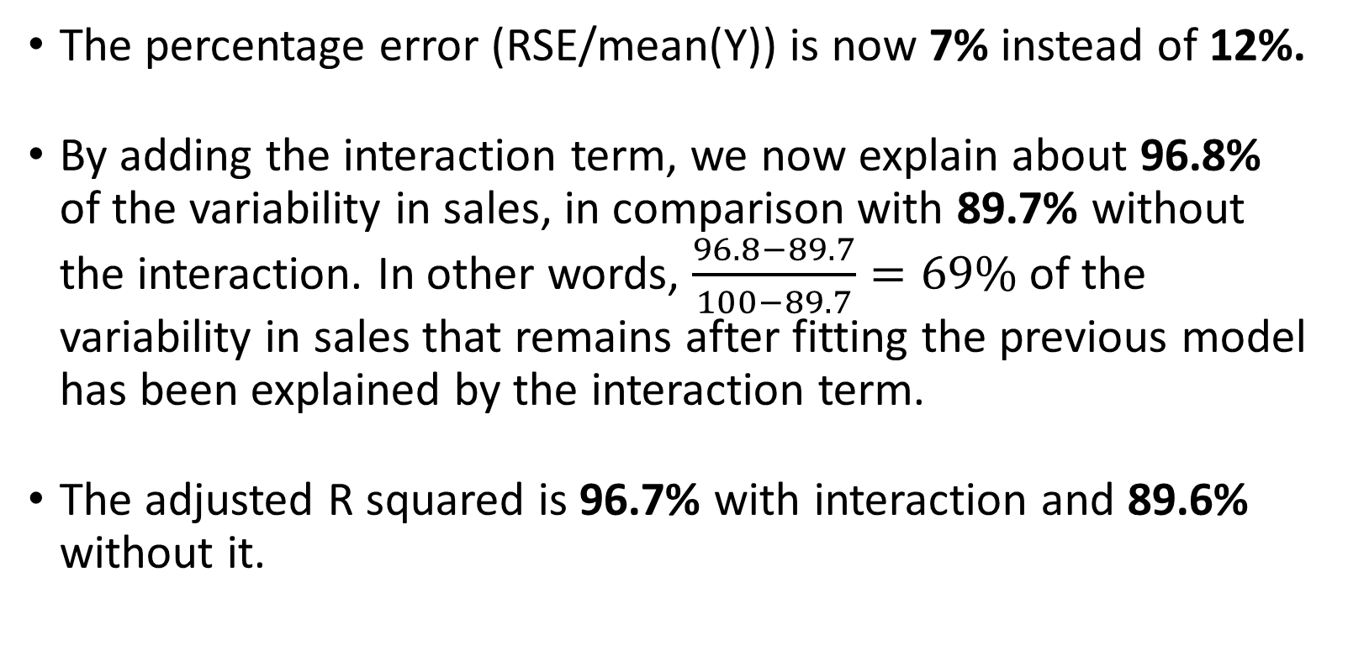
Multiple linear regression in R: Interactions
The percentage error (RSE/mean(Y)) is now 7% instead of 12%.
By adding the interaction term, we now explain about 96.8% of the variability in sales, in comparison with 89.7% without the interaction. In other words, $\frac{96.8−89.7}{100−89.7}=69\%$ of the variability in sales that remains after fitting the previous model has been explained by the interaction term.
The adjusted R squared is 96.7% with interaction and 89.6% without it.

Slide 33
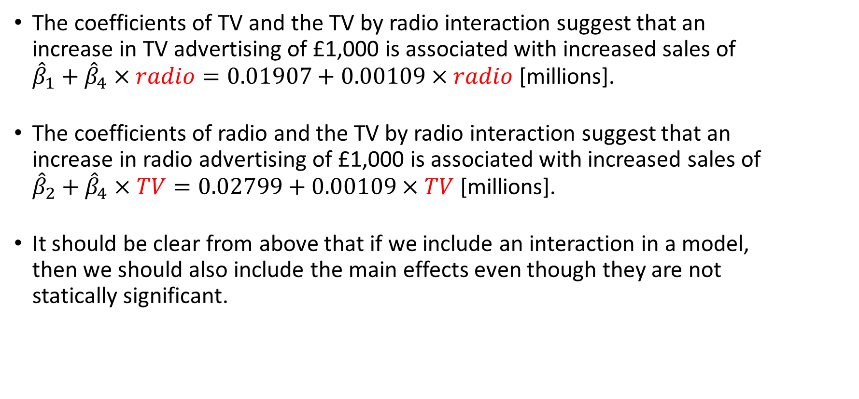
Multiple linear regression in R: Interactions
The coefficients of TV and the TV by radio interaction suggest that an increase in TV advertising of £1,000 is associated with increased sales of ${\hat{β}}_{1}+{\hat{β}}_{4}×radio=0.01907+0.00109×radio$ [millions].
The coefficients of radio and the TV by radio interaction suggest that an increase in radio advertising of £1,000 is associated with increased sales of ${\hat{β}}_{2}+{\hat{β}}_{4}×TV=0.02799+0.00109×TV$ [millions].
It should be clear from above that if we include an interaction in a model, then we should also include the main effects even though they are not statically significant.

Slide 34
Task 2: Add an interaction term between chi and age to your previous multiple linear regression model.

Slide 35
Importing topics to learn but were not covered here
How to add categorical predictors to a linear regression model
How to include interactions between a continuous and categorical predictor
Where can it go wrong (i.e. checking model assumptions)

Slide 36
The end

