Slide 1


Adnane Ez-zizi – University of Sheffield

Slide 2
Before we start…
Practice
Download the folder provided on the following link: https://github.com/Adnane017/SVM_course_SAVworkshop
Open the file “RcodeForLecture.R”.
Run the package install command which will install all the packages that we will be using during this session while we are going through the first few slides (it might take up to 20mins!).
Notes:
- Format of the lecture: Few slides then a simple task in R to apply learned concepts.
- Run install.packages() command

Slide 3
Outline
Maximal margin classifier
Intuition
Maximal margin classifier as an optimisation problem
Geometric view of the optimisation problem
Soft margin classifier
Motivation
Soft margin classifier as an optimisation problem
Parameter interpretation
Support vector machines
Motivation
Kernels
Support vector machines with more than two classes
Applications in R: Predicting survey responses

Slide 4
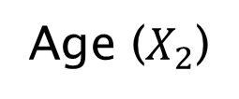
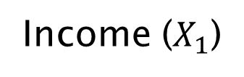
Linear classifiers: Which decision boundary?
Intuition
= Response (y=1)
= No response (y=-1)

Slide 5
Linear classifiers: Which decision boundary?
Intuition
= Response (y=1)
= No response (y=-1)

Slide 6
Linear classifiers: Which decision boundary?
Intuition
= Response (y=1)
= No response (y=-1)

Slide 7
Linear classifiers: Which decision boundary?
Intuition
= Response (y=1)
= No response (y=-1)

Slide 8
Maximal margin classifier
Intuition

Slide 9
Maximal margin classifier
Intuition
M: margin, which is the smallest distance from the observations to the decision boundary
M
Notes:
The distance shown are all equal to M

Slide 10
Maximal margin classifier
Intuition
M'
M
Notes:
Choose the decision boundary that has the largest margin (in our case M is larger than M’)

Slide 11
Another intuition
Intuition
Finding the maximal margin classifier is like having to place the fattest separator possible between classes

Slide 12
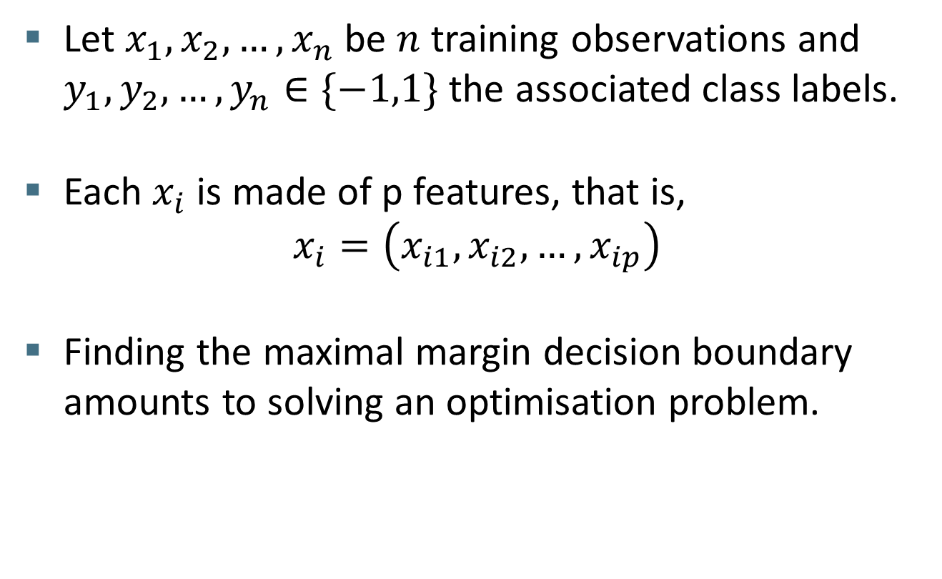
Maximum Margin: Formalization
Theory
Let $x_{1},x_{2},…,x_{n}$ be $n$ training observations and $y_{1},y_{2},…,y_{n}∈\{−1,1\}$ the associated class labels.
Each $x_{i}$ is made of p features, that is,
$$x_{i}=\left(x_{i1},x_{i2},…,x_{ip}\right)$$
Finding the maximal margin decision boundary amounts to solving an optimisation problem.

Slide 13



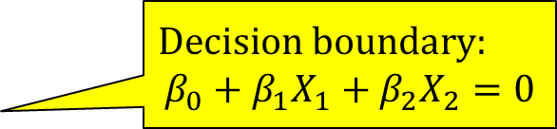


Geometric view
Theory
$$\max_{β_{0},β_{1},β_{2}}{M}$$
$subject to \sum_{j=1}^{2}{β_{j}^{2}}=1$
$$y_{i}\left(β_{0}+β_{1}x_{i1}+β_{2}x_{i2}\right)≥M ∀i=1,…,n$$
$$Decision boundary:$$
$$β_{0}+β_{1}X_{1}+β_{2}X_{2}=0$$
$$x_{i}$$
$$X_{2}$$
$$β=(β_{1},β_{2})$$
$$X_{1}$$
Notes:
- Explain the max and sum symbols if audience is not familiar with them
- Explain the meaning of the beta’s

Slide 14

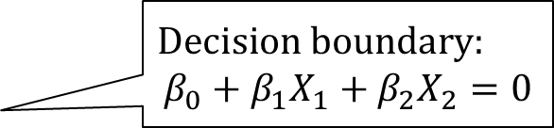
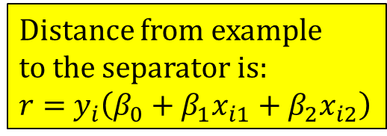
Geometric view
Theory
$$\max_{β_{0},β_{1},β_{2}}{M}$$
$subject to \sum_{j=1}^{2}{β_{j}^{2}}=1$
$$y_{i}\left(β_{0}+β_{1}x_{i1}+β_{2}x_{i2}\right)≥M ∀i=1,…,n$$
$$Decision boundary:$$
$$β_{0}+β_{1}X_{1}+β_{2}X_{2}=0$$
$$x_{i}$$
M
r
Distance from example
to the separator is:
$r=$ $y_{i}\left(β_{0}+β_{1}x_{i1}+β_{2}x_{i2}\right)$
$$X_{2}$$
$$β=(β_{1},β_{2})$$
$$X_{1}$$

Slide 15

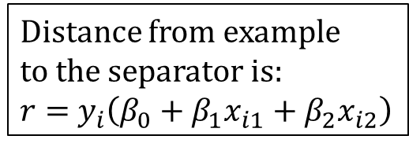
Geometric view
Theory
$$\max_{β_{0},β_{1},β_{2}}{M}$$
$subject to \sum_{j=1}^{2}{β_{j}^{2}}=1$
$$y_{i}\left(β_{0}+β_{1}x_{i1}+β_{2}x_{i2}\right)≥M ∀i=1,…,n$$
$$Decision boundary:$$
$$β_{0}+β_{1}X_{1}+β_{2}X_{2}=0$$
$$x_{i}$$
M
r
Distance from example
to the separator is:
$r=$ $y_{i}\left(β_{0}+β_{1}x_{i1}+β_{2}x_{i2}\right)$
$$X_{2}$$
$$β=(β_{1},β_{2})$$
$$X_{1}$$

Slide 16

Geometric view
Theory
$$\max_{β_{0},β_{1},…,β_{p}}{M}$$
$subject to \sum_{j=1}^{2}{β_{j}^{2}}=1$
$$y_{i}\left(β_{0}+β_{1}x_{i1}+β_{2}x_{i2}\right)≥M ∀i=1,…,n$$
$$Decision boundary:$$
$$β_{0}+β_{1}X_{1}+β_{2}X_{2}=0$$
$$x_{i}$$
M
r
Distance from example
to the separator is:
$r=$ $y_{i}\left(β_{0}+β_{1}x_{i1}+β_{2}x_{i2}\right)$
$$X_{2}$$
Support vectors
The boundary is fully
specified by these vectors
$$β=(β_{1},β_{2})$$
$$X_{1}$$
Notes:
The support vectors are the only observations that affect the choice of the decision boundary. All observations that lie strictly on the correct side of the margin does not affect the maximum margin classifier, provided that they remain in the correct side of the margin

Slide 17
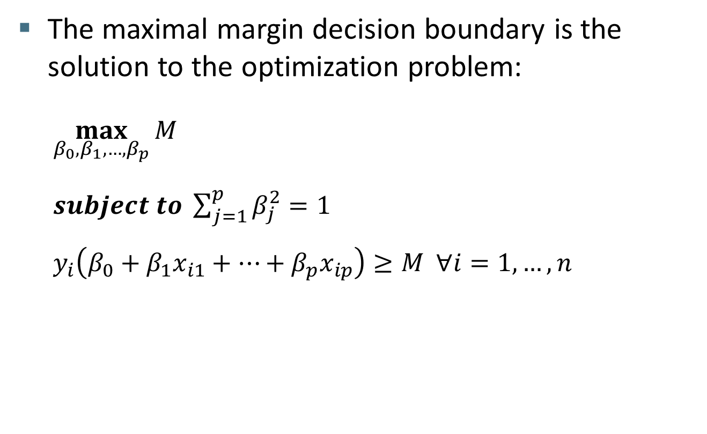
Maximum Margin: general case
Theory
The maximal margin decision boundary is the solution to the optimization problem:
$$\max_{β_{0},β_{1},…,β_{p}}{M}$$
$subject to \sum_{j=1}^{p}{β_{j}^{2}}=1$
$$y_{i}\left(β_{0}+β_{1}x_{i1}+…+β_{p}x_{ip}\right)≥M ∀i=1,…,n$$

Slide 18
Task in R
Practice
The objective of this first task is to familiarise you with the type of data we will be using throughout this lecture and also with the main function “svm()” that we will use to build our classifiers in R.
Use the code of Sec.1 to simulate an artificial data set and plot it.
Fit a maximum margin classifier to the data. Have a quick look at the help of svm (use ?svm) and try to fit the same classifier using the feature matrix and response vector instead of inputting the data as a dataframe.
Find the indices of the support vectors.
Plot the output of the fitted model using the function provided.
Notes:
Almost all the code needed is already in the “RcodeForLecture.R” file. Most of the time, you just need to run it or change a few parameter values.

Slide 19




Soft margin classifier: motivation
Intuition
$$X_{2}$$
$$X_{2}$$
$$X_{1}$$
$$X_{1}$$
Adding a single observation change drastically
the decision boundary
Notes:
The decision boundary depends only on the closest points. For example, it can change drastically due to the addition of a single observation!

Slide 20


Soft margin classifier: motivation
Intuition
This is a situation where there is no separating
linear decision boundary, so the maximal margin
Classifier cannot be used.
$$X_{2}$$
$$X_{1}$$
Notes:
Worst, most of the time there will be no separating linear decision boundary. The question is how can we soften the maximal margin constraint and allow for some classification error?
This is of interest because: (1) We will have greater robustness to individual observations and (2) We are more likely to avoid over-fitting.

Slide 21

Soft margin classifier
Theory
The soft margin decision boundary is the solution to the optimisation problem:
$$\max_{β_{0},β_{1},…,β_{p},ε_{0},ε_{1},…,ε_{n}}{M}$$
$subject to \sum_{j=1}^{p}{β_{j}^{2}}=1$
$$y_{i}\left(β_{0}+β_{1}x_{i1}+…+β_{p}x_{ip}\right)≥M(1−ε_{i}) ∀i=1,…,n$$
$ε_{i}≥0, \sum_{i=1}^{n}{ε_{i}}≤C$
Notes:
This can be achieved by slightly modifying the optimisation problem. We add some slack variables epsilon and a new parameter C. Don’t worry they can also be explained in an intuitive way.

Slide 22
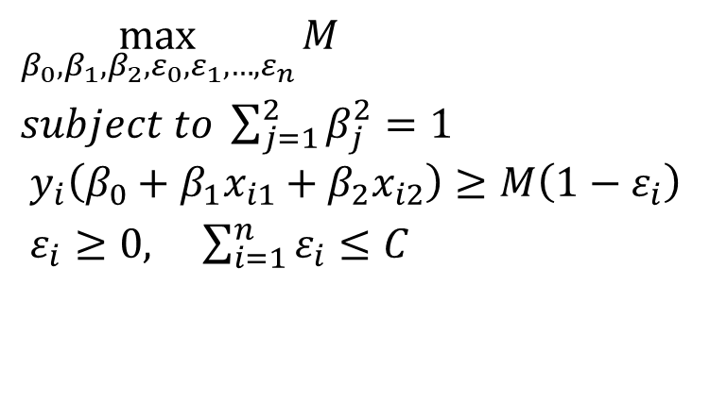


Geometric view
Theory
$$\max_{β_{0},β_{1},β_{2},ε_{0},ε_{1},…,ε_{n}}{M}$$
$subject to \sum_{j=1}^{2}{β_{j}^{2}}=1$
$${ y}_{i}\left(β_{0}+β_{1}x_{i1}+β_{2}x_{i2}\right)≥M\left(1−ε_{i}\right)$$
$ε_{i}≥0, \sum_{i=1}^{n}{ε_{i}}≤C$
M
r
$$X_{2}$$
$$X_{1}$$
Notes:
Basically, $ε_{1},…,ε_{n}$ are variables that allow individual observations to be on the wrong side of the margin or even the decision boundary.

Slide 23


Geometric view
Theory
$$\max_{β_{0},β_{1},β_{2},ε_{0},ε_{1},…,ε_{n}}{M}$$
$subject to \sum_{j=1}^{2}{β_{j}^{2}}=1$
$${ y}_{i}\left(β_{0}+β_{1}x_{i1}+β_{2}x_{i2}\right)≥M\left(1−ε_{i}\right)$$
$ε_{i}≥0, \sum_{i=1}^{n}{ε_{i}}≤C$
$$ε_{i}=0$$
$$x_{i}$$
M
r
$$X_{2}$$
$$X_{1}$$
Notes:
If $ε_{i}=0$, then the $i$th observation is forced to be on the correct side of the margin (distance r is greater or equal to M).

Slide 24

Geometric view
Theory
$$\max_{β_{0},β_{1},β_{2},ε_{0},ε_{1},…,ε_{n}}{M}$$
$subject to \sum_{j=1}^{2}{β_{j}^{2}}=1$
$${ y}_{i}\left(β_{0}+β_{1}x_{i1}+β_{2}x_{i2}\right)≥M\left(1−ε_{i}\right)$$
$ε_{i}≥0, \sum_{i=1}^{n}{ε_{i}}≤C$
$$ε_{i}=0$$
$$x_{i}$$
M
r
$$X_{2}$$
$$ε_{i}>1$$
$$X_{1}$$
Notes:
If $ε_{i}>1$, then the $i$th observation is on the wrong side of the decision boundary.

Slide 25

Geometric view
Theory
$$\max_{β_{0},β_{1},β_{2},ε_{0},ε_{1},…,ε_{n}}{M}$$
$subject to \sum_{j=1}^{2}{β_{j}^{2}}=1$
$${ y}_{i}\left(β_{0}+β_{1}x_{i1}+β_{2}x_{i2}\right)≥M\left(1−ε_{i}\right)$$
$ε_{i}≥0, \sum_{i=1}^{n}{ε_{i}}≤C$
$$ε_{i}=0$$
$$x_{i}$$
M
r
$$X_{2}$$
$$ε_{i}>1$$
$$X_{1}$$
$${0<ε}_{i}<1$$
Notes:
If ${0<ε}_{i}<1$, then the $i$th observation is on the wrong side of the margin.

Slide 26
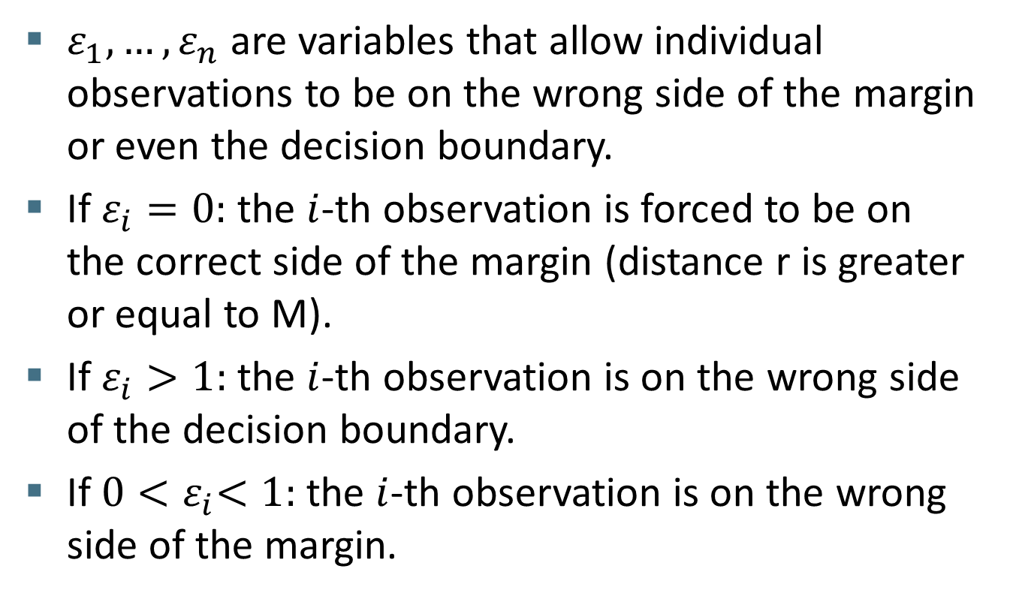
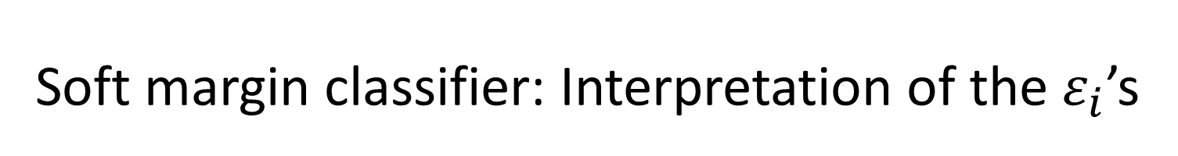
Soft margin classifier: Interpretation of the $ε_{i}$’s
Theory
$ε_{1},…,ε_{n}$ are variables that allow individual observations to be on the wrong side of the margin or even the decision boundary.
If $ε_{i}=0:$ the $i$-th observation is forced to be on the correct side of the margin (distance r is greater or equal to M).
If $ε_{i}>1:$ the $i$-th observation is on the wrong side of the decision boundary.
If $0{<ε}_{i}<1:$ the $i$-th observation is on the wrong side of the margin.

Slide 27

Soft margin classifier: Interpretation of C
Theory
C determines the number and severity of the violations to the margin and to the decision boundary.
$$\max_{β_{0},β_{1},…,β_{p},ε_{0},ε_{1},…,ε_{n}}{M}$$
$subject to \sum_{j=1}^{p}{β_{j}^{2}}=1$
$$y_{i}\left(β_{0}+β_{1}x_{i1}+…+β_{p}x_{ip}\right)≥M\left(1−ε_{i}\right)$$
$ε_{i}≥0, \sum_{i=1}^{n}{ε_{i}}≤C$
Notes:
C bounds the sum of the $ε_{i}$’s, and so it determines the number and severity of the violations to the margin (and to the decision boundary) that we will tolerate

Slide 28

Soft margin classifier: Interpretation of C
Theory
C determines the number and severity of the violations to the margin and to the decision boundary.
If $C=0$, then $ε_{1}=…=ε_{n}=0$ and so there is no violation to the margin. This results in the maximal margin optimization problem.
$$\max_{β_{0},β_{1},…,β_{p},ε_{0},ε_{1},…,ε_{n}}{M}$$
$subject to \sum_{j=1}^{p}{β_{j}^{2}}=1$
$$y_{i}\left(β_{0}+β_{1}x_{i1}+…+β_{p}x_{ip}\right)≥M\left(1−ε_{i}\right)$$
$ε_{i}≥0, \sum_{i=1}^{n}{ε_{i}}≤C$

Slide 29
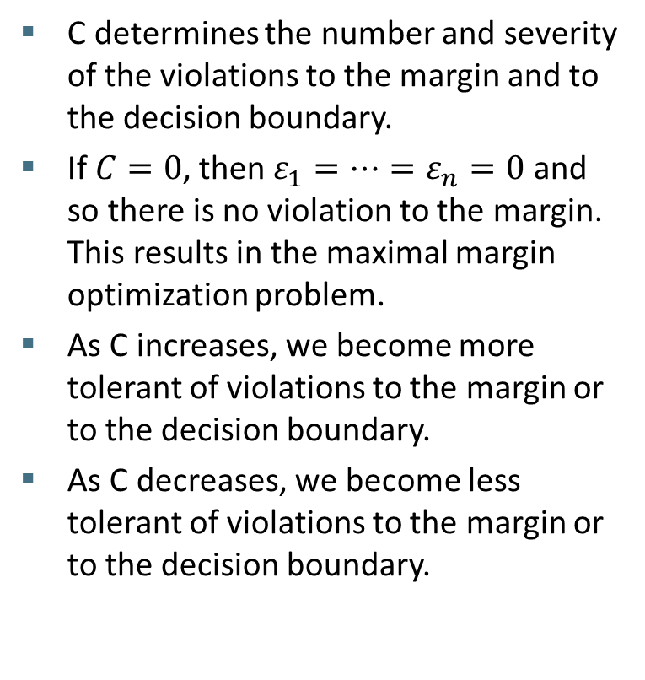
Soft margin classifier: Interpretation of C
Theory
C determines the number and severity of the violations to the margin and to the decision boundary.
If $C=0$, then $ε_{1}=…=ε_{n}=0$ and so there is no violation to the margin. This results in the maximal margin optimization problem.
As C increases, we become more tolerant of violations to the margin or to the decision boundary.
As C decreases, we become less tolerant of violations to the margin or to the decision boundary.
$$\max_{β_{0},β_{1},…,β_{p},ε_{0},ε_{1},…,ε_{n}}{M}$$
$subject to \sum_{j=1}^{p}{β_{j}^{2}}=1$
$$y_{i}\left(β_{0}+β_{1}x_{i1}+…+β_{p}x_{ip}\right)≥M\left(1−ε_{i}\right)$$
$ε_{i}≥0, \sum_{i=1}^{n}{ε_{i}}≤C$
Notes:
We can think of C as a budget for the amount that the margin can be violated by the n observations. If C is high, then we will have more tolerance towards violations to the margin or to the decision boundary.

Slide 30
Task in R
Practice
The objective of this task is to study the effect of the parameter C on the decision boundary and margin
Use the code of Sec.2 to simulate the artificial data set for this task and plot it.
Fit a soft margin classifier with a low and a high value for C (C=0.01 and C=10) and compare the resulting margins and decision boundaries.
Try other values for C.
Notes:
- A quick practical task in R where we will study the effect of C
- Important note: C is 1/cost in the svm() function

Slide 31
Tuning the parameter C using cross-validation
Intuition
One of the techniques that is often used in machine learning (ML) to select model parameters is cross-validation (CV).
The easiest case of CV is when the data is divided into two folds:
Original data set
1 2 3 4 5 6 7 8 9 10
7 2 4 9 5
8 10 1 6 3
Training set
Validation set
Notes:
The other use of CV is to tell how well a machine learning is doing in terms of prediction.

Slide 32
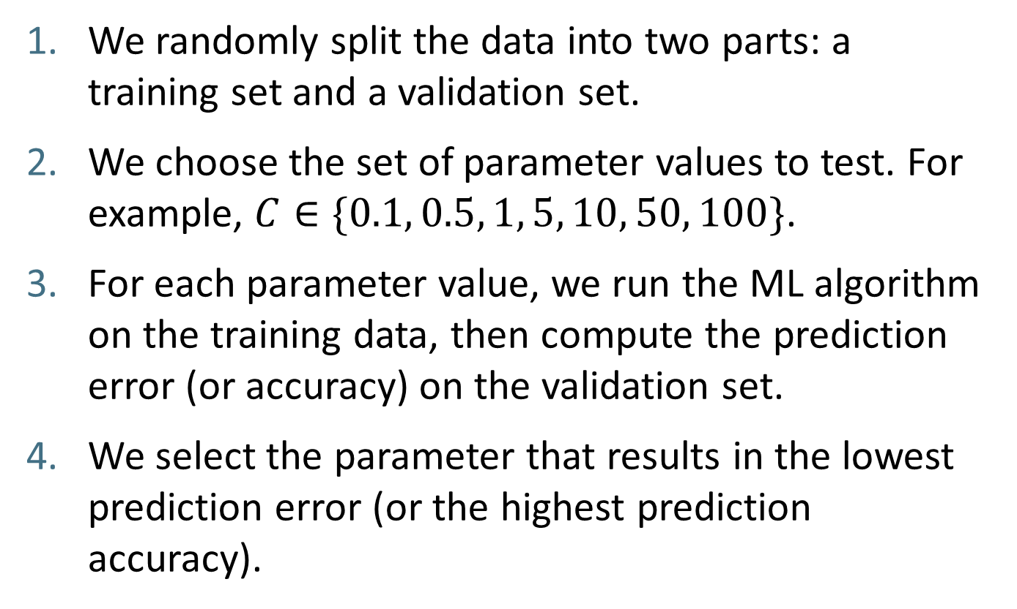
2-fold cross-validation
Intuition
We randomly split the data into two parts: a training set and a validation set.
We choose the set of parameter values to test. For example, $C∈\{0.1, 0.5, 1, 5, 10, 50, 100\}$.
For each parameter value, we run the ML algorithm on the training data, then compute the prediction error (or accuracy) on the validation set.
We select the parameter that results in the lowest prediction error (or the highest prediction accuracy).
Notes:
The two-fold approach will generally be sensitive to the split that we end up with (i.e. results will vary depending on the resulting samples).

Slide 33
K-fold cross-validation
Intuition
In K-fold CV we repeat the process K times. That is we now divide the data into K equal parts.
We leave out one part each time (say part k), fit the model to the other K-1 parts combined, and then compute the prediction error for the left-out part.
We select the parameter that results in the lowest average error across all K validation sets
Notes:
We finally average all errors to get the final error for the current model fit.

Slide 34
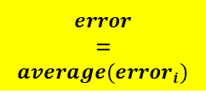





K-fold cross-validation
Intuition
We divide the dataset into K equal-sized parts (here K=5).
Validation
Train
Train
Train
Train
$${error}_{1}$$
Train
Validation
Train
Train
Train
$${error}_{2}$$
Train
Train
Validation
Train
Train
$$error$$
$$=$$
$$average({error}_{i})$$
$${error}_{3}$$
Train
Train
Train
Validation
Train
$${error}_{4}$$
Train
Train
Train
Train
Validation
$${error}_{5}$$
Notes:
- Here is a diagram that illustrates how K-fold CV works.
- The other use of CV is to tell how well a machine learning is doing in terms of prediction.

Slide 35
Training/Test division
Intuition
Actually to have a more precise measure of the prediction performance of a ML algorithm, we also reserve a part of the data for testing.
Original data set
Training set
Test set
…
CV division
Notes:
- Actually, CV is not the whole story. If you want to do things properly, we need to split things further. That is, we will separate the data into a training and a test set.
- The idea of having a separate test set is to avoid over-fitting because if we tweak the parameters for a given dataset, it is likely that the algorithm would perform well for that given dataset

Slide 36
Task in R
Practice
In this task, you will use cross-validation to choose a good value for the parameter C. You will also assess the performance of the selected classifier on a test set.
Use the code of Sec.3 to simulate a similar artificial data set to that used on Sec.2 but of a larger size.
Divide the data into a training and a test set of equal sizes
Use the tune() function to select the best value for C using cross-validation.
Use the alternative function train() from the caret package. Caret is a very useful package that allows to apply tones of machine learning algorithms in a simple and efficient way.
Notes:
The good news is that you can perform CV directly with SVMs using either the tune() function or the train() function which is part of the caret package.
I am introducing the train() from the caret package because you will need it in the final practical application in R (it runs faster since you can use multiple CPU cores).
train() and tune() would give different results especially for small datasets because:
. The CV folds will be different.
. train() is based on a different package, kernlab instead of e1071.
. They also use different eps/maxiteration or other optimization related threshold

Slide 37


Support vector machines: motivation
Intuition
This is a situation where it is better to use a non linear
decision boundary.
$$X_{2}$$
$$X_{1}$$
Notes:
So far we have tried to fit only classifiers with linear decision boundaries. Consider now the case where it is better to use a non-linear decision boundary.

Slide 38
Support vector machines: motivation
Intuition
One way to deal with datasets that are not linearly separable is to map the data to a higher-dimensional space:
0
x
x²
0
x
Notes:
Assume we have a space with one feature only (all points are on the same line)

Slide 39
Support vector machines: motivation
Intuition
The original feature space can always be mapped to some higher-dimensional feature space where the training set is separable:

Slide 40
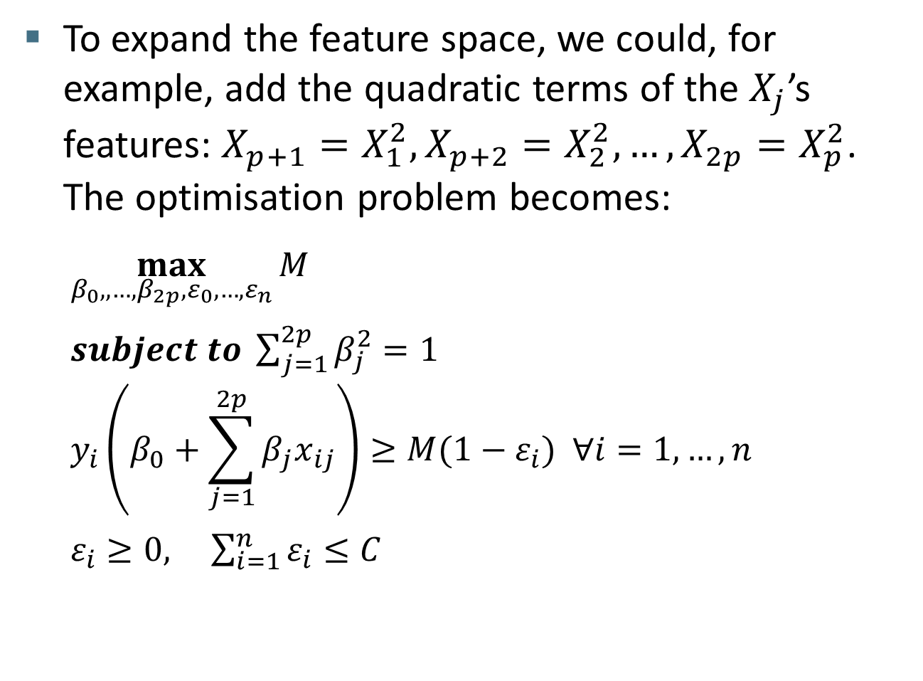
Support vector machines: Adding new features
Theory
To expand the feature space, we could, for example, add the quadratic terms of the $X_{j}$’s features: $X_{p+1}=X_{1}^{2},{X_{p+2}=X}_{2}^{2},…,{X_{2p}=X}_{p}^{2}$. The optimisation problem becomes:
$$\max_{β_{0},,…,β_{2p},ε_{0},…,ε_{n}}{M}$$
$subject to \sum_{j=1}^{2p}{β_{j}^{2}}=1$
$$y_{i}\left(β_{0}+\sum_{j=1}^{2p}{β_{j}x_{ij}}\right)≥M(1−ε_{i}) ∀i=1,…,n$$
$ε_{i}≥0, \sum_{i=1}^{n}{ε_{i}}≤C$
Notes:
- We add the quadratic terms of the Xj’s, so instead of having p features we will end up with 2p features.
- We can also add higher-order polynomial terms or interaction terms of the form Xj.Xj’. We can even consider other functions of the predictors Xj’s rather than polynomial.
- Unless we are carful, we can end up with a huge number of features. One way to keep things under control is to use what we call kernels.

Slide 41
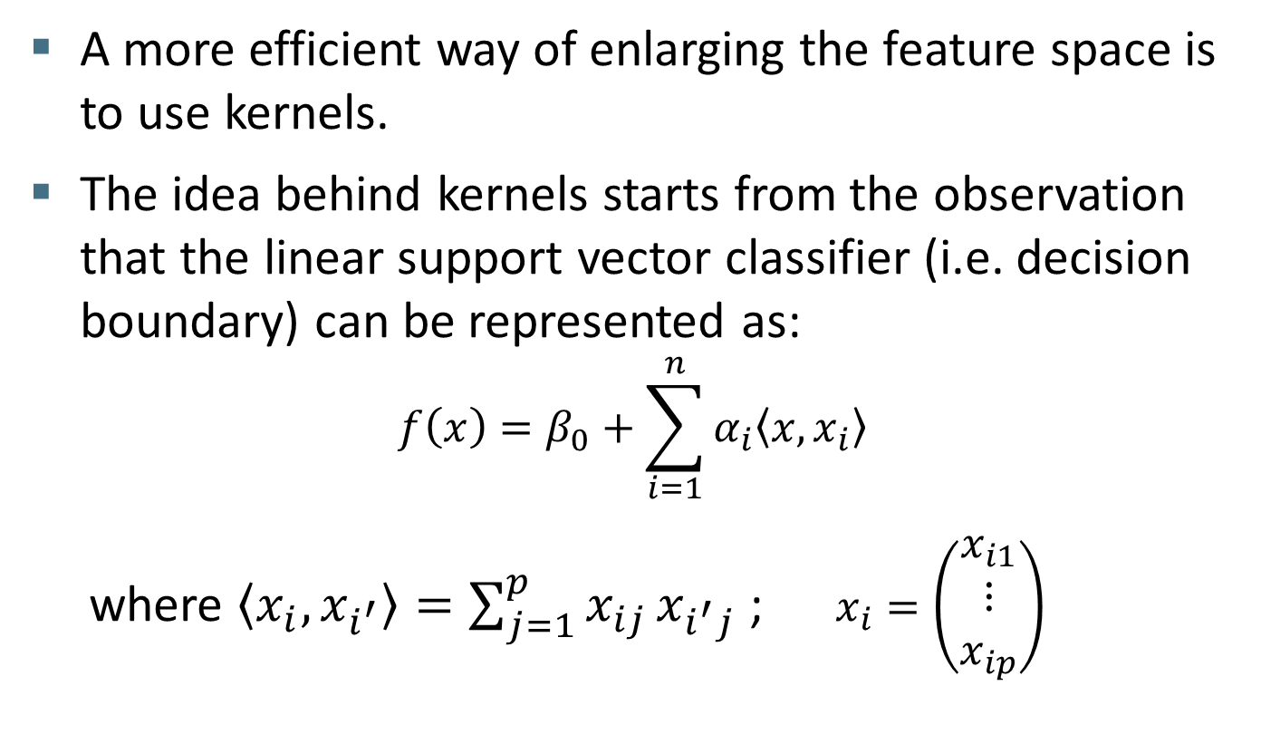
Support vector machines: Kernels
Theory
A more efficient way of enlarging the feature space is to use kernels.
The idea behind kernels starts from the observation that the linear support vector classifier (i.e. decision boundary) can be represented as:
$$f\left(x\right)=β_{0}+\sum_{i=1}^{n}{α_{i}\left\langle x,x_{i}\right\rangle }$$
where $\left\langle x_{i},x_{i^{′}}\right\rangle =\sum_{j=1}^{p}{x_{ij}}x_{i^{′}j}$ ; $x_{i}=\left(\begin{matrix}x_{i1} \\ ⋮ \\ x_{ip}\end{matrix}\right)$
Notes:
- $\left\langle x_{i},x_{i^{′}}\right\rangle =\sum_{j=1}^{p}{x_{ij}}x_{i^{′}j}$ is called the inner product of $x$ and $x_{i}$
- There are $n$ parameters $α_{i}$; one per training observation

Slide 42
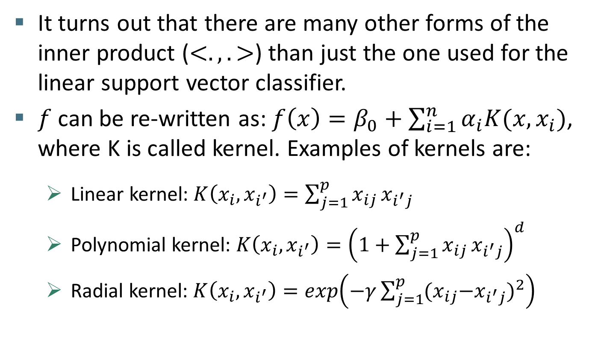
Support vector machines: Kernels
Theory
It turns out that there are many other forms of the inner product ($<.,.>$) than just the one used for the linear support vector classifier.
$f$ can be re-written as: $f\left(x\right)=β_{0}+\sum_{i=1}^{n}{α_{i}K(x,x_{i})}$, where K is called kernel. Examples of kernels are:
Linear kernel: $K\left(x_{i},x_{i^{′}}\right)=\sum_{j=1}^{p}{x_{ij}}x_{i^{′}j}$
Polynomial kernel: $K\left(x_{i},x_{i^{′}}\right)={\left(1+\sum_{j=1}^{p}{x_{ij}}x_{i^{′}j}\right)}^{d}$
Radial kernel: $K\left(x_{i},x_{i^{′}}\right)=exp\left(−γ\sum_{j=1}^{p}{{{{(x}_{ij}−x}_{i^{′}j})}^{2}}\right)$

Slide 43

Radial Kernel
Theory
$K\left(x_{i},x_{i^{′}}\right)=exp\left(−γ\sum_{j=1}^{p}{{{{(x}_{ij}−x}_{i^{′}j})}^{2}}\right), γ>0$
Notes:
- The radial kernel has a parameter gamma (that we can tweak) + a sum term which is simply the distance between xi and xi’
- For a test observation${ x}_{i^{′}}$ that is far from a training observation $x_{i}$, the distance $\sum_{j=1}^{p}{{{{(x}_{ij}−x}_{i^{′}j})}^{2}}$ will be large and so $K\left(x_{i},x_{i^{′}}\right)$ will be small. So $x_{i}$, and other training observations that are far from the test observation $x_{i^{′}}$ will not play an important role in the prediction of the class label for $x_{i^{′}}$.

Slide 44

Radial Kernel
Theory
$K\left(x_{i},x_{i^{′}}\right)=exp\left(−γ\sum_{j=1}^{p}{{{{(x}_{ij}−x}_{i^{′}j})}^{2}}\right), γ>0$
If a training observation $x_{i}$is far from a test observation${ x}_{i^{′}}$, then $x_{i}$ will not play an important role in the prediction of the class label for $x_{i^{′}}$.
Notes:
- For a test observation${ x}_{i^{′}}$ that is far from a training observation $x_{i}$, the distance $\sum_{j=1}^{p}{{{{(x}_{ij}−x}_{i^{′}j})}^{2}}$ will be large and so $K\left(x_{i},x_{i^{′}}\right)$ will be small. So $x_{i}$, and other training observations that are far from the test observation $x_{i^{′}}$ will not play an important role in the prediction of the class label for $x_{i^{′}}$.

Slide 45
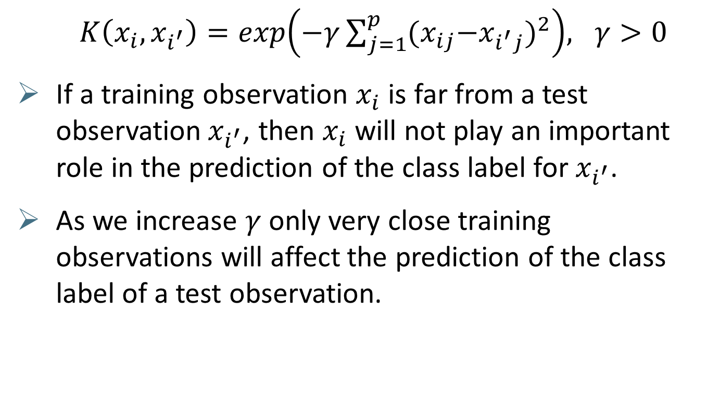
Radial Kernel
Theory
$K\left(x_{i},x_{i^{′}}\right)=exp\left(−γ\sum_{j=1}^{p}{{{{(x}_{ij}−x}_{i^{′}j})}^{2}}\right), γ>0$
If a training observation $x_{i}$is far from a test observation${ x}_{i^{′}}$, then $x_{i}$ will not play an important role in the prediction of the class label for $x_{i^{′}}$.
As we increase $γ$ only very close training observations will affect the prediction of the class label of a test observation.
Notes:
- For a test observation${ x}_{i^{′}}$ that is far from a training observation $x_{i}$, the distance $\sum_{j=1}^{p}{{{{(x}_{ij}−x}_{i^{′}j})}^{2}}$ will be large and so $K\left(x_{i},x_{i^{′}}\right)$ will be small. So $x_{i}$, and other training observations that are far from the test observation $x_{i^{′}}$ will not play an important role in the prediction of the class label for $x_{i^{′}}$.

Slide 46
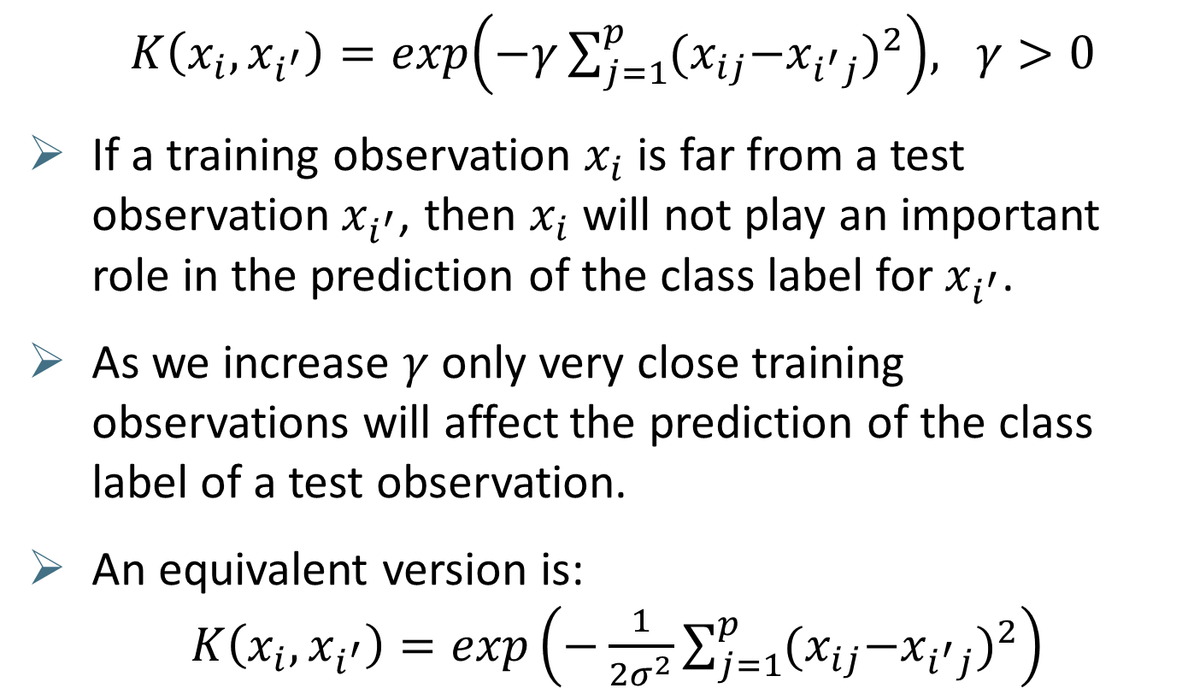
Radial Kernel
Theory
$K\left(x_{i},x_{i^{′}}\right)=exp\left(−γ\sum_{j=1}^{p}{{{{(x}_{ij}−x}_{i^{′}j})}^{2}}\right), γ>0$
If a training observation $x_{i}$is far from a test observation${ x}_{i^{′}}$, then $x_{i}$ will not play an important role in the prediction of the class label for $x_{i^{′}}$.
As we increase $γ$ only very close training observations will affect the prediction of the class label of a test observation.
An equivalent version is: $K\left(x_{i},x_{i^{′}}\right)=exp\left(−\frac{1}{2σ^{2}}\sum_{j=1}^{p}{{{{(x}_{ij}−x}_{i^{′}j})}^{2}}\right)$
Notes:
- For a test observation${ x}_{i^{′}}$ that is far from a training observation $x_{i}$, the distance $\sum_{j=1}^{p}{{{{(x}_{ij}−x}_{i^{′}j})}^{2}}$ will be large and so $K\left(x_{i},x_{i^{′}}\right)$ will be small. So $x_{i}$, and other training observations that are far from the test observation $x_{i^{′}}$ will not play an important role in the prediction of the class label for $x_{i^{′}}$.

Slide 47
Task in R
Practice
In this task, you will use THE support vector machine algorithm to classify non-linear data.
Use the code of Sec.4 to simulate a new artificial data set that is non linearly separable.
Fit the data using a radial kernel with parameters C=1 and gamma=1 and plot the SVM output.
Try other values for the parameters.
Use Sec.5 to perform cross validation and make an informed choice for the parameters C and gamma.

Slide 48
Multi-class support vector machines
Intuition
Example:
A company is interested in predicting the satisfaction level of its customers. There are four outcomes:
Very satisfied;
somehow satisfied;
somehow unsatisfied
very unsatisfied.
Notes:
- This is the case where there are more than 2 classes. It is called multi-class classification or multinomial classification
- Imagine that now instead of wanting to predict whether a person would respond to a survey, you want to predict say their satisfaction with a company. And they have to choose between 4 classes: Very satisfies, somehow satisfied, somehow unsatisfied and very unsatisfied.
- Note here that we ignore the ordering that might exist between the 4 levels and assume that all 4 levels are unrelated to each other (i.e. we assume that the variable is categorical instead of ordinal).

Slide 49
Multi-class support vector machines
Intuition
Method 1: One-versus-one classification
Construct an SVM for each possible pair of classes. In our example, one SVM would compare “very satisfied” to “somehow unsatisfied”. Another one would compare “very satisfied” to “very unsatisfied”.
For a new test observation, predict a class label using each of the constructed SVMs.
The final class label that is predicted is the class that wins the majority of votes from the multiple SVMs.
Notes:
- There are two approaches to extend the SVM model with binary choices to multinomial choices: (1) One-versus-one classification and (2) One-versus-all classification
- Under the ‘one-versus-one classification’ method, with 4 outcomes we will need to construct 6 SVM models!
- We choose the most frequently predicted class. Say if very satisfied is predicted 4 times out of 6, then our multi-class SVM would predict “very satisfied”.

Slide 50
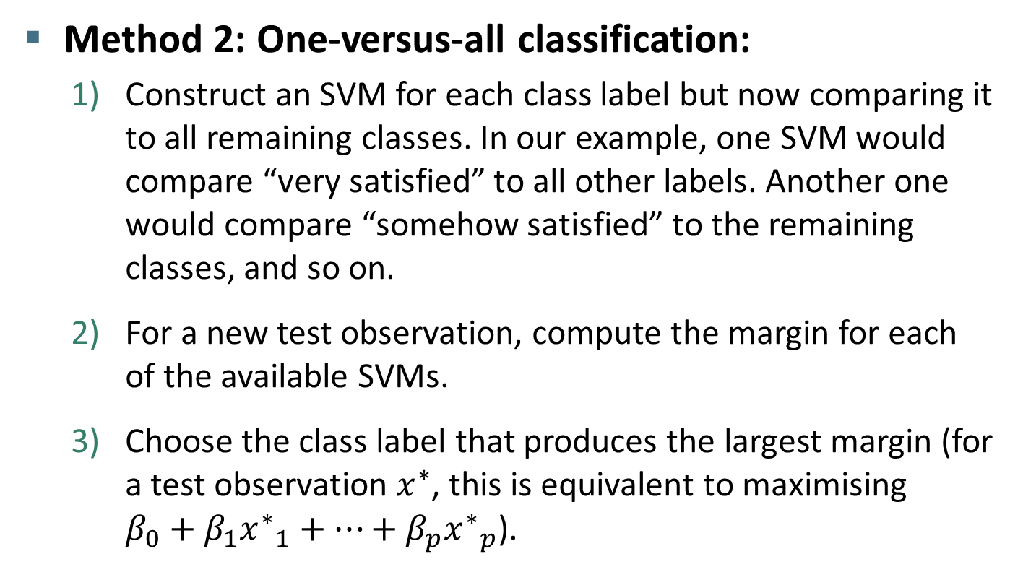
Multi-class support vector machines
Intuition
Method 2: One-versus-all classification:
Construct an SVM for each class label but now comparing it to all remaining classes. In our example, one SVM would compare “very satisfied” to all other labels. Another one would compare “somehow satisfied” to the remaining classes, and so on.
For a new test observation, compute the margin for each of the available SVMs.
Choose the class label that produces the largest margin (for a test observation $x^{∗}$, this is equivalent to maximising $β_{0}+β_{1}{x^{∗}}_{1}+…+β_{p}{x^{∗}}_{p}$).
Notes:
Under the ‘one-versus-all classification’ method, If there are K classes, the first class would be compared to the K-1 remaining classes. Then, the second class is compared to the other K-1 classes and so on until we cover all possible classes
Note that these two approaches are general and extend beyond SVMs. Can be used for example for logistic regression or other examples.

Slide 51
Some advantages and disadvantages of SVMs
Advantages | Disadvantages
SVMs can work well when the data is not linearly separable using the kernel trick. | SVMs can be computationally intensive when applied to large data sets. One needs to carefully choose a kernel and tweak the hyperparameters that goes with it (for example using CV).
SVMs find the global optimal parameters unlike other ML methods that rely on local minima. | SVMs are in the lower spectrum of interpretability.
SVMs can perform better than other ML algorithms when applied to unbalanced data.
Notes:
- SVMs can seem like black boxes in that a final functional form or a table of coefficients for various predictors is not provided as part of the estimation as for logistic regression.

Slide 52
Practical application in R
Practice
This example is based on a subset of the National Health Interview Survey (NHIS) dataset. The objective here is to predict whether a person would respond or not the survey given some demographic information about the person such as age, sex and income.
Load the data from the “SPData2.Rda” file, then divide the dataset into training and test sets.
Perform a 5-fold cross-validation using the train() function to tune the parameters C (sigma is estimated analytically from the training set). Also use “tuneLength” option to automatically select the values to test.
Evaluate the performance of the resulting SVM.
Compare it with the performance of logistic regression.
Notes:
The decision boundary changes drastically due to the addition of a single observation!

Slide 53
References used
“An introduction to statistical learning” by G. James, D. Witten, T.Hastie and R.Tibshirani.
“Using support vector machines for survey research” by A. Kirchner and C. S. Signorino.
“Machine learning course on coursera” by Andrew Ng.
“Introduction to information retrieval course – Lecture 14” by C. Manning and P. Nayak (borrowed some of their figures).

Slide 54
The end
Notes:
Take home message:

