Slide 1
Planet System Simulator
Jonathan Albert
Kevin Ireland
Adnan Khan
Joshua Zwolan

Slide 2
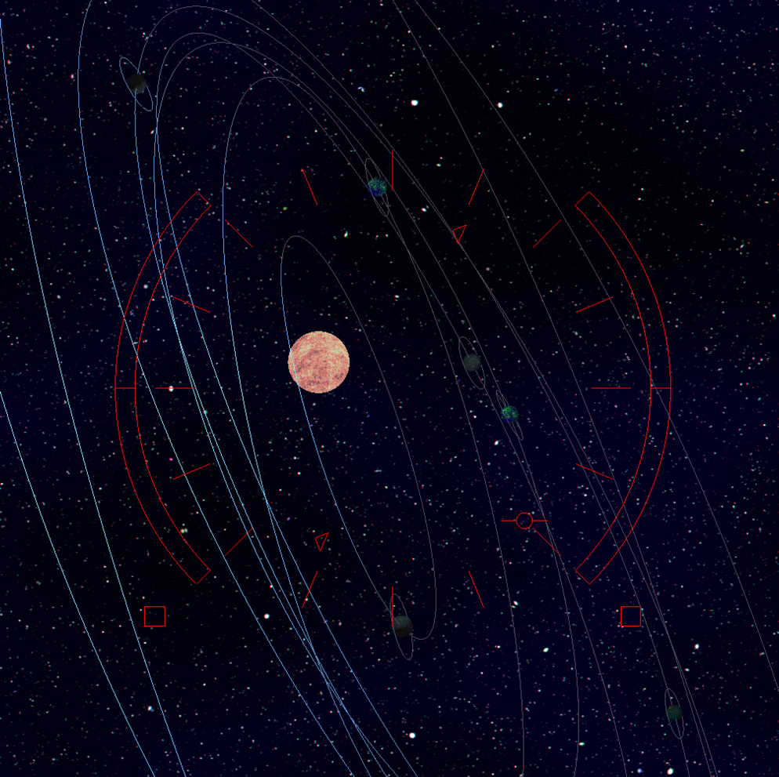
Overview
Planetary system simulator
2 View Options
Ship Camera
Planet Follower

Slide 3
UI
2D drawn on top of 3D scene

Slide 4
Camera

Slide 5
Planet Movement
Handled separately from the rendering loop

Slide 6
Planet Texturing
Procedurally generated textures using brownian motion algorithm.

Slide 8
Lighting and Shading

Slide 9
Further possibilities
Drawing the Spaceship itself
Multiple Suns in wide orbits of each other
Non-spherical objects

