Slide 1
Planet System Simulator
Jonathan Albert
Kevin Ireland
Adnan Khan
Joshua Zwolan

Slide 2
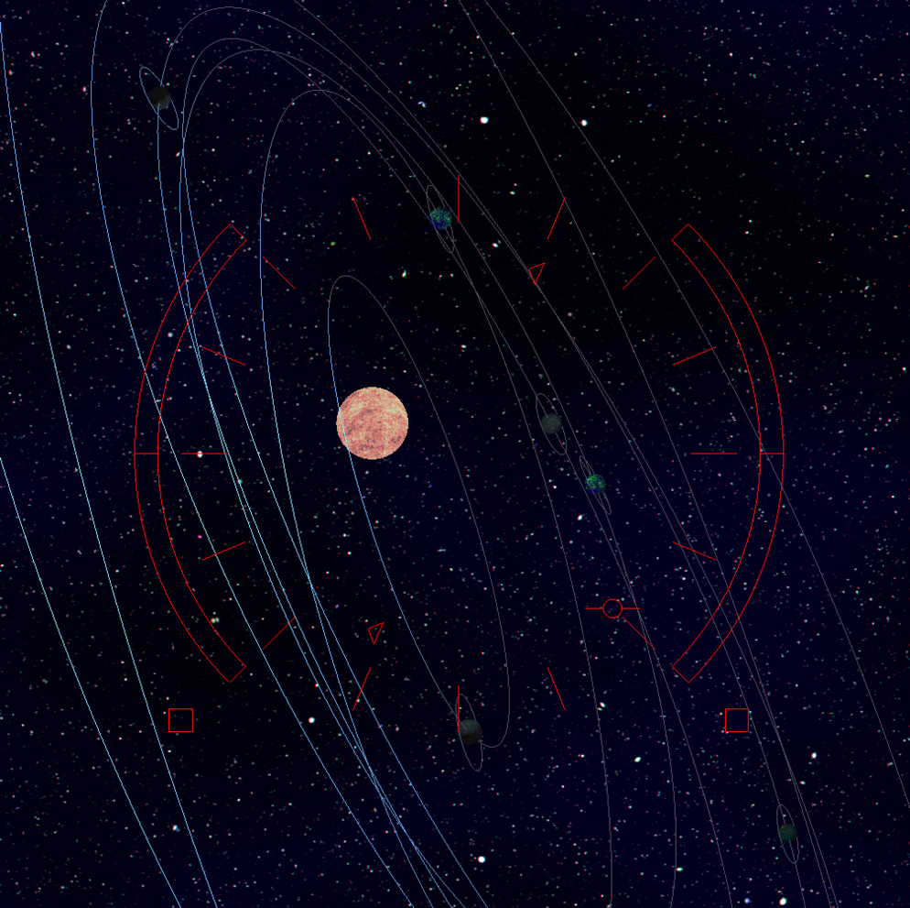
Overview
Planetary system simulator
2 View Options
Ship Camera
Planet Follower

Slide 3
UI
2D drawn on top of 3D scene

Slide 4
Camera
Ship Based Camera:
Cross products were very useful
After calculations values were passed into gluLookat to specify the camera
Planet Following Camera

Slide 5
Planet Movement
Handled separately from the rendering loop
Orbital planes defined using random normal vector which defined the orientation of the plane with respect to its orbital parent.
Orbits are drawn to illustrate planet motion

Slide 6
Planet Texturing
Procedurally generated textures using Brownian motion algorithm.

Slide 8
Lighting and Shading

Slide 9
Further possibilities
Drawing the Spaceship itself
Multiple Suns in wide orbits of each other
Non-spherical objects

