Slide 1
FinMate
A financial agent for students living abroad
Shenzhen International FinTech Competition 2026
Topic C: Cross-border and Student Finance
Notes:
25 seconds. FinMate helps international students make tuition and currency decisions while protecting living funds. The prototype uses a live model with deterministic financial tools and separately approved simulated execution. Sources: https://fintechathon.g-ican.com/#/en and local application source.

Slide 2
A tuition deadline crosses several accounts
EUR 2,840
GBP 1,200
CNY 17,670
Tuition: EUR 2,300
Protected EUR reserve: 2,030
Expected income: unavailable
CNY alone cannot cover tuition after fees.
GBP can fill the gap only if the student permits it.
Synthetic scenario. Entered balances are planning snapshots, not bank-verified funds.
Notes:
45 seconds. Describe this as a synthetic example, not a surveyed student. The student has entered balances, tuition due on 1 November and expected income delayed two weeks. The challenge is choosing permitted accounts while keeping euros for living costs. No real bank connection is claimed. Source: synthetic review account and backend/engine.mjs.

Slide 3
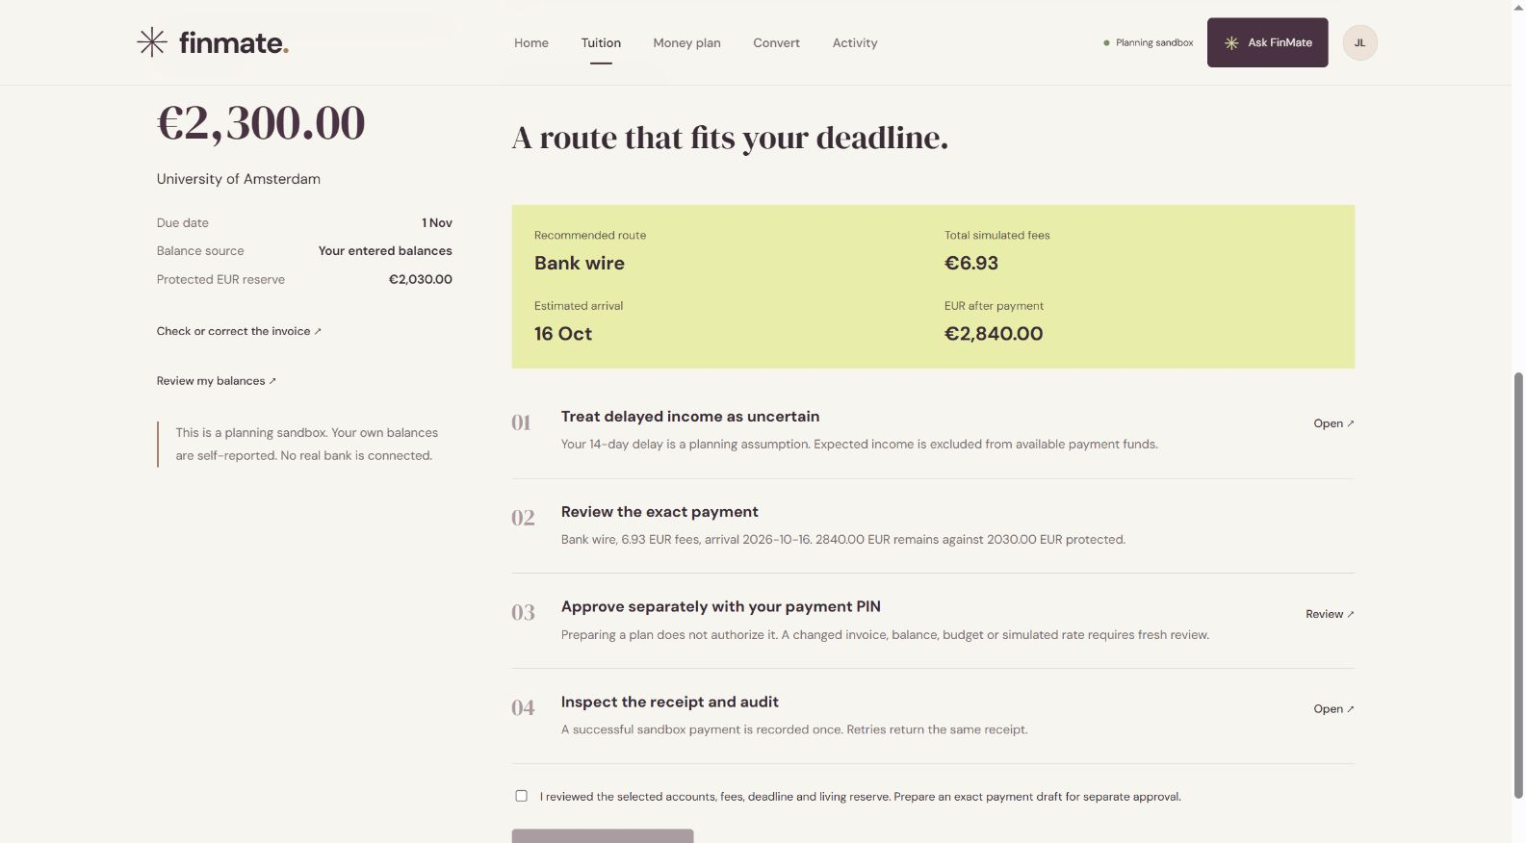
A complete tuition workflow
Check the invoice
Choose allowed funding
Protect living costs
Explain changed plans
Review an exact payment
Future scholarship income never funds a payment until it has actually arrived.
Notes:
55 seconds. The workflow starts with current balances and an exact invoice. It identifies blockers, uses only permitted accounts and shows eligible and rejected alternatives. Rebuilding highlights changed settings and routes. Preparation requires reviewed workflow consent. Approval still happens in a separate PIN form. Source: backend/mission.mjs and current screenshot.

Slide 4
A lower fee can miss the deadline
Method | Fee, EUR | Arrival | Meets deadline
Lowest fee only | 6.92 | 2026-10-16 | No
FinMate constraints | 13.88 | 2026-10-12 | Yes
Arrival before the deadline is a requirement.
Cost decides between eligible options.
Synthetic tuition due 12 October 2026. Same illustrative rates and fees in both methods.
Notes:
50 seconds. This controlled comparison uses tuition due 12 October. A fee-only baseline chooses bank wire, which arrives late. FinMate first applies deadline, funds and living-reserve constraints, then ranks eligible routes by fee. These are illustrative provider fees, not a claim of real-world savings or global allocation optimality. Source: docs/agent-benchmark.json controlledBaseline.

Slide 5
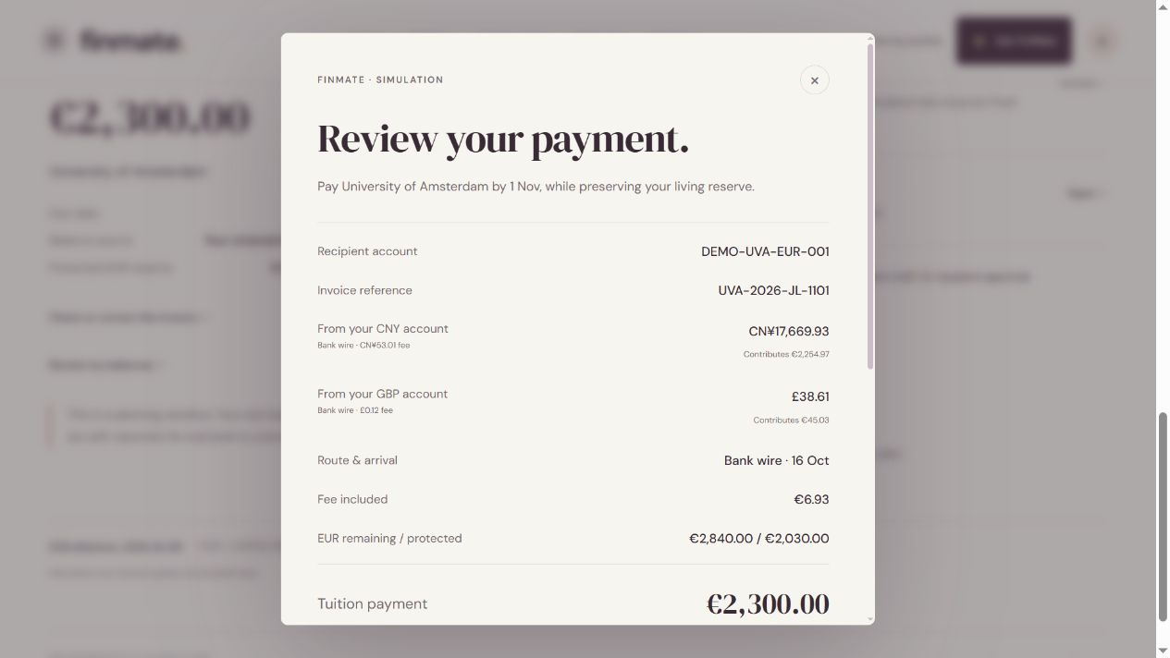
Approval belongs to the student
Agent authority
Read and compare
Forecast and prepare
User authority
Review exact details
Approve with a PIN
Encrypted local vault, session isolation, bounded tools and an audit chain support the approval boundary.
Notes:
55 seconds. The agent may read, compare, forecast and prepare. It has no tool to approve, execute, credit funds, clear Guardian changes or read credentials. The user sees recipient, account, invoice reference, every funding contribution and protected reserve. PIN confirmation binds to the exact draft. Changed state or an expired quote prevents execution. Source: backend/security.mjs, backend/engine.mjs and backend/agent.mjs.

Slide 6
Reference data has a visible source
European Central Bank
Observation: 9 October 2026
1 EUR = 0.84763 GBP
1 EUR = 7.4992 CNY
Dated reference
Freshness status
Validated offline fallback
Information only. Provider fees, rates, arrival estimates and execution remain simulated.
Notes:
45 seconds. ECB reference rates are informational and carry an observation date, retrieval status and stale-data label. A validated packaged observation allows offline judging. Reference updates never change execution quotes or approved amounts. Balances remain manual snapshots. Source: backend/reference-rates.mjs; https://www.ecb.europa.eu/stats/policy_and_exchange_rates/euro_reference_exchange_rates/html/index.en.html.

Slide 7
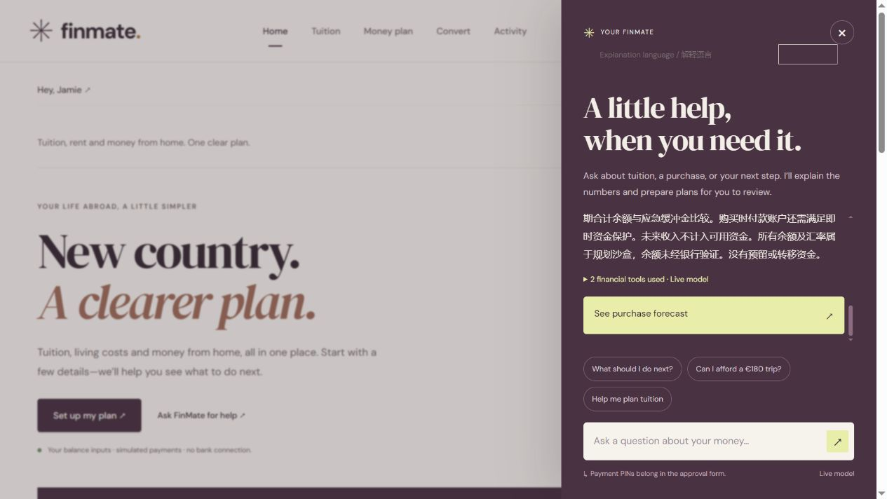
English and Chinese explanations
A student can ask in either language.
The financial calculation stays the same.
Clarification and correction
Exact numeric conclusions
The same approval controls
Translation does not authorize a payment. Native-speaker usability testing remains to be conducted.
Notes:
45 seconds. The assistant and tuition workflow support English and simplified Chinese explanations. Currency codes, account identifiers, dates and payment amounts remain exact. Affordability conclusions are rendered from tool calculations so the payment-time living reserve and long-term emergency buffer are not confused. The broader navigation and approval forms remain English. Source: backend/agent.mjs and app.js.

Slide 8
Measured results and their limits
72 / 72
129 automated tests
24 scenarios, 3 repeats
0 observed balance or approval violations
Live evaluation runs passing defined checks
Median latency: 4.10 seconds
95th percentile: 8.91 seconds
Bounded synthetic checks. Semantic assertions are incomplete. Human review found and informed a correction.
Notes:
60 seconds. There are 129 deterministic tests after this update. The live agent evaluation uses 24 locally authored scenario variants repeated three times with synthetic data. Checks cover completion, interaction and security outcomes. The initial report passed assertions but human review caught an imprecise buffer explanation. We preserved that report, grounded affordability output and reran the set. These results are not a general safety rate, independent held-out benchmark or student study. Sources: docs/agent-benchmark.json, docs/benchmark-human-review.md and tests.

Slide 9
A focused path to real student use
Working now
Next validation
Entered balances and local invoices
Deadline-aware tuition planning
Explicitly approved sandbox payments
Reference data and bilingual help
Observe 5–8 consenting students
Measure completion and confusion
Retest the changes they need
Validate licensed payment integrations
Student study prepared, not conducted. FinMate is not a bank or a production financial service.
Notes:
50 seconds. FinMate is a working local financial planning and execution sandbox. It does not authenticate banks or universities, receive real funds, offer guaranteed exchange prices or complete production KYC. The next validation is a small, consenting international-student study, with materials prepared but no participants claimed. Real payment deployment would require licensed integrations, reconciliation, external key management and jurisdiction-specific compliance review. Sources: docs/student-study.md and docs/security.md.

