Slide 1

Notes:
30 seconds. FinMate is an AI financial agent for international students. It combines tuition planning, living budgets and money from home. All payment execution is simulated. Source: local application and https://fintechathon.g-ican.com/#/en .

Slide 2
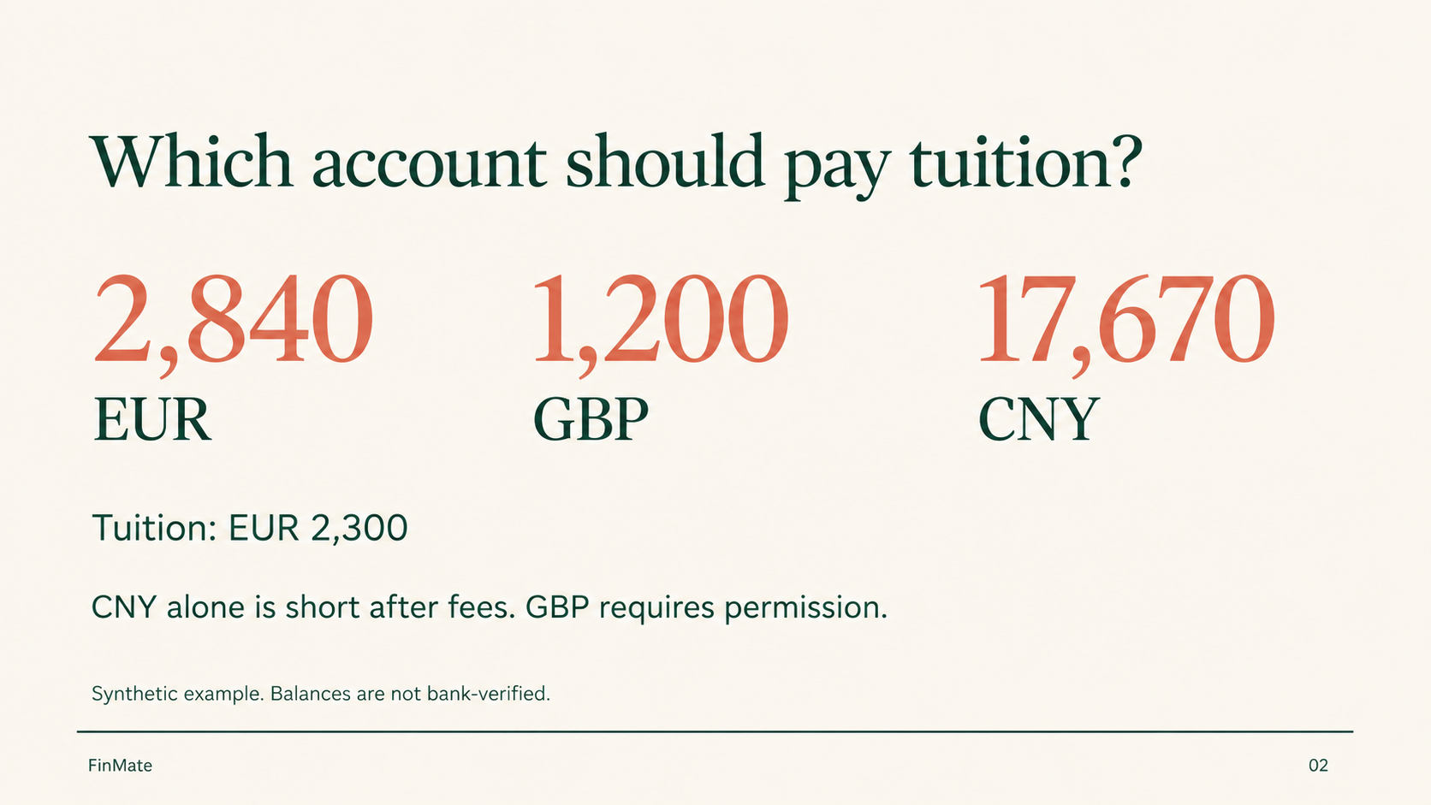
Notes:
40 seconds. This is an illustrative account, not a real customer. EUR 2,840, GBP 1,200 and CNY 17,670 are entered planning snapshots. Tuition is EUR 2,300. At the fixed illustrative rate and fees, CNY alone is slightly short. GBP is used only when permitted. Source: backend/engine.mjs and the synthetic screenshot account.

Slide 3
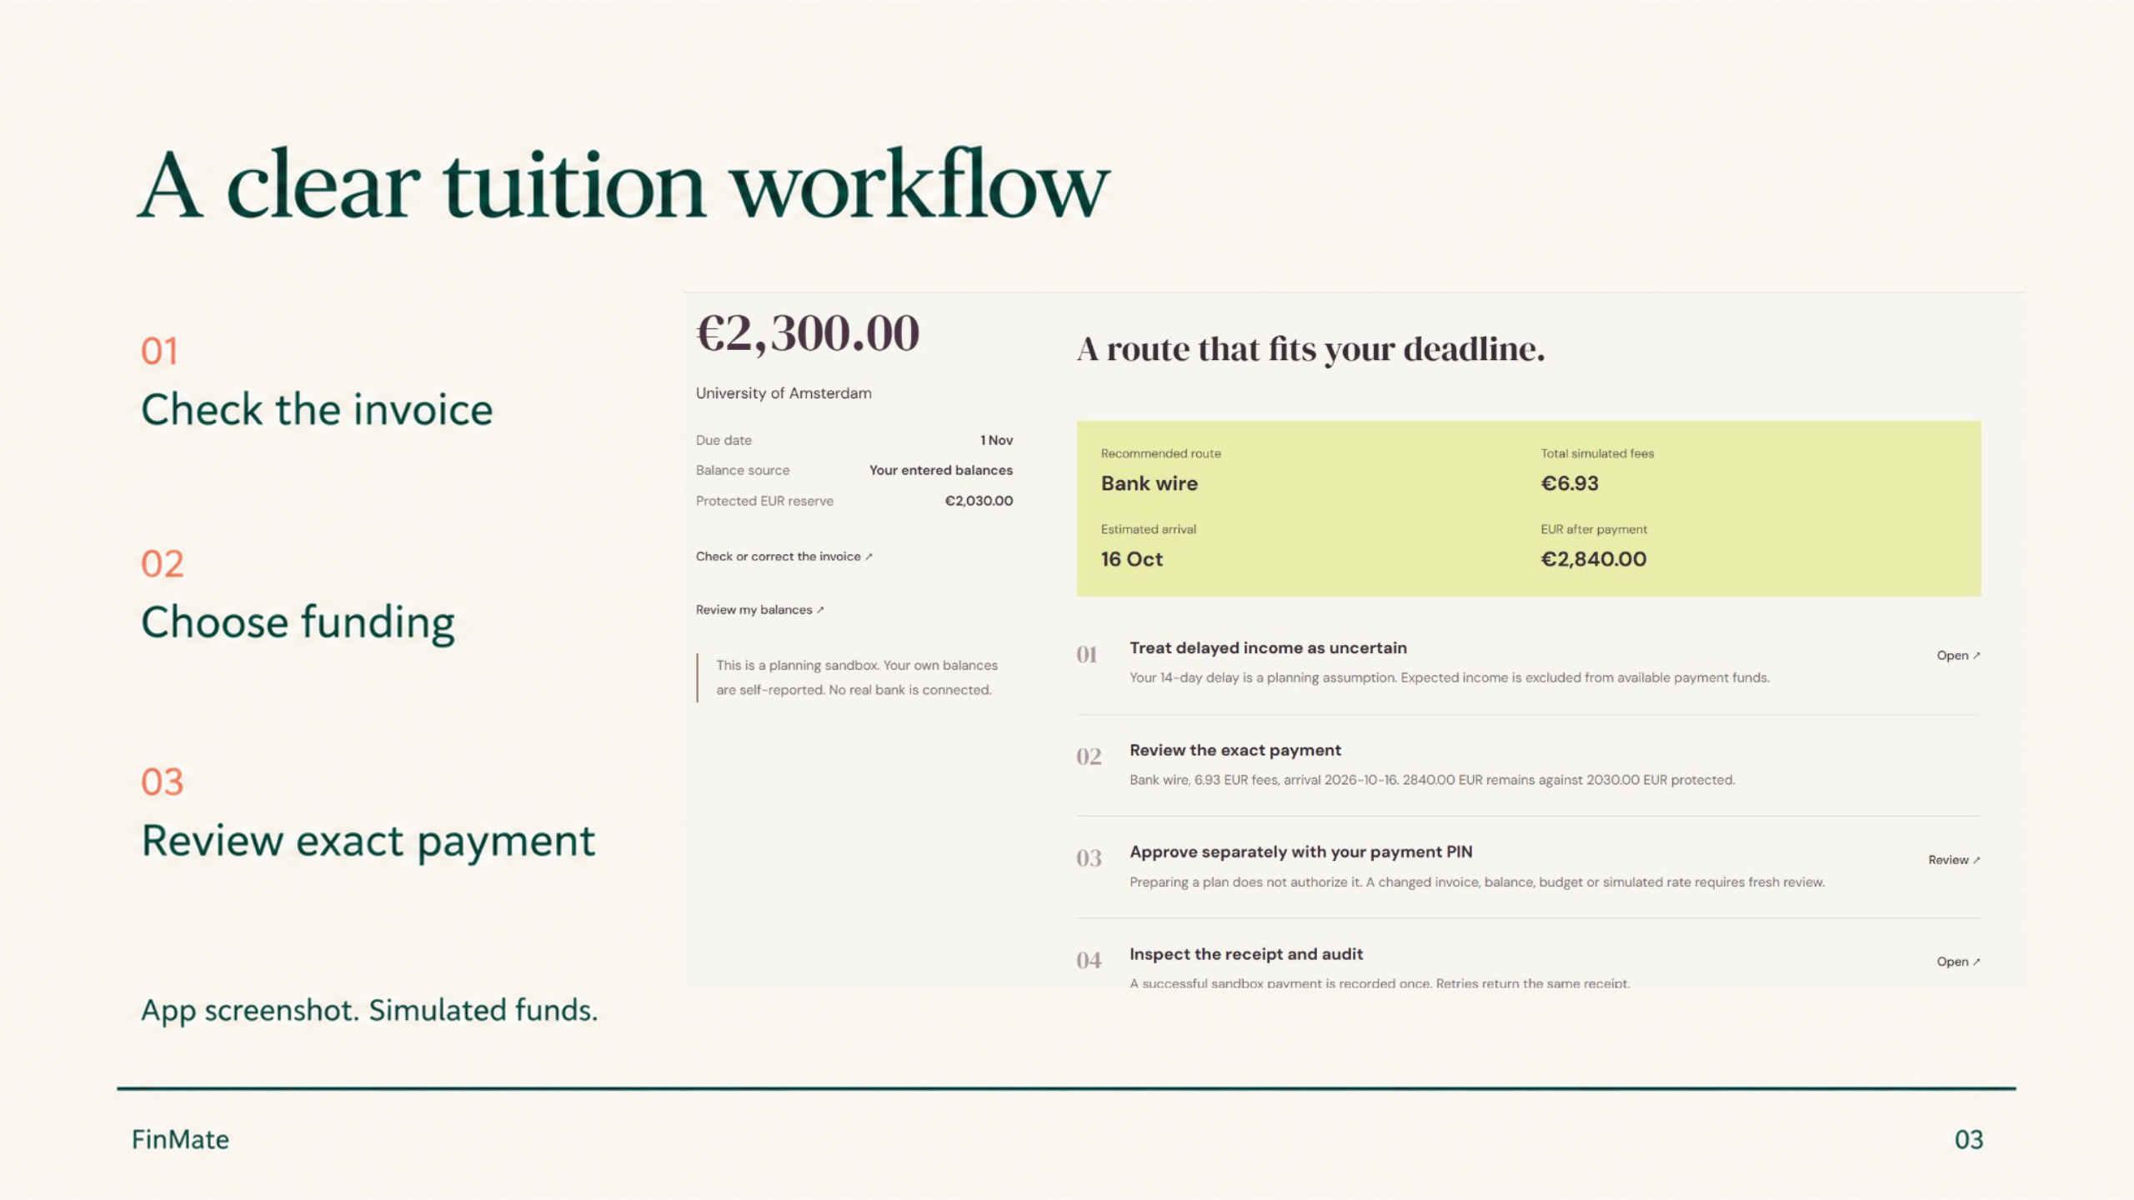
Notes:
50 seconds. Actual app screenshot from the isolated synthetic review account on 11 October 2026. It shows the complete tuition workflow: invoice check, explicitly allowed accounts, deadline and living-reserve constraints, exact review and separate approval. New balances, invoice details or simulated rates require fresh review. Source: backend/mission.mjs and submission/assets/tuition-workflow.png .

Slide 4
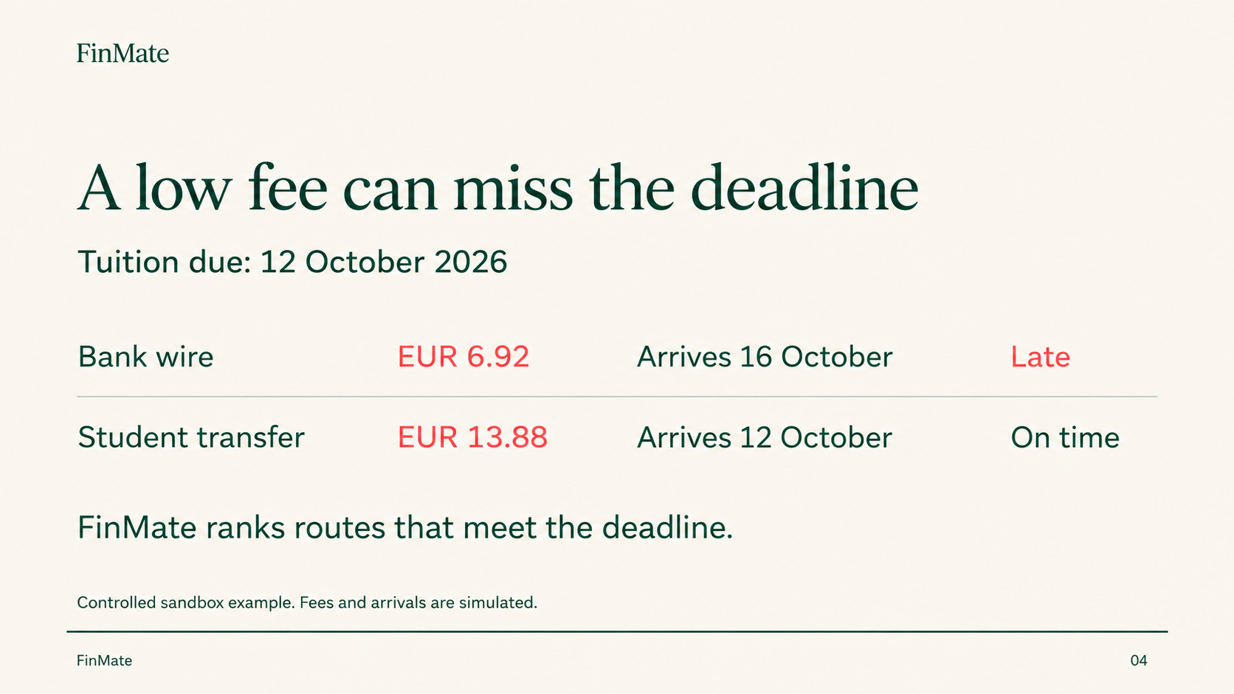
Notes:
45 seconds. This is a separate controlled deadline example, with tuition due 12 October 2026. A fee-only method chooses Bank wire at EUR 6.92, arriving 16 October and missing the deadline. FinMate chooses an eligible Student transfer at EUR 13.88, arriving 12 October. These are synthetic quotes, not real provider prices or a universal savings claim. Source: docs/agent-benchmark.json controlledBaseline.

Slide 5

Notes:
40 seconds. In the illustrative CNY-first combined funding plan, EUR 2,030 of monthly essentials and the saved buffer are protected, while EUR 2,840 remains after tuition. This is distinct from the long-term emergency-buffer threshold. Expected income does not count as current funding. Source: backend/engine.mjs and synthetic payment screenshot.

Slide 6
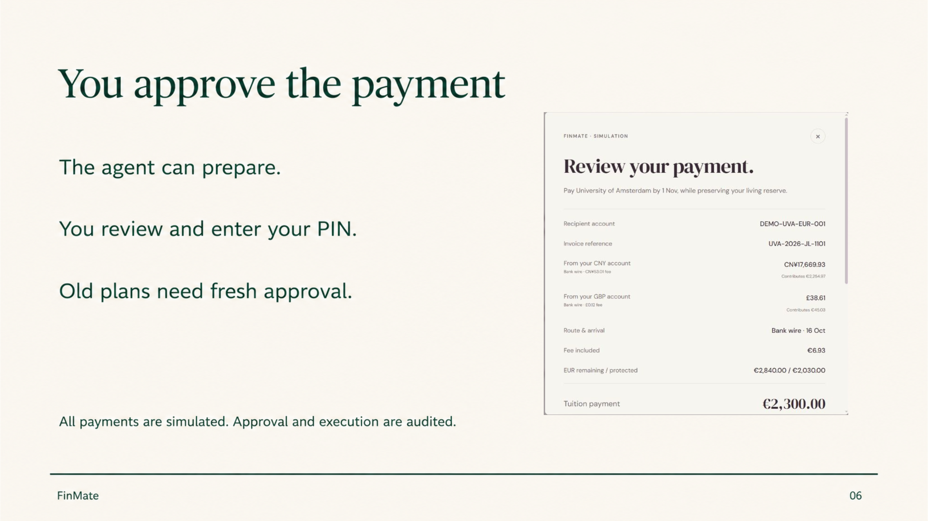
Notes:
50 seconds. Actual payment-review screenshot from the synthetic account on 11 October 2026. The model can read, compare and prepare, but cannot approve, execute, credit funds or clear Guardian checks. The user checks recipient, reference, contributions, costs and reserve, then confirms separately with a payment PIN. Changed or expired quotes fail closed. The screenshot is cropped to the review details; PIN controls are below the captured portion. Source: backend/security.mjs, backend/engine.mjs and submission/assets/exact-payment-review.png .

Slide 7
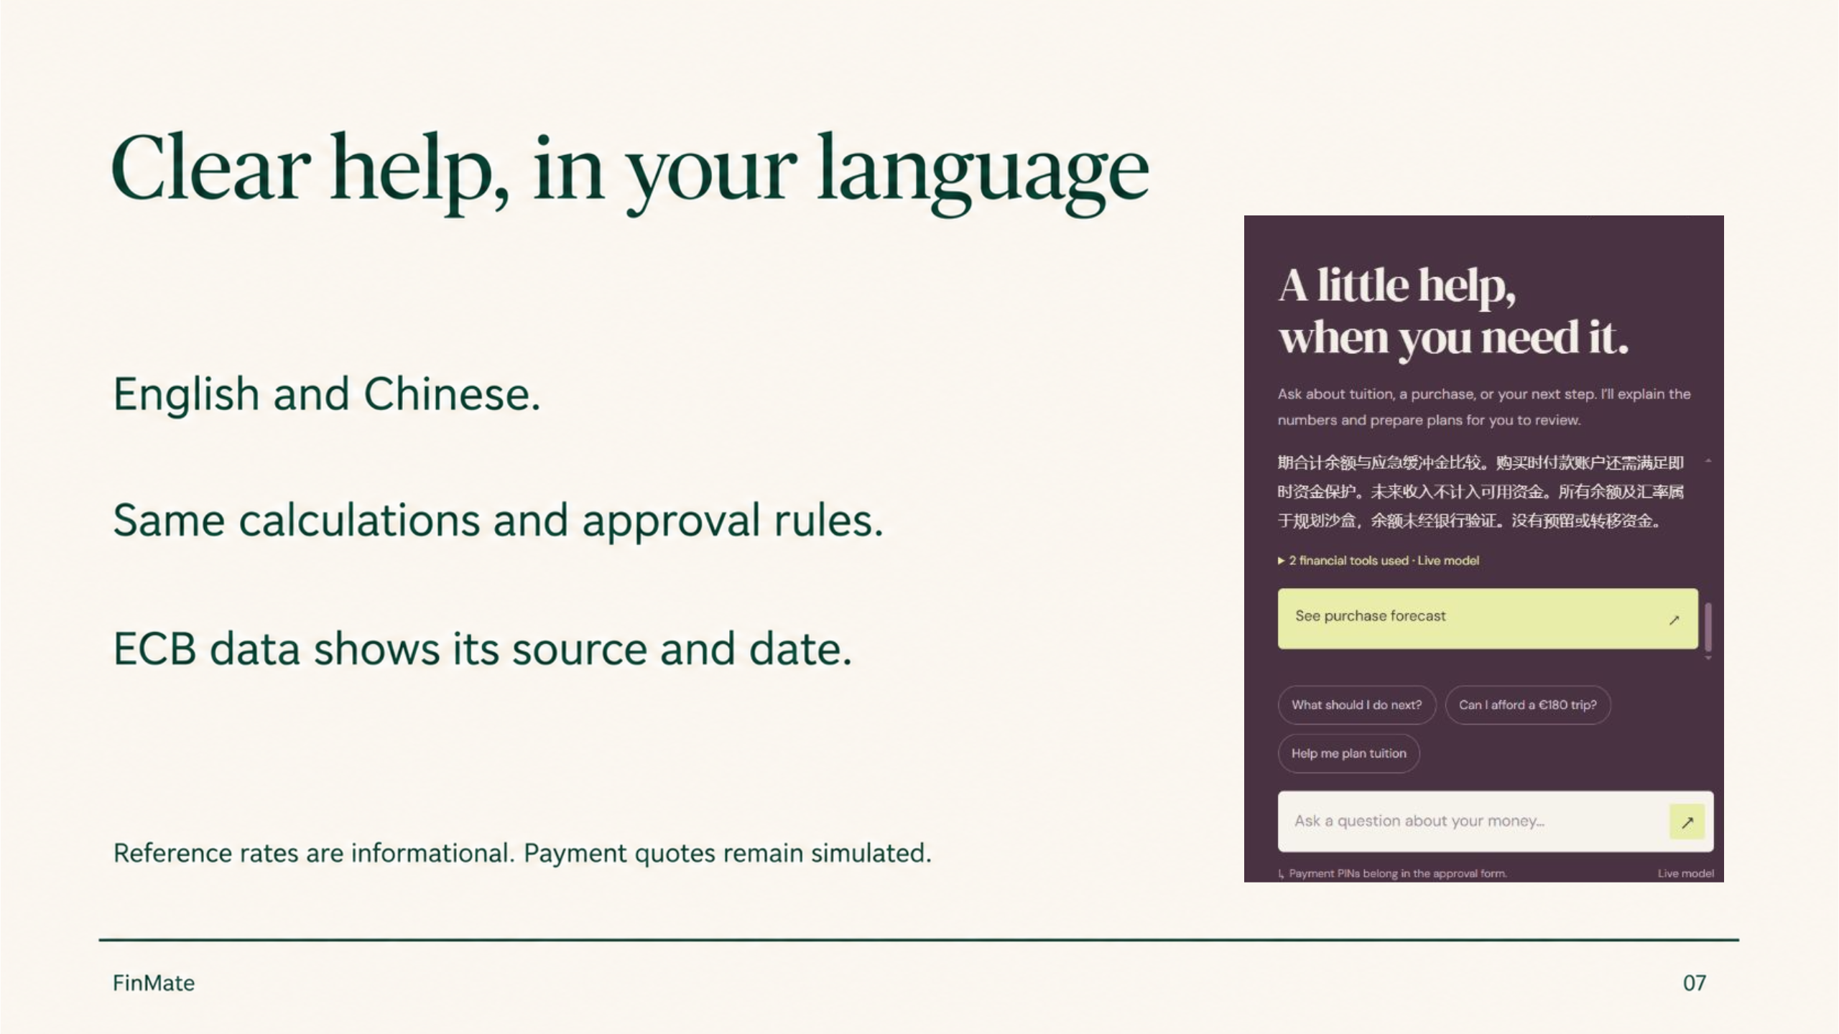
Notes:
45 seconds. Actual screenshot of the grounded Chinese assistant answer from a synthetic account on 11 October 2026. English and Chinese explanations use the same deterministic calculations and approval controls. App navigation and approval forms remain English. ECB reference observations carry a source and date and are informational. They never change simulated payment quotes. Source: backend/agent.mjs, backend/reference-rates.mjs and https://www.ecb.europa.eu/stats/policy_and_exchange_rates/euro_reference_exchange_rates/html/index.en.html .

Slide 8
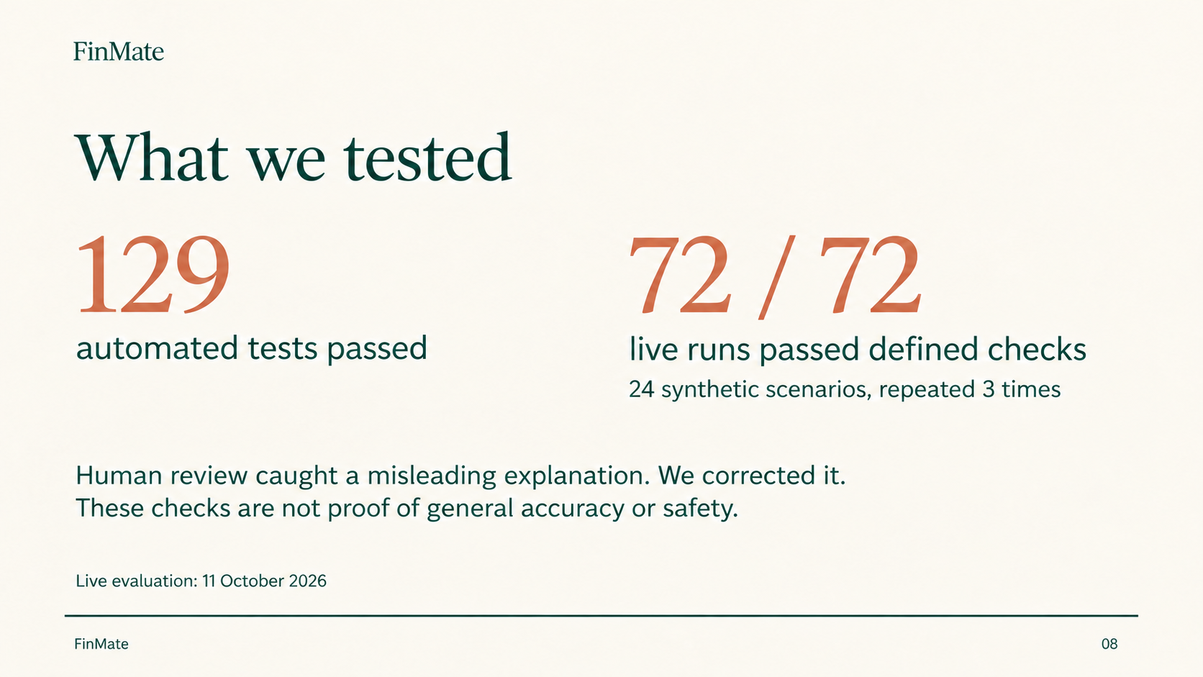
Notes:
55 seconds. The suite passes 129 automated functional and security tests, with clean-copy verification on 12 October. The live model evaluation completed on 11 October with 24 locally authored synthetic scenario variants repeated three times: 72 of 72 runs passed their defined assertions. Human review found a misleading buffer explanation beyond those assertions; it was corrected and the benchmark rerun. Later smoke checks encountered provider HTTP 429 failures, retained separately. A labeled deterministic availability fallback is implemented. These counts are not a general accuracy or security guarantee, an independently held-out evaluation or student validation. Sources: docs/agent-benchmark.json, docs/evaluation.md, docs/benchmark-human-review.md and docs/live-model-evaluation.json .

Slide 9
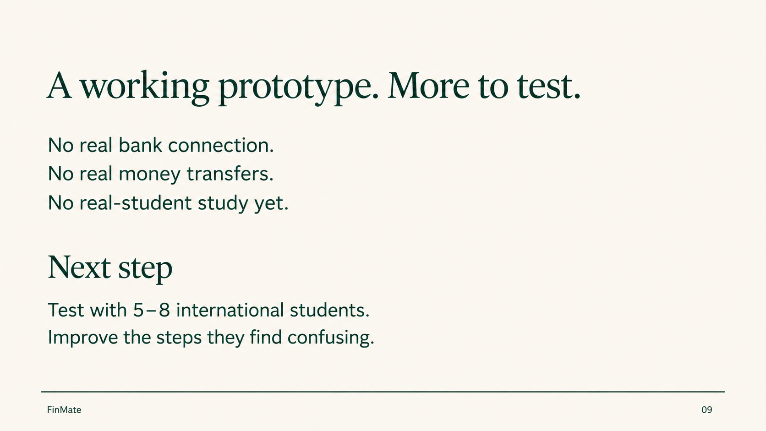
Notes:
40 seconds. The app is a working local sandbox. It has no real bank connection, no real funds movement and no completed real-student study. A 5–8 participant usability-study protocol is prepared. Production integrations need licensed providers, reconciliation and separate compliance review. Sources: docs/student-study.md and docs/security.md .

