Slide 1

MAVEN
BY: SHAIKH ADNAN
MIS: 112003128
DIV:2
S3 BATCH

Slide 2
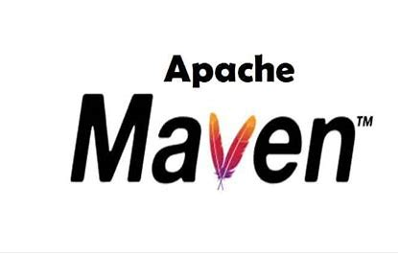
INTRODUCTION
Maven is a build tool that helps in project management.
The tool helps in building and documenting the project.
Maven is written in Java and C# and is based on the Project Object Model (POM).
The tool is used to build and manage any Java-based project. It simplifies the day to day work of Java developers and helps them in their projects.

Slide 3
HISTORY
Maven, created by Jason van Zyl, began as a sub-project of Apache Turbine in 2002.
In 2003, it was voted on and accepted as a top level Apache Software Foundation project.
In July 2004, Maven's release was the critical first milestone, v1.0. Maven 2 was declared v2.0 in October 2005 after about six months in beta cycles.
Maven 3.0 was released in October 2010 being mostly backwards compatible with Maven 2.
Apache Maven 3.8.4 is the latest release and recommended version for all users.

Slide 4
THE NEED FOR MAVEN
Maven is chiefly used for Java-based projects.
It helps in downloading dependencies, which refers to the libraries or JAR files.
->The task of downloading JAR files and other dependencies does not need to be done manually.
It helps to create the right project structure which is essential for execution.
It helps in building and deploying the project to make it work.
It helps manage all the processes, such as building, documentation, releasing and distribution in project management.

Slide 5
IMPLEMENTATION
Maven facilitates a number of uses, including managing dependencies.
Printing current date and time - Joda time libraries can be used.
This can be made easier by including Joda Time as a compile dependency in the build (pom.xml).
<dependencies>
<dependency>
<groupId>joda-time</groupId>
<artifactId>joda-time</artifactId>
<version>2.9.2</version>
</dependency>
</dependencies>
After this, I imported org.joda.time.LocalTime; and gave program the necessary instructions.
I have used JODA-Time because it offers better classes and having efficient methods to handle date and time than classes from java.util package like Calendar, Gregorian Calendar, Date, etc.

Slide 6
GLOSSARY – BUILD TOOL
Build Tool: Build tools are programs that automate the creation of executable applications from source code. They are necessary for the process of building.
It is needed for the following processes:
Generating Source code.
Generating documentation from the Source code.
Compiling of Source code.
Packaging of the compiled codes into JAR (Java ARchive) files.
Installing the packaged code into local repository, server or central repository

Slide 7
GLOSSARY – POM.xml file
POM stands for "Project Object Model", and xml stands for "Extensible Markup Language".
The POM file has all the information regarding project and configurational details.
Executing a task - Maven searches for the POM in the current directory.
It contains default values for most projects.
Some of the configuration that can be specified in the POM are the project dependencies, the plugins or goals that can be executed, the build profiles, and so on.
Other information such as the project version, description, developers, mailing lists and such can also be specified.

Slide 8
Important files in the GitHub repository

Slide 9
System.out.printIn(“THANK YOU”);

