Slide 1
◆
XGBoost
supervised
Isolation Forest
anomaly
CRF
sequence (PGM)
SHAP
explainability
CIC-IDS-2017 · WEB ATTACK DETECTION
Detecting Web Attacks with a Three-Layer Machine Learning System
Brute Force · XSS · SQL Injection generated against DVWA
CSLAB CHALLENGE 2026
Muhammad Adnan
Notes:
Open: detecting web attacks (Brute Force, XSS, SQL Injection) run against DVWA in CIC-IDS-2017. Three complementary detection layers plus SHAP. Used the GeneratedLabelledFlows version because it keeps timestamps, needed for the sequence layer.

Slide 2
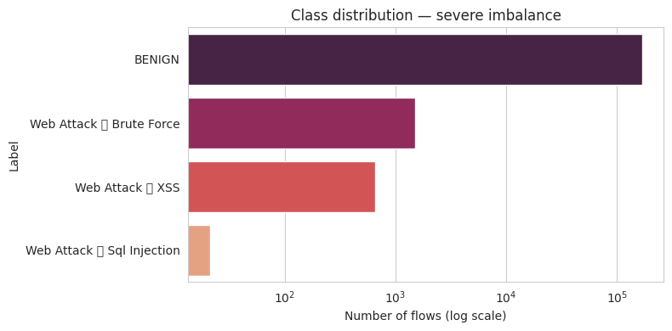
THE PROBLEM & THE DATA
Rare attacks hidden in normal traffic
Dataset: CIC-IDS-2017 (GeneratedLabelledFlows — keeps timestamps & IPs).
170,231 clean flows × 77 features (duration, packets, bytes, timing, TCP flags & window sizes).
Only 1.28% are attacks — severe imbalance. Guessing “benign” always scores 98.7% accuracy yet catches zero attacks.
→ Evaluate with F1 & Recall; balance training with SMOTE. Metadata (IPs, ports) dropped so the model learns behaviour, not attacker identity.
Figure 1 — class distribution (log scale): 168,051 benign vs 2,180 attacks.
Notes:
Imbalance is the core challenge — 1.28% attacks. Figure 1 uses a log scale so the tiny attack bars are visible. Use F1/Recall and SMOTE. Dropped IP/port metadata so the model learns behaviour, not attacker IP.

Slide 3
THE APPROACH
Three complementary detection layers
01
02
03
XGBoost
Isolation Forest
CRF
Supervised · per-flow
Unsupervised · per-flow
Sequence · PGM
300 boosted trees, each fixing the previous ones' errors. Learns known web-attack patterns from labels.
Flags flows that isolate quickly under random cuts — a safety net for novel anomalies, no labels needed.
A probabilistic graphical model that labels each flow using its time-ordered neighbours — detects attack sequences.
Explainability: SHAP reveals which network features drive each detection.
Pipeline: clean → scale → SMOTE (train only) → stratified split for per-flow models, blocked split for the CRF — a leak-free evaluation.
Notes:
Left to right: XGBoost supervised backbone; Isolation Forest unsupervised novelty net; CRF the sequence layer that labels each flow using its neighbours in time. SHAP explains decisions. Leak-free methodology: split first, SMOTE on training only, blocked split for CRF.

Slide 4
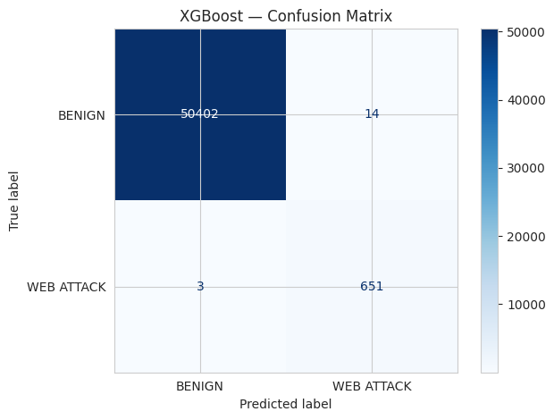
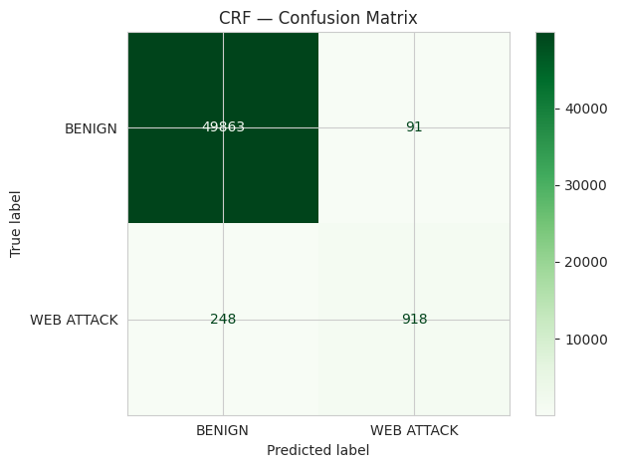
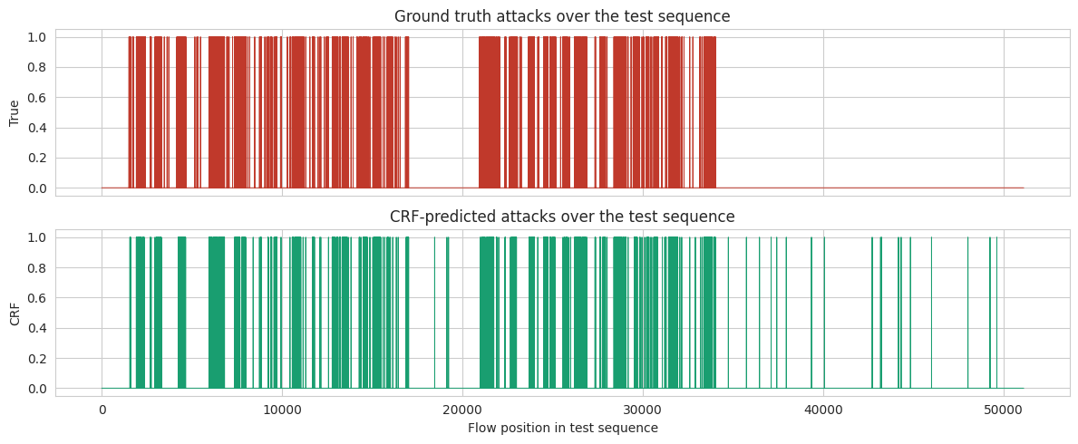
RESULTS
Detection performance
XGBoost confusion matrix
CRF confusion matrix
Model comparison — Precision / Recall / F1
0.987
1.000
0.844
XGBoost F1
ROC-AUC
CRF F1
XGBoost caught 651/654 attacks (missed 3) with 14 false alarms. Isolation Forest is weak alone (expected). CRF detects attacks in temporal sequence.
CRF detections vs ground truth over the time sequence
Notes:
Real results. XGBoost F1 0.987, recall 0.995, AUC 1.0 — confusion matrix: 651 attacks caught, 3 missed, 14 false alarms. Isolation Forest weak alone — expected; catches novel attacks. Combined OR: full recall, lower precision. CRF F1 0.844 — the sequence-over-time figure shows CRF predictions tracking the real attack activity. If asked about AUC 1.0: held-out test set, leak-free pipeline, highly separable dataset.

Slide 5
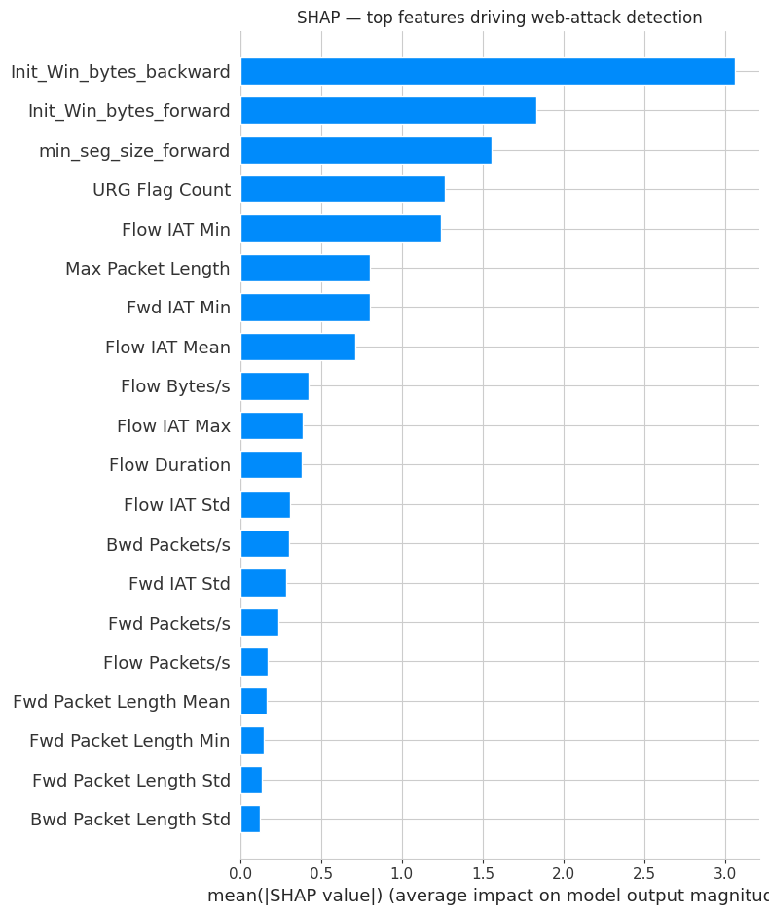
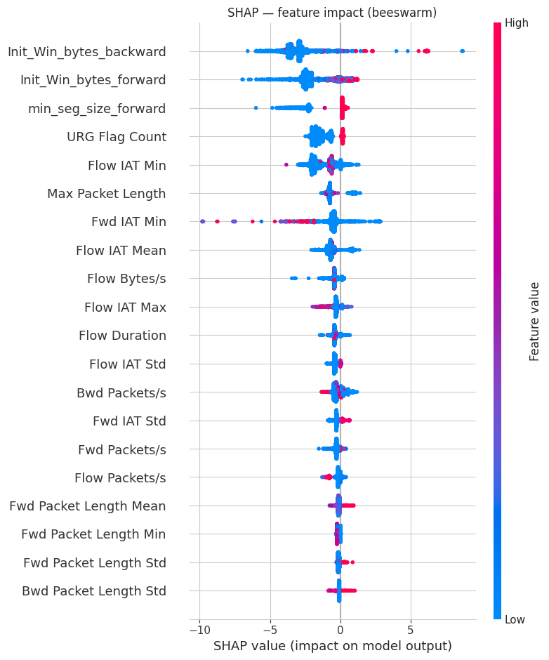
EXPLAINABILITY & CONCLUSIONS
Why it works — and what we found
Key findings
✓
XGBoost detects known attacks near-perfectly (F1 0.987)
✓
Isolation Forest adds novelty detection (no labels)
✓
CRF models attack sequences in time (F1 0.844)
✓
CRF uses neighbouring flows to detect attack bursts
✓
Attacks signalled by TCP window sizes, timing & flags
SHAP — top features by importance
SHAP beeswarm — right = pushes toward attack
✓
Deployed as a live Streamlit detection console
Notes:
Close on explainability. SHAP importance shows top features; the beeswarm shows how each feature pushes a flow toward attack (right) or benign (left), coloured by feature value. Six key findings. Python tools listed. Offer to demo the live Streamlit app.

