Slide 1
⚡ NEXT-GEN TELECOM & AI BROADBAND
MK NET 2.0 AI PLATFORM
Master Executive Presentation: Smart Broadband Operations, AI Experience Layer & 100% Admin Governance
🤖 AI Neural Brain
10 Specialized AI Assistants, multi-lingual NLU & voice synthesis.
⚡ Flexi-Recharge Pass
1 to 30 Days custom plan renewals with dynamic pricing.
🎛️ 100% Admin Control
40+ Admin modules, live settings, user resets & AI rules.
MK Net 2.0 AI ISP Platform | Smart Broadband & AI Experience | Slide 1 of 20

Slide 2
STRATEGIC OVERVIEW
Executive Summary: Transforming ISP Services with AI
1. AI Experience Layer
Integrated 10 specialized AI Assistant personas providing 24/7 bilingual voice & chat support, line diagnostics, and instant action redirects.
2. Flexi-Plan Billing Engine
Empowers subscribers with 1 to 30-day custom duration passes, bKash & Nagad automated payments, and real-time invoice matching.
3. 100% Admin Governance
Centralized Master AI Control Center, password management, complete CRUD over packages, invoices, users, and site content.
4. Network Uptime & Transparency
99.99% SLA Uptime monitoring, regional POP hub incident reporting, BDIX 100 Mbps routing, and fast speed testing.
MK Net 2.0 AI ISP Platform | Smart Broadband & AI Experience | Slide 2 of 20

Slide 3
SYSTEM ARCHITECTURE
MK Net 2.0 Full-Stack Technology Stack
🌐 Presentation Layer (Frontend)
HTML5, Vanilla CSS Design System, Glassmorphism UI, Responsive Mobile Flexbox, Web Speech API (STT/TTS).
🧠 AI Experience & NLP Layer
Bilingual Intent Engine (Bengali, English, Banglish), Multi-Intent Fusion, Real-time Database Profile Lookups.
⚡ Application & Billing Engine
PHP 8.x Core Engine, Flexi-Plan Pricing Algorithms, bKash & Nagad Payment Verification, CSRF Protection.
🗄️ Database & Storage Layer
MySQL Relational Database, Self-Healing Auto-Schema Bootstrapper (`ensure_mknet_db_schema`), Automated Invoicing.
MK Net 2.0 AI ISP Platform | Smart Broadband & AI Experience | Slide 3 of 20

Slide 4
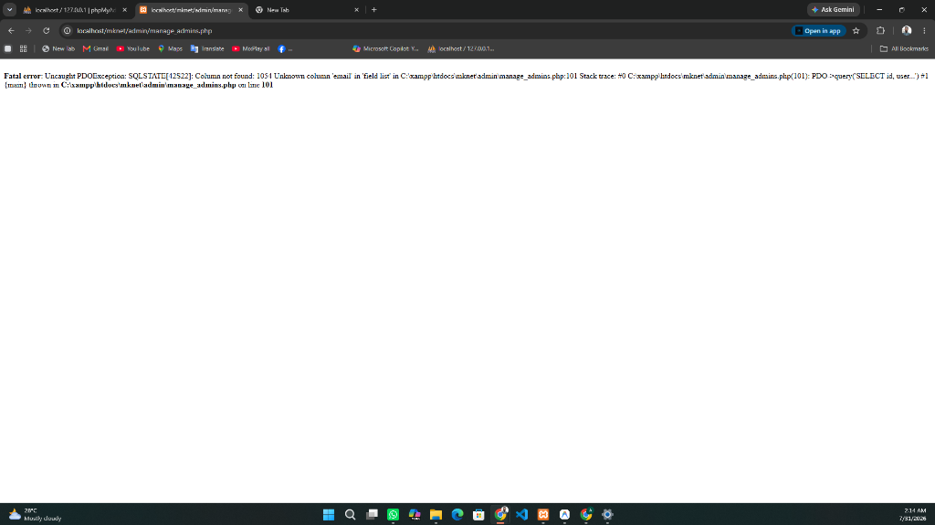
AI NEURAL ENGINE
AI Experience Layer: 10 Specialized Assistants
Key Neural Intelligence Features:
🗣️ Bilingual NLU Engine: Recognizes Bengali script, English, and Romanized Banglish.
🔀 Multi-Intent Fusion: Simultaneously resolves compound queries (e.g., line issue + bill lookup).
👤 Live Subscriber Context: Greets users by name and retrieves active package, due bill, and open tickets.
🎙️ Web Speech STT/TTS: Voice recognition and natural audio synthesis with auto-listen mode.
⚡ Automated Action Redirects: Auto-navigates to Pay Bill, Packages, Ticket Creation, and Speedtest.
MK Net 2.0 AI ISP Platform | Smart Broadband & AI Experience | Slide 4 of 20

Slide 5
AI PERSONA 1
🛠️ AI Technical Support Specialist & ONU Line Diagnostics
1. ONU LOS Red Light Detection
Detects optical signal loss caused by external fiber cable cuts or bends. Provides immediate diagnosis to subscriber.
2. Power Cycle Reboot Guide
Instructs subscriber to unplug ONU and Wi-Fi router power adapters for 30 seconds to refresh IP leases.
3. Patch Cord SC Connector Check
Guides physical inspection of yellow optical patch cords into the ONU PON port for secure latching.
4. Automated Support Ticket Logging
Automatically logs Support Ticket (#TKT-XXXX), sets priority to 'High', and alerts NOC engineering team.
MK Net 2.0 AI ISP Platform | Smart Broadband & AI Experience | Slide 5 of 20

Slide 6
AI PERSONA 2
🎯 AI Package Advisor & Bandwidth Optimization
🎓 Student / Single User
20 Mbps Fiber • 500 BDT/month
Designed for HD browsing, Zoom calls, and social media.
🏠 Family & Smart TV 4K
50 Mbps Fiber • 1,000 BDT/month
Zero buffer 4K YouTube, Netflix, and multiple household devices.
🎮 Gamer & Online Streamer
100 Mbps BDIX • 1,800 BDT/month
Ultra low ping gaming, BDIX FTP servers, and Twitch streaming.
🏢 Office & Corporate SLA
200 Mbps Dedicated • 14,999 BDT/month
1:1 Dedicated optical fiber line with 99.99% SLA Uptime SLA.
MK Net 2.0 AI ISP Platform | Smart Broadband & AI Experience | Slide 6 of 20

Slide 7
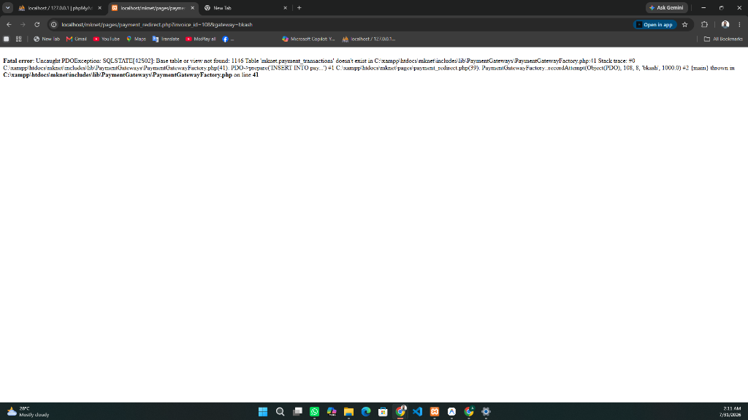
AI PERSONA 3
💳 AI Billing Assistant & Instant Payment Gateways
bKash & Nagad Merchant Workflows:
📲 bKash Merchant Payment: Dial *247# or open bKash App -> Make Payment -> Merchant Number.
📲 Nagad Merchant Payment: Dial *167# or open Nagad App -> Merchant Pay.
🧾 Instant TrxID Submission: Enter Transaction ID on Pay Bill page for instant account renewal.
📄 Automated Invoice PDF Download: Access historical billing receipts directly from Selfcare.
MK Net 2.0 AI ISP Platform | Smart Broadband & AI Experience | Slide 7 of 20

Slide 8
AI PERSONA 4
📶 AI Router Setup Guide & Interactive Gateway Tool
TP-Link Routers
Gateway IP: 192.168.0.1 / tplinkwifi.net
Log in admin/admin -> Wireless -> Wireless Security -> WPA2-PSK Password -> Save.
Tenda Routers
Gateway IP: 192.168.0.1 / tendawifi.com
Go to Wireless Settings -> Change Wi-Fi Name (SSID) & Password -> Click OK.
D-Link Routers
Gateway IP: 192.168.1.1
Log in admin/admin -> Setup -> Wireless Settings -> Pre-Shared Key -> Save Settings.
Netgear / Totolink
Gateway IP: 192.168.1.1
Log in admin/password -> Wireless Setup -> WPA2 Passphrase -> Apply.
MK Net 2.0 AI ISP Platform | Smart Broadband & AI Experience | Slide 8 of 20

Slide 9
AI PERSONA 5
⚡ AI Internet Diagnosis & BDIX Speed Test Integration
🚀 Fast.com & Speedtest.net API
Launches live real-time bandwidth test measuring download, upload, and latency metrics.
⚡ 100 Mbps BDIX Route Inspection
Verifies zero-buffer 4K YouTube streaming and high-speed BDIX FTP server connectivity (Samonline, CircleFTP).
🛠️ Latency & Packet Loss Diagnostic
Measures ping latency (1ms - 5ms BDIX) for online gaming servers (Valorant, PUBG, CS2).
MK Net 2.0 AI ISP Platform | Smart Broadband & AI Experience | Slide 9 of 20

Slide 10
AI PERSONA 6
🎫 AI Complaint Assistant & SLA Escalation Workflow
Step 1: Reporting
Subscriber speaks or types complaint via AI Assistant.
Step 2: Auto Ticket
Generates unique Ticket ID (#TKT-XXXX) & assigns priority.
Step 3: NOC Dispatch
Alerts optical engineers for 2 to 4-hour SLA resolution.
Step 4: Resolution
Real-time updates via SMS & Selfcare ticket portal.
MK Net 2.0 AI ISP Platform | Smart Broadband & AI Experience | Slide 10 of 20

Slide 11
AI PERSONA 7
📚 AI Knowledge Base & 24/7 ISP Wiki
Centralized Knowledge Wiki Content:
📞 24/7 Support Hotline: 16335 / 09678-123123 (NOC Engineering Team).
✉️ Official Support Email: support@mknet.com
📍 Head Office Location: Police Plaza Concord, Gulshan 1, Dhaka, Bangladesh.
🌐 BDIX FTP Servers: Samonline, CircleFTP, BDIX Torrent zero-buffer links.
📑 Terms & SLA Policies: Clear terms on fair usage, bandwidth allocation, and line maintenance.
MK Net 2.0 AI ISP Platform | Smart Broadband & AI Experience | Slide 11 of 20

Slide 12
BILLING ENGINE
⚡ Flexi-Plan Custom Duration Recharge (1 to 30 Days)
1 Day Flexi Pass
Ideal for emergency top-up when traveling.
3 Days Weekend Plan
Great for weekend gaming sessions.
7 Days Weekly Pass
Short-term flexibility with 5% discount.
15 Days Mid-Month
Half-month pass with 10% discount.
30 Days Full Monthly
Standard monthly plan with maximum savings.
MK Net 2.0 AI ISP Platform | Smart Broadband & AI Experience | Slide 12 of 20

Slide 13
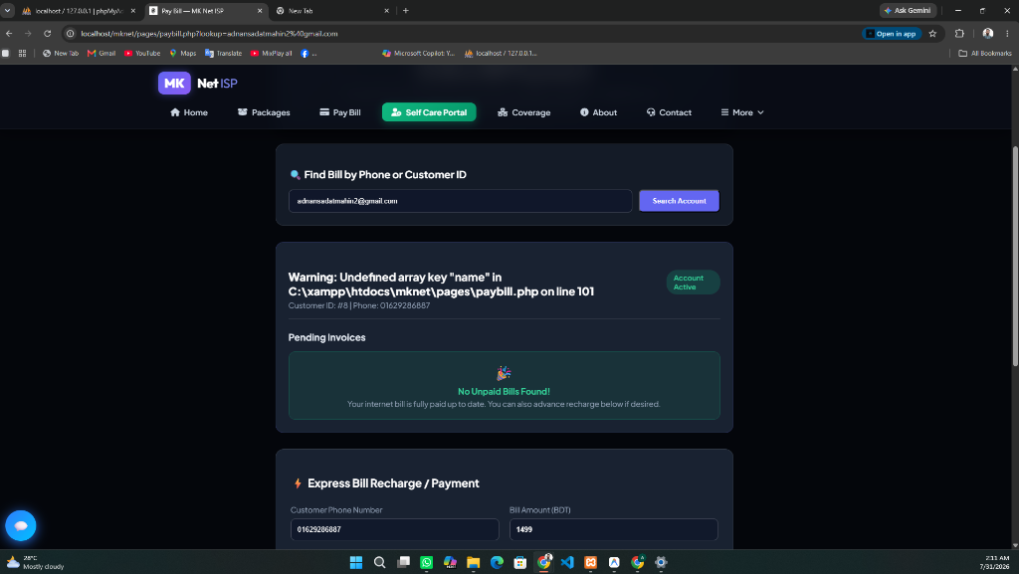
SUBSCRIBER PORTAL
📱 Customer Super App & Selfcare Dashboard
Selfcare Dashboard Features:
📊 Live Bandwidth Usage & Daily Consumption Graph.
💳 Instant Invoice Download & Manual TrxID Verification.
🔄 Package Upgrade & Flexi Duration Extension.
🎫 Ticket History & Real-Time Engineering Comments.
🔑 Account Password Reset & Security Profile Settings.
MK Net 2.0 AI ISP Platform | Smart Broadband & AI Experience | Slide 13 of 20

Slide 14
E-COMMERCE STORE
🛒 MK Net Hardware Store & Optical Addons
WiFi 6 Dual Band Gigabit Routers
3000 Mbps combined wireless speed with OFDMA & MU-MIMO technology.
Gigabit Optical ONUs (XPON)
High-sensitivity SC/APC fiber terminal supporting up to 1000 Mbps.
Fiber Patch Cords (SC-SC Simplex)
Low insertion loss optical fiber drop cables in 1m, 3m, and 5m lengths.
Cat6 Pure Copper Ethernet Cables
High-frequency twisted pair patch cables for zero latency LAN connections.
MK Net 2.0 AI ISP Platform | Smart Broadband & AI Experience | Slide 14 of 20

Slide 15
ENGAGEMENT
🎁 Customer Loyalty System & Referral Rewards
Loyalty Program Structure:
🥉 Bronze Badge: Initial signup tier for new subscribers.
🥈 Silver Badge: Unlocked after 3 consecutive on-time bill payments.
🥇 Gold Badge: Unlocked after 6 months of continuous active subscription.
💎 Platinum Badge: Top tier subscribers with bonus referral multipliers.
🔗 Referral Reward System: Earn 100 BDT balance bonus for every friend who signs up via your link.
MK Net 2.0 AI ISP Platform | Smart Broadband & AI Experience | Slide 15 of 20

Slide 16
NETWORK MONITORING
📡 Network Transparency & POP Incident Status
99.99% Uptime SLA
Guaranteed high availability across all regional POP hubs.
Live Regional POP Hub Status
Real-time monitoring of Gulshan, Dhanmondi, Uttara, & Chittagong POPs.
Maintenance Incident Logs
Proactive alerts for scheduled optical fiber splicing maintenance.
MK Net 2.0 AI ISP Platform | Smart Broadband & AI Experience | Slide 16 of 20

Slide 17
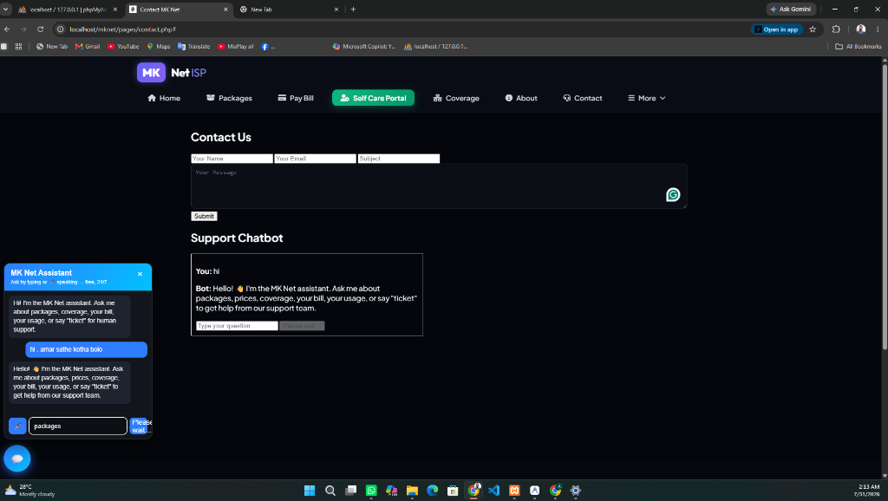
ADMINISTRATIVE CONTROL
🎛️ Master AI Experience Control Center (`admin/manage_ai_control.php`)
Master AI Control Center Capabilities:
🎛️ Master AI Switch: Enable/disable chatbot platform-wide.
🔄 Auto-Listen Toggle: Turn hands-free voice mode on/off by default.
⚡ Action Redirection Toggle: Enable/disable auto-page redirects.
📝 Custom Prompt Customizer: Edit fallback responses in Bengali & English.
🎓 Knowledge Training Rules: Live database CRUD for custom AI trigger keywords.
MK Net 2.0 AI ISP Platform | Smart Broadband & AI Experience | Slide 17 of 20

Slide 18
ADMINISTRATIVE GOVERNANCE
🔐 100% Admin Panel Control & Module Matrix
Packages & Pricing CRUD
Add, edit, delete, and hide internet plans with live speed/price updates.
User & Password Management
Admin password reset, user profile management, and account activation.
Invoices & Revenue Ledger
Full CRUD over pending, paid, and canceled invoices with manual verification.
Support Tickets & NOC Dispatch
Assign engineers, update ticket statuses, and post official responses.
MK Net 2.0 AI ISP Platform | Smart Broadband & AI Experience | Slide 18 of 20

Slide 19
MOBILE & PWA
📲 Progressive Web App (PWA) & Cross-Platform Support
📱 Home Screen Installation
Installable as a standalone app on iOS, Android, Windows, and macOS without app store downloads.
⚡ Offline Service Worker Caching
Pre-caches static assets and core pages for lightning-fast loading speeds on mobile data.
🔔 Mobile Responsive Layout
Zero horizontal overflow design system built with responsive flexbox and touch-friendly controls.
MK Net 2.0 AI ISP Platform | Smart Broadband & AI Experience | Slide 19 of 20

Slide 20
MK NET 2.0 — READY FOR NEXT-GEN EXPANSION
Future Strategic Roadmap:
📡 5G Fixed Wireless Access (FWA) Integration for rural broadband extension.
🔮 Predictive Optical Cable Splicing AI to detect fiber degradation before line break.
💳 Automated Auto-Debit Subscriptions via bKash & Nagad Recurring Payment APIs.
📞 24/7 Hotline: 16335 / 09678-123123 | ✉️ Email: support@mknet.com | 📍 Location: Police Plaza Concord, Gulshan 1, Dhaka
MK Net 2.0 AI ISP Platform | Smart Broadband & AI Experience | Slide 20 of 20

