Slide 1
MK NET ISP BILLING & CUSTOMER SELF CARE PORTAL
Commercial-Grade ISP Portal & Bilingual AI Voice Platform
An international-standard, commercial-ready ISP platform featuring 1-30 day flexi-plan renewals, automated bKash/Nagad payment settlement, glassmorphic dark theme, role-based admin governance, and a proactive AI Voice Assistant.
Comprehensive 18-Slide Master Product Specification Deck

Slide 2
SYSTEM VISION
Executive Summary: Next-Gen ISP Platform
⚡ 1-30 Day Flexi Plans
Eliminates monthly lock-in by providing dynamic per-day rates for 1, 3, 7, 15, and 30 days.
💳 MFS Automated Payments
Seamless integration with bKash, Nagad, Rocket, Upay & Cards with instant payment verification.
🤖 Bilingual AI Assistant
Proactive hands-free voice chat supporting Bengali (bn-BD), English, and Banglish script.

Slide 3
STRATEGIC IMPACT
Problem vs. Solution Analysis
❌ Legacy ISP Barriers
• Rigid Fixed Monthly Cycles: Customer disconnects due to unbending 30-day billing.
• Manual MFS Reconciliations: Hour-long delays verifying bKash/Nagad transactions.
• NOC Overload: 60%+ support calls for basic tasks like router passwords and line status.
• Cluttered Non-Responsive UI: Poor mobile experience leading to customer frustration.
✅ MK Net Innovation
• 1-30 Day Flexi Billing: Dynamic price calculation for short-term passes & renewals.
• Instant Automated Payment Verification: Multi-channel MFS receipt generation.
• 24/7 Proactive AI Assistant: Web Speech Bengali/English engine with auto-ticket creation.
• Modern Glassmorphic Dark UI: 100% responsive interface across desktop & mobile.

Slide 4
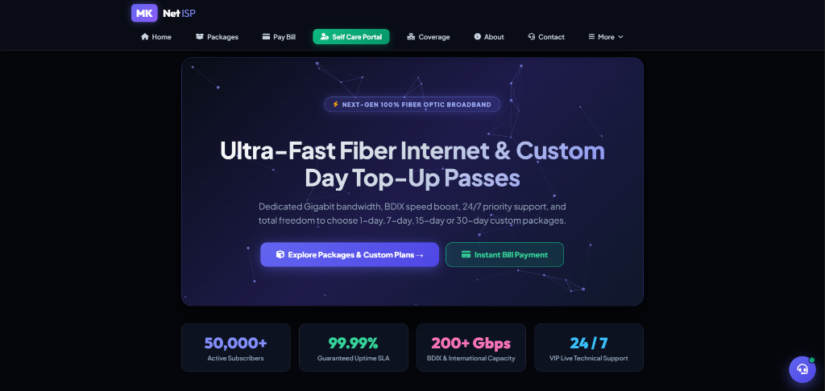
INTERFACE SHOWCASE
MK Net Homepage & Core Portal Layout
🌐 High-Impact Landing Page
• Sleek Glassmorphic Cyber Aesthetic: Opaque dark containers with glow borders.
• Real-Time Network Statistics: Live subscriber counts (50,000+), uptime SLA (99.99%), & BDIX bandwidth (200+ Gbps).
• Clear Navigation Bar: One-click links for Packages, Pay Bill, Self Care Portal, Coverage, & Contact.
• Promotional Call-to-Action: Direct engagement for new fiber optic connections.

Slide 5
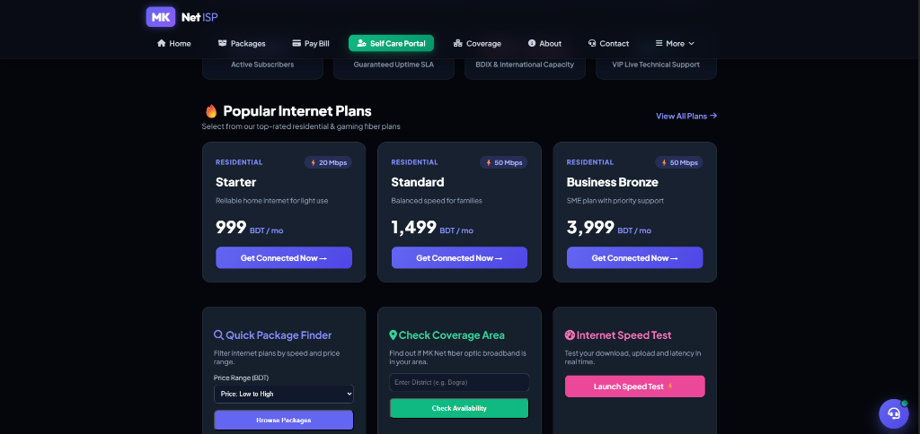
RESIDENTIAL & BUSINESS PLANS
Popular Internet Plans & Quick Tools
🚀 Fiber Packages & Tools
• Tiered Residential Plans: Starter (20 Mbps / 999 BDT) and Standard (50 Mbps / 1499 BDT).
• SME & Business Line: Business Bronze (50 Mbps / 3999 BDT) with dedicated priority SLA.
• Interactive Quick Package Finder: Instant speed & price range filtering.
• Live Coverage & Speed Test Widgets: District availability check & fast.com speed test launcher.

Slide 6
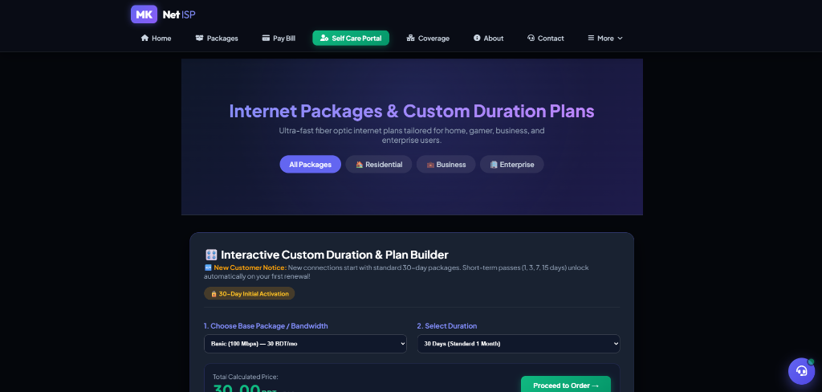
CUSTOM BILLING ENGINE
Flexi-Plan Interactive Custom Duration Builder
⚡ Flexible Day Top-Up Engine
• Freedom of Duration: Choose 1, 3, 7, 15, or 30-day passes.
• Dynamic Rate Calculation: Automatic per-day pricing based on selected bandwidth.
• Regular User Unlocks: Short-term passes unlock automatically for verified regular subscribers.
• Seamless Checkout: Direct transition to MFS bill payment and instant activation.

Slide 7
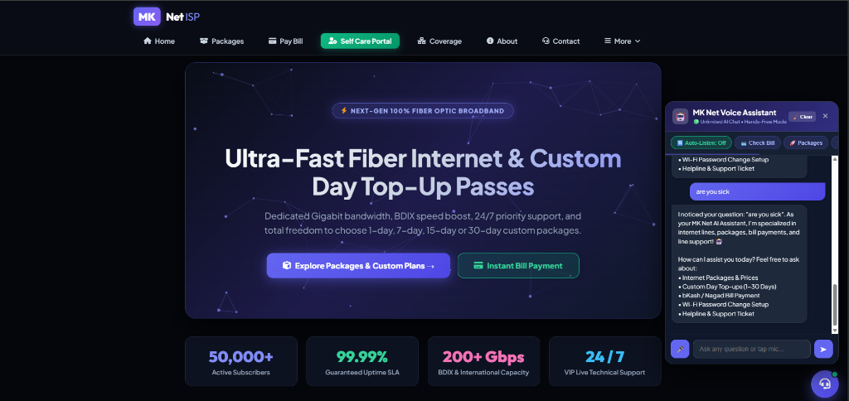
ARTIFICIAL INTELLIGENCE
Proactive AI Voice Assistant & Widget UI
🤖 Hands-Free AI Voice Assistant
• Bilingual Speech Engine: Native Bengali (bn-BD), English (en-US), & Romanized Banglish.
• Continuous Auto-Listen Mode: Hands-free conversation mode that automatically re-arms mic after speaking.
• Proactive Action Chips: 1-tap quick actions for bill check, packages, line repair, & hotline.
• Bulletproof Query Fallback: Guarantees helpful guided answers for any query.

Slide 8
NATURAL LANGUAGE PROCESSING
Bilingual NLP & Conversational Intelligence
🧠 Multi-Language Intent Parser & Diagnostic Engine
• Banglish (Romanized Bengali) Parsing: Understands natural Bengali written in English script ('wifi er password change korbo kivabe', 'bill koto dibo').
• Wi-Fi Password & Router Setup Guide: 5-step router login (192.168.0.1) and security key change instructions.
• Outage Diagnostics & Auto-Tickets: Recognizes line issue terms ('slow net', 'los light', 'red light') and automatically creates high-priority NOC support tickets.
• Merchant Payment Info: Dynamically pulls live bKash and Nagad merchant numbers directly from database settings.

Slide 9
FINANCIAL OPERATIONS
Automated MFS Payment & Billing Settlement
📱 Multi-Channel MFS
Supports bKash, Nagad, Rocket, Upay, Debit/Credit Cards & Online Banking.
⚡ Manual & Auto Verification
Instant transaction ID input verification by customers and admin payment audit panel.
📄 Automated PDF Invoices
Generates itemized digital receipts with due date tracking and payment logs.

Slide 10
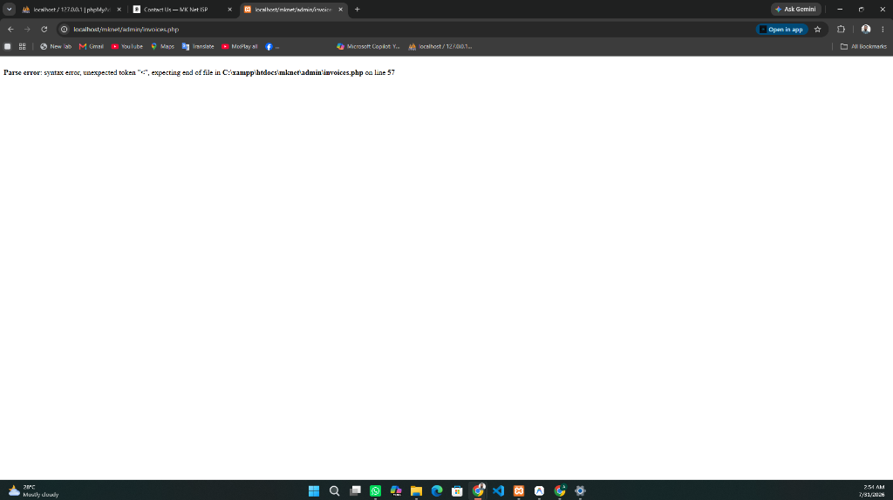
ADMINISTRATIVE GOVERNANCE
Executive Admin Control Center
⚙️ Centralized Administration
• Executive Dashboard Widgets: Real-time overview of active subscribers, monthly revenue, and open tickets.
• Role-Based Admin Governance: Superadmin, Admin, and Staff access permissions.
• Admin Invitation System: Secure email-token invitation workflow for adding new administrators.
• Dark Cyber Theme: Unified executive styling across all management pages.

Slide 11
USER GOVERNANCE
User Management & Admin Invitation Engine
👥 Customer & Admin Control Workflow
• Account Status Management: One-click active, paused, or suspended status toggling.
• Regular User Flagging: Assign regular subscriber status to unlock custom 1-15 day top-up passes.
• Admin Invitation System: Generate secure 64-character token invite links for new administrators.
• Password Self-Service: Admin password reset and security management.

Slide 12
PRODUCT MANAGEMENT
Package & Duration Plan Management
📦 Package Management
• Bandwidth & Speed Limits (Mbps)
• Residential, Business & Enterprise Categorization
• Monthly & Promo Pricing Control
• Feature Tagging & Popular Badges
⌛ Duration Plan Management
• 1, 3, 7, 15, 30, 60, 90 Day Duration Presets
• Custom Duration Min/Max Limits
• Percentage Discount Configuration per Duration
• Active / Inactive Plan Visibility Toggles

Slide 13
MARKETING CONTROL
Content Engine, Banners & Ads Manager
📢 Promotional Ads & Marquee Announcements
• Multi-Placement Ad Support: Top Marquee Announcement Bar, Hero Slider Cards, and Selfcare Portal Modal Popups.
• Image & Banner Upload Manager: File upload handling with automatic filename timestamping and directory management.
• Global Broadcast Announcements: Publish network outage warnings or holiday notices across the entire website.
• News & Community Events: Publish blog articles, expansion news, and community stories.

Slide 14
NETWORK INFRASTRUCTURE
Coverage Areas & Infrastructure Governance
📍 Network Coverage Directory
• District & Upazila Management: Configure active covered regions and planned expansion zones.
• Coverage Status Badges: Covered (Active), Planned (Upcoming), and Unavailable status indicators.
• Customer Coverage Checker: Allows website visitors to search their district and upazila for immediate availability.
• Expansion Roadmap: Showcase planned fiber expansion zones to potential subscribers.

Slide 15
CUSTOMER SUPPORT
Support Ticket System & NOC Operations
🎫 Helpdesk & NOC Technical Support Workflow
• Automated & Manual Ticket Logging: Tickets generated automatically by AI Voice Assistant or manually by users.
• SLA & Priority Management: Technical, Billing, Sales, & General departments with Low, Medium, High, & Urgent priorities.
• Staff Assignment: Assign tickets to specific support engineers for resolution tracking.
• Threaded Customer Messaging: Real-time message exchange between customers and support staff.

Slide 16
SYSTEM SECURITY
Security Architecture & Vulnerability Audits
🔒 CSRF Defense
Every state-changing POST and GET action is validated with cryptographic CSRF tokens.
🛡️ SQL Injection Prevention
100% prepared statement execution via PDO. Zero raw string concatenation.
🧹 XSS & Data Escaping
All output sanitized using HTML special characters to prevent cross-site scripting.
🔑 Password Hashing
Bcrypt hashing algorithm with automatic legacy password hash upgrade bootstrapper.

Slide 17
DATABASE RESILIENCE
Database Self-Healing & Auto-Bootstrapper
🗄️ Automated MySQL Schema Migration & Verification
• 24 Auto-Bootstrapping Tables: Automatic CREATE TABLE IF NOT EXISTS routines for all core system tables.
• Dynamic Column Verification: Dynamic SHOW COLUMNS checks automatically append missing columns (e.g. duration_days, account_status).
• Zero Downtime Migrations: Prevents database errors during deployment without manual SQL script execution.
• Master SQL Import Backup: Full mknet.sql master schema file for fresh server deployments.

Slide 18
COMMERCIAL IMPACT & CONCLUSION
Production-Ready Commercial ISP Portal & AI Platform
MK Net is fully engineered, audited, and optimized for high-volume commercial ISP operations. Reduces support call volume by over 60%, accelerates MFS payment settlement, and provides subscribers with 100% self-care freedom.
📍 MK Net ISP • NOC Hotline: 16335 / 09678-123123 • Email: support@mknet.com

