Slide 1
Online Detection and Classification of Dynamic Hand Gestures with Recurrent 3D Convolutional Neural Networks
  Authors:
    Pavlo Molchanov
    Xiaodong Yang (NVIDIA)
    Shalini Gupta (NVIDIA)
    Kihwan Kim
    Stephen Tyree
    Jan Kautz
Published in:
IEEE Conference on Computer Vision and Pattern Recognition (CVPR) 2016

Slide 2
Challenge:
1. There is a large diversity in how people perform gestures, making detection and
classification difficult.
2. The system must work online in order to avoid noticeable lag between performing a gesture and its classification.

Slide 3
Main Work:
1. A recurrent three-dimensional convolutional neural network that performs simultaneous detection and classification of dynamic hand gestures from multi-modal data
2.

Slide 4
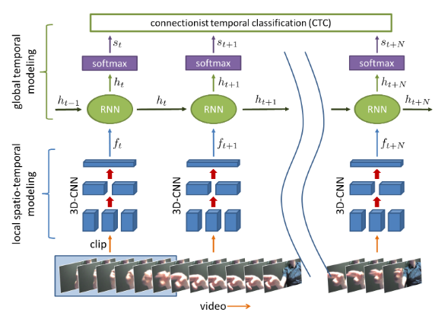
System Framework:

Slide 5
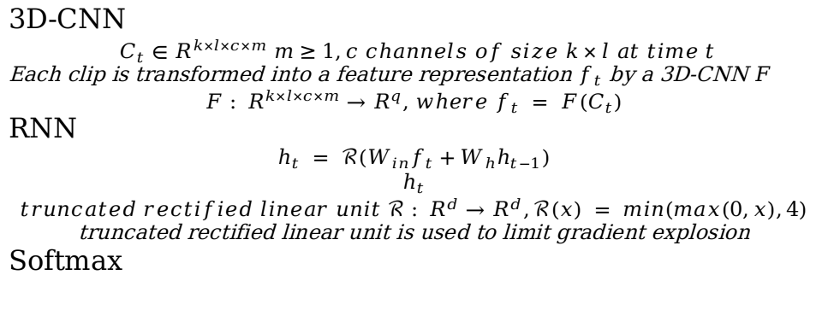
Network Architecture:

