Slide 1
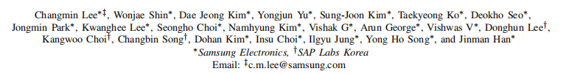
NVDIMM-C: A Byte-Addressable Non-Volatile Memory Module for Compatibility with Standard DDR Memory Interfaces

Slide 2
2 representative NVDIMM
Proprietary Inter DDR-T and JEDEC NVDIMM-P
Adoption of new platform is costly and measuring its efficiency of migrating to the new platform is much more complex.
This study is an alternative way of them—finding a new memory device that can be supported by all existing systems.
NVDIMM-C:

Slide 3
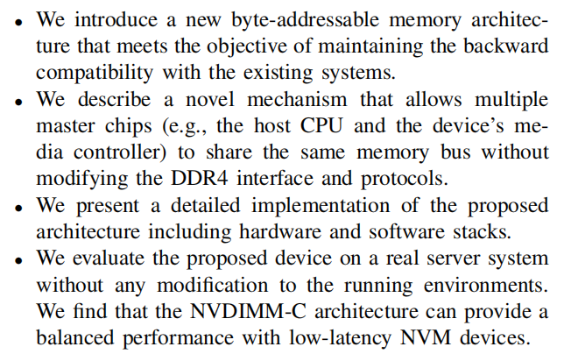
Contributions

Slide 4
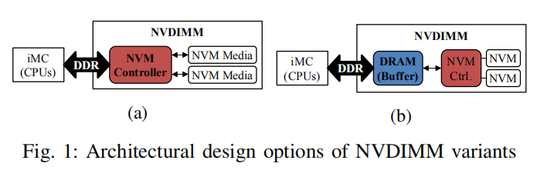
ARCHITECTURE
Only if the latency of NVM media is competitive with DRAM
Or if both the iMC and NVMCs support an asynchronous handshake protocol (e.g., JEDEC NVDIMM-P and Intel DDR-T)

Slide 5
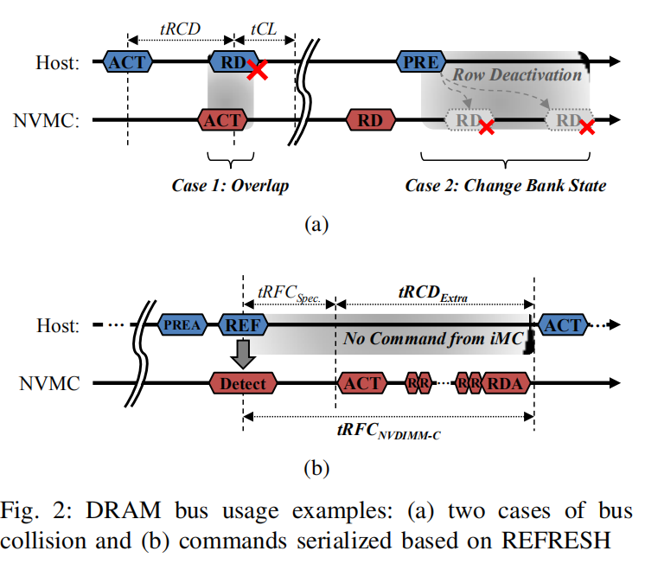
总线争用
Command conflict
访问冲突
A collision-free mechanism

Slide 6
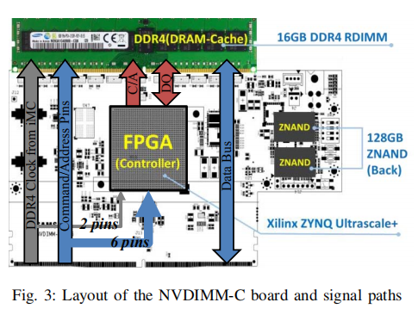
PROOF-OF-CONCEPT DEVICE

