Slide 1

Q-Zilla: A Scheduling Framework and Core Microarchitecture for Tail-tolerant Microservices
Notes:
密歇根大学
尾部延迟,尾部延迟的容忍性
https://www.youtube.com/watch?v=pdC-SzwsaA8&t=1200s

Slide 2
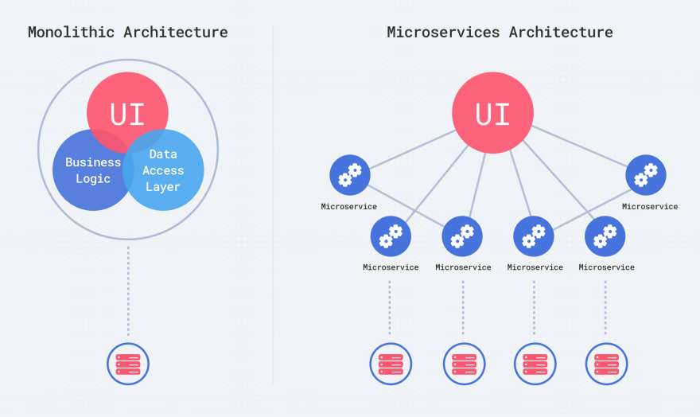
From Monolith to Microservices
Monoliths:10s to 100s of ms mean service time
Microservices: Single digits to 10s of us mean service time
https://dev.to/alex_barashkov/microservices-vs-monolith-architecture-4l1m
Notes:
RPC 远程过程调用

Slide 3


Tail latency direct impacts cloud provider’s revenue
every 100 milliseconds of latency causes a 1% decrease in sale.
a two-second slowdown was found to reduce revenue per user by 4.3%.
Tail latency is the small percentage of response times from a system, out of all of responses to the input/output (I/O) requests it serves, that take the longest in comparison to the bulk of its response times.
https://www.computerweekly.com/opinion/Storage-How-tail-latency-impacts-customer-facing-applications

Slide 4
Sources of Tail Latency
Rare, long service times
System hiccups:
Garbage collection
Memory interference
Cache interference
Virtualization effects
……
Queuing delays
……

Slide 5

Q-Zilla

Slide 6
Outline
Background
Classic Queueing Approaches
Express-Lane Simultaneous Multithreading
Q-Zilla Framework
SQD-SITA Algorithm
CoreZilla Microarchicture
Evaluation

Slide 7

Classic Queueing Approaches
S0
S0
S1
S1
S2
S2
Scale-out Organization
Scale-up Organization
Scale-out: High-disparity services → HoL blocking
Scale-up: Microservices + many-cores → high contention
HoL: Head-of-line blocking
Solution: Hierarchical Queuing and Scheduling
Notes:
高差异
高竞争

Slide 8
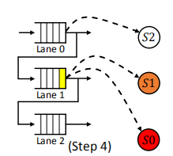
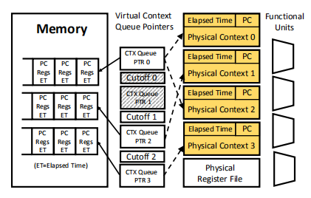
The Q-Zilla Framework
Theoretical Task Scheduling Mechanism
Hierarchical Server Pooling
Incremental Preemption
Server-Queue Decoupling(SQD-SITA Algorithm)
Core Microarchitecture(CoreZilla)
Express-Lane Simultaneous Multithreading
Automatic Load Adaptation
Q-Zilla improves tail latency by more than 2x

Slide 9
Hierarchical Queuing(Server Pooling)
core
A small degree of concurrency is usually sufficient to eliminate HoL blocking
Finally approach: Sharing the queue only across hyperthreads in SMT cores
Hyperthread
But, the number of hyperthreads is usually small in modern SMT cores
Notes:
至多8

Slide 10
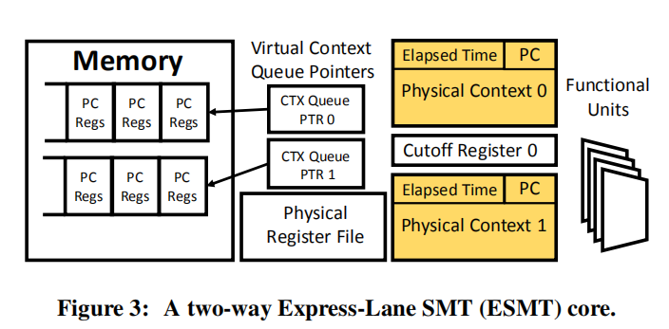
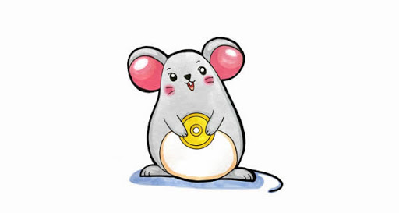

Express-lane SMT(ESMT)[ICAC 2019]
Express-lane for short task(Size-Interval Task Assignment)
Incremental preemption

Slide 11
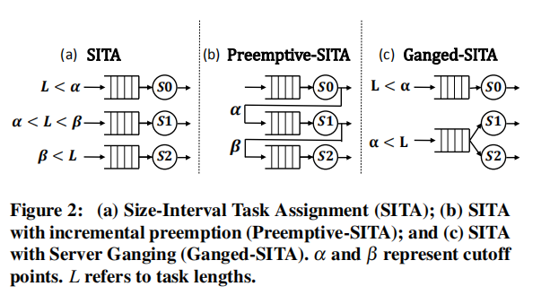
Server-Queue Decoupled SITA

Slide 12
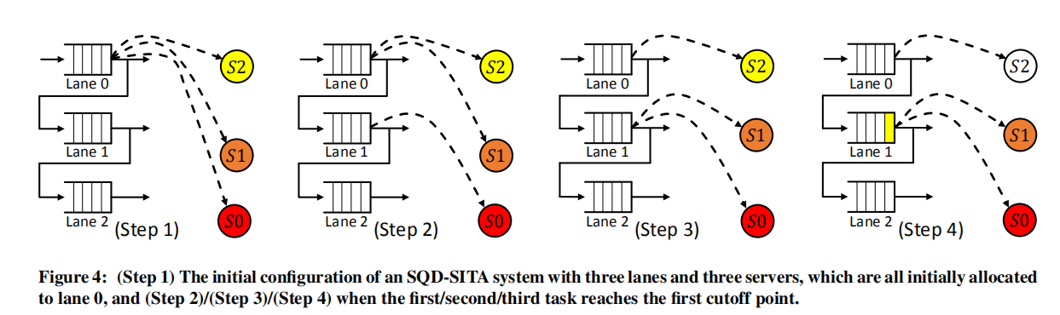

Server-Queue Decoupled SITA
upper-bound criterion
SQD-SITA always allows a server to “follow its task” unless it results in on upper-bound violation(leading to starvation)
Notes:
3 tasks
The red task, cutoff point, move to lane1
S0 seek the eldest waiting task, upper-bound criterion

Slide 13
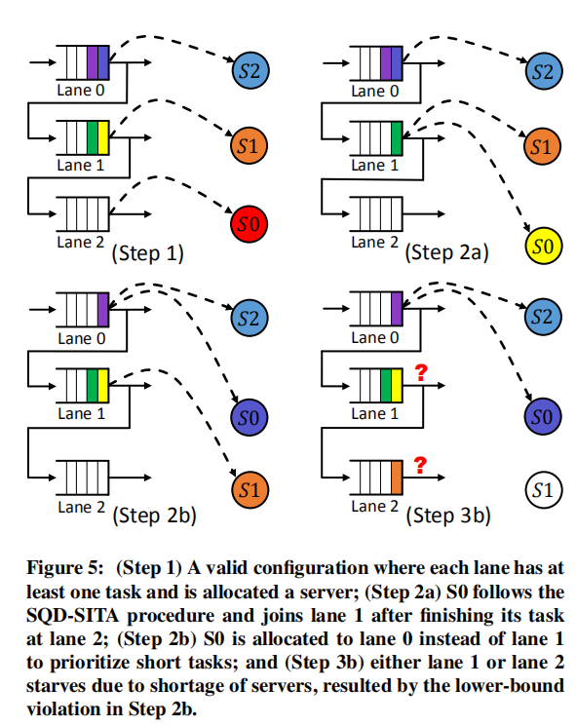
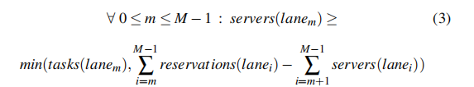
Server-Queue Decoupled SITA
Lower-bound
Notes:
3 tasks蓝橙红
队列中有四个tasks在等待
S0完成后,

Slide 14
Interruptible SQD-SITA
When a new task arrives, if no idle server waits at lane 0, ISQD-SITA scans lanes from highest to lowest to check if the upper-bound criterion has been violated in any lane. If so, it preempts the youngest running task in that lane and allocates the preempted server to the arriving task in lane 0.
Goal: maximize utilizations and minimize preemptions with no “starvation”
Key idea
No Starvation
Incremental preemption
Dynamic reallocation of servers to lanes

Slide 15
CoreZilla
Synthesis of three key ideas:
Express-lane SMT(ESMT)
Isolate short tasks from long tasks to prevent HoL blocking
SQD-SITA Scheduling
Dynamic reallocation of physical contexts to context queues to prevent underutilization and unnecessary preemptions

Slide 16
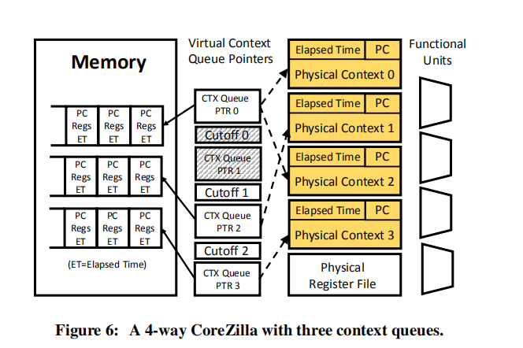
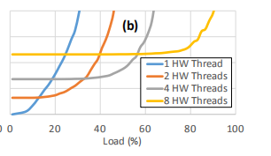
CoreZilla
Synthesis of three key ideas:
3. Automatic Load Adaptation
CoreZilla improves tail latency by more than 2x

