Slide 1
Fittings
Francis Adoah

Slide 2
Project 1: HATNA derivatives with electron-donating/withdrawing groups
F₄-HATNA-OC₁₀SAc
(MeO)₄-HATNA-OC₁₀SAc
(NO₂)₄-HATNA-OC₁₀SAc
(NH₂)₄-HATNA-OC₁₀SAc

Slide 3
Table 1. Summary of surface characterization of HATNA molecules on Au
Molecule |  |  | Energy levels (eV) |  |  |  |  | Surface coverage (10⁻¹⁰ mol/cm²) ^{c}
 |  | E_{HOMO} | E_{LUMO} | E_{LUMO+1} | E_{LUMO+2} | E_{F}ª | E_{gap}^{b}
HATNA | Exp. | -6.33^{d} | -3.52^{d} | -3.30^{d} | -2.97^{d} |  | 2.81 | 2.73±0.35
 |  | -6.90e | -4.09e
 |  | -6.28^{f} | -3.47^{f} |  |  | 4.18
 | Theor.^{g} | -6.17 | -2.79 | -2.37 | -2.31
F₄-HATNA | Exp. | -6.41 | -3.62 | -3.26 | -2.96 |  | 2.79 | 1.32±0.14
 |  | -6.89 | -4.10
 |  | -6.12 | -3.33 |  |  | 4.02
 | Theor. | -6.37 | -3.09 | -2.67 | -2.62
(MeO)₄-HATNA | Exp. | -6.18 | -3.44 | -3.16 | -2.74 |  | 2.74 | 2.96±0.19
 |  | -6.83 | -4.09
 |  | -5.80 | -3.06 |  |  | 3.88
 | Theor. | -5.99 | -2.58 | -2.2 | -2.11
(NO₂)₄-HATNA | Exp. | -6.75 | -4.15 | -3.89 | -3.58 |  | 2.60 | 2.33±0.13
 |  | -6.71 | -4.11
 |  | -6.83 | -4.23 |  |  | 3.76
 | Theor. | -6.65 | -4.11 | -3.71 | -3.62
(NH₂)₄-HATNA | Exp. | -5.65 | -3.37 | -2.79 | -2.64 |  | 2.28 | 2.00±0.10
 |  | -6.39 | -4.11
 |  | -5.41 | -3.13 |  |  | 4.01
 | Theor. | -5.45 | -2.23 | -1.81 | -1.74
H₆-HATNA | Theor. | -4.35 | -0.38 | -0.34 | -0.27
F₄-(H₆-HATNA) | Theor. | -4.68 | -0.77 | -0.68 | -0.66
(MeO)₄-(H₆-HATNA) | Theor. | -4.29 | -0.33 | -0.27 | -0.23
(NO₂)₄-(H₆-HATNA) | Theor. | -5.50 | -3.07 | -3.03 | -2.34
(NH₂)₄-(H₆-HATNA) | Theor. | -4.00 | -0.05 | 0.05 | 0.10
ª Measured with UPS.
^{b} Measured with UV.
^{c} Measured with SAM CV.
^{d} Measured with solution CV and UV.
^{e} Measured with SAM CV and UV
^{f} Measured with UPS and UV.
^{g} Calculated with DFT in gas phase

Slide 4
Project 2: HATNA, TAP and DAP derivatives
HATNA-OC₁₀SAc
TAP-OC₁₀SAc
DAP-OC₁₀SAc

Slide 5
Table 2. Summary of surface characterization of DAP, TAP and HATNA SAMs on Au
Molecule |  | Energy levels (eV) |  |  |  |  |  | Surface coverage (10⁻¹⁰ mol/cm²)^{c}
 |  | E_{HOMO} | E_{LUMO} | E_{LUMO+1} | E_{LUMO+2} | E_{F}ª | E_{gap}^{b}
HATNA | Exp.^{d} | -6.28±0.1 | -3.54 |  |  | -4.18 | 2.74 | 2.73±0.35
 | Theor.^{e} | -6.27 | -2.79 | -2.39 | -2.32
TAP | Exp. | -6.17±0.1 | -3.43 |  |  | -4.06 | 2.74 | 2.10±0.34
 | Theor. | -6.19 | -2.56 | -2.55
DAP | Exp. | -6.06±0.1 | -3.24 |  |  | -4.16 | 2.82 | 2.86±0.14
 | Theor. | -5.95 | -2.56
HATNA-H₆ | Theor. | -4.37 | -0.57 | -0.40 | -0.36
HATNA-H₄ | Theor. | -4.24 | -2.38 | -0.67 | -0.59
HATNA-H₂ | Theor. | -4.53 | -2.48 | -2.41 | -0.78
TAP-H₄ | Theor. | -4.36 | -0.57 | -0.31
TAP-H₂ | Theor. | -4.48 | -2.48 | -0.65
DAP-H₂ | Theor. | -4.31 | -0.57
ª Measured with UPS.
^{b} Measured with UV.
^{c} Measured with CV.
^{d} Measured with UPS and UV.
^{e} Calculated with DFT in gas phase

Slide 6
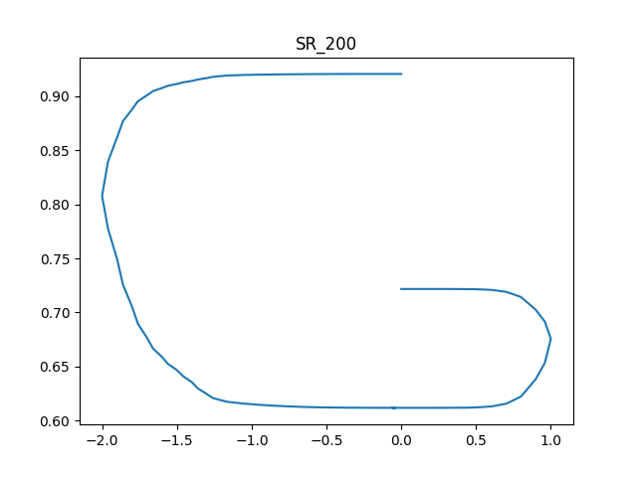
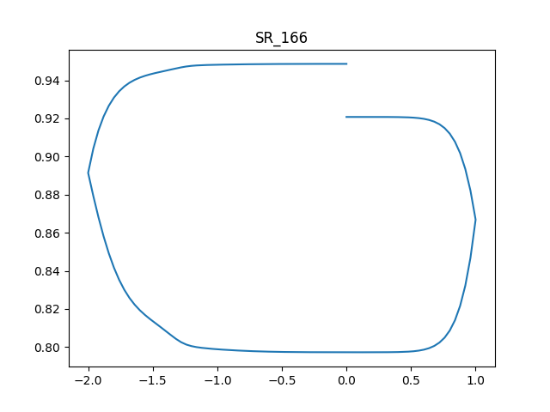
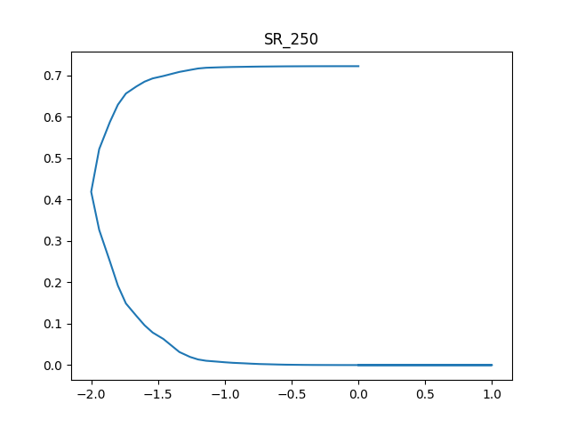
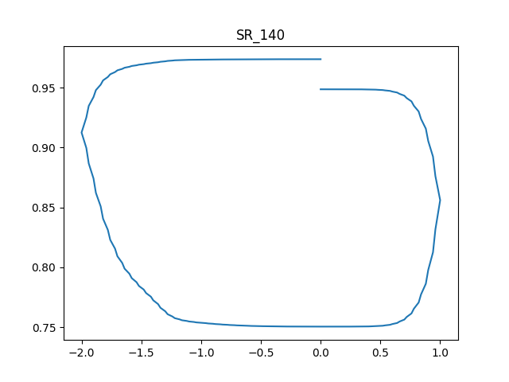
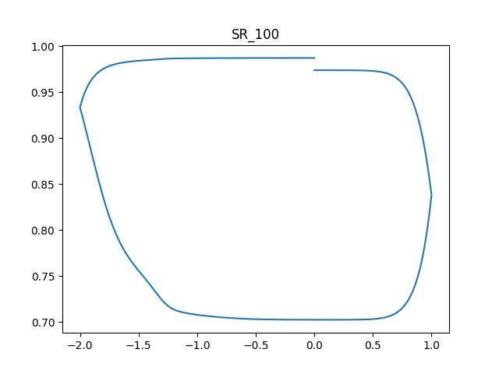
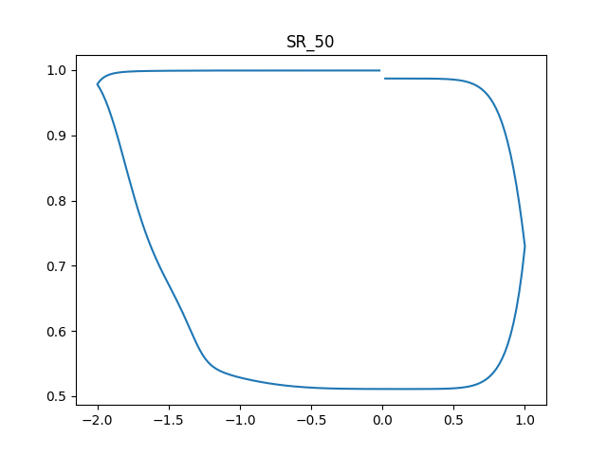
Probability

Slide 7
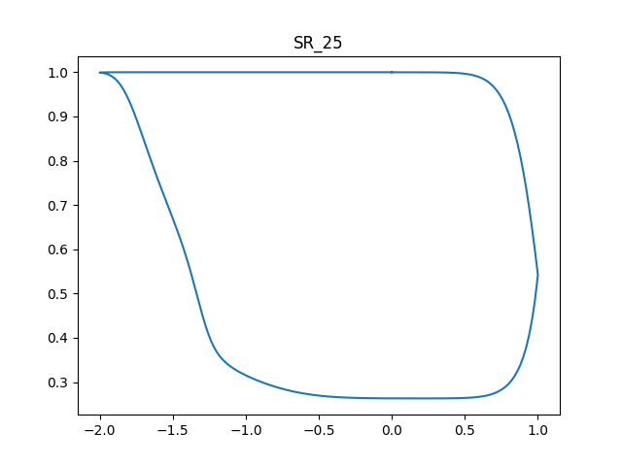
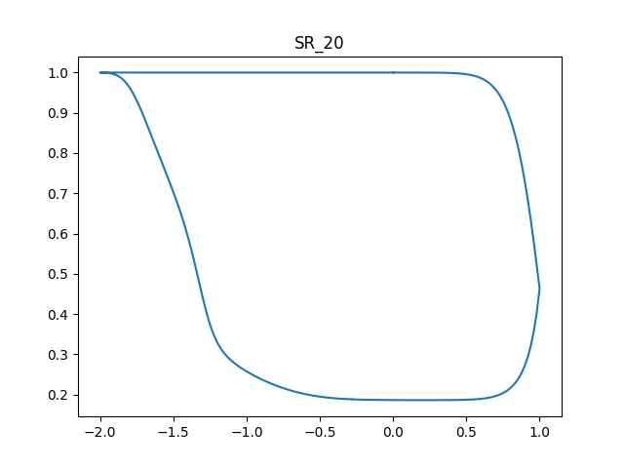
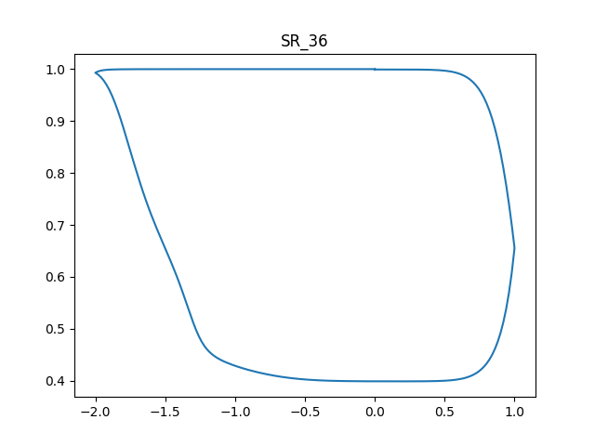
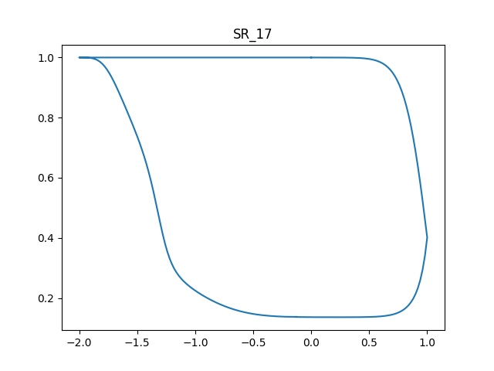
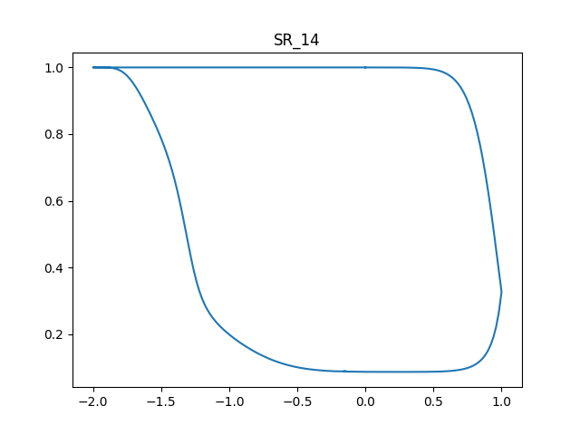
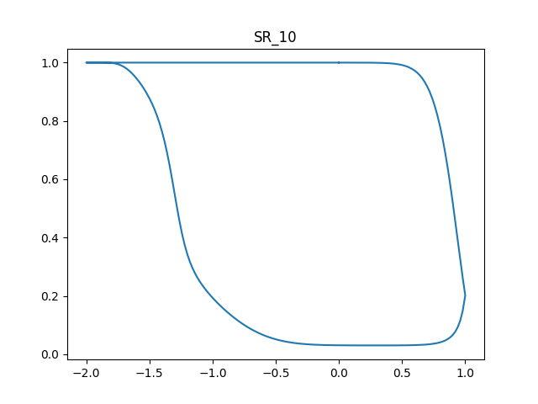

Slide 8
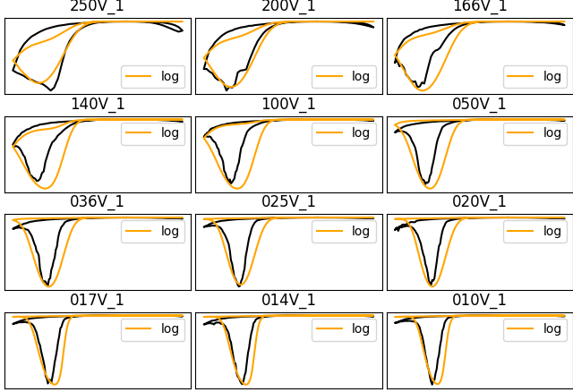
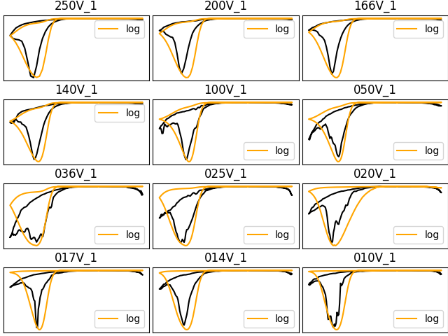
Scan rate fittings for DAP & TAP(Project_2)
TAP
DAP

Slide 9
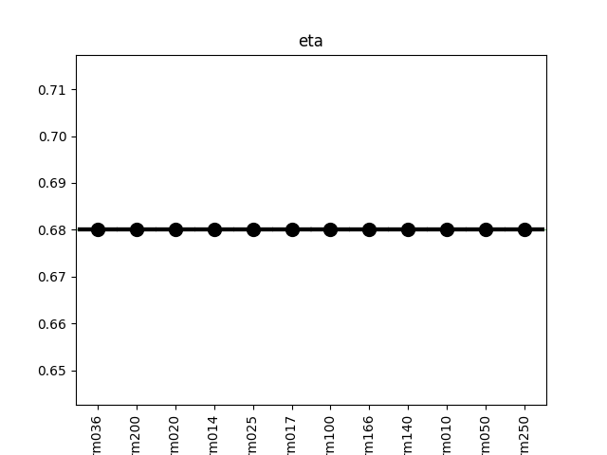
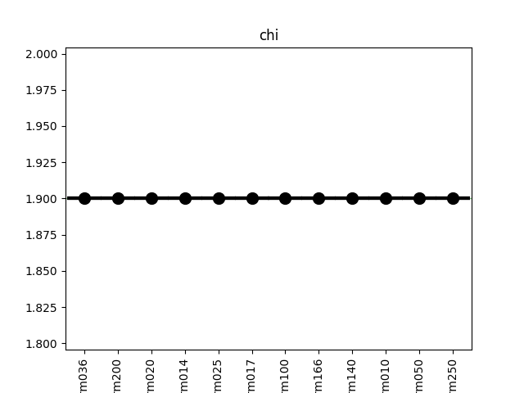
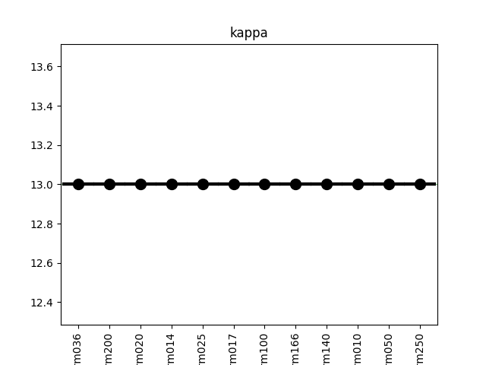
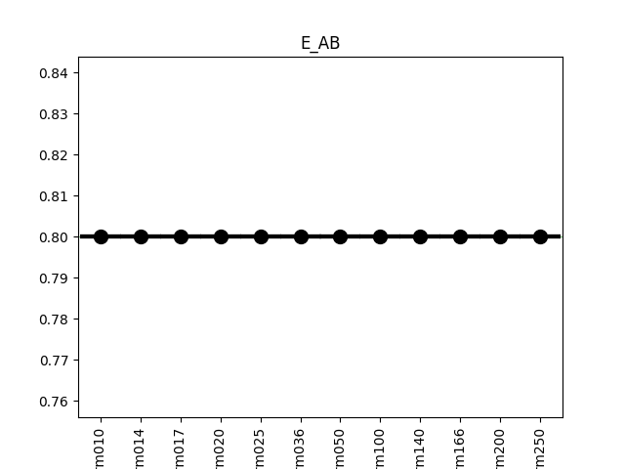
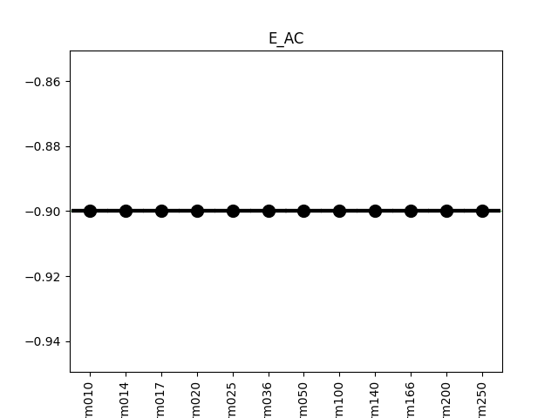
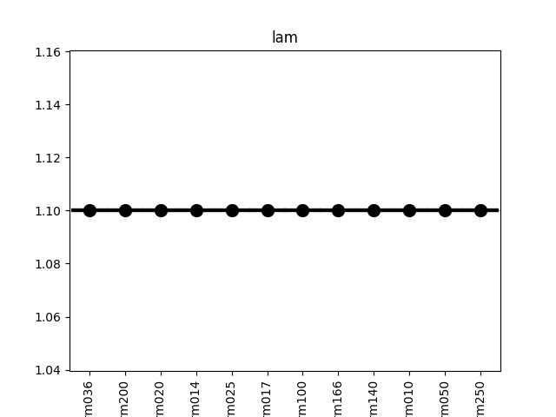
Scan rate parameters for DAP(Project_2)

Slide 10
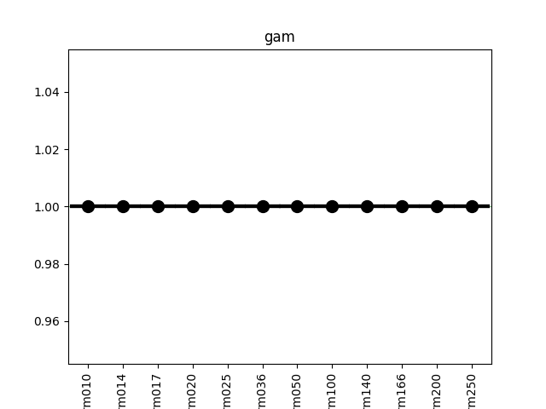
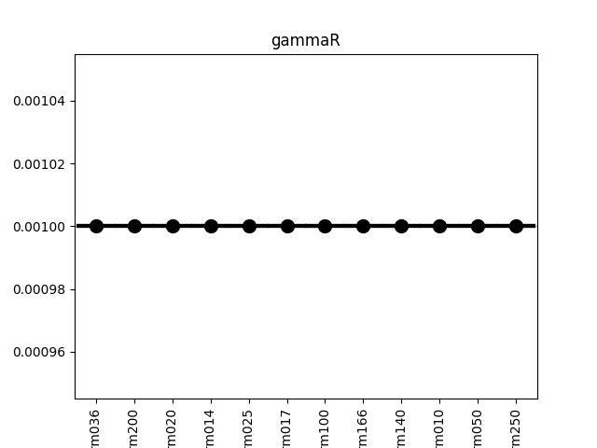
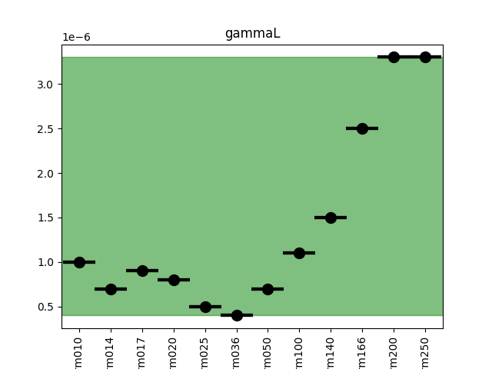
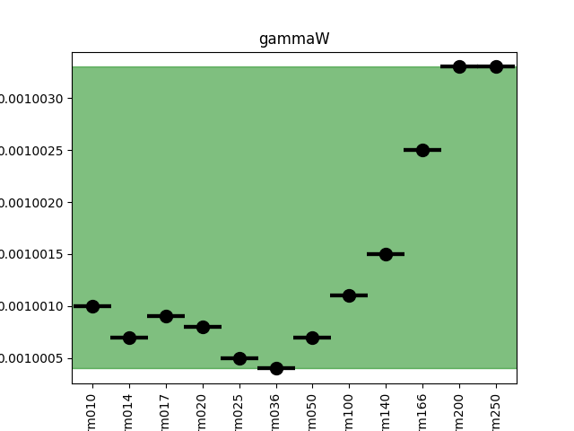


Slide 11
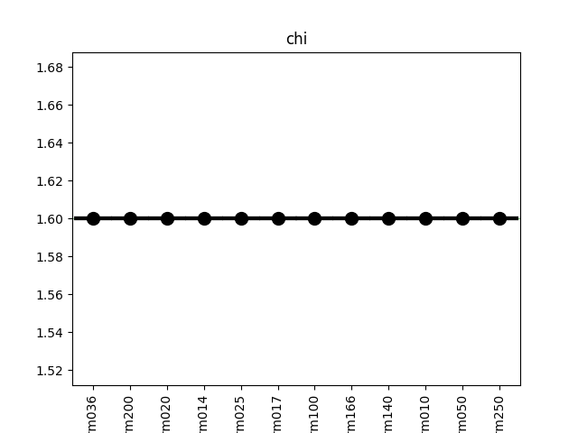
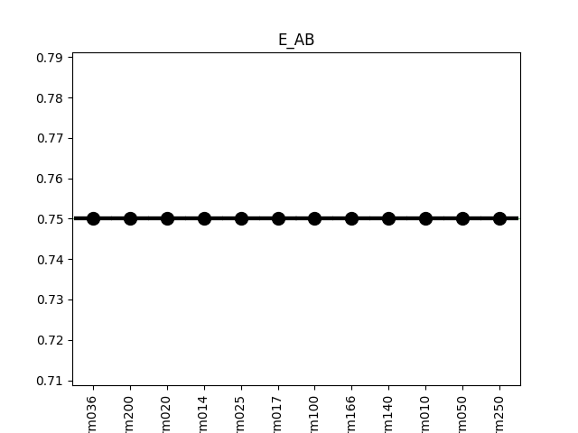
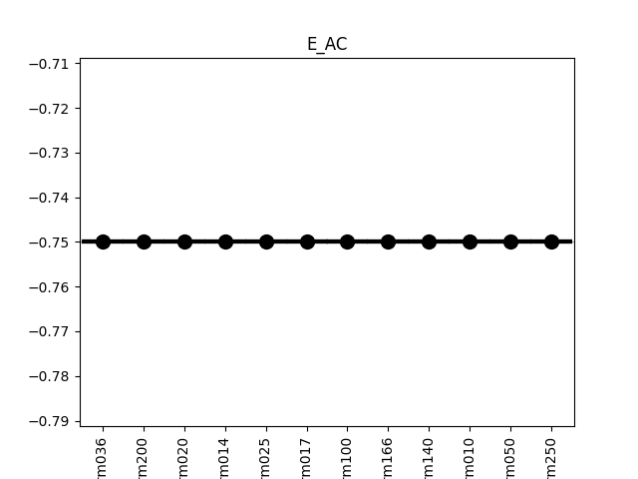
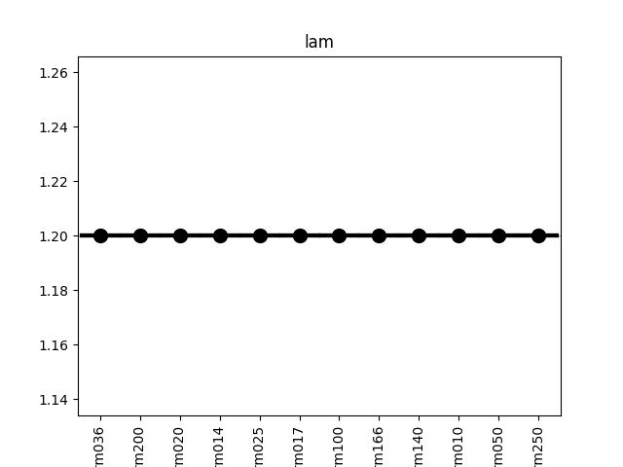
Scan rate parameters for TAP(Project_2)

Slide 12
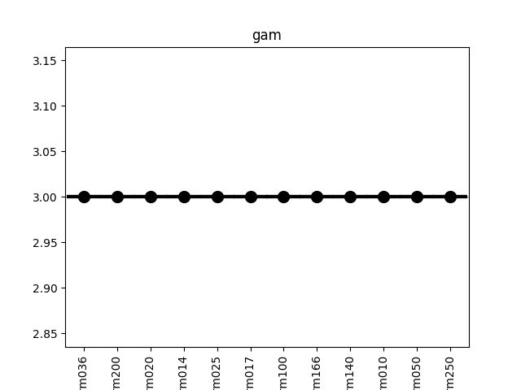
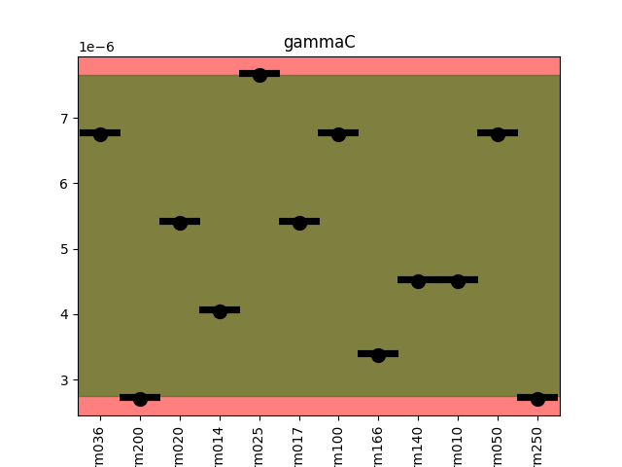
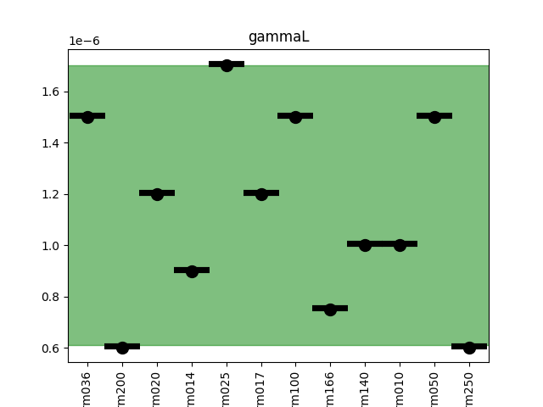
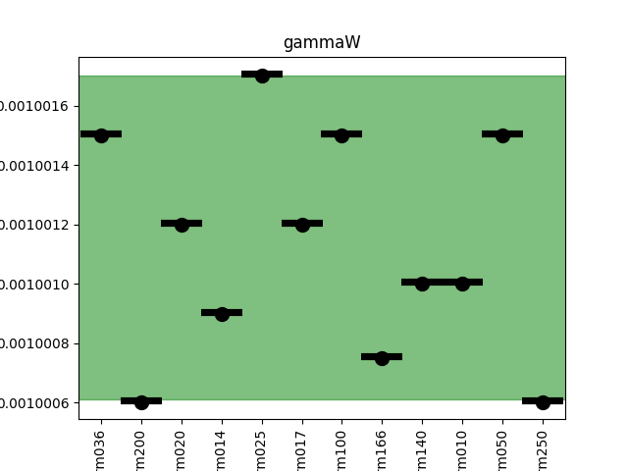

Slide 13
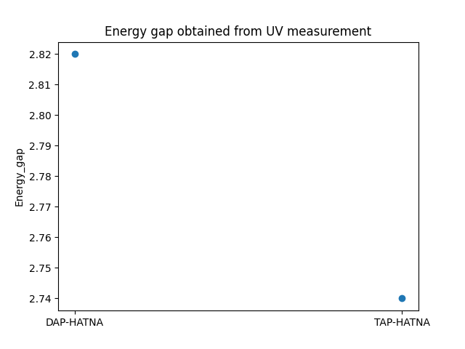
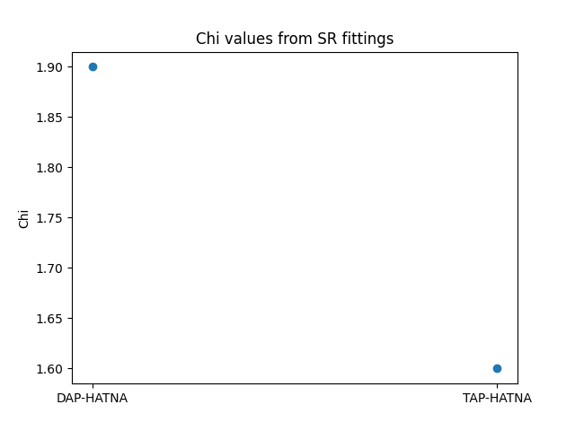
Interpretation of scan rate results for TAP& DAP
From UV measurement as plotted on the left, DAP has higher energy gap than TAP.
This is manifested in the difference in Chi values obtained from the fittings where DAP had a Chi of 1.9 and that of TAP was 1.6
Also, there is a change in E_AB and E_AC values.
There were changes in the gammas, every other parameter stayed the same for the molecule DAP and TAP .

Slide 14
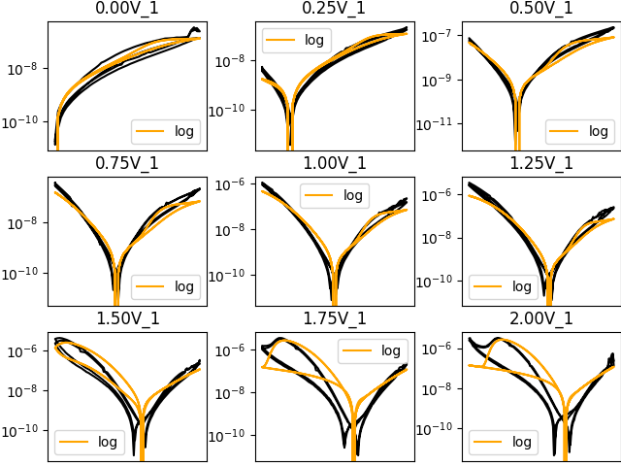
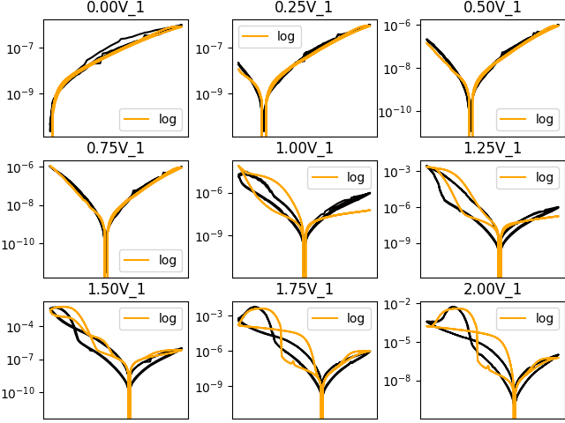
Negative bias dependent fittings for TAP & DAP
TAP
DAP

Slide 15
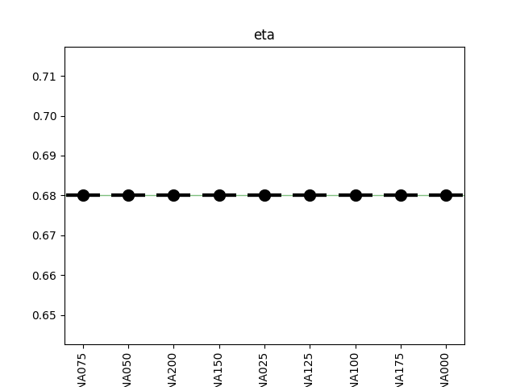
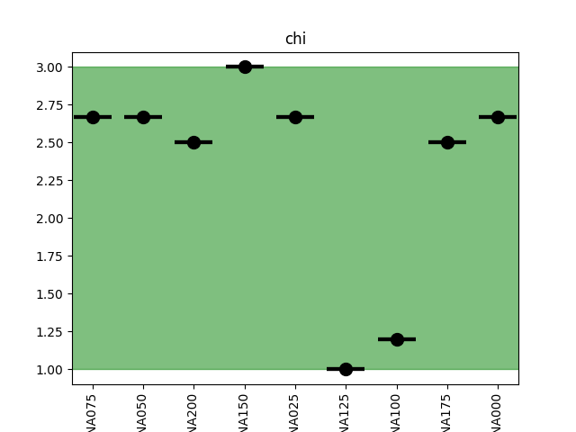
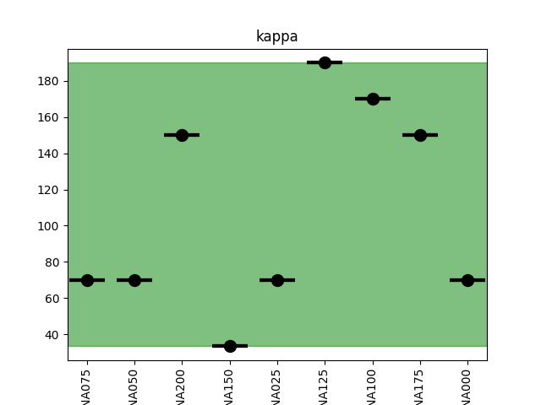
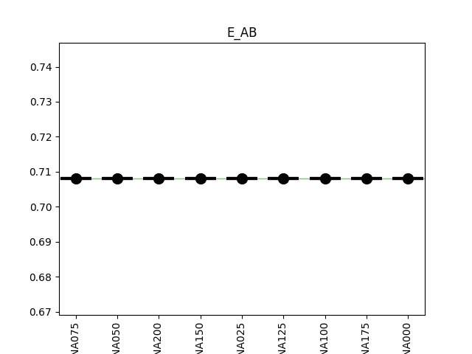
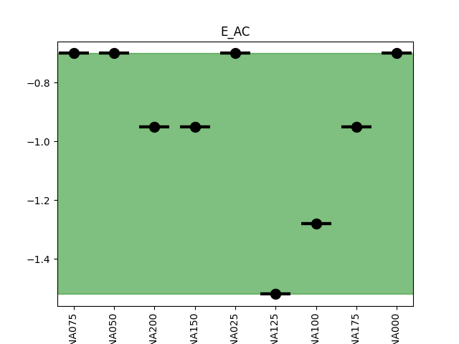
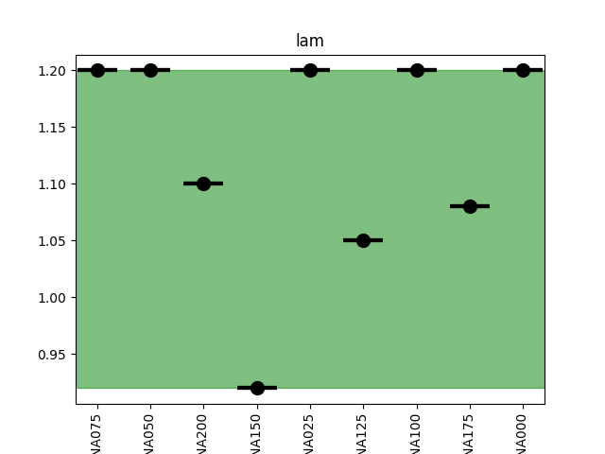
Negative bias dependent parameters for TAP

Slide 16
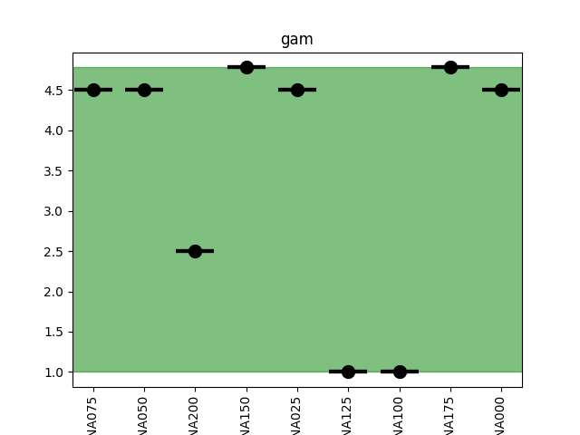
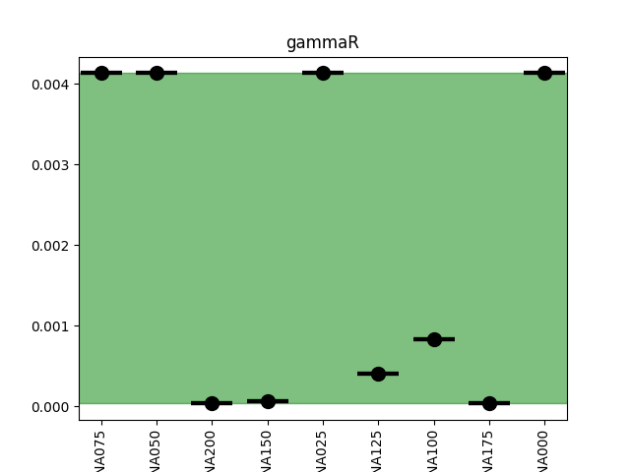
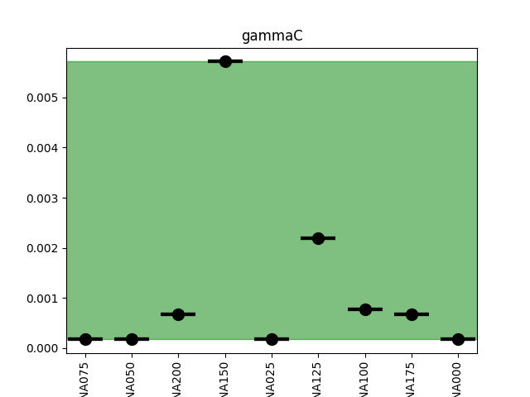
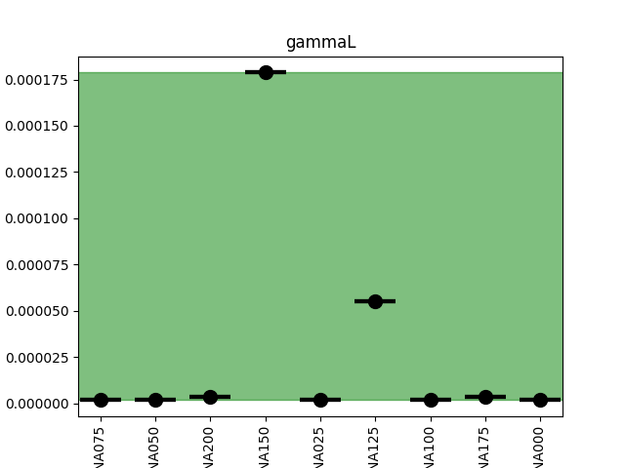


Slide 17
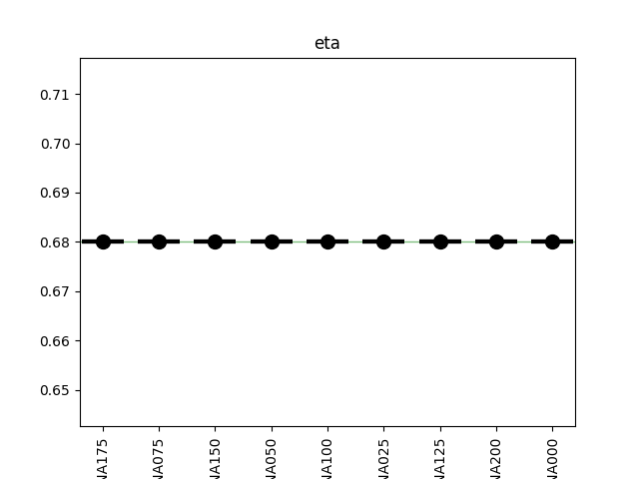
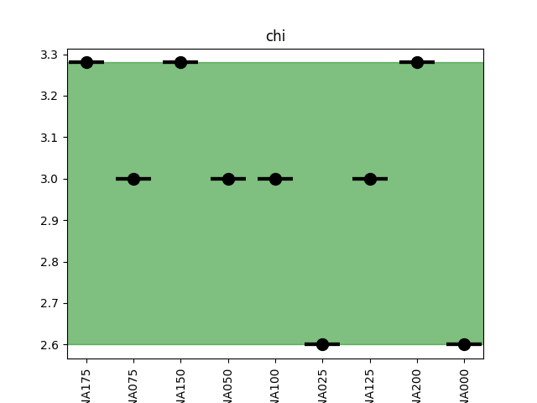
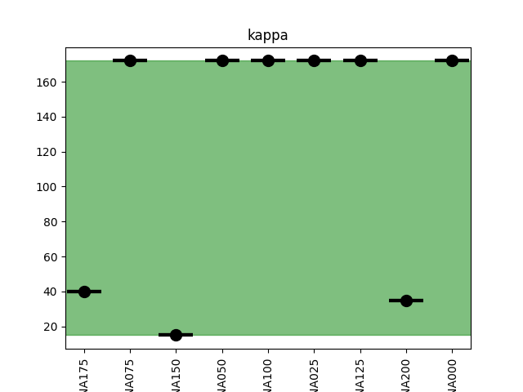
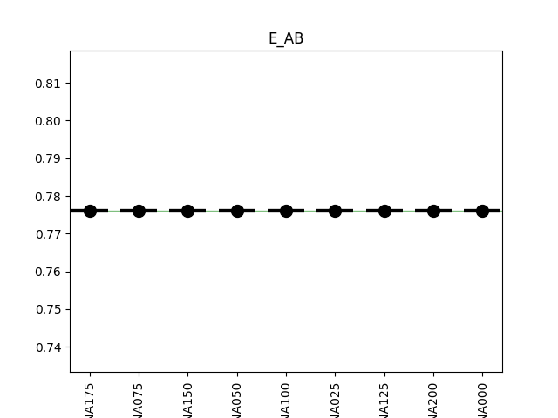


Negative bias dependent parameters for DAP

Slide 18






Slide 19
Observation from the Negative bias dependence of TAP and DAP
E_AB was fixed at 0.776 for DAP even as voltage was changing.
E_AB was fixed at 0.708 for TAP even as voltage was changing.
The rest of the parameters were changing as voltage was changing.
Although Chi was changing, the average for chi of DAP was 3.0 and that of TAP was 2.32
Kappa was changing with voltage but average kappa for DAP was 124.67 and that of TAP was 108.2
We observe here that higher overall higher Chi leads to overall higher kappa
Higher Chi also led to higher E_AB. This was also observed from the scan rate fittings.

Slide 20


Scan rate fittings for MeO and F4(Project_1)
MeO-HATNA
F4-HATNA

Slide 21



Scan rate parameters for F4-HATNA

Slide 22





Slide 23

Scan rate parameters for MeO-HATNA

Slide 24




Slide 25


Interpretation of results for MeO and F4
Chi dropped from 1.6 to 1.5 as we change from F4-HATNA to MeO-HATNA according to our fitting results.
From UV measurement shown on the left, F4-HATNA has an energy gap just a little bit higher than MeO-HATNA and that could be the reason why there is a small variation in Chi values.
There is slight changes in E_AC and lambda
Every other parameter stayed the same for both molecules

Slide 26


Scan rate fittings for (NO2)4 and (NH2)4
(NO2)4-HATNA
(NH2)4-HATNA

Slide 27





Scan rate parameters for (NO2)4-HATNA

Slide 28






Slide 29




Scan rate parameters for (NH2)4-HATNA

Slide 30





Slide 31
Interpretation for results for (NO2)4 and (NH2)4
Chi changed from 1.4 to 1.3 as we change the molecule from (NO2)4-HATNA to (NH2)4-HATNA.
The difference in Chi from 1.4 to 1.3 could be explained by the UV measurement shown on the left.
Every other parameter stayed the same with slight variations in gammaL.

Slide 32


Negative bias dependent fittings for MeO and F4
MeO-HATNA
F4-HATNA

Slide 33






Negative bias dependent parameters for F4-HATNA

Slide 34






Slide 35






Negative bias dependent parameters for MeO-HATNA

Slide 36






Slide 37
Observation from Negative bias dependence of F4 and MeO-HATNA
E_AB stayed at 0.708 across both molecules.
Except for eta , all other parameters were changing.
Chi was changing but average value for Chi was 2.47 for F4 and that of
MeO was 2.23
Average kappa for F4 was 78.59 and that of MeO was 87.48
We are not able to say much here but what we see is that the slightly high Chi values for F4 are also observed from the scan rate fittings.
Higher Chi led to decrease in kappa.

Slide 38


Negative bias dependent fittings for (NO2)4 and (NH2)4
(NO2)4
(NH2)4

Slide 39





Negative bias dependent parameters for (NO2)4

Slide 40






Slide 41






Negative bias dependent parameters for (NH2)4

Slide 42






Slide 43
Observation from Negative bias dependence of (NO2)4 and (NH2)4
E_AB for (NO2)4 was fixed at 0.80 was voltage was changing.
E_AB for (NH2)4 was fixed at 0.72 was voltage was changing.
Except eta, every other parameter was changing as voltage was changing.
Average Chi for (NH2)4 was 2.15 and that of (NO2)4 was 1.95
Average kappa for (NH2)4 was 83.03 and that of (NO2)4 was 88.96
Although the values we are talking about here are completely different from those obtained for F4 and MeO in previous slides, the pattern of behavior is similar, higher average Chi here led to decrease in average kappa. This is opposite to the behavior observed in project_2 for TAP and DAP.

Slide 44

Positive bias dependent fittings for (NO2)4-HATNA

Slide 45






Positive bias dependent parameters for (NO2)4-HATNA

Slide 46






Slide 47
Observation from positive bias dependence of (NO2)4
Except eta, every other parameter is changing as voltage changes.
What we see here is that positive bias dependence led a sharp decrease in Chi.
The average Chi is found to be 1.48. The last time fittings was done for HATNA(By Cameron Nickle), positive bias dependence led to a sharp decrease to Chi vales. Although the values are different now, how the molecules behave in terms of bias dependence is somehow similar to what has been previously observed.
The average kappa was found to be 100.04.
Again, as average Chi decreases, average kappa increases. For all the molecules within project_1 , this pattern of behavior has been observed even with different bias dependence.

Slide 48
Observations from SR Fittings of the two projects
Project_1
Kappa was 10 for molecules within this project.
These molecules had their Chi values lesser than those in project_2.
The remaining parameters are also different from those in project_2 .
Project_2
Kappa was 13 for molecules within this project.
These molecules had their Chi values larger than those in project_1.
The remaining parameters are also different from those in project_1 .

Slide 49
Observations from bias dependence Fittings of the two projects
Project_1
Average kappa values were lesser than those in project_2. We also observed this from S_R fittings.
Average Chi values were lesser compared to those in project_2. This behavior was also observed from UV measurements and SR fittings.
Decrease in average Chi led to increase in average kappa. This behavior was observed in both positive and negative bias dependence data.
Project_2
Average kappa values were larger than those in project_1. We also observed this from S_R fittings.
Average Chi values were larger compared to those in project_1. This behavior was also observed from UV measurements and SR fittings.
Increase in average Chi values led to increase in average kappa. This is opposite to what is seen in project_1.

Slide 50
Comments on eta
Eta was fixed at 0.68 throughout all the fittings.
This asymmetric behavior is due to the fact that the functional units is close to one of the electrodes than the other electrode.

