Slide 1
Expanding your Analysis with MBI Cohort Reports
Jessica Magness & Jim Roddy

Slide 2
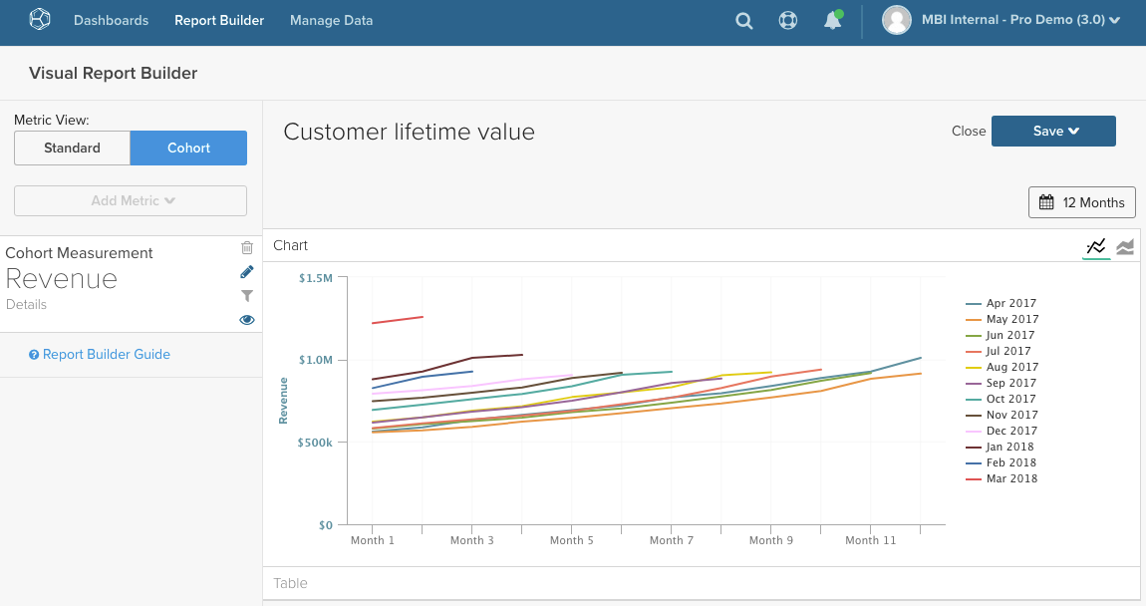

Slide 3
Cohort Reporting
What is a cohort
Why are they valuable
How does MBI Cohort Reporting work
What’s to come in MBI Cohorts
Questions

Slide 4
What is a Cohort

Slide 5
What is a Cohorts?
A subgroup within a population that share a characteristic and are often analyzed against one another
Two types
Time Based cohorts – grouping factor is a time period, typically a start date
Enrollment year
First purchase month
Qualitative Cohorts – grouping factor is a categorical variable
Acquisition channel
Subscription type

Slide 6
Customer Cohorts
In eCommerce, the most common use of cohorts is to group customers
A cohorting factor can be any attribute that defines a customer group
Account creation month (time based)
First purchase quarter (time based)
Acquisition channel (qualitative)
Subscription type (qualitative)
First purchase product (qualitative)
Return date (time based)

Slide 7
Why Use Cohorts

Slide 8
Advantages of Cohorting
Cohorts shift from calendar time to relative time
All customers start at “Month 1” and are tracked from there
Accurately compare customers and their actions (orders, revenue, etc…) regardless of when they were acquired
Analyze the Customer Lifetime
Look at customer retention and repeat purchasing habits
Understand how CLV builds over time
Determine Value between groups
Analyze what customer attributes are determining factors in strong/profitable customer relationships

Slide 9
Our Take on Cohorts

Slide 10
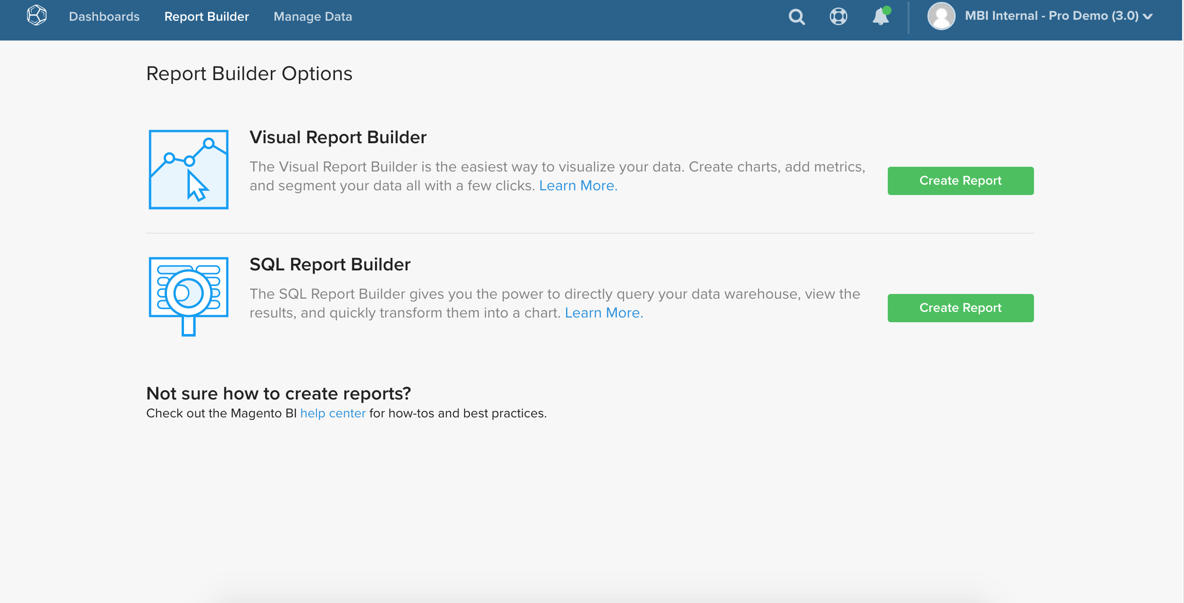

Slide 11
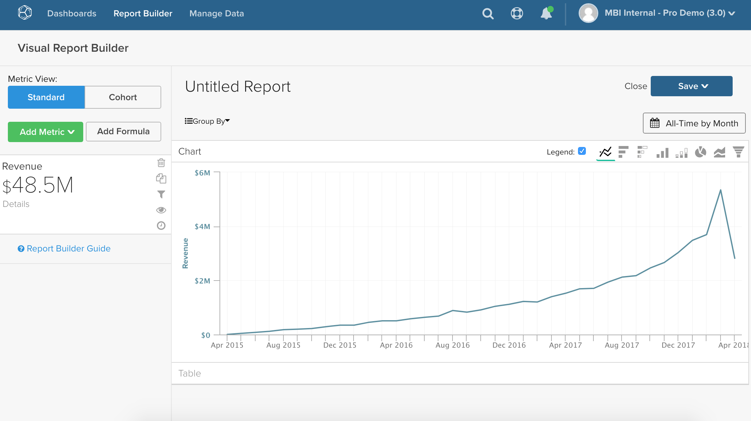

Slide 12
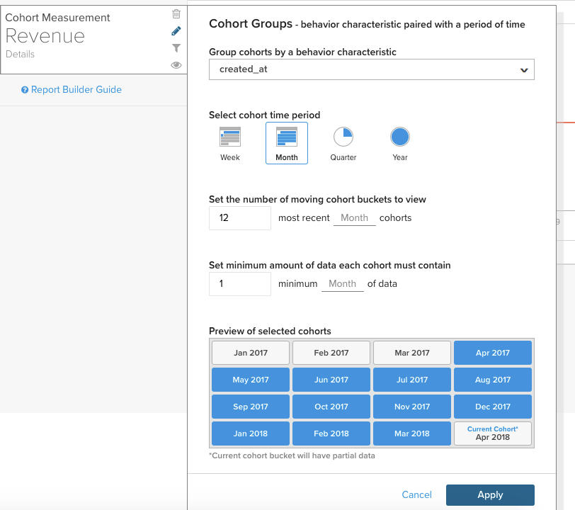

Slide 13
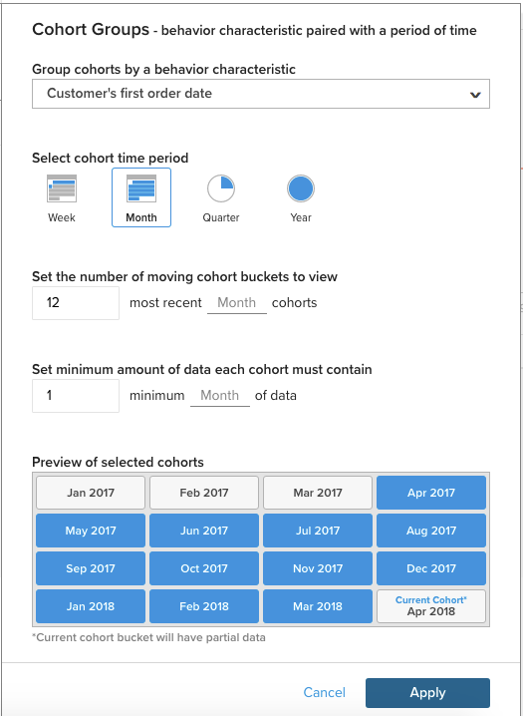
Group Cohorts by Behavior Characteristic
This is our grouping factor
Currently configured for time based groups. This drop down contains every timestamp on the metric’s table
This should always be different from the metric timestamp

Slide 14
Select Cohort Time Period
This determines the size of our groups and intervals
Groups – Every customer that made their first purchase within the same month is in the same cohort
Interval – First purchase month will be month 1, the next month will be month 2 and so on…

Slide 15
Set the Number of Moving Cohort Buckets
This determines how many cohorts will be on the report
Each cohort will have its own line on the chart and row on the table
Related to the number of highlighted blocks in the preview section

Slide 16
Set the Minimum Amount of Data
This determines how long a cohort must have existed before it is plotted on the report
Each cohort will have at least this many data points beyond the initial period
Related to the which blocks in the preview section

Slide 17
* Note – perspective changed to cumulative

Slide 18
What’s Next in MBI Cohorts

Slide 19
Qualitative Cohorts
The next evolution in cohorts and currently in development
Instead of grouping on cohorts, group on other customer based factors
Acquisition Channel
Billing/Shipping State or Country
Gender
Initial Purchase Products
First Coupon Usage

Slide 20
Questions?

Slide 21
Thanks!

