Slide 1
MBI New Architecture Breakdown
Jessica Magness & Jim Roddy

Slide 2
What is our New Architecture
Release date Q2 2017
Complete reworking of the Data Warehouse and how columns and reports are calculated
Why?
Reduced Data Latency
More Resilient Updates
More End-User Control
Deeper Analysis

Slide 3
MBI New Architecture
Update Cycles
Data Warehouse Views
Data Warehouse Manager
Cohort Reports
Upgrade Path

Slide 4
Revamped Update Cycles

Slide 5
Update Cycles
2.0 Update Cycles
Sync New Rows
Resync Changed Values
Calculate Columns
Cache Charts
3.0 Update Cycles
Sync New Rows
Resync Changed Values
Data Warehouse Views
Cache Charts

Slide 6
2.0 Update Cycle
2.0 Update Cycles
Sync New Rows
Resync Changed Values
Calculate Columns
Cache Charts
Query your local database or any third party connections and replicate over any new rows found
Speed and efficiency are determined by set replication methods

Slide 7
2.0 Update Cycle
2.0 Update Cycles
Sync New Rows
Resync Changed Values
Calculate Columns
Cache Charts
Based on the rechecks set in your Data Warehouse Manager, certain columns are checked for changed values
Order Status
Returned Amount
Speed and efficiency are determined by set replication methods

Slide 8
2.0 Update Cycle
2.0 Update Cycles
Sync New Rows
Resync Changed Values
Calculate Columns
Cache Charts
Recalculates all existing columns in case values change, and calculates any newly added columns for the first time
Typically the largest portion of updates, especially for larger clients
Leading cause of update failures and extreme latency

Slide 9
2.0 Update Cycle
2.0 Update Cycles
Sync New Rows
Resync Changed Values
Calculate Columns
Cache Charts
With all the fresh data, the queries for charts are rerun on the Data Warehouse
The results are saved in order to have reduce load time on dashboards

Slide 10
3.0 Update Cycle
3.0 Update Cycles
Sync New Rows
Resync Changed Values
Data Warehouse Views
Cache Charts
A brand new feature that allows end users to create new Data Warehouse tables by writing PostgreSQL
Exposes consolidated tables to the end user
Expands analytics potential

Slide 11
3.0 Update Cycle
3.0 Update Cycles
Sync New Rows
Resync Changed Values
Data Warehouse Views
Cache Charts
All calculations have been pushed to the Cart Cache phase
Eliminates the greatest cause of data latency
Improves resilience of updates
Unlocks many new front end features for clients

Slide 12
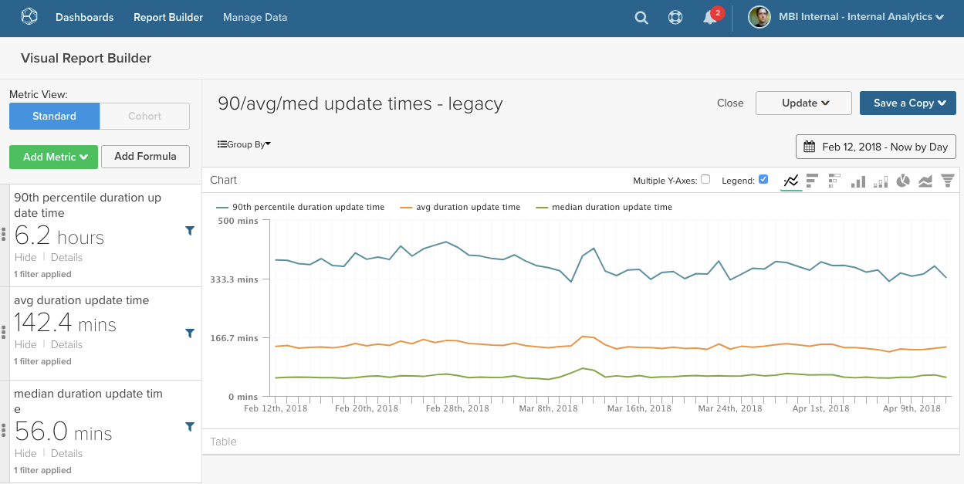
MBI 2.0 Latency Data
User https://admin.rjmetrics.com/admin/v3b/user/45035
Report https://dashboard.rjmetrics.com/v2/client/7568/dashapp/reports/1878140?dashboardId=430557
Pull closer to presentation date

Slide 13
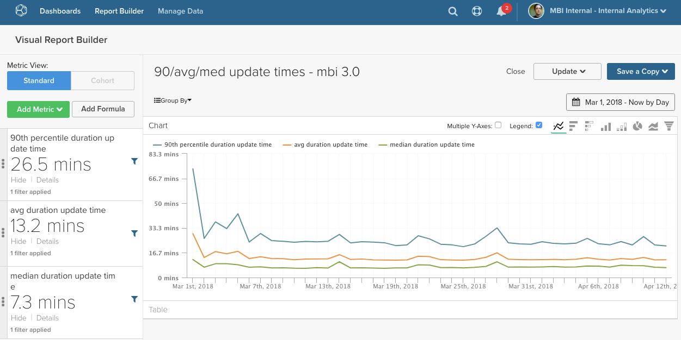
MBI 3.0 Latency Data
User https://admin.rjmetrics.com/admin/v3b/user/45035
Report https://dashboard.rjmetrics.com/v2/client/7568/dashapp/reports/1878141?dashboardId=430557
Pull closer to presentation date

Slide 14
Data Warehouse View

Slide 15
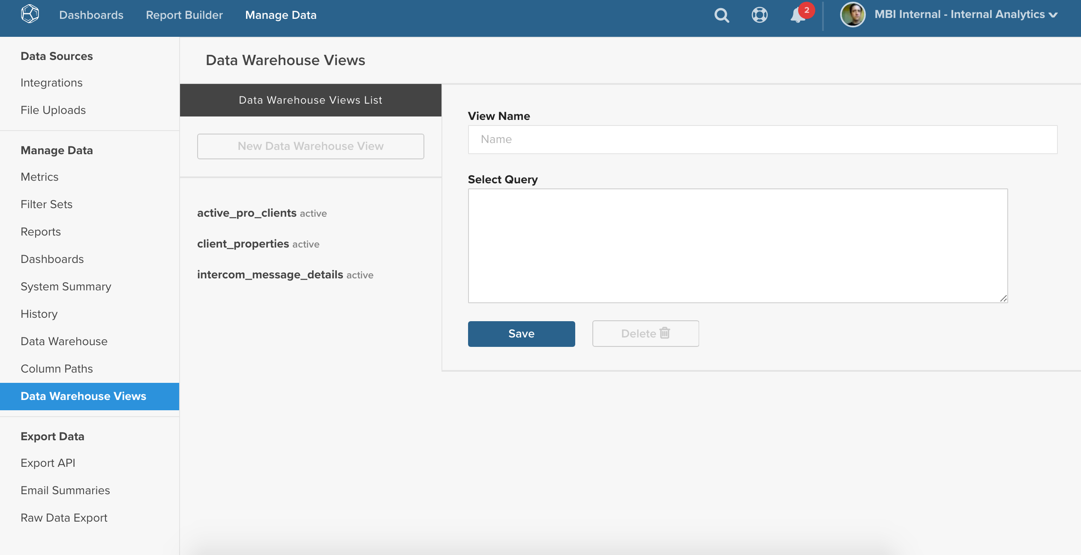
Building a View

Slide 16
Consolidated tables
Old Architecture used to unionize two or more tables that contained the same type of data
Ad spending
Google AdWords
Facebook Ads
External Marketing
Production and Legacy Sales
Could only be edited by support
Creating the table
Editing the fields or adding additional fields
Creating calculated columns

Slide 17
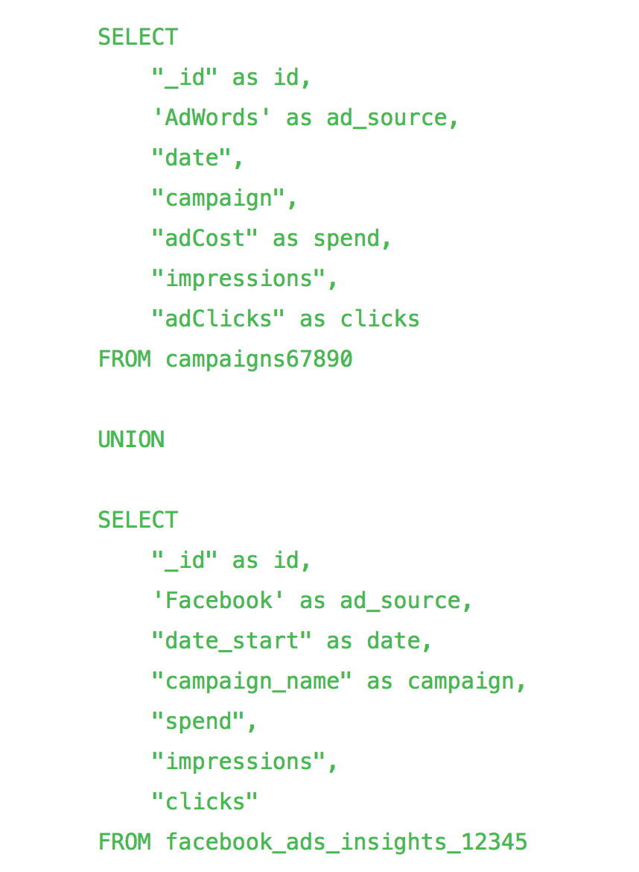
Building a Consolidated AdSpend Table
Step 1: Copy and edit the query from our support article
Step 2: Test it in the SQL RB to makes sure it works
Step 3: Enter it in the Views page and save it
Step 4: Wait an Update Cycle
Step 5: Build all the metrics and columns you need

Slide 18
New Capabilities Using Views
A view can be saved for any table that can be written with a SQL query within MBI
Consolidating tables
Aligning data from different structures
Unify Shopify, Magneto, ERPs, and homegrown tables
Advanced data modeling
Freedom to structure your data from various sources however you would like
Access to any functions available in PostgreSQL

Slide 19
Data Warehouse Manager
New and Improved Features

Slide 20
Exposed Calculation Types
Due to the fragility of the calculation of derivatives phase, certain column types had to be done by analysts here at MBI
Date Difference
Event Number
Sequential Comparison
Currency Converter
Calculation
Same table calculation that allows you to combine any amount of columns on the same table using PostgreSQL functions
Replaces the Java calculations that Support used to create columns

Slide 21
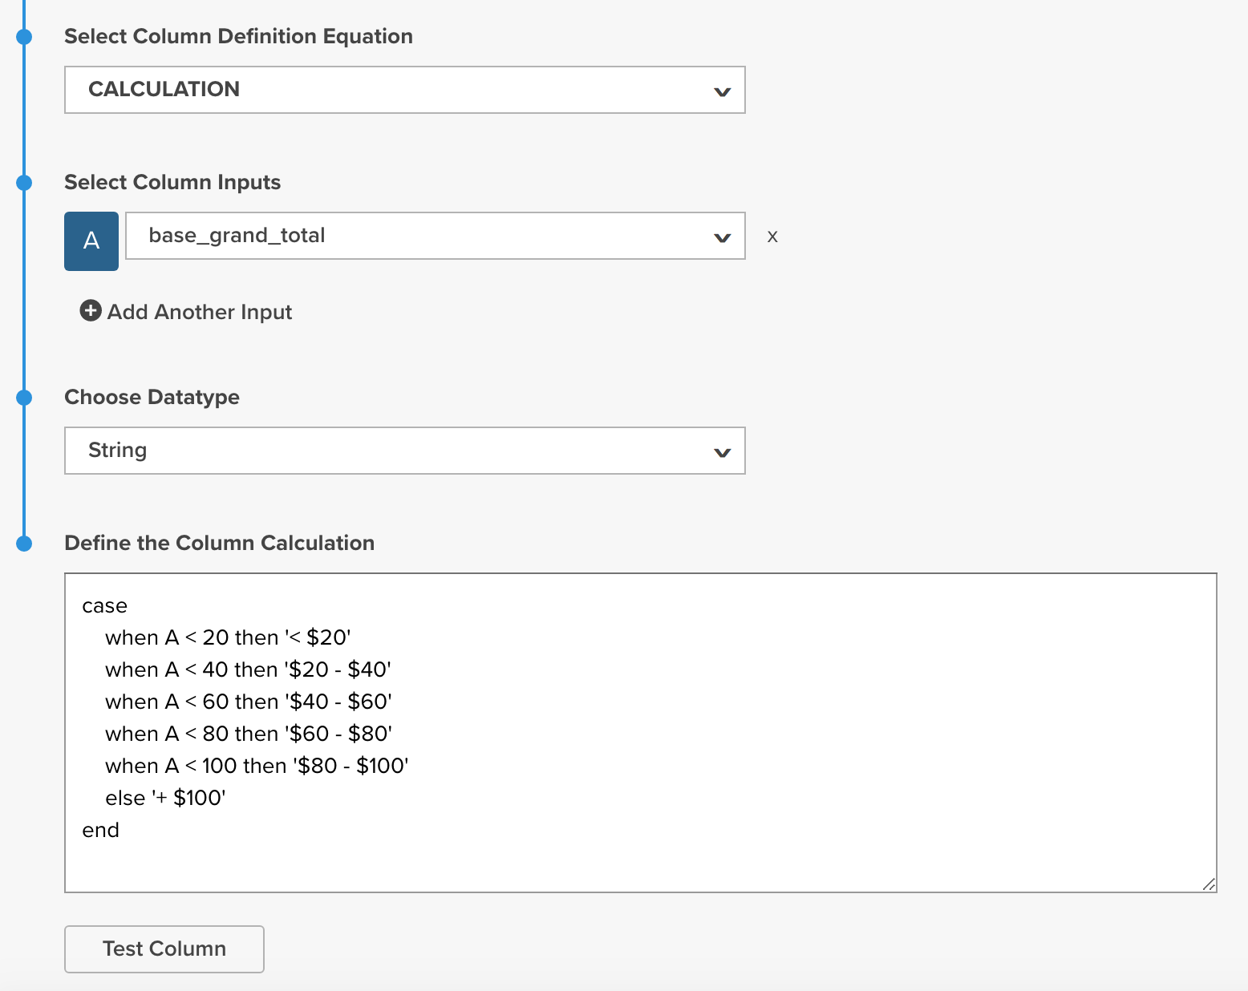
SQL Calculation Derivatives
Common Use cases
Mathematical operations
Order item value (price * qty)
Parsing Strings
Cleaning SKUs
Pulling data from arrays
If then logic
Bucketing revenue
Uses the PostgreSQL CASE statement

Slide 22
Live Derivatives
“Your column will be available for use after the completion of the next full update”
All calculated columns become available for use IMMEDIATELY
No more waiting for support to respond or for updates to finish
Incorrect or inaccurate column definitions can be edited mid analysis

Slide 23
A New Take on Cohorts

Slide 24
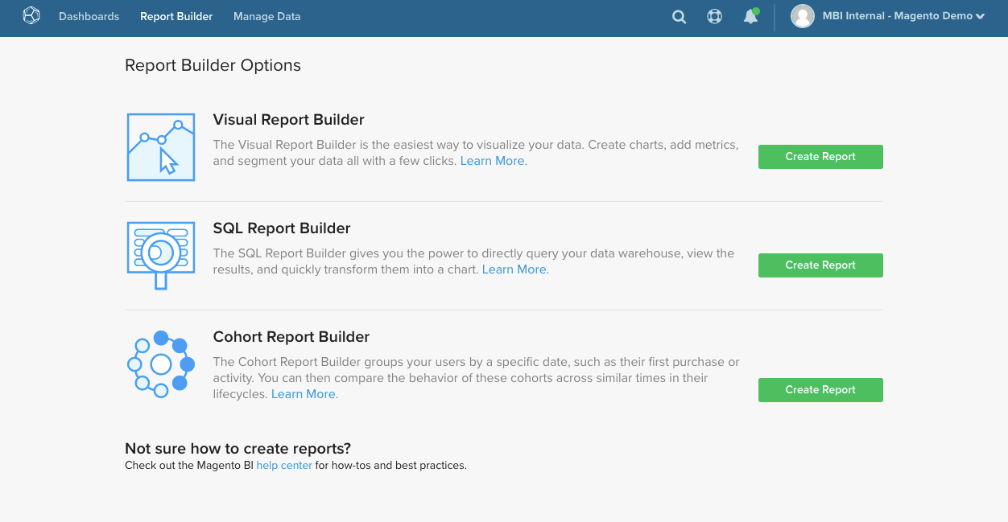

Slide 25
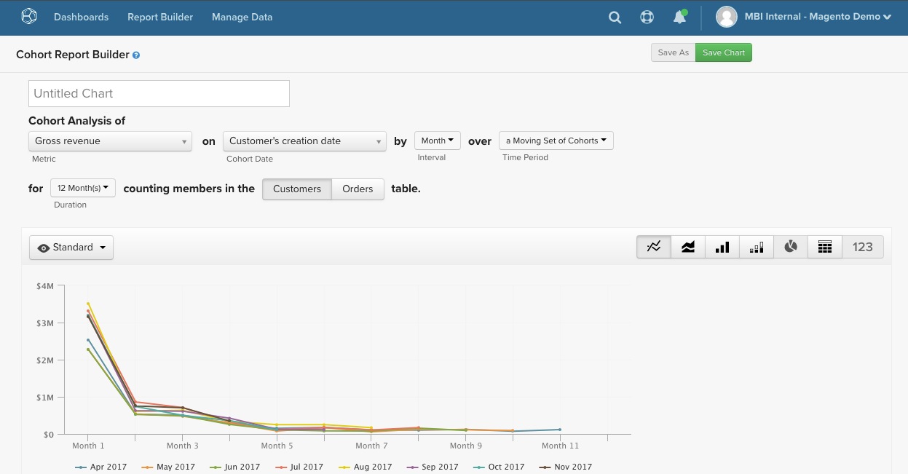

Slide 26
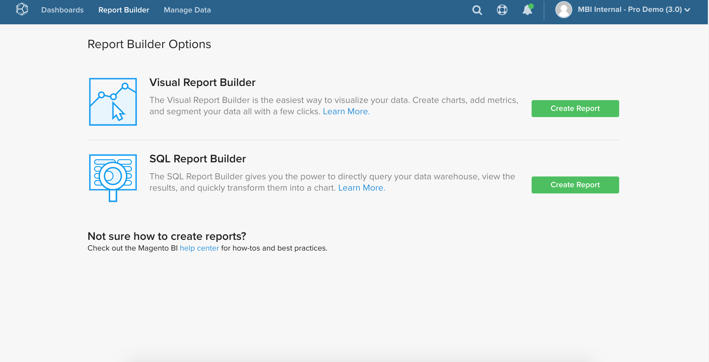

Slide 27
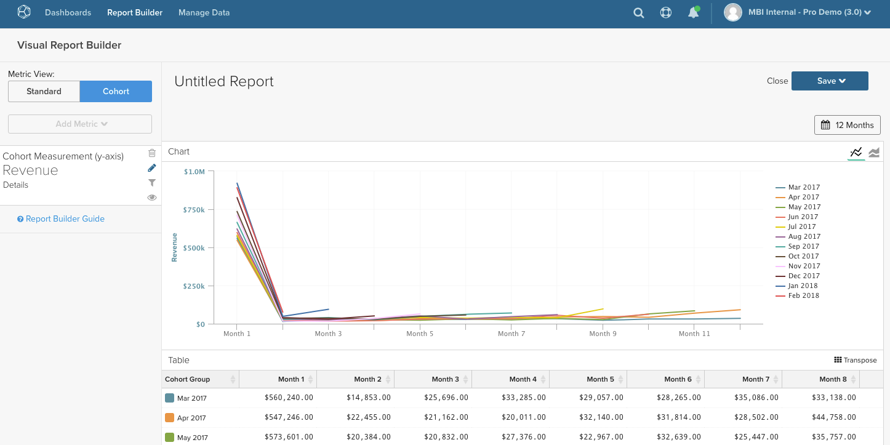

Slide 28
The New Cohort Report
Exists within the same menu as the Visual Report Builder
Same feel, style, filtering
Improved Report Builder table layout
Color code that aligns with the chart for ease of interpretation
Benefits from live columns
Can tweak and adapt analysis with new or altered columns in real time

Slide 29
Qualitative Cohorts
The next evolution in cohorts and currently in development
Instead of grouping on cohorts, group on other customer based factors
Acquisition Channel
Billing/Shipping State or Country
Gender
Initial Purchase Products
First Coupon Usage

Slide 30
Questions?

Slide 31
Thanks!

