Slide 1

ADOBE SUPPORT PLANS
Adobe Experience Cloud
Online | Business | Enterprise | Elite
Adobe provides a comprehensive range of technical resources to help support your business included as part of your Experience Cloud license subscription and further enhanced in the ELITE support package. ELITE support includes access to personalized learning paths and monitored community forums via the Adobe Experience League. You can also take advantage of our detailed and in-depth technical product documentation and current release notes. ELITE customers will also have access to a Named Support Engineer as well as a Technical Account Manager who combine and work in partnership with you to provide best in class proactive and reactive support while acting as your designated technical contacts in the Adobe Support Team. With deep experience in your designated Experience Cloud solutions, your support team work to ensure that no matter how complex your support needs are, the Adobe Support team will be there side by side with you throughout, to ensure you maximize your investment in the Adobe Experience Cloud solutions and to help you avoid problems before they happen.
 |  | Online Support | Elite Support
 |  |  | Paid Support ($)
Assigned Experts | Account Support Lead
 | Named Support Engineer |  | ✓
 | Technical Account Manager |  | ✓
Support Services | Online Support | Business hours | 24x5
 | 24x7x365 P1 Issue Support | ✓ | ✓
 | Named Support Contacts (per product) | 4 | 15
 | Live Telephone Support |  | ✓
 | Escalation Management |  | ✓
 | Service Reviews per Year |  | 4
 | Expert Sessions per Year |  | 4
 | Case Reviews |  | ✓
 | Event Management |  | ✓
 | Environment Review, Maintenance & Monitoring |  | ✓
 | Release, Migration, Upgrade & Product Roadmap Review |  | ✓
 | Cloud Support Activities – Experience Manager as Cloud |  | ✓
Field Services | Launch Advisory Services – First Year of new solution |  | ✓
 | Field Service Activities |  | 4
Service Level Targets: Initial Response
Priority | Online Support | Elite Support
PRIORITY 1 Customer's production business functions are down or have significant data loss or service degradation and immediate attention is required to restore functionality and usability | 24x7 / 1 hour | 24x7 / 15 minutes
PRIORITY 2 Customer's business functions have major service degradation or potential data loss, or a major feature is impacted | Business hours / 4 hours | 24x5 / 30 minutes
PRIORITY 3 Customer’s business functions has minor to no service degradation but there exists a solution/workaround allowing business functions to continue normally | Business hours / 6 hours | 24x5/ 1 hour
PRIORITY 4 General question regarding current product functionality or an enhancement request | Business days / 3 days | Business days / 1 day
©2021 Adobe. All Rights Reserved. Adobe Confidential.

Slide 2


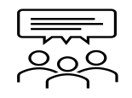











Elite Support Features
Technical Account Manager
Named Support Engineer
Case Reviews
A designated Technical Account Manager to oversee your Elite experience, coordinate the support and field services engagements, and provide proactive services to maximize your business value.
A designated support engineer who becomes familiar with your solution environment and business goals. The NSE is an experienced support engineer that helps coordinate your Enterprise Support experience.
Regular scheduled review of open support requests, ensuring customer alignment on case description, business impact, status, priority and agreement on next steps required to ensure an expedient resolution.
Escalation Management
Service Reviews
Expert Sessions
A designated point of contact within Adobe who can provide escalation assistance, regular updates and ensure priority is given to your most critical open support requests.
A regular review of Elite program services, support metrics, and deliverables, including a forward-looking plan
A 60-minute session focusing on a specific product feature and how it can be utilized to solve common business problems.
Environment Review
Solution Roadmap Review
Maintenance & Monitoring
Proactive review of your solution deployment, configuration, and overall architecture, including integrations.
Compare and align Adobe solution roadmap with your project roadmap to mitigate risk and prepare for the future.
.
Receive maintenance best practices and latest fixes (SPs, MR, patches, FPs) to remain up-to- date on all maintenance checks.
Release Preparation & Review
Knowledge Transfer
Event Management
Receive personalized guidance on new product features to take advantage of latest innovations, and have Adobe experts review release and upgrade plan.
Ongoing knowledge transfer from Adobe Support team to provide best practices around solution usage.
Manage key events to ensure you have the right level of support, coverage, and mitigation plan in place during those key business and project milestones.
Online Support Features
Community Forums
24X7 P1
Experience League
Online Forums
Phone Support
Self-guided Journeys
Continuous online access to a growing database of technical solutions, product documentation, FAQs and more. Connect with practitioners and other customers on Adobe Community to share best practices and lessons learned.
Authorized users or Named Support Contacts can submit issues through all available channels (including phone for P1) and interact with our technical support team on behalf of your company.
Experience Makers are made with Experience League. Customers can kickstart their Customer Experience Management abilities with personalized learning to develop skills, engage with a global community of peers, and earn career advancing recognition.
Office Hours
Live Chat Support*
Self-help Portals
Webinars
Chat Support
24/7 Support Portal
Office Hours led by the Adobe Customer Support team includes sessions designed to inform as well as help participants troubleshoot problems and provide tips and tricks for success with Adobe solutions.
Start a chat session to get answers & help with case submission.
*Not all products have live chat support.
On-demand access to the online Self-help Support Portal to submit support requests, review case status, and browse other resources, like our knowledgebase, news and alerts, featured tips, and more.
©2021 Adobe. All Rights Reserved. Adobe Confidential.

Slide 3


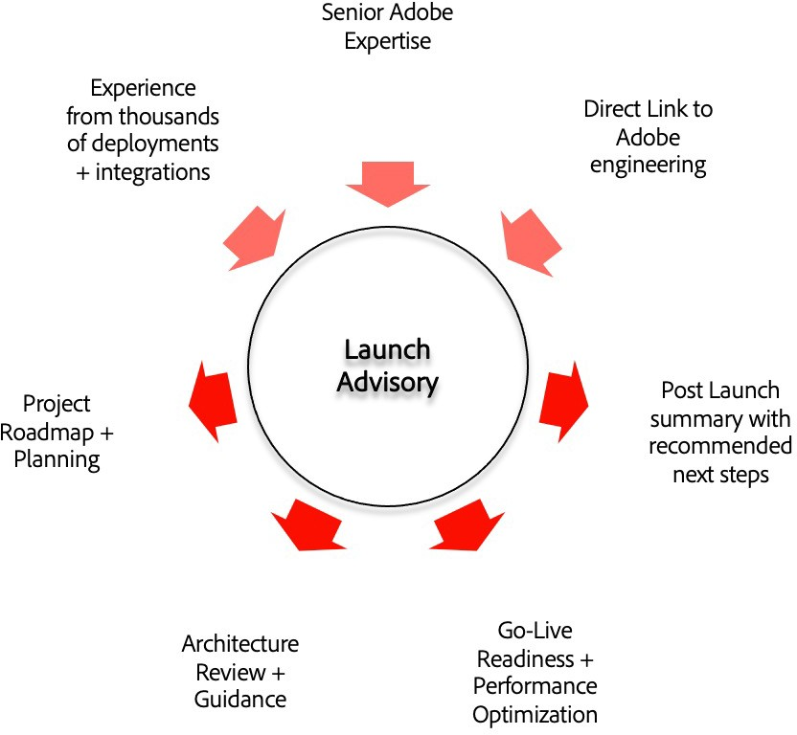
Cloud Support Activities - AEM
Governance for AEM as a Cloud Service
Value-added Services for AEM as a Cloud Service
Customization Best Practices for AEM as a Cloud Service
Technical & operational governance to assist AEM as a Cloud Service Customers in adhering to industry standards and best practices for AEM as a Cloud Service.
Identify, review and provide recommendations on customized solution adoption areas that have opportunities for optimization.
Drive adoption of customization best practices and core components in AEM as a Cloud Service.
Launch Advisory
Field Service Activities
For customers implementing a new Adobe Experience Cloud solution, Launch Advisory is a core set of advisory
services and recommendations that are proven to support successful deployments and accelerate time-to-value.
Field Services are used for quick resolution, focused customer success and accelerated time-to-value. If Launch advisory is active there will be no Field Services in year 1 for any solution product covered by a Support contract.
Kickoff
Define
Design
Go-Live
Post Launch
4 Activities per Year
Implementation
Adobe solution experts help validate requirements, architecture, development process, and launch readiness reviews with best practice-based guidance to customers and implementation partners.
Run & Operate
As an Elite customer, you are eligible for 4 activities per year from the following two tracks: Technical and/or Strategic.
Implementation
Run & Operate
Launch Advisory will align with your project schedule through common milestones (Kickoff, Define, Design, Go-live and Post Launch) to guide, validate, assess and make recommendations.
Technical Track Activities ensure customers are technically sound and maximizing their tool adoption. Specifically, these types of activities include support and recommendations related to platform configurations, integrations and troubleshooting.
Key Deliverables include:
Types of technical activities available::
Health audit
Platform audit
Feature set enablement
Basic integrations and configurations
Customer solution troubleshooting
Cloud service support
Kickoff (including project collaboration plan) deck
Assessment & recommendations document(s)
Engagement summary
Strategic Track Activities locate opportunities to ensure value is being realized from a customer’s Adobe solutions. They include support recommendations related to strategy, measurement and maturity to drive value realization across one or more Adobe solutions.
Types of strategic activities available::
Maturity Roadmap
Use case development/measurement
Reporting & analysis
Best practices enablement

Slide 4





Resources
Experience League | Experience League is how Adobe helps businesses achieve the value they expect from their Adobe investment. It’s the unified place where customers can learn, connect, and grow along a personalized path to success that includes self-help tutorials, product documentation, instructor-led training, community and technical support.
Training | Adobe Digital Learning Services courses are accessible from Experience League. Learning courses integrate both on-demand and instructor-led lessons. Here you can accrue skills that have recognized market value and position them to drive success in your organizations.
Production Issues & System Outages | Status.adobe.com conveys the health information of all Adobe products and services that are deployed in multi-tenant environments. Customers can choose their subscription preferences to get email notifications whenever Adobe creates, updates or resolves a product event. This can include scheduled maintenance or service issues of varying levels of severity.
Terms and Conditions | Terms and conditions detailing Support Services offerings
Regional scope of Adobe Support, Local Hours Of Operation And Language Support
The regional scope of Adobe Support is established by aligning the customer's billing address (via the Sales Order or other Adobe Support purchasing document) to one of the following regions:
Americas | Europe, Middle East & Africa | Asia Pacific | Japan ¹
6 am – 5:30 pm | 9 am – 5 pm | 9 am – 5 pm | 9 am – 5:30 pm
Language support is only available in English and Japanese. ¹ P2, P3, P4 cases are limited to business hours only in Japan.
Unparalleled Expertise
Accelerated Support
Strategic Advice
To learn more about Adobe Support Offerings and the right level for you, contact your Named Account Manager (NAM) or Customer Success Manager (CSM)
©2021 Adobe. All Rights Reserved. Adobe Confidential.
Adobe
345 Park Avenue
San Jose, CA95110-2704
USA
www.adobe.com
©2020 Adobe. All Rights Reserved. Adobe Confidential.
©2020 Adobe. All Rights Reserved. Adobe Confidential.

