Slide 1
Adobebaba
PPT
365
TAKE MY BREATHE AWAY
Power of love
Because I loved you
Can you feel the love tonight
Rhythm of Rain
Right here waiting
Yesterday once more
Everything I do, I do it for you
Unchained melody
Sound of slience
I love you more than I can say
Sealed with kiss
网格效果试水
The 7th

Slide 2
Adobebaba
PPT
365
Because I loved you
TAKE MY BREATHE AWAY
Rhythm of Rain
Power of love
Yesterday once more
Can you feel the love tonight
Everything I do, I do it for you
Sound of slience
Right here waiting
Sealed with kiss
Unchained melody
I love you more than I can say
网格效果试水
The 7th

Slide 3
Adobebaba
PPT
365
Rhythm of Rain
Because I loved you
Yesterday once more
TAKE MY BREATHE AWAY
Everything I do, I do it for you
Power of love
Sound of slience
Sealed with kiss
Can you feel the love tonight
I love you more than I can say
Right here waiting
Unchained melody
网格效果试水
The 7th

Slide 4
Hello World
Fuck the World
FUCK FUCK FUCK
Oh my God
Come on baby
FUCK FUCK FUCK
FUCK FUCK FUCK

Slide 5
What the fuck
Hello World
Fuck the World
FUCK FUCK FUCK
Oh my God
FUCK FUCK FUCK

Slide 6
Fuck the World
Fuck the World
FUCK FUCK FUCK

Slide 7
What the fuck
Hello World
Fuck the World
FUCK FUCK FUCK
Oh my God
FUCK FUCK FUCK
FUCK FUCK FUCK

Slide 8
Fuck the World
Fuck the World

Slide 9
TAKE MY BREATHE AWAY
TAKE MY BREATHE AWAY
Power of love
Because I loved you
Can you feel the love tonight
Rhythm of Rain
Yesterday once more
Right here waiting
Everything I do, I do it for you
Unchained melody
Sound of slience
I love you more than I can say
Sealed with kiss
Power of love
Because I loved you
Can you feel the love tonight
Rhythm of Rain
Right here waiting
Yesterday once more
Everything I do, I do it for you
Unchained melody
Sound of slience
I love you more than I can say
Sealed with kiss

Slide 10
Rhythm of Rain
Rhythm of Rain
Because I loved you
Because I loved you
Yesterday once more
Yesterday once more
TAKE MY BREATHE AWAY
TAKE MY BREATHE AWAY
Everything I do, I do it for you
Everything I do, I do it for you
Power of love
Sound of slience
Power of love
Sound of slience
Sealed with kiss
Sealed with kiss
Can you feel the love tonight
Can you feel the love tonight
I love you more than I can say
I love you more than I can say
Right here waiting
Right here waiting
Unchained melody
Unchained melody

Slide 11
Everything I do, I do it for you
Everything I do, Ido it for you
Because I loved you
Because I loved you
TAKE MY BREATHE AWAY
TAKE MY BREATHE AWAY
Rhythm of Rain
Rhythm of Rain
Power of love
Power of love
Yesterday once more
Yesterday once more
Can feel the love tonight
Everything I do, I do it for you
Can you feel the love tonight
Sound of slience
Sound of slience
Right here waiting
Right here waiting
Sealed with kiss
Sealed with kiss
Unchained melody
Unchained melody
I love you more than I can say
I love you more than I can say

Slide 12
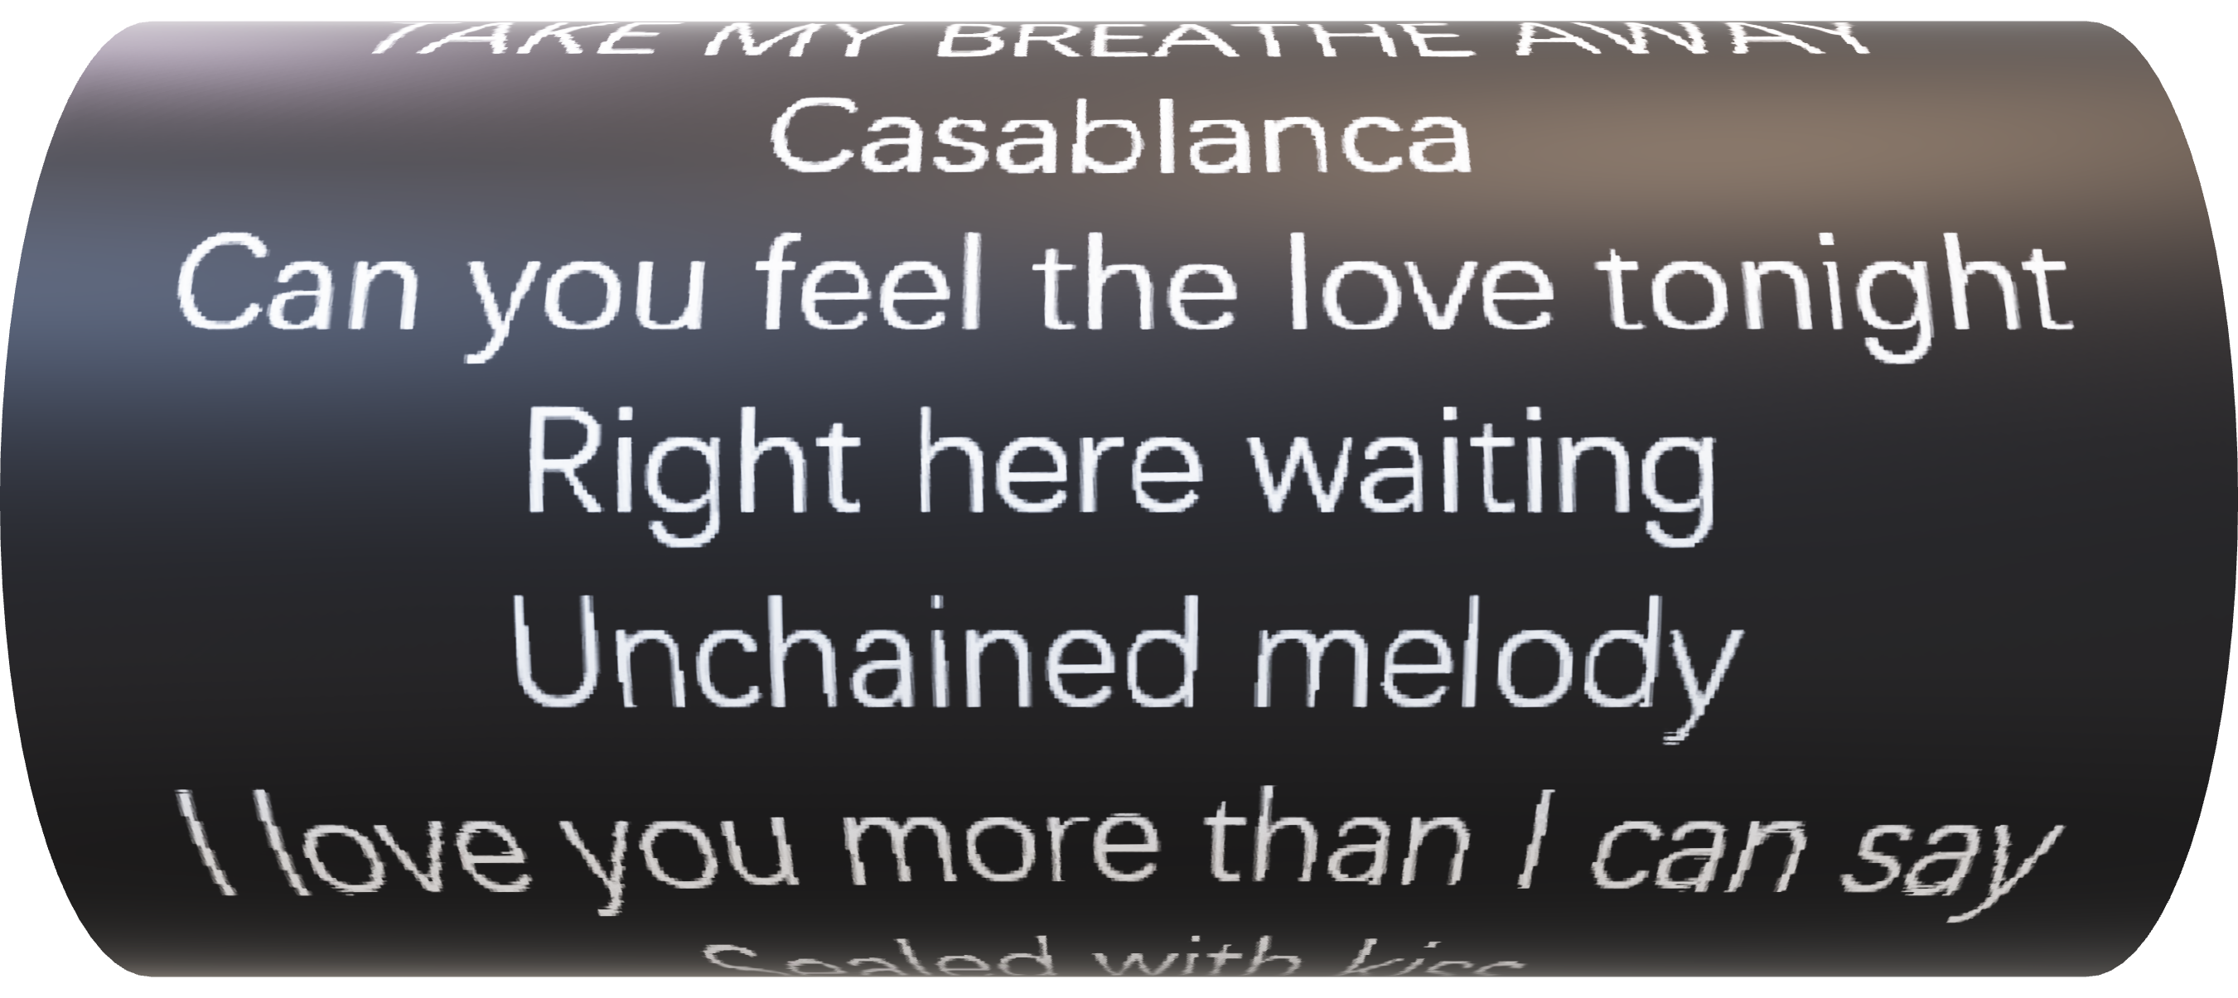

Slide 13
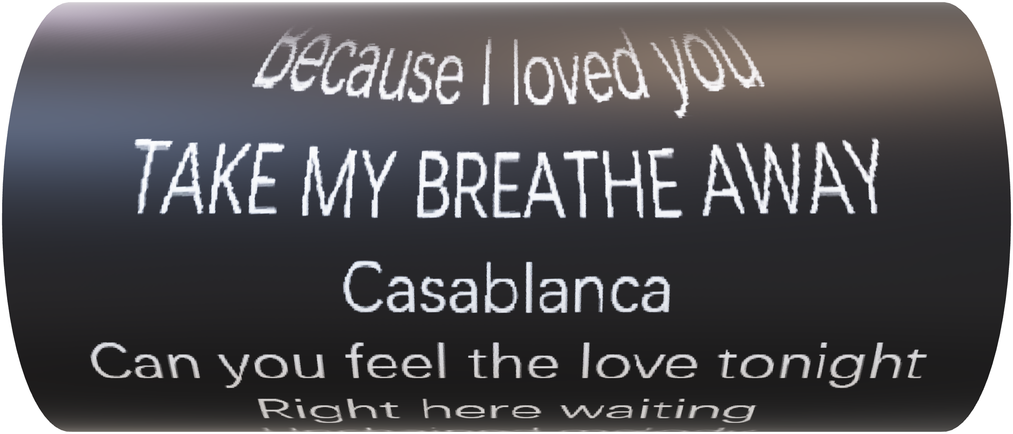

Slide 14
FUCK FUCK FUCK
Oh my god
FUCK FUCK FUCK

Slide 15
Oh my god
FUCK FUCK FUCK
FUCK FUCK FUCK

