Slide 1
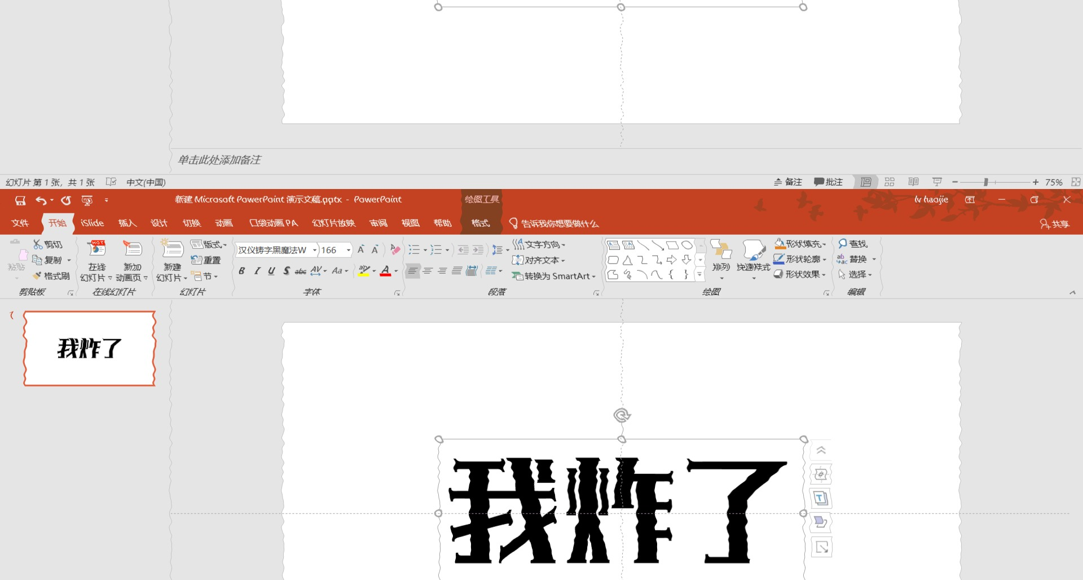
Adobebaba
PPT
365
故障风格试玩：艺术就是爆炸
The 9th

