Slide 1

Installing Linux
F O R W I N D O W S U S E R S
Image courtesy of https://wallpaperaccess.com/gruvbox

Slide 2


What is Linux?
Image courtesy of linuxscriptshub.com

Slide 3
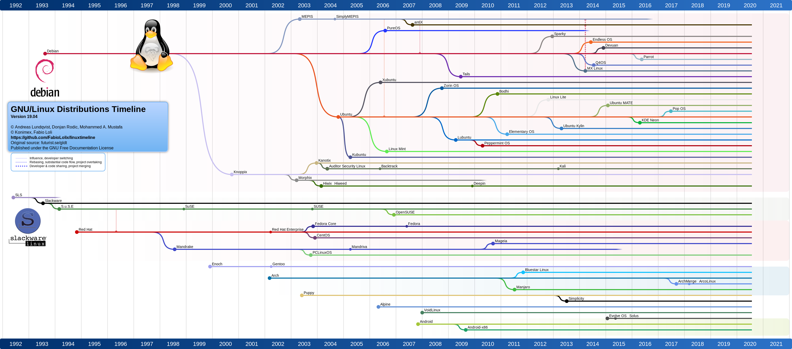
What is a Linux Distribution?
Image courtesy of u/philippleclercq on Reddit

Slide 4
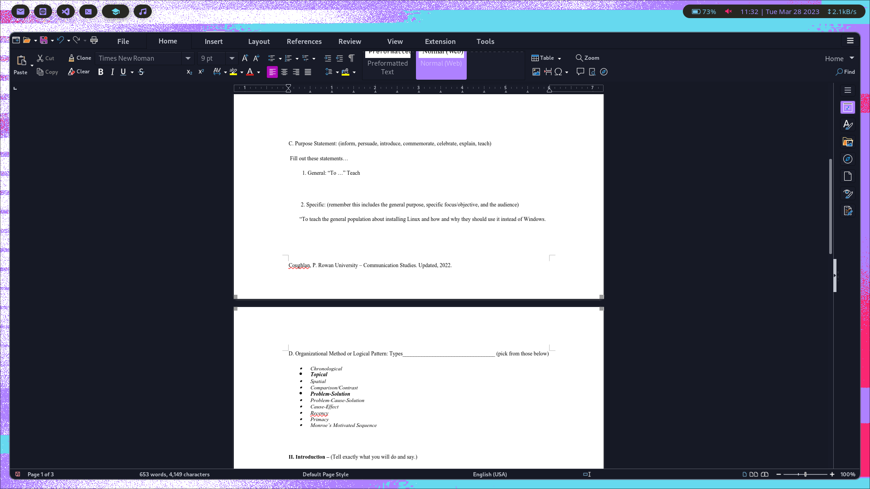
This is a Linux Desktop
Image courtesy of my screenshot tool

Slide 5
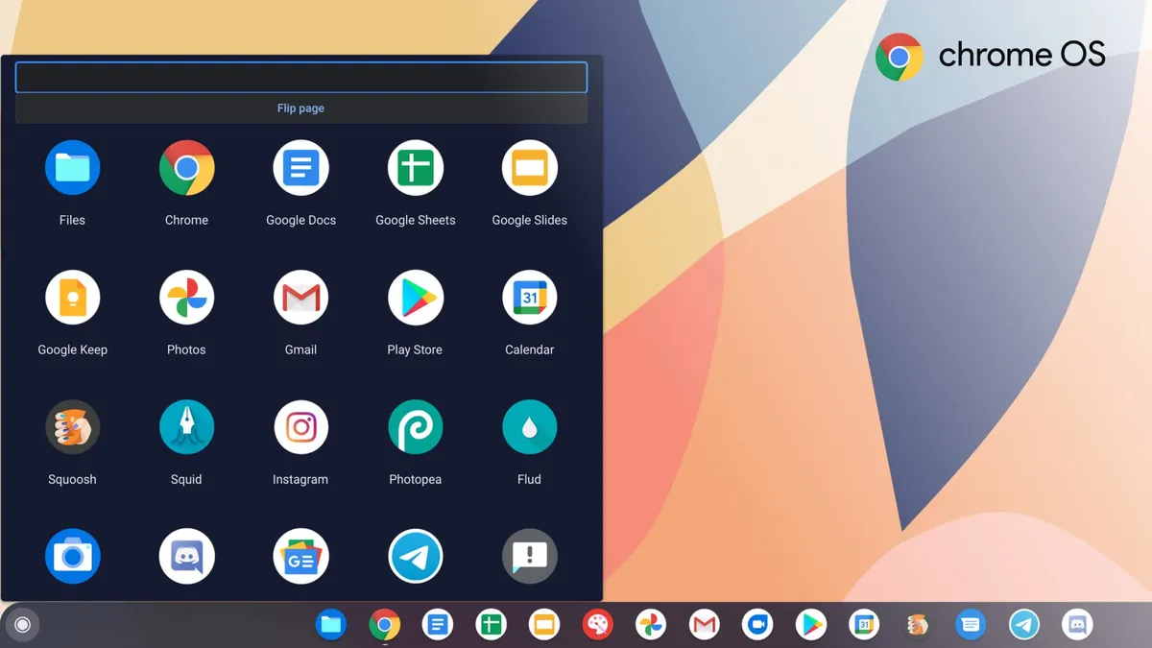
This is a Linux Desktop
Image courtesy of www.thedailyrag.co.uk

Slide 6
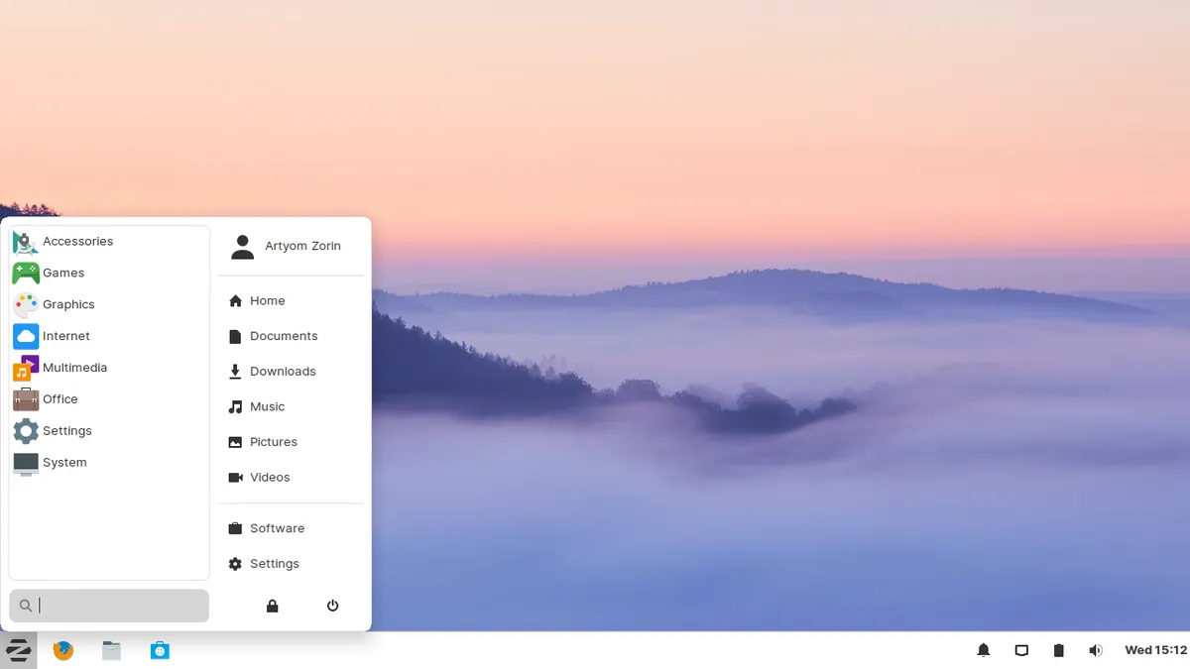
This is a Linux Desktop
Image courtesy of blog.zorin.com

Slide 7
This is Zorin OS.
Image courtesy of blog.zorin.com

Slide 8
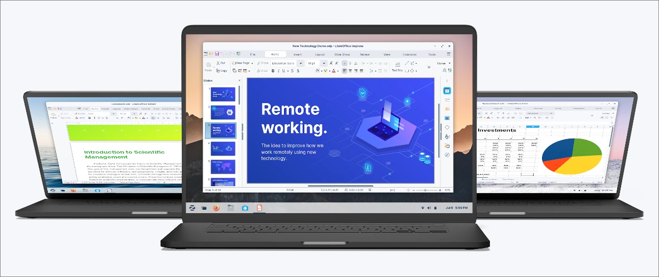

Why Zorin OS?
Images courtesy of zorin.com/os

Slide 9
Let's Do a Demonstration
Downloading Zorin OS
Installing Zorin OS
Flash Drive Etching
Using Zorin OS

Slide 10
Thank You
Image courtesy of https://wallpaperaccess.com/gruvbox

