Slide 1
CHAPTER 4: Software Design

Slide 2
Software Design
Deriving a solution which satisfies software requirements

Slide 3
Software Design
Design activity begins with a set of requirements, and may be an architecture
Design done before the system is implemented
Design focuses on module view – i.e. what modules should be in the system
Design of a system is a blue print for implementation

Slide 4
SW architecture definition constitutes a High level design (modules are defined), while the design we are referring to is low level design(logic specified).
Design is a creative activity
Goal: to create a plan to satisfy requirements
Perhaps the most critical activity during system development

Slide 5
Design…
Design determines the major characteristics of a system
Has great impact on testing and maintenance
Design document forms reference for later phases
Design methodology – systematic approach for creating a design

Slide 6
Design Concepts
Design is correct, if it will satisfy all the requirements and is consistent with architecture
Of the correct designs, we want best design
We focus on modularity as the main criteria (besides correctness)

Slide 7
Modularity
Modular system – in which modules can be built separately and changes in one have minimum impact on others
Modularity supports independence of models
Modularity enhances design clarity, eases implementation
Reduces cost of testing, debugging and maintenance

Slide 8
Cannot simply split a program into modules to get modularly
Need some criteria for decomposition – coupling and cohesion , and Open-Closed principles are such criteria

Slide 9
Cohesion
Cohesion is a measure that defines the degree of intra-dependability within elements of a module.
The greater the cohesion, the better is the program design.

Slide 10
Coupling
Coupling is a measure that defines the level of inter-dependability among modules of a program. It tells at what level the modules interfere and interact with each other.
The lower the coupling, the better the program

Slide 11
Modules can be treated “independently”:
can understand each module in isolation
can use each module in isolation
failure in one module doesn’t affect other modules, so easier to isolate failures
change in one module doesn’t affect other modules.

Slide 12
1. Coupling
Two modules are independent only if it can function completely without presence of other.
Coupling is a measure of the dependencies between two part of a system. If two classes are strongly coupled, it is hard to modify one without modifying the other.
Strength of interaction between objects in system.
Notes:
http://www.eli.sdsu.edu/courses/spring01/cs635/notes/module/module.html

Slide 13
Coupling
Independence between modules is desirable
Modules can be modified separately
Can be implemented and tested separately
Programming cost decreases
In a system all modules cannot be independent
Modules must cooperate with each other

Slide 14
More connections between modules
More dependent they are
More knowledge about one module is required to understand the other module.
Coupling captures the notion of dependence

Slide 15
Coupling…
In general, the more we must know about module A in order to understand module B the more closely connected is A to B
"Highly coupled" modules are joined by strong interconnection
"Loosely coupled" modules have weak interconnections; means component changes are unlikely to affect other components.

Slide 16
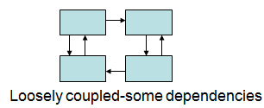
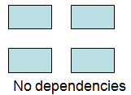
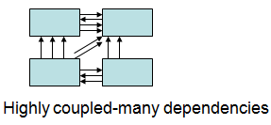

Slide 17
Tight Coupling

Slide 18
Loose Coupling

Slide 19
High coupling makes modifying parts of the system difficult, e.g., modifying a component affects all the components to which the component is connected.

Slide 20
Coupling…
Goal: modules as loosely coupled as possible
- Where possible, have independent modules
- Coupling is decided during design
- Cannot be reduced during implementation
- Coupling is inter-module concept

Slide 21
2. Cohesion
A measure of how well a component “fits together”.
Cohesion is a measure of dependencies within part of a system. If a class contains many closely related functions its cohesion is high.
Degree to which the tasks performed by a single module are functionally related
Aim for high cohesion within classes and weak coupling between them; Cohesion and coupling are interrelated;

Slide 22
Object-Oriented Methodology

Slide 23
Objectives
Be knowledgeable in the theory of object oriented systems development ;
Be competent in the production of object oriented Systems Requirements and Design specifications using the Unified Modeling Language (UML).
Be able to create diagrams in the UML notation; and
be familiar with an OO CASE tool, e.g., starUML.

Slide 24
Object-Oriented Methodology
(mid/late-1980s - now)
Object modeling
Compliments object-oriented programming
Object perspective of the problem domain
Describes the real world by its objects, the attributes,
services, and relationships

Slide 25
UML
In 1997, the Object Management Group (OMG) developed UML
UML is a graphical notation for expressing object-oriented designs.
UML is a language representing unified best engineering practices or specifying, visualizing, constructing, and documenting the element of business modeling, software and even non software systems.
Is process and programming language independent.

Slide 26
Ideas characterize object-oriented programming:
- An object, which represents a real-world thing or event
A class, or group of related objects
Messages, sent between objects

Slide 27
The UML Visual Languages
State
Diagrams
State
Diagrams
Class
Diagrams
Use Case
Diagrams
Use Case
Diagrams
State
Diagrams
Use Case
Diagrams
Use Case
Diagrams
State
Diagrams
Use Case
Diagrams
Object
Diagrams
Activity
Diagrams
Scenario
Diagrams
State
Diagrams
Scenario
Diagrams
State
Diagrams
Sequence
Diagrams
State
Diagrams
Model
Scenario
Diagrams
Component
Diagrams
Scenario
Diagrams
Component
Diagrams
Collaboration
Diagrams
Deployment
Diagram
Component
Diagrams

Slide 28
Functional specification using use case

Slide 29
Use Cases Basics
A use case is a task that an actor needs to perform with the help of the system
A use case model is part of an analysis model of a system that is created in the requirements analysis.
– A description of sequences of actions performed by a given system to produce a result for an actor
- Use cases are created based on identified functional
Requirements.
- Use-case diagrams illustrate the relationship between a software system and its users.

Slide 30
Use Case model is used to specify the functionality of a system from the point of view of the business users.
Use cases once specified can be denoted using a clear and precise visual modeling language such as UML.
The Use Case description describes the interaction between the system and the outside world.

Slide 31
Basics..
Actor: Represent roles that humans, hardware devices, or external systems play while interacting with a given system
They are not part of the system and are situated outside of the system boundary
Actors may be both at input and output ends of a use case

Slide 32
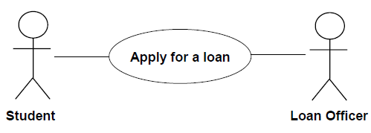

Slide 33

Use case name
Simple name: Register student

Slide 34
Relationships between use cases
Association , Extends and Includes Relationships

Slide 35
Association
The association relationship is the interface between an actor and a use case. It is represented by a line between an actor and a use case.

Slide 36

Relationships among use cases
Include: Common behavior of more than one use case is referenced as a separate instance to avoid repetition
a dotted line labeled <<include>> beginning at base use case and ending with an arrows pointing to the include use case.
The include relationship occurs when a set of behavior is similar across more than one use case; used to extract use case fragments that are duplicated in multiple use cases

Slide 37
The included use case cannot stand alone and the original use case is not complete without the included one.
A base use case is dependent on the included use case(s); without it/them the base use case is incomplete.
Includes the functionality of one use case in another.

Slide 38
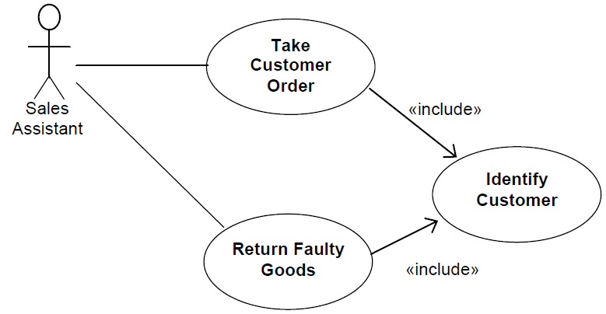

Slide 39

– Extend: Implicit integration of the behavior of another use case by declaring the extension points / events in the base.
a dotted line labeled <<extend>> with an arrow toward the base case. The extending use case may add behavior to the base use case. The base class declares “extension points”.

Slide 40
The extending Use Cases represent additional functionality, without which the model is consistent in itself.
Extend is used when a use case conditionally adds steps to another first class use case (those use cases are optional).

Slide 41
Case study 1: AUCA Library system
AUCA stores a number of books that can be borrowed by its members. At the moment the AUCA deals with loans, returns and reservations of the books in a manual system that is not efficient. AUCA requires a new computerized Library system in replacement of the current system, in order to provide more effective services. In the new system, all membership cards and books stored are bar coded so that the scanning machine integrated with the new library system can support borrows, returns and reservation of the books.

Slide 42
The system records all details of a new member (e.g., name, address, telephone number, start date, expire date) when a new membership card is issued to that member.
It also records the details of books (e.g., title, author, ISBN, publisher, publication year) when purchased.

Slide 43
The member who wishes to borrow a book pick from the bookshelves. She/he needs to present his/her membership card to librarian each time they wish to borrow a book.
The librarian uses the scanning machine to read the card. The librarian will stamp the book with the return date before giving it to the member.
The book borrowed will also read by the scanning machine so than loan details (e.g., issue date, borrower’s details, book’s details, and its return date) can be recorded in the Library system. The membership card will be then returned to the member together with the book issued.

Slide 44
A book is requested for return before return date only if reserved by another member. When member reserves a book, he/she needs to present the librarian his/her membership card and provide details (e.g., name, author) to be reserved. The librarian uses the scanning machine to read the card. The reservation will be carried out if the system accepts the card.
The librarian then needs to enter the books details for reservation. The system will add the new reservation with information (e.g., member details, current date, book details) to the list of reservations kept in the system.

Slide 45
The reservation list is scanned weekly by the system to generate return request (to the member who borrowed the book). When a book is returned, either as a result of a return request or when the borrower has finished with it, the reservations list is scanned again and if the book has been served an availability notification is sent to the appropriate member.

Slide 46
A book is scanned using a scanning machine for validation when returned. If returned late, the borrower will receive a fine notice. His/her membership will be scanned until the fine has been paid. The membership will be cancelled if the fine is not paid within two weeks.
The AUCA must store more than one copy for the books that are requested very often. In this case, different copy numbers are used for distinguishing between copies of the same book.

Slide 47
USE CASES
1. BORROW A BOOK
2. RESERVE A BOOK
3. RECORD NEW BOOK
4. SCAN RESERVATION LIST
5. RETURN A BOOK
6. SEND FINE NOTICE
7.RECORD DETAILS OF NEW NEMBER
8. CANCEL THE MEMBERSHIP
9. PAY FINE
10. VALIDATE MEMBERSHIP CARD
11. ISSUE MEMBERSHIP CARD
12. SEND AVAILABILITY NOTIFICATION

Slide 48
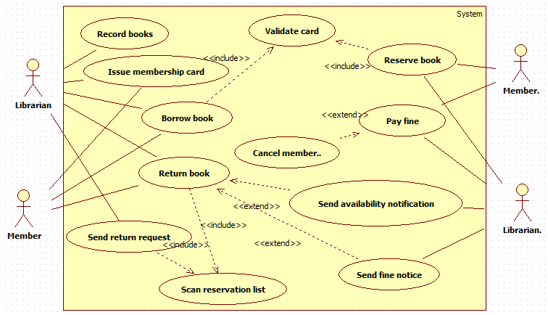

Slide 49
System development focus on three different models of the system:
The functional model, represented in UML with use case diagrams, describe the functionality of the system from the user’ s point of view.
The object model represented in UML with class diagram, describe the structure of the system in terms of objects, attributes, associations and operations.
- The dynamic model, represented in UML with Sequence, interaction , state chart , and activity diagrams, describe the internal behavior of the system.

Slide 50
Requirements engineering languages:
Use-cases diagrams.
Activity diagrams.
Structure (static) modeling languages:
Class diagrams.
Object diagrams.
Behavioral (dynamic) modeling languages:
Sequence diagrams; collaboration diagrams.
Statecharts.
Implementation level languages:
Deployment diagrams.
Component diagrams.

Slide 51
Elements of a UML Class Diagram
Class
Attributes
Operations
Relationships
1. Associations
-Aggregation
-Composition
2. Generalization
3. Dependency
4. Realization
Constraint Rules and Notes

Slide 52
What is a Class?
A class is a description of a group of objects with common properties (attributes), behavior (operations), relationships, and semantics.
Class refers to a template for a group of individual
objects with common attributes and common behavior.
A class is represented using a compartmented (partition) rectangle.
Notes:
Compartment: partition

Slide 53
Class diagram
The difference between an Object and a Class is that the class defines shared attributes and behaviors of objects.
Another name for attribute is property
Another name for operation is method.
A class diagram is a STATIC view of system

Slide 54
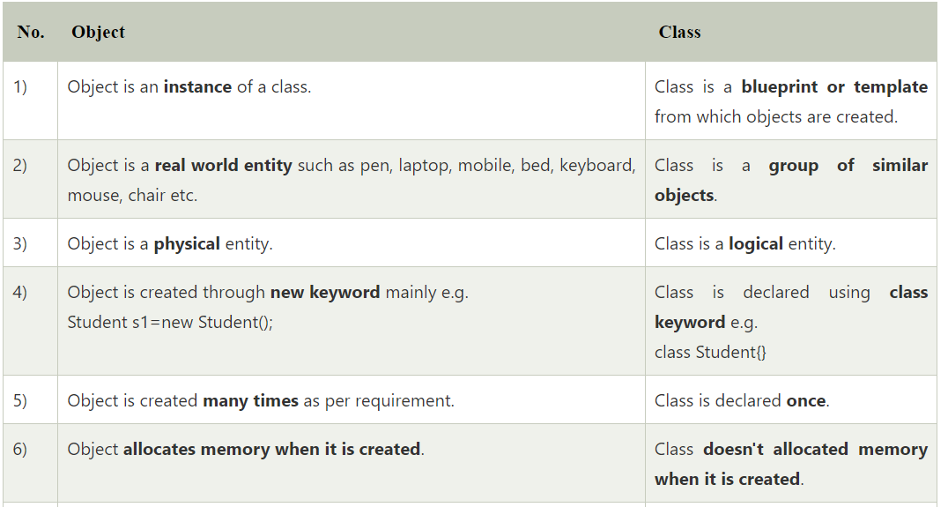

Slide 55
Real life example of class and object
Class: Human Object: Man, Woman
Class: Fruit Object: Apple, Banana, Mango, Guava
Class: Mobile phone Object: iPhone, Samsung, Moto
Class: Food Object: Pizza, Burger, Samosa

Slide 56
The class diagram of UML is the central piece in a design or model.
As the final code of an OO implementation is mostly classes, these diagrams have a very close relationship with the final code.
A class diagram contains Class name, Attributes, Methods, relationships (association ,aggregation, composition dependency and generalization) between classes, visibility of data and multiplicities.

Slide 57
CLASS DIAGRAMS
Example:
In the Library information system:
System is broken by the object model into:
Classes: Book, Copy, Library Manager,...
Attributes:
Methods:

Slide 58
Relationships between Classes
1. Association
-Aggregation
- Composition
2. Generalization
3. Dependency
4. Realization

Slide 59
1. Associations
A semantic relationship between two or more classes that specifies connections among their instances.
A structural relationship, specifying that objects of one class are connected to objects of a second class.
Example: “An Employee works for a Company”
Employee
Department
Company

Slide 60
An association between two classes indicates that objects at one end of an association “recognize” objects at the other end and may send messages to them.

Slide 61
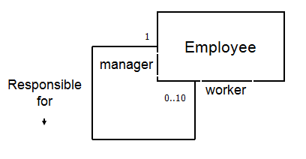
Association - Self
An association that connects a class to itself is called a self association.
A Company has Employees.
A single manager is responsible for up to 10 workers.

Slide 62
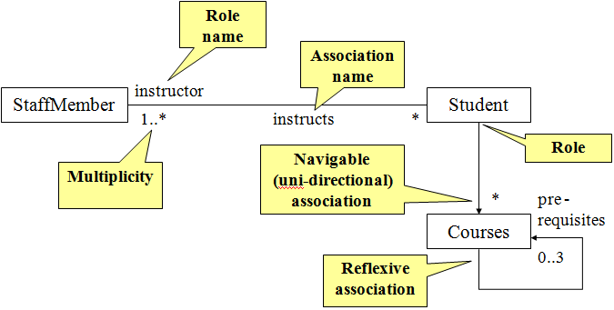
Example 1: Association

Slide 63
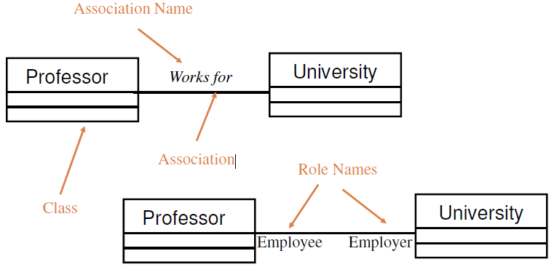
Example 2: Association

Slide 64
To clarify its meaning, an association may be named.
The name is represented as a label placed midway along the association line.
Usually a verb or a verb phrase.
A role is an end of an association where it connects to a class.
May be named to indicate the role played by the class attached to the end of the association path.
Usually a noun or noun phrase
Mandatory for reflexive associations

Slide 65
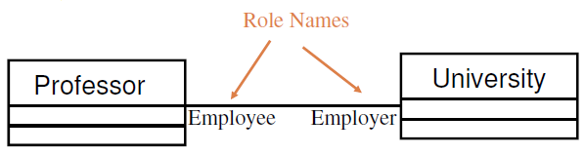

Slide 66
Aggregation
A special form of association that models a whole-part relationship between an aggregate (the whole) and its parts.
Aggregation (open diamond) represents nonexclusive relationship between two class objects (e.g., a student is a part of one or more faculties).
May form "part of" the association, but may not be essential to it.

Slide 67


They may also exist independent of the aggregate. e.g.: A door is part of a car. A car is not part of a door.
2..*
1..*
Door
Car
House

Slide 68
Aggregation tests:
Is the phrase “part of” used to describe the relationship?
A door is “part of” a car
Are some operations on the whole automatically applied to its parts?
Move the car, move the door.
Are some attribute values propagated from the whole to all or some of its parts?
The car is blue, therefore the door is blue.
Is there an essential asymmetry to the relationship where one class is subordinate to the other?
A door is part of a car. A car is not part of a door.

Slide 69
Composition
A strong form of aggregation
The whole is the sole (exclusive) owner of its part.
The part object may belong to only one whole
Multiplicity on the whole side must be zero or one.
The life time of the part is dependent upon the whole.
The composite must manage the creation and destruction of its parts.

Slide 70
Composition (closed diamond) represents exclusive relationship between two class objects (e.g., a faculty cannot exist without nor be a part of more than one university), every part may belong to only one whole, and if the whole is deleted, so are the parts.
components live or die with their owner
Example: Each car has an engine that can not be shared with other cars.

Slide 71
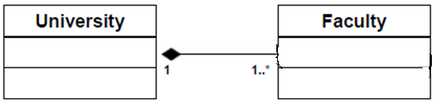
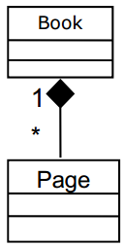

Slide 72
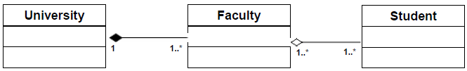
Aggregation and composition

Slide 73
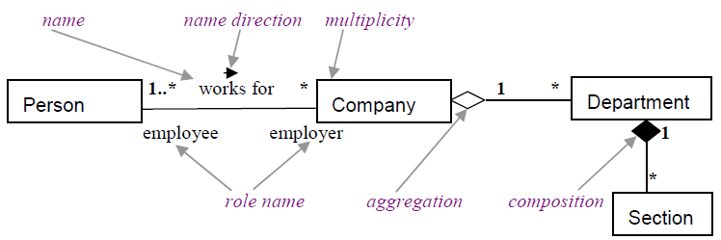
Association aggregation and composition

Slide 74
2. Generalization
A sub-class inherits from its super-class
Attributes
Operations
Relationships
A sub-class may
Add attributes and operations
Add relationships
Refine (improve) inherited operations

Slide 75
Generalization
A relationship among classes where one class shares the structure and/or behavior of one or more classes
Defines a hierarchy of abstractions in which a subclass inherits from one or more superclasses
- Single inheritance
- Multiple inheritance
Generalization is an “is-a-kind of” relationship

Slide 76
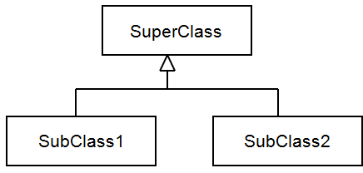
Child class is a special case of the parent class

Slide 77
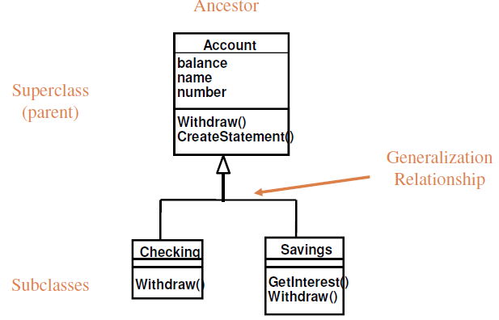
Example 1: Single Inheritance

Slide 78
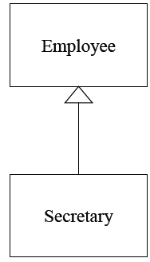
Example 2: Single inheritance

Slide 79
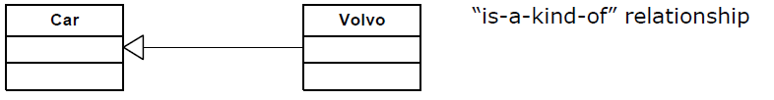

Slide 80
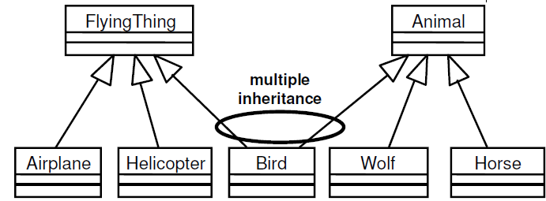
Example: Multiple Inheritance

Slide 81
A subclass inherits its parent’s attributes, operations, and relationships
A subclass may:
Add additional attributes, operations, relationships
Common attributes, operations, and/or relationships are shown at the highest applicable level in the hierarchy.

Slide 82

Generalization

Slide 83
Shape
Circle
Rectangle

Slide 84
3. Dependency
A dependency indicates a semantic relation between two or more classes in which a change in one may force changes in the other although there is no explicit association between them.
A stereotype (label) may be used to denote the type of the dependency.
Notes:
Example of dependency relationship

Slide 85
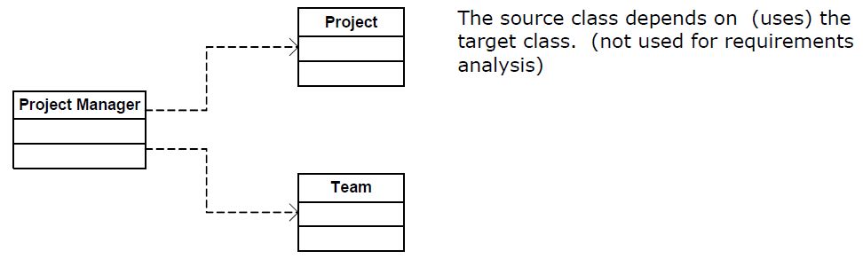

Slide 86
4. Realization
A realization relationship indicates that one class implements a behavior specified by another class (an interface or protocol).

Slide 87
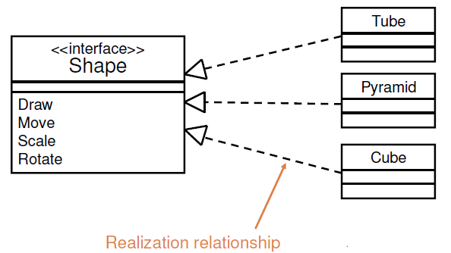
Realization

Slide 88
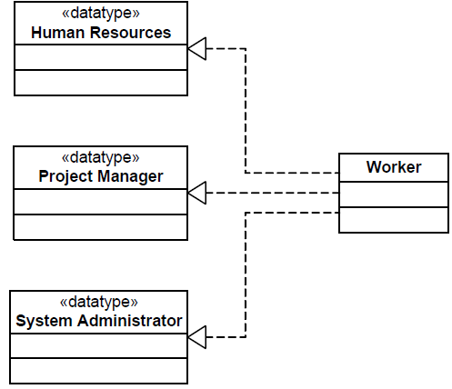
Class supports all operations of target class but not all attributes or associations. (not used for requirements analysis)

Slide 89
Association: Multiplicity and Navigation
Multiplicity defines how many objects participate in
a relationships
- The number of instances of one class related to ONE
instance of the other class
Specified for each end of the association
Indicates whether or not an association is mandatory.
Provides a lower and upper bound on the number of instances

Slide 90
Unspecified
Exactly one | 1
Zero or more (many, unlimited) | 0..*
One or more | * Or (1..*)
Zero or one | 0.. 1
Specified range | 2..4
Multiple, disjoint ranges | 2, 4..6

Slide 91
Association - Multiplicity
A cricket team has 11 players. One of them is the captain.
A player can play only for one Team.
The captain leads the team members.

Slide 92
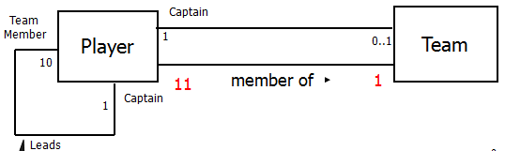

Slide 93
Navigability (unidirectional, bidirectional)

Slide 94
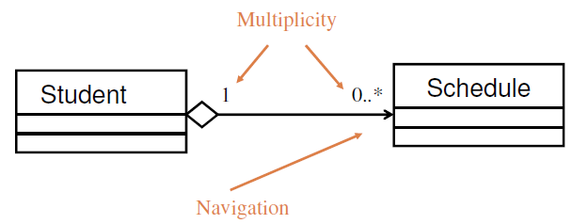
Example: Multiplicity and Navigation

Slide 95
Guidelines for drawing class diagram
1. Identify objects and classes
- Real-world objects and classes from the problem statement
- Nouns and noun-phrases in the problem statement that describe people, physical entities and concepts, they have to be containers for data (attributes).
- They should not be redundant, irrelevant, vague , or attributes.

Slide 96
2. Prepare a data dictionary containing the description of each class.
3. Identify association, aggregation, composition,… between classes.
4. Specify multiplicity and roles names, if necessary, for each association.
5. Identify attributes:
Nouns followed by possessive phrases, or adjectives in the problem statement

Slide 97
6. Identify operations
from use case, attributes, messages, actions and activities.
7. Identify generalization relationships between classes
generalize common aspect of existing classes into a super class.

Slide 98
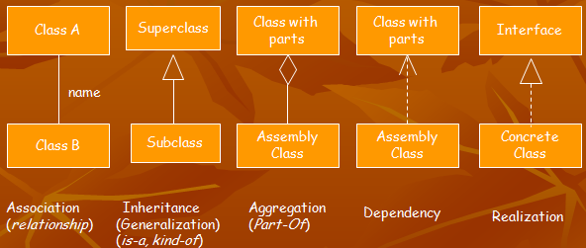

Slide 99
Operations Visibility
Visibility is the level of access an external object has to an attribute or method.
Public attributes/methods can be accessed/invoked by any other method in any other object or class.
Denoted by the + symbol
Protected attributes/methods can be accessed/ invoked by any method in the same class or in subclasses of that class.
Denoted by the # symbol
Private attributes/methods can be accessed/invoked by any method in the same class.
Denoted by the – symbol
Method – the software logic that is executed in response to a message.

Slide 100
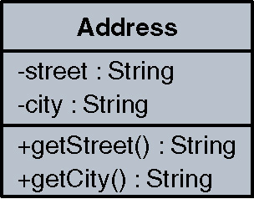

Slide 101
Operation name is generally a short verb or a verb phrase written in lowerCase-first text.
Operation may include visibility, parameters, and return.

Slide 102
Exercise
Draw a class diagram for a information modeling system for a school.
School has one or more Departments.
Department offers one or more Subjects.
A particular subject will be offered by only one department.
Department has instructors and instructors can work for one or more departments.
Student can enroll in up to 5 subjects in a School.
Instructors can teach up to 3 subjects.
The same subject can be taught by different instructors.
Students can be enrolled in more than one school.

Slide 103
Class Diagram Example
has
School
Department
1
1..*
1..*
1…*
1
offeres
assignedTo
member
*
1..*
1..*
attends
teaches
Instructor
Student
Subject
*
1..5
1..3
1..*

Slide 104
Class Diagram - Example
School has one or more Departments.
School
Department
1
has
1..*
-Department offers one or more Subjects.
- A particular subject will be offered by only one department.
Department
Subject
1
offers
1..*

Slide 105
Class Diagram - Example
Department has Instructors and instructors can work for one or more departments.
Instructor
Department
1..*
assigned to
1..*
- Student can enroll in up to 5 Subjects.
Student
Subject
*
takes
0..5

Slide 106
Class Diagram - Example
Instructors can teach up to 3 subjects.
The same subject can be taught by different instructors.
1..*
Instructor
Subjects
teaches
1..3

Slide 107
Class Diagram - Example
Students can be enrolled in more than one school.
Student
*
School
member
1..*

Slide 108
Class Diagram Example
has
School
Department
1
1..*
1..*
1…*
1
offeres
assignedTo
member
*
1..*
1..*
attends
teaches
Instructor
Student
Subject
*
1..5
1..3
1..*

Slide 109
Exercises
Draw a class diagram representing a book defined
by the following statement:
“A book is composed of a number of parts, which in
turn are composed of a number of chapters.
Chapters are composed of sections.”
Focus only on classes and relationships.
Add multiplicity to the class diagram.

Slide 110
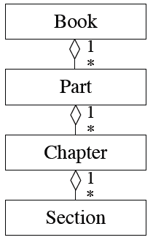

Slide 111
Extend the class diagram of Exercise to include
the following attributes:
- book includes a publisher, publication date, and an ISB
- a part includes a title and a number
- a chapter includes a title, a number, and an abstract
- a section includes a title and a number

Slide 112
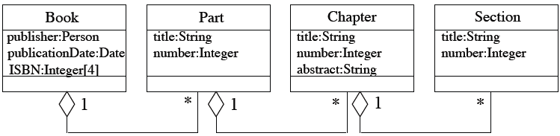

Slide 113
Constraint Rules and Notes
Constraints and notes annotate among other things associations, attributes, operations and classes.
Constraints are semantic restrictions noted as Boolean expressions.
UML offers many pre-defined constraints
id: long { value > 0 }
Customer
1
*
Order
may be canceled
{ total < $50 }
Constraint
Note

Slide 114
CLASS DIAGRAM LIBRARY MS
Classes:
Copy
Book
Loan
Fine notice
Reservation
MembershipInfo
Membership card

Slide 115
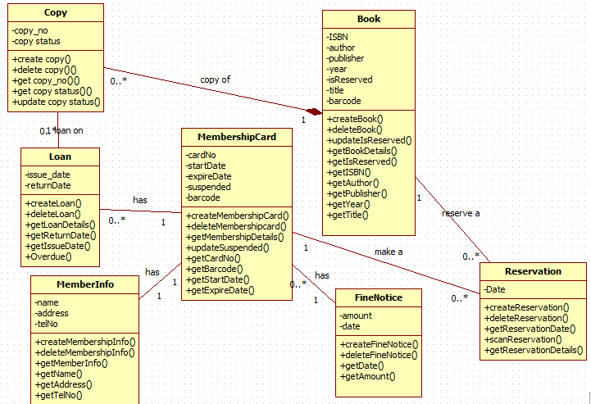

Slide 116
Example Class
Class name
BankAccount
- accountNumber: Integer
- balance: Money = 0
+ open(accountName: String): Boolean
+ close( ): Boolean
+ withdraw (amount: Money): Boolean
Attributes
UML
Operations
public class BankAccount {
private int accountNumber;
private Money balance;
…
public boolean open(String accountName){
…
} …
}
Java

Slide 117
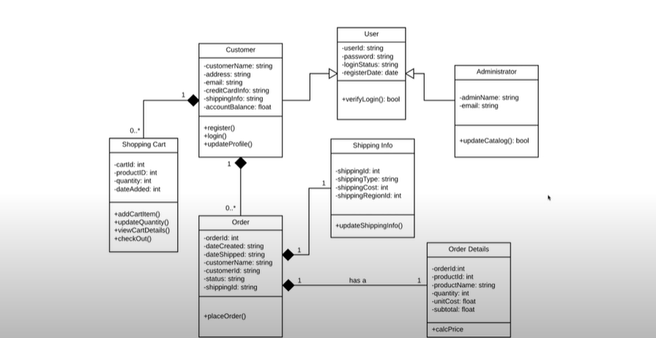

Slide 118
create table customer
(cust_num numeric,
cust_name char(20),
address varchar(256),
credit_level numeric,
check (credit_level >= 1000),
primary key (cust_num));

Slide 119
create table item
(item_num numeric,
item_name char(20),
price numeric,
weight numeric,
primary key (item_num));

Slide 120
create table order
(ord_num char(15),
cust_num numeric not null,
item_num numeric not null,
quantity numeric,
total_cost numeric,
primary key (ord_num),
foreign key (cust_num) references customer
on delete no action on update cascade,
foreign key (item_num) references item
on delete no action on update cascade);

Slide 121
Using Interaction Diagrams
Interaction Diagrams
– Represent interaction between class objects based on conditions and operations
– Can also represent a use case scenario of interaction
between actors and the system
Two main subtypes:
- Sequence diagrams emphasize the temporal order of
interaction and show lifetime of each object
- Collaboration diagrams emphasize layout and show interaction as numbering of steps in a scenario

Slide 122
3. Sequence Diagrams
Sequence diagram is an interaction diagram that details how operations are carried out.
What messages are sent and when.
In particular, it shows the objects participating in the interaction by their lifelines and the messages that they exchange arranged in time sequence. A lifeline represents an individual participant in a sequence diagram.

Slide 123
It doesn’t show the associations among objects.
Can model simple sequential flow, iteration, recursion and concurrency.
Identify objects needed to support use case, determine sequence of internal events following the external initiating event.

Slide 124
A sequence diagram has 2 dimensions: the vertical dimension represents time and object’s lifeline, the horizontal dimension represents different objects.
Messages are shown as lines with message arrows between the vertical object’ s lifelines, i.e. the sender and the receiver of the messages.
Sequence diagrams are good at showing which objects communicate with which other objects;
Associated with use cases.

Slide 125
Elements of a sequence diagram
1. Class(object) roles
2. Lifelines
3.Activation
4. Massages
5. Creating/Destroying Objects
6. Loops

Slide 126

1. Class(object) roles
Object naming:
syntax: [objectName][:className]
Name classes consistently with your class diagram (same classes).

Slide 127
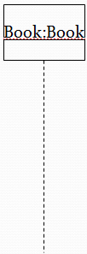
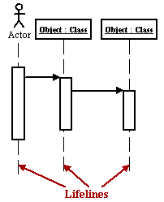
2. Lifelines
The Life-Line represents the object’s life during the interaction.
Lifelines are vertical
dashed lines that indicate
the object's presence over time.

Slide 128
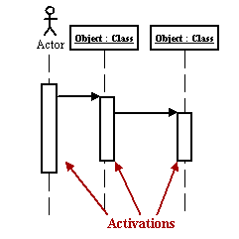
3. Activation
The time required by the receiver object to process the message is denoted by a white rectangles on a lifeline are called activations and indicate that an object is responding to a message.
It starts when the message is received and ends when the object is done handling the message.
Activation boxes represent the time an object needs to complete a task.
Notes:
Activation (double line) is the execution of the procedure.

Slide 129
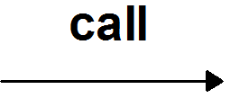
4. Messages
To show an object (i.e., lifeline) sending a message to another object, you draw a line to the receiving object with a solid arrowhead (if a synchronous call operation)
The message/method name is placed above the arrowed line.
The message that is being sent to the receiving object represents an operation/method that the receiving object's class implement.

Slide 130

Use half-arrowed lines to represent asynchronous messages.
Asynchronous messages are sent from an object that will not wait for a response from the receiver before continuing its tasks.

Slide 131
Call – invoke an operation
Send – sends a signal (message) to an object

Slide 132
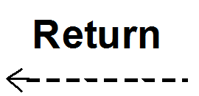
Diagram includes return messages. These return messages are optional; a return message is drawn as a dotted line with an open arrowhead back to the originating lifeline, and above this dotted line you place the return value from the operation.

Slide 133
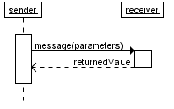
Optionally, a value that the receiver returns to the sender
can be placed near the return arrow.
If you want your diagrams to be easy to read, only show the return arrow if a value is returned. Otherwise, hide it.

Slide 134
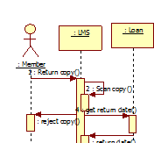
Self calls
Self calls are also allowed. To draw an object calling itself, you draw a message as you would normally, but instead of connecting it to another object, you connect the message back to the object itself.

Slide 135
5. Creating/Destroying Objects
Stereotypes (label)
<<create>>
<<destroy>>
Objects can be create and terminated early using an arrow labeled "<< create>>“, "<< destroy >>" that points to an X.

Slide 136
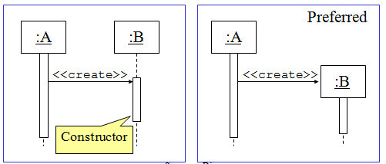
Object Creation
An object may create another object via a <<create>> message.

Slide 137
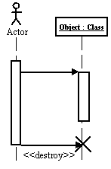
Destroying Objects
Objects can be terminated early using an arrow labeled "<< destroy >>" that points to an X.
Avoid modeling object destruction unless memory management is critical.

Slide 138
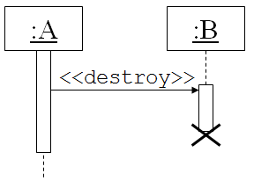
An object may destroy itself.

Slide 139
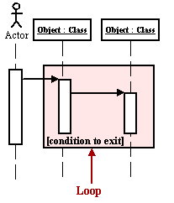
Loops
A repetition or loop within a sequence diagram is depicted as a rectangle. Place the condition for exiting the loop at the bottom left corner in square brackets [ ].

Slide 140
The sequence diagram is a good diagram to use to document a system's requirements and to flush out a system's design.
The reason the sequence diagram is so useful is because it shows the interaction logic between the objects in the system in the time order that the interactions take place.

Slide 141
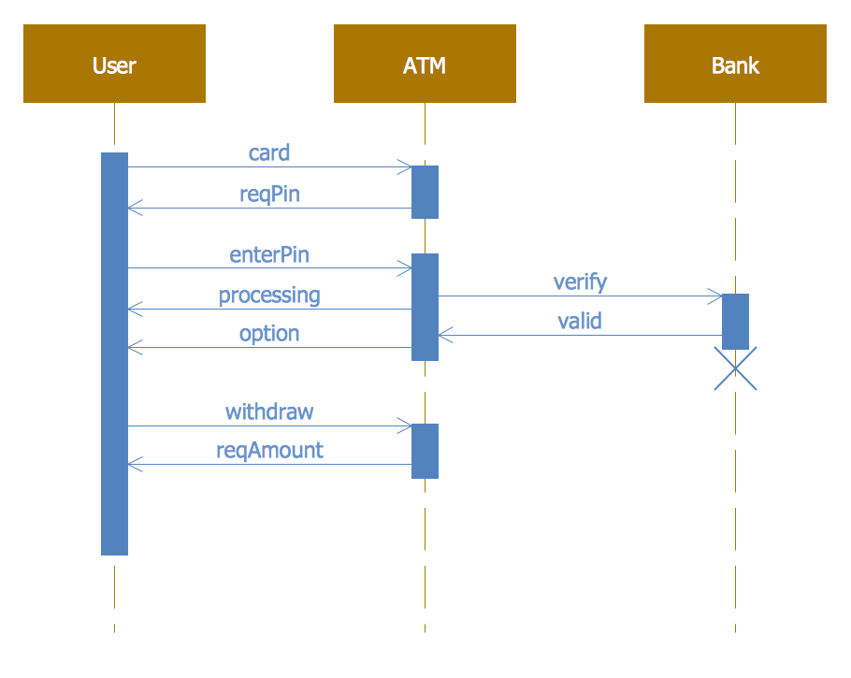

Slide 142
Guidelines or drawing sequence diagram
Set the context (e.g. scenario including normal, abnormal and error case) or the interaction that may be an operation, scenarios of use case, a subsystem, or a system, in Structured English.
Set the stage or the interaction by identifying which objects play a role in the interaction.

Slide 143
Set the lifeline for each object. For those objects that are created and destroyed during the interaction, set theirs lifelines and explicitly indicate their birth and death with appropriately stereotyped messages.
Starting with the message that initiate this interaction, lay out each subsequent message's property.

Slide 144
Sample Structured English for the scenario of the use case Return book in Library system

Slide 145
Borrower returns a copy of a book to Librarian
Librarian scans the copy
if the copy is accepted
then Librarian gets due return date from the loan details (normal case)
(loan details(issue date, borrower details, book details, return date)
if overdue (special case)
The system create a fine Notice, and then Librarian sends fine
Notice to the member.
end if
Librarian scans reservation list (refers to included use case Scan reservation list)
if reserved (special case)
then Librarian sends notification to the member (refers to extending use case Send availability notification)
end if
Librarian deletes the loan
Librarian changes the copy status to available
else Librarian rejects the copy (error case)
end if

Slide 146
Scenario of the use case Send fine notice
get the loan details including borrower details
create a fine notice
send the notice to the borrower
suspend borrower’s membership
Scenario of the use case Scan reservation list
Scenario of the use case Send availability notification
get reservation details including book and member details
create availability notification
send the notification to the member

Slide 147
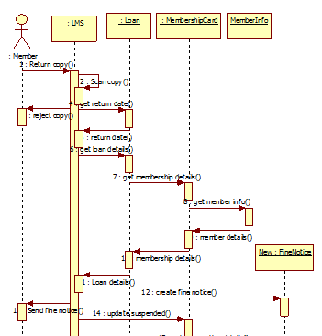

Slide 149
UML Diagram Usage
Analysis
Use Cases, Class Diagrams, Activity Diagrams, Collaboration Diagrams, Sequence Diagrams
Design
Class Diagrams, Collaboration Diagrams, Sequence Diagrams, State Diagrams, Component Diagrams Deployment Diagrams
Development
Collaboration Diagrams, Sequence Diagrams, Class Diagrams, State Diagrams, Component Diagrams, Deployment Diagrams
Implementation
Package Diagrams, Deployment Diagrams

Slide 150
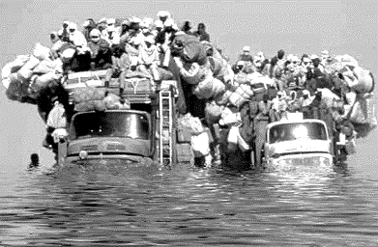
Diagrams overloaded with details are difficult to read and understand

Slide 151
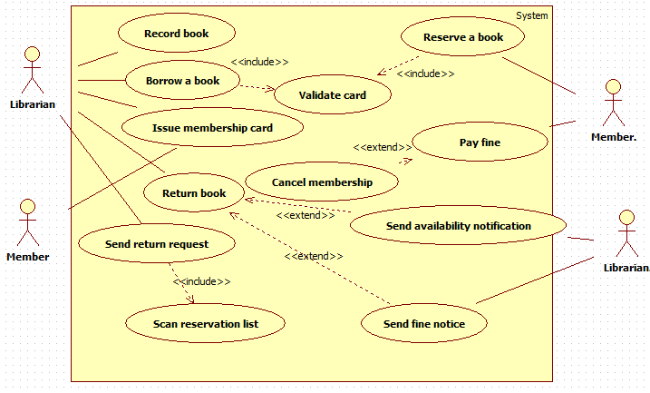

Slide 152
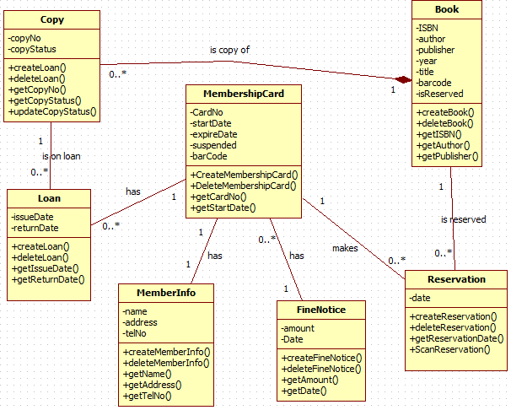

Slide 153
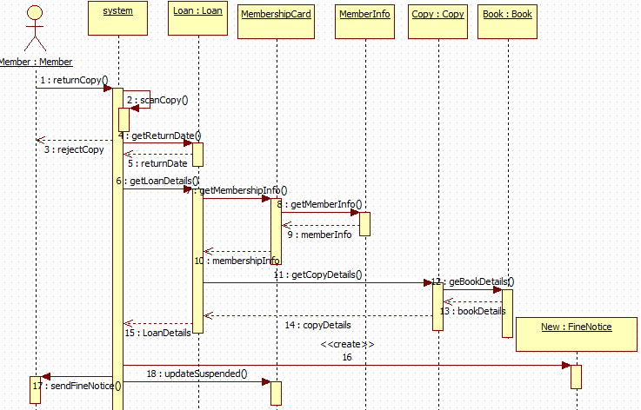

Slide 154
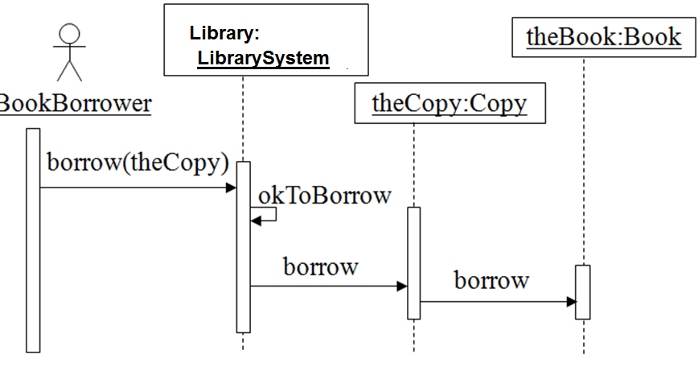
Sequence Diagram: Borrow copy of a Book
Object
Life Line
message
condition
Activation box

Slide 155
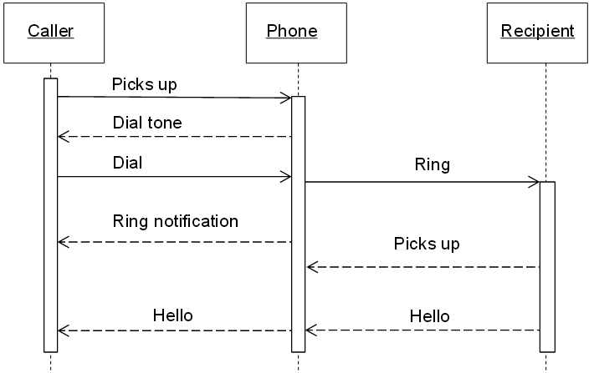
Sequence Diagram (Make a phone call)

Slide 156


Slide 157
EXERCICE 1
University Management System” :
In a university management system, a Student can submit the assignments, the instructor marks those assignments and then uploads the result. The Student is allowed to view the Results.

Slide 158
EXERCICE 2
Consider the Library Management System. A Student is allowed to issue books for a period of two weeks. Student can read newspapers/magazines in the library and can even access the databases for e-books.
The Library Staff is responsible for maintaining the records of students and along with the issued books. The Staff marks an entry in the register whenever a student issue or return a book.
A fine is charged on a student if he/she fail to return the book on time. The Librarian is there to manage the staff, check the records and prepare reports for DG/DEAN.

Slide 159
Example 1: Draw the Use case diagram for Student Administration System; enrolment process
Students send in an application form containing their personal details, and their desired course. The university checks that the course is available and that the student has necessary academic qualifications.
If the course is available the student is enrolled in the course, and the university confirms the enrolment by sending a confirmation letter to the student.
If the course is unavailable the student is sent a rejection letter.

Slide 160
Ex 2: BOOK LENDING LIBRARY
The library receives details of books, and orders books from one or more book suppliers. Books may be reserved and borrowed by members of the public, who are required to give a borrower number.
The library will notify borrowers when a reserved book becomes available or when a borrowed book becomes overdue.
In addition to supplying books, a book supplier will furnish details of specific books in response to library enquiries.

Slide 161
Use case diagram
Class diagram
Context diagram or level 0 DFD
Level 1 DFD
Level 2 DFD

Slide 162
Summary
Goal of designing is to find the best possible correct design
Modularity is the criteria for deciding quality of the design
Modularity enhanced by low coupling, high cohesion, and following open-closed principle

Slide 163
Structured System analysis and Design and Object oriented analysis and design are the common used.

Slide 164
End of chapter 4
Thank you

Slide 165
Case study 2:Courseware Management system
The task is of constructing the design elements for a system that can be used to manage courses and classes for an organization that specializes in providing training.
The name of the system is Courseware System. The organization offers courses in a variety of areas such as learning management techniques and understanding different software languages and technologies. Each course is made up of a set of topics. Tutors in the organization are assigned courses to teach according to the area that they specialize in and their availability.

Slide 166
The organization publishes and maintains a calendar of the different courses and the assigns tutors every year.
There is a group of course administrators in the organization who manage the courses including course content, assigning courses to tutors, and defining the course schedule. The training organization aims to use the Courseware System to get a better control and visibility to the course management and to also streamline the process of generating and managing schedules for different courses. Students can view and take courses.

Slide 167
Provide use case diagram

Slide 168
Provide class diagram

Slide 169
Provide sequence diagram

Slide 170
Courseware Overview
The following terms and entities are specific to the system:
– Courses and Topics that make up courses
– Tutors that teach courses
– Course Administrators who manage the assignment of courses to tutors
– Calendars and Course Schedules that are generated as a result of the work performed by the course administrators
– Students who refer to Calendars and Course Schedules to decide which courses they wish to take up for study

Slide 171
Courseware Actors and Use Cases
Actors: Tutor, Student, Course Administrator (main actor)
Use Cases (primary business: secondary user)
– Manage courses: View courses, Manage topics for a course, and Manage course information
– Manage tutors: View course calendar, View tutors, Manage tutor information, and Assign courses to tutors.

Slide 172


Slide 173


Slide 174
Case study : courseware
The following classes are identified:
– As use case actors:
• Course Administrator
• Student
• Tutor
– As system objects:
• Course Calendar
• Course
• Topic

Slide 175
The following class operations are identified:
– For Course Administrator, using use cases:
• View courses
• Manage topics for a course (Manage topic)
• Manage course information (Manage course)
• View course calendar
• View tutors
• Manage tutor information (but not manage tutors)
• Assign courses to tutors (assign tutors to courses)

Slide 176


Slide 177


Slide 178
Case study: Solent Hotel
A computer system is required by the Solent Hotel to assist the management of the hotel using computer.
The Solent Hotel has 5 function rooms, 20 single bedrooms and 40 double bedrooms. The room are distinguished by their room numbers. The function rooms have different sizes, but have same tariff. The hotel accepts the booking requests for bedroom or function room only at present.

Slide 179
When customers arrive at the hotel, the receptionist books them into the first available room of the required type. If none of rooms of the required type is available, the receptionist has to reject the room booking request.

Slide 180
The customer’s name is recorded, along with the payee (i.e. who is paying for the room.) This is recorded as ‘private’ if the customer is the payee, or the name of a company or organization may be entered. The tariffs are £40 for a single bedroom, £55 for a double bedroom and £200 for a function room.

Slide 181
There is a set of presentation equipments in the hotel which may be moved between function rooms if necessary. The equipments are known with their names and descriptions. The hotel also ensures that a room is made available for further bookings as soon as it is vacated.

Slide 182
In order to improve the business, the hotel requires an information system that supports the room booking using the computer and to store information for later access.

Slide 183

Use case diagram for the Solent Hotel System

Slide 184

Class diagram including associations and aggregations

Slide 185

Class diagram including operations

Slide 186

Class diagram including generalization

Slide 187
Sequence diagram : Solent Hotel

Slide 188
Structured English for use case Book bedroom in the Solent Hotel System
Scenario of the use case Book bedroom
Customer requests a bedroom with required type and date
Receptionist books a bedroom (inherits scenario of use case Book room)
Scenario of use case Book room
validate request (refers to the included use case Validate request)
if request is valid
then repeat
get room status of rooms required one by one
until (a room required is available) or
(no room required is available)
if a room required is available
then create a room booking (normal situation)
tell customer the room number
else tell no room required available (special situation)
end if
else reject the request (error situation)
end if

Slide 189
Scenario of the user case Validate request
if room required is a bedroom or a function room
then request is valid
else request is invalid
end if
Refinement of “create a room booking”
record the title part
record the customer details
record room part
update room status of booked room to occupied

Slide 190


Slide 191


Slide 192
Case study2:
The library contains books and journals. It may have several copies of a given book. Some of the books are reserved for short-term loans only. All others may be borrowed by any library member for three weeks. Members of the library can normally borrow up to six items at a time, but members of staff may borrow up to 12 items at one time. Only members of staff may borrow journals.
The system must keep track of when books and journals are borrowed and returned and enforce the rules.

Slide 193
Noun Identification: A Library Example
The library contains books and journals. It may have several copies of a given book. Some of the books are reserved for short-term loans only. All others may be borrowed by any library member for three weeks. Members of the library can normally borrow up to six items at a time, but members of staff may borrow up to 12 items at one time. Only members of staff may borrow journals.
The system must keep track of when books and journals are borrowed and returned and enforce the rules.

Slide 194
Candidate Classes
Library the name of the system
Book
Journal
Copy
ShortTermLoan event
LibraryMember
Week measure
MemberOfLibrary repeat
Item book or journal
Time abstract term
MemberOfStaff
System general term
Rule general term

Slide 195
Operations
LibraryMember borrows Copy
LibraryMember returns Copy
MemberOfStaff borrows Journal
MemberOfStaff returns Journal

Slide 196


Slide 197


Slide 198
Summary
User case diagram used to define the functionality of a system as use cases in the process view
Activity diagram used to specify a flow of the activities included in the use cases in the behaviour view.
The class diagram is used to describe the static structure of the system in the data view.
The sequence diagram introduced in this unit is used to specify communication between objects that are involved in the use case in the event view.

Slide 199
References
G. Booch, J. Rumbaugh and I. Jacobson. The UML User
Guide, Addison-Wesley, 1999.
M. Fowler and K. Scott. UML Distilled, Addison-Wesley, 2000.
B. Bruegge and A. H. Dutoit, Object-Oriented Software
Engineering, Prentice Hall, 2004.

Slide 200


Slide 201

Example – sequence diag.

Slide 202
Sequence Diagram: Borrow Copy of a Book
libMem: LibraryMember
theBook:Book
BookBorrower
theCopy:Copy
borrow(theCopy)
In this diagram, time runs downwards
okToBorrow
borrow
borrow

Slide 203
Noun Identification for Application Classes: A Library Example
The library contains books and journals. It may have several copies of a given book. Some of the books are reserved for short-term loans only. All others may be borrowed by any library member for three weeks. Members of the library can normally borrow up to six items at a time, but members of staff may borrow up to 12 items at one time. Only members of staff may borrow journals. The system must keep track of when books and journals are borrowed and returned and enforce the rules.

Slide 204
Noun Identification: A Library Example
The library contains books and journals. It may have several copies of a given book. Some of the books are reserved for short-term loans only. All others may be borrowed by any library member for three weeks. Members of the library can normally borrow up to six items at a time, but members of staff may borrow up to 12 items at one time. Only members of staff may borrow journals.
The system must keep track of when books and journals are borrowed and returned and enforce the rules.

Slide 205
Actor and Use Case Diagram
• An actor is a user of a system in a
particular role.
An actor can be human or an external system.
• A use case is a a task that an actor
needs to perform with the help of the system.
BookBorrower
Borrow book

Slide 206
Use Cases and Actors
• A scenario is an instance of a use case
• Actor is role, not an individual
(e.g., librarian can have many roles)
• Actor must be a "beneficiary" of the use case
(e.g., not librarian who processes book when borrowed)
In UML, the system boundary is the set of use cases.

Slide 207
Use Cases for Borrowing Books
Borrow copy of book
BookBorrower
Return copy of book
Reserve book
Extend loan

Slide 208
Relationships Between Use Cases: <<uses>>
Extend loan
<<uses>>
Check for reservation
BookBorrower
Borrow copy of book
<<uses>>

Slide 209
Relationships Between Use Cases: <<extends>>
<<extends>>
Refuse loan
Borrow copy of book
BookBorrower

Slide 210
Use Cases in the Development Cycle
• Use cases are a tool in requirements analysis
• Intuitive -- easy to discuss with clients
• Use cases are often hard to translate into class models
• Scenarios are useful to validate design

Slide 211
Candidate Classes
Library the name of the system
Book
Journal
Copy
ShortTermLoan event
LibraryMember
Week measure
MemberOfLibrary repeat
Item book or journal
Time abstract term
MemberOfStaff
System general term
Rule general term

Slide 212
Relations between Classes
Book is an Item
Journal is an Item
Copy is a copy of a Book
LibraryMember
Item
MemberOfStaff is a LibraryMember
Is Item needed?

Slide 213
Operations
LibraryMember borrows Copy
LibraryMember returns Copy
MemberOfStaff borrows Journal
MemberOfStaff returns Journal
Item not needed yet.

Slide 214
A Possible Class Diagram
MemberOfStaff
LibraryMember
1
1
on loan
on loan
0..*
0..12
Journal
Copy
is a copy of
1..* 1
Book

Slide 215
Modeling Dynamic Aspects of Systems
Interaction diagrams: set of objects and their relationships including messages that may be dispatched among them
• Sequence diagrams: time ordering of messages
• Collaboration diagrams: structural organization of
objects that send and receive messages
Activity diagram: flow chart showing flow of control from activity to activity
Statechart diagram: models a state machine

Slide 216
Actions on Objects
returnCopy(c)
call
return
send
create
destroy
okToBorrow()
local
status
notifyReturn(b)
asynchronous signal
<<create>>
stereotypes
<<destroy>>

Slide 217
Links
LibraryMember
+borrowCopy()
+returnCopy()
1
Copy
on loan
0..*
association
class
message
borrowCopy(c)
libMem:LibraryMember
c:Copy
link
object

Slide 218
Sequence Diagram: Borrow copy of a Book
libMem: LibraryMember
theBook:Book
BookBorrower
theCopy:Copy
borrow(theCopy)
okToBorrow
borrow
borrow

Slide 219
Exercises

Slide 220
Stella Express
Stella Express is a transport company, where different passengers from different area come to book for places. The services or any activity is done manual; recording in books. The manager of Stella Express wants a computerized system that can allow performing the following:
The manager registers the bus details (bus plate number, chasse number, number of places, date of manufacture and register also driver details (driver Id, first name, last name, DoB, permit number, and categories, sex and telephone number).

Slide 221
The receptionist of Stella Express is in charge of scheduling drivers, buses and lines. In order to do scheduling, the following information are needed line (eg. from Kigali to Huye), departure time, bus plate number) and tariff for a specific line.
When a passenger want to book for a place, he first sign up to get the ID, and provide his information (first name, last name, DoB, email and telephone), then he has to check if there are available places at a specific line and time.

Slide 222
Once there is an available place, he can book for a place by providing his ID, travel line, departure time). After booking, the passenger will receive a confirmation message from the system.
If the schedule has been cancelled, the system informs passenger that a trip has been cancelled or postponed by email or sms.
A passenger is requested to buy the ticket 30 minutes before departure time at the Stella Express office. He can also cancel the booking before 30 minutes before departure time.

Slide 223


Slide 224


Slide 225
Hospital Management System
Kigali International Hospital is a hospital in Kigali where Patients come up for general diseases.
All the work is done manually by the receptionist and other operational staff and lot of papers are needed to be handled and taken care of.
Doctors have to remember various medicines available for diagnosis and it is hard to remember them, and to find the information of existing patients takes time. Thus there is a need for an information system to manage efficiently the hospital information.

Slide 226
The work will be done as follows:
The hospital manager keep records of all staff; Doctors (doctor_No, Name, Specialty), nurses (nurse_No, Name) in the system.
In this hospital, patients come for treatment, at the reception they have to be registered by the receptionist by providing their personal information such as the patient name, date of birth (DoB), gender, address, their condition and they get the patient identifier (patient number).

Slide 227
Patients are assigned to a ward (identified by a ward name which is unique across the hospital) by the receptionist.
Patients are treated by doctors who prescribe test (Blood, urine, X-RAY,..) and medications(name, quantity) to patients. Wards contain many beds (identified by a number) occupied by many patients. Nurses work in a ward, where they attend to patients. Patients consume medications dispensed by nurses.
Bills are generated by receptionist by recording price for each facility provided to Patient.
Receptionist record Immunization information of children is maintained in the system.

Slide 228


Slide 229


Slide 230


