Slide 1
SPARK version
JNI plus C/C++
Source files
DRIVER
Spark Executors
Features:
Spark handles: scheduling, fault tolerance
Files on HDFS
Granularity: one file/task
Elasticity
Possible issues
Granularity-Load imbalance?(need be tested first)
Data locality and data coping overhead
The cost of scaling down
HDFS

Slide 2
What Ibis could achieve?
Cross region – utilize more idle computation resources
Close to data – move compute rather than move data
LOFAR data need to be staged first to disk then be able to access
Data probably has been already collected and gathered?
Auto provision – probably need simple daemon like spark

Slide 3
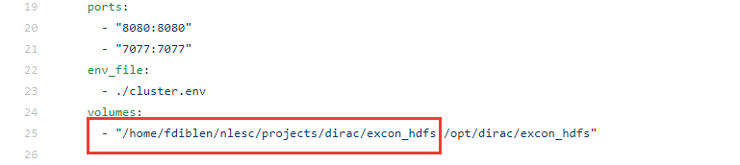
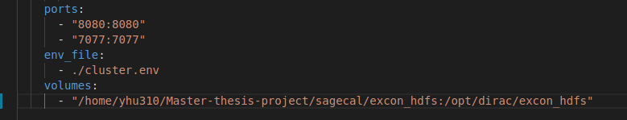

Slide 4
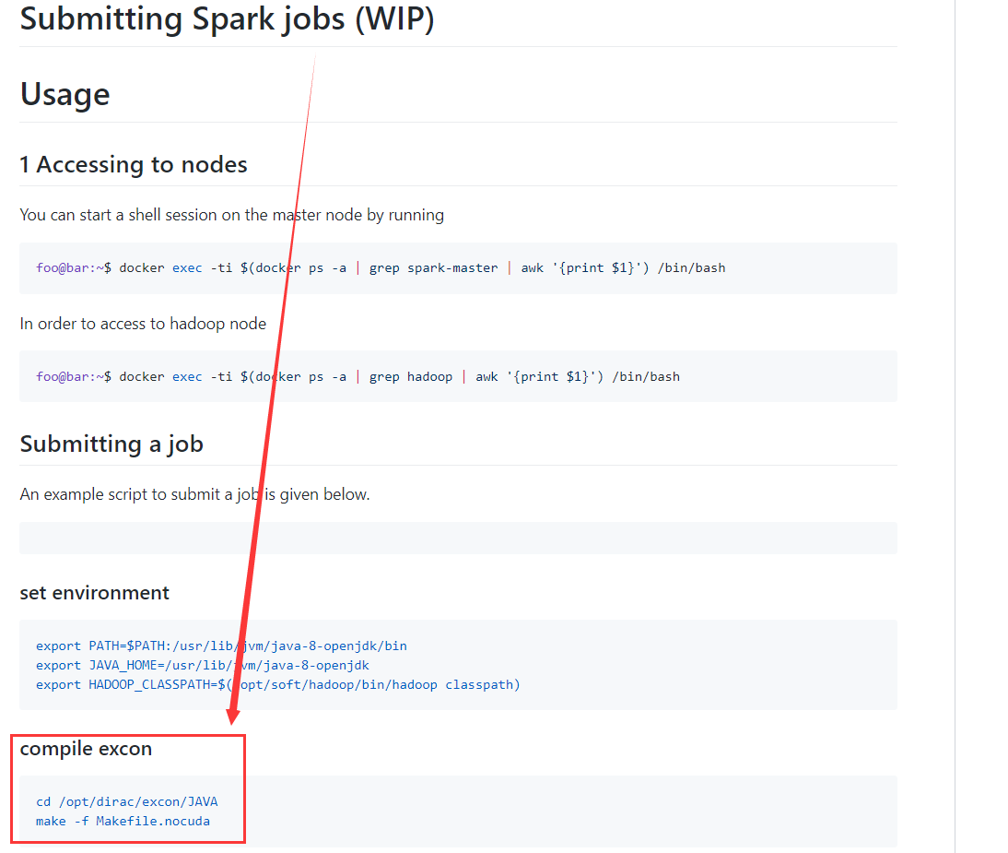
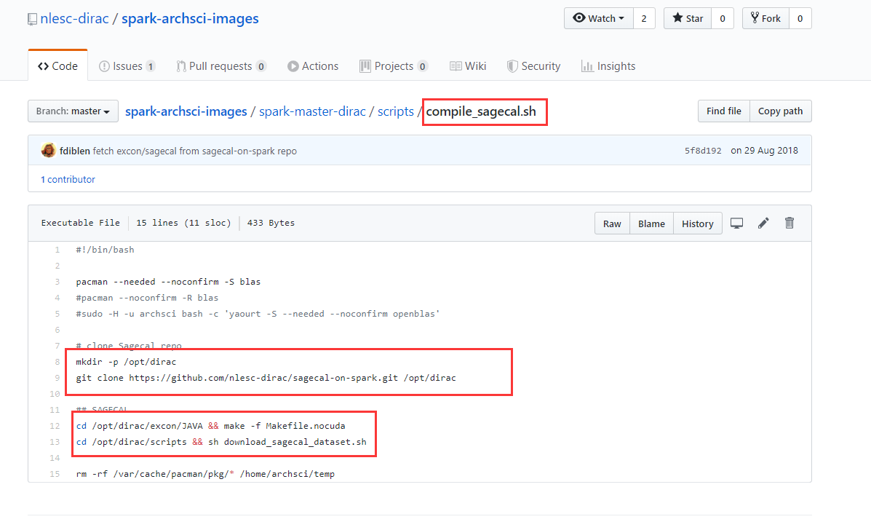
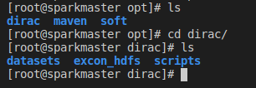

Slide 5
